Slide 1


Speciation takes time: a conceptual individual-based model
© 2016 Richel Bilderbeek

Slide 2
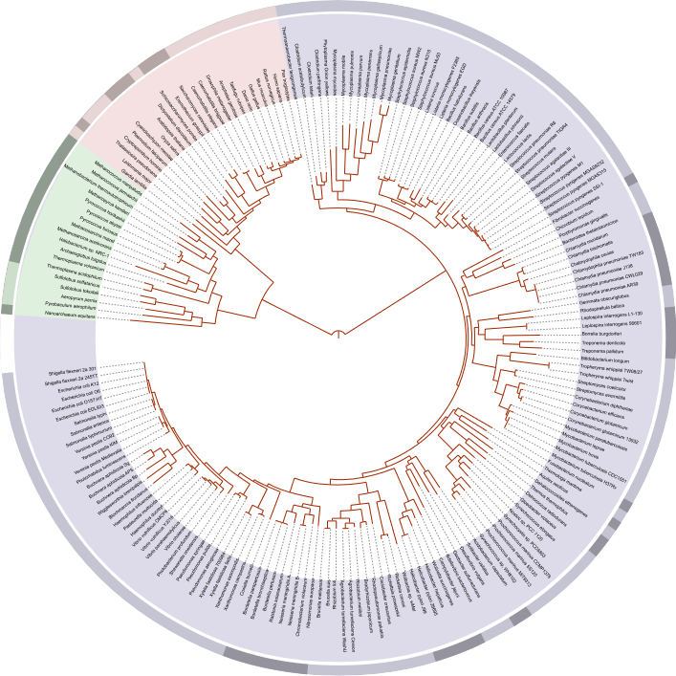
Ciccarelli FD, et al., Science.; 2006 Mar 3. 311(5765): 1283-7

Slide 3
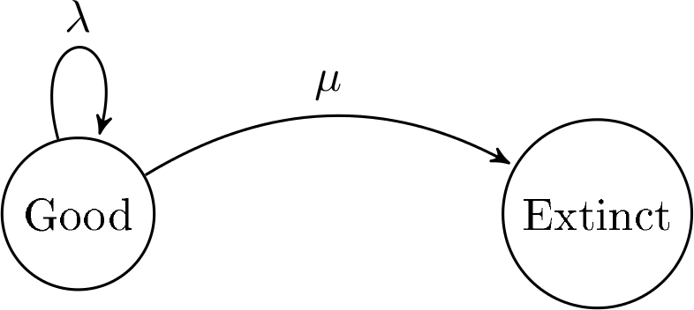
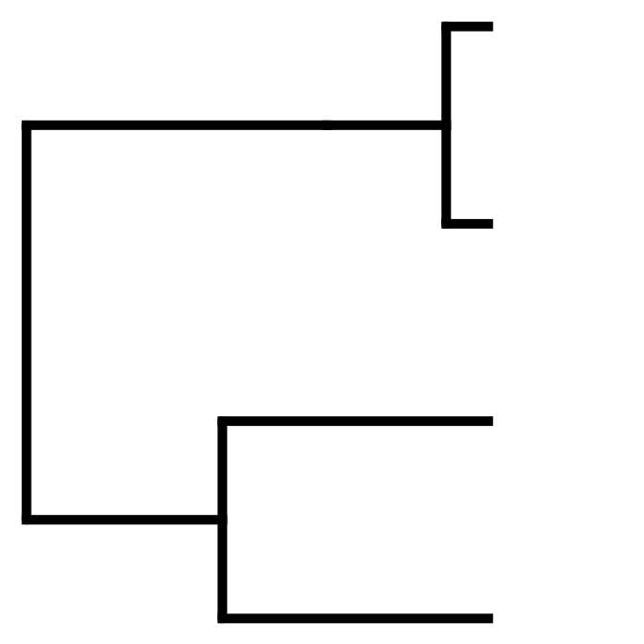

Instantaneous birth-death model
Stadler, Tanja, et al. "How well can the exponential-growth coalescent approximate constant-rate birth–death population dynamics?." Proc. R. Soc. B. Vol. 282. No. 1806. The Royal Society, 2015.

Slide 4
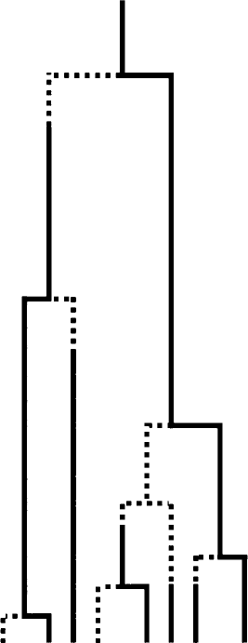
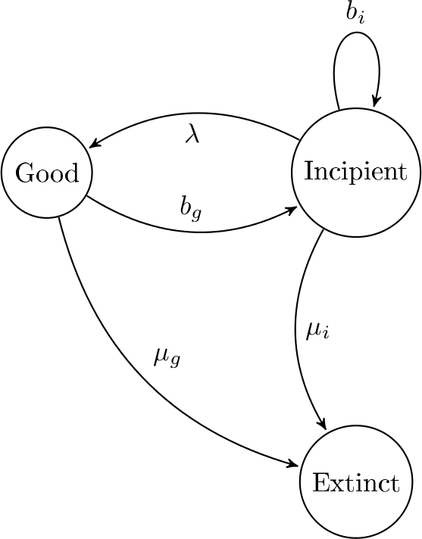
Protracted birth-death model
Etienne, Rampal S., and James Rosindell. "Prolonging the past counteracts the pull of the present: protracted speciation can explain observed slowdowns in diversification." Systematic Biology 61.2 (2012): 204-213.

Slide 5
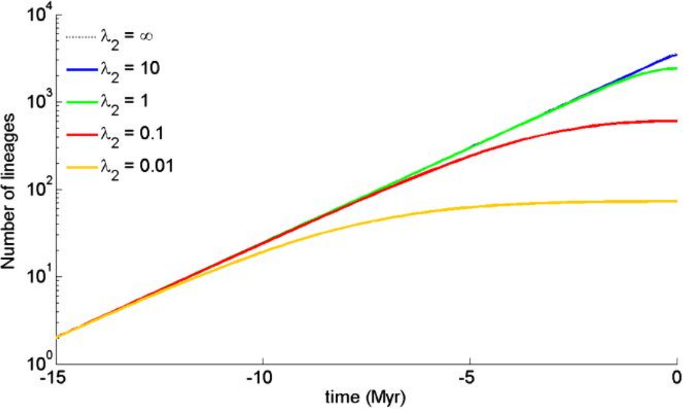
Lineages through time
Etienne, Rampal S., and James Rosindell. "Prolonging the past counteracts the pull of the present: protracted speciation can explain observed slowdowns in diversification." Systematic Biology 61.2 (2012): 204-213.

Slide 6
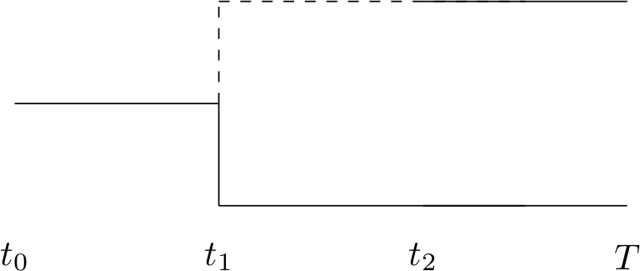
Mechanism?
No gene flow, thus allopatric speciation?
Here, […] we deliberately do
not assume a specific mechanism
for speciation but only recognize
[…] that it is gradual
rather than instantaneous
?
?
Etienne, Rampal S., and James Rosindell. "Prolonging the past counteracts the pull of the present: protracted speciation can explain observed slowdowns in diversification." Systematic Biology 61.2 (2012): 204-213.

Slide 7
Research question
Can we verbally offer a biological explanation?
Can we put this in an IBM at the species level?
If yes, how much do these approaches match?

Slide 8
Speciation models
Bateson-Dobzhansky-Muller
  Two loci, two alleles per locus
‘Van Doorn’
  Species trait and species preference
Mallet
  Minimum genetic similarity threshold
Mallet J (2008) A species definition for the Modern Synthesis. Trends Ecol Evol 10: 294–299.

Slide 9
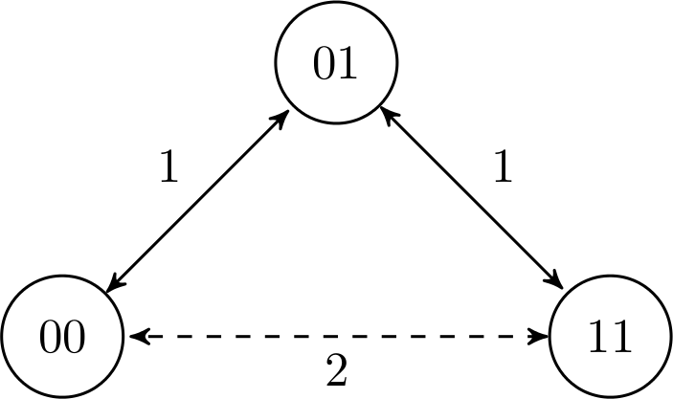

Slide 10


Slide 11
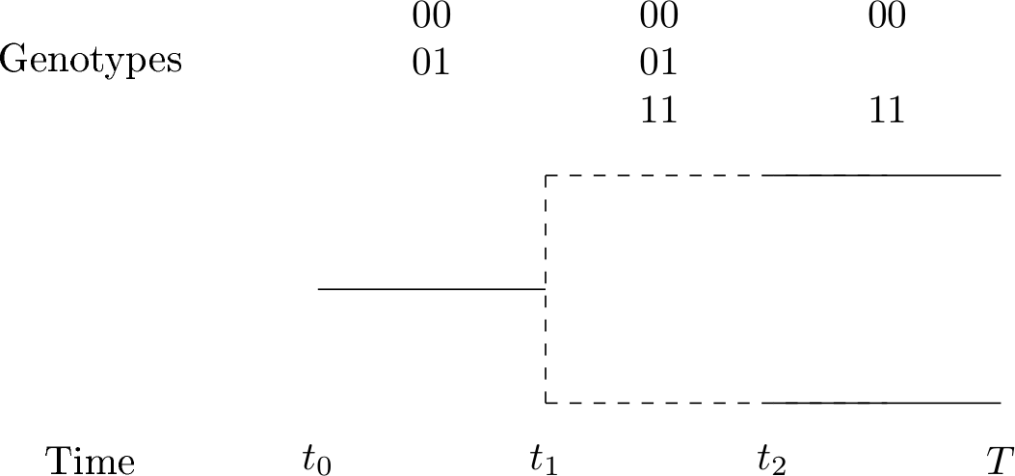

Slide 12
Verbal biological explanation
A speciation-initiation event happens when there is the possibility of a new species
A speciation-completion event happens when the linking genotype is lost

Slide 13
Individual
Number of SIL
Haploid
00

Slide 14
Population
Population size
Random mating
00
01
01
00
00
00

Slide 15
Generation
00
00
Random father
Random mother
Random individual to be replaced
Alleles inherit independently
Father and mother must be of same species
Maximum genetic distance
Chance of one SIL mutation
11
0?
01
01
t_{x}
t_{x+1}

Slide 16
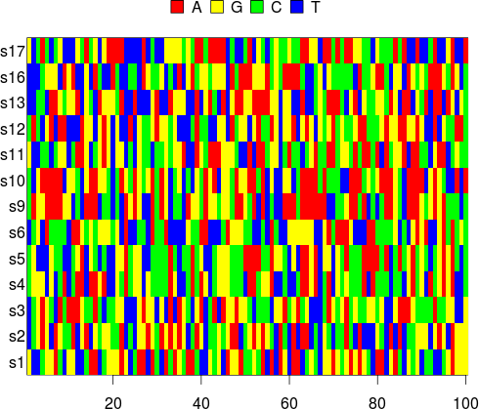
Research questions
How similar are the incipient-species trees between LBM and IBM?
Can we convert the model parameters?
When adding a neutral DNA sequence, where do our current tools estimate the branching points?

Slide 17
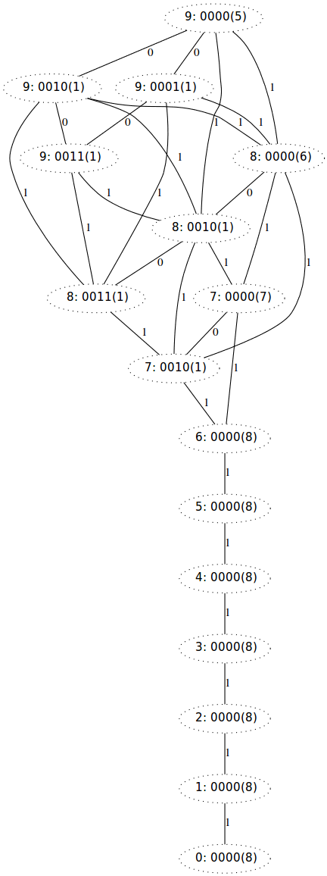
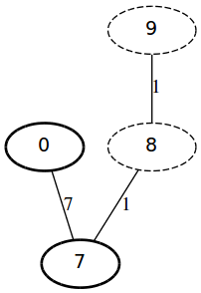
Results in progress
[Incipient species tree here]

Slide 18
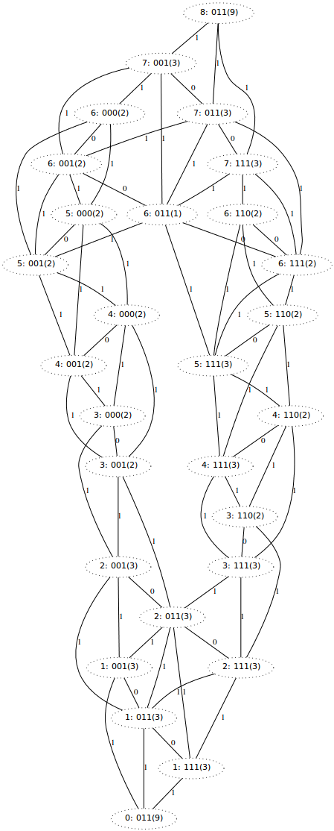
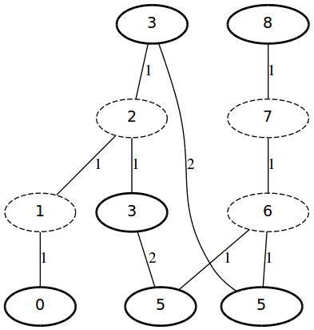
Results in progress
[Incipient species tree here]

Slide 19
Results in progress
More SIL → more species
Population size smaller → more species
Higher mutation rate → more species

Slide 20
Insights
Smaller population size
→
more species
For analytical tractability [...],
we must assume that all rates
of speciation-initiation are equal
This means assuming
populations are
seperated in equal halves!
Etienne, Rampal S., Hélène Morlon, and Amaury Lambert. "Estimating the duration of speciation from phylogenies." Evolution 68.8 (2014): 2430-2440.

Slide 21
Conclusion
This IBM offers a conceptual biological explanation of the processes in an incipient species tree
How well the incipient species trees match is in progress

Slide 22
Discussion
Still only a conceptual mechanism
One of many speciation models
Density (not diversity) dependent effects due to limited population sizes?

