Slide 1

Progress
TECE meeting 2016-07-14
© 2016 Richel Bilderbeek
www.github.com/richelbilderbeek/Science

Slide 2
Research question
If speciation in nature takes time, what is the error made in inferring a phylogeny?
Under which conditions does it hurt?
Are these conditions relevant and/or realistic?
Tool used: BEAST2, assumes speciation is instantaneous

Slide 3
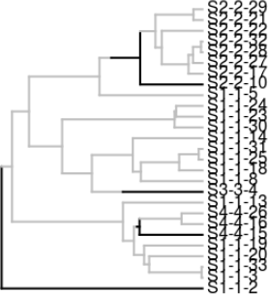
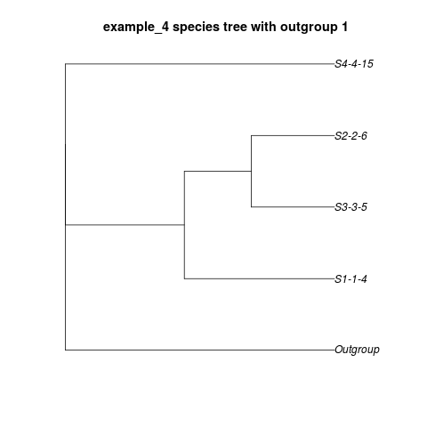
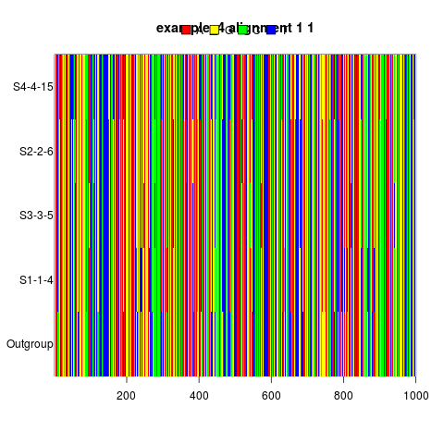
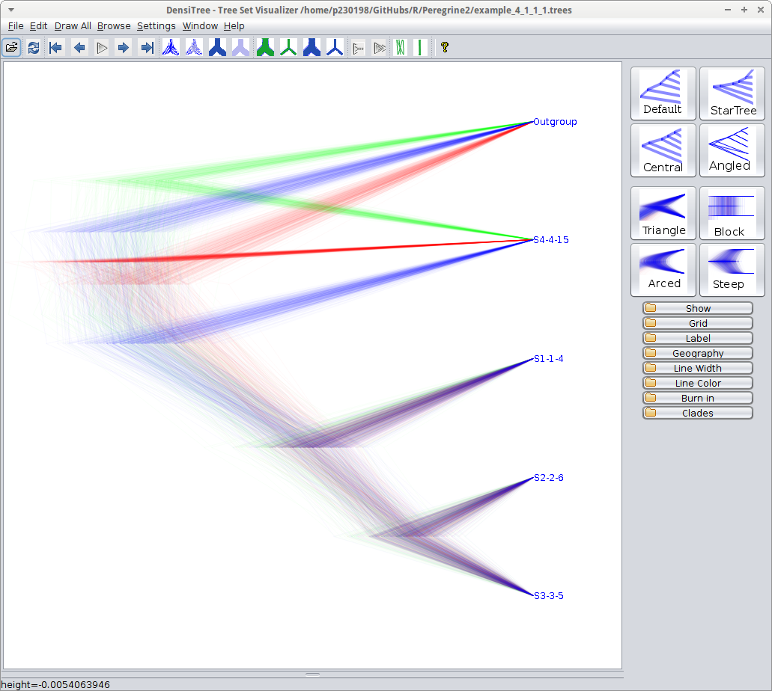
Approach
Simulate an incipient species tree
Sample species trees
Simulate DNA alignments
Infer species tree posterior
Measure difference/error

Slide 4
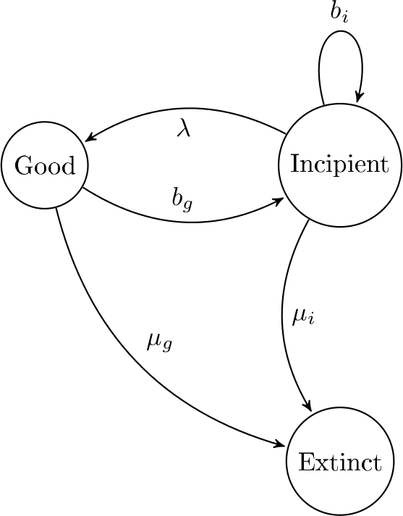
Parameter space
#
#

Slide 5
Sampling
A-1
A-1
B
A-2
A-2
A-2
B
B
B
B
B
A-3
B
A-3

Slide 6
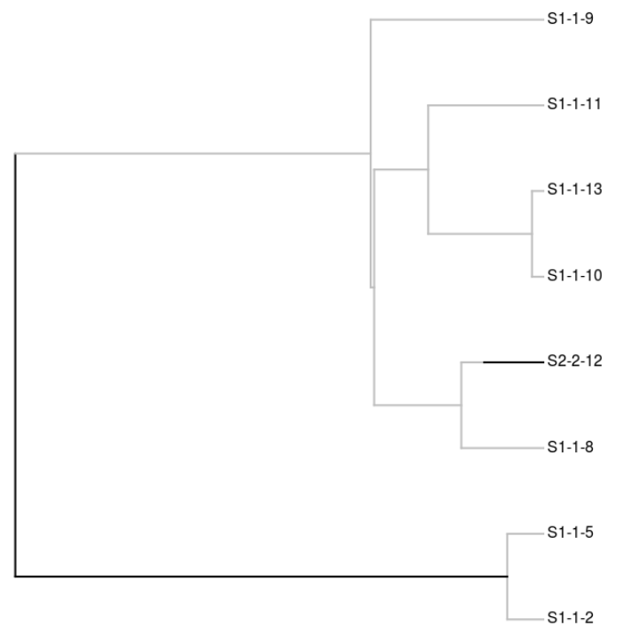
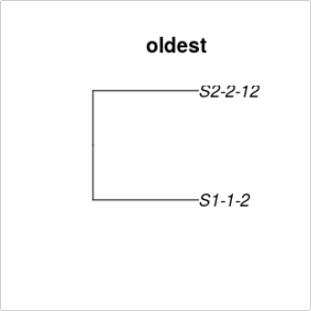
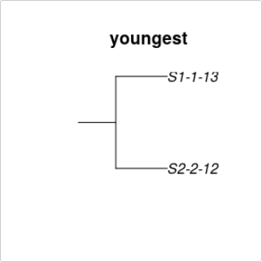
Sampling

Slide 7
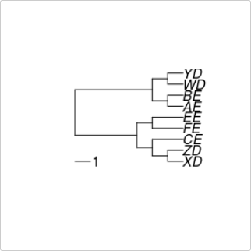
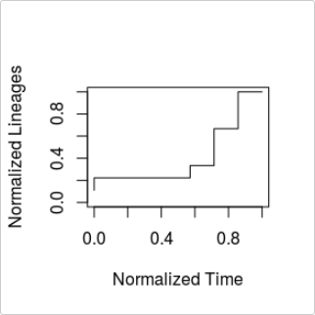
nLTT
Normalized Lineages-Through -Time
Janzen, Thijs, Sebastian Höhna, and Rampal S. Etienne. "Approximate Bayesian computation of diversification rates from molecular phylogenies: introducing a new efficient summary statistic, the nLTT." Methods in Ecology and Evolution 6.5 (2015): 566-575.

Slide 8
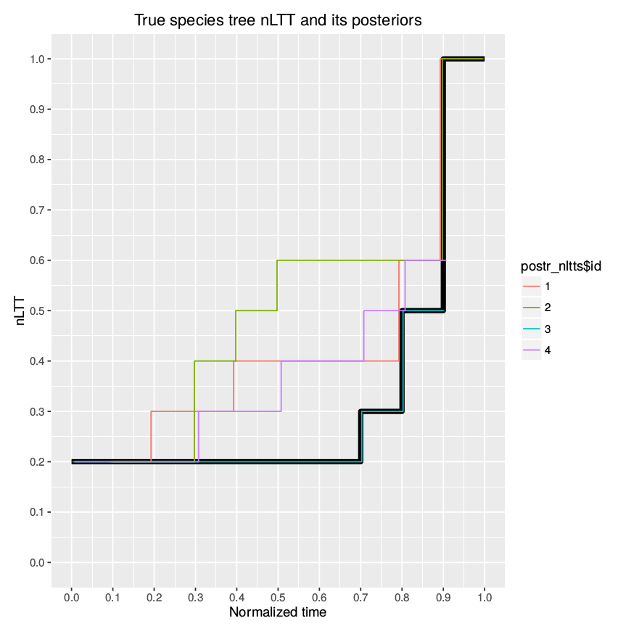
NLTT statistic
Surface between two nLTT curves

Slide 9
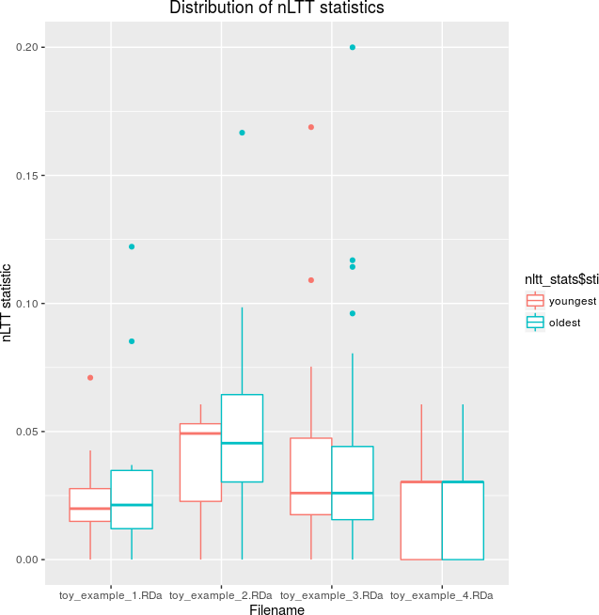
NLTT statistic measured

Slide 10
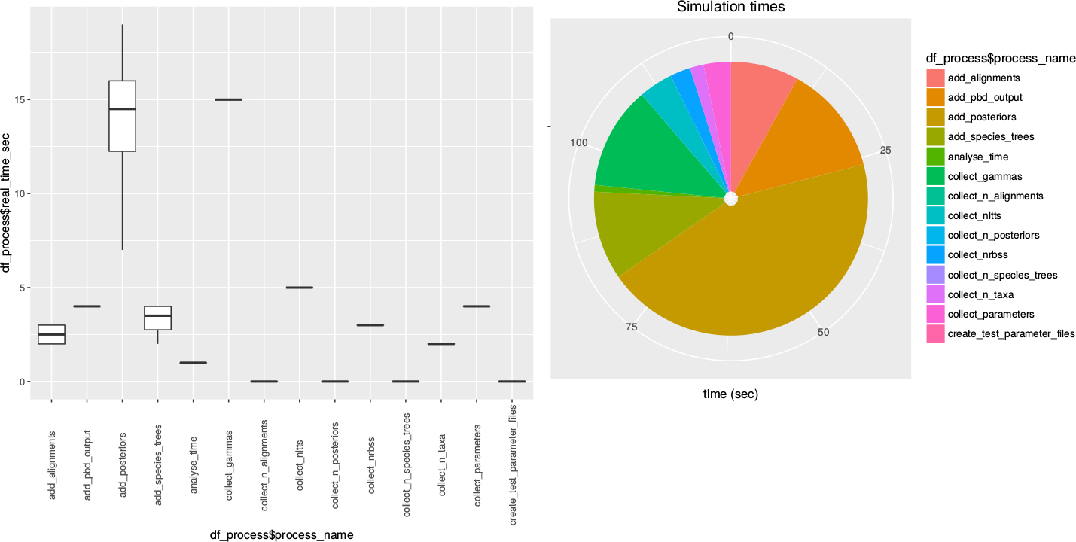
Time measurements

Slide 11
Work in progress
Under which parameters can I simulate?
Measure the nLTT statistics for those parameters
Finish article

