Slide 1



Ignoring incipient species
NAEM 2017-02-15
© 2017 Richel Bilderbeek
www.github.com/richelbilderbeek/Science

Slide 2

Notes:
From http://walldiskpaper.com/mobilehd/tropical-island-wallpapers-2560x1600/

Slide 6
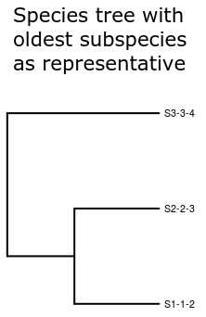
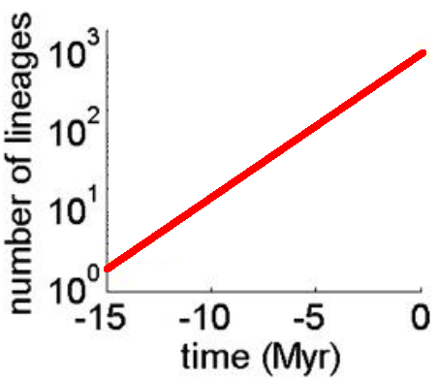
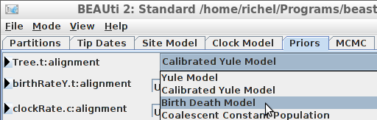
Birth Death model [1]
All species are ‘good’ species
Constant rate for speciation and extinction
Number of species grows exponentially
Widely used as prior in tools
[1] Nee et al., 1994

Slide 10
Research question
What is the effect of ignoring incipient* species ?
  (*) A (possibly) future good species

Slide 12
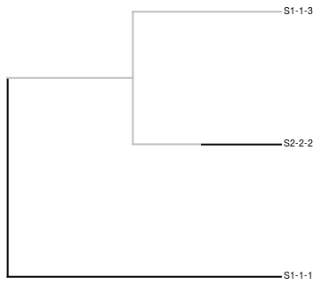
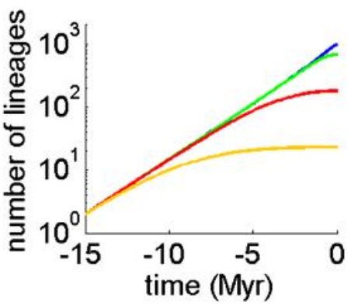
Protracted speciation [1]
Extension of BD model
New species start as incipient
Speciation completion rate
  Incipient → good
  Falls back to BD if SCR equals infinity
Number of lineages towards the present flattens off
[1] Etienne & Rosindell, 2012

Slide 13
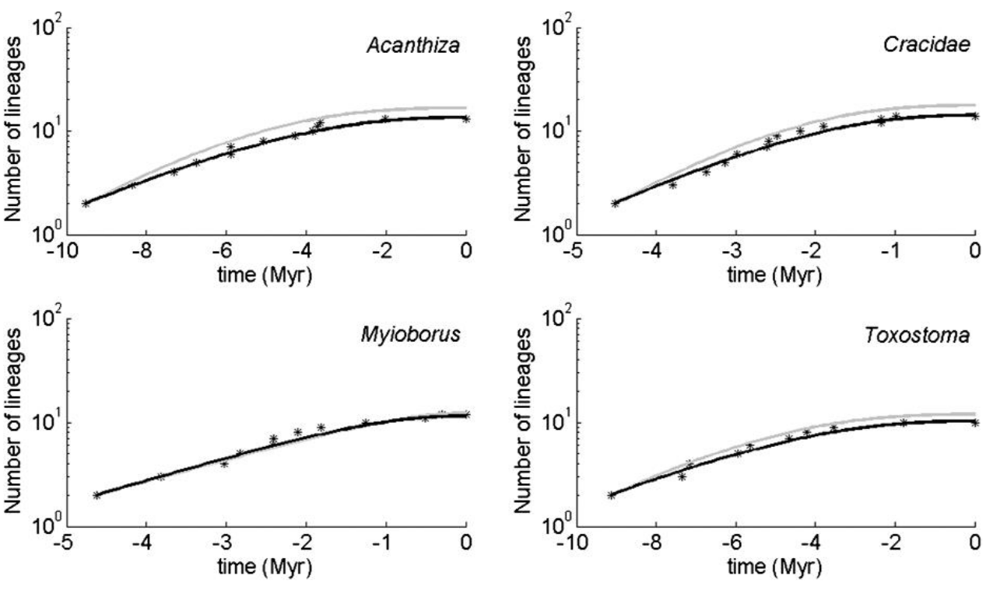
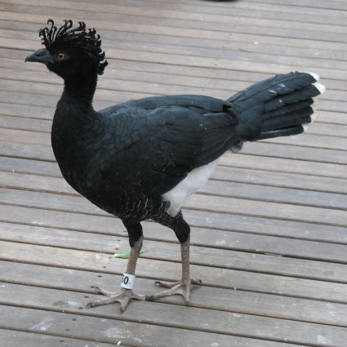
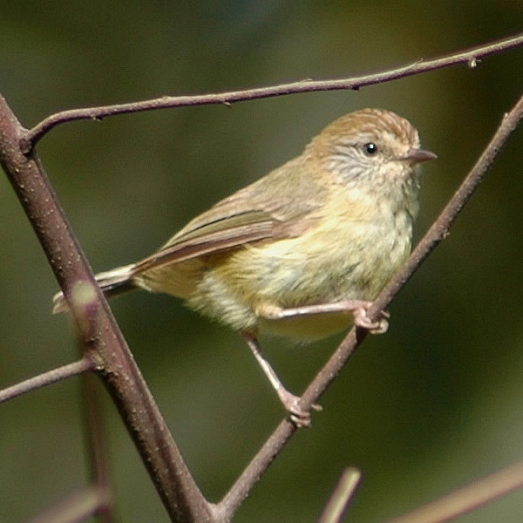
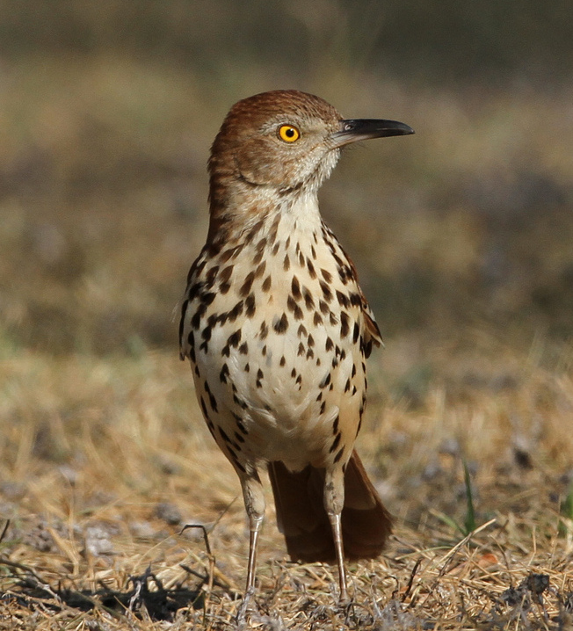
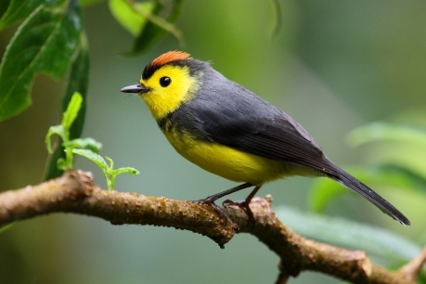
PBD in nature
Crax
daubentoni,
Yellow-
knobbed
Curassow
Acanthiza
nana,
Yellow
Thornbill
Myioborus torquatus,
Collared Whitestart
Toxostoma rufum,
Brown Thrasher
Etienne & Rosindell, 2012

Slide 14
Research question
What is the effect of ignoring incipient* species ?
What if a BD model is assumed to make inferences about a PBD reality?
  (*) A (possibly) future good species

Slide 15
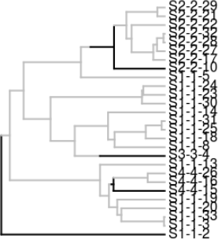
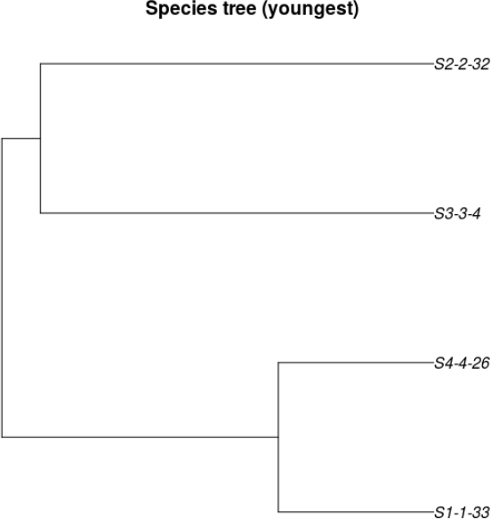
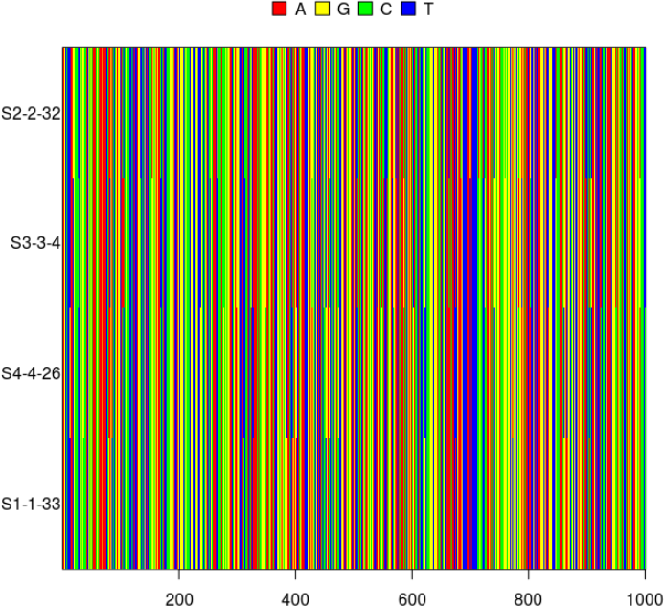
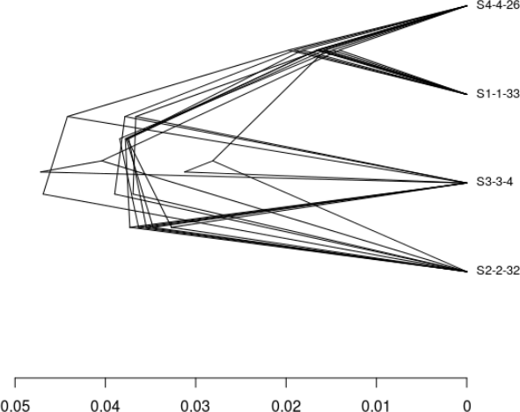
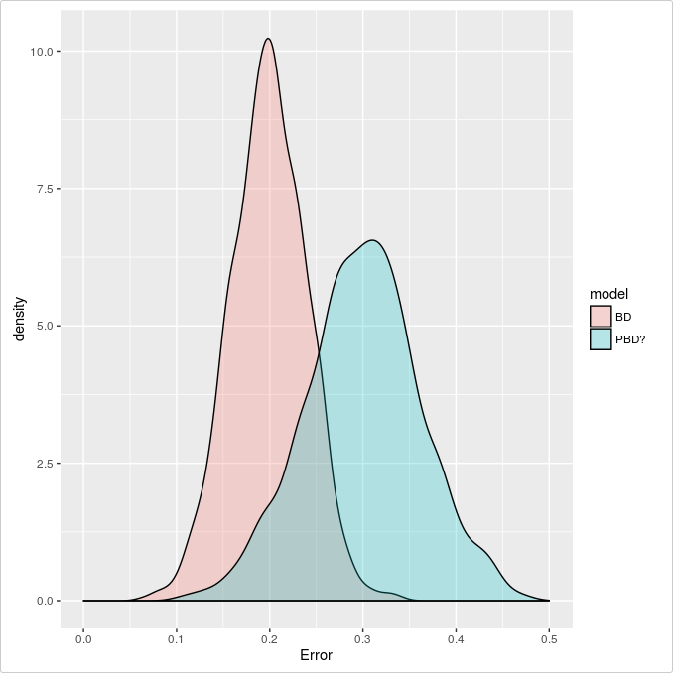
Approach
Simulate an incipient species tree
Sample species trees
Simulate DNA alignments
Infer species tree posterior
(BEAST2)
PBD
BD prior
Measure difference/error (nLTT statistic)
Notes:
Parameter space: http://www.mymodernmet.com/profiles/blogs/numen-for-use-string-prototype

Slide 16
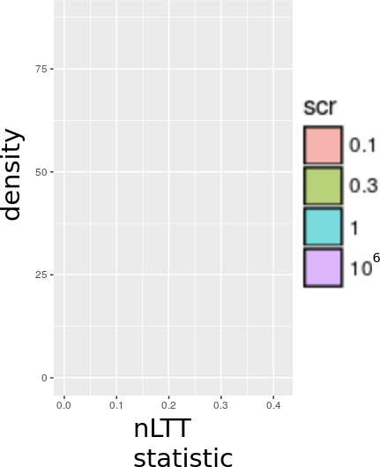
Effect of SCR, prediction
Speciation Completion Rate
Protracted Birth-Death
Birth-Death (BD) model

Slide 17
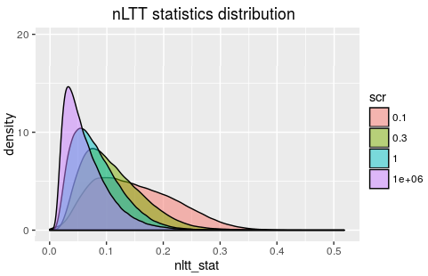
Effect of SCR, measured

Slide 18
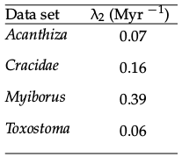
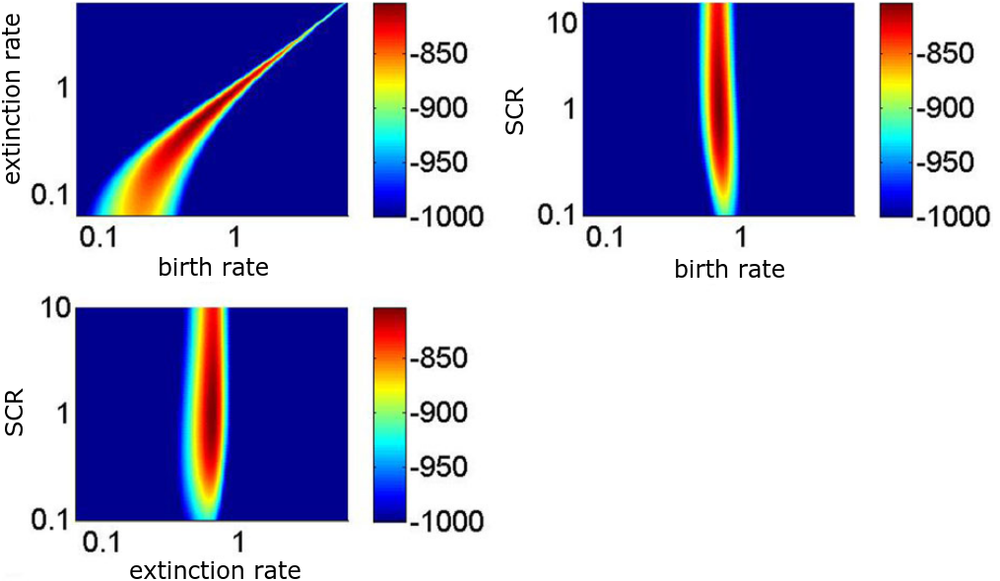
SCRs in nature
Birds: 0.04-0.89
Primates: around 1
Adapted from Etienne et al., 2014

Slide 19
Conclusion
Low SCR increases the error made in inference by a BD prior
For primates (SCR ≈ 1): good enough
For birds (SCR < 1): maybe not
Higher extinction rates reduces error (not shown)

Slide 20

Discussion
Factorial setup of all parameters failed for some combinations for unknown reasons
  Only one speciation initiation rate
Other summary statistics
  gamma, ∆r, NRBS
Redo my research:
  www.github.com/richelbilderbeek
    wiritttes: simulation
    wiritttea: analysis

Slide 21
Acknowledgements
Rampal Etienne
Jolien Gay
Femke Thon

Slide 22
Questions?

Slide 23
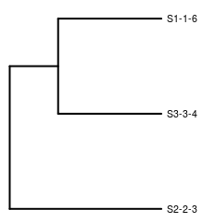
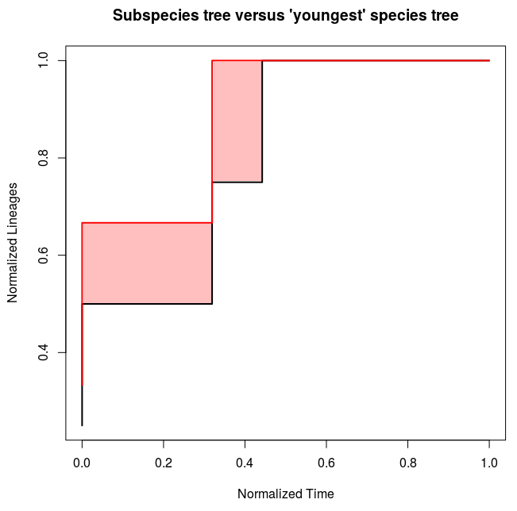
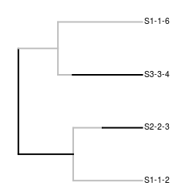
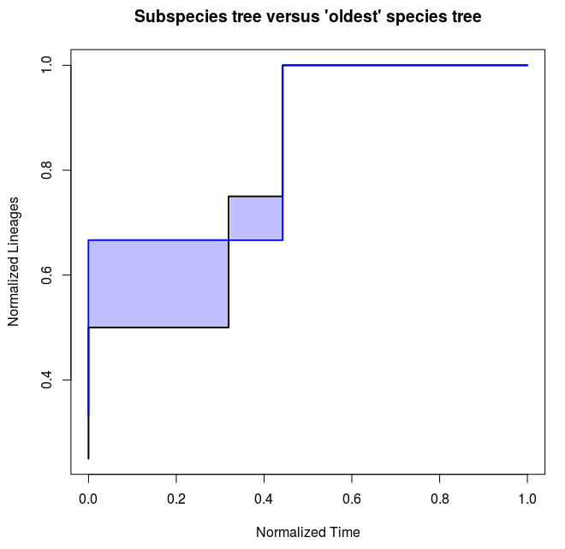
Simulated truth

Slide 24
nLTT statistic [1]
Quantify difference between two phylogenies
[1] Janzen et al., 2015

Slide 25
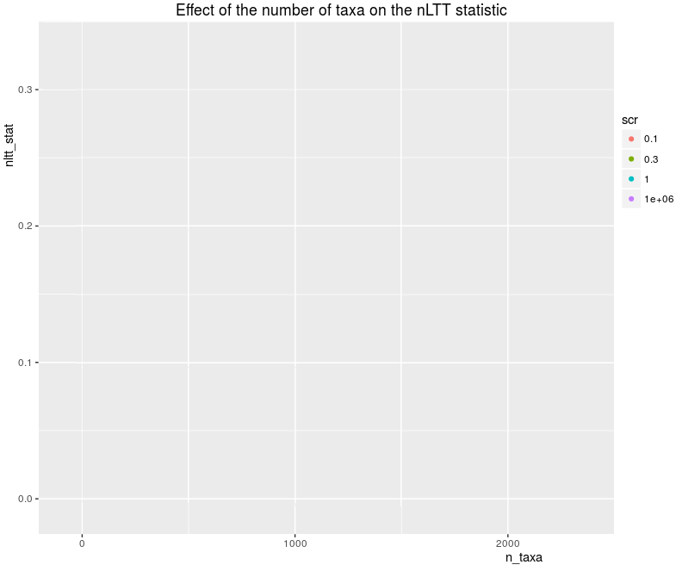
Effect of #taxa, expected

Slide 26
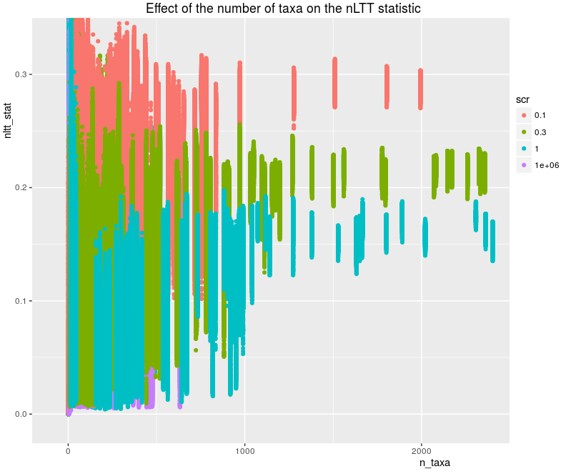
Effect of #taxa, measured

Slide 27
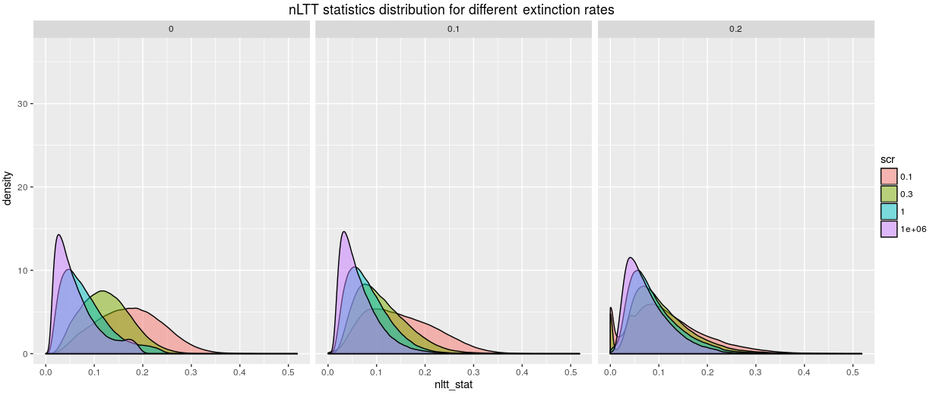
Extinction rates

Slide 28
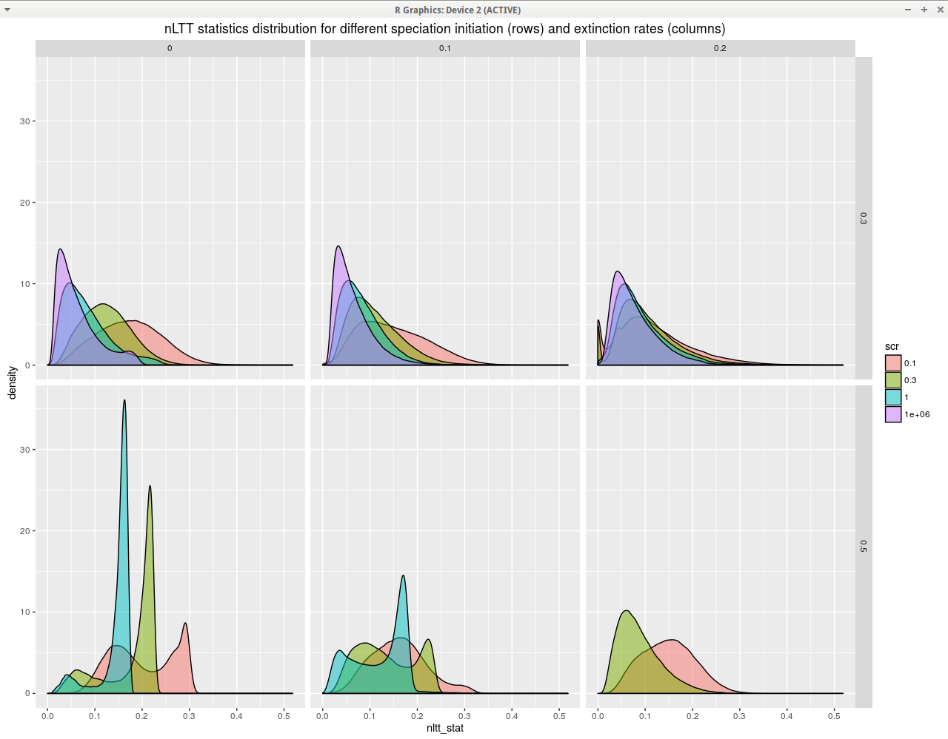
SIRs and ERs

