Slide 1
My research
© 2015 Richel Bilderbeek

Slide 2
Parameters estimated from phylogenies
Effective population size (Kuhner et al. 1995)
Rate of population growth or decline (Kuhner et al. 1998, Drummond et al. 2002)
Migration rates and population structure (Beerli & Felsenstein 1999, Beerli & Felsenstein 2001, Ewing et al. 2004, Ewing & Rodrigo 2006)
Recombination rates and reticulate ancestry (Kuhner et al. 2000, Bloomquist & Suchard 2010)
Notes:
Beerli, P. & Felsenstein, J. (1999), ‘Maximum-likelihood estimation of migration rates and effective population numbers in two populations using a coalescent approach’, Genetics 152(2), 763.
Beerli, P. & Felsenstein, J. (2001), ‘Maximum likelihood estimation of a migration matrix and effective population sizes in n subpopulations by using a coalescent approach.’, Proc Natl Acad Sci U S A 98(8), 4563–4568.
Bloomquist, E. W. & Suchard, M. A. (2010), ‘Unifying vertical and nonvertical evolution: A stochastic ARG-based framework’, Systematic Biology 59(1), 27 –41.
Drummond, A. J., Nicholls, G. K., Rodrigo, A. G. & Solomon, W. (2002), ‘Estimating mutation parameters, population history and genealogy simultaneously from temporally spaced sequence data’, Genetics 161(3), 1307–20.
Ewing, G. & Rodrigo, A. (2006), ‘Coalescent-Based estimation of population parameters when the number of demes changes over time’, Molecular Biology and Evolution 23(5), 988–996.
Ewing, G., Nicholls, G. & Rodrigo, A. (2004), ‘Using temporally spaced sequences to simultaneously estimate migration rates, mutation rate and population sizes in measurably evolving populations’, Genetics 168(4), 2407–2420.
Kuhner, M., Yamato, J. & Felsenstein, J. (1995), ‘Estimating effective population size and mutation rate from sequence data using metropolis-hastings sampling’, Genetics 140, 1421–1430.
Kuhner, M., Yamato, J. & Felsenstein, J. (1998), ‘Maximum likelihood estimation of population growth rates based on the coalescent’, Genetics 149, 429–434.
Kuhner, M., Yamato, J. & Felsenstein, J. (2000), ‘Maximum likelihood estimation of recombination rates from population data’, Genetics 156(3), 1393.

Slide 3




Workflow
Ecology
Molecular data
Alignment
Phylogeny
Parameter estimates
Lambda = ?
Lambda = 0.5

Slide 4
Multi-step
Ecology
Molecular data
Alignment
Phylogeny
Parameter estimates
Lambda = ?
Use best
Use best
Use best
Lambda = 0.5 +- 0.01

Slide 5

Joint inference
Ecology
Molecular data
Alignments
Phylogenies
Parameter estimates
Lambda = ?
This alignment, this phylogeny
and lambda = 0.5 have a 90% probability

Slide 6
Example
Is he/she a researcher?
  City: GRN
  Address: NIEUWST
  Last name: BER

Slide 7
Multi-step approach
Step 1: find the best fitting city name: Groenlo
Step 2: within Groenlo, find the best fitting street name: Nieuwstad
Step 3: within Nieuwstad, find the best fitting last name: Bergsma
Step 4: Bergsma cannot be found by Google
Is he/she a researcher? 0%

Slide 8
Joint inference
Look for combinations of GRN, NIEUWST, BER, probability
Groenlo – Nieuwstad – Bergsma – 0%
Groenlo – Nieuwstad – others – 0%
Groenlo – other streets - 0%
Groningen – Nieuwstraat – Bilderbeek – 100%
Groningen – Nieuwstraat – others – 2%
Groningen – other streets - 2%
Chance he/she a researcher? 1%

Slide 9
Current research
From the same (unaligned) molecular data, different alignment programs result in different phylogenies (Wong et al, 2008)
There is no difference between multi-step approach and joint inference, when starting from alignment data (but do use two tree models)(Hohna et al, 2015)
Notes:
Wong, Karen M., Marc A. Suchard, and John P. Huelsenbeck. "Alignment uncertainty and genomic analysis." Science 319.5862 (2008): 473-476.
S Hohna, T Janzen, RS Etienne, Join inference of phylogeny and diversification rates from molecular sequences does not outperform a 2-step approach. 2015

Slide 10
Experiments
Can parameters be estimated from phylogeny, or must these be inferred jointly with the phylogeny itself?
Which model fits the data best?
Does it matter which model is used?

Slide 11
Experiments
Check likelihood
Estimate
Data
Model
Phylogeny
Parameters
Create best

Slide 12
Experiments
Model
Data
Phylogeny
Parameters
Different?
Model
Phylogeny
Parameters
Data

Slide 13
Model unknown?
Model A
Phylogeny
Data
Model B
Phylogeny
Take phylogeny with the highest likelihood

Slide 14
Model unknown
Parameter
estimates
Model A
Simulated
input
Take estimates
with highest
likelihood
Model B
Parameter
estimates
Notes:
Input can be:
1) Aligned molecular sequence
2) Phylogeny
Parameter estimates can be:
1) Phylogeny
2) Parameters of species community
3) Both

Slide 15
Does model matter?
Take best
Fitting
parameters
(2) Which is best
parameter
estimation?
Should match
Calculated
likelihood
Model A
Model A
Known
Parameters,
e.g. extinction
and speciation rate
Branching
times
(1) Which model has highest likelihood
Model B
Calculated
likehood
Take best
Fitting
parameters
Do these differ?
Martinez, unpublished
Notes:
Input can be:
1) Aligned molecular sequence
2) Phylogeny
Parameter estimates can be:
1) Phylogeny
2) Parameters of species community
3) Both

Slide 16
Does model matter?
Should match
Parameter
estimates
Model A
Aligned
molecular
data
Model A
Known
Parameters,
e.g. speciation
rate, mutation
rate, total time
Model B
Parameter
estimates
Do these differ?
Notes:
Input can be:
1) Aligned molecular sequence
2) Phylogeny
Parameter estimates can be:
1) Phylogeny
2) Parameters of species community
3) Both

Slide 17
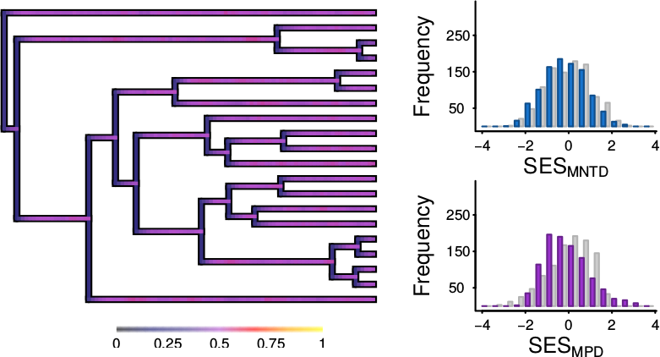
Does model matter?
Random-draw
DAMO
CLES
Check if picture is correct
P = 95%
High extinction rate
A Pigot & RS Etienne, 2015
Notes:
Pigot, Alex L., and Rampal S. Etienne. "A new dynamic null model for phylogenetic community structure." Ecology letters 18.2 (2015): 153-163.

Slide 18
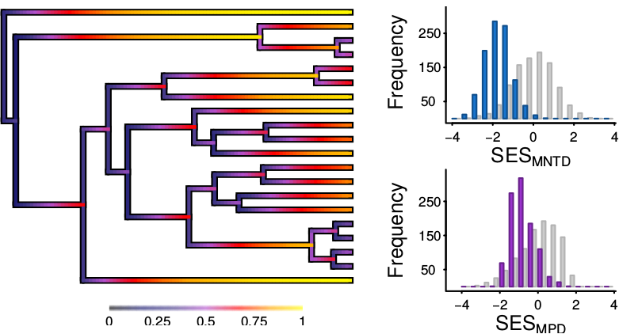
Does model matter?
Random-draw
DAMO
CLES
Check if picture is correct
P = 95%
Low extinction rate
A Pigot & RS Etienne, 2015
Notes:
Pigot, Alex L., and Rampal S. Etienne. "A new dynamic null model for phylogenetic community structure." Ecology letters 18.2 (2015): 153-163.

Slide 19
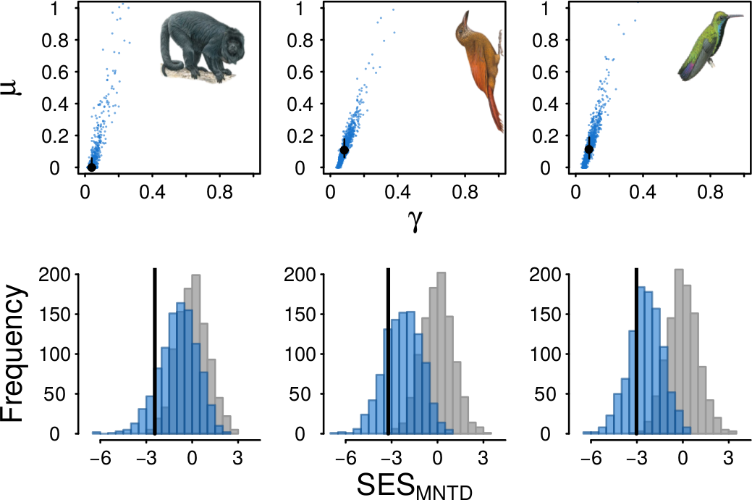
Does model matter?
Random-draw
DAMO
CLES
Observed
A Pigot & RS Etienne, 2015
Notes:
The random-draw model suggests that there probably is a biological force acting, where DAMOCLES suggests that the data observed is close to (its) random
Pigot, Alex L., and Rampal S. Etienne. "A new dynamic null model for phylogenetic community structure." Ecology letters 18.2 (2015): 153-163.

Slide 20
Does model matter?
Comparing a time and density-dependent model
  Time-dependent: fast to calculate, no mechanism
  Density dependent: more difficult to calculate, has biological mechanism
If both yield identical results, using a time-dependent model is proven to be acceptable
C Martinez, unpublished

Slide 21
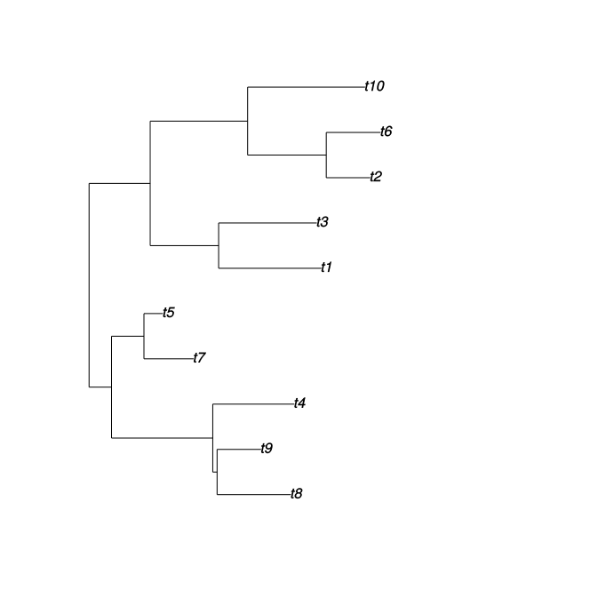
Generating null phylogenies
Can be done in R:
Random tree
Algorithm from Paradis, 2012
library(ape);
p = rtree(10)
plot(p)
Notes:
Paradis, E. (2012) Analysis of Phylogenetics and Evolution with R (Second Edition). New York: Springer.

Slide 22
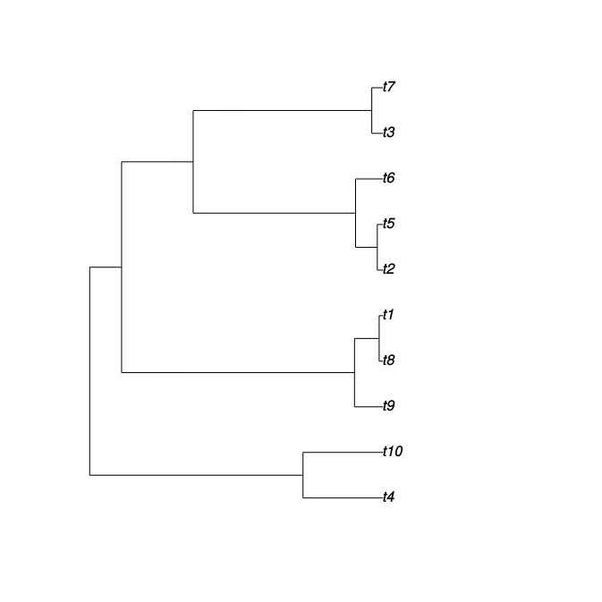
Generating null phylogenies
Can be done in R:
Random coalescent tree: only those individuals sampled at the current time
Algorithm from Paradis, 2012
library(ape);
p = rcoal(10)
plot(p)
Notes:
Paradis, E. (2012) Analysis of Phylogenetics and Evolution with R (Second Edition). New York: Springer.

Slide 23
Markov Chain
Memoryless states
Probabilistic state transitions
0.6
Sunny
Rainy
0.95
0.4
0.05
Notes:
In the Netherlands, it is raining 7% of the time. These values might not result in that percentage, but will result in a rainyness less than 14%.

