Slide 1
Compare models with known likelihood function: a workflow
© 2015 Richel Bilderbeek

Slide 2
Research question
Does it matter to use model A or B in parameter estimation from aligned molecular data?
Prerequisites:
  The likelihood function of both models must be known (and be put in BEAST2)
  The creation of null phylogenies of at least one model must be known
  The parameters of both models can be estimated from a phylogeny

Slide 3
Models
Model | Birth death | Coalescent Constant Population | Coalescent Exponential Population
Parameter #1 | Speciation rate | Number of species¹ | Number of species¹
Parameter #2 | Extinction rate | - | Growth rate²
1: Called 'Population size' in BEAST2
2: Growth rate = speciation rate – extinction rate

Slide 4
Workflow
1. Using model A:
  1.1 create random parameter values
  1.2 with those values, create simulated phylogeny
  1.3 from that phylogeny, create simulated aligned molecular data
2. Using model A and B:
  2.1 create posterior¹ from that data using BEAST2
  2.2 check posterior using Tracer for convergence
  2.3 for model A: obtain parameter distribution from posterior
  ?2.4 for model B: estimate parameters used by model A
  2.5 Does model A give a higher likelihood?
3. Do the same vice versa
4. Statistical analysis
1. posterior = phylogenies + parameter estimates

Slide 5
Does model matter?
Parameter
recovery
Model A
Extract
Posterior
Parameter
estimates
Model A
Random
parameters
Simulated
phylogenies
Alignment
Posterior
Parameter
estimates
Model B
Estimate
?
How good can
the other model
estimate the
parameters?
?
Likelihood of phylogeny
Notes:
Input can be:
1) Aligned molecular sequence
2) Phylogeny
Parameter estimates can be:
1) Phylogeny
2) Parameters of species community
3) Both

Slide 6
  1.1. Create random parameter values
Different models have a different number of parameters
Model | Birth death | Coalescent Constant Population | Coalescent Exponential Population
Parameter #1 | Speciation rate | Number of species¹ | Number of species¹
Parameter #1 | Extinction rate |  | Growth rate²
1: Called 'Population size' in BEAST2
2: Growth rate = speciation rate – extinction rate

Slide 7
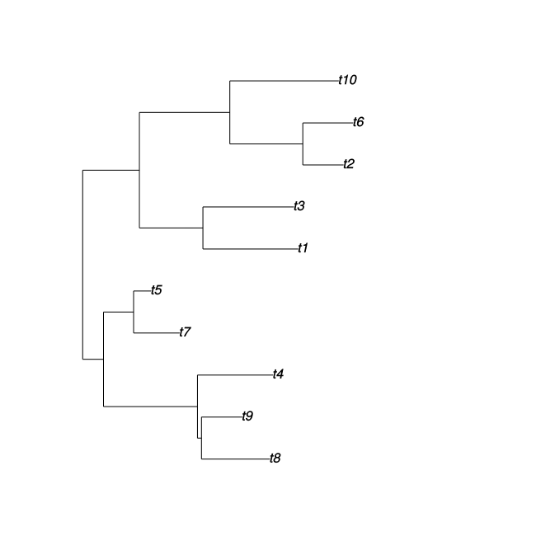
1. Generating random phylogenies
Can be done in R:
Random tree
Algorithm from Paradis, 2012
library(ape)
p <- rtree(10)
plot(p)
Notes:
Paradis, E. (2012) Analysis of Phylogenetics and Evolution with R (Second Edition). New York: Springer.

Slide 8
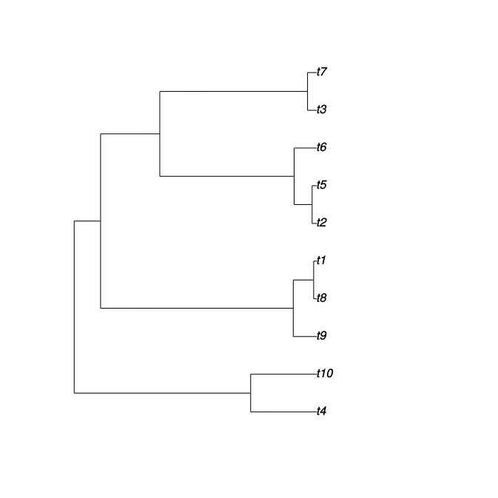
1. Generating random phylogenies
Can be done in R:
Random coalescent tree: only those individuals sampled at the current time
Algorithm from Paradis, 2012
library(ape)
p <- rcoal(10)
plot(p)
Notes:
Paradis, E. (2012) Analysis of Phylogenetics and Evolution with R (Second Edition). New York: Springer.

Slide 9
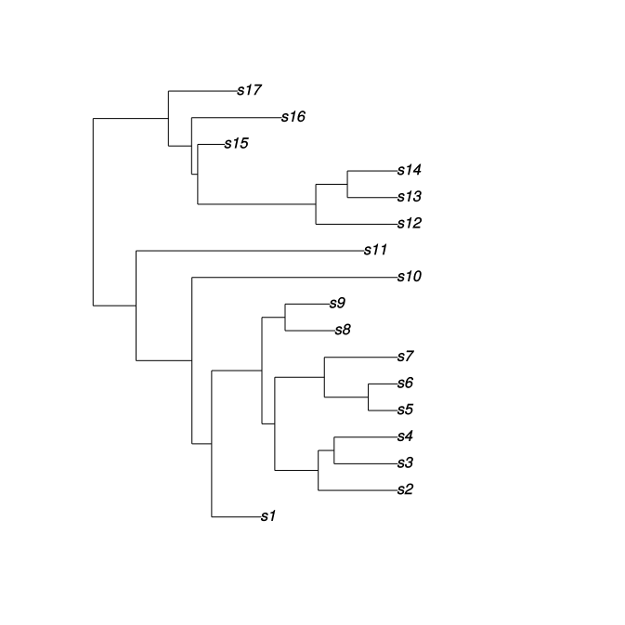
1.2. Generating random phylogenies
Can be done in R:
library(geiger)
p <- sim.bdtree(
birth_rate,
death_rate,
n_taxa,
stop = “taxa”)
plot(p)
Random birth-death tree
Notes:
phylogeny_birthdeath <- sim.bdtree(
birth_rate,death_rate,n_taxa,stop="taxa"
)
Paradis, E. (2012) Analysis of Phylogenetics and Evolution with R (Second Edition). New York: Springer.

Slide 10
  1.3. Create simulated aligned molecular data
Can be done in R:
library(phangorn)
sequence_length <- 10
data <- simSeq(phylogeny,
l=sequence_length)
write.phyDat(data,
file="t.nexus",
format="nexus")
Or other formats

Slide 11
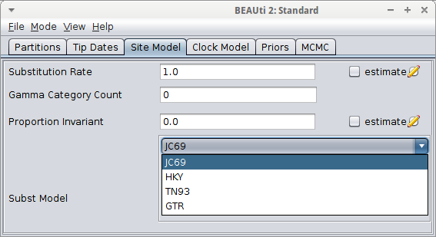
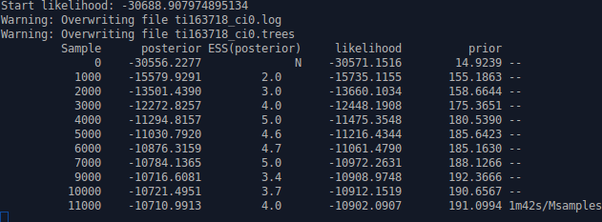
2.1. Create posterior from that alignments for different models using BEAST2
BEAST2: platform for Bayesian evolutionary analysis
FOSS (LGPL 2.1)
R Bouckaert R et al., 2014
Notes:
Bouckaert R, Heled J, Kühnert D, Vaughan TG, Wu C-H, Xie D, Suchard MA, Rambaut A, Drummond AJ (2014) "BEAST2: A software platform for Bayesian evolutionary analysis". PLOS Computational Biogogy 10(4): e1003537, 2014. doi:10.1371/journal.pcbi.1003537

Slide 12
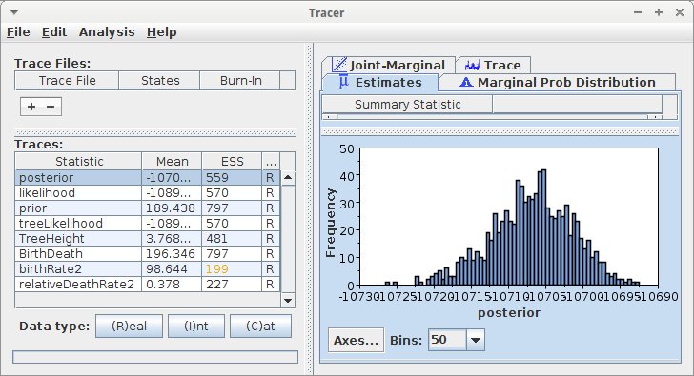
2.2. Check posterior using Tracer
No burn-in visible
ESS must be in range 700-800
All parameters follow a smooth distribution
Drummond & Bouckaert, 2015
Notes:
Alexei J. Drummond and Remco R. Bouckaert. Bayesian evolutionary analysis with BEAST. 2015. Cambridge University Press
ESS: Effective Sample Size
Some guidelines in general MCMCs:
Kass, Robert E., et al. "Markov chain Monte Carlo in practice: a roundtable discussion." The American Statistician 52.2 (1998): 93-100.

Slide 13
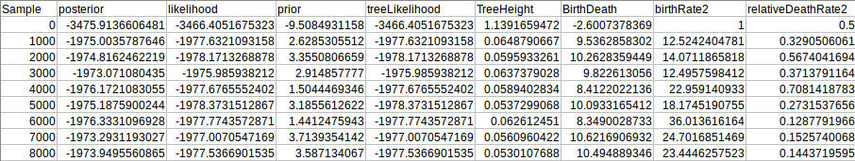
  2.3. For model A: obtain parameter distribution from posterior
Read the parameter from a text file
Easy!

Slide 14

  ?2.4 for model B: estimate parameters used by model A
Model A has different parameters than model B
Parameters for model A can be estimated from the phylogenies in the posterior of model B

Slide 15
?2.4. Estimate parameters from phylogenies
Effective population size (Kuhner et al. 1995)
Rate of population growth or decline (Kuhner et al. 1998, Drummond et al. 2002)
Migration rates and population structure (Beerli & Felsenstein 1999, Beerli & Felsenstein 2001, Ewing et al. 2004, Ewing & Rodrigo 2006)
Recombination rates and reticulate ancestry (Kuhner et al. 2000, Bloomquist & Suchard 2010)
Notes:
Beerli, P. & Felsenstein, J. (1999), ‘Maximum-likelihood estimation of migration rates and effective population numbers in two populations using a coalescent approach’, Genetics 152(2), 763.
Beerli, P. & Felsenstein, J. (2001), ‘Maximum likelihood estimation of a migration matrix and effective population sizes in n subpopulations by using a coalescent approach.’, Proc Natl Acad Sci U S A 98(8), 4563–4568.
Bloomquist, E. W. & Suchard, M. A. (2010), ‘Unifying vertical and nonvertical evolution: A stochastic ARG-based framework’, Systematic Biology 59(1), 27 –41.
Drummond, A. J., Nicholls, G. K., Rodrigo, A. G. & Solomon, W. (2002), ‘Estimating mutation parameters, population history and genealogy simultaneously from temporally spaced sequence data’, Genetics 161(3), 1307–20.
Ewing, G. & Rodrigo, A. (2006), ‘Coalescent-Based estimation of population parameters when the number of demes changes over time’, Molecular Biology and Evolution 23(5), 988–996.
Ewing, G., Nicholls, G. & Rodrigo, A. (2004), ‘Using temporally spaced sequences to simultaneously estimate migration rates, mutation rate and population sizes in measurably evolving populations’, Genetics 168(4), 2407–2420.
Kuhner, M., Yamato, J. & Felsenstein, J. (1995), ‘Estimating effective population size and mutation rate from sequence data using metropolis-hastings sampling’, Genetics 140, 1421–1430.
Kuhner, M., Yamato, J. & Felsenstein, J. (1998), ‘Maximum likelihood estimation of population growth rates based on the coalescent’, Genetics 149, 429–434.
Kuhner, M., Yamato, J. & Felsenstein, J. (2000), ‘Maximum likelihood estimation of recombination rates from population data’, Genetics 156(3), 1393.

Slide 16
3. Do the same vice versa
Easy

Slide 17
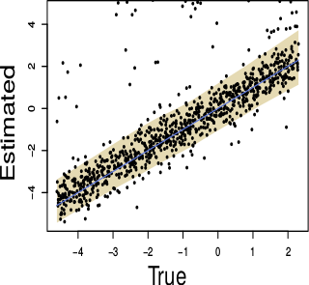
4. Statistical analysis
 | Data created by model A | Data created by model B
Parameters estimated best by model A |  | Compare posteriors (next slide)
Parameters estimated best by model B | Compare posterior (next slide)

Slide 18
4. Statistical analysis
θ: phylogeny and parameters
D: data, in this case, a molecular alignment
Posterior: Pr(θ|D): certainty θ is true, given D. Often, ¹⁰log value is given, then 0 denotes a 100% certainty, negative values imply less certainty
Likelihood: Pr(D|θ): chance D is observed, given θ. Often, ¹⁰log value is given, then 0 denotes a 100% certainty, negative values imply less certainty
?Will be increasingly similar in MCMC

Slide 19
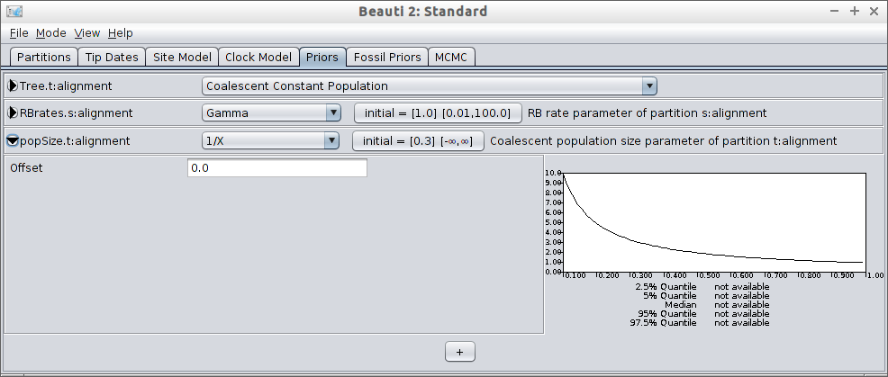
4. Statistical analysis
θ: phylogeny and parameters
Prior: Pr(θ): chance θ is true, a priori estimated (without any data)
Can be more then 1
The (hyper)parameter 'popSize' is assigned a lower probability at higher values
Notes:
The probability of a phylogeny is a function of its branching times only (in BD model), Etienne et al 2012
We should point out that the term “probability of a phylogeny” is a misnomer for two reasons. First, we are dealing with a probability density rather than with a probability, because the branching times are continuous variables. Strictly speaking, the probability of a phylogeny is zero. Second, what we call the probability of a phylogeny is really the probability of a vector of branching times, thus using the common terminology for the constant-rate birth-death model. Note that, because of the property mentioned above, the difference between the two probabilities is a combinatorial factor that does not depend on the model parameters, and hence does not affect the parameter estimation. Etienne et al 2012
Prior loses its relative contribution given enough data, 'let the data do the talking'

Slide 20
4. Statistical analysis
?treeLikelihood: same as likelihood, ?influence of parameter values too small to be observed
TreeHeight: substitutions per site (in this case)

Slide 21
Specific parameters
Birth-Death model:
  BirthDeath: ?sampling rate
  BirthRate2: ? rho * lambda (rho = sampling probability, must be small)
  RelativeDeathRate2: ?lambda - mu
CCP
  popSize:
  CoalescentConstant:

Slide 22
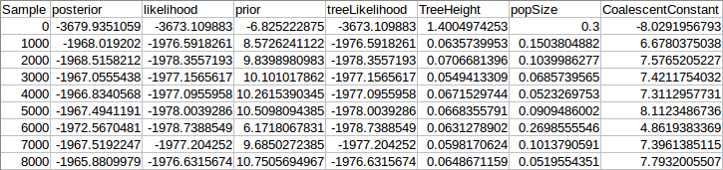
4. Statistical analysis
Model A on data simulated by model A (example values)
Model B on data simulated by model A (example values)
Compare posteriors: performance A = posterior A / posterior B
If BF > 2 there is a evidence A is to be preferred

Slide 23
4. Statistical analysis
Null expectation
 | Data created by model A | Data created by model B
Parameters estimated best by model A | 100 | 0
Parameters estimated best by model B | 0 | 100

Slide 24
4. Statistical analysis
B is superior
 | Data created by model A | Data created by model B
Parameters estimated best by model A | 0 | 0
Parameters estimated best by model B | 100 | 100

Slide 25
4. Statistical analysis
But else?
 | Data created by model A | Data created by model B
Parameters estimated best by model A | 60 | 30
Parameters estimated best by model B | 40 | 70

Slide 26
4. Statistical analysis
?
 | H₀: A = true | H₀: A = false
Accept A | OK | Type I error
Reject A | Type II error | OK

Slide 27
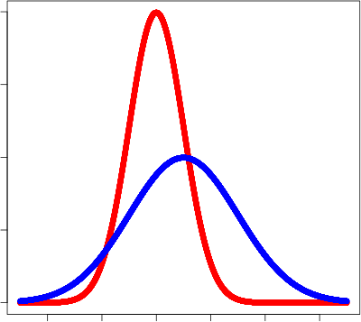
4. Statistical analysis
If the known parameter value (black bar) is estimated best by its own model (red): OK
Probability
Parameter value

Slide 28
4. Statistical analysis
If the known parameter value (black bar) is estimated best by other model (blue): ?
Probability
Parameter value

Slide 29
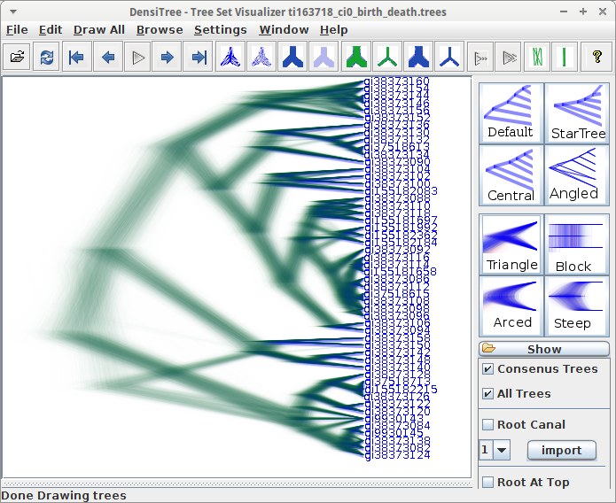
4. ?Compare phylogenies using statistics
DensiTree shows all phylogenies in the posterior
?Distance metric

Slide 30
?How to compare two phylogenies?
When does a phylogeny have a significantly different outcome?
Only in parameter estimation?

