Slide 1
Workflow STBase
© 2015 Richel Bilderbeek

Slide 2
Workflow
1. Take molecular data and proposed phylogeny from STBase
2. Create phylogenies from that data for different models using BEAST2
3. Check posterior using Tracer
4. ?Compare phylogenies using statistics
5. Estimate parameters from phylogenies

Slide 3
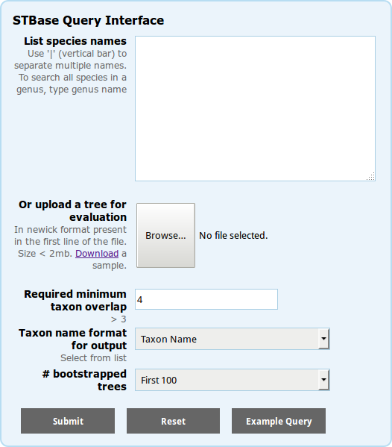
1. Take molecular data and proposed phylogeny from STBase
Database of 1M data sets in 413K eukaryotic taxa
  Single- and multi-locus DNA sequences
  Per set: 1K suggested species trees
Quick access: all data is already calculated
MM McMahon et al., 2015

Slide 4
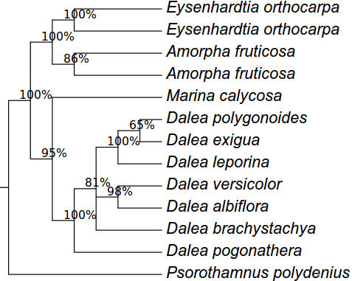

1. Take molecular data and proposed phylogeny from STBase
Data set ID: 5357
Amorpheae
Low complexity, but not trivial
http://stbase.org/pb184/aligned_muscle_184
/ti1xx/ti163718_ci0.nex

Slide 5
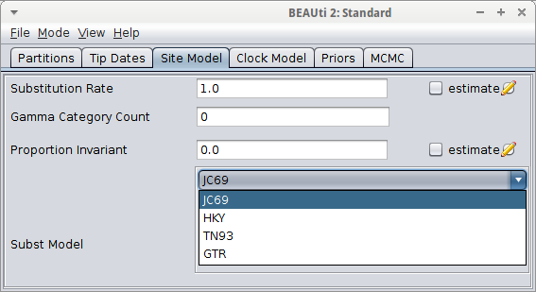
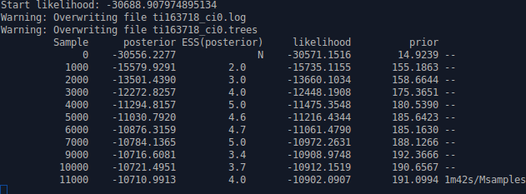
2. Create phylogenies from that data for different models using BEAST2
BEAST2: platform for Bayesian evolutionary analysis
FOSS (LGPL 2.1)
R Bouckaert R et al., 2014
Notes:
Bouckaert R, Heled J, Kühnert D, Vaughan TG, Wu C-H, Xie D, Suchard MA, Rambaut A, Drummond AJ (2014) "BEAST2: A software platform for Bayesian evolutionary analysis". PLOS Computational Biogogy 10(4): e1003537, 2014. doi:10.1371/journal.pcbi.1003537

Slide 6
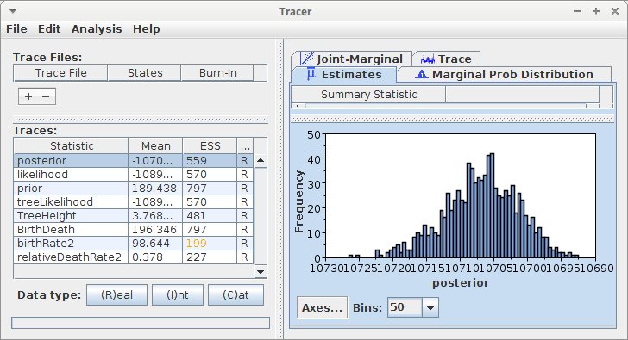
3. Check posterior using Tracer
ESS must be in range 700-800
Drummond & Bouckaert, 2015
Notes:
Alexei J. Drummond and Remco R. Bouckaert. Bayesian evolutionary analysis with BEAST. 2015. Cambridge University Press
ESS: Effective Sample Size
Some guidelines in general MCMCs:
Kass, Robert E., et al. "Markov chain Monte Carlo in practice: a roundtable discussion." The American Statistician 52.2 (1998): 93-100.

Slide 7
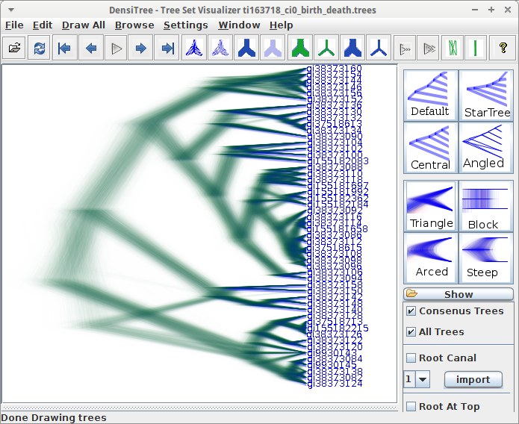
4. ?Compare phylogenies using statistics
DensiTree shows all phylogenies in the posterior
?Distance metric

Slide 8
?How to compare two phylogenies?
When does a phylogeny have a significantly different outcome?
Only in parameter estimation?

Slide 9
5. Estimate parameters from phylogenies
Effective population size (Kuhner et al. 1995)
Rate of population growth or decline (Kuhner et al. 1998, Drummond et al. 2002)
Migration rates and population structure (Beerli & Felsenstein 1999, Beerli & Felsenstein 2001, Ewing et al. 2004, Ewing & Rodrigo 2006)
Recombination rates and reticulate ancestry (Kuhner et al. 2000, Bloomquist & Suchard 2010)
Notes:
Beerli, P. & Felsenstein, J. (1999), ‘Maximum-likelihood estimation of migration rates and effective population numbers in two populations using a coalescent approach’, Genetics 152(2), 763.
Beerli, P. & Felsenstein, J. (2001), ‘Maximum likelihood estimation of a migration matrix and effective population sizes in n subpopulations by using a coalescent approach.’, Proc Natl Acad Sci U S A 98(8), 4563–4568.
Bloomquist, E. W. & Suchard, M. A. (2010), ‘Unifying vertical and nonvertical evolution: A stochastic ARG-based framework’, Systematic Biology 59(1), 27 –41.
Drummond, A. J., Nicholls, G. K., Rodrigo, A. G. & Solomon, W. (2002), ‘Estimating mutation parameters, population history and genealogy simultaneously from temporally spaced sequence data’, Genetics 161(3), 1307–20.
Ewing, G. & Rodrigo, A. (2006), ‘Coalescent-Based estimation of population parameters when the number of demes changes over time’, Molecular Biology and Evolution 23(5), 988–996.
Ewing, G., Nicholls, G. & Rodrigo, A. (2004), ‘Using temporally spaced sequences to simultaneously estimate migration rates, mutation rate and population sizes in measurably evolving populations’, Genetics 168(4), 2407–2420.
Kuhner, M., Yamato, J. & Felsenstein, J. (1995), ‘Estimating effective population size and mutation rate from sequence data using metropolis-hastings sampling’, Genetics 140, 1421–1430.
Kuhner, M., Yamato, J. & Felsenstein, J. (1998), ‘Maximum likelihood estimation of population growth rates based on the coalescent’, Genetics 149, 429–434.
Kuhner, M., Yamato, J. & Felsenstein, J. (2000), ‘Maximum likelihood estimation of recombination rates from population data’, Genetics 156(3), 1393.

