Slide 1

Phylogenetic diversity–ecosystem function
relationships are insensitive to phylogenetic edge lengths, Marc W. Cadotte
Paper discussion by
Karen Bisschop & Richel Bilderbeek
Marc W. Cadotte

Slide 2
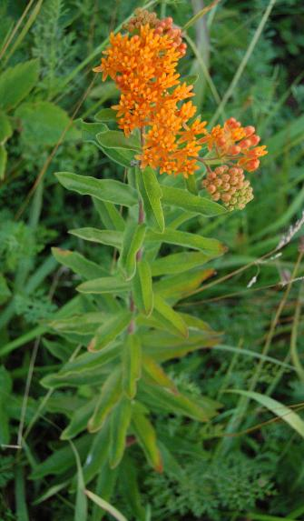
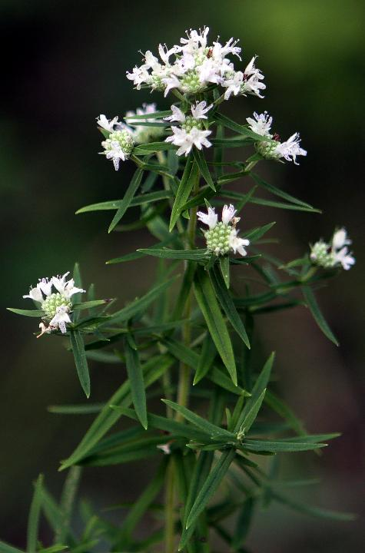
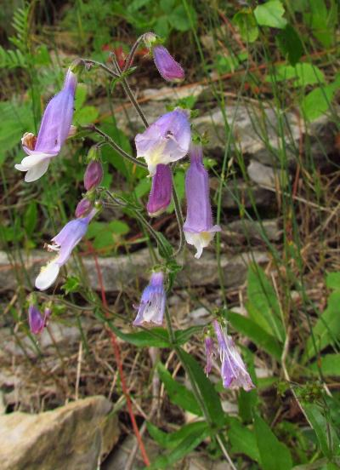
Previous research
Marc W. Cadotte, “Experimental evidence that evolutionarily diverse assemblages result in higher productivity”, 2013, PNAS
Research question: What is the relationship between genetic diversity and plant community biomass production? And which measure of genetic diversity is the best predictor of biomass production?
VS

Slide 3
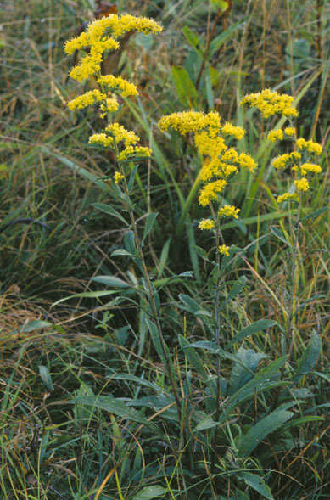
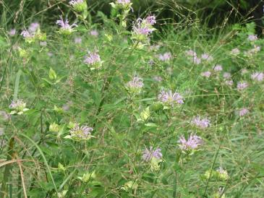
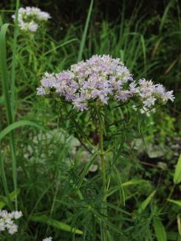
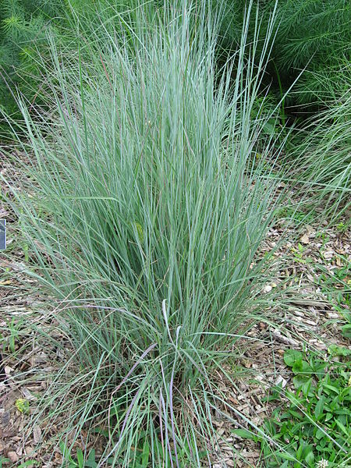
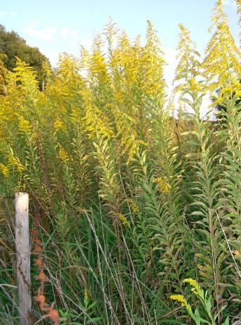
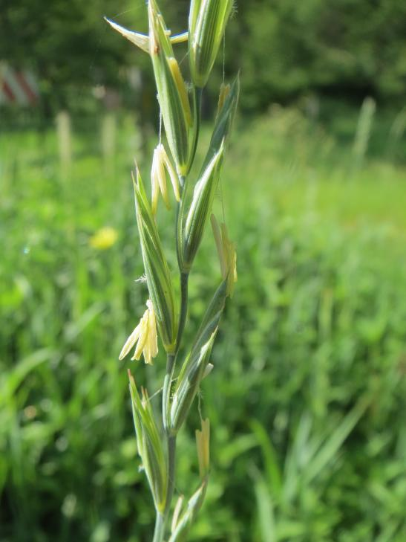
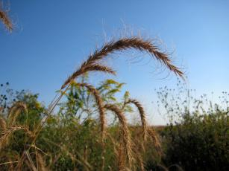
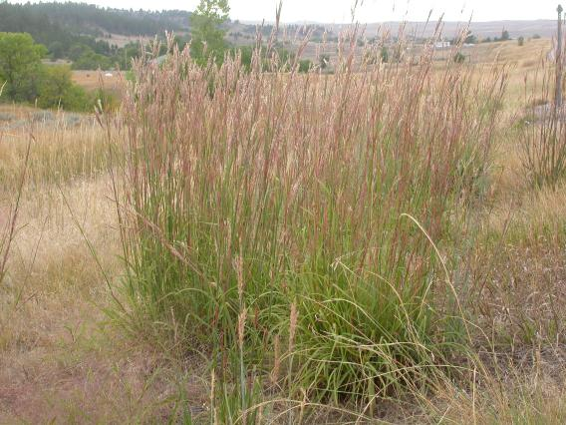
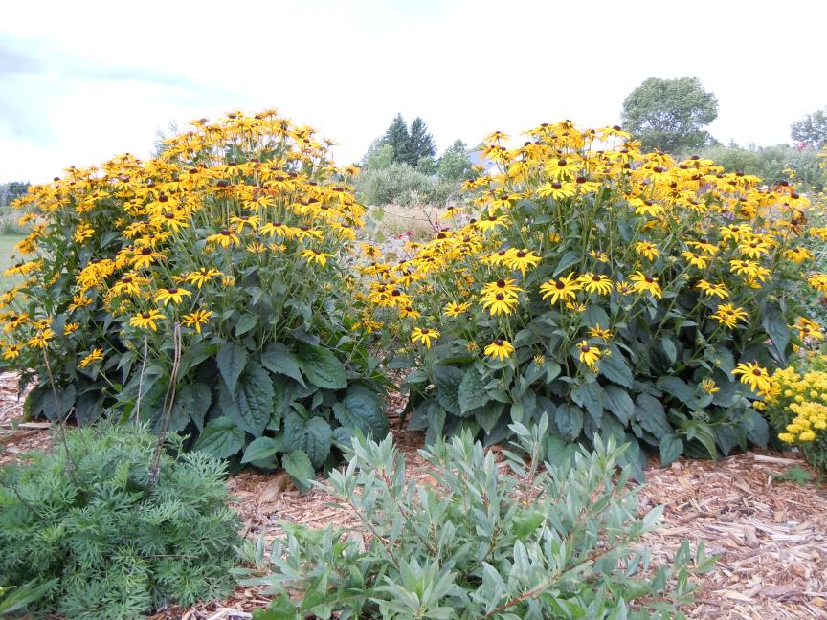
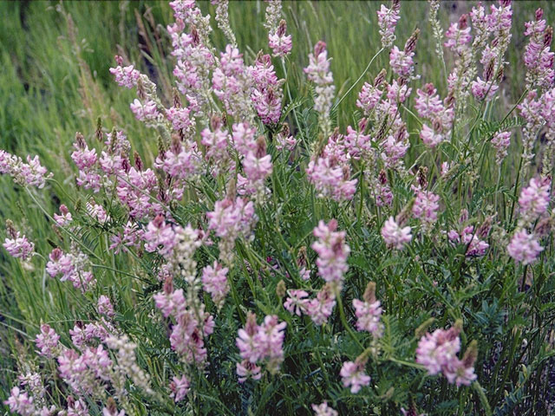
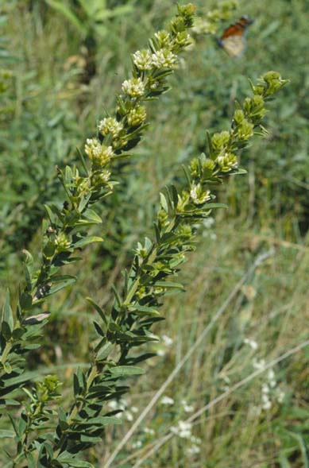
Species used

Slide 4
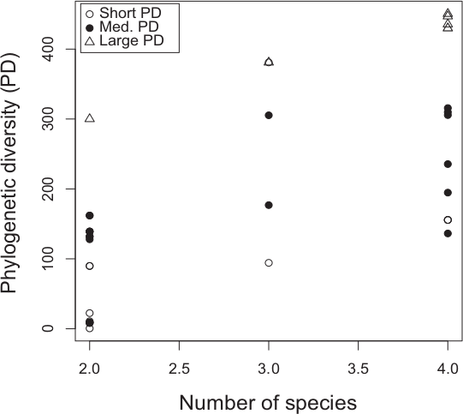
Previous research: experiment
Created 91 2x2 m plots with different plant communities of 1-4 species out of 14 species with 54 different genetic diversities
Each community was replicated 1-6 times
Measured above-ground biomass 2 years later
Cadotte, 2013

Slide 5
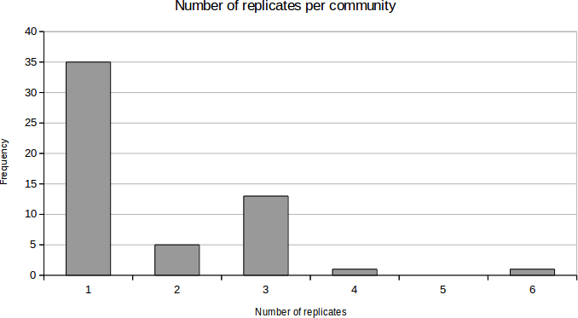
Number of replicates

Slide 6
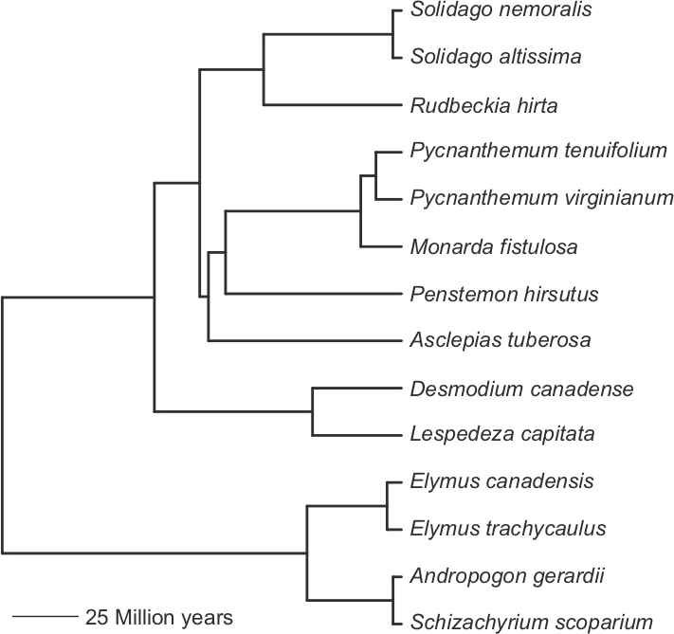
Previous research: phylogeny
Use 1-5 gene sequences
Sequence alignment with MUSCLE
In phylogeny construction, use angiosperm lineages as outgroup and use Modeltest
Cadotte, 2013
Notes:
Phylogeny was created with 5 genes from GenBank, all except 1 species had at least one. To fit Solidago altissima in, they used S. rigida. Two early diverging angiosperm lineages were used as outgroup species. Sequence alignment with MUSCLE, used best-fit ML models of nucleotide substitution for each gene using AIC with Modeltest (model was HKY+I+G)

Slide 7
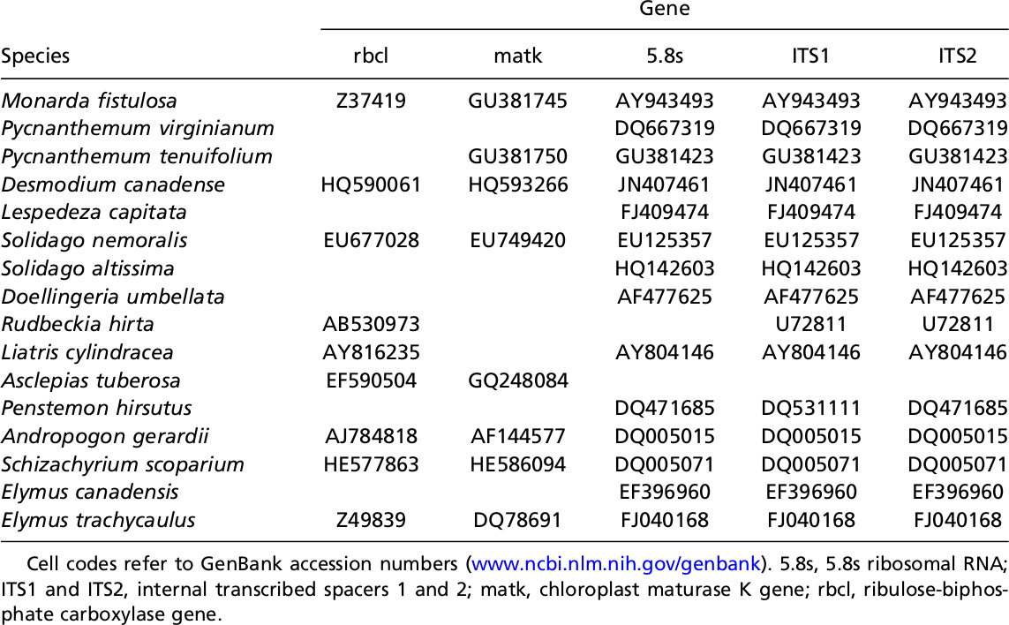
Genes used
Cadotte, 2013
Notes:
Did not use Solidago altissima, but the close relative Solidago rigida

Slide 8
Alignment
Using MUSCLE (MUltiple Sequence Comparison by Log- Expectation)
Comparable to CLUSTALW, MAFFT and T-COFFEE

Slide 9
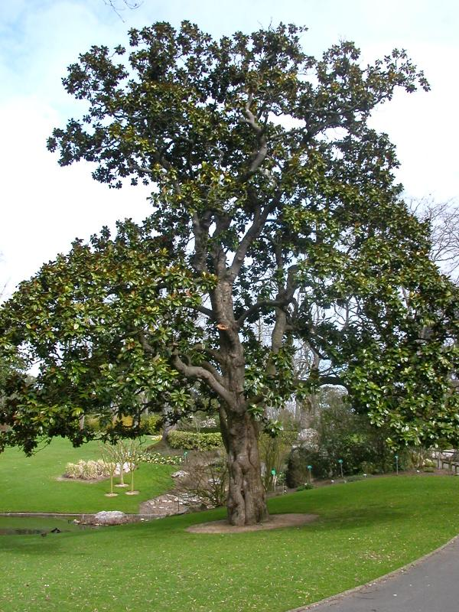
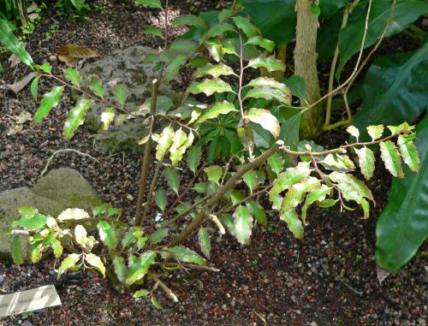
Phylogeny construction
Used two other angiosperms as outgroups
Used best-fit maximum-likelihood models of nucleotide substitution for each gene (?) using the Akaike Information Criterion with Modeltest
(model was HKY+I+G)
Eudicots
Monocots
Angiosperms
Amborella trichopoda
Amborellales
Magnolia grandiflora
Magnoliids
Notes:
HKY: Hasegawa, Kishino and Yano, 1985
AC=AT=CG=GT; AG=CT
+I: invariant sites
+G: rate variation among sites

Slide 10
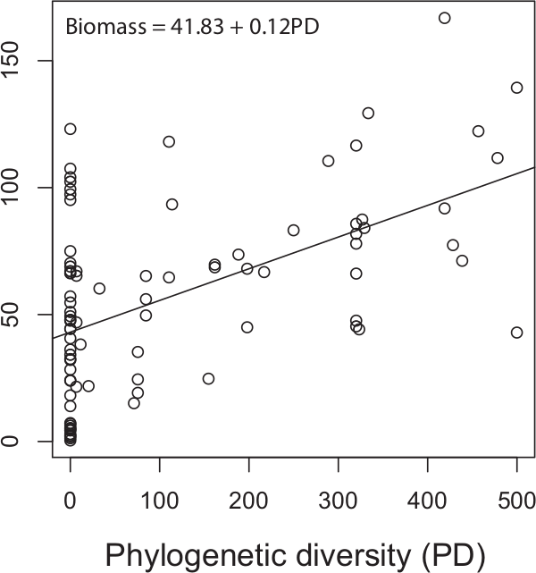
Previous research
BM = 43.08 + 0.12 GD
The more genetic distance in a plot, the higher the biomass
Genetic distance (GD) is the best predictor of biomass (BM) compared to 11 other measures of diversity
Cadotte, 2013
Notes:
This is weird: I took the best fitting equation from Table S3, upper table, 3rd row and this differs from the picture. Author confirmed this was a type and the value in table S3 is correct.

Slide 11
This research
In the previous research, constant mutation (nucleotide substitution) rate is assumed
With different mutation rates per clade the tree will have different taxa lengths
Does it matter if edge lengths have errors, compared to errors in topology?
Cadotte, 2015

Slide 12
Method
Randomize phylogenies
Fit new PDs to real data
If randomized phylogenies have similar likelihoods, the data is robust, thus the treatment has little effect
BM = 43.08 + 0.12 GD
Cadotte, 2015

Slide 13
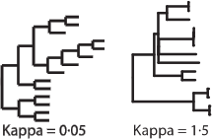
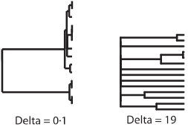
Randomize
Five treatments:
  Pagel's δ tranform on edge lengths
  Pagel's K transform on edge lengths
  Randomize edge lengths
  Randomize tips
  Randomize tips and edges
Cadotte, 2015

Slide 14
Fit
For every phylogeny
  PD is calculated
  New PD is fit to data with the linear model
EF = β₀ + β₁PD + ε
  using maximum-likelihood (assumes error is distributed independently and identically according to a normal distribution)
BM = 43.08 + 0.12 GD
BM = β₀ + β₁GD
Cadotte, 2015
Cadotte, 2015
Cadotte, 2015
Notes:
Dashed line: value of original tree

Slide 15
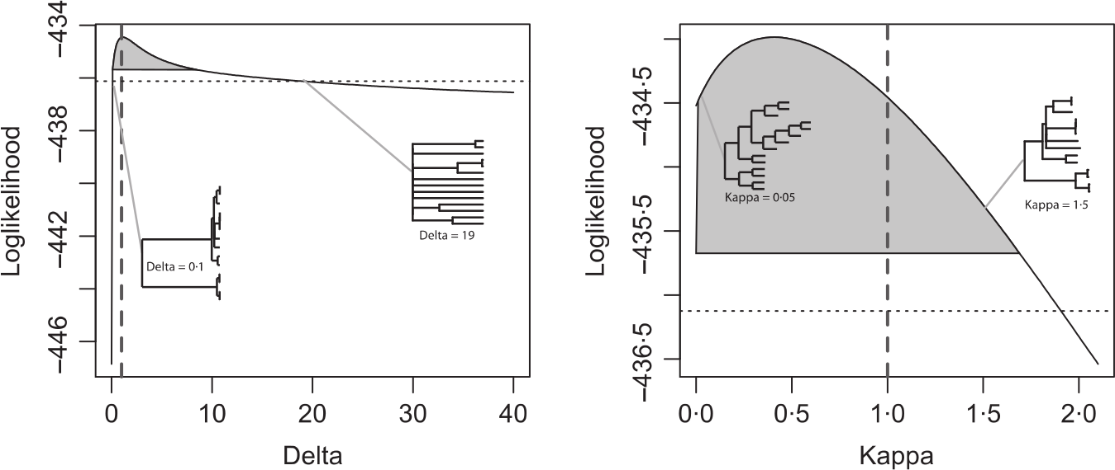
Results
The best Pagel's δ transform coincidentally has highest likelihood at its original value
The best Pagel's K transform has non-significantly different likelihood at best value compared to the original value
Cadotte, 2015
Notes:
Dashed line: value of original tree

Slide 16
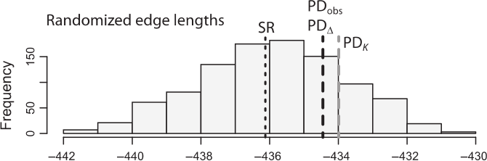
Results
PD_{obs}: Likelihood of fit with original phylogeny
PD_{Δ}: Highest likelihood of Pagel's δ transform
PD_{K}: Highest likelihood of Pagel's K transform
SR: Likelihood using species richness instead of PD
Log-likelihood
Cadotte, 2015

Slide 17
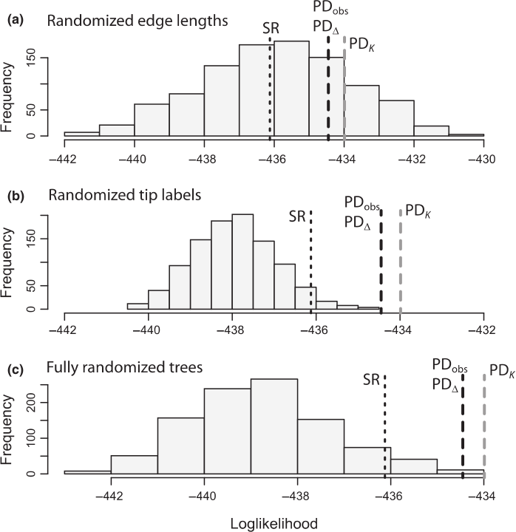
Results
Randomizing edge lengths has least influence, as PD_{obs} is within high frequency
In other treatments, PD_{obs} falls outside of the random tree range
Cadotte, 2015

Slide 18
Discussion
Isn't it weird to use 'fitting to the data well' as a result variable?
Does a better way exists?
BM = 43.08 + 0.12 GD
BM = β₀ + β₁GD
Cadotte, 2015
Cadotte, 2015
Cadotte, 2015

Slide 19
Discussion
Was the initial data of 2013 weak to begin with?
  35 out of 55 communities had no replicates
  It is a gradient of 55 communities
Cadotte, 2013

Slide 20
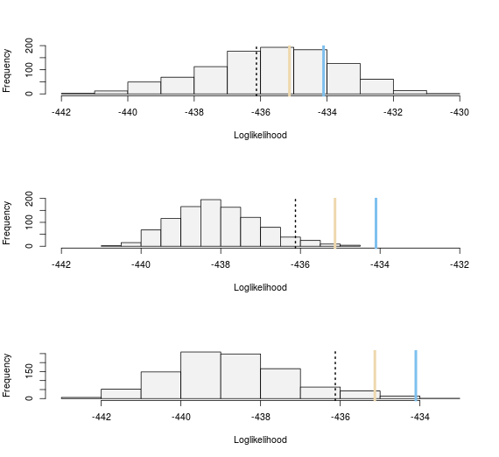
Discussion
Could not reproduce result
  Different plot (minor detail)
  Used random number seed
Redone
Cadotte, 2015

Slide 21
Discussion
Isn't it obvious that changing branch lengths has less impact than changing labels?
It is good that this has been checked
Should we abandon researching speciation models then?

