Slide 1

Phylogenetic diversity–ecosystem function
relationships are insensitive to phylogenetic edge lengths, Marc W. Cadotte
Paper discussion by
Karen Bisschop & Richel Bilderbeek
Marc W. Cadotte

Slide 2
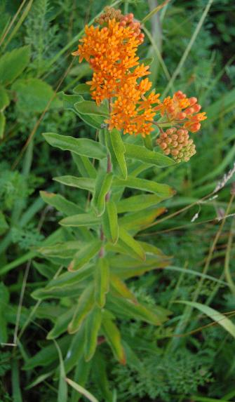
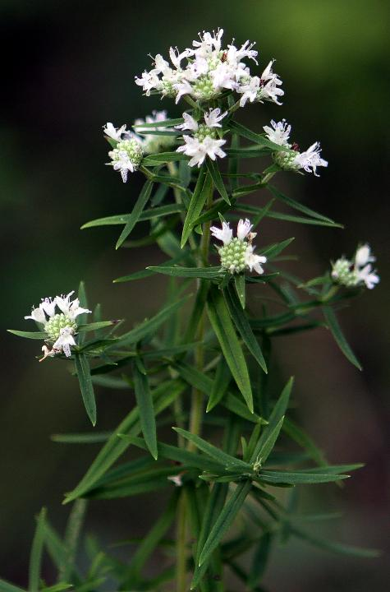
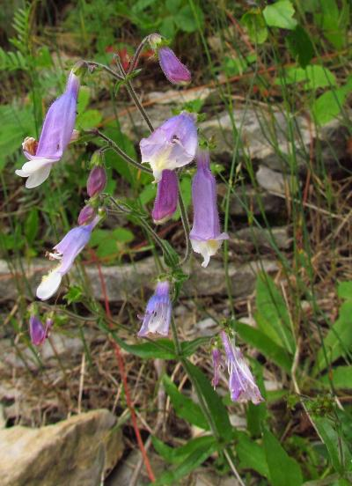
Previous research
Marc W. Cadotte, “Experimental evidence that evolutionarily diverse assemblages result in higher productivity”, 2013, PNAS
Research question: What is the relationship between genetic diversity and plant community biomass production? And which measure of genetic diversity is the best predictor?
VS

Slide 3
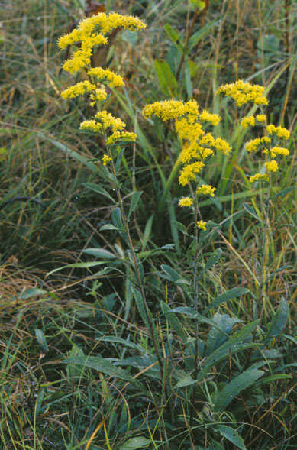
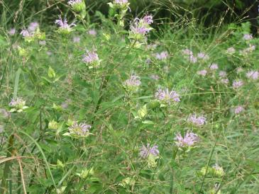
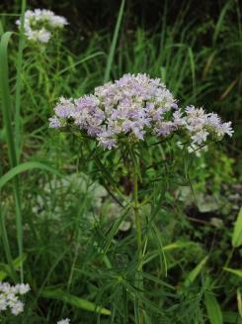
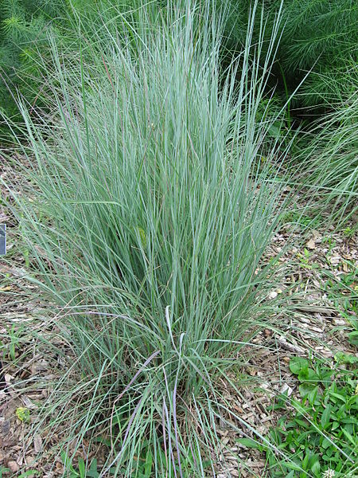
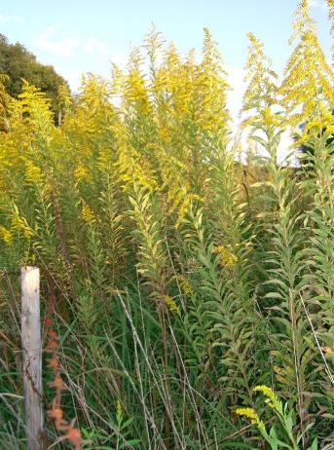
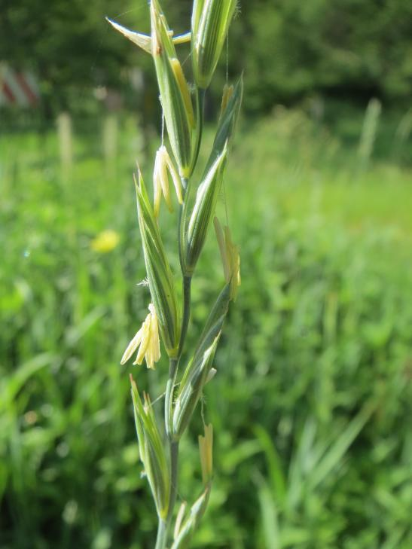
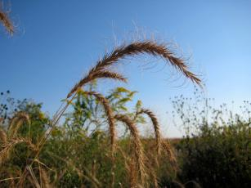
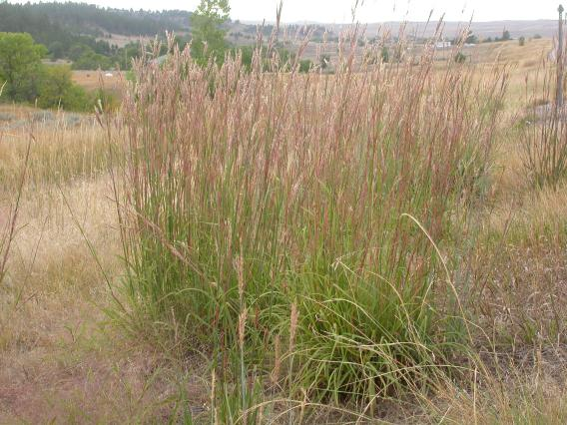
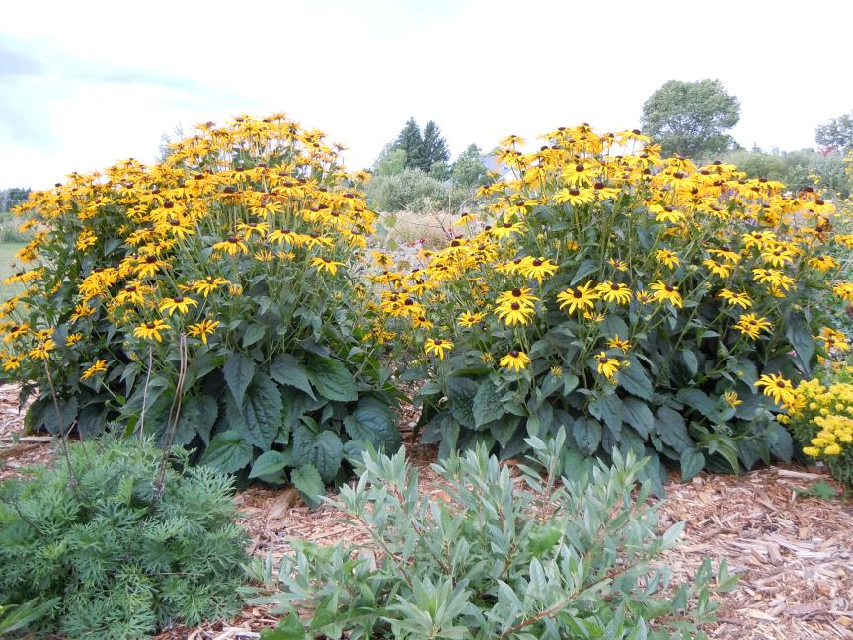
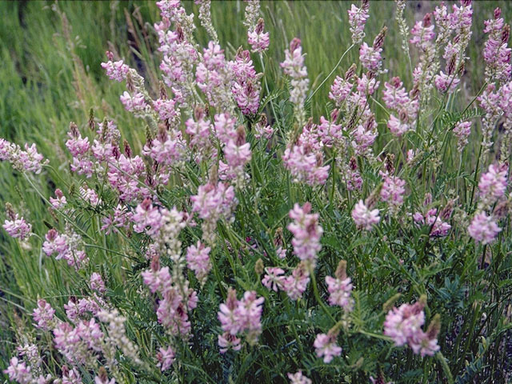
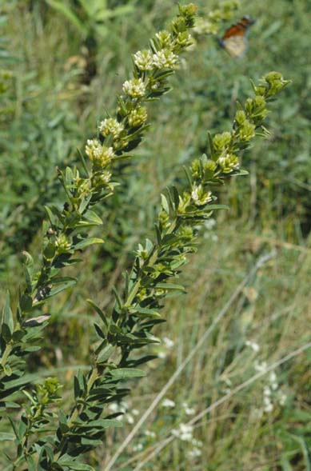
Species used

Slide 4
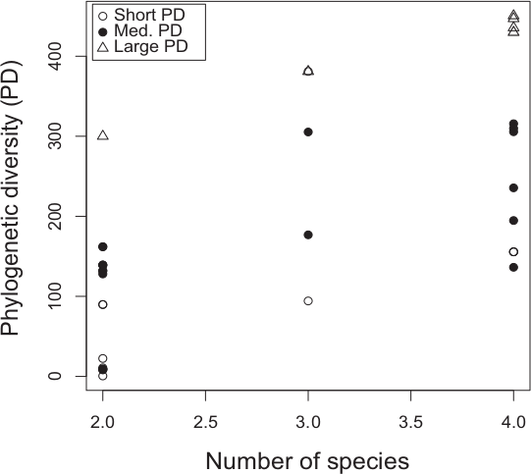
Previous research: experiment
Created 91 2x2 m plots with different plant communities of 1-4 species out of 14 species with 54 different genetic diversities
Measured above-ground biomass 2 years later
Cadotte, 2013

Slide 5
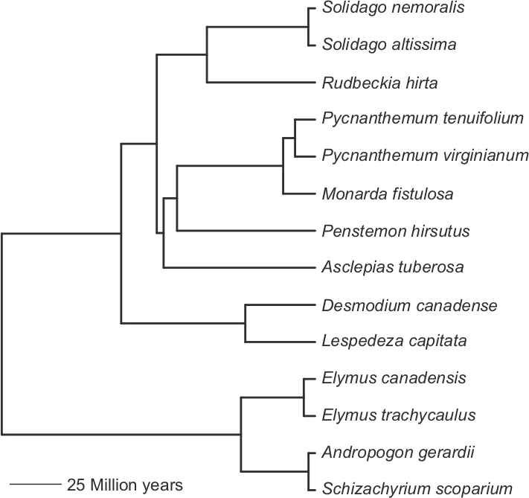
Previous research: phylogeny
Use 1-5 gene sequences
Sequence alignment with MUSCLE
In phylogeny construction, use angiosperm lineages as outgroup and use Modeltest
Cadotte, 2013
Notes:
Phylogeny was created with 5 genes from GenBank, all except 1 species had at least one. To fit Solidago altissima in, they used S. rigida. Two early diverging angiosperm lineages were used as outgroup species. Sequence alignment with MUSCLE, used best-fit ML models of nucleotide substitution for each gene using AIC with Modeltest (model was HKY+I+G)

Slide 6
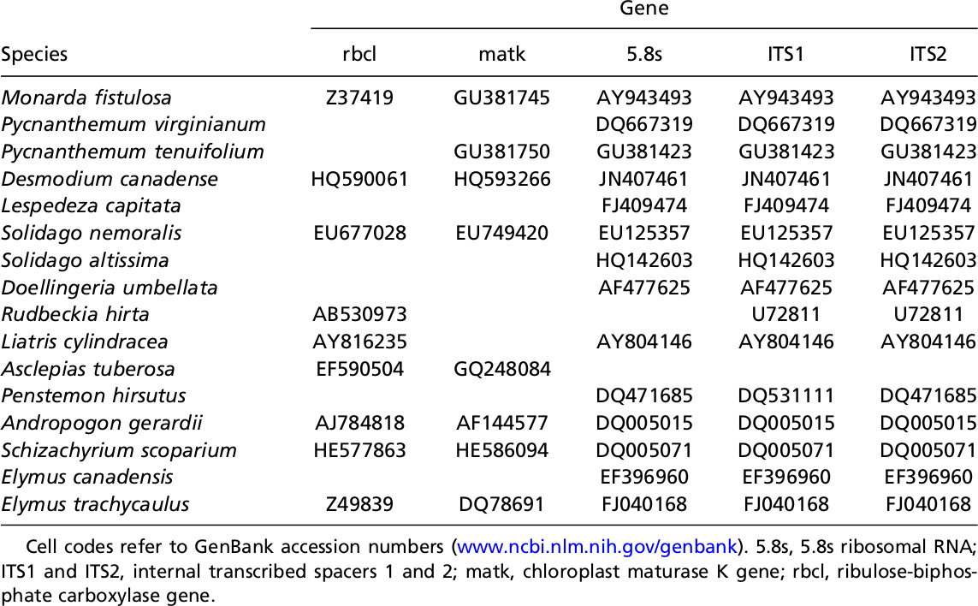
Genes used
Cadotte, 2013

Slide 7
Alignment
Using MUSCLE
TOCHECK: ?Per gene a seperate gene tree?

Slide 8
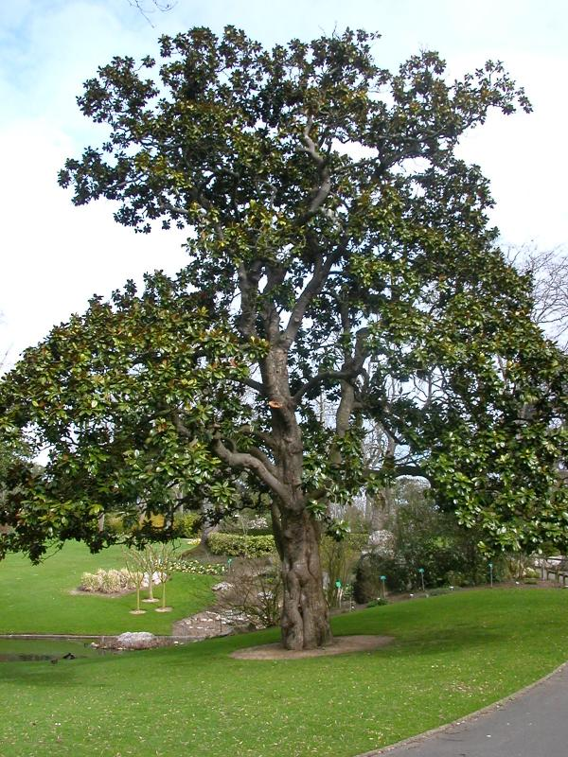
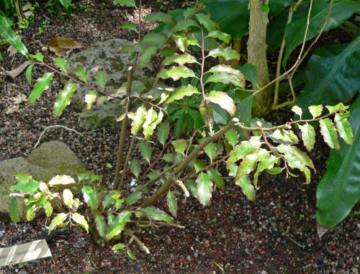
Phylogeny construction
Used two other angiosperms as outgroups
Used best-fit maximum-likelihood models of nucleotide substitution for each gene using the Akaike Information Criterion with Modeltest
(model was HKY+I+G)
Eudicots
Monocots
Angiosperms
Amborella trichopoda
Amborellales
Magnolia grandiflora
Magnoliids

Slide 9
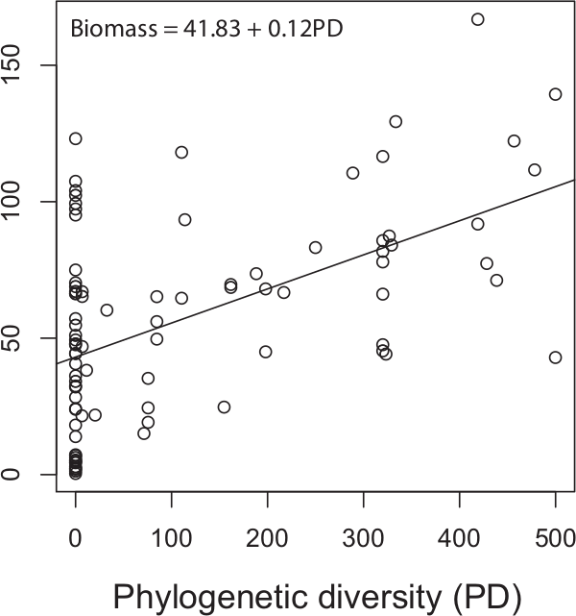
Previous research
BM = 43.08 + 0.12 GD
The more genetic distance in a plot, the higher the biomass
Genetic distance (GD) is the best predictor of biomass (BM) compared to 11 other measures of diversity
Cadotte, 2013
Notes:
This is weird: I took the best fitting equation from Table S3, upper table, 3rd row and this differs from the picture. Author confirmed this was a type and the value in table S3 is correct.

Slide 10
This research
In the previous research, constant mutation rate is assumed
With different mutation rates per clade the tree will have different taxa lengths
Does it matter if edge lengths have errors, compared to errors in topology?
Cadotte, 2015

Slide 11
Method
BM = 43.08 + 0.12 GD
Randomize phylogenies
Fit new PDs to real data
If fit has same likelihood, the treatment has little effect
Cadotte, 2015

Slide 12
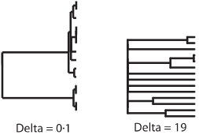
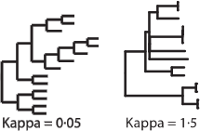
Randomize
Five treatments:
  Pagel's δ tranform on edge lengths
  Pagel's K transform on edge lengths
  Randomize edge lengths
  Randomize tips
  Randomize tips and edges

Slide 13
Fit
For every phylogeny
  PD is calculated
  New PD is fit to data with the linear model
EF = β₀ + β₁PD + ε
  Calculate likelihood of best model
BM = 43.08 + 0.12 GD
Cadotte, 2015
Cadotte, 2015
Notes:
Dashed line: value of original tree

Slide 14
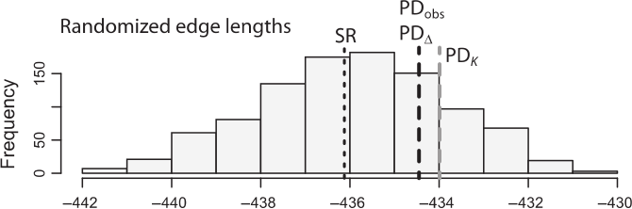
Results
PD_{obs}: Likelihood of fit with original phylogeny
PDΔ: Highest likelihood of Pagel's de
Cadotte, 2015

Slide 15
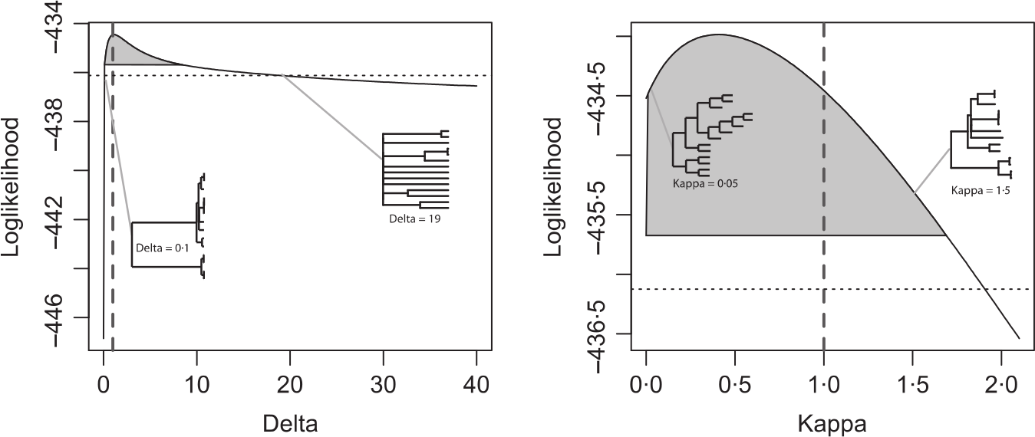
Results
The best Pagel's δ transform coincidentally has highest likelihood at its original value
The best Pagel's K transform has non-significantly different likelihood at best value compared to the original value
Cadotte, 2015
Notes:
Dashed line: value of original tree

Slide 16
Results
PD_{obs}: Likelihood of fit with original phylogeny
PD_{Δ}: Highest likelihood of Pagel's δ transform
PD_{K}: Highest likelihood of Pagel's K transform
SR: Likelihood using species richness instead of PD
Cadotte, 2015

Slide 17
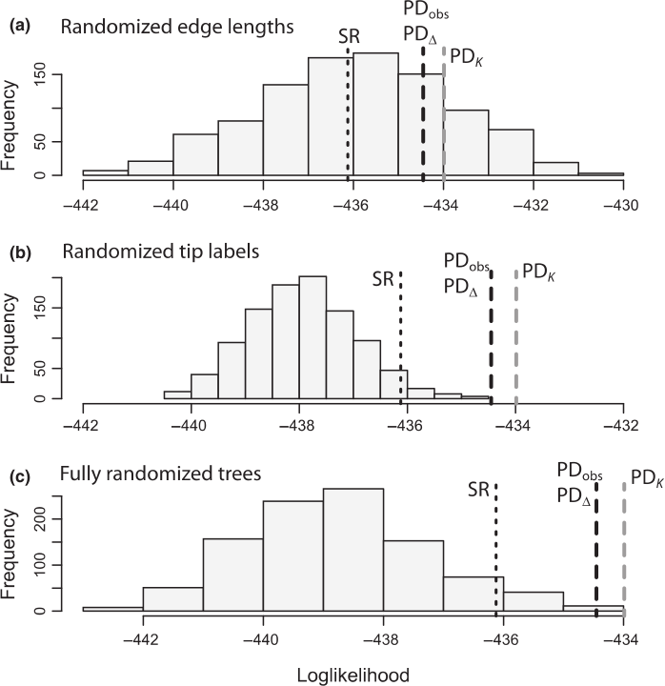
Results
Randomizing edge lengths has least influence, as PD_{obs} is within high frequency
In other treatments, PD_{obs} becomes an outlier
Cadotte, 2015

Slide 18
Discussion
Isn't it weird to use 'fitting to the data well' as an indicator of success?

Slide 19
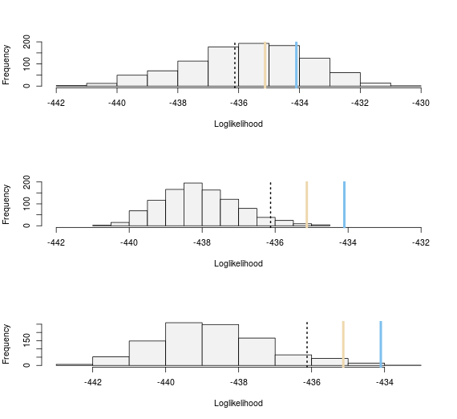
Discussion
Could not reproduce result (emailed author already)
Redone
Cadotte, 2015

