Slide 1



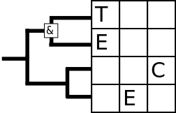
Progress
TECE meeting 2016-12-14
© 2016 Richel Bilderbeek
www.github.com/richelbilderbeek/Science

Slide 2
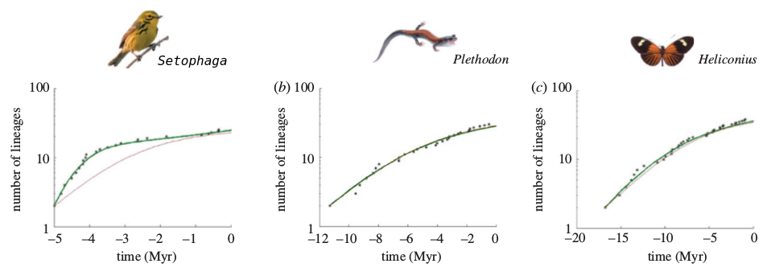
Problem
LTT (‘Lineages-through-time’) plots flatten off towards the present
Adapted from Etienne et al., 2012

Slide 3

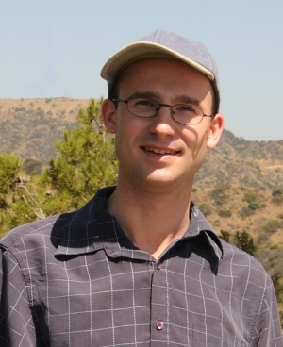
Hypotheses for problem
Diversity dependence [1]
Protracted speciation [2, 3]
[1] Etienne et al, 2012
[2] Rosindell & Etienne, 2011
[3] Etienne & Rosindell 2012
Rampal S. Etienne
James Rosindell

Slide 4
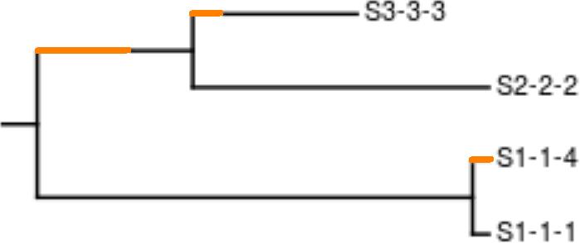
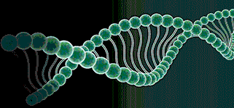
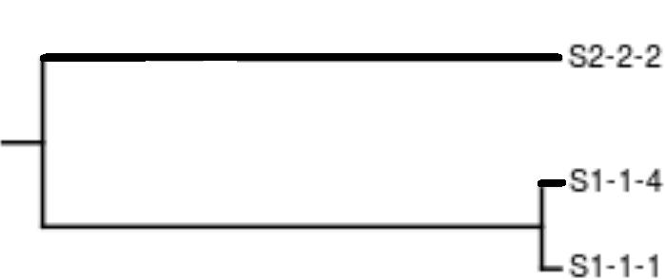
Approach
Simulate protracted phylogenies, ‘the truth’
Simulate DNA, ‘as measured in the field’
Infer phylogeny, using current tools
Measure difference with nLTT statistic

Slide 5
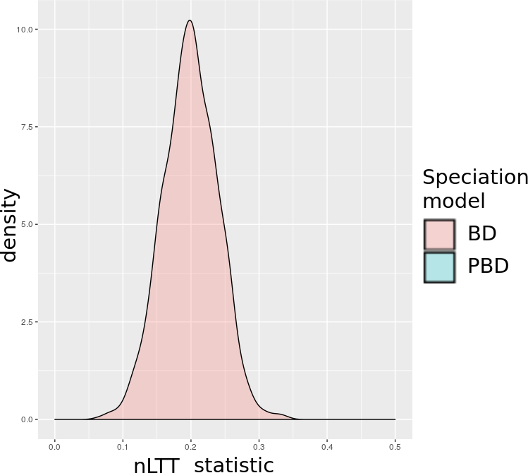
Idealized predictions
BD:
Birth Death
PBD:
Protracted BD

Slide 6
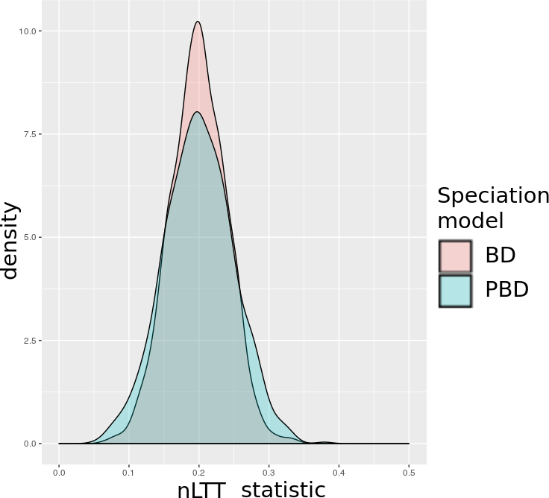
Idealized predictions
BD:
Birth Death
PBD:
Protracted BD

Slide 7
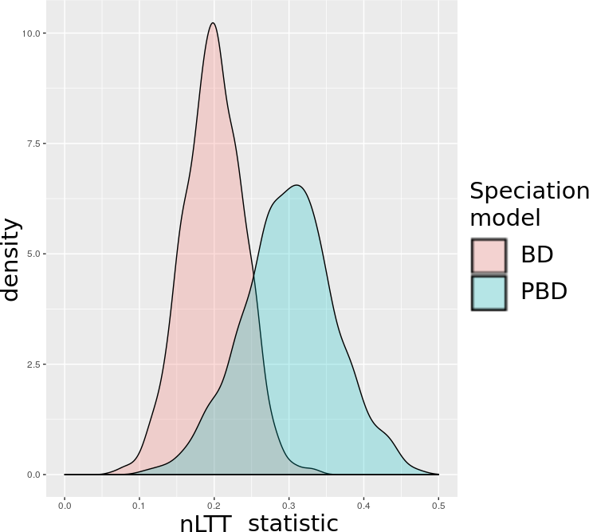
Idealized predictions
BD:
Birth Death
PBD:
Protracted BD

Slide 8


Predictions
Strong
protracted-
ness
Weak
input
data
Biologically
relevant?
Strong
input
data
Weak
protracted-
ness
Parameter
space

Slide 9
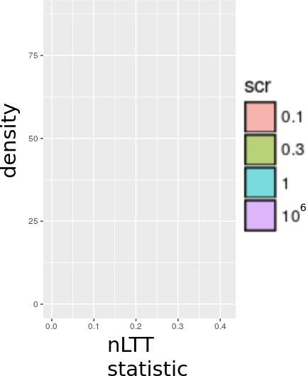
Speciation completion rate
Infinity: BD
Small: PBD

Slide 10
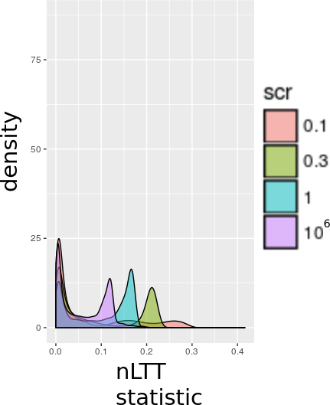
Bimodal distributions
Here:
  extinction rate (ER) = 0.0
  speciation initiation rate (SIR) = 0.5
And other SIRs and ERs?

Slide 11
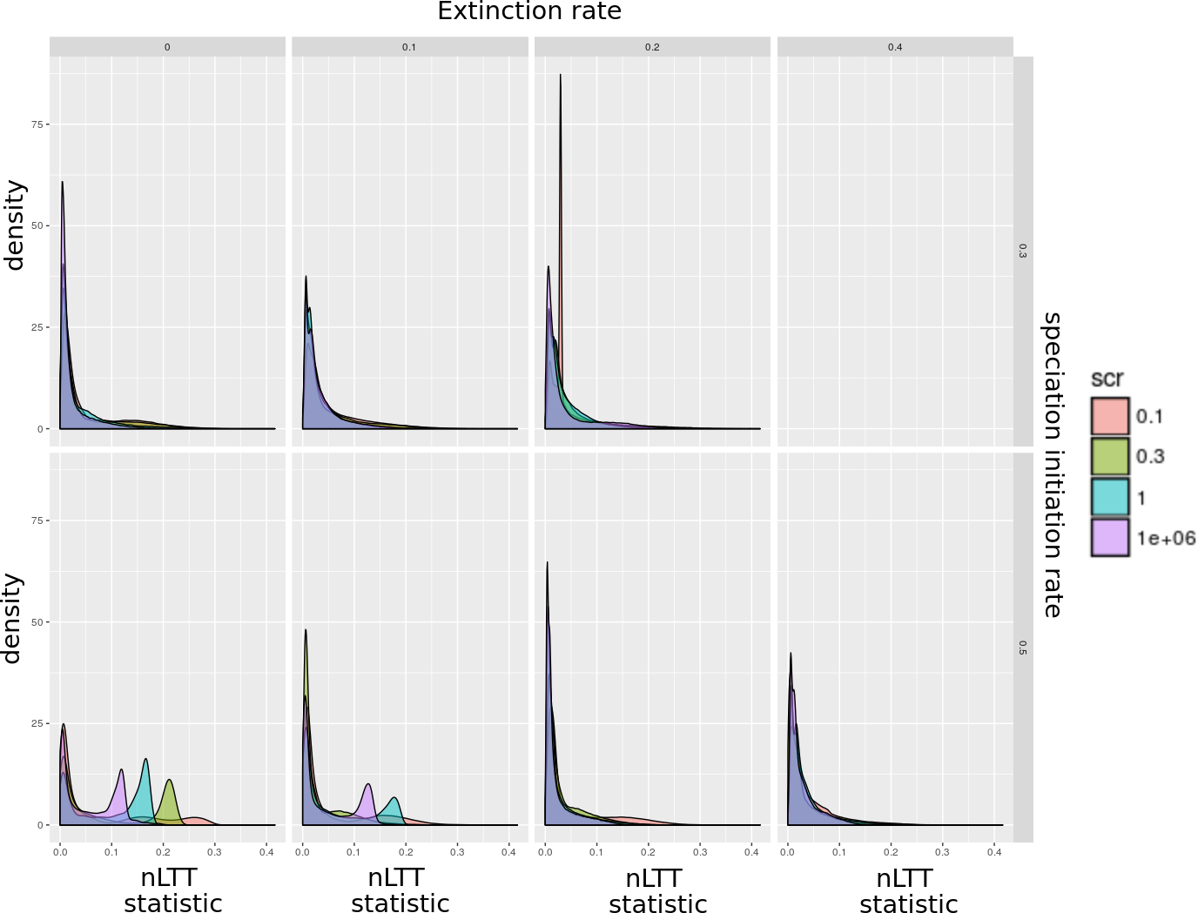

Slide 12
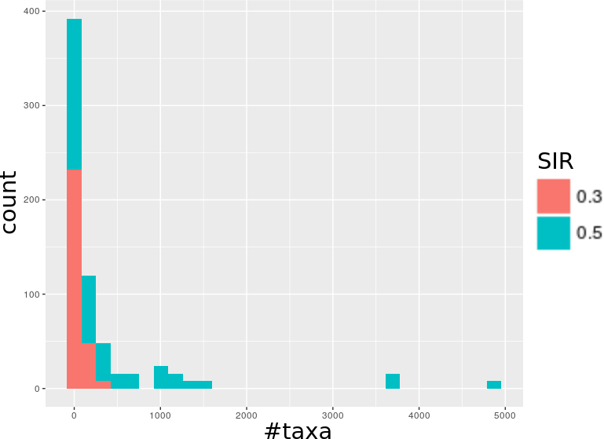
Hypothesis
The bimodal distribution is somehow correlated by the number of taxa in the simulated trees?

Slide 13
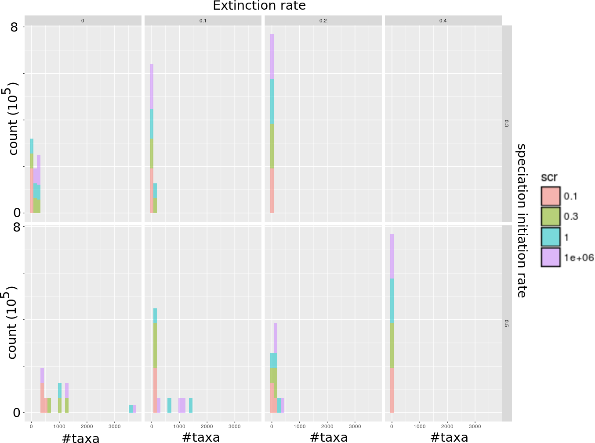

Slide 14
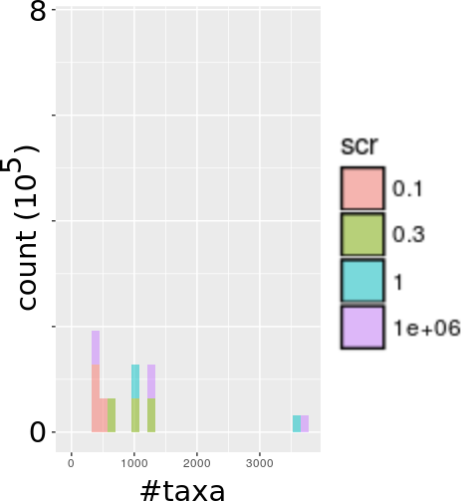
Zooming in

Slide 15
Zooming in

Slide 16
Zooming in

Slide 17
Zooming in

Slide 18
Zooming in

Slide 19
Conclusion
Bimodal distribution probably caused by distribution of taxa
More pronounced of DNA sequences contains more information (not shown here)
Need to simulate a smooth distribution of phylogenies

Slide 20

Acknowledgements
Rampal
The Rmy
TECE
TRES

Slide 21
Questions?

Slide 22
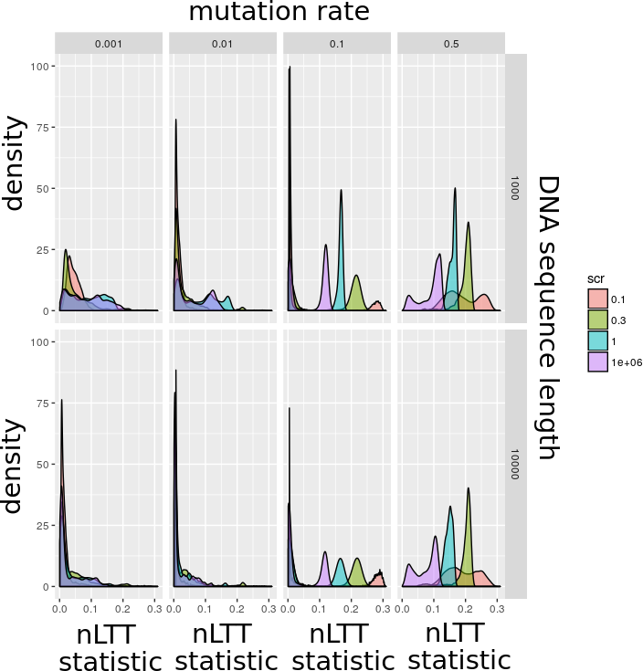
Bimodal distributions get more pronounced with more information on DNA

