Slide 1


Ignoring incipient species
TRES meeting 2017-02-13
© 2017 Richel Bilderbeek
www.github.com/richelbilderbeek/Science

Slide 2

Notes:
From http://walldiskpaper.com/mobilehd/tropical-island-wallpapers-2560x1600/

Slide 8
Research question
What is the effect of ignoring the phase in which species are being formed?
How long does that phase last?
Which species lived when?

Slide 10
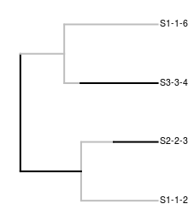
Protracted speciation [1]
Extension of Birth-Death (BD) model [2]
New species are incipient
Speciation completion rate
  Incipient → good
  BD if infinite
[1] Etienne & Rosindell, 2012 [2] Nee et al., 1994

Slide 11
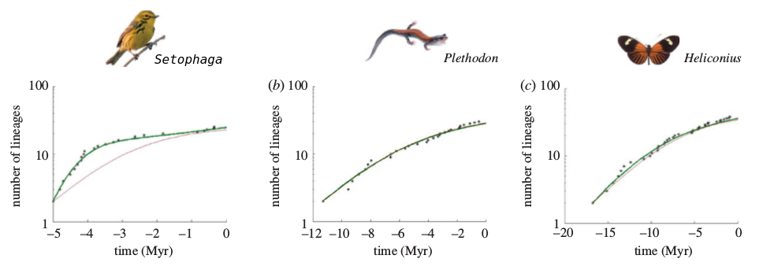
Adapted from Etienne et al., 2012

Slide 12
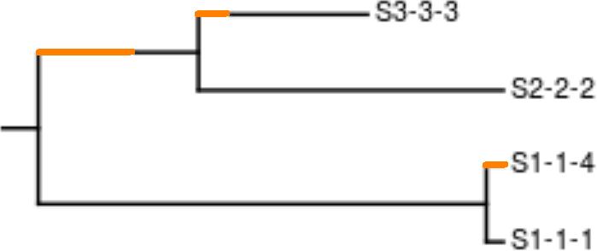
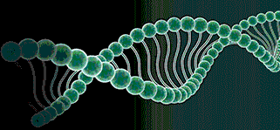
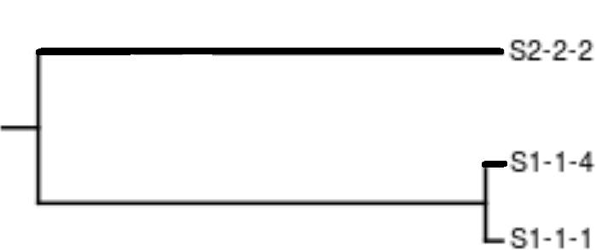
Approach
Simulate protracted phylogenies, ‘the truth’
Simulate DNA, ‘as measured in the field’
Infer phylogeny, using current tools
Measure difference with nLTT statistic

Slide 13


Predictions
Strong
protracted-
ness
Weak
input
data
Biologically
relevant?
Strong
input
data
Weak
protracted-
ness
Parameter
space

Slide 14
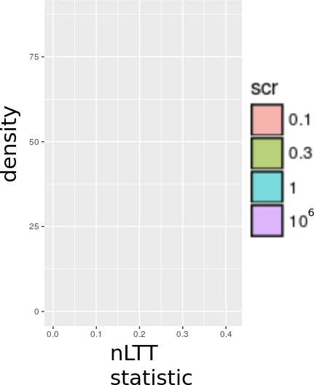
Effect of SCR, prediction
Infinity: BD
Small: PBD
SCR: Speciation Completion Rate
BD: Birth Death model
PBD: Protracted BD model

Slide 15
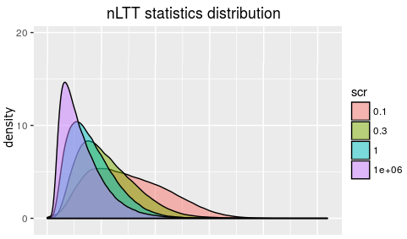
Effect of SCR, measured
Infinity: BD
Small: PBD
SCR: Speciation Completion Rate
BD: Birth Death model
PBD: Protracted BD model

Slide 16
Conclusion
The measurements follow the expectations qualitatively
Need to quantify this better
  Compare with expected error

Slide 17
Discussion
Bigger phylogenies (>5000 taxa) were not analysed

Slide 18
Acknowledgements
Femke Thon
Jolien Gay
Rampal Etienne

Slide 19
References
Nee et al., 1994

Slide 20
Questions?

Slide 21
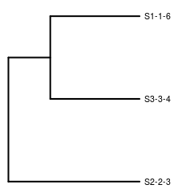
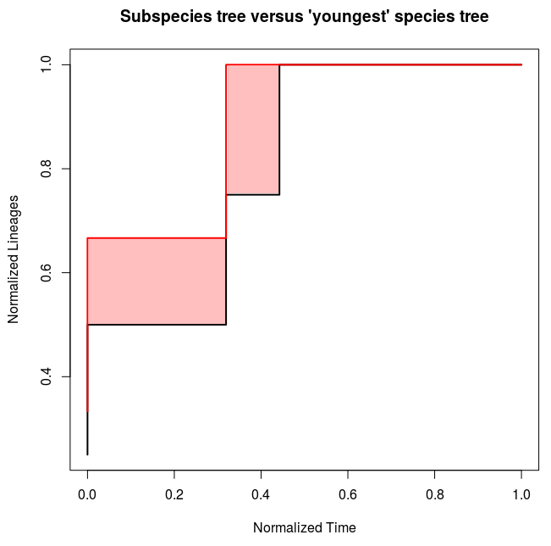
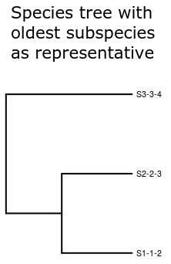
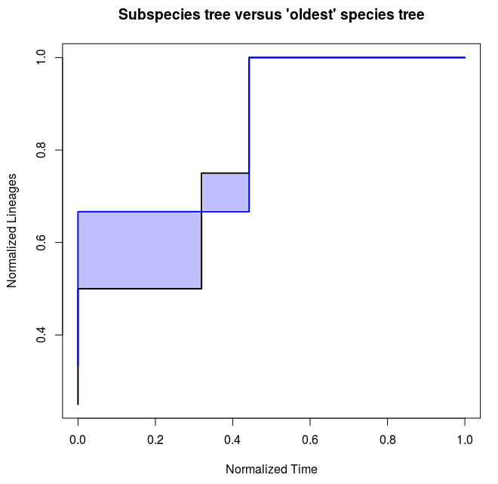
Simulated truth

