Slide 1


Progress
© 2016 Richel Bilderbeek
www.github.com/richelbilderbeek/Wip

Slide 2
Research question
If speciation in nature takes time, what is the error BEAST2 makes in inferring a phylogeny?
Under which conditions does it hurt?
Are these conditions relevant and/or realistic?

Slide 3
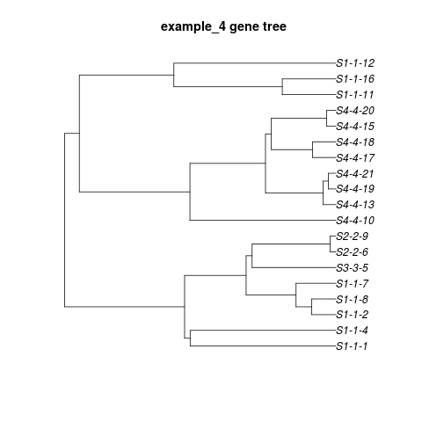
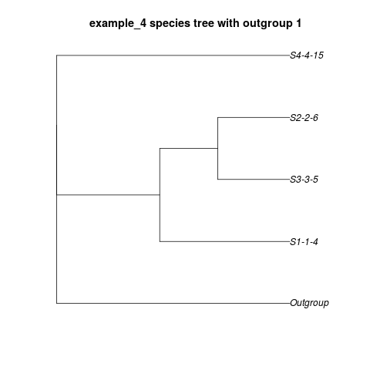
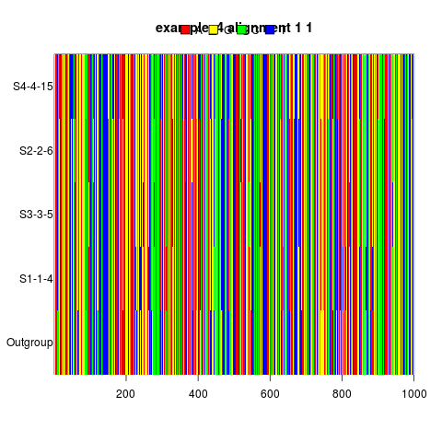
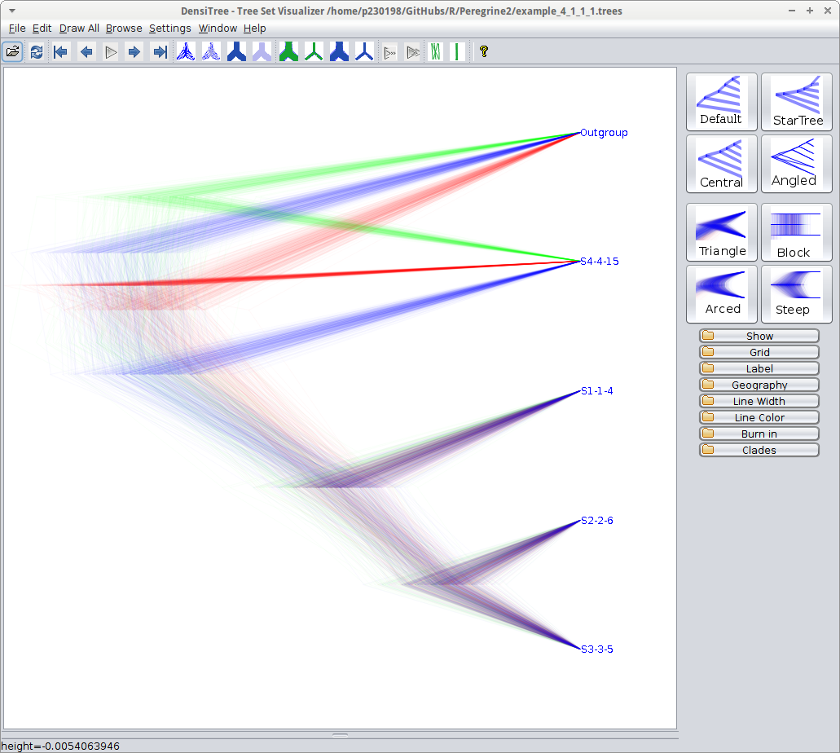
Recap
Step with highest impact
Simulate a true gene tree
Sample a species tree
Simulate a DNA alignment
Run BEAST2 to obtain a posterior

Slide 4
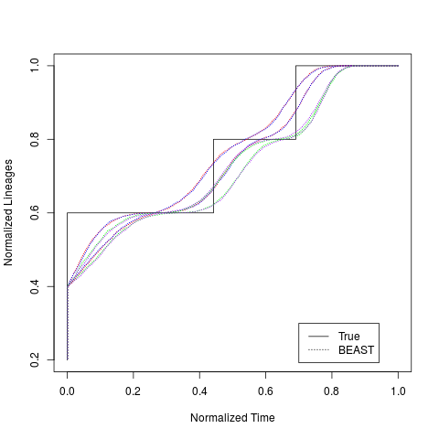
Pipeline works
Average nLTT of posteriors
nLTT of species tree
True gene tree
True species tree

Slide 5
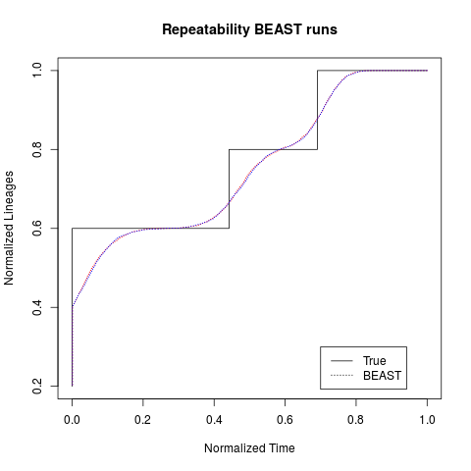
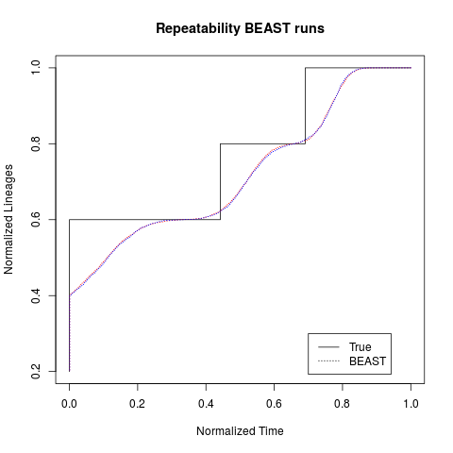
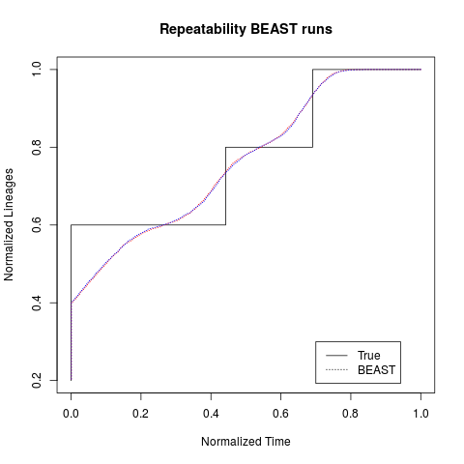

BEAST2 reps are reps
Two BEAST2 runs on the same alignment give very similary nLTT plots

Slide 6
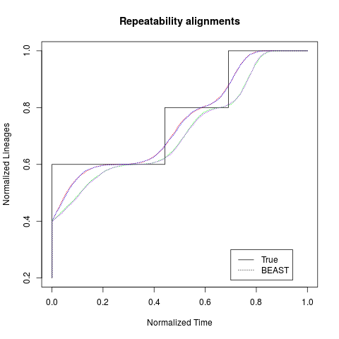
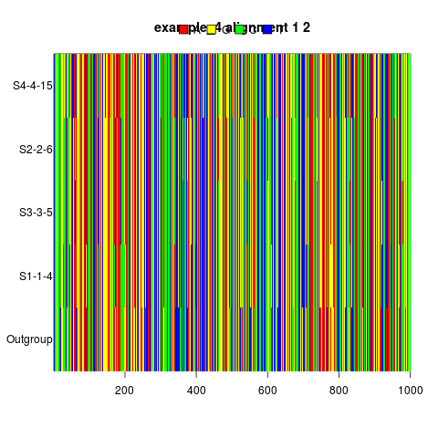
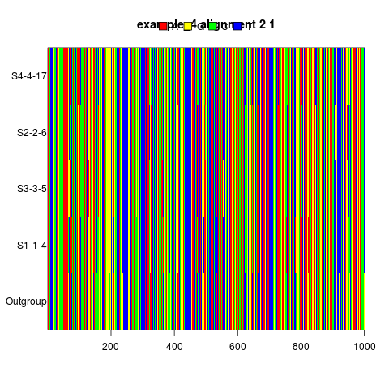
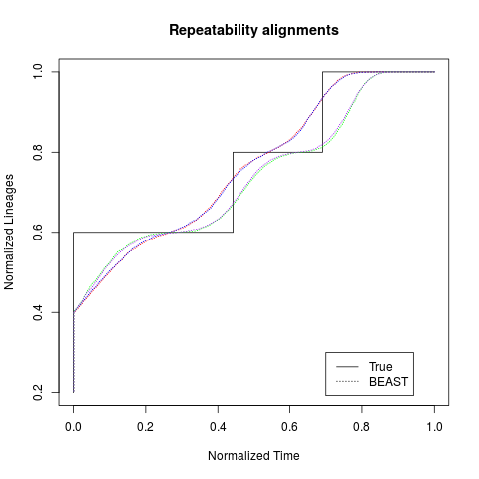
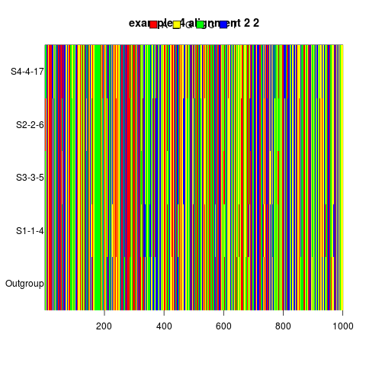
Alignment reps are less rep
Two different alignments on the same species tree give similarish nLTT plots

Slide 7
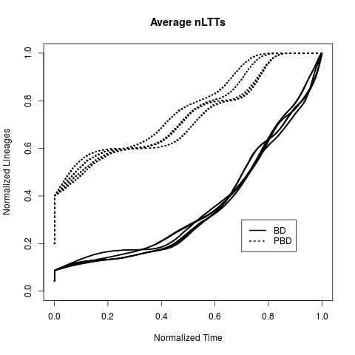
BD = PBD?
No.
When speciation takes time (PBD), we can observe a difference in the shape of the phylogenies of the posterior

Slide 8
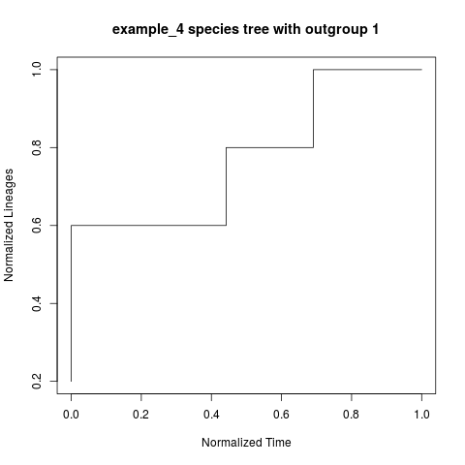
Error
Sum of the difference between true species tree nLTT and average posterior nLTT

Slide 9
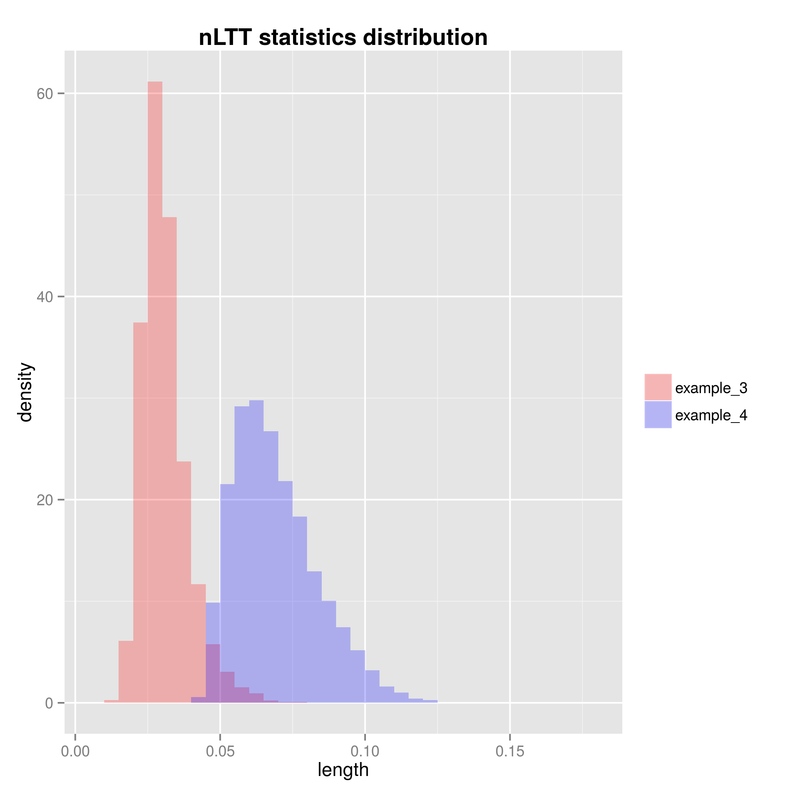
Error BD = error PBD?
If speciation takes time, how big will the estimation errors be?
If speciation
takes time
(example_4),
BEAST2 will
have a threefold
error in recovering
a known phylogeny

Slide 10
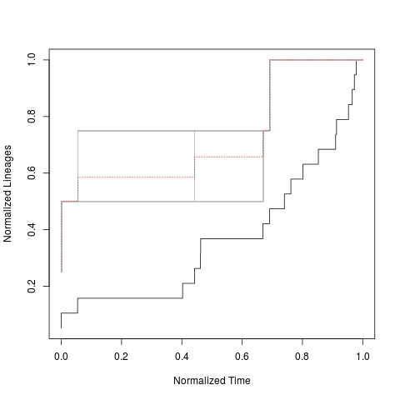
Major cause
Most of the differences comes from the sampling of the gene tree to obtain a species tree
Average nLTT of all species trees (red line)
All sampled species trees (grey lines)
Gene tree (black solid line)

Slide 11
Preliminary conclusions
Speciation taking time causes bigger error
The expected difference is now quantified

Slide 12
Preliminary conclusions
BEAST2 always does a fine job

Slide 13
Preliminary conclusions
Sampling species trees from gene trees has the biggest impact

Slide 14

Future work
Quantify the errors
Use *BEAST to do a multi-individual inference

