Slide 1
The effect of choosing a prior tree model on phylogeny construction
(C) Richèl Bilderbeek

Slide 2
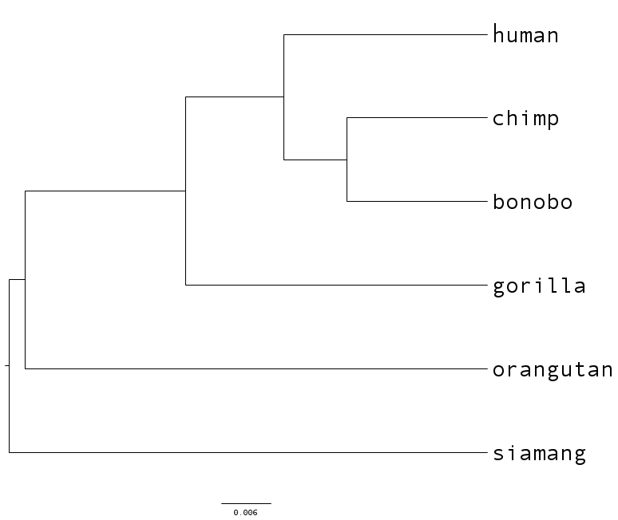
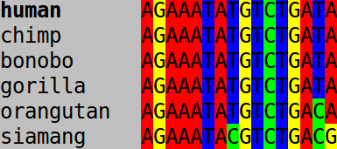
Introduction
How to derive a phylogeny from aligned molecular data?

Slide 3
Introduction
Multiple algorithms and tools to generate a likely candidate
BEAST2: Bayesian Markov chain Monte Carlo analysis
Bayesian statistics needs a prior: 'How do you believe the system works?'
  DNA substitution rate: transition rates of nucleotides, due to mutation
  Tree model: what are the population dynamics?

Slide 4
Tree priors
 | Name | When use it?
Y | Yule | No extinction, complete sampling, commonly used
CY | Corrected Yule
CRBD | Constant-rate Birth-Death | Yule with extinction and incomplete samping
CCP | Coalescent Constant Population | Small sample of large population, population at equilibrium
CEP | Coalescent Exponential Population | Small sample of large population, population just founded
CBS | Coalescent Bayesian Skyline
CEBS | Coalescent Extended Bayesian Skyline

Slide 5
Yule model
No extinction
Complete sampling
G Yule, 1924
Notes:
Yule, G. (1924), 'A mathematical theory of evolution based on the conclusions of dr. j.c. willis', Philosophical Transactions of the Royal Society of London, Series B 213, 21–87.
From BeastBook:
We conclude the section on the constant rate birth-death model with several remarks: The constant rate birth-death model with μ = 0 and ρ = 1, i.e. no extinction and complete sampling, corresponds to the well-known Yule model (Yule 1924).

Slide 6
Calibrated Yule model

Slide 7
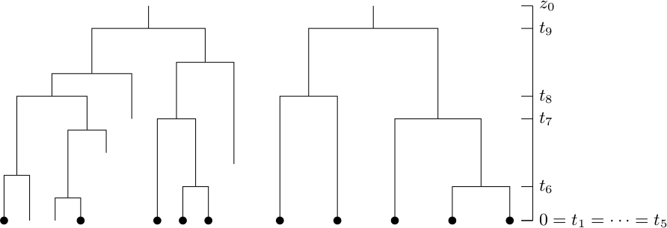
Constant rate birth-death model
Birth and death rate constant
Incomplete sampling
AJ Drummond and RR Bouckaert, 2014
Notes:
Figure 2.7 of BeastBook:
Bayesian evolutionary analysis with BEAST 2. Alexei J. Drummond and Remco R. Bouckaert. Cambridge University Press, 2014

Slide 8
Coalescent constant population model

Slide 9
Coalescent exponential population model

Slide 10
Introduction: 4 of 12 tree priors
Model | When use it?
Yule | No extinction, commonly used
BD | Yule with extinction
CCP | Small sample of large population, population at equilibrium
CEP | Small sample of large population, population just founded

Slide 11
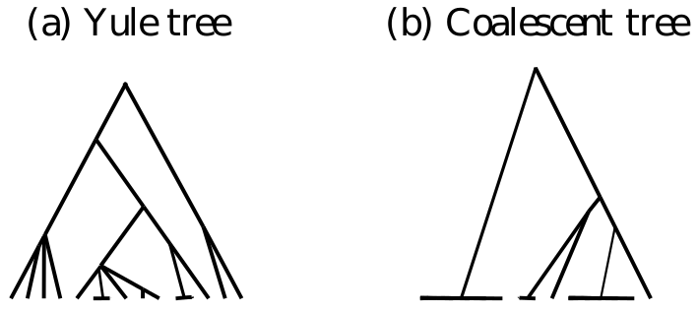
Expectation
Drummond & Bouckaert, 2014
Notes:
Bayesian evolutionary analysis with BEAST 2. Alexei J. Drummond and Remco R. Bouckaert. Cambridge University Press, 2014

Slide 12
Research question
Does choosing a model prior matter?
  Will the phylogeny have the same structure?
  Will the branching times be the same?

Slide 13
Method & Materials
Use the same molecular alignments
Vary the model prior
Per prior
  Construct ten independent phylogenies
  Collect the branching times
Compare branching time distributions

Slide 14
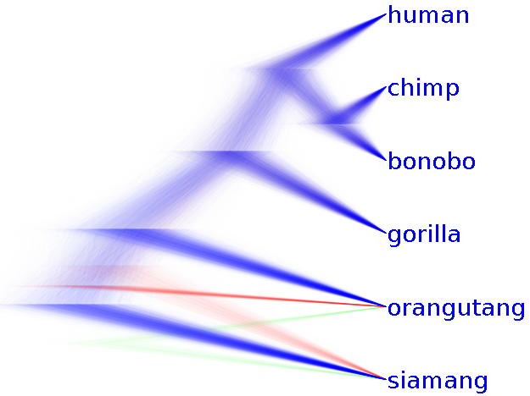
Method & Materials

Slide 15
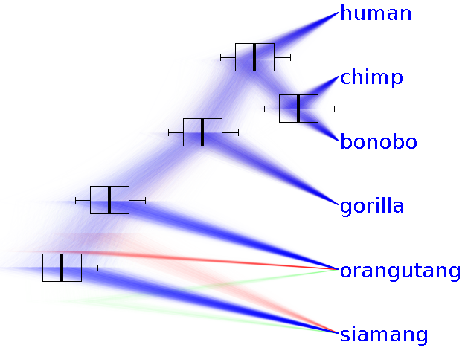
Method & Materials

Slide 16
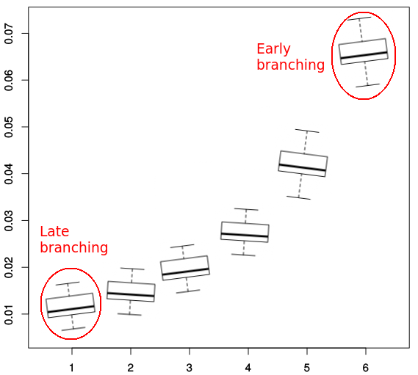
Method & Materials

Slide 17
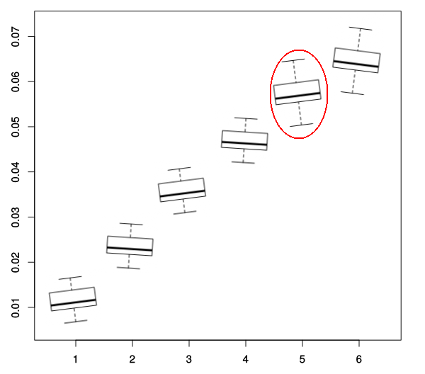
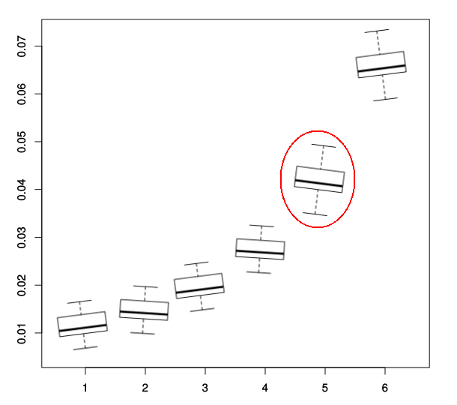
Method & Materials

Slide 18
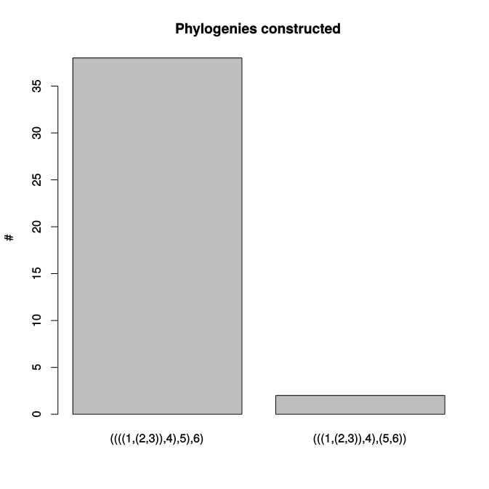
Results
Trees differ in topology, but only in earliest branching
Early branches suffer the most from noise
Notes:
The Fitch-Margoliash method uses a weighted least squares method for clustering based on genetic distance.[9] Closely related sequences are given more weight in the tree construction process to correct for the increased inaccuracy in measuring distances between distantly related sequences. Fitch WM, Margoliash E. (1967). Construction of phylogenetic trees. Science 155: 279-84.

Slide 19
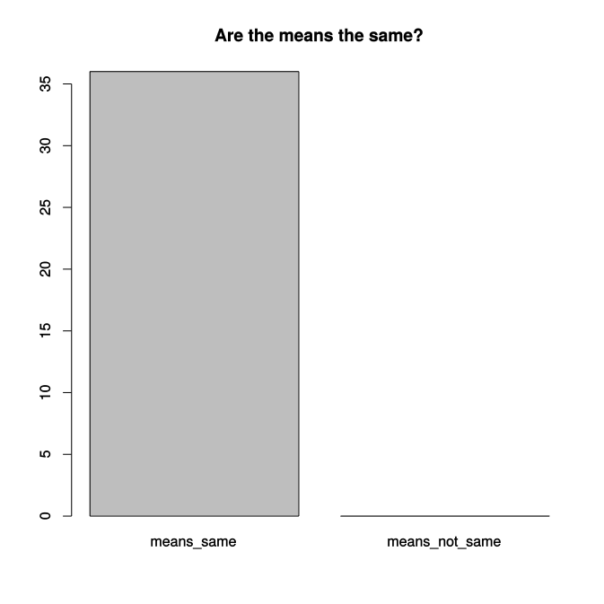
Results
The branching times between models are the same (Welch Two Sample t-test, p < 0.05)

Slide 20
Conclusion
Different prior models yield the same phylogeny
It does not matter which prior model is used

Slide 21
Discussion
Molecular data has 6 samples, too little resolution?
Only 10 phylogenies were created per parameter set, too little statistical power?
Per branching time, a Welch Two-Sample t-test was done
  but branching times are related, as they occur sequentially
Think you can do better? Run the scripts at https://github.com/richelbilderbeek/Beast

