Slide 1
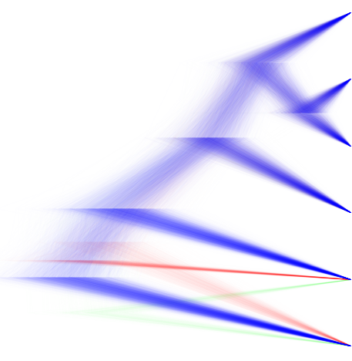
135
2015
On Trees Without Birds
Richel Bilderbeek

