Slide 1
My research as of 2015-04-16
Richel Bilderbeek

Slide 2
Research question
How do species assemblages form?
How can DNA sequences help in increasing our understanding of this process?
Why DNA?
  DNA is measured in huge quantities nowadays
  Creates better phylogenies than a single trait (Pigot & Etienne, 2015)
Which parameters?
  Speciation and extinction rate
  Migration rates
  Number of species 'carrying capacity'
  Geographical distribution/situation

Slide 3
Possibilities
Extend joint inference?
Extend individual-based models?
Lineage-based modeling?

Slide 4

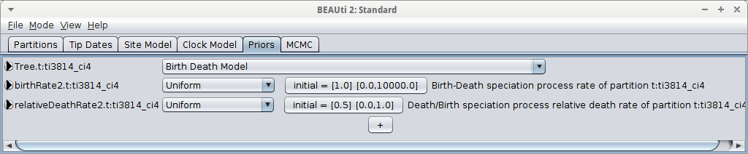
Joint inference
Conclude a phylogeny hand-in-hand with the parameters that affected the phylogeny creation
Uses a Bayesian approach
Some models implemented in BEAST2
  I could add more

Slide 5
Individual-based modeling
Use existing models, give all individuals DNA. Redo the analysis with DNA. Will the results be the same?
  Null hypothesis: yes
Models to expand
  Webb et al., 2002: competition versus habitat filtering
  Avise et al., 1987: biogeography
  Ricklefs, 1987: species saturation
  Rosindel & Etienne, 2015: protracted speciation
Some other ideas
  Nowak's superstar
  Non-neutral DNA
Notes:
• Avise, John C., et al. "Intraspecific phylogeography: the mitochondrial DNA bridge between population genetics and systematics." Annual review of ecology and systematics (1987): 489-522.
• Ricklefs, Robert E. "Community diversity: relative roles of local and regional processes." Science 235.4785 (1987): 167-171.
• Webb, Campbell O., et al. "Phylogenies and community ecology." Annual review of ecology and systematics (2002): 475-505.

Slide 6
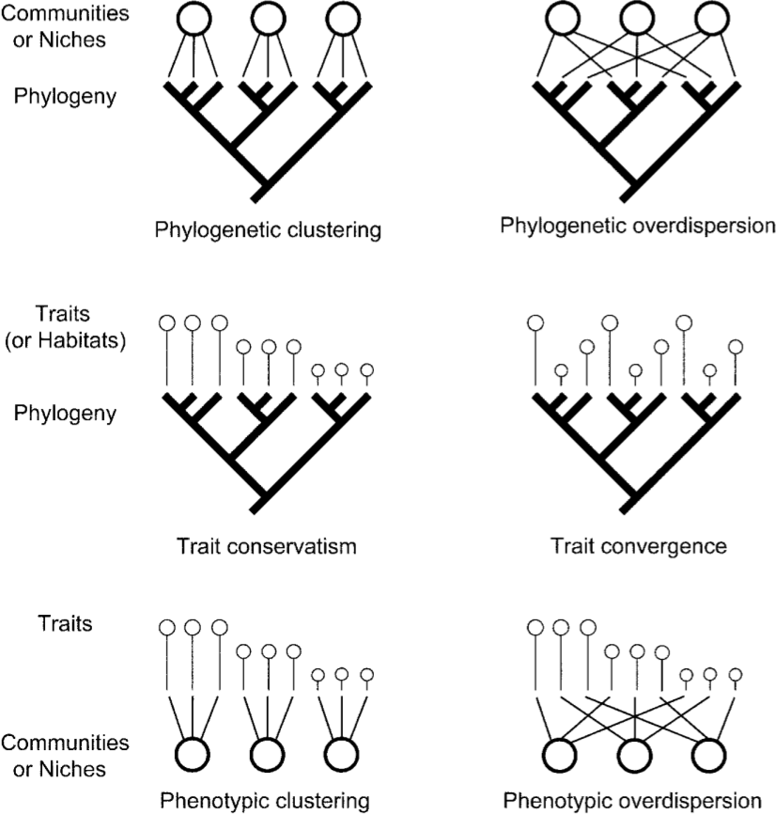
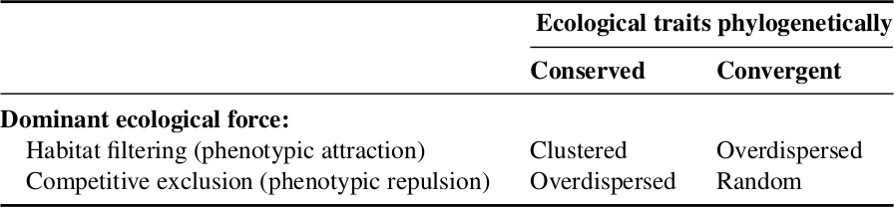
Webb et al., 2002
Competition versus habitat filtering
Notes:
• Avise, John C., et al. "Intraspecific phylogeography: the mitochondrial DNA bridge between population genetics and systematics." Annual review of ecology and systematics (1987): 489-522.
• Webb, Campbell O., et al. "Phylogenies and community ecology." Annual review of ecology and systematics (2002): 475-505.

Slide 7
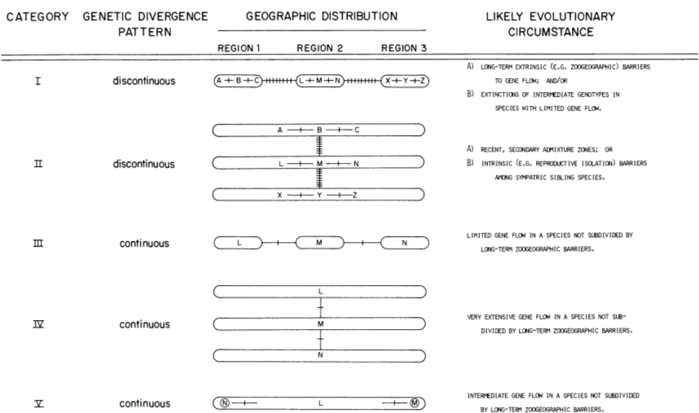
Avise et al., 1987
Phylogeography
Notes:
• Avise, John C., et al. "Intraspecific phylogeography: the mitochondrial DNA bridge between population genetics and systematics." Annual review of ecology and systematics (1987): 489-522.
• Webb, Campbell O., et al. "Phylogenies and community ecology." Annual review of ecology and systematics (2002): 475-505.

Slide 8
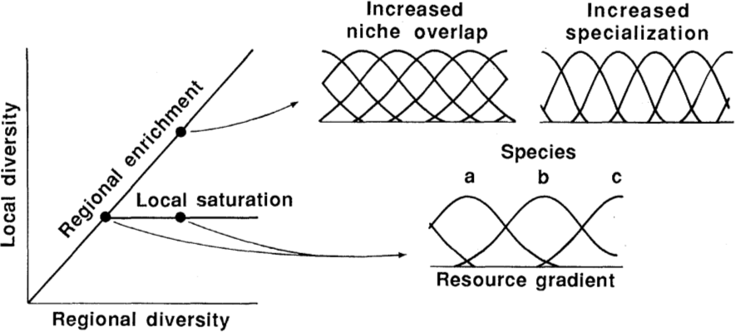
Ricklefs, 1987
Species saturation
Notes:
• Ricklefs, Robert E. "Community diversity: relative roles of local and regional processes." Science 235.4785 (1987): 167-171.

Slide 9
Rosindell & Etienne, 2015
Protracted speciation
Incipient species become true species after n generations
Extension:
  Use DNA
  DNA 0-97% similar: different species, no mating
  97-100% similar: same species, mating probability higher for high similarity

Slide 10
Non-neutral DNA
Most DNA is assumed to be neutral towards a trait
What if it is not?
Notes:
• Avise, John C., et al. "Intraspecific phylogeography: the mitochondrial DNA bridge between population genetics and systematics." Annual review of ecology and systematics (1987): 489-522.
• Webb, Campbell O., et al. "Phylogenies and community ecology." Annual review of ecology and systematics (2002): 475-505.

Slide 11
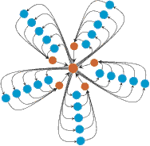
Nowak's graphs
Certain population structures (e.g. superstar) can amplify selection
Notes:
• Avise, John C., et al. "Intraspecific phylogeography: the mitochondrial DNA bridge between population genetics and systematics." Annual review of ecology and systematics (1987): 489-522.
• Webb, Campbell O., et al. "Phylogenies and community ecology." Annual review of ecology and systematics (2002): 475-505.

Slide 12
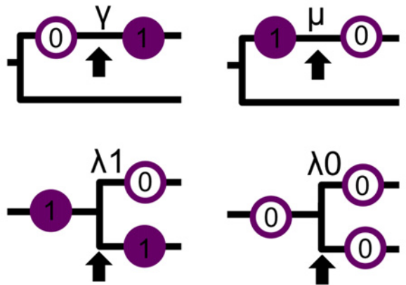
Lineage-based modeling
Create better null-phylogenies using better phylogeny construction model, like Pigot & Etienne, 2015
No idea for another extension yet

Slide 13
Conclusion
A lot can potentially be done
  What is scientifically relevant?
  What is new?

