Slide 1

Rational selection of speciation models
Richèl Bilderbeek
Supervised by Rampal Etienne

Slide 2
Research lines
Speciation model comparison
Fluctuation of neutral traits in time

Slide 3
Speciation
Speciation has been successful in creating many species
  5 ± 3 million [1] and 8.7 ± 1.3 million [2] extant species
  100x more species extinct [3]
Many speciation models, which one fits the data best?
[1] Costello et al., 2013
[2] Sweetlove, 2014
[3] Raup, 1981

Slide 4
Speciation models
There are multiple models:
  Diversification happens at a constant rate
  Diversification rate changes in time
  Speciation rate is dependent on the current number of lineages present
  Speciation itself is a a trait
  Speciation take time
  Speciation rate is dependent on the age of the lineage

Slide 5
Model phylogeny
Birth
Birth-Death
Density
Time
Protracted
Age
Equilibrium
Trait dep
Exponential
Constant
Coalescent
models
Forward
models
Fisher Wright
Moran
Coalescent
Simulation
techniques

Slide 6
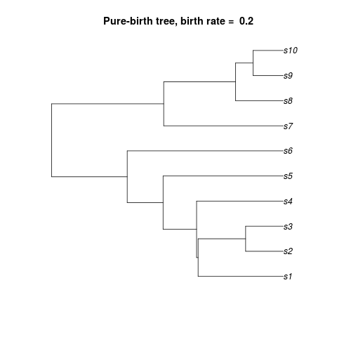
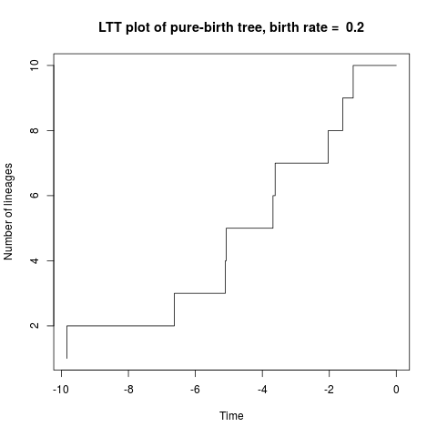
Pure-birth (PB) models
Also called the Yule model, after [1]
Assumes
  speciation is constant
  no extinction
  speciation is instantaneous
Simplest model
  One parameter: birth rate
Number of lineages changes exponentially
[1] Yule, 1925

Slide 7
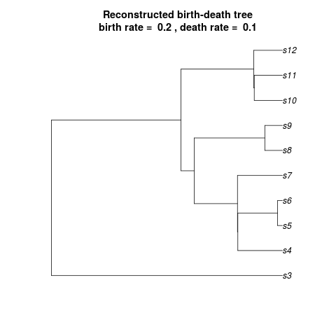
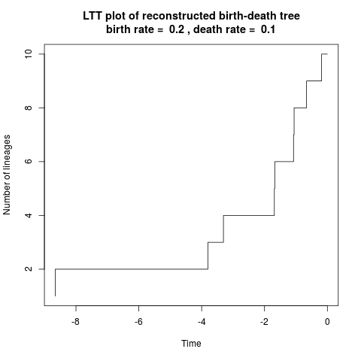
Birth-death (BD) models
Assumes
  speciation is constant
  extinction is constant
  speciation is instantaneous
  most taxa sampled
Two parameters: birth and death rate
Suggested as a null model [1-3]
Number of extant lineages is expected to change exponentially
[1] Nee et al.,1994 [2] Mooers & Heard, 1997 [3] Nee, 2001

Slide 8
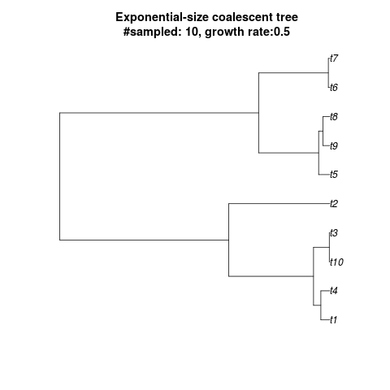
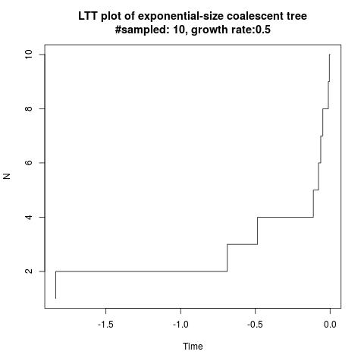
Exponential-growth coalescent (EGC) model
Assumes
  number of lineages grows exponentially
  speciation is instantaneous
  small fraction of all taxa sampled
Two parameters: population growth, branching probability

Slide 9
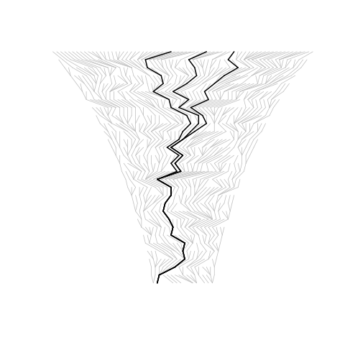
BD versus EGCM
Expected N_{BD}(t) = e^{(λ-μ)t}
Expected N_{EGCM}(t) = e^{rt}
For λ-μ = r, they are expected to be identical?

Slide 10
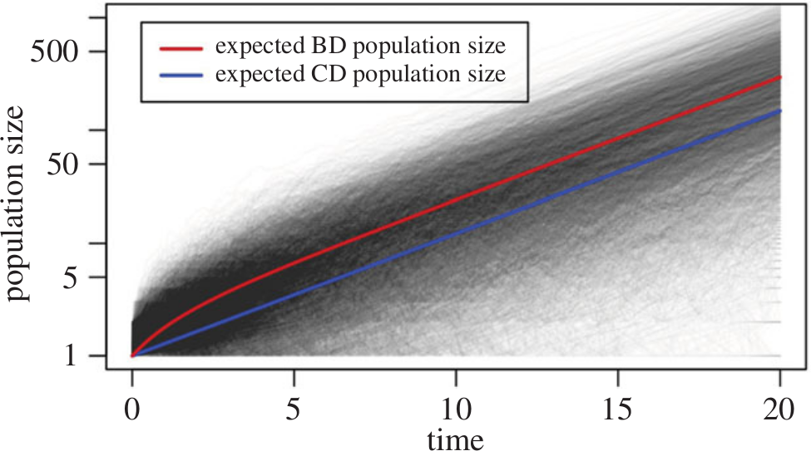
They are different!
Expected N_{BC}
Expected N_{EGC}
Number of lineages
Adapted from Stadler et al., 2015

Slide 11
Research project #1
BD and EGCM were assumed to be the same
But BD and EGCM differ in practice
Will conclusions drawn from inferred phylogenies differ?
Setup: create phylogenies under both models, compare summary statistics
Except LTT of course

Slide 12
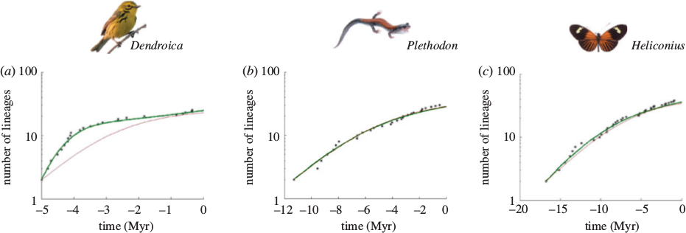
Time dependent birth-death (TDBD) model
Family of models
Assumes speciation rate changes with time
Speciation is caused by an external mechanism, e.g. climate change
A time dependent diversification? Picture from Etienne et al., 2012

Slide 13
Diversity dependent birth-death (DDBD) model
Family of models
Assumes speciation rate changes with the number of lineages present
How different are time- and diversity dependent birth-death models?
  Investigated by César!
Or density dependent diversification? Picture from Etienne et al., 2012

Slide 14
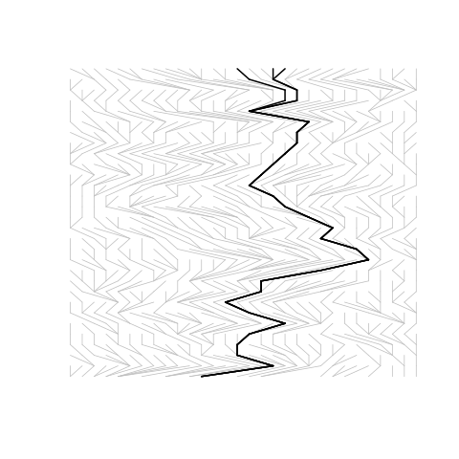
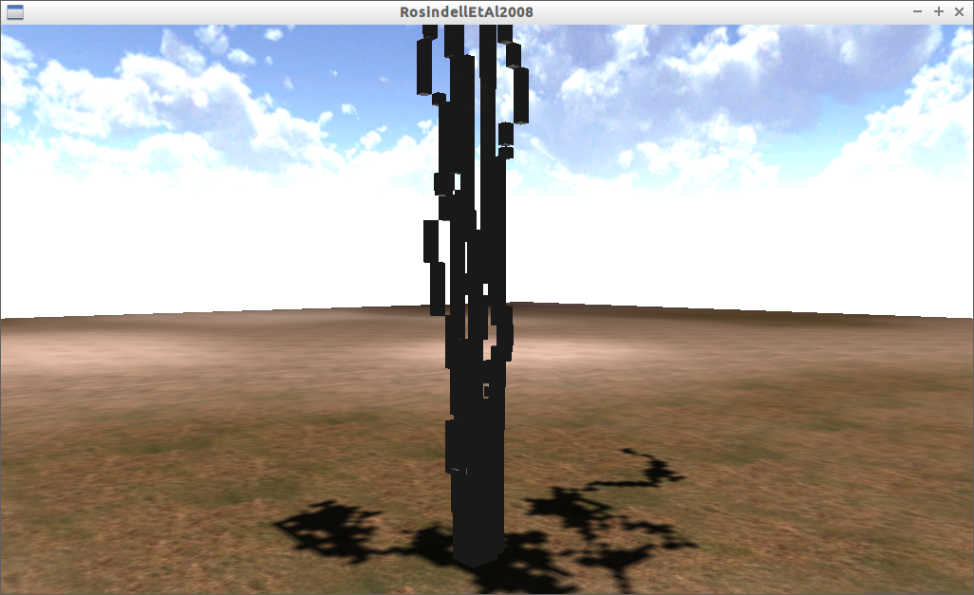
Constant-population coalescence (CPC) model
Population → number of lineages
Assumes the number of species has reached its (dynamic) equilibrium
Assumes sample size is smaller than the constant population size
Also inspired coalescent modeling
Visualisation of a coalescent modeling technique of Rosindell et al., 2008

Slide 15
Fisher-Wright individual-based (FWIB) model
Very commonly used
Simulate all individuals from past to present
Strictly seperated generations
Uses a constant population size

Slide 16
Research project #2
CPC model is assumed to be complementary to a Fisher-Wright simulation
Are they really?
Setup:
  Run FWIB model
  Sample with CPC model
  Should have similar results

Slide 17
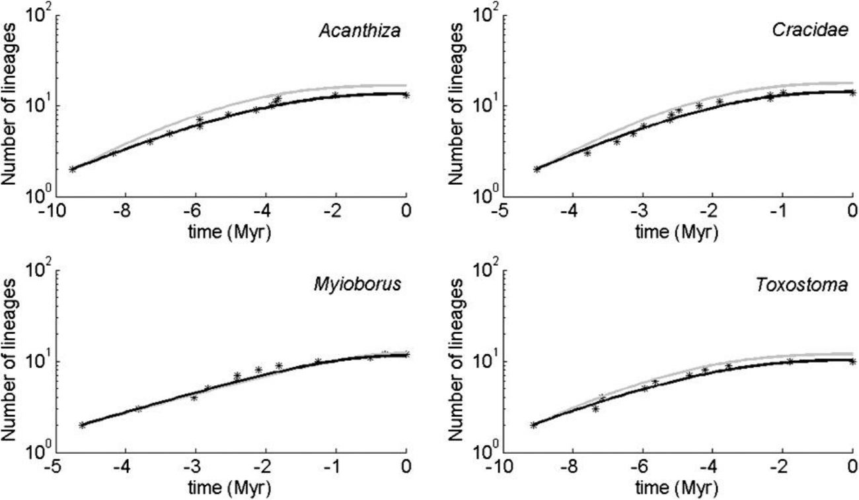
Protracted speciation
Assumes speciation takes time
Likelihood function derived recently (Lambert et al., 2015)
Etienne & Rosindell, 2012

Slide 18
Doesn't this data look similar?
Density
dependent
speciation
Etienne et al., 2012
Protracted
speciation
Etienne & Rosindell, 2012

Slide 19
Research project #3
How well do the models fit on the other's data?
Could not do it, likelihood was not available yet
Or: what is the contrast between the two models?
Setup: compare likelihoods, similar to project of César

Slide 20
Age-specific speciation
Assumes that speciation decreases with lineage age
Novel model, similar to the protracted speciation model
Yield more realistic phylogenies than protracted speciation model [1]
No likelihood function derived yet (César side project?)
[1] Hagen et al. 2015

Slide 21
Research project #4
What is the fit of the age-dependent speciation model to the data?
Setup:
  Create phylogenies with both models
  How well do they fit to the data?

Slide 22
Fluctuations of species traits in time

Slide 23
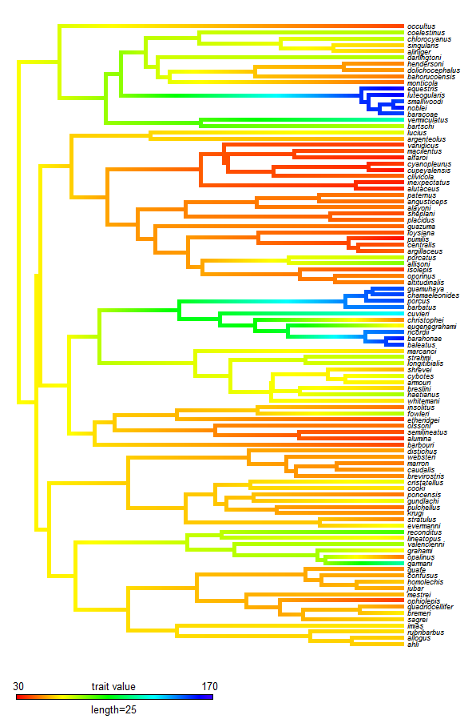
Fluctuations of neutral traits in time
Traits may be neutral for selection
This can be detected by measuring the trait value in time
Is the trait following a Brownian motion? Than it is assumed neutral
But do neutral traits follow this motion?
Body size in Greater Antillean anoles,
from DiversiTree dataset

Slide 24
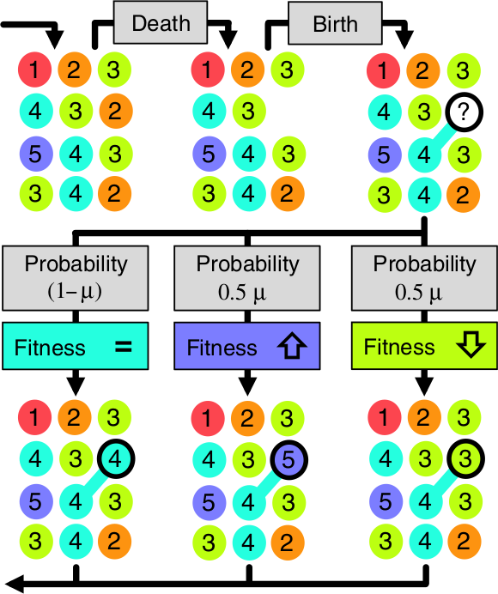
Unified Theory of Ecology and Macroevolution (UTEM) model
Individual-based model that adds mild selection to lineages
Moran model
Spatially implicit
Follows the protracted speciation model
Yields realistic phylogenies
Rosindell et al., 2015

Slide 25
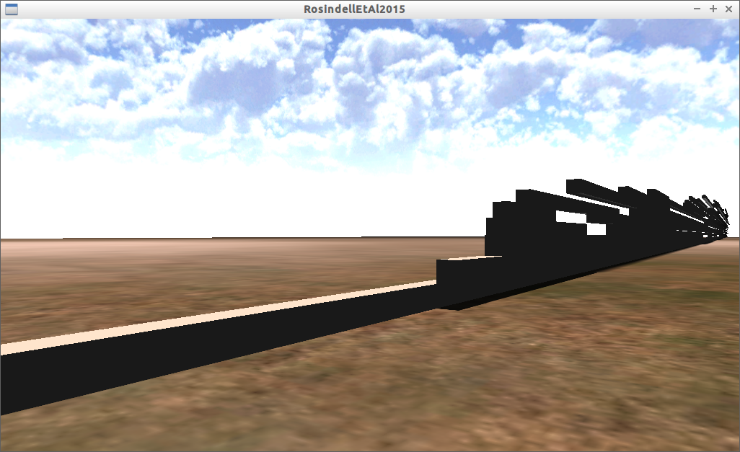
Research project #5
Hunch: adding a neutral trait to the current behavior might yield something else than a Brownian motion (Rosindell & Harmon, personal communication)
Possibly also true in simpler simulations!
Setup: add neutral trait to model, follow it in time, test its motion being Brownian or other

Slide 26
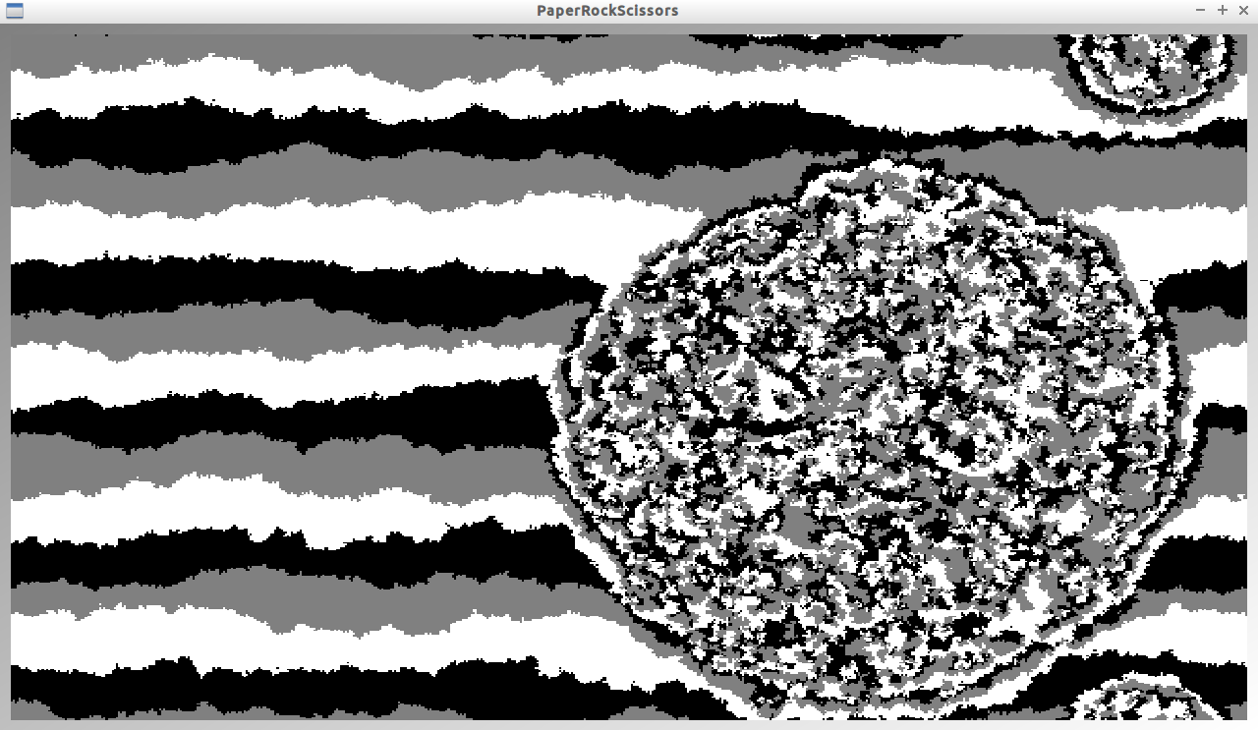
Research project #6
Hunch: will speciation models still produce realistic phylogenies in a spatial model?
Setup: take an IBM, add spatiality, check the phylogenies produced

Slide 27
Conclusion
Cohesive project
  Approach from multiple angles
  Overlap between techniques used in different projects

Slide 28
Thanks!
Questions?
Notes:
Mention all parameters of models
Exonential growh when spc rate > ext rate

Slide 29
References
Etienne, Rampal S., and James Rosindell. "Prolonging the past counteracts the pull of the present: protracted speciation can explain observed slowdowns in diversification." Systematic Biology 61.2 (2012): 204-213.
Etienne, Rampal S., and James Rosindell. "The spatial limitations of current neutral models of biodiversity." PloS one 6.3 (2011): e14717.
Hagen, Oskar, et al. "Age-dependent speciation can explain the shape of empirical phylogenies." Systematic biology (2015): syv001.
Nee, Sean. “Inferring speciation rates from phylogenies.” Evolution 55.4 (2001): 661-668.
Nee, Sean, Robert M. May, and Paul H. Harvey. "The reconstructed evolutionary process." Philosophical Transactions of the Royal Society B: Biological Sciences 344.1309 (1994): 305-311.
Rosindell, James, Luke J. Harmon, and Rampal S. Etienne. "Unifying ecology and macroevolution with individual-based theory." Ecology letters 18.5 (2015): 472-482.
Stadler, Tanja, et al. "How well can the exponential-growth coalescent approximate constant-rate birth-death population dynamics?." Proceedings of the Royal Society of London B: Biological Sciences 282.1806 (2015): 20150420.
Yule, G. Udny. "A mathematical theory of evolution, based on the conclusions of Dr. JC Willis, FRS." Philosophical Transactions of the Royal Society of London. Series B, Containing Papers of a Biological Character (1925): 21-87.

