Slide 1
Tree priors
© 2015 Richel Bilderbeek

Slide 2
Does model matter?
Model A
Simulated
phylogeny
Different?
Model B
Simulated
Data
Phylogeny

Slide 3
Tree priors
 | Name | When use it?
Y | Yule | No extinction, complete sampling, commonly used
CY | Corrected Yule
CRBD | Constant-rate Birth-Death | Yule with extinction and incomplete samping
CCP | Coalescent Constant Population | Small sample of large population, population at equilibrium
CEP | Coalescent Exponential Population | Small sample of large population, population just founded
CBS | Coalescent Bayesian Skyline
CEBS | Coalescent Extended Bayesian Skyline

Slide 4
Yule model
No extinction
Complete sampling
G Yule, 1924
Notes:
Yule, G. (1924), 'A mathematical theory of evolution based on the conclusions of dr. j.c. willis', Philosophical Transactions of the Royal Society of London, Series B 213, 21–87.
From BeastBook:
We conclude the section on the constant rate birth-death model with several remarks: The constant rate birth-death model with μ = 0 and ρ = 1, i.e. no extinction and complete sampling, corresponds to the well-known Yule model (Yule 1924).

Slide 5
Calibrated Yule model

Slide 6
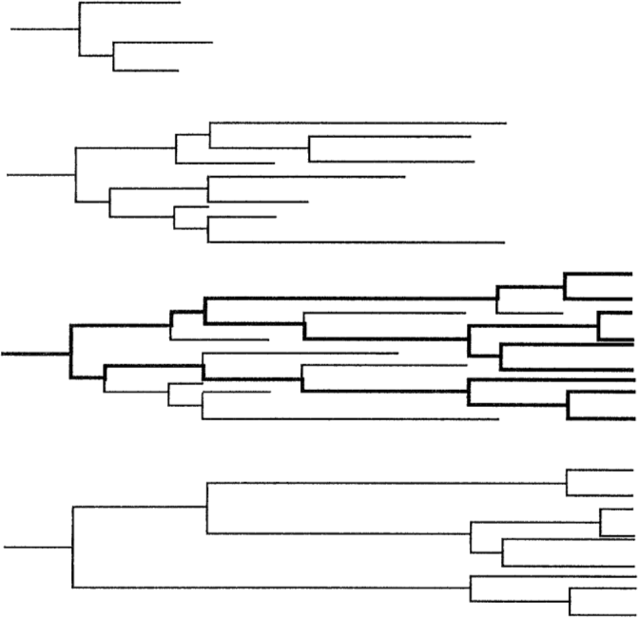
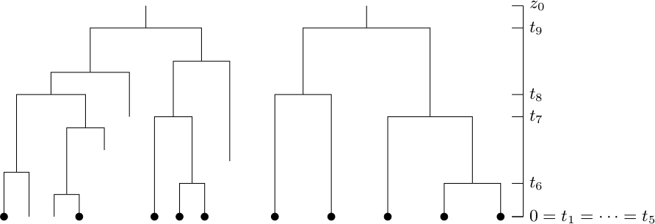
Constant rate birth-death model
Birth and death rate constant
Incomplete sampling
S Nee, RM May and PH Harvey, 1994
AJ Drummond and RR Bouckaert, 2014
Notes:
Figure 2.7 of BeastBook:
Bayesian evolutionary analysis with BEAST 2. Alexei J. Drummond and Remco R. Bouckaert. Cambridge University Press, 2014
Nee, Sean, Robert M. May, and Paul H. Harvey. "The reconstructed evolutionary process." Philosophical Transactions of the Royal Society B: Biological Sciences 344.1309 (1994): 305-311.

Slide 7
Coalescent constant population model
Notes:
Nee, Sean, Robert M. May, and Paul H. Harvey. "The reconstructed evolutionary process." Philosophical Transactions of the Royal Society B: Biological Sciences 344.1309 (1994): 305-311.

Slide 8
Coalescent exponential population model

Slide 9
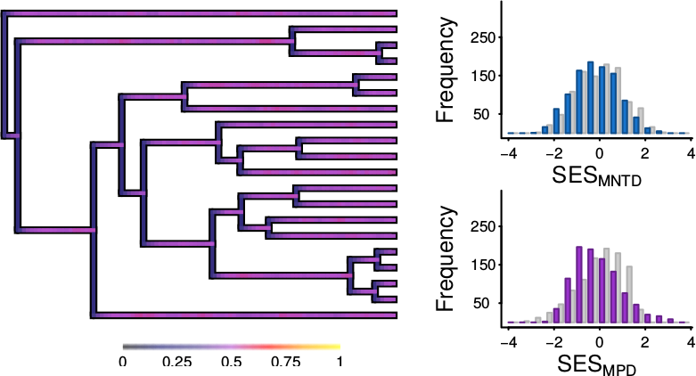
Does model matter?
Random-draw
DAMO
CLES
High extinction rate
A Pigot & RS Etienne, 2015
Notes:
Pigot, Alex L., and Rampal S. Etienne. "A new dynamic null model for phylogenetic community structure." Ecology letters 18.2 (2015): 153-163.

Slide 10
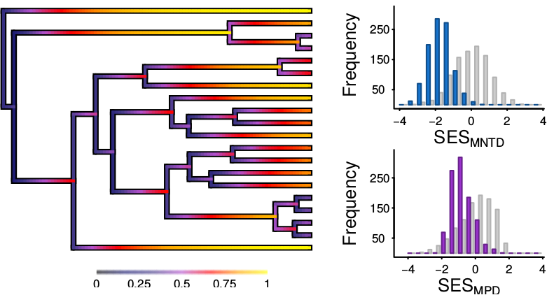
Does model matter?
Random-draw
DAMO
CLES
Low extinction rate
A Pigot & RS Etienne, 2015
Notes:
Pigot, Alex L., and Rampal S. Etienne. "A new dynamic null model for phylogenetic community structure." Ecology letters 18.2 (2015): 153-163.

Slide 11
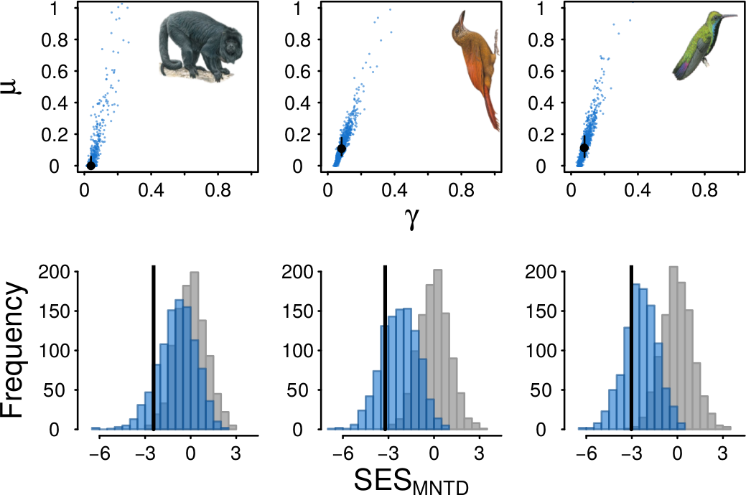
Does model matter?
Random-draw
DAMO
CLES
Observed
A Pigot & RS Etienne, 2015
Notes:
The random-draw model suggests that there probably is a biological force acting, where DAMOCLES suggests that the data observed is close to (its) random
Pigot, Alex L., and Rampal S. Etienne. "A new dynamic null model for phylogenetic community structure." Ecology letters 18.2 (2015): 153-163.

