Slide 1



Paper discussion
L Ranjard et al., Modelling competition and dispersal in a statistical phylogeographic framework, 2014
Discussed by Richel Bilderbeek
https://github.com/richelbilderbeek/Science

Slide 2
One-slide summary
Model with alignment, spatiality, dispersal and competition
Is tested on simulated data to recover the parameters put it
Recovery is claimed to be good
Is set to work on an alignment of spatially sperated species
The model is shown to make its best estimate

Slide 3
Overview
Idea of the model
Parameters of the model
Parameter recovery
Natural system
Estimating parameters from natural system
Discussion

Slide 4
Idea of the model

Slide 5
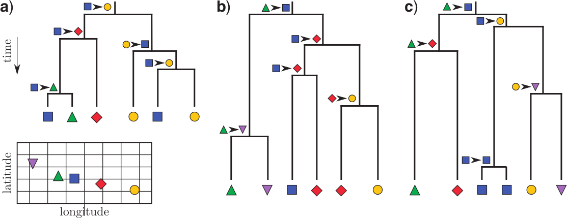
Competition and dispersal
Different combinations of competition and dispersal result in different phylgenies
Free dispersal
Competition low
Short dispersal
Competition low
Free dispersal
Competition high

Slide 6
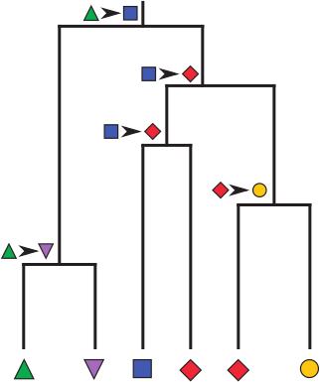
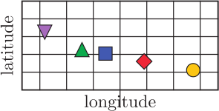
Short dispersal
Islands can only colonize the adjacent islands
Competition is low, as gets colonized twice

Slide 7
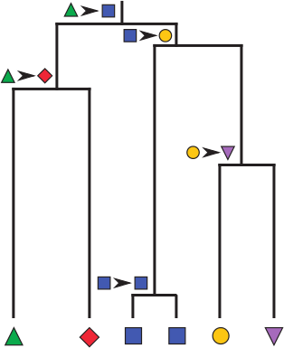
Competition high
Hard to colonize an occupied island
Dispersal is free in this case, as colonizes

Slide 8
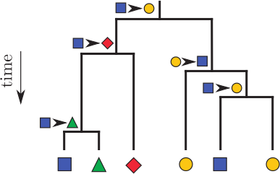
Both
Competition is low, as gets colonized twice
Dispersal is free, as colonizes

Slide 9
Competition and dispersal
Different combinations of competition and dispersal result in different phylgenies
Free dispersal
Competition low
Short dispersal
Competition low
Free dispersal
Competition high

Slide 10
Model details

Slide 11
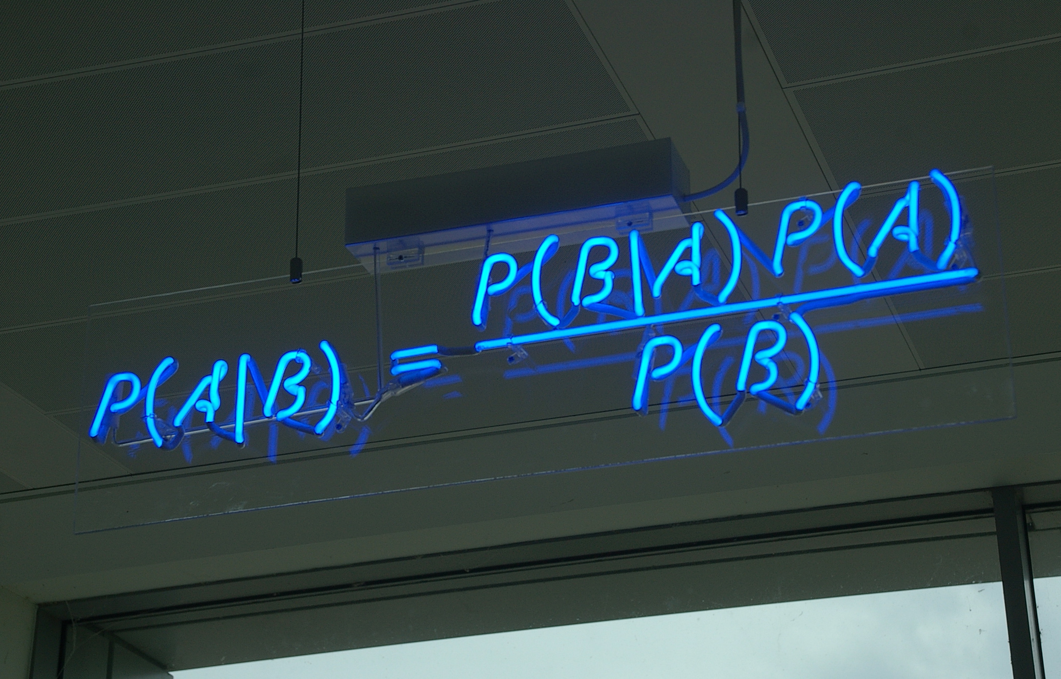
Bayes' theorem
A: parameters
B: data
P(A|B): posterior, the certainty of the parameter estimates given the data
P(B|A): likelihood, how well the data fits, given the parameters
P(A): prior distribution, the chance these parameters occur
P(B): marginal likelihood, normalization factor, the chance this data is measured

Slide 12
Model parameters
Lambda: competition
  Lambda < 0: unoccupied patches are preferred, (indicating competition)
  Lambda > 0: occupied patches are preferred
Sigma: dispersal
  Sigma e [0,10]
Tau: overall dispersal
  Tau e [0,10]

Slide 13
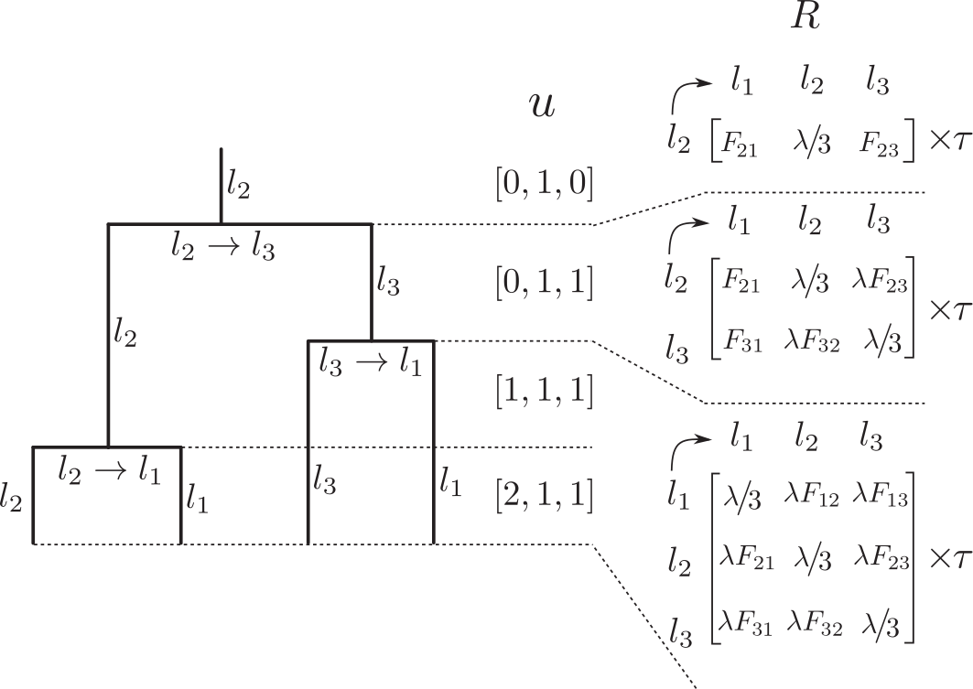
Likelihood
A function to determine the probability of finding a phylogeny-parameter-combination by chance
Not analyzed

Slide 14
Recovering the model parameters

Slide 15
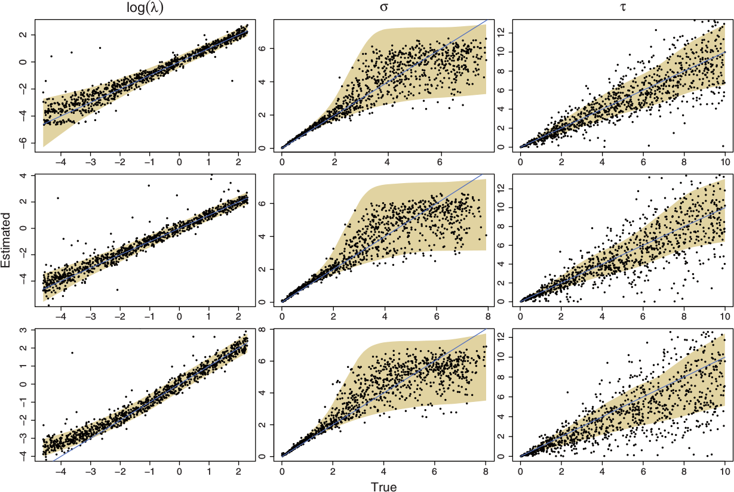
Recovering the model parameters
Uses 100 taxa
Line: value put in
Dots: value estimated
Area: 95% confidence interval
Number of locations
150
100
50
Lambda:
competition
parameter
sigma:
dispersal
parameter
tau:
overall
dispersal
rate

Slide 16
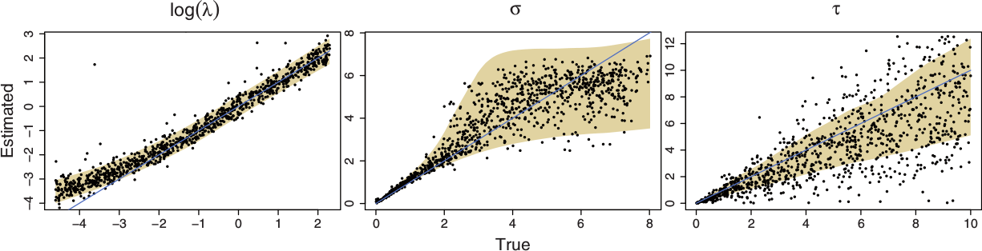
Recovering the model parameters
For 50 taxa the estimation is worst
The competition parameter is 'slightly overestimated' when lambda < 0
  unoccupied patches are preferred
  competition is strong
50
competition parameter
dispersal parameter
overall dispersal rate

Slide 17
Recovering the model parameters
For 50 taxa the estimation is worst
The overal dispersal is underestimated
50
competition parameter
dispersal parameter
overall dispersal rate

Slide 18
Natural system

Slide 19
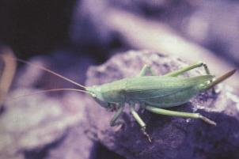
Banza
Banza: genus of the katydids (Tettigoniidae) family that is endemic to Hawaii
Katydids are also known as bush crickets or long-horned grasshoppers (but are not grasshoppers)
Banza nihoa
Notes:
Image from https://en.wikipedia.org/wiki/Nihoa_conehead_katydid

Slide 20
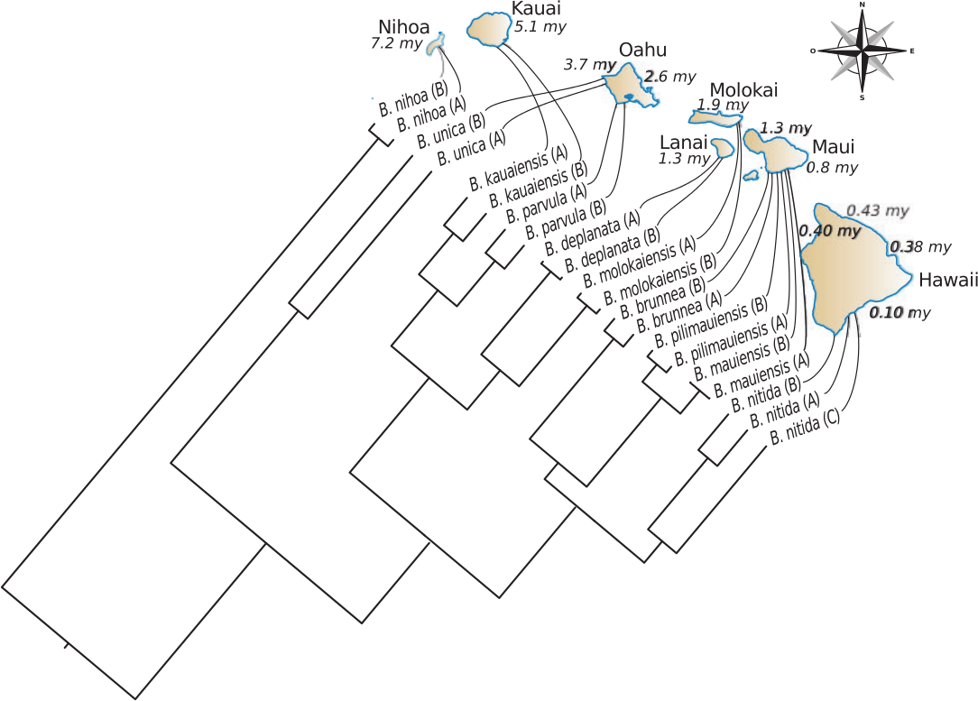
Phylogenetic tree
Notes:
B. nihoa is mentioned twice???

Slide 21
Estimating parameters from natural system

Slide 22
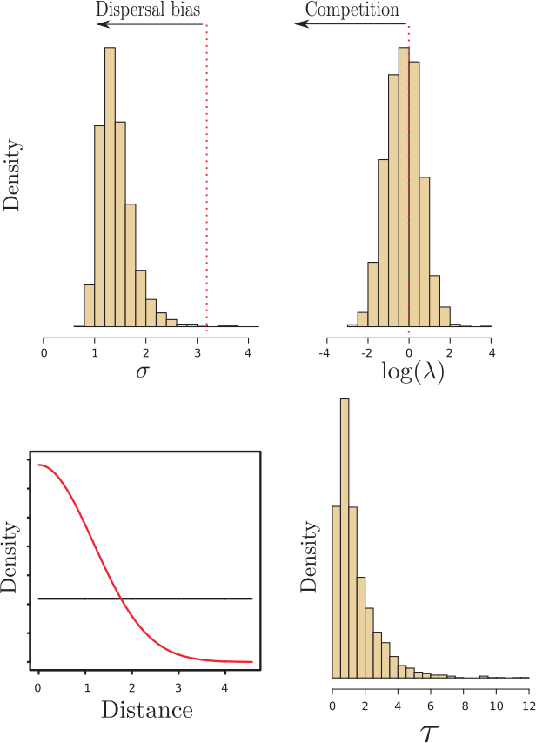
Posterior
A high-quality (converged) estimation (posterior) has a smooth distribution of parameter estimates
This is the case

Slide 23
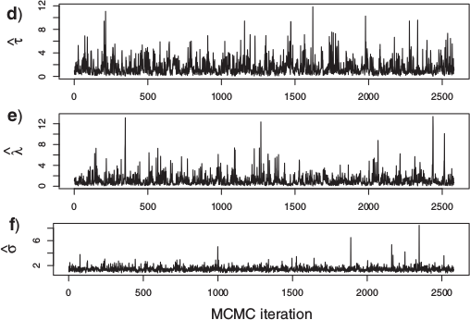
Posterior
A high-quality estimation has regular parameter estimates in time (no visible burn-in)
This is the case

Slide 24
Discussion

Slide 25
Discussion: model
'There is no extinction of lineages in our model' (The Dispersal and Colonization Process)
  this model (Yule) can best be used complete sampling, (AJ Drummond & RR Bouckaert)
'We also assumed a coalescent prior on the joint distribution of node heights with constant population size' (Appendix 6)
  this model (Coalescent Consant Population) can best be used by a small sample of large population, population at equilibrium (AJ Drummond & RR Bouckaert)
How to combine these two?
Are these realistic?

Slide 26
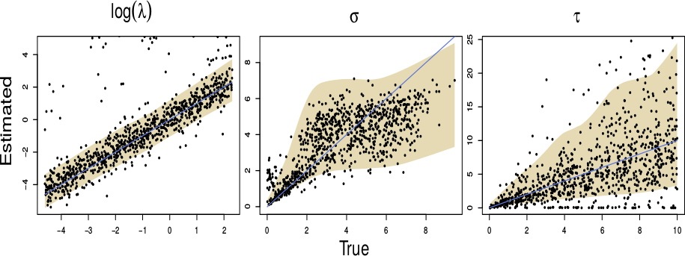
Discussion: recovering the model parameters
For supplement, figure S3:
  20 taxa
  10 locations
What is the quality of this recovery?
50
competition parameter
dispersal parameter
overall dispersal rate

Slide 27
Discussion: phylogenetic tree
Multiple species occur twice, for example, B. nihoa
Lanai, Molokai and Maui are treated as one island
Hawaii is treated as one location
Notes:
B. nihoa is mentioned twice???

Slide 28
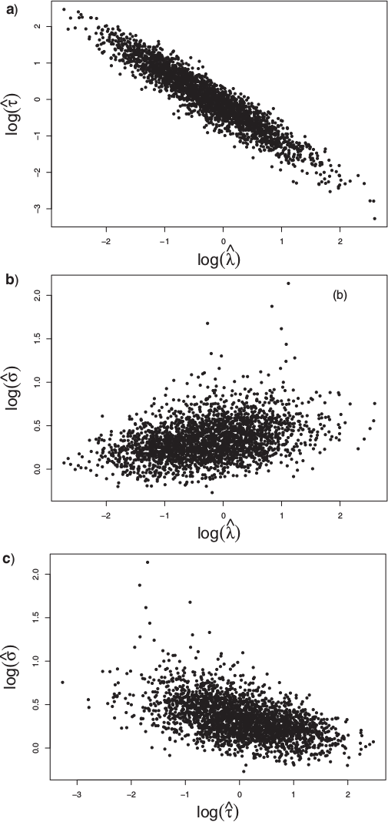
Discussion: posterior
How important are this scatter plots to assess parameter estimate quality?

