Slide 1
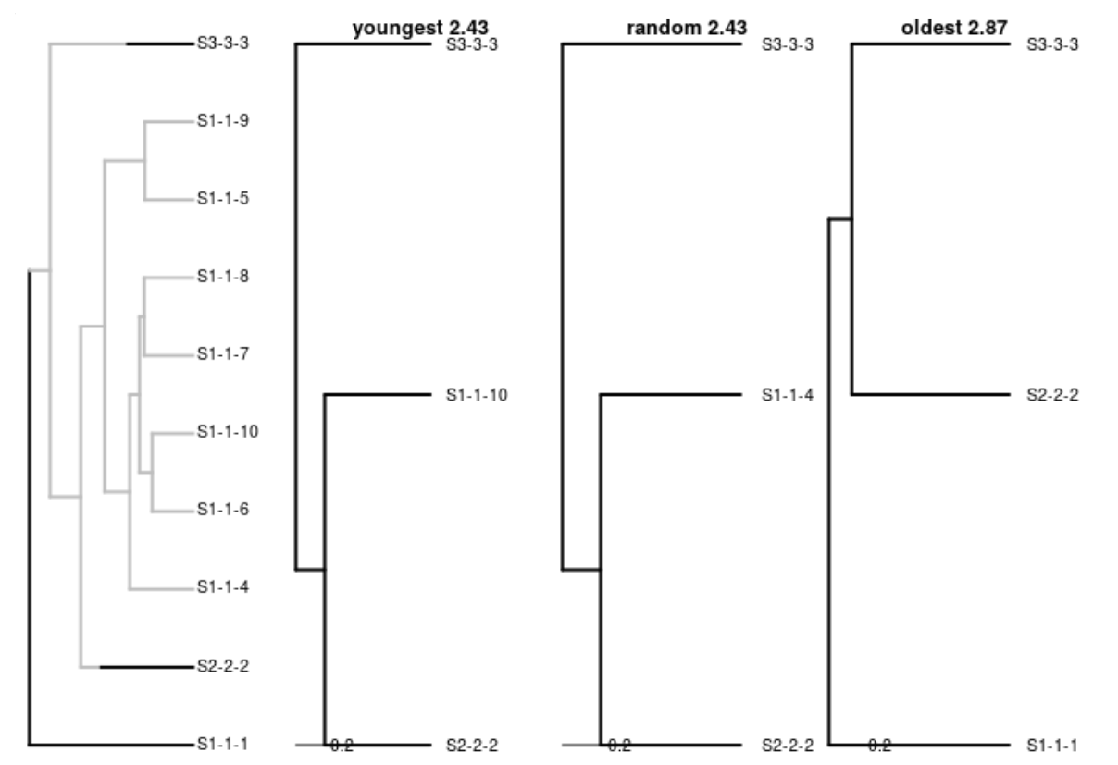


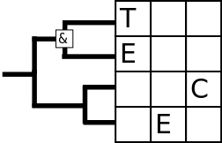
Sampling incipient trees
© 2018 Richel Bilderbeek
www.github.com/richelbilderbeek/Science

Slide 2
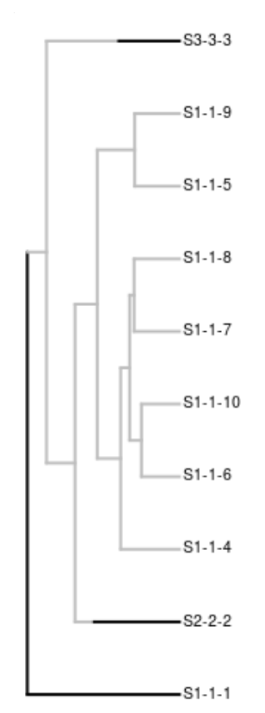
Goal
Share my naivety and insights
I will:
  Describe how incipient species trees are sampled
  When the behavior is as I expected
  When the behavior appeared unexpected
  Suggest a new sampling method

Slide 3
Sampling
An algorithm to pick an incipient species to represent a species
Three ways:
  1) oldest
  2) random
  3) youngest
Can result in different species trees

Slide 4
My naive branch length expectations
youngest ≤ oldest
youngest ≤ random ≤ oldest

Slide 5
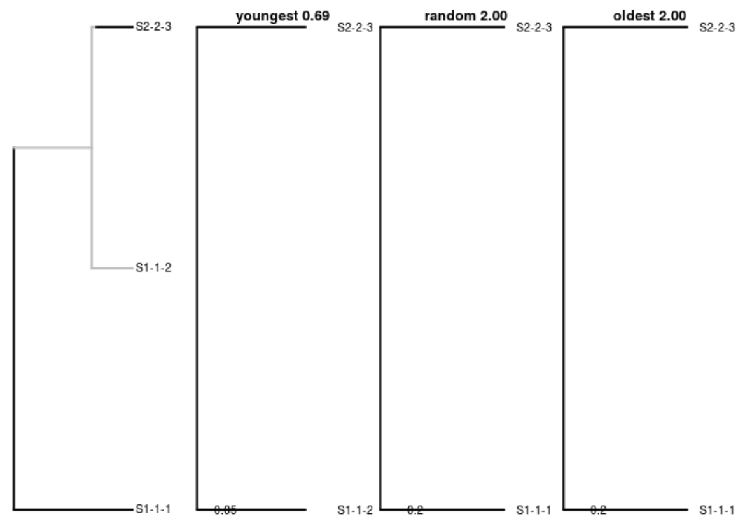
Expected #1
youngest ≤ random ≤ oldest

Slide 6
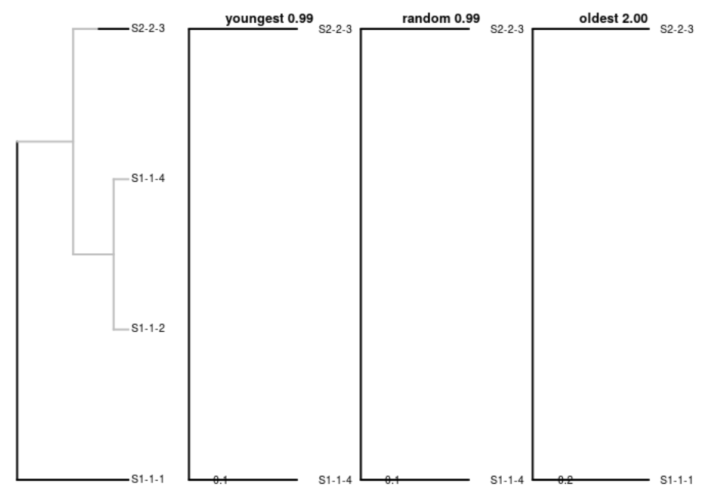
Expected #2
youngest ≤ random ≤ oldest

Slide 7
Expected #3
youngest ≤ random ≤ oldest

Slide 8
My naive branch length expectations
youngest ≤ oldest
youngest ≤ random ≤ oldest

Slide 9
My naive branch length expectations
youngest ≤ oldest
youngest ≤ random ≤ oldest

Slide 10
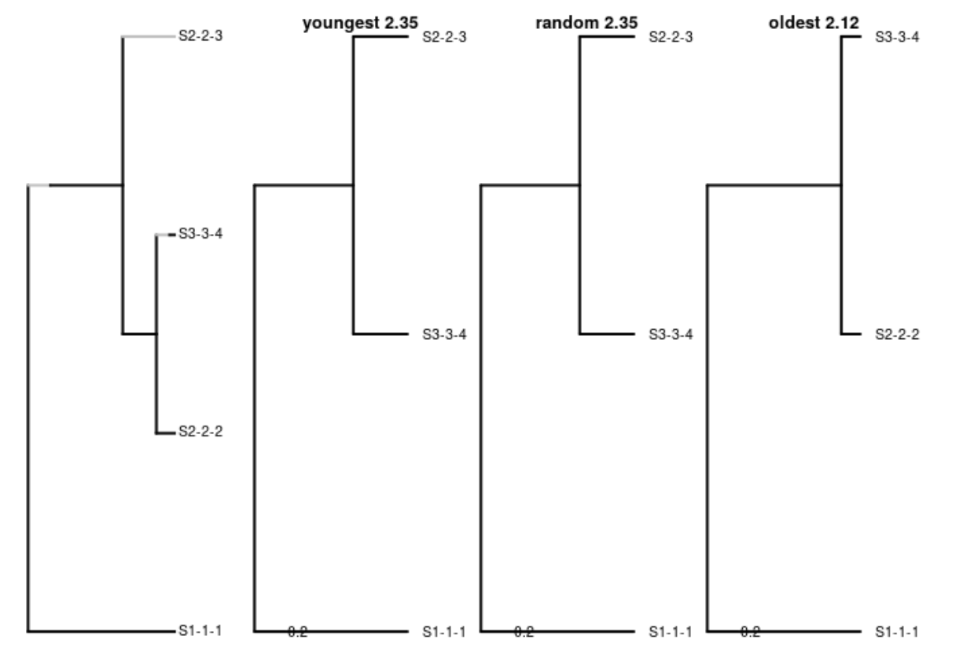
oldest ≤ youngest

Slide 11
My naive branch length expectations
youngest ≤ oldest
youngest ≤ random ≤ oldest

Slide 12
My naive branch length expectations
youngest ≤ oldest
youngest ≤ random ≤ oldest

Slide 13
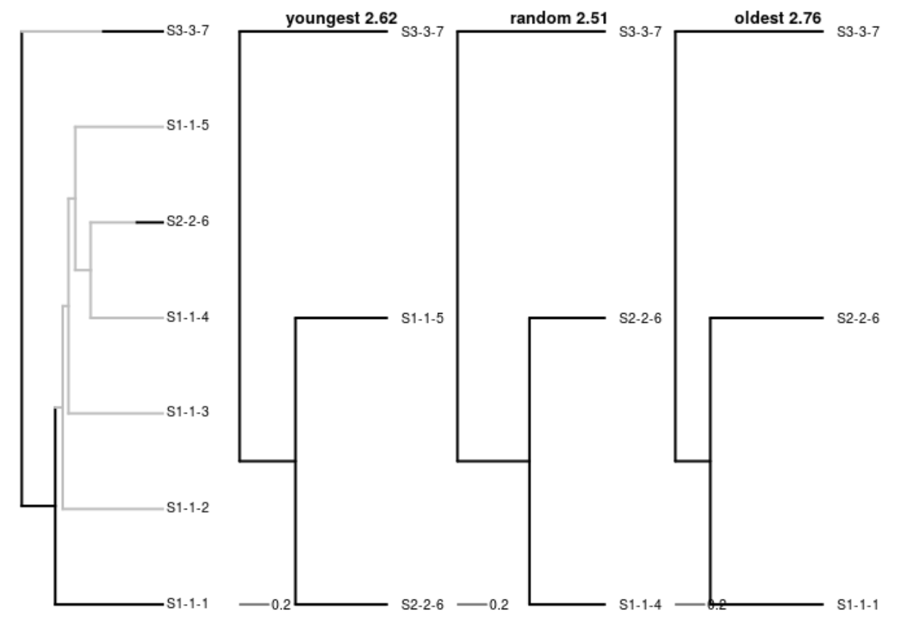
random ≤ youngest

Slide 14
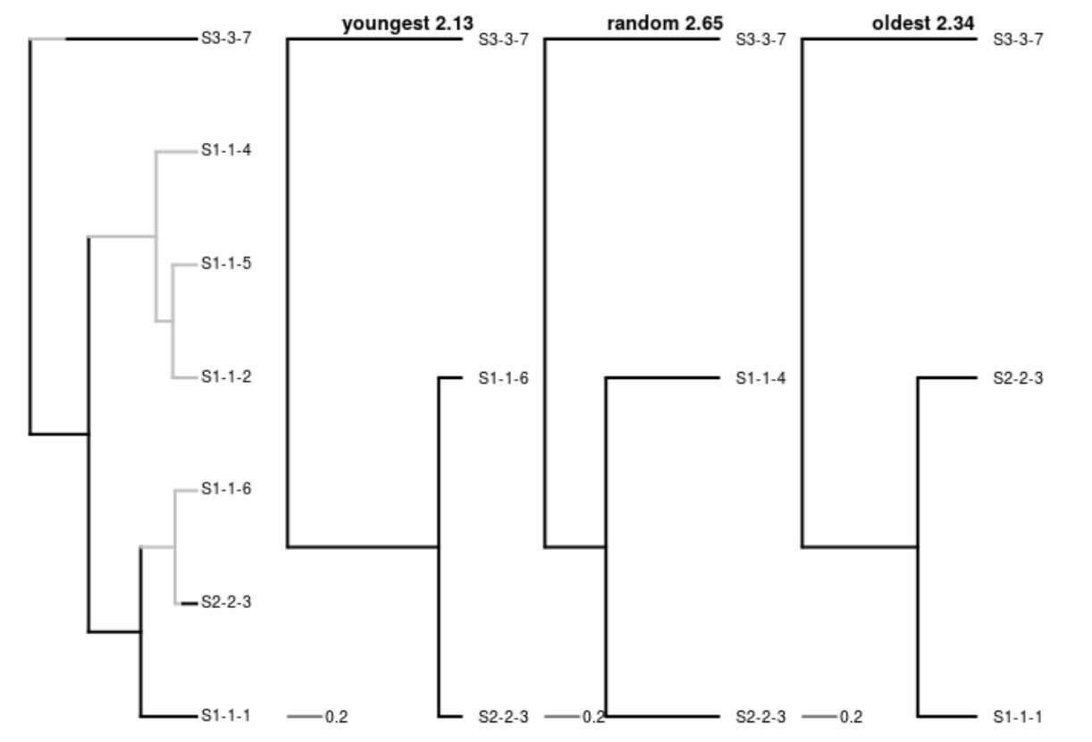
oldest ≤ random

Slide 15
My naive branch length expectations
youngest ≤ oldest
youngest ≤ random ≤ oldest

Slide 16
Conclusions
The names ‘youngest’ and ‘oldest’ misled me:
  Youngest does not give shortest branch lengths
  Oldest does not give longest branch lengths
  Random does not give intermediate branch lengths
youngest ≤ random ≤ oldest

Slide 17
Conclusions
Suggest to add ‘shortest’ and ‘longest’
  Shortest gives shortest branch lengths
  Longest gives longest branch lengths
  Random gives intermediate branch lengths
shortest ≤ random ≤ longest

Slide 18
Questions?
Redo out these calculations by running the vignette ‘pbd_sampling’ from:
https://github.com/richelbilderbeek/raket
devtools::install_package("richelbilderbeek/raket")
git clone https://github.com/richelbilderbeek/raket

