Slide 1

The hidden importance of transmembrance helices
Richèl Bilderbeek
https://github.com/richelbilderbeek/
cellbio_presentation_20210201

Slide 2
Introduction
Introduction
* Epitope presentation

Slide 3
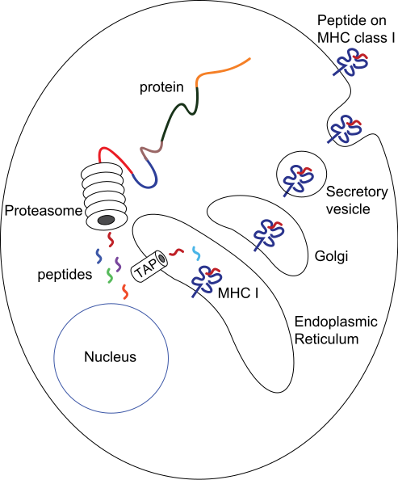
Epitope presentation by MHC-I
Proteasome in cytosol
Random cytosolic peptide fragments
(TAP prefers 8-12 mers)
MHC-I prefers 8-10-mers
https://en.wikipedia.org/wiki/Antigen_presentation#/media/File:MHC_Class_I_processing.svg

Slide 4
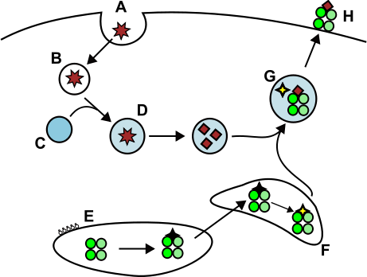
Epitope presentation by MHC-II
Cathepsins in cytosol
Random cytosolic peptide fragments
MHC-II prefers 15-24-mers
https://en.wikipedia.org/wiki/Antigen_presentation#/media/File:MHC2.svg

Slide 5
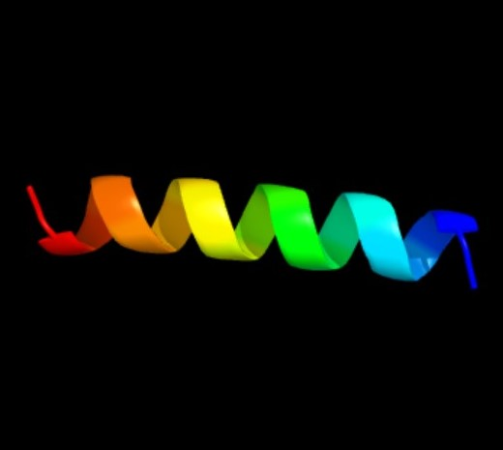
SMIM11A (from human ref prot)
58 residues
1 TMH predicted
Approx 36.2% TMH
50 9-mers, of which
29 overlap with TMH
58% of 9-mers overlap
>sp|P58511|SI11A_HUMAN Small integral membrane protein 11A
MNWKVLEHVPLLLYILAAKTLILCLTFAGVKMYQRKRLEAKQQKLEAERKKQSEKKDN
0000000000111111111111111111111000000000000000000000000000
https://upload.wikimedia.org/wikipedia/commons/c/ce/BI_tert_structure.jpg
Notes:
SMall Integral Membrane protein 11A

Slide 6
Counting binders
peptide | ic50
MNWKVLEHV | 5451.25
NWKVLEHVP | 5462.95
WKVLEHVPL | 5445.73
KVLEHVPLL | 5440.51
VLEHVPLLL | 4000.05
LEHVPLLLY | 5440.92
EHVPLLLYI | 5423.94
HVPLLLYIL | 5418.49
VPLLLYILA | 5446.31
PLLLYILAA | 5454.72
LLLYILAAK | 5456.88
LLYILAAKT | 5439.58
... | ...
>NP_478062.1
MNWKVLEHVPLLLYILAAKTLILCLTFAGVKMYQRKRLEAKQQKLEAERKKQSEKKDN
0000000000111111111111111111111000000000000000000000000000
*********
1 of 1 binders overlap with TMH
p = 0.58
k = 1
HLA-A*01:01, top 2%
Notes:
readr::write_csv(mhcnuggetsr::predict_ic50s(protein_sequence="MNWKVLEHVPLLLYILAAKTLILCLTFAGVKMYQRKRLEAKQQKLEAERKKQSEKKDN", peptide_length=9, mhcnuggets_options=mhcnuggetsr::create_mhcnuggets_options(mhc_class="I", mhc=mhcnuggetsr::to_mhcnuggets_name("HLA-A*01:01"))), "~/ic50s.csv")

Slide 7
Counting binders
Haplotype | Protein | n_{binders} | n_{binders_TMH} | n_{spots} | n_{spots_TMH}
HLA-A*01:01 | SI11A_HUMAN | 1 | 1 | 50 | 29

Slide 8
SMIM11A (from ncbi_results)
58 residues
1 TMH predicted
Approx 36.2% TMH
>NP_478062.1
MNWKVLEHVPLLLYILAAKTLILCLTFAGVKMYQRKRLEAKQQKLEAERKKQSEKKDN
>NP_478062.1
0000000000111111111111111111111000000000000000000000000000
https://upload.wikimedia.org/wikipedia/commons/c/ce/BI_tert_structure.jpg
Notes:
SMall Integral Membrane protein 11A

Slide 9
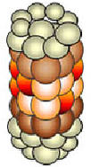
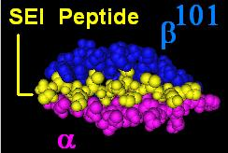
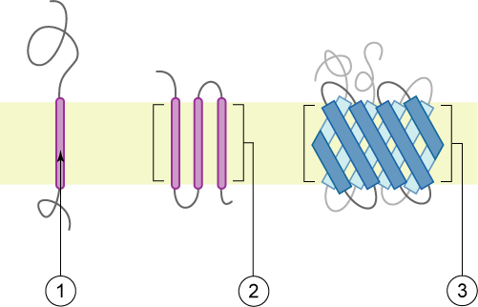
Epitope presentation

Slide 10
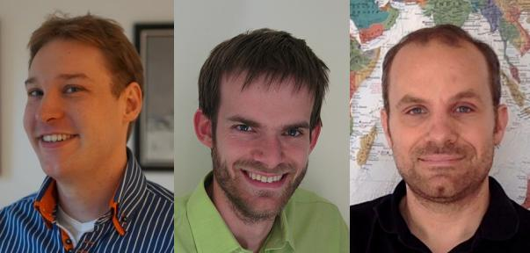
Research question
Are epitopes derived from transmembrane helices presented?
Bianchi, Frans, Johannes Textor, and Geert van den Bogaart. "transmembrane Helices are an overlooked source of Major Histocompatibility Complex Class I epitopes." Frontiers in Immunology 8 (2017): 1118.

Slide 11
BTB Research question
Are peptide fragments derived from TMHs presented?
TMH = transmembrane helix

Slide 12
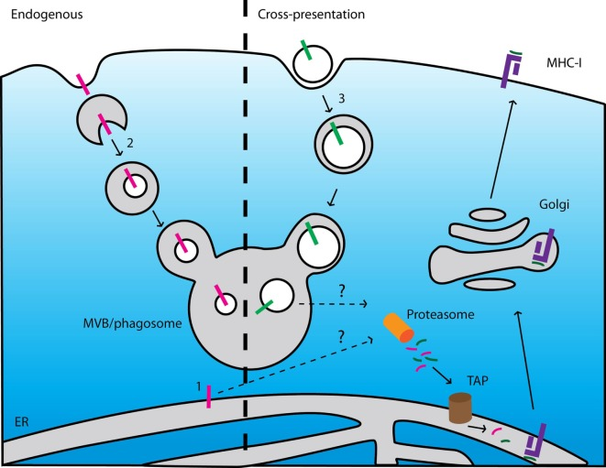
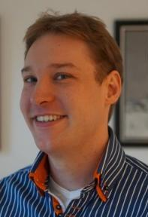

Yes, TMHs are presented
Mechanism is unknown
TMH = transmembrane helix

Slide 13
BTB Research question
Are peptide fragments derived from TMHs presented as often as expected by chance?
For example,
if 5.5% of all 9-mers overlap with a TMH,
5.5% of all 9-mers that MHC-I presents will stem from a TMH
TMH = transmembrane helix

Slide 14
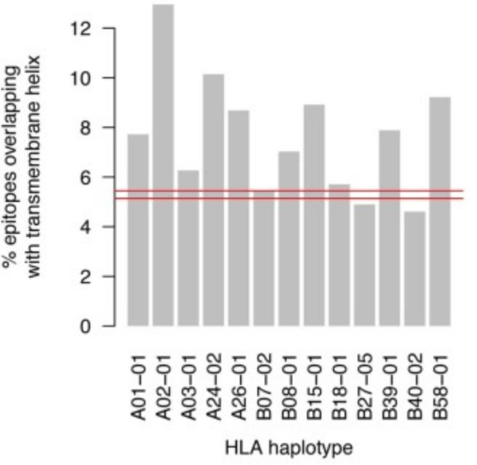
No, TMH-derived epitopes are over-presented in MHC-I in humans
5.5%
TMH = transmembrane helix

Slide 15
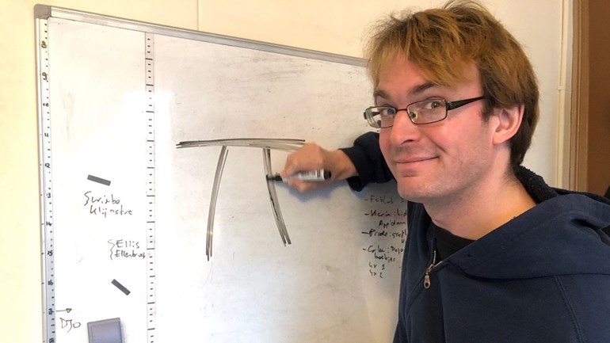
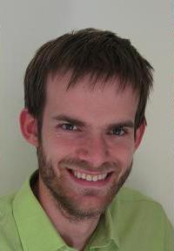
BBB research question
Are peptide fragments derived from TMHs presented as often as expected by chance,
* in MHC-I and MHC-II?
* in humans and other pathogens?
TMH = transmembrane helix

Slide 16
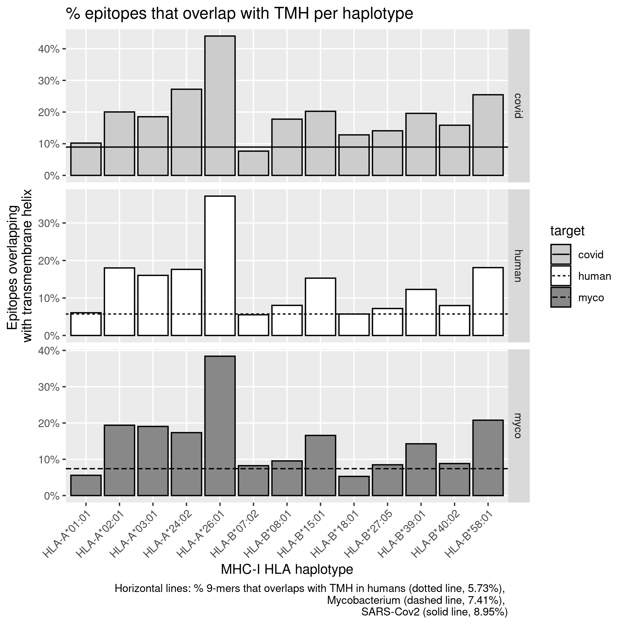
MHC-I in humans

Slide 17
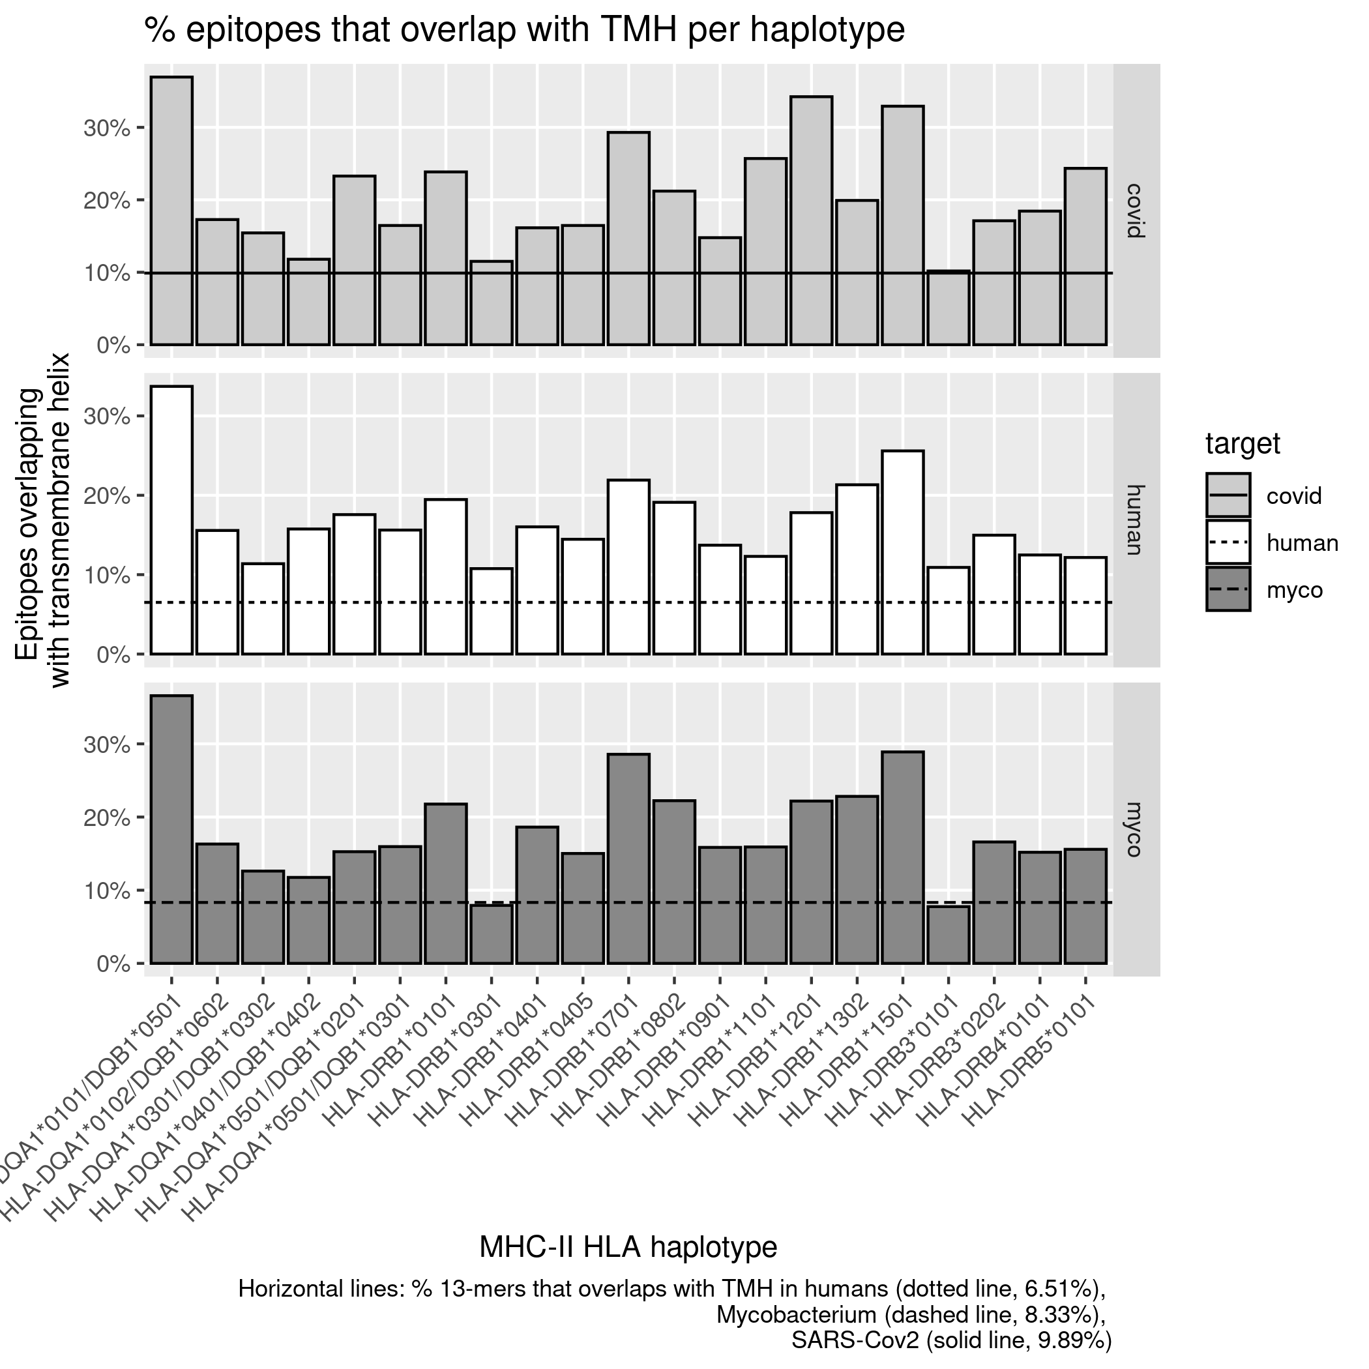
MHC-II in humans

Slide 18
In virus, humans and bacterium

Slide 19
Conclusion
TMHs are presented more often than expected by chance consistently
TMH = transmembrane helix

Slide 20
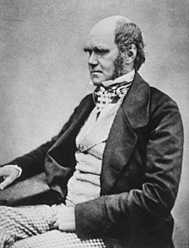
Conclusion
TMHs are presented more often than expected by chance consistently
TMH = transmembrane helix

Slide 21
Research question
Are TMHs evolutionarily conserved?

Slide 22
Are TMHs evolutionary conserved?
Structural integrity TMH
vs
non-TMH
Attentive human immune system
vs
runaway mutation

Slide 23
Methods
Collect SNPs of membrane proteins
Per SNP:
  Get protein sequence
  Predict topologies
  Score if SNPs is in/outside TMH
Do statistics

Slide 24

Collect SNPs of membrane proteins
≈20 millions human SNPs
≈1100 membrane proteins
≈5% of SNPs are AA substitutions
NP_002345.2:p.Ala295Val

Slide 25
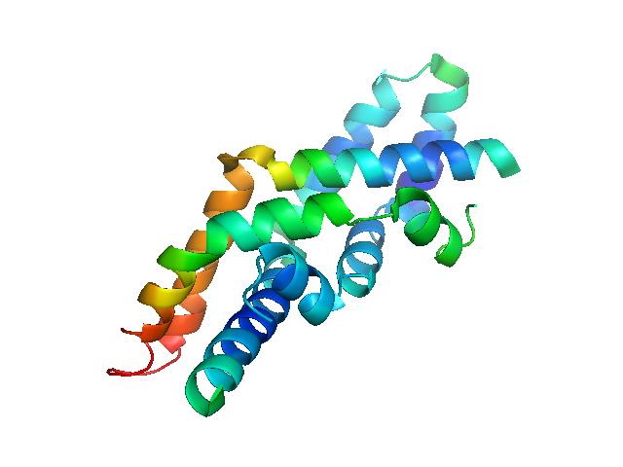
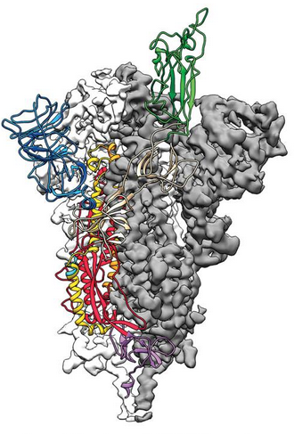
Statistics
A protein has % amino acids that are TMH
Mutations can occur at each amino acids
Do mutations occur in TMHs as often as expected by chance?
(percentages do not resemble real % of TMH of proteins)

Slide 26
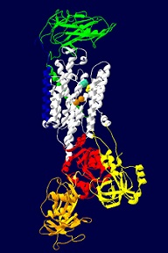
ATP1A3
Na⁺/K⁺-ATPase
≈16.667% TMH
Involved in Rapid-Onset Dystonia-Parkinsonism
Picture from https://www.atp1a3diseases.org

Slide 27
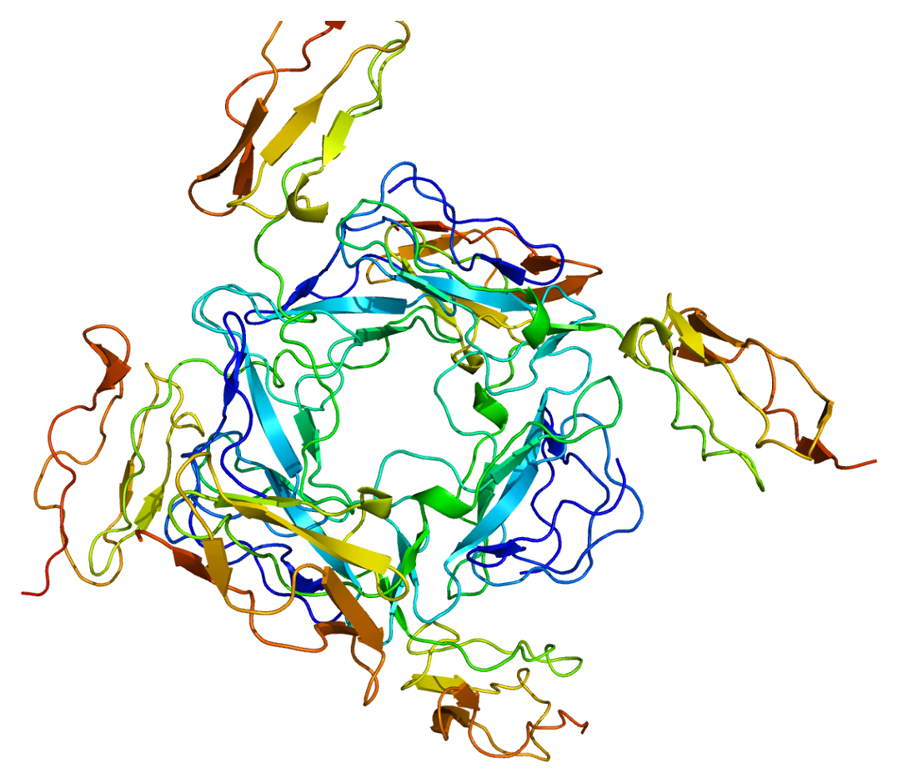
CD46
Inhibitory complement receptor
≈5% TMH
Receptor for MV-NIS
Picture from https://en.wikipedia.org/wiki/CD46#/media/File:Protein_CD46_PDB_1ckl.png
Notes:
Complement system = enhances (only) innate immune response
MV-NIS = Measles virus encoding the human thyroidal sodium iodide symporter, an attenuated oncolytic Edmonston strain of measles virus for which a vaccin has been developed

Slide 28
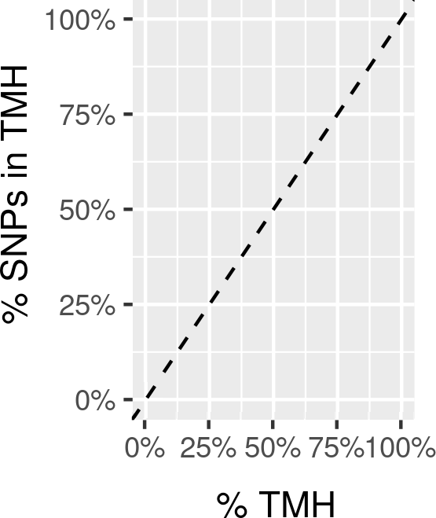
Conservation of SNPs

Slide 29
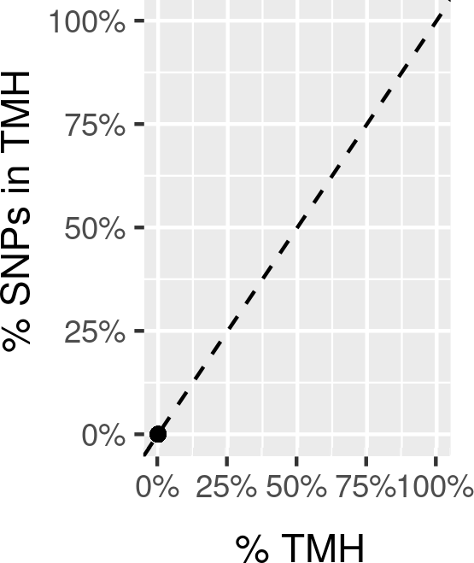
Cytosolic proteins

Slide 30
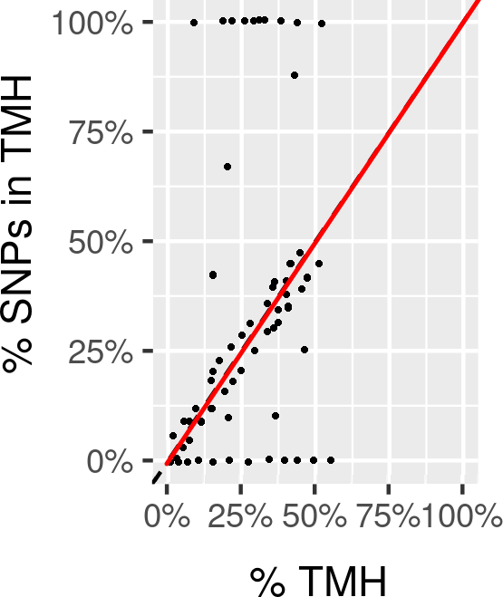
TMHs are evolutionarily neutral

Slide 31
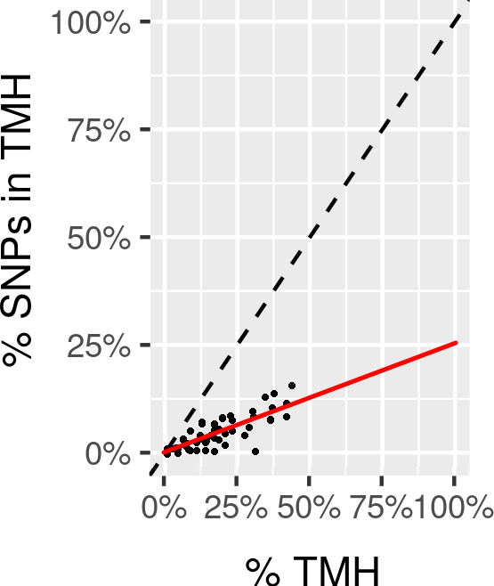
TMHs are evolutionarily conserved

Slide 32
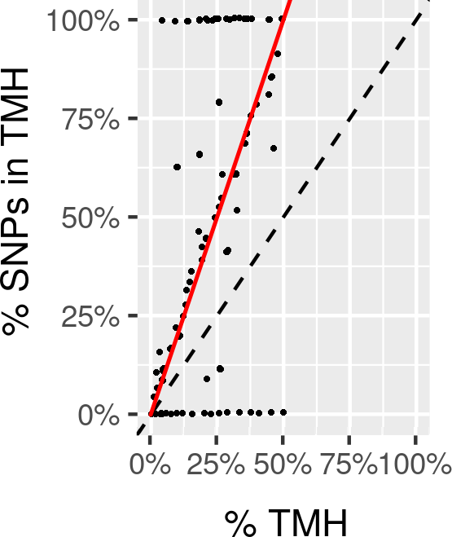
TMHs are a hotspot for mutations

Slide 33
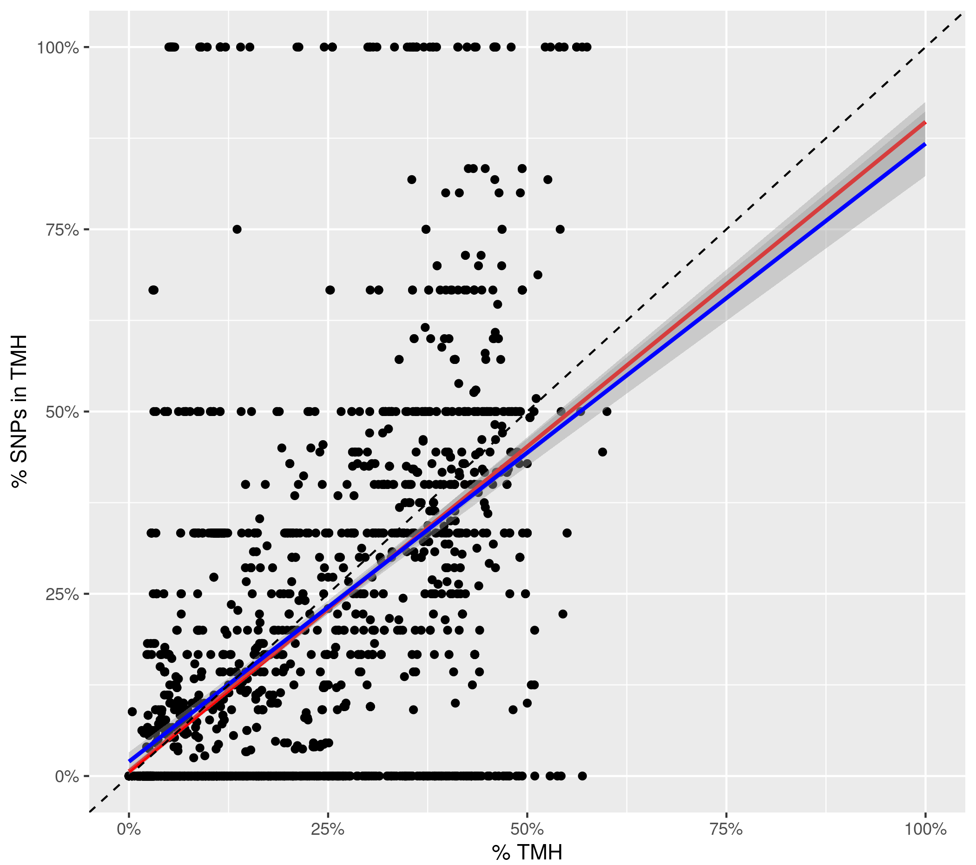
TMHs look evolutionarily conserved!

Slide 34

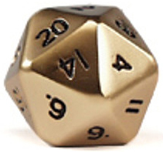
TMHs are evolutionarily conserved!
Poisson binomial distribution
Do we find as much successes as we expected?
p_{i} = p_{TMH}
n = n_{SNP} = 61457
E(k) ≈ 4203 (p_{mean} ≈ 6.8%)
k = n_{SNP} in TMH = 3889
p ≈ 1.6201 . 10⁻⁹

Slide 35
TMHs are evolutionarily conserved!
Per 1 SNP found in non-TMH, there are 0.925 SNPs in TMHs

Slide 36
Research question 2b
Are TMHs in single-spanner as conserved as TMHs in multi-spanners?
Less wiggle-room
to maintain 1 function
vs
Active sites
within membrane

Slide 37
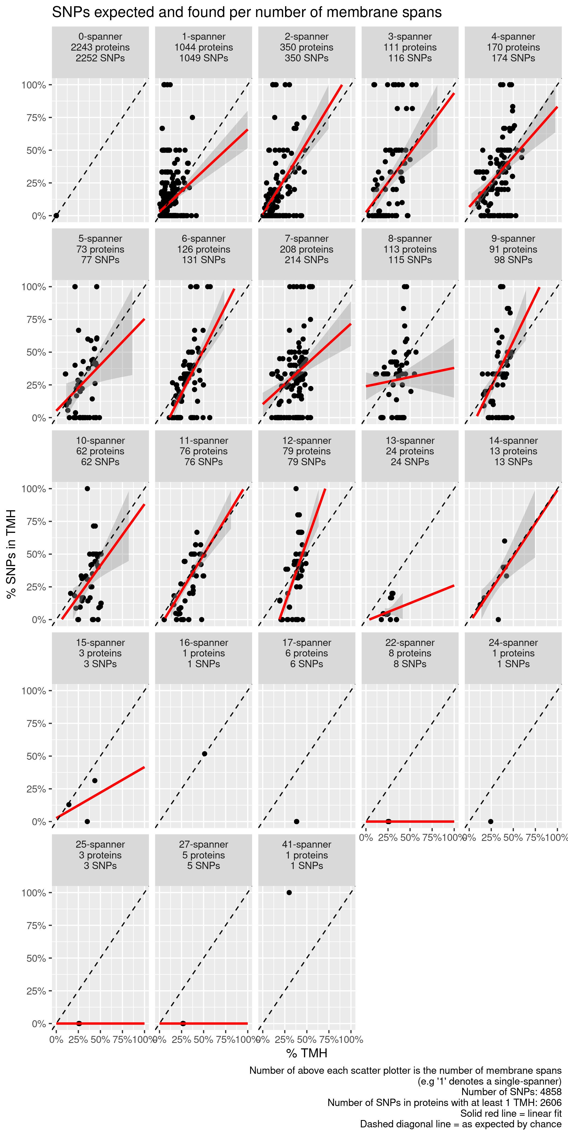
Separate by number of TMHs

Slide 38
Single-spanners look conserved
% SNPs in TMHs
% TMH in protein

Slide 39
2,3,4-spanners look undecided
% SNPs in TMHs
% TMH in protein

Slide 40
4+-spanners look undecided
% SNPs in TMHs
% TMH in protein

Slide 41
Conclusion
TMHs are presented more often than expected by chance consistently
TMHs are evolutionarily conserved

Slide 42
Questions?
richel@richelbilderbeek.nl
https://github.com/richelbilderbeek/molimm_presentation_20210111

