Slide 1
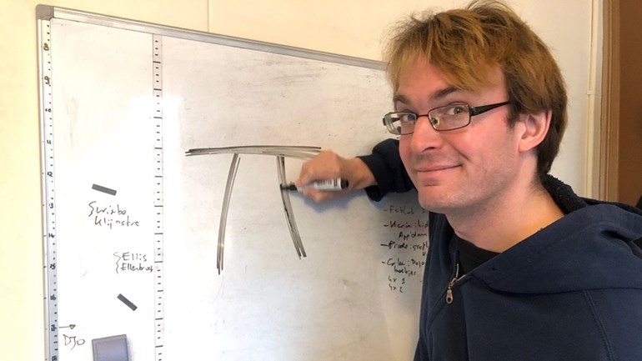

Postdoc projects
Richèl Bilderbeek
UU, IGP
https://github.com/richelbilderbeek/
igp_presentation_20210511

Slide 2
Goal
Share my postdoc’s idea for improvement
https://commons.wikimedia.org/wiki/File:Gereedschapskist.jpg

Slide 3
My postdoc
Machine learning in genetic epidemiology
2 years

Slide 4
Machine Learning Projects
1. Bilderbeek, [?], Johansson: SKAT biomarkers – SKAT + ML
2. Bilderbeek, Gourlé, Johansson: ML + UKB + gene wide ML
3. Bilderbeek, Gourlé, Karlsson, Johansson: the effectiveness of machine learning in GWAS studies

Slide 5
Grant-dependent Projects
4. Bilderbeek, Johansson, Johansson: when can a control group be replaced by a historical control.
5. Bilderbeek, [?], Johansson: pangenomics

Slide 6
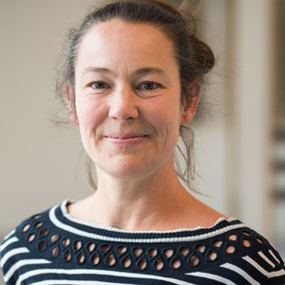
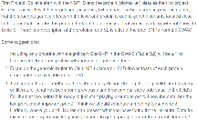

ML projects

Slide 7
ML projects
SKAT Biomarkers
- SKAT + ML
Hadrien’s ML work
other disease
other dataset

Slide 8
Method
Phenotype
Dataset

Slide 9
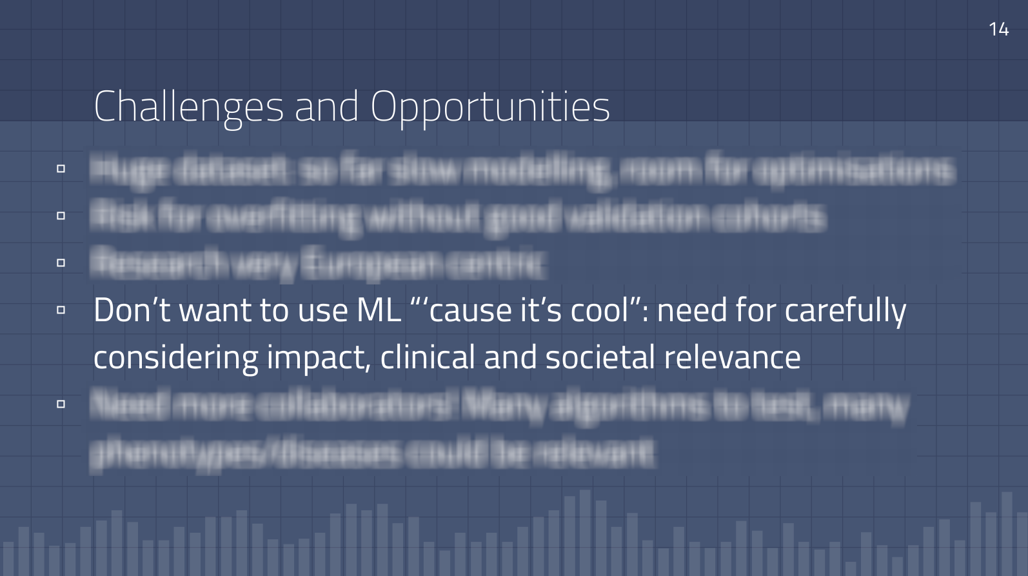


Slide 10
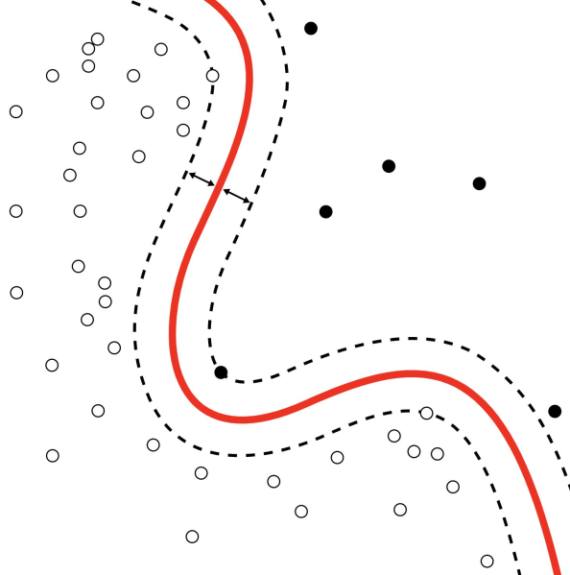
Why use ML?
Non-
linearity

Slide 11
Why use ML in GWAS?
Epistasis
Covariates
Non-
linearity

Slide 12
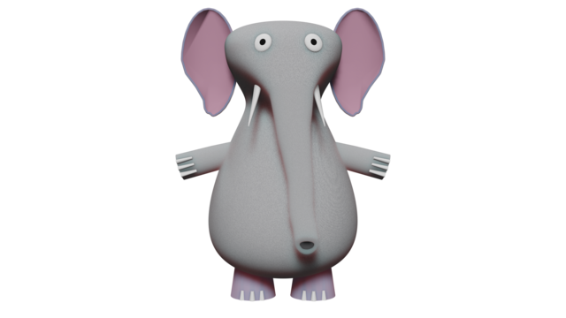
But is it worth it?
room
Notes:
https://commons.wikimedia.org/wiki/File:Elephant_shadows_front_view_animation.png

Slide 13
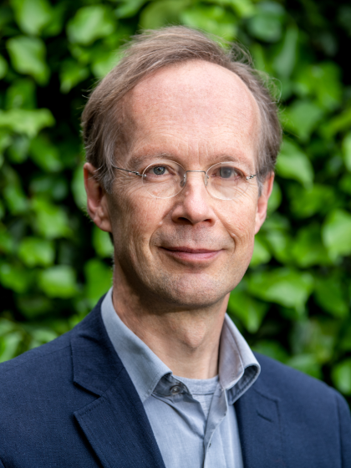
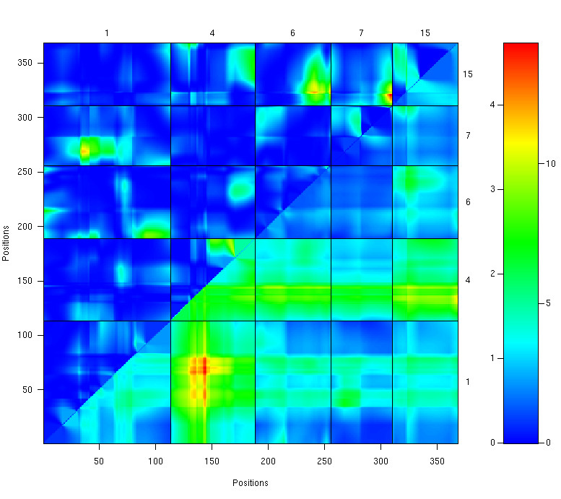
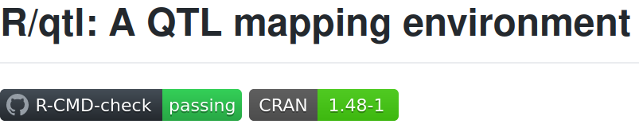
Data is too noisy
to warrant non-linearity
Professor Ritsert Jansen
https://www.rug.nl/staff/r.c.jansen/

Slide 14

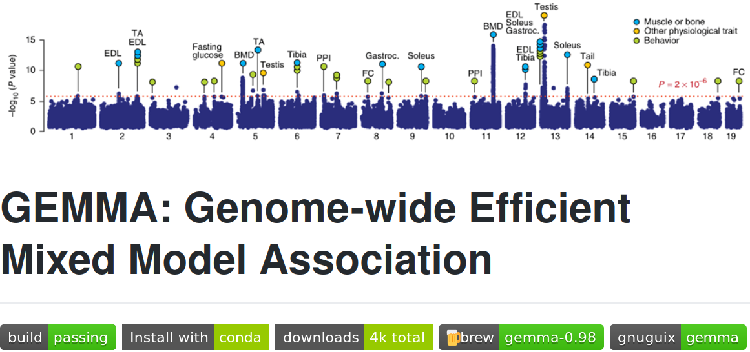
Negligible increase in accuracy
Profoundly more resources
Pjotr Prins
https://thebird.nl/

Slide 15
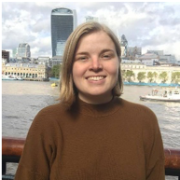
We are in the infancy
of the use
of machine learning
in GWAS
Nicholls, Hannah L., et al. "Reaching the end-game for GWAS: machine
learning approaches for the prioritization of complex disease loci."
Frontiers in genetics 11 (2020): 350.

Slide 16
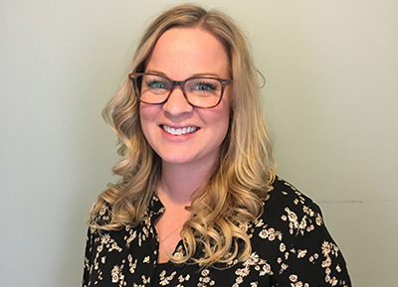
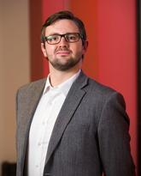
[Romagnoni et al., 2019]
found that non-linear
classification methods […]
perform considerably better
compared to linear models
MacEachern, Sarah J., and Nils D. Forkert. "Machine learning
for precision medicine." Genome 64.4 (2021): 416-425.

Slide 17
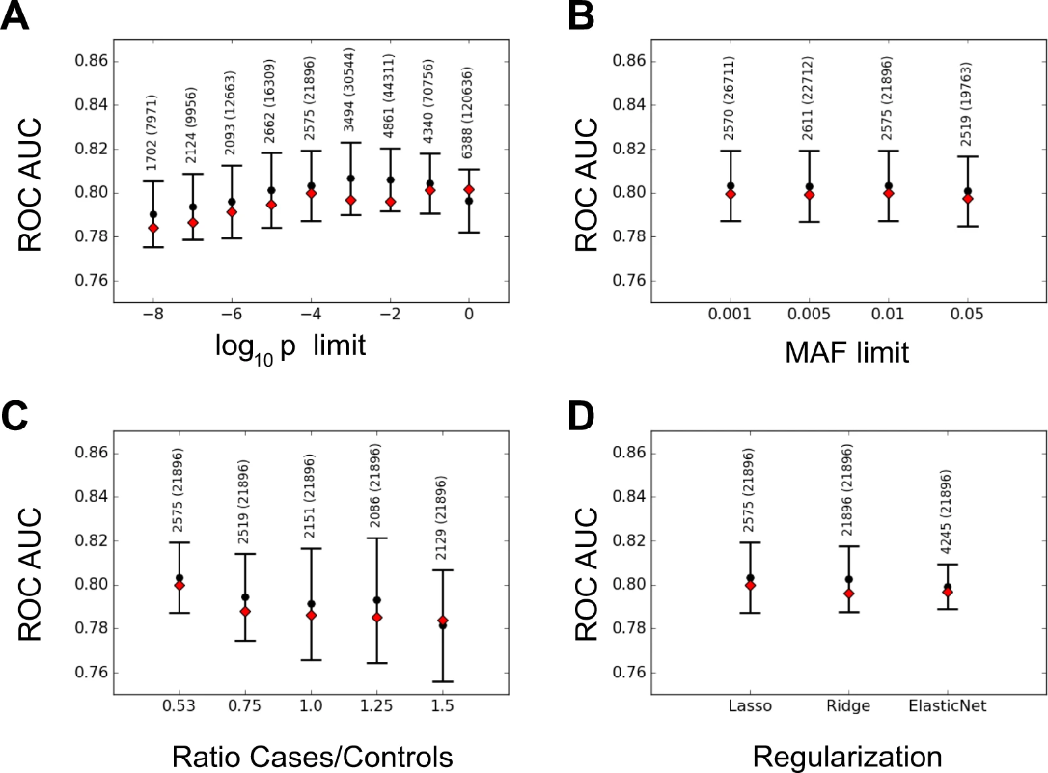
Linear models
Romagnoni, Alberto, et al. "Comparative performances of machine learning
methods for classifying Crohn Disease patients using genome-wide
genotyping data." Scientific reports 9.1 (2019): 1-18.

Slide 18
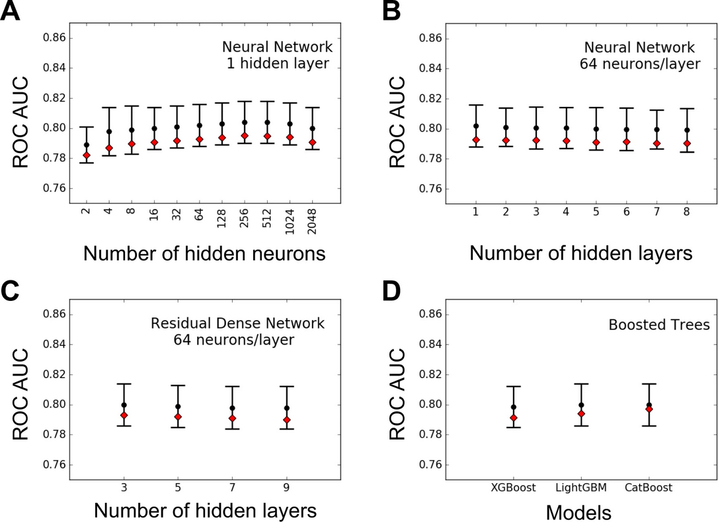
Machine learning
Romagnoni, Alberto, et al. "Comparative performances of machine learning
methods for classifying Crohn Disease patients using genome-wide
genotyping data." Scientific reports 9.1 (2019): 1-18.

Slide 19

[Romagnoni et al., 2019]
found that non-linear
classification methods […]
perform considerably better
equally well or worse
compared to linear models
Bilderbeek, 2021 (personal communication)

Slide 20

ML methods have been proven
to perform better in detecting
candidate SNPs and predicting
complex genetic diseases
such as Type-2 Diabetes [27],
Inflammatory Bowel Syndrome [28]
and Obesity [29]
Oriol, Javier De Velasco, et al. "Benchmarking machine learning models for late-onset alzheimer’s disease prediction from genomic data." BMC bioinformatics 20.1 (2019): 1-17.

Slide 21
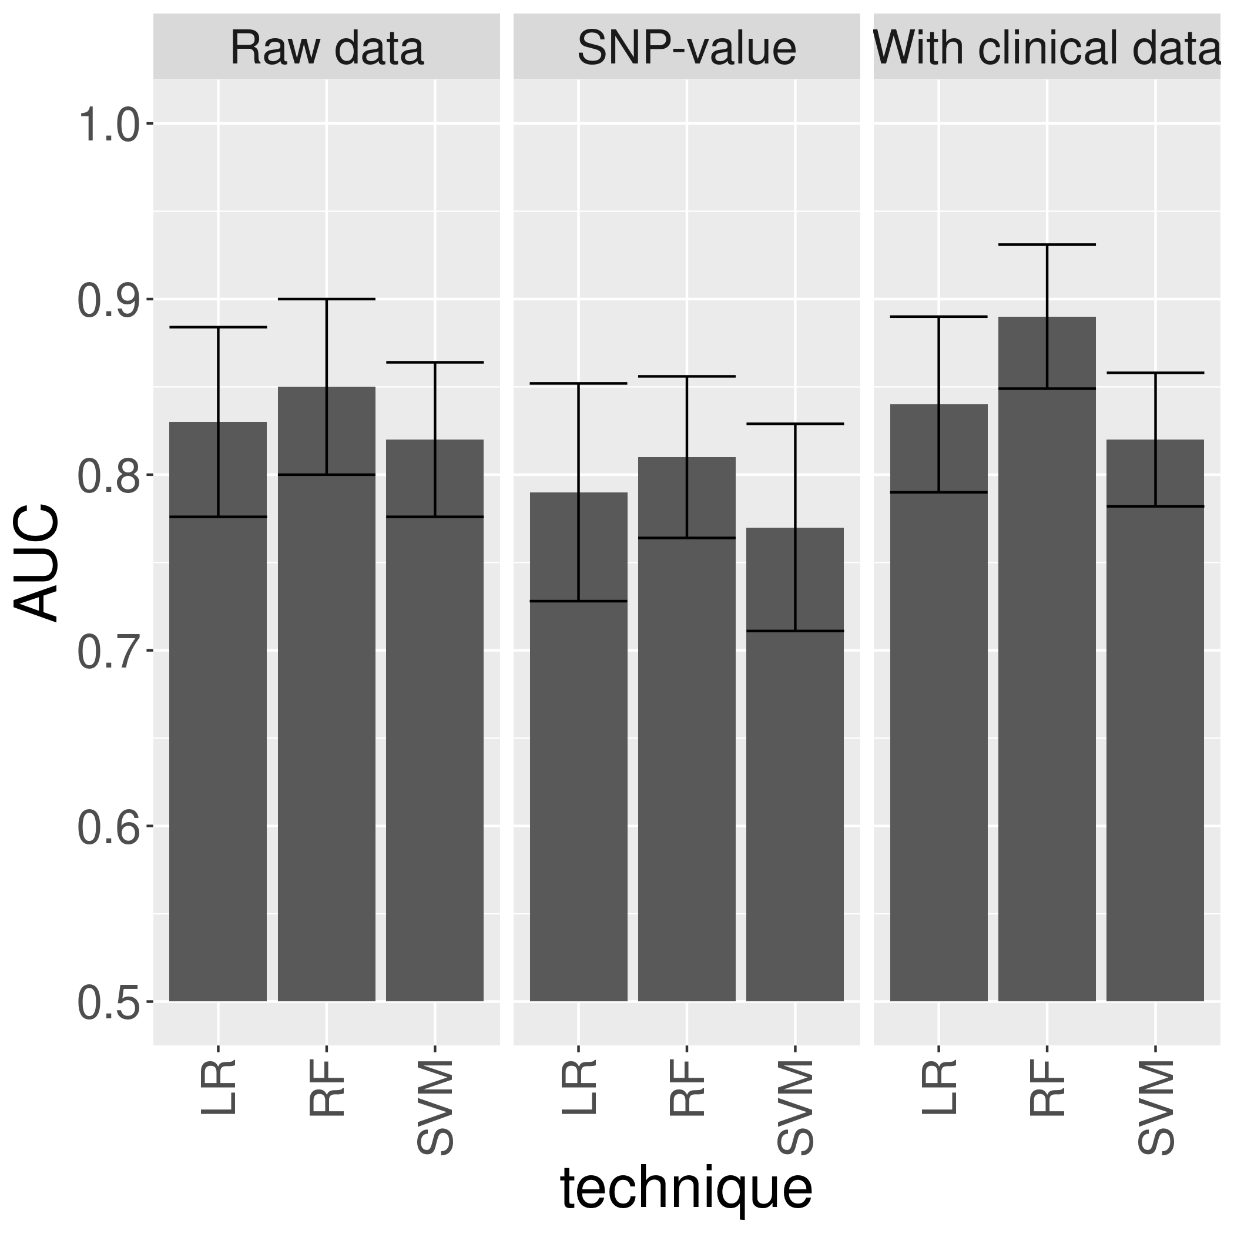


Type-2 Diabetes [27]
López, Beatriz, et al. "Single Nucleotide Polymorphism relevance learning with Random Forests for Type 2 diabetes risk prediction." Artificial intelligence in medicine 85 (2018): 43-49.

Slide 22
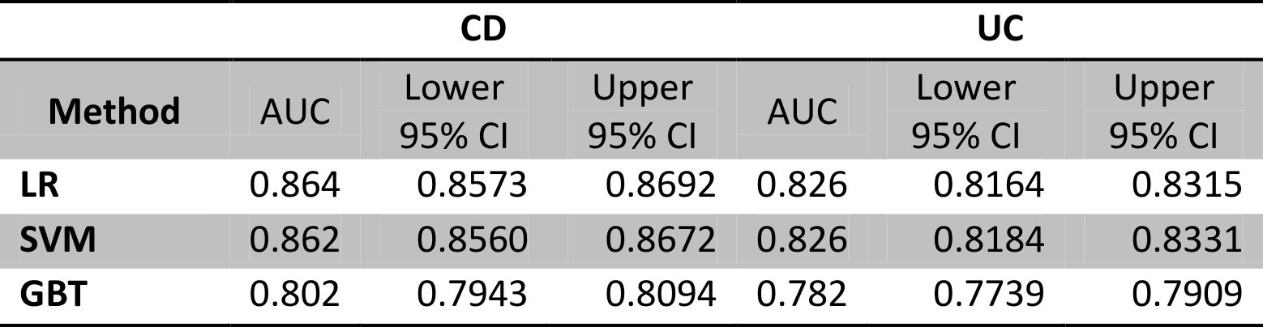
Inflammatory Bowel Syndrome [28]
Wei, Zhi, et al. "Large sample size, wide variant spectrum, and advanced machine-learning technique boost risk prediction for inflammatory bowel disease." The American Journal of Human Genetics 92.6 (2013): 1008-1012.

Slide 23
Obesity [29]
Nah.

Slide 24
If you ever see a paper
that convincingly shows that
ML outperforms classic methods,
in the context of GWAS,
please let me know

Slide 25
Intermediate conclusion
It is reasonable to doubt ML

Slide 26


Slide 27
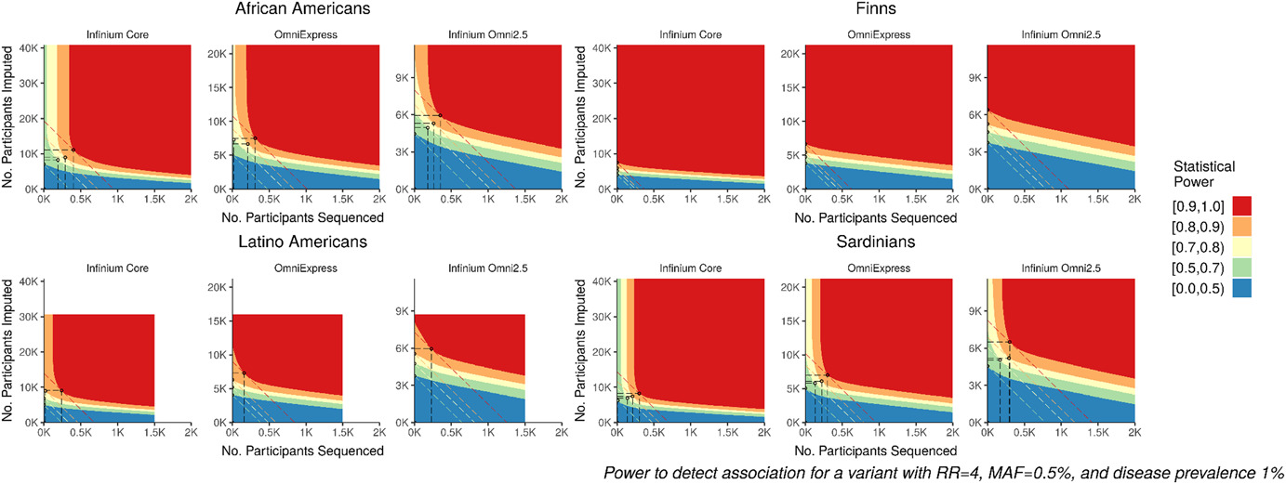
Quick, Corbin, et al. "Sequencing and imputation in GWAS: Cost‐effective strategies to increase power and genomic coverage across diverse populations." Genetic epidemiology 44.6 (2020): 537-549.

Slide 28
Quick, Corbin, et al. "Sequencing and imputation in GWAS: Cost‐effective strategies to increase power and genomic coverage across diverse populations." Genetic epidemiology 44.6 (2020): 537-549.

Slide 29
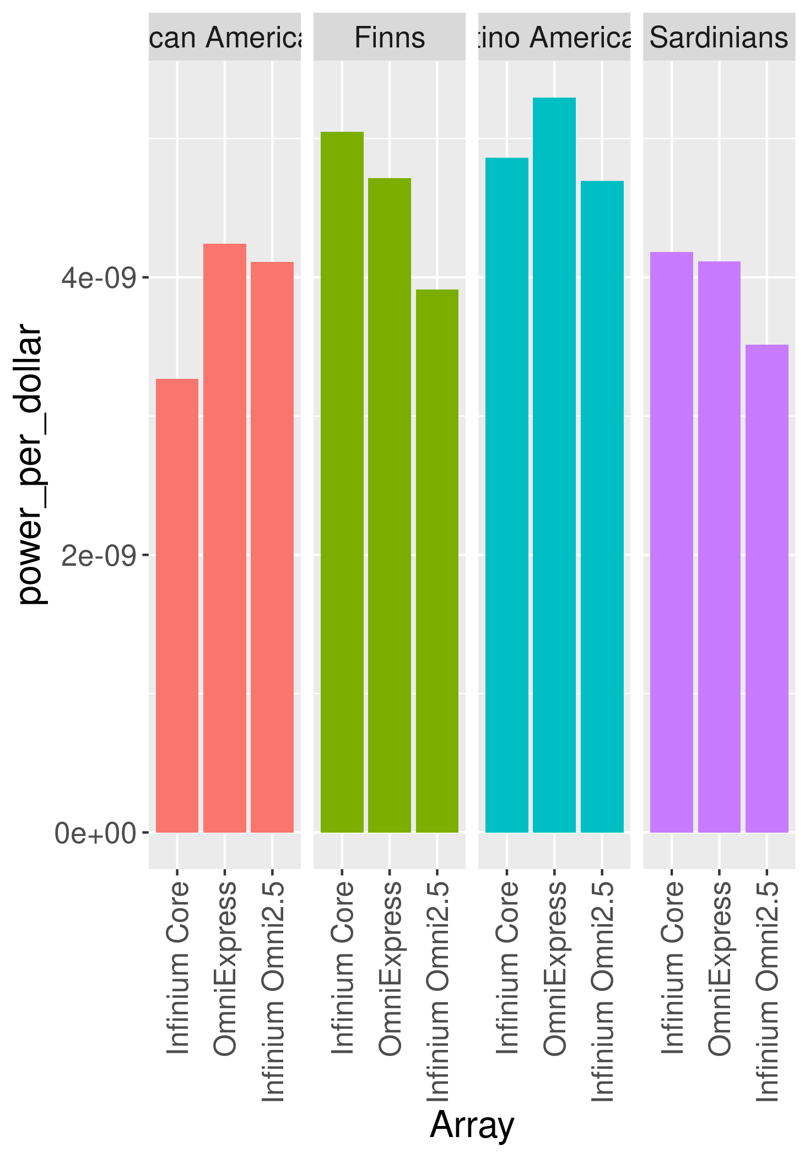
n_{sequenced} = 1000
n_{imputed} = 5000
https://github.com/richelbilderbeek/APSIS/blob/master/run.R

Slide 30
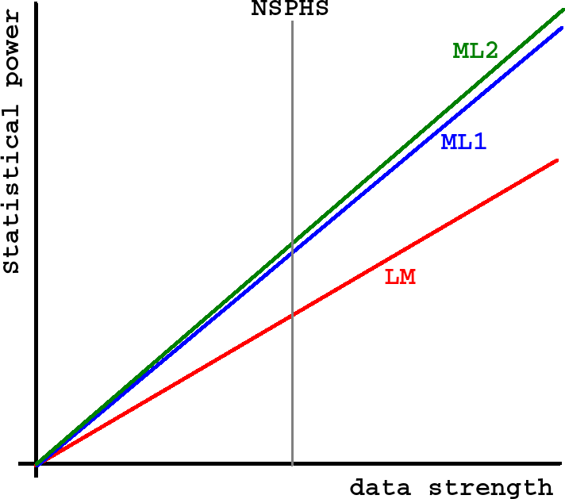

Slide 31
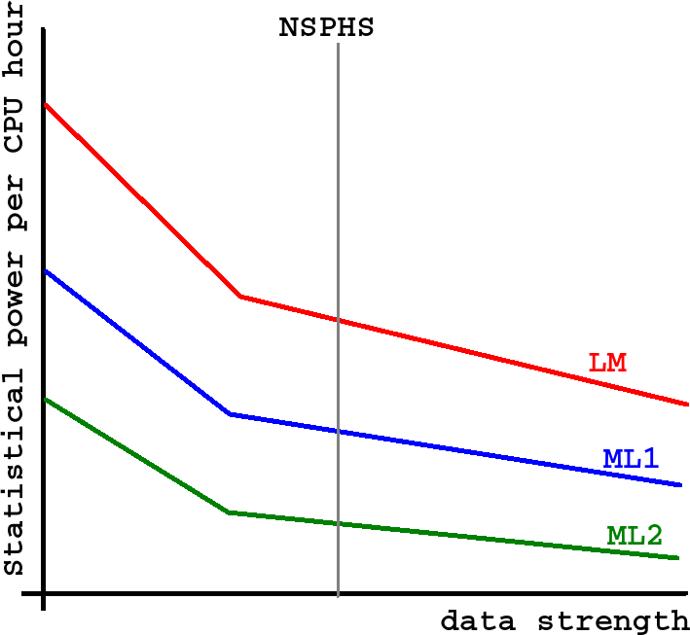

Slide 32
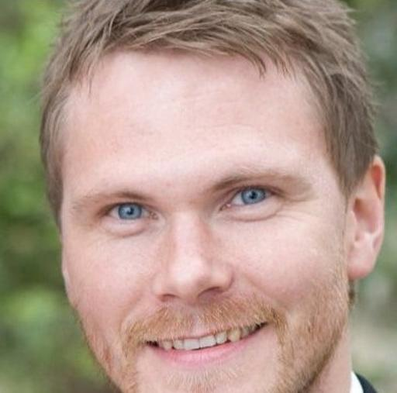
People

Slide 33
Questions?
Richèl Bilderbeek
richel@richelbilderbeek.nl
https://github.com/richelbilderbeek/
igp_presentation_20210511

