Slide 1
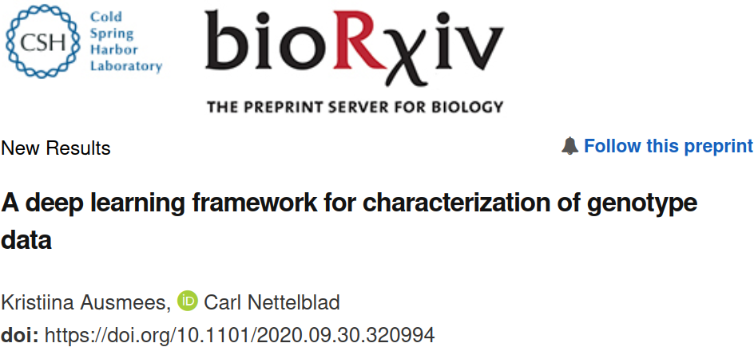
Journal Club
https://github.com/richelbilderbeek/journal_club_20220120

Slide 2
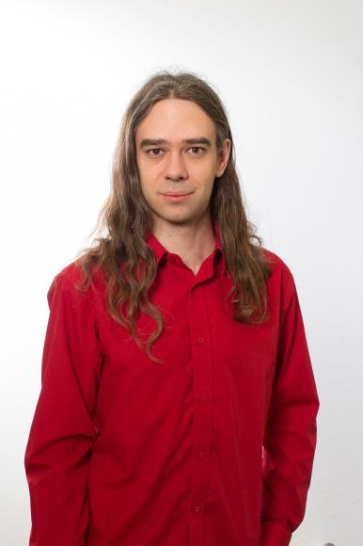
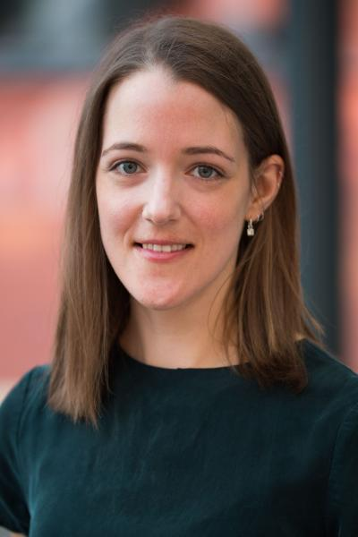
Why this article
Google ‘GWAS + “machine learning”’ for 2021
Start of collaboration
Carl Nettelblad
Kristiina Ausmees

Slide 3
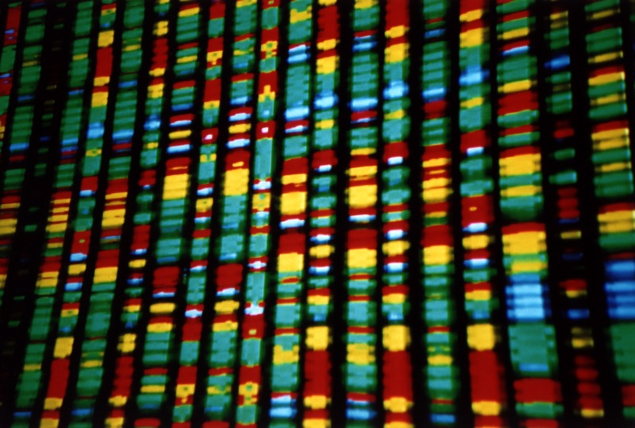
Background
Can we order genomes?
  Similar genomes close
Because then we can ...
  See amount of genetic variation
  Identify population structure
  Do ancestry mapping
  Simulate genotypes
https://upload.wikimedia.org/wikipedia/commons/b/bc/DNA_representation.jpg

Slide 4
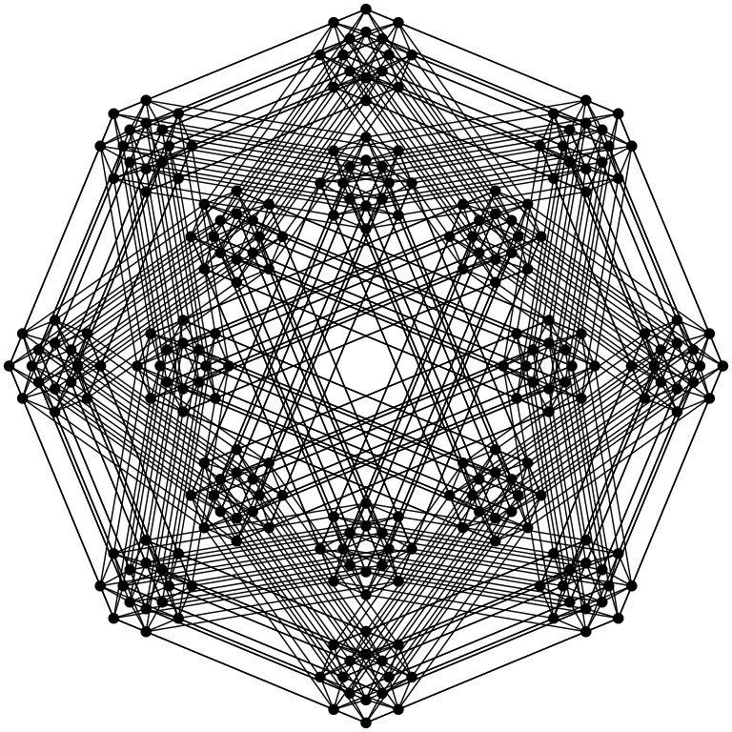
It is easy to order genomes
3 billion base pairs
A | A | A | A
(1, 1, 1, 1, ...)
A | A | A | T
(1, 1, 1, 4, ...)
A | C | G | T
(1, 2, 3, 4, ...)
https://commons.wikimedia.org/wiki/File:Octeract_graph.svg

Slide 5
Background
Can we order genomes in a smart way?
  Similar genomes close
Because then we can ...
  See amount of genetic variation
  Identify population structure
  Do ancestry mapping
  Simulate genotypes
Dimensionality
reduction
https://upload.wikimedia.org/wikipedia/commons/b/bc/DNA_representation.jpg

Slide 6
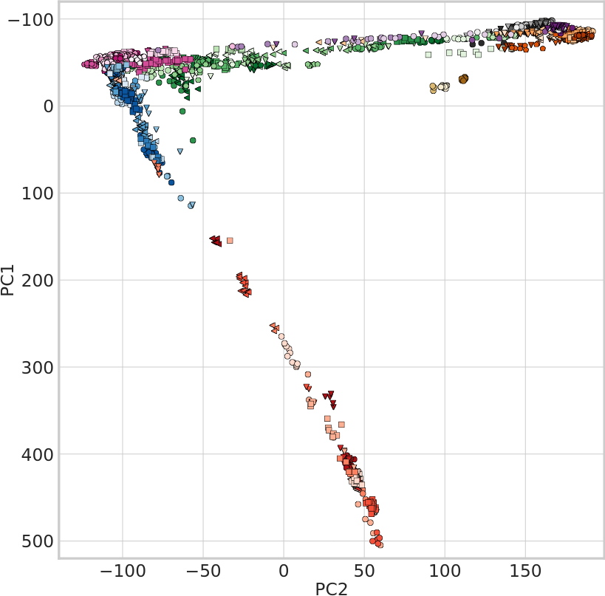
Problem
PCA reduces dimensionality linearily
Typical V shape
Overlap in first 2 dimensions
Ausmees, Kristiina, and Carl Nettelblad. "A deep learning framework for characterization of genotype data." bioRxiv (2020).

Slide 7
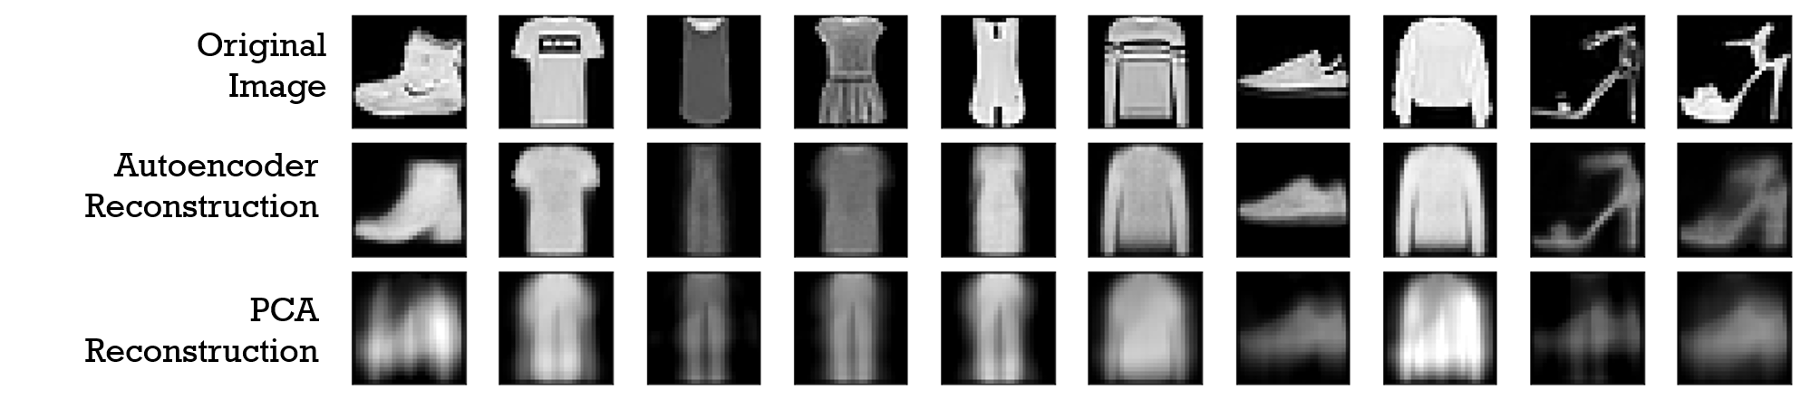
Hypothesis
Convolutional autoencoders seem promising
  Can work with noisy data as well
https://commons.wikimedia.org/wiki/File:Reconstruction_autoencoders_vs_PCA.png

Slide 8
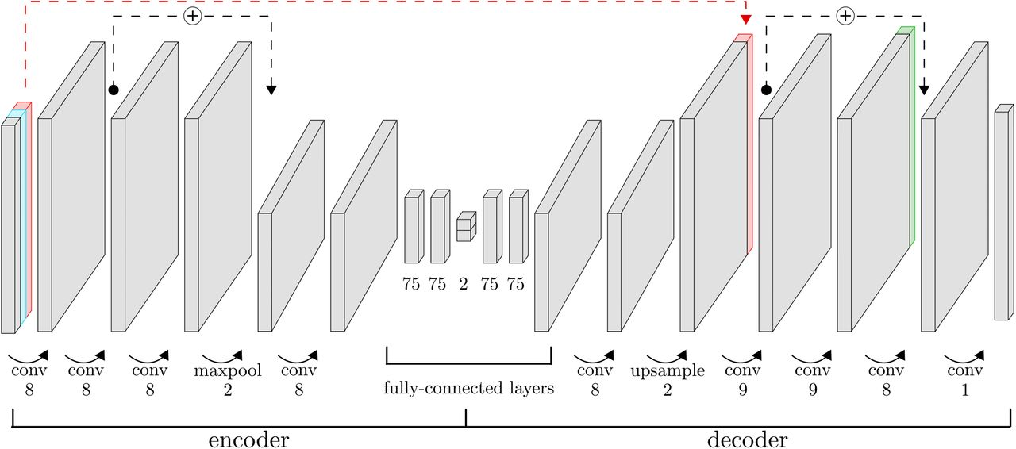
Method
NEW
Neural networks
Set up a convolutional autoencoder
See how well it performs
Auto
encoders
Auto
encoders
Convolutional
Ausmees, Kristiina, and Carl Nettelblad. "A deep learning framework for characterization of genotype data." bioRxiv (2020).

Slide 9
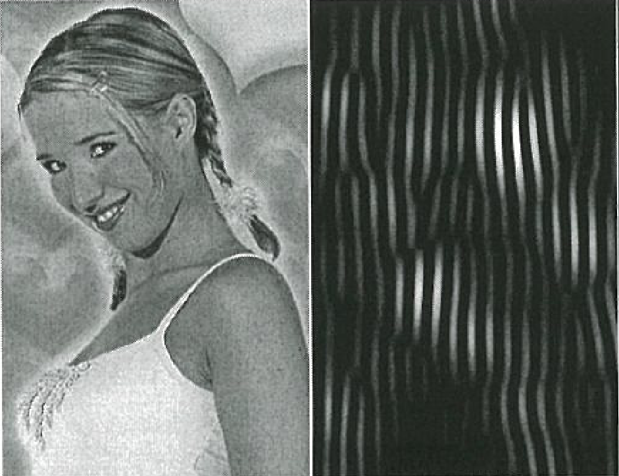
What is a convolutional autoencoder?
Convolutional: preprocess the data, i.e. do not only use the raw data
Autoencoder: type of neural network that learns how to encode data
Neural networks
Auto
encoders
Auto
encoders
Convolutional
https://github.com/richelbilderbeek/
the_bochum_project

Slide 10
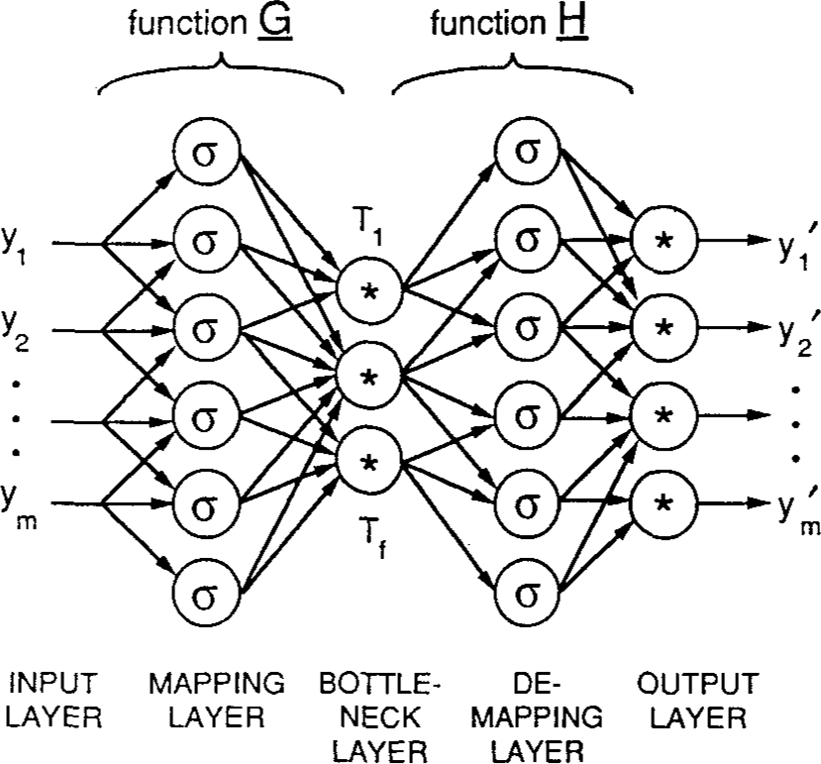
What is an autoencoder?
Bottleneck layer
Input
Latent
space
Output
Encoding layers
Decoding layers
Y = { y₁, y₂, … }
Y’ = { y’₁, y’₂, … }
Loss function = E = Y - Y’
Goal: learn to represent/label data, nonlinearily
Kramer, Mark A. "Nonlinear principal component analysis using autoassociative neural networks." AIChE journal 37.2 (1991): 233-243.

Slide 11
GCAE
More in research
presentations
Ausmees, Kristiina, and Carl Nettelblad. "A deep learning framework for characterization of genotype data." bioRxiv (2020).

Slide 12
Article
How well does GCAE perform?
  genotype separation
  deduce genotype origin
  rare and common alleles
  LD

Slide 13
Separating genotypes
?
Affymetrix Human Origins SNP array
2,067 unrelated humans from 166 populations
No sex chromosomes
Remove MAF < 1%
LD pruning, remove R² > 0.2
160,858 biallelic sites
Show genotypes in first 2 PCs
Ausmees, Kristiina, and Carl Nettelblad. "A deep learning framework for characterization of genotype data." bioRxiv (2020).

Slide 14
PCA dimensionality reduction
Ausmees, Kristiina, and Carl Nettelblad. "A deep learning framework for characterization of genotype data." bioRxiv (2020).

Slide 15
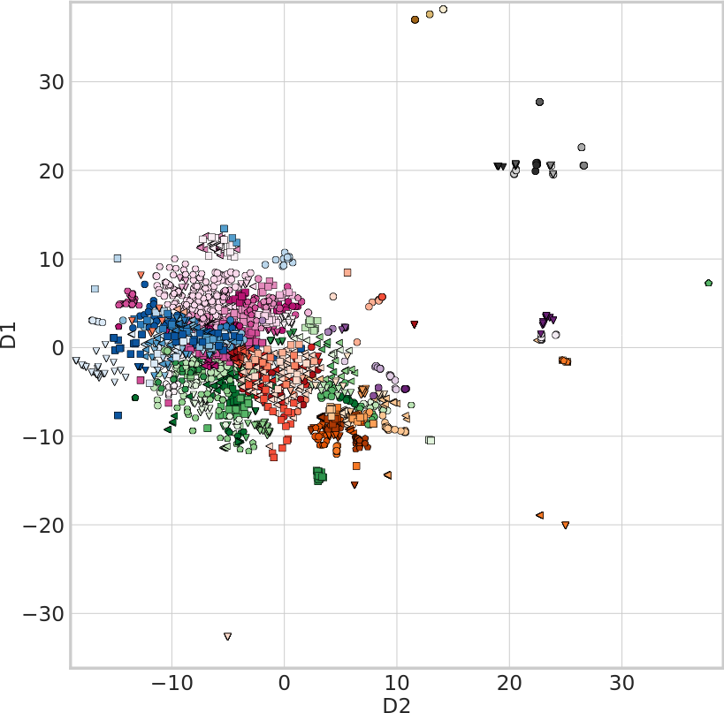
t-SNE dimensionality reduction
Ausmees, Kristiina, and Carl Nettelblad. "A deep learning framework for characterization of genotype data." bioRxiv (2020).

Slide 16
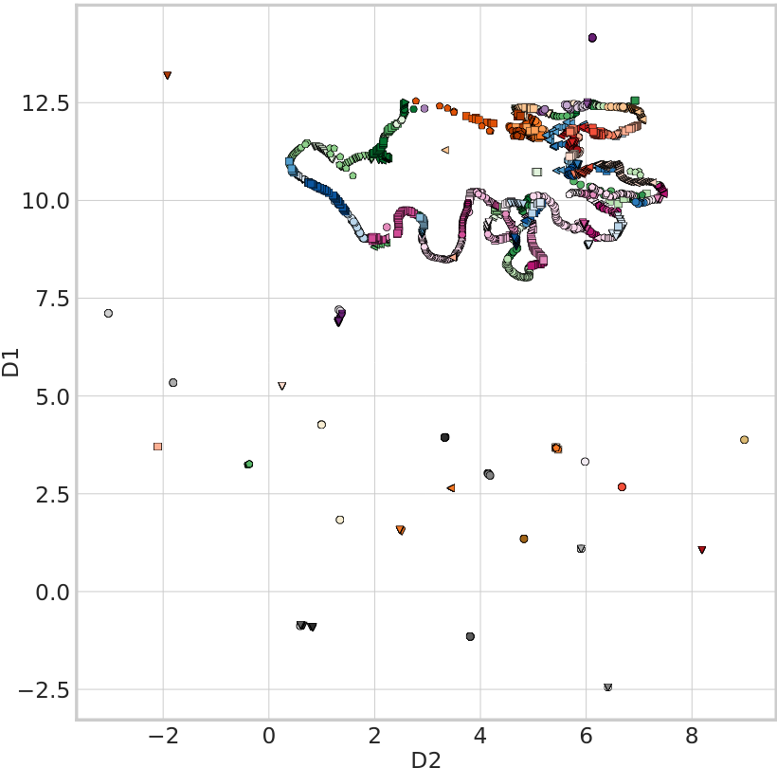
UMAP dimensionality reduction
Ausmees, Kristiina, and Carl Nettelblad. "A deep learning framework for characterization of genotype data." bioRxiv (2020).

Slide 17
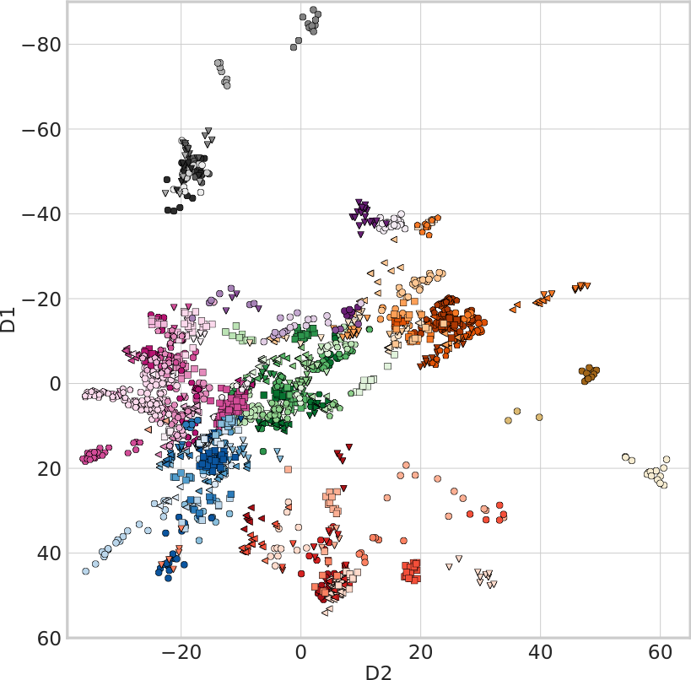
GCAE dimensionality reduction
Ausmees, Kristiina, and Carl Nettelblad. "A deep learning framework for characterization of genotype data." bioRxiv (2020).

Slide 18
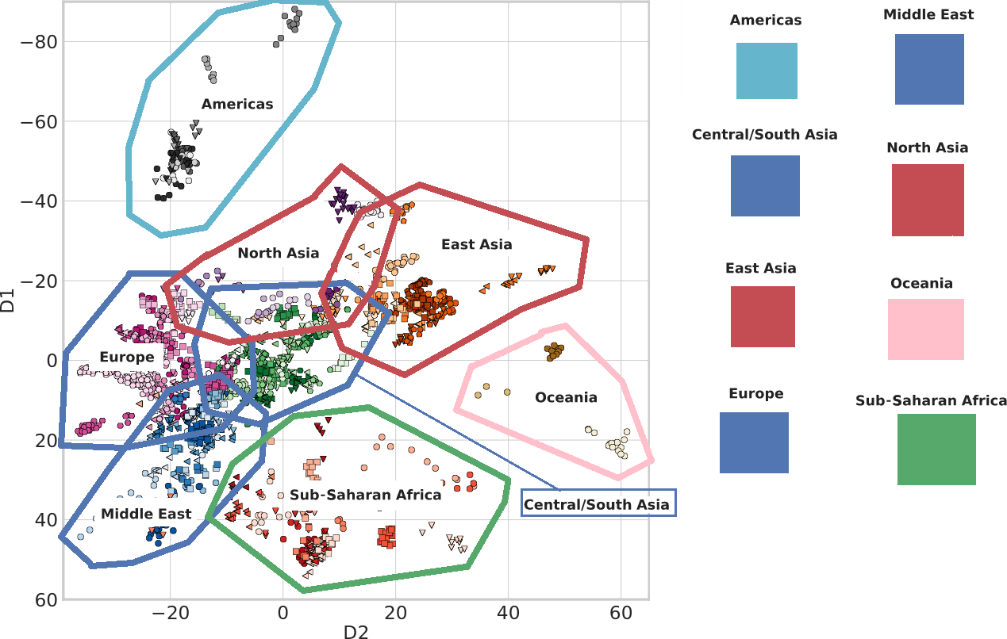
GCAE dimensionality reduction
Ausmees, Kristiina, and Carl Nettelblad. "A deep learning framework for characterization of genotype data." bioRxiv (2020). Adapted by Richel Bilderbeek

Slide 19
Questions
How well can genotypes be separated by eye?
How well can we deduce the origin of a genotype?
  Clustering similar to ADMIXTURE
  F1 scrore
Other measurements

Slide 20
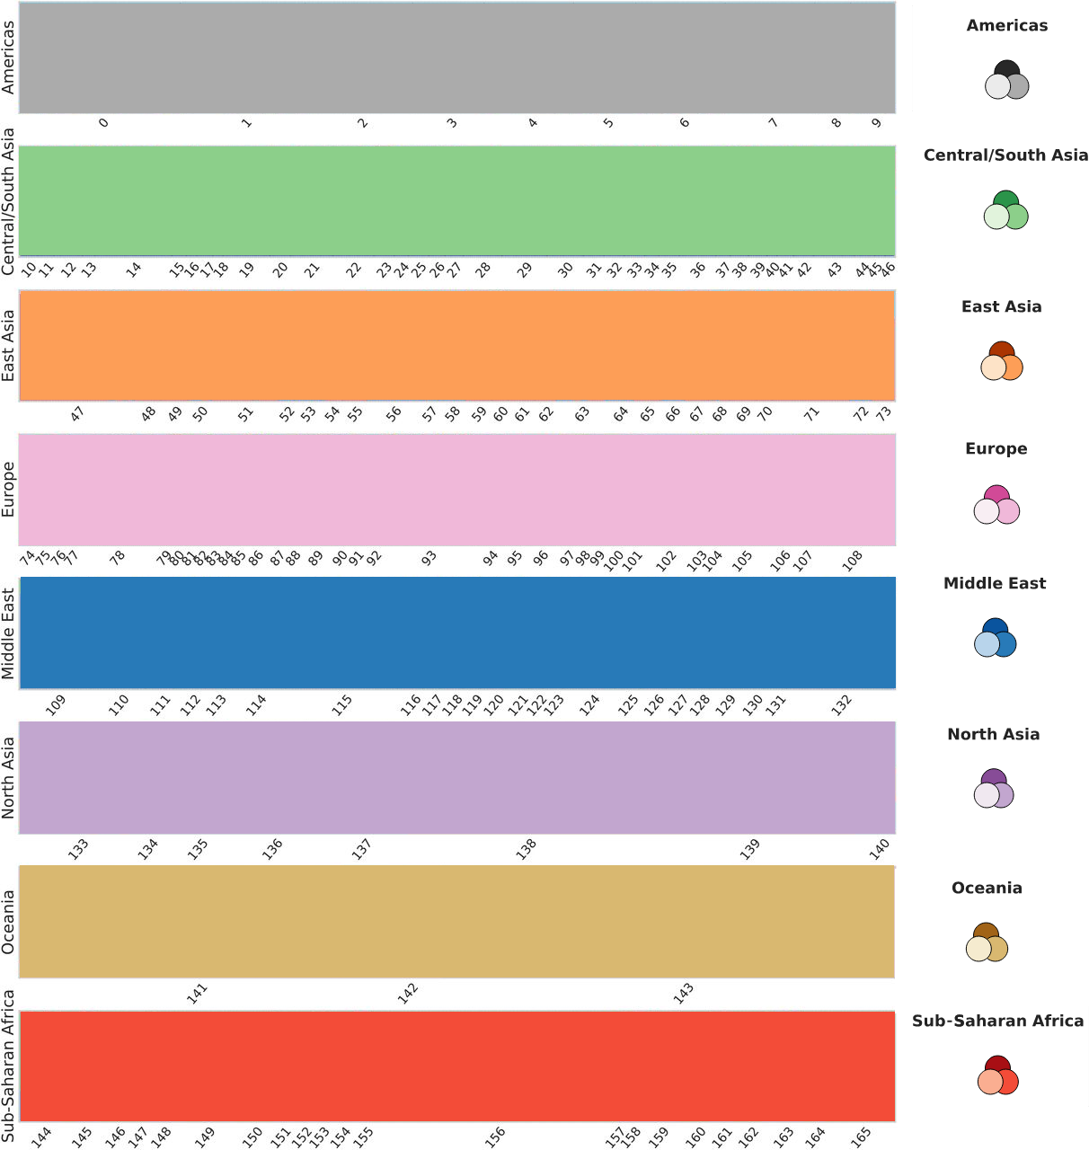
How well can we deduce the origin of a genotype?
Go through all individuals (x axis)
Assign the likelihood it belong to a subcontinent (the rows)
Ideally, all individuals are assigned their correct subcontinent

Slide 21
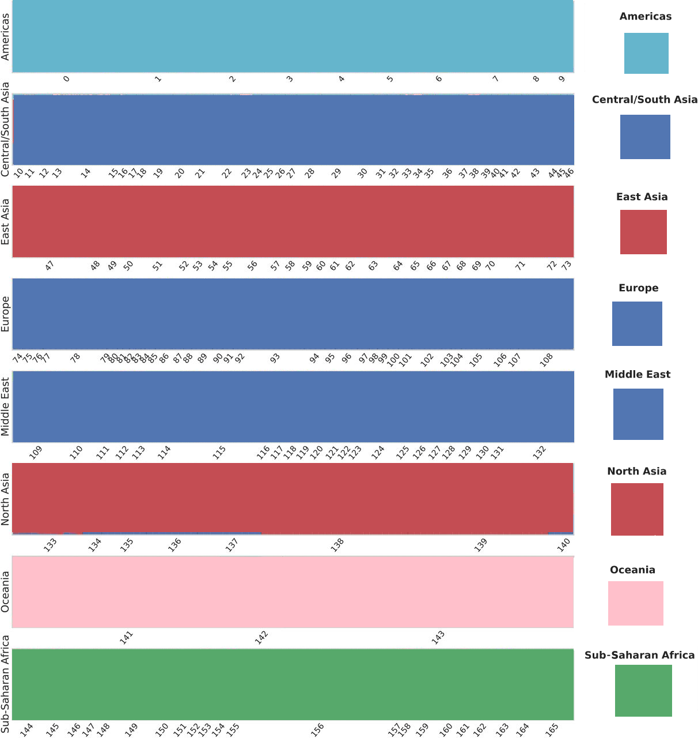
How well can we deduce the origin of a genotype?
Go through all individuals (x axis)
Assign the likelihood it belong to a subcontinent (the rows)
Ideally, all individuals are assigned their correct subcontinent
Use five clusters

Slide 22
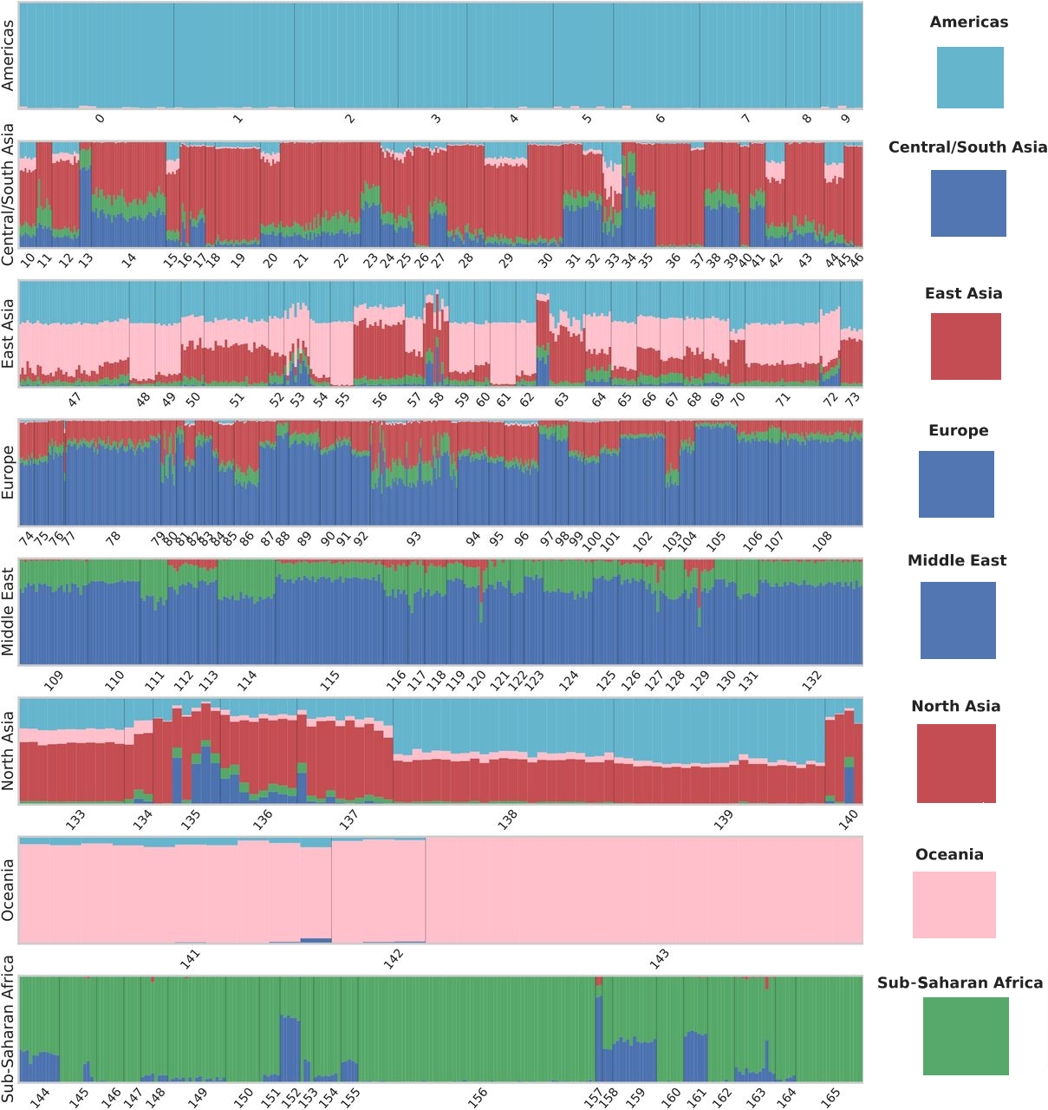
GCAE: ADMIXTURE ↔ plot

Slide 23
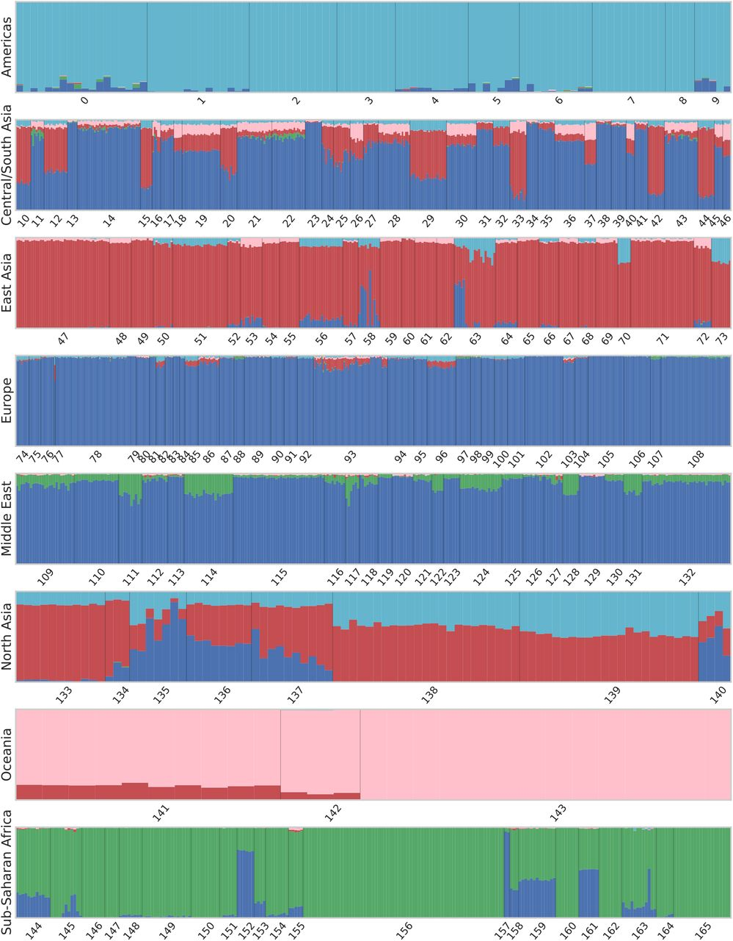
PCA: ADMIXTURE

Slide 24
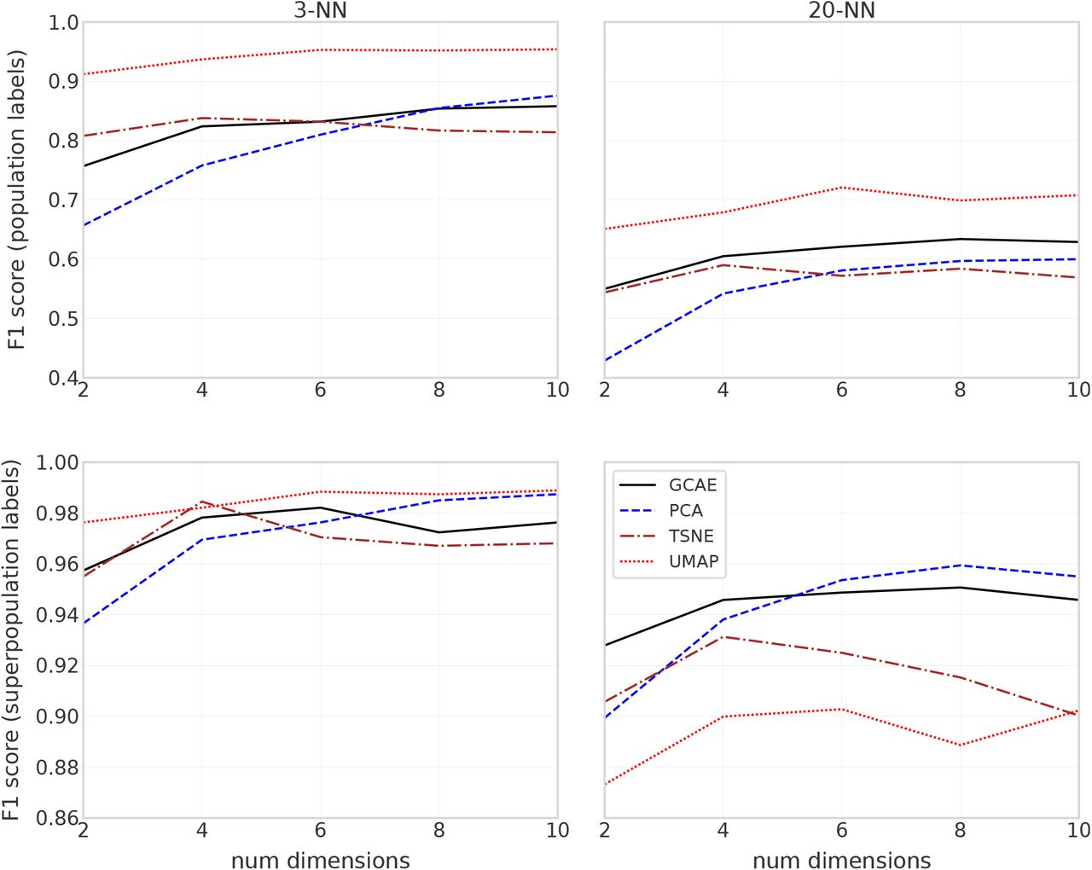
Figure 4
Ausmees, Kristiina, and Carl Nettelblad. "A deep learning framework for characterization of genotype data." bioRxiv (2020).

Slide 25
F1 scores
Number of nearest neighbors
2. hyperparameter,
too low = overfitting
On population or
subpopulation labels
How well
do the models
classify samples
to the correct
sub/population?
1. performance
score,
higher is better
3. hyperparameter,
too high = overfitting
Number dimensions of latent space
Ausmees, Kristiina, and Carl Nettelblad. "A deep learning framework for characterization of genotype data." bioRxiv (2020). Adapted by Rcihel Bilderbeek
Figure 4

Slide 26
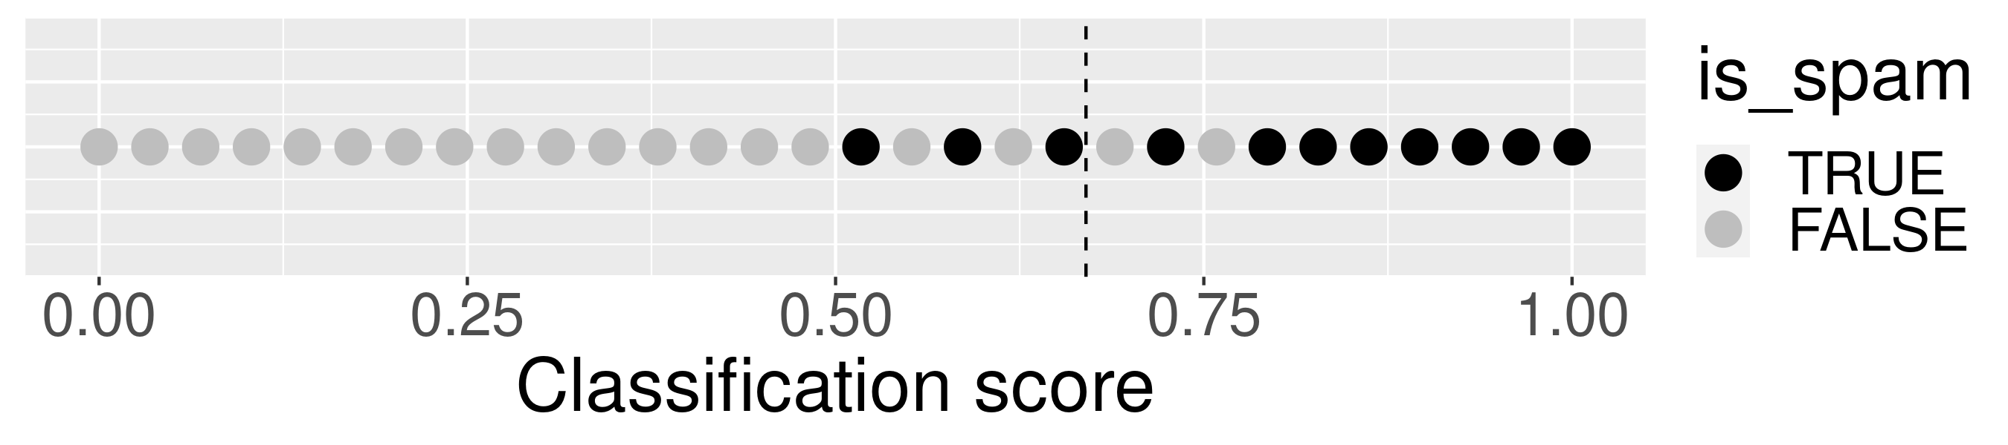
What is the F1 score?
A metric for the trade-off between precision and recall →
https://developers.google.com/machine-learning/crash-course/classification/precision-and-recall
https://github.com/richelbilderbeek/journal_club_20211216/f1_score.R

Slide 27
What is precision?
Precision:
  how often is the classifier right?
  the number of true positives of all estimated positives
precision
  = n_{tp} / (n_{tp} + n_{fp})
  = 8 / (8 + 2) = 8/10
where
  n_{tp} = # of true positives
  n_{fp} = # of false positives
https://github.com/richelbilderbeek/journal_club_20211216/f1_score.R

Slide 28
What is recall?
Recall:
  how often are the positive cases recognized as such?
  the number of true positives of all known positives
recall
  = n_{tp} / (n_{tp} + n_{fn})
  = 8 / (8 + 3) = 8/11
where
  n_{tp} = # of true positives
  n_{fn} = # of false negatives
https://github.com/richelbilderbeek/journal_club_20211216/f1_score.R

Slide 29
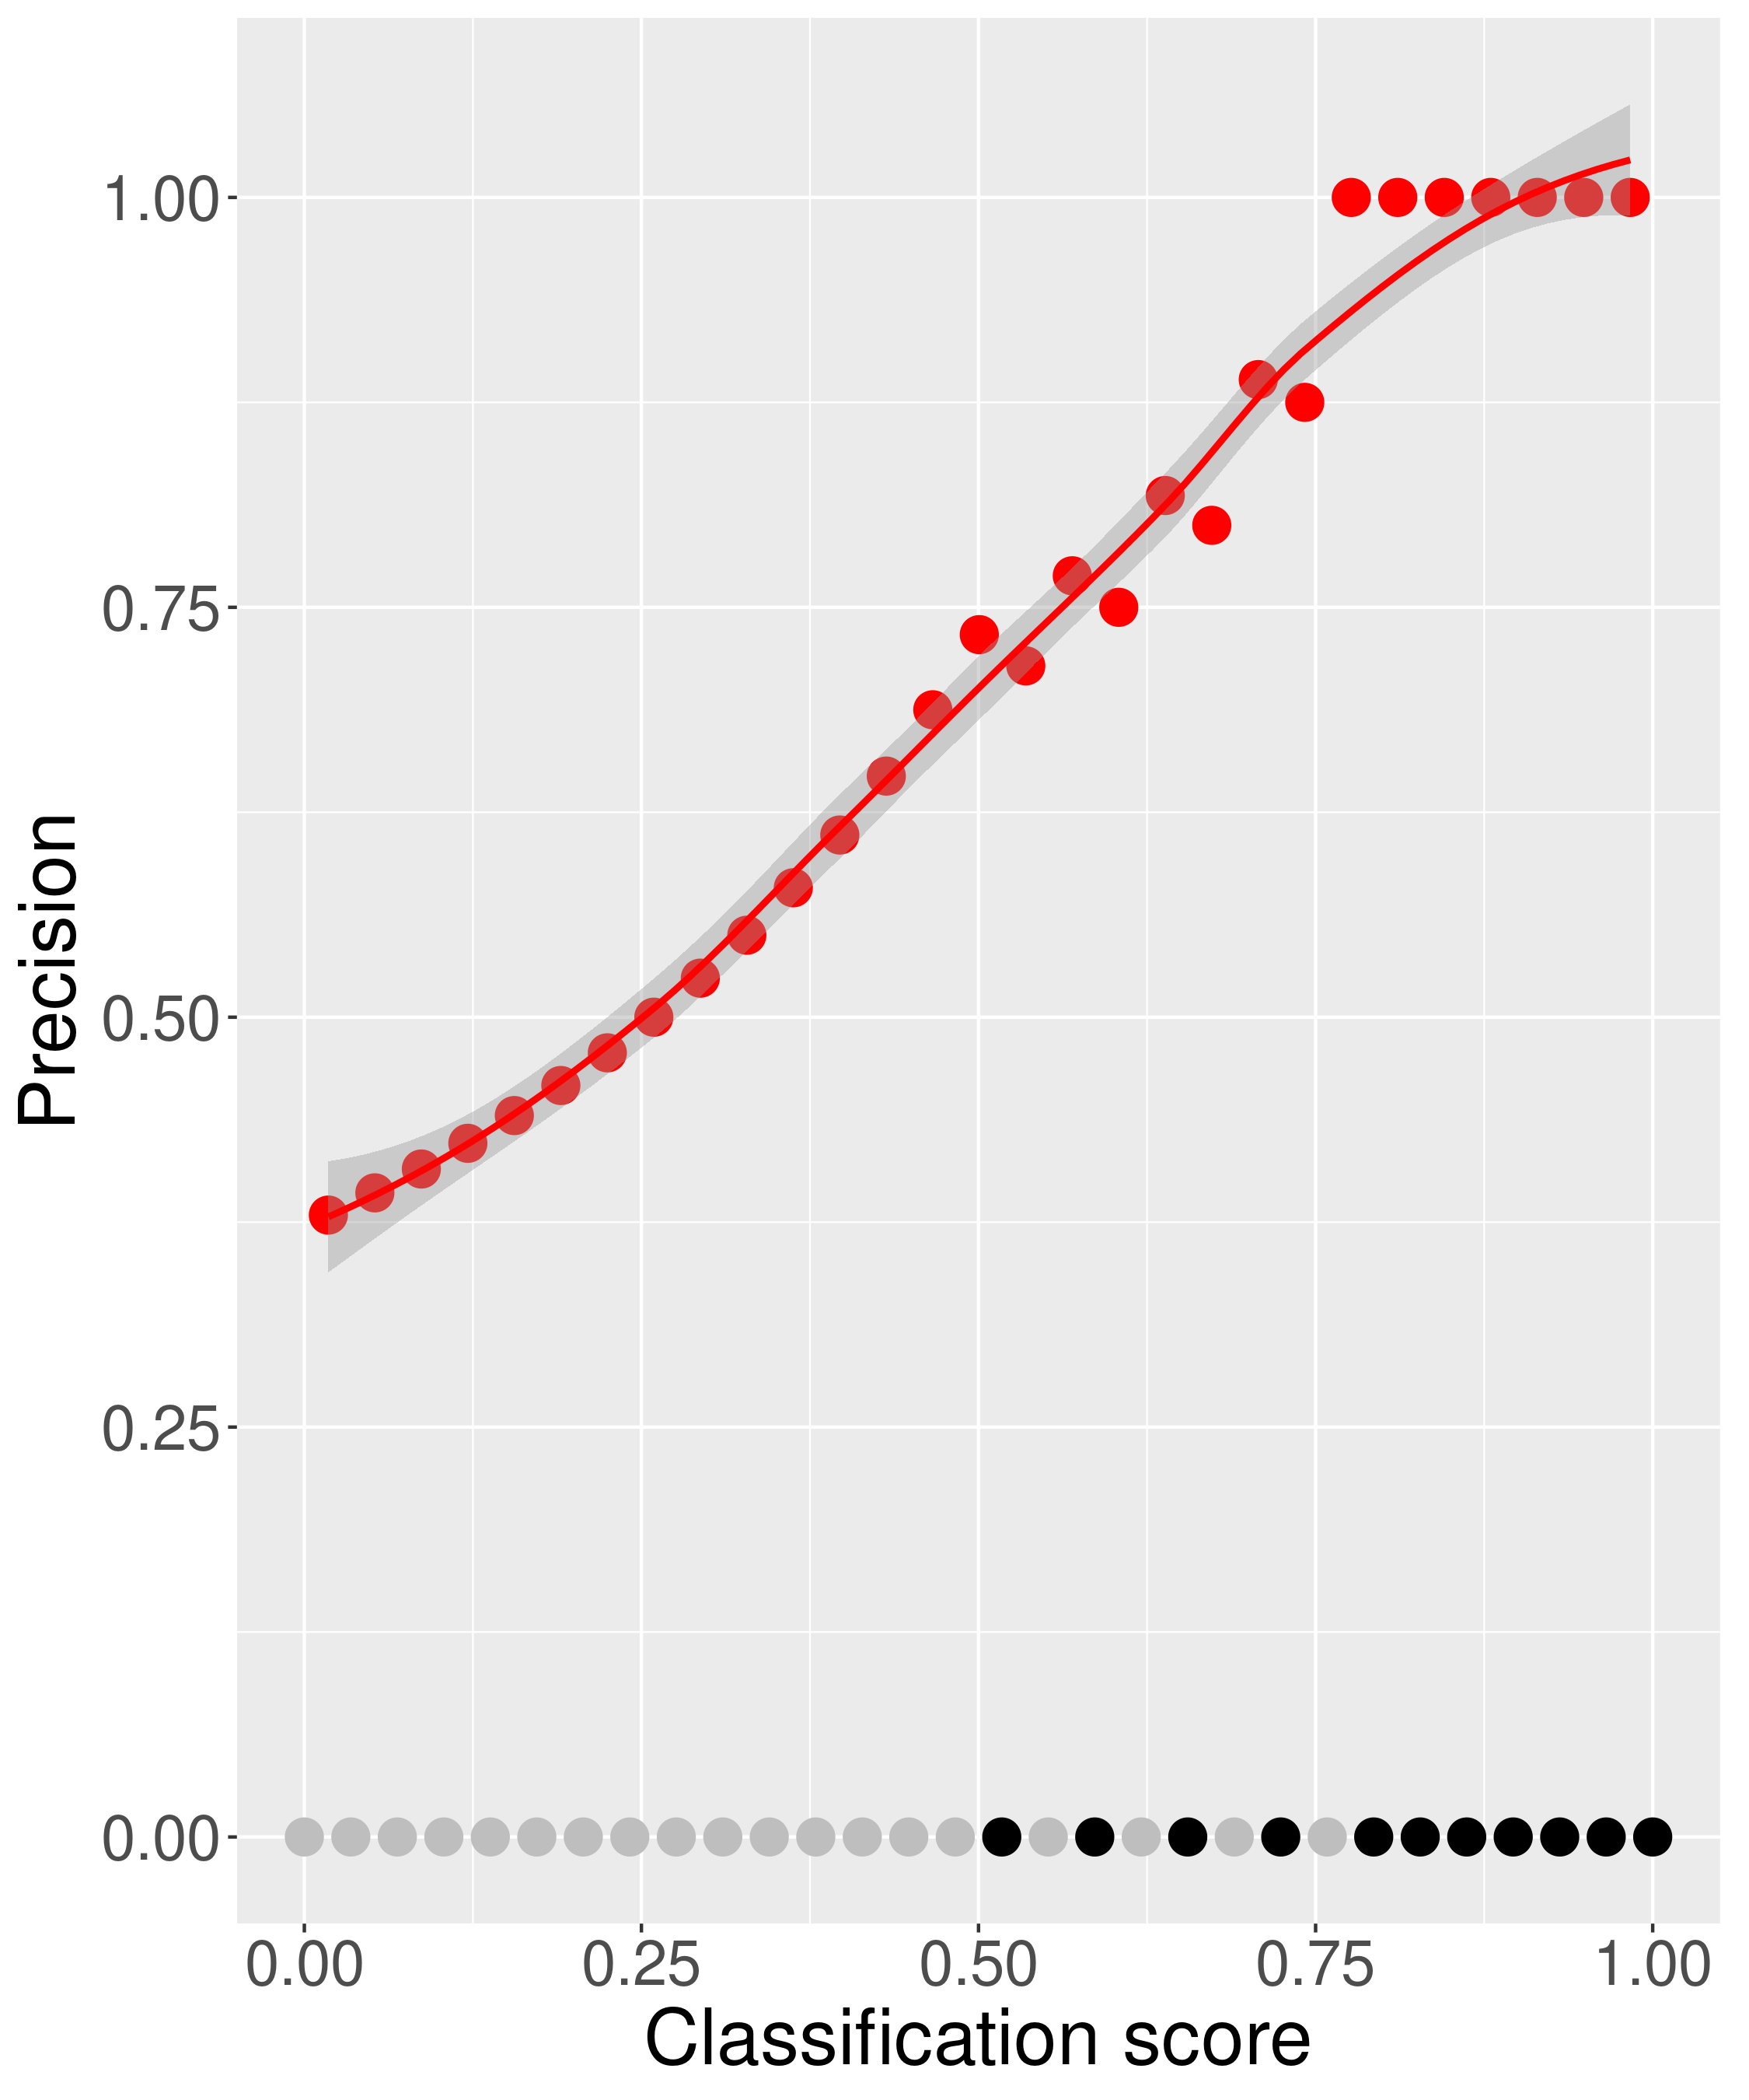
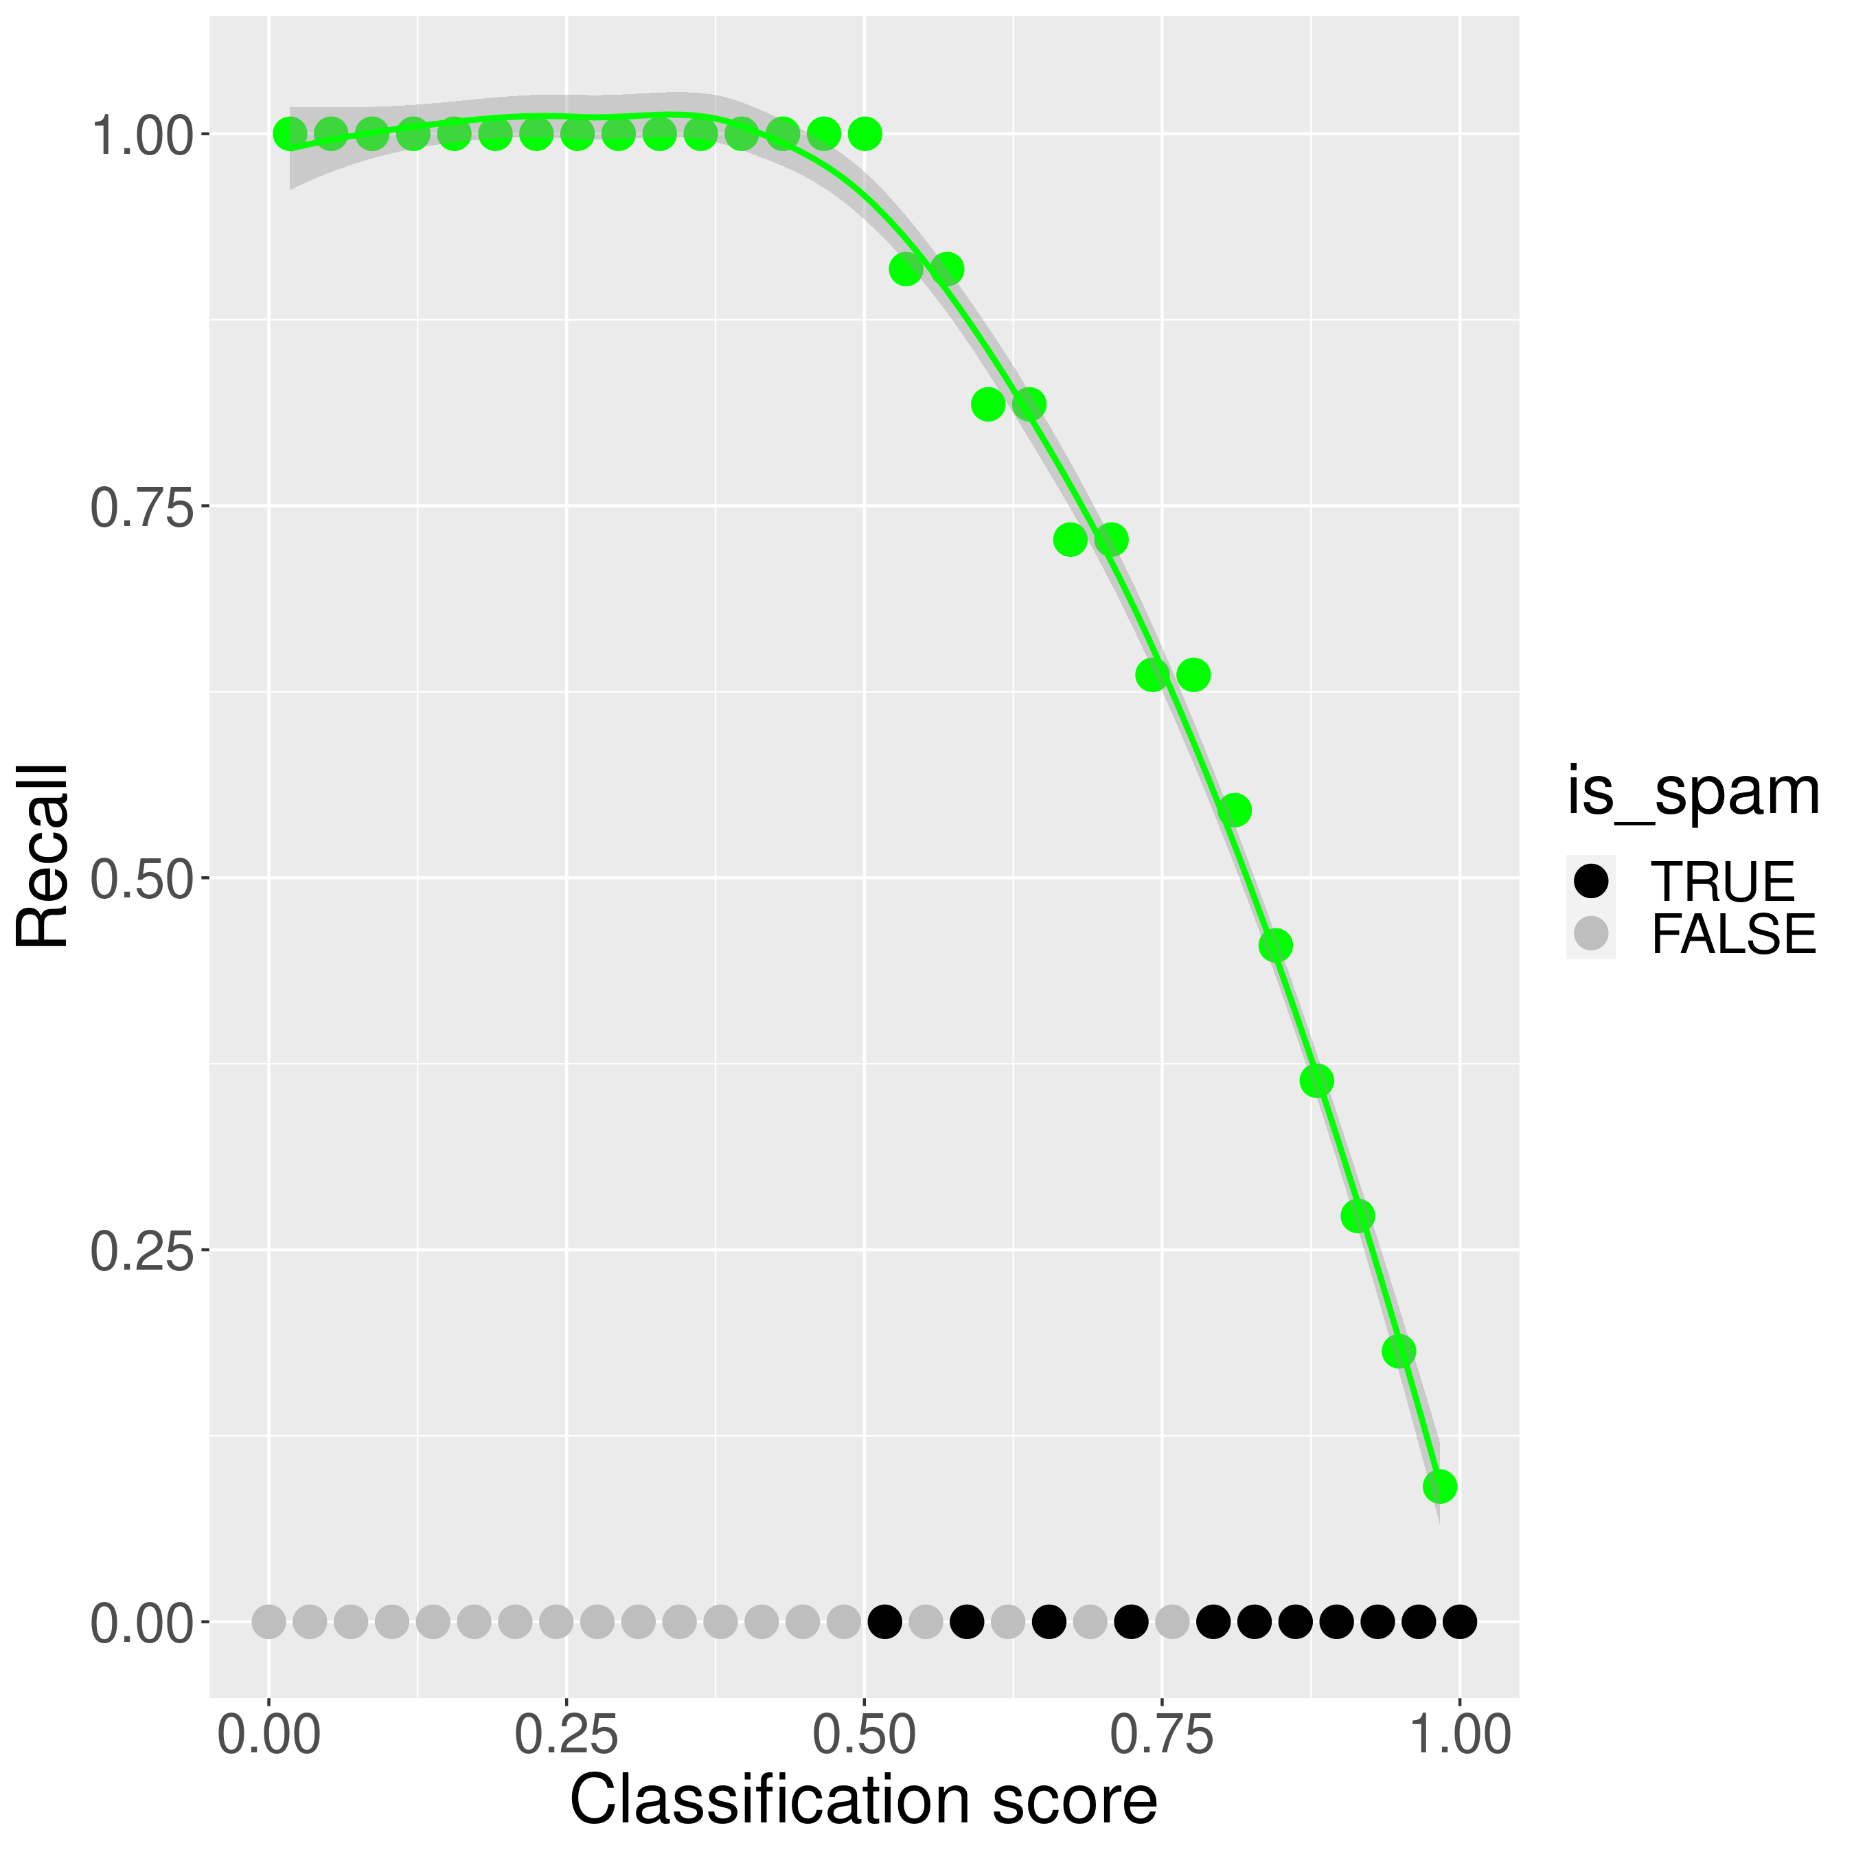
Trade-off between precision and recall
All emails
classified as spam
are spam
All emails
known to be spam
are classified
as spam
https://github.com/richelbilderbeek/journal_club_20211216/f1_score.R

Slide 30
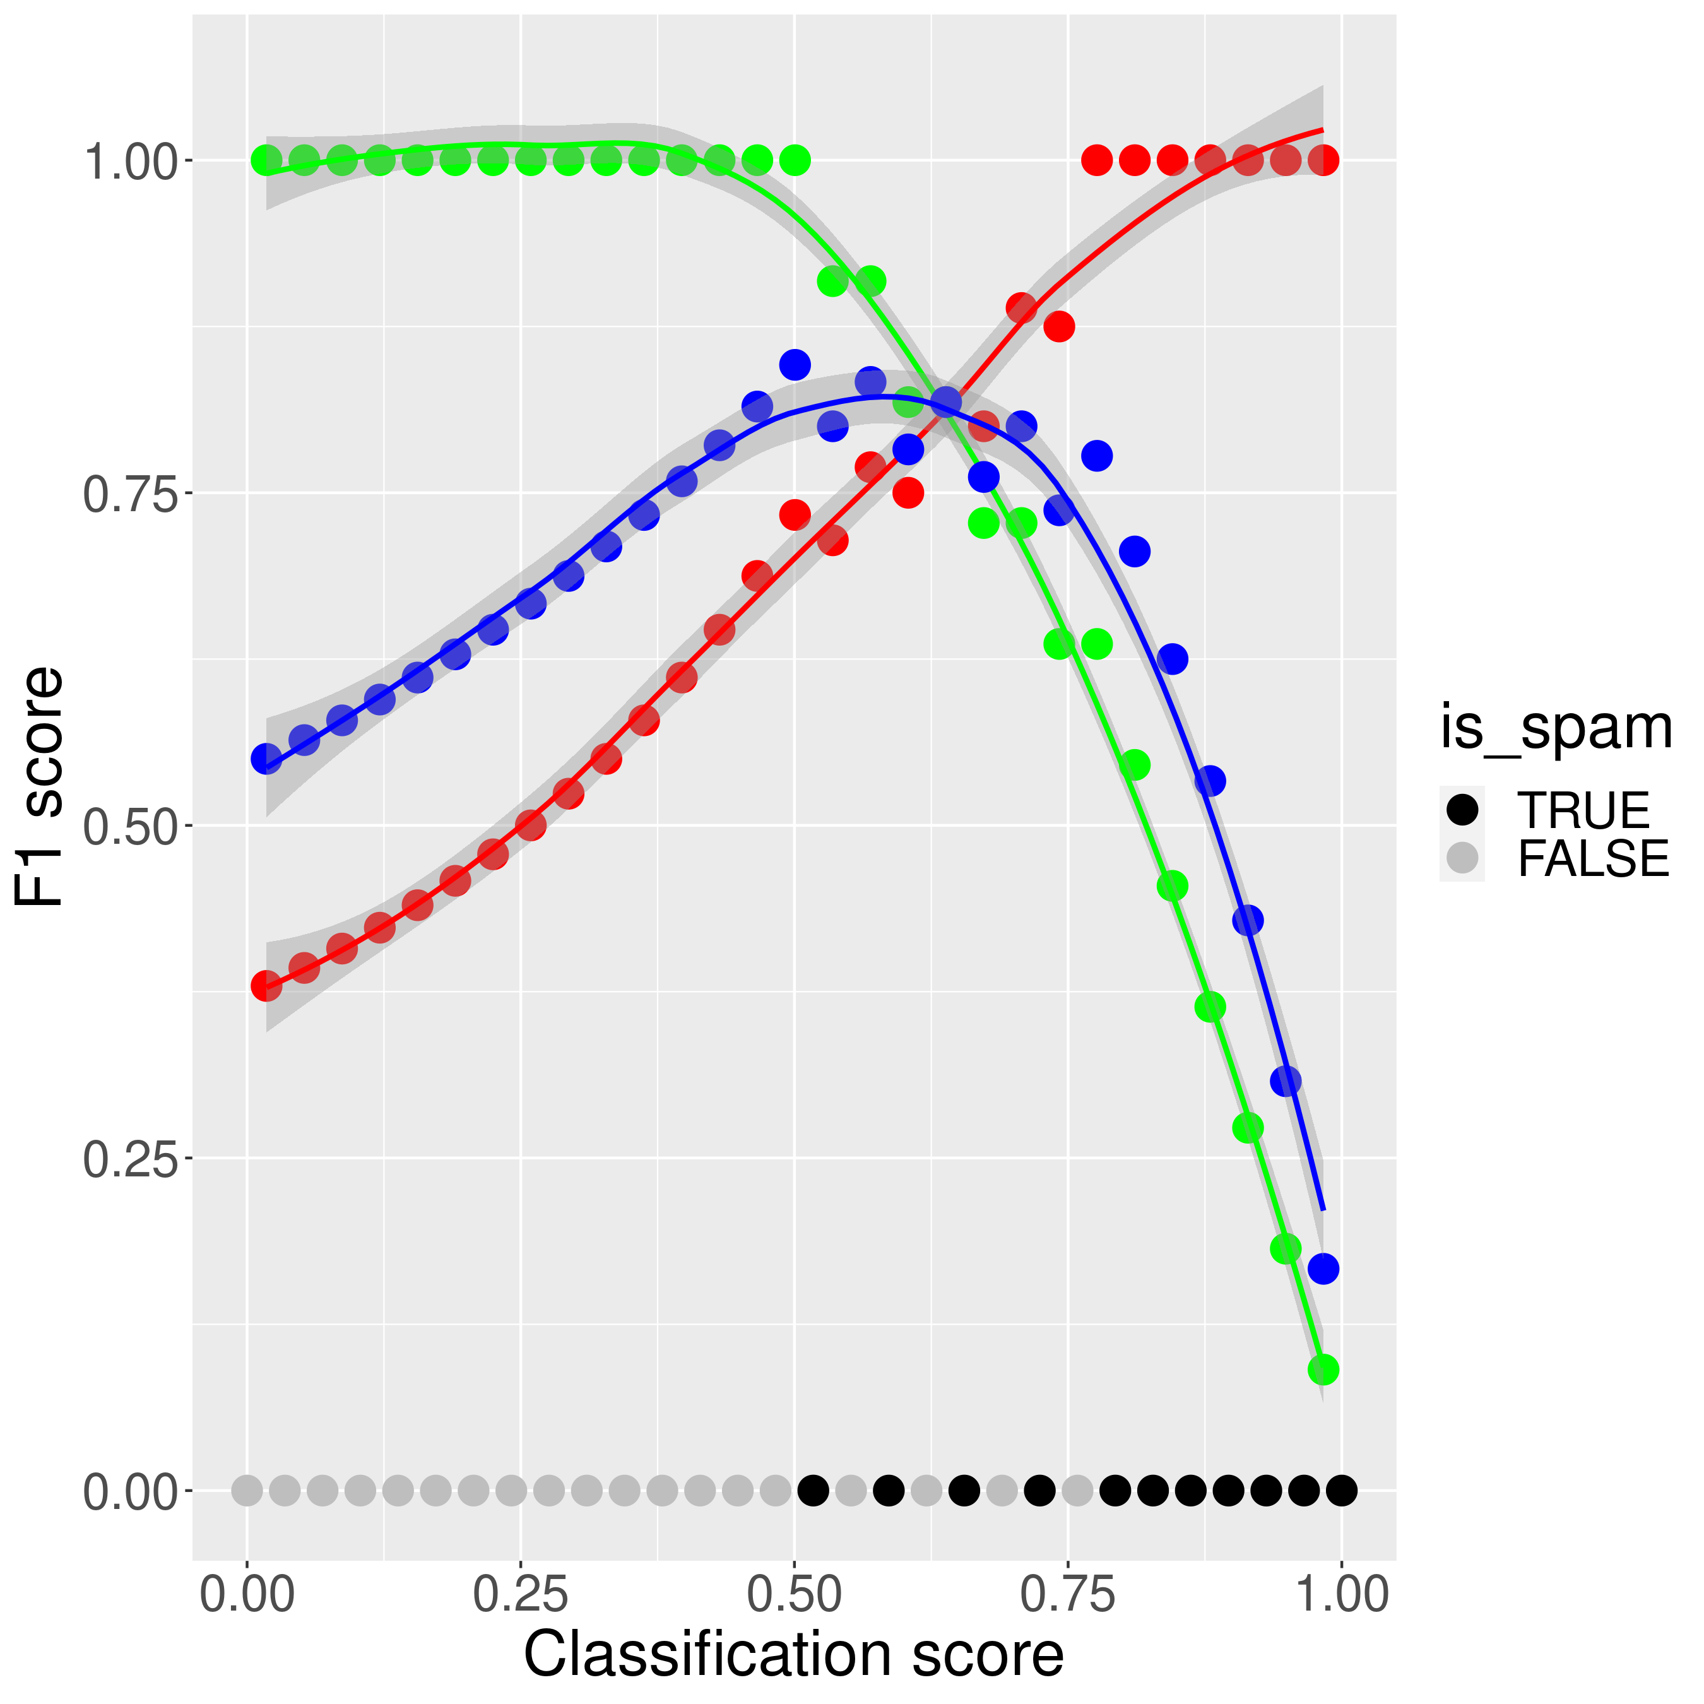
F1 Score
A metric for the trade-off between precision and recall:
  The harmonic mean of precision and recall
F₁
  = 2 / (precision⁻¹ + recall⁻¹)
  = n_{tp} / (n_{tp} + ½(n_{fp} + n_{fn}))
where
  n_{tp} = # of true positives
  n_{fp} = # of false positives
  n_{fn} = # of false negatives
https://github.com/richelbilderbeek/journal_club_20211216/f1_score.R

Slide 31
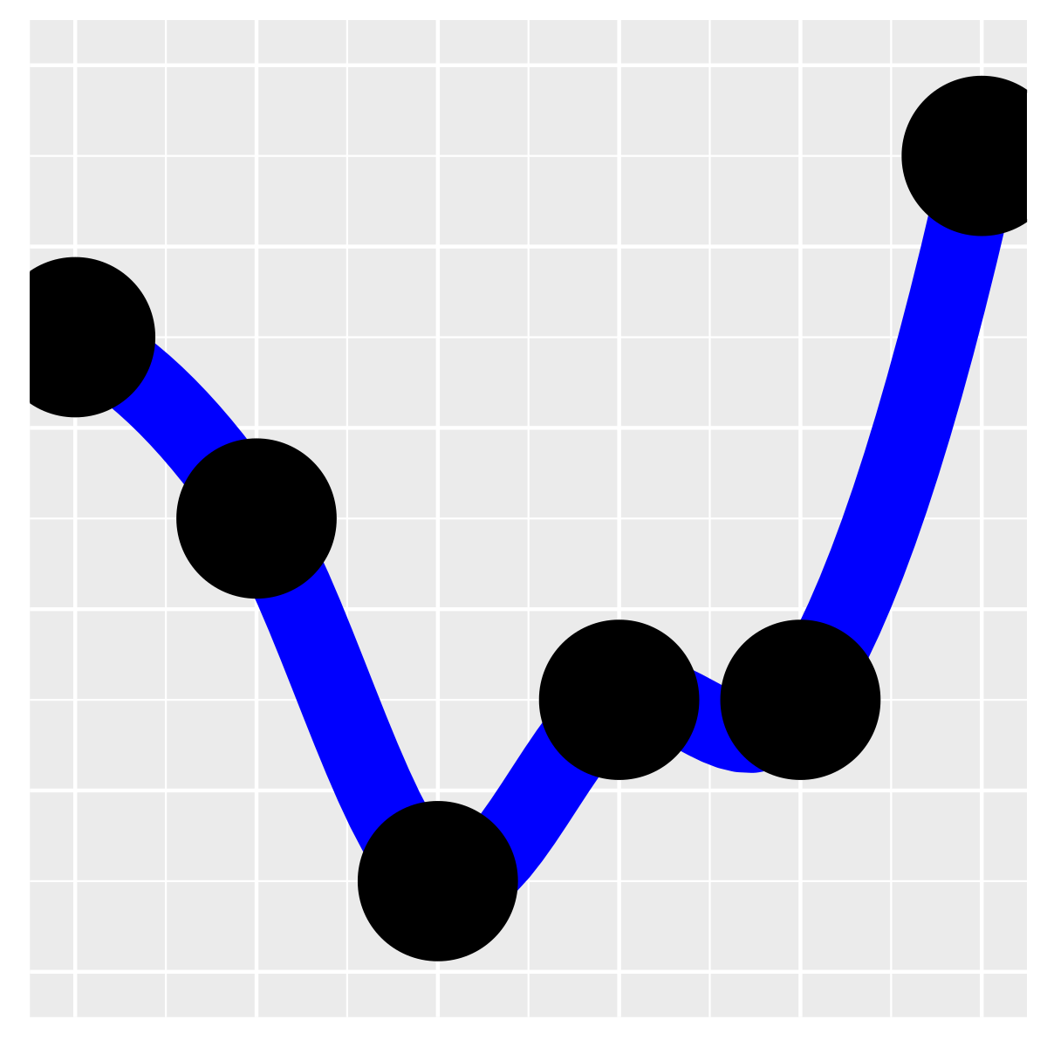
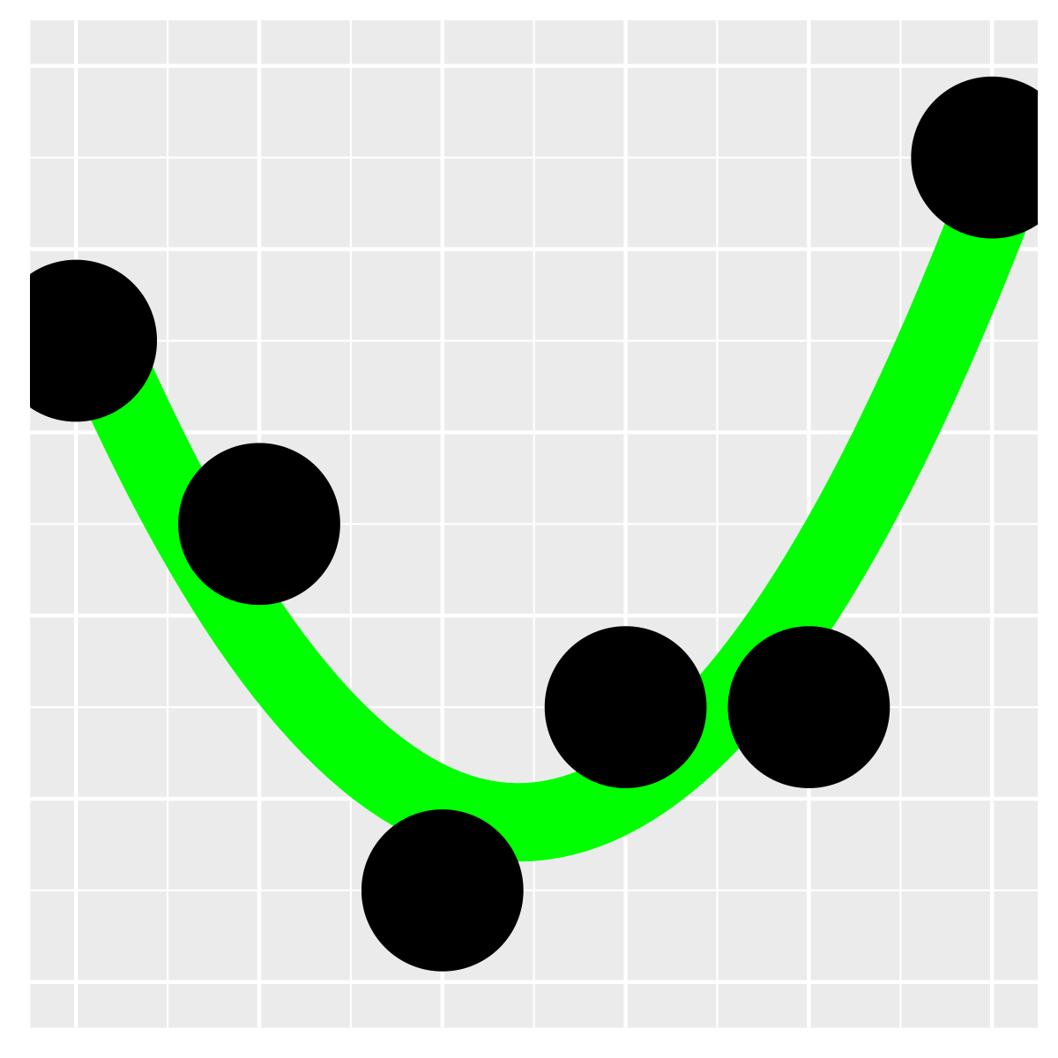
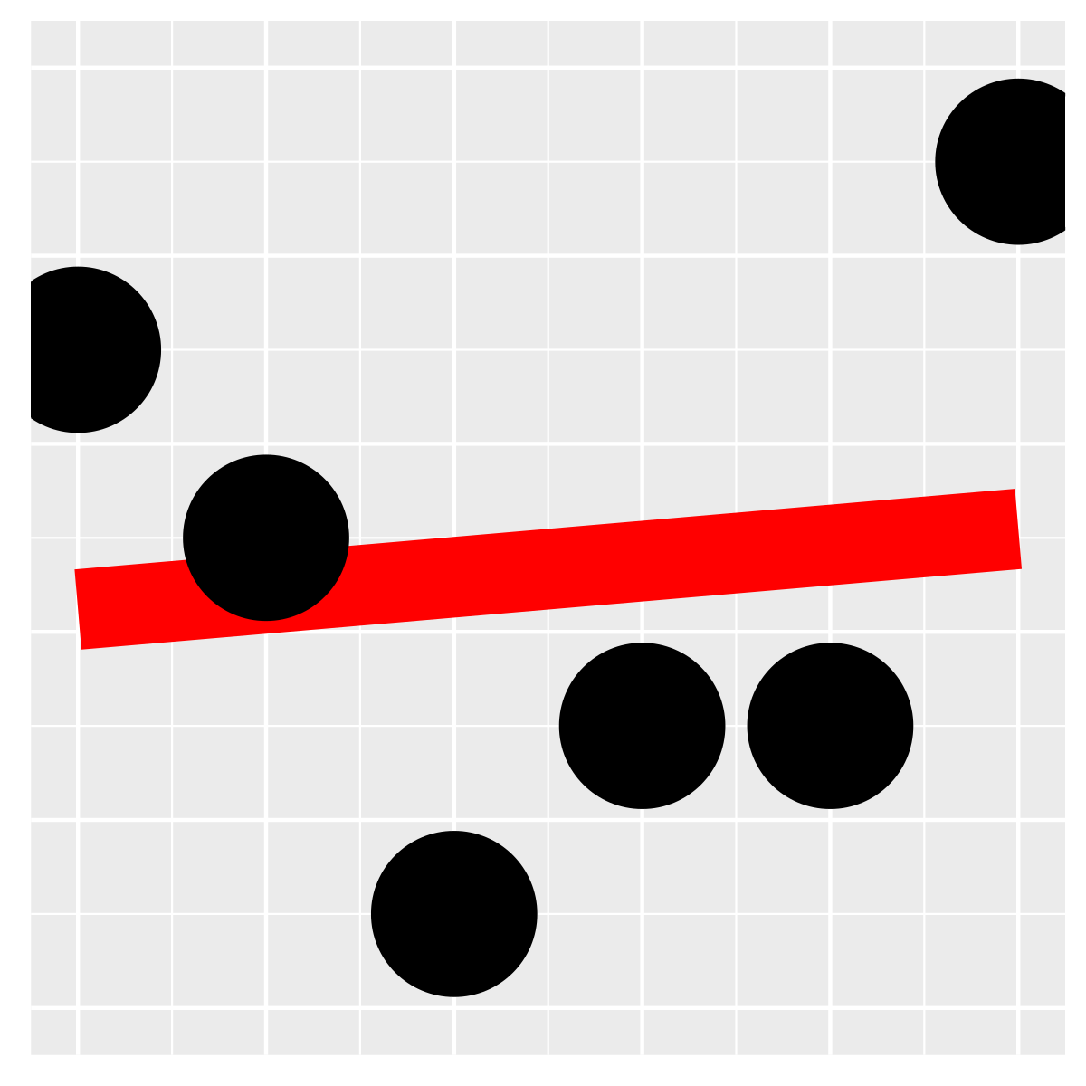
Figure 4
Number of nearest neighbors
2. hyperparameter
On population or
subpopulation labels
How well
do the models
classify samples
to the correct
sub/population?
1. performance
score,
higher is better
3. hyperparameter
Number dimensions of latent space
Ausmees, Kristiina, and Carl Nettelblad. "A deep learning framework for characterization of genotype data." bioRxiv (2020). Adapted by Richel Bilderbeek

Slide 32
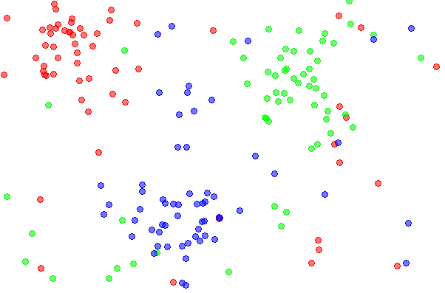
Number of nearest neighbors
https://en.wikipedia.org/wiki/File:Data3classes.png

Slide 33
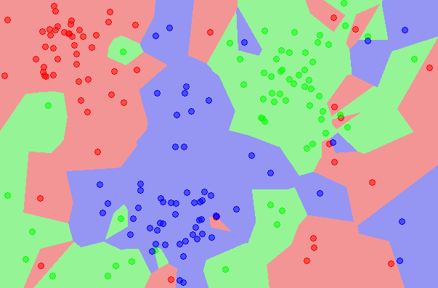
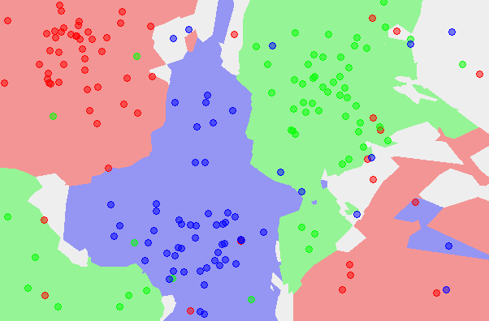
Number of neighbors
1 5
https://en.wikipedia.org/wiki/File:Map1NN.png
https://en.wikipedia.org/wiki/File:Map5NN.png

Slide 34

Optimal number for k?
Nontrivial to determine a priori
Possible to determine from data
  e.g. calculate the k with the lowest error
  problem: these may differ between different methods (i.e. PCA, GCAE)
  Prefer k being odd
√n
(√n)/2
166 populations → √n ≈ 13, (√n)/2 ≈ 6
8 superpopulations → √n ≈ 3, (√n)/2 ≈ 1
k = number of neighbors
n = the number of categories

Slide 35
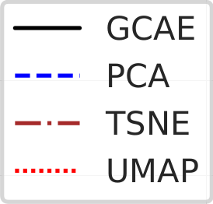
Figure 4a
num dimensions
Ausmees, Kristiina, and Carl Nettelblad. "A deep learning framework for characterization of genotype data." bioRxiv (2020).

Slide 36
Figure 4ab
num dimensions
num dimensions
Ausmees, Kristiina, and Carl Nettelblad. "A deep learning framework for characterization of genotype data." bioRxiv (2020).

Slide 37
Figure 4 revisited
Ausmees, Kristiina, and Carl Nettelblad. "A deep learning framework for characterization of genotype data." bioRxiv (2020).

Slide 38
Questions
How well can genotypes be separated by eye?
How well can we deduce the origin of a genotype?
Other measurements
  Representing rare alleles
  Representing linkage disequilibrium

Slide 39
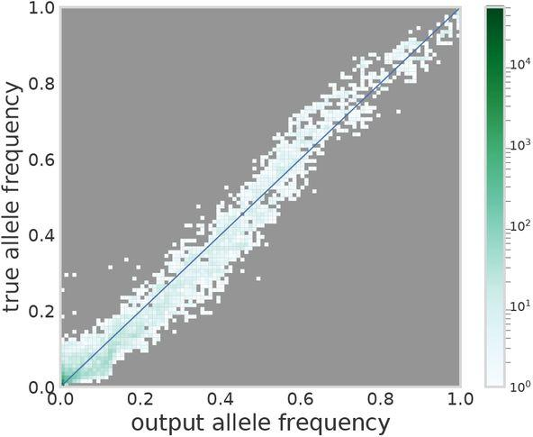
Representing of rare alleles
Rare alleles are represented less well

Slide 40
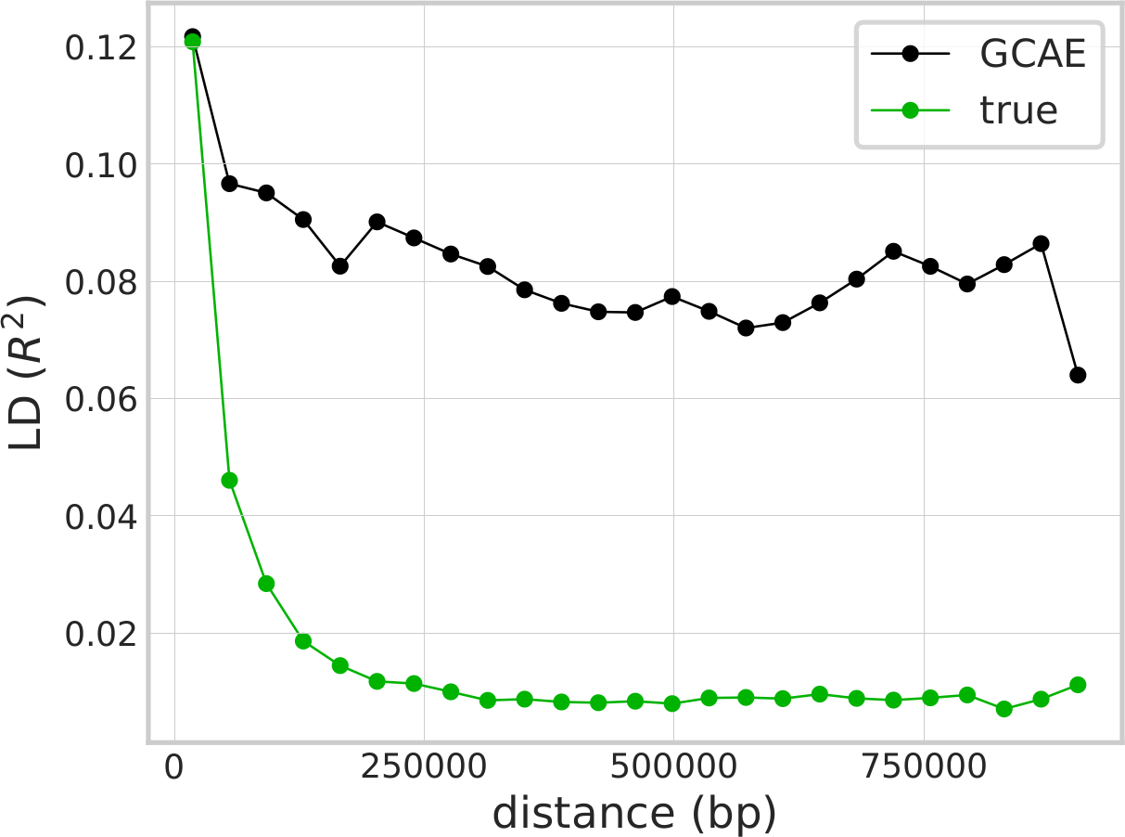
Representing LD
GCAE ‘feels’ all alleles are in LD
Proof it takes local structure into account
Pruned
on LD < 0.2
?
Allele independent
Ausmees, Kristiina, and Carl Nettelblad. "A deep learning framework for characterization of genotype data." bioRxiv (2020). Adapted by Richel Bilderbeek

Slide 41
Discussion
Dimensionality reduction
ADMIXTURE
F1 scores

Slide 42
GCAE versus t-SNE and UMAP again
GCAE
t-SNE
UMAP
Ausmees, Kristiina, and Carl Nettelblad. "A deep learning framework for characterization of genotype data." bioRxiv (2020).

Slide 43
GCAE versus UMAP
Ausmees, Kristiina, and Carl Nettelblad. "A deep learning framework for characterization of genotype data." bioRxiv (2020).

Slide 44
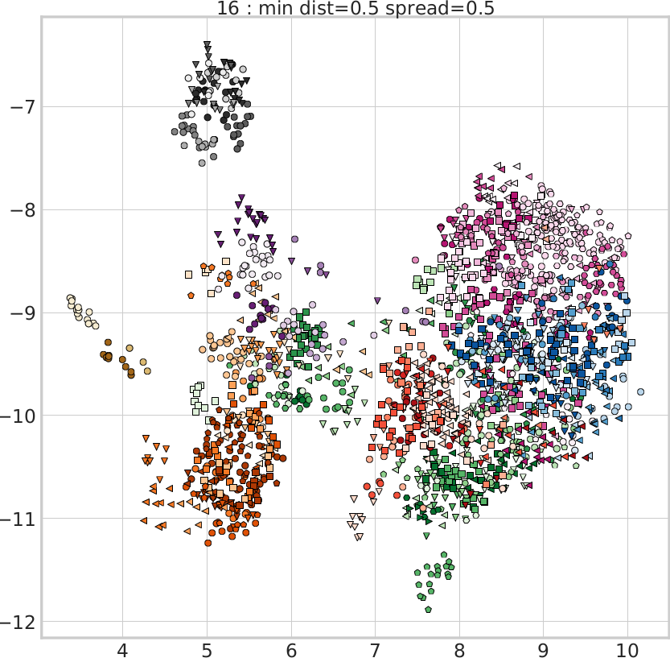
GCAE versus UMAP
While in the Supplementary Materials ...
Ausmees, Kristiina, and Carl Nettelblad. "A deep learning framework for characterization of genotype data." bioRxiv (2020).

Slide 45
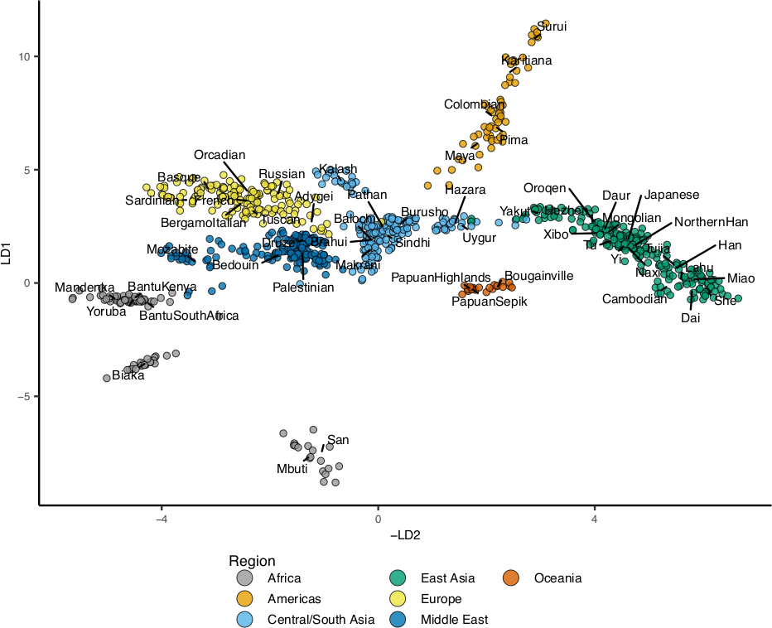
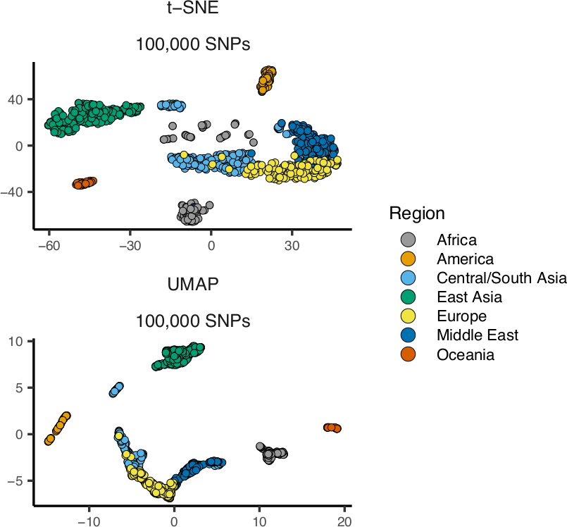
Comparisons by other study
Battey, C. J., Gabrielle C. Coffing, and Andrew D. Kern. "Visualizing population structure with variational autoencoders." G3 11.1 (2021): 1-11.

Slide 46
ADMIXTURE
So, which one is better?
No figure legend on purpose :-)

Slide 47
ADMIXTURE
So, which one is better?
No figure legend on purpose :-)

Slide 48
Method
How is the ADMIXTURE-like plot generated?
  Reproducible from text only?
  No code
[…] what you see is not
ADMIXTURE w/PCA vs ADMIXTURE w/GenoCAE,
but rather ADMIXTURE vs. k-pop softmaxed GenoCAE

Slide 49
F1 Scores
So, which one is better?
“The F1 score of a classification model based on the dimensionality reduction is not a simple metric for which the method with the highest score is the most correct”
Ausmees, Kristiina, and Carl Nettelblad. "A deep learning framework for characterization of genotype data." bioRxiv (2020).

Slide 50
Discussion
Novel approach
  … but there are others (non-convolutional) autoencoders
  … best for non-linear effects on common SNPs
Dimensionality reduction looks impressive
  … how well do other autoencoders do?
Performance is measured
  … but how conclusively?
Performance is compared
  … but how much care/tuning for these comparisons?

Slide 51
The end
https://github.com/richelbilderbeek/journal_club_20220220

Slide 53
Data removal procedure
Human Origins data set
[...]
The data was filtered to exclude sex chromosomes and non-
informative sites, and one sample (NA13619) was removed due
to relation to another (HGDP01382).
Because of ADMIXTURE assumption

Slide 54
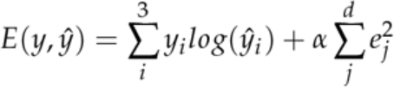
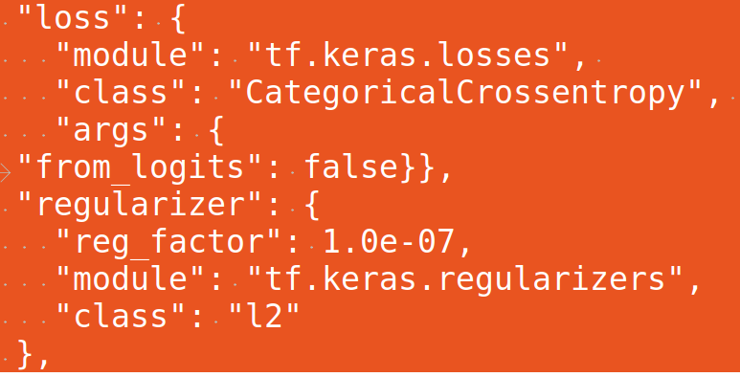
Equations
E(y, y^{hat}): error
i: one of the three variants, i.e. AA, AC, CC
y_{i}: the actual value of a variant, i.e.
AA = 0.0, AC = 0.5, CC = 1.0
y^{hat}_{i}: the decoded value of a variant

Slide 55
Equations
Lower
=
better
G | y_{i} | y^{hat}_{i} | E
AA | 0 | 0.5 | 0
AC | 1 | 0.1 | -2.3
CC | 0 | 0.3 | 0
One-hot
encoding
Zero
=
best
Lower
=
better

Slide 56
Equations
i: one of the three variants, i.e. AA, AC, CC
y_{i}: the actual value of a variant, i.e.
AA = 0.0, AC = 0.5, CC = 1.0
y^{hat}_{i}: the decoded value of a variant

