Slide 1
Journal Club

Slide 2
Overview
Why article?
Introduction
Methods
Results
Conclusion
Discusssion

Slide 3
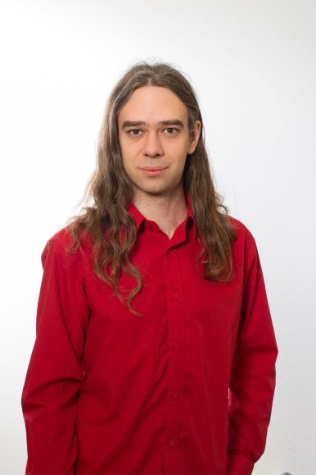
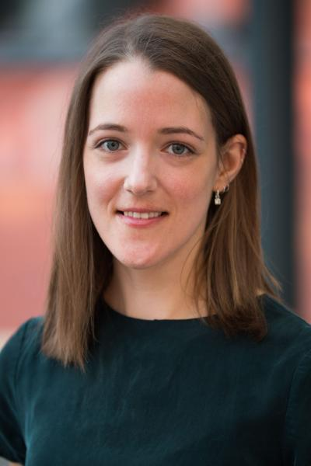
Why this article
I Googled for ‘GWAS + “machine learning” for 2021
Start of collaboration
Carl Nettelblad
Kristiina Ausmees

Slide 4
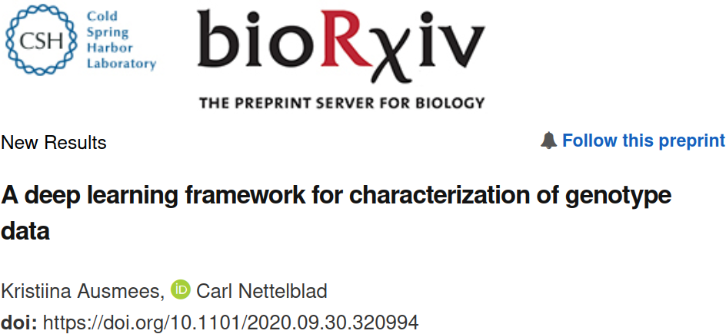

Slide 5
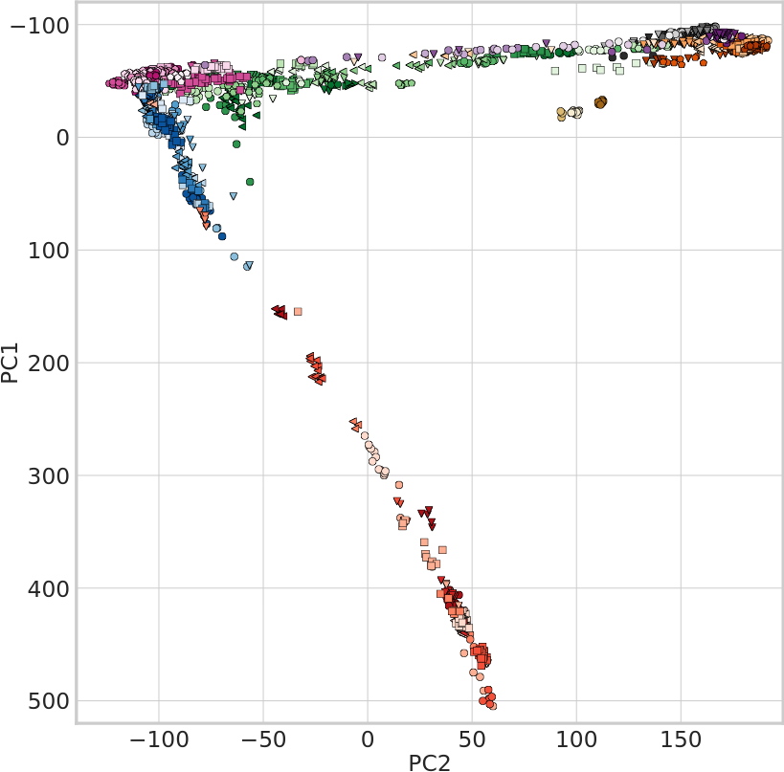
Problem
PCA reduces dimensionality linearily
Typical V shape
Overlap in first 2 dimensions
Ausmees, Kristiina, and Carl Nettelblad. "A deep learning framework for characterization of genotype data." bioRxiv (2020).

Slide 6
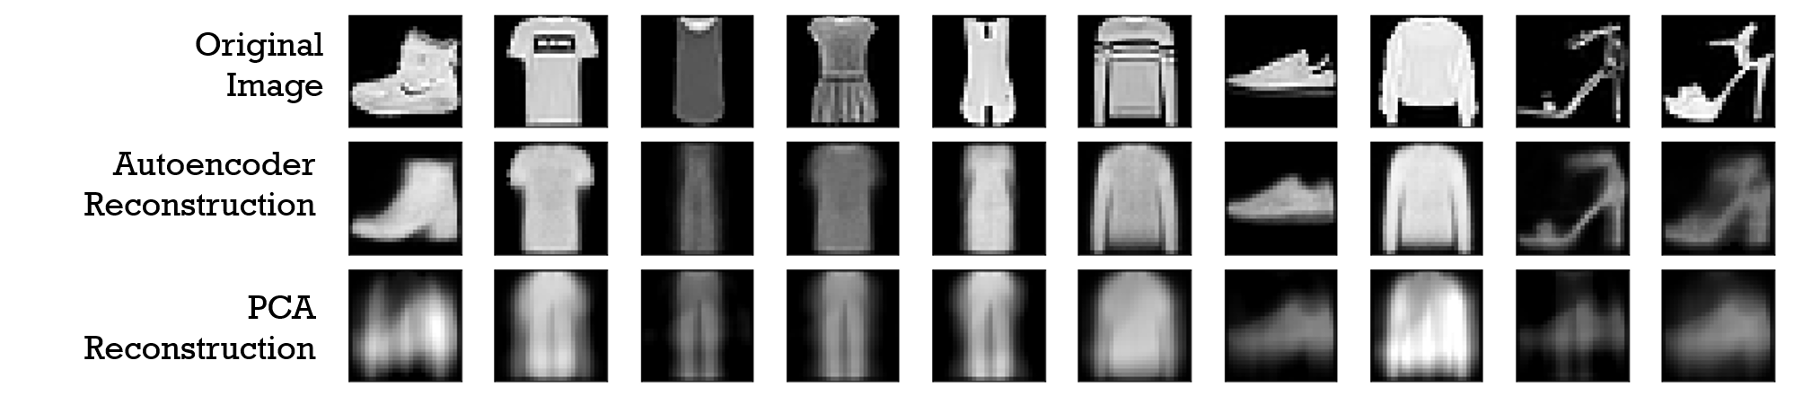
Hypothesis
Convolutional autoencoders can do better
https://commons.wikimedia.org/wiki/File:Reconstruction_autoencoders_vs_PCA.png

Slide 7
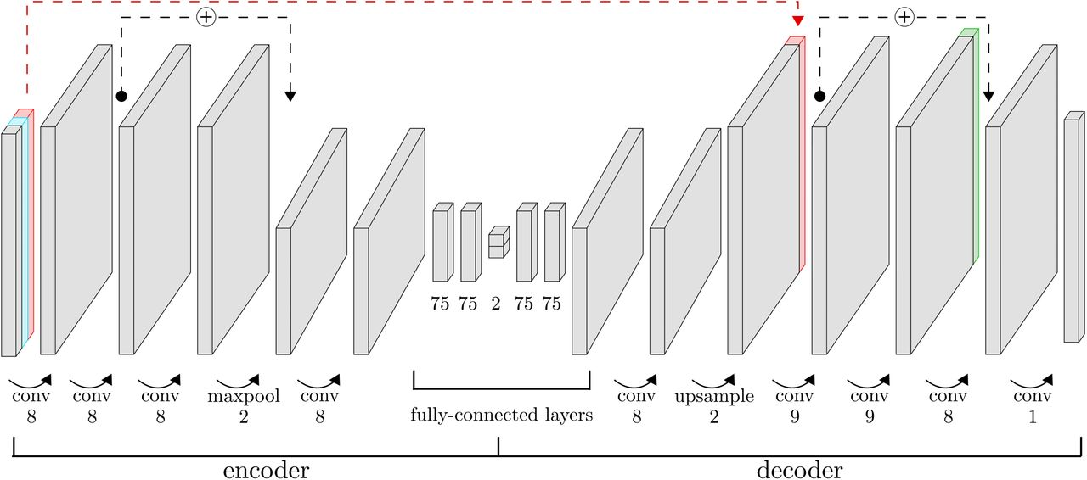
Method
NEW
Neural networks
Set up a convolutional autoencoder
See how well it performs
Auto
encoders
Auto
encoders
Convolutional
Ausmees, Kristiina, and Carl Nettelblad. "A deep learning framework for characterization of genotype data." bioRxiv (2020).

Slide 8
Autoencoder
Bottleneck layer
Input
Output
Goal: learn to represent/label data

Slide 9
Autoencoder
Bottleneck layer
Ausmees, Kristiina, and Carl Nettelblad. "A deep learning framework for characterization of genotype data." bioRxiv (2020).

Slide 10
GCAE
Input:
* grey bar: genotype data
* red bar: marker-specific trainable variable per SNP
* blue bar: missing yes/no
Output:
* grey bar: genotype data
Ausmees, Kristiina, and Carl Nettelblad. "A deep learning framework for characterization of genotype data." bioRxiv (2020).

Slide 11
GCAE
More in research
presentations
Ausmees, Kristiina, and Carl Nettelblad. "A deep learning framework for characterization of genotype data." bioRxiv (2020).

Slide 12
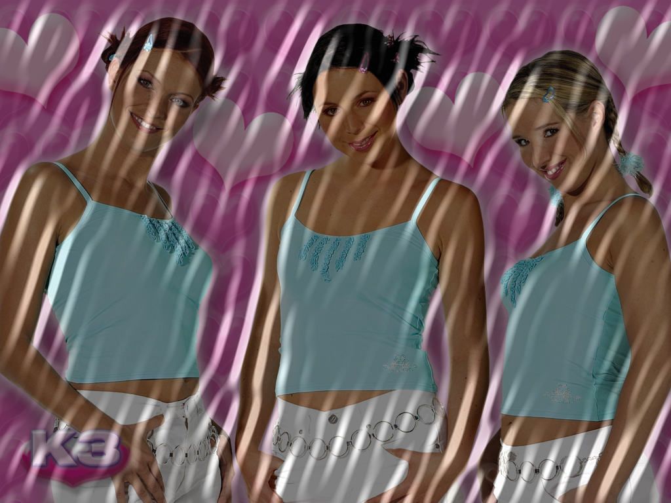
Convolutional neural network
Convolutional:
  Preprocess the data,i.e. do not only use the raw data
DNA
Input
First layer
..
DNA
Only 5
Improve
..
AC
..
Add spatial aspect, i.e. linkage disequilibrium
..

Slide 13
Questions
How well can genotypes be separated?
Can we deduce the origin of a genotype?

Slide 14
Separating genotypes
?
Affymetrix Human Origins SNP array
2,067 unrelated humans from 166 populations
No sex chromosomes
Remove MAF < 1%
LD pruning, remove R² > 0.2
160,858 biallelic sites
Show genotypes in first 2 PCs
Ausmees, Kristiina, and Carl Nettelblad. "A deep learning framework for characterization of genotype data." bioRxiv (2020).

Slide 15
Separating genotypes
PCA
Ausmees, Kristiina, and Carl Nettelblad. "A deep learning framework for characterization of genotype data." bioRxiv (2020).

Slide 16
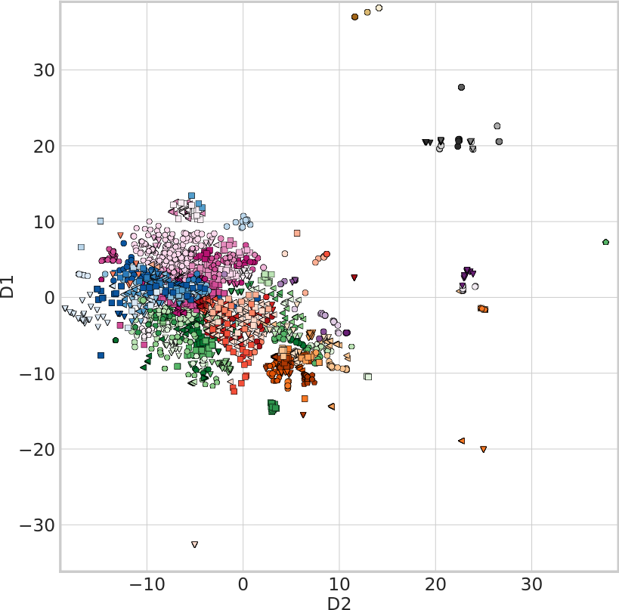
Separating genotypes
t-SNE
Ausmees, Kristiina, and Carl Nettelblad. "A deep learning framework for characterization of genotype data." bioRxiv (2020).

Slide 17
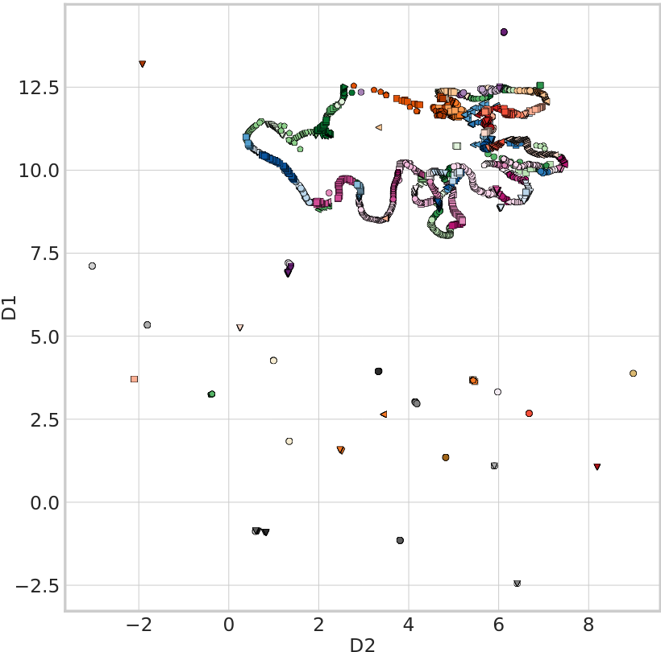
Separating genotypes
UMAP
Ausmees, Kristiina, and Carl Nettelblad. "A deep learning framework for characterization of genotype data." bioRxiv (2020).

Slide 18
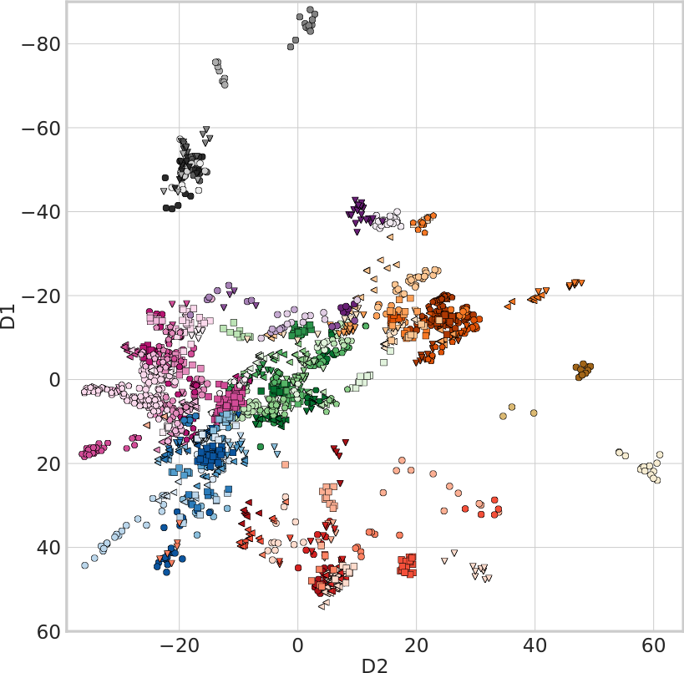
Separating genotypes
GCAE
Ausmees, Kristiina, and Carl Nettelblad. "A deep learning framework for characterization of genotype data." bioRxiv (2020).

Slide 19
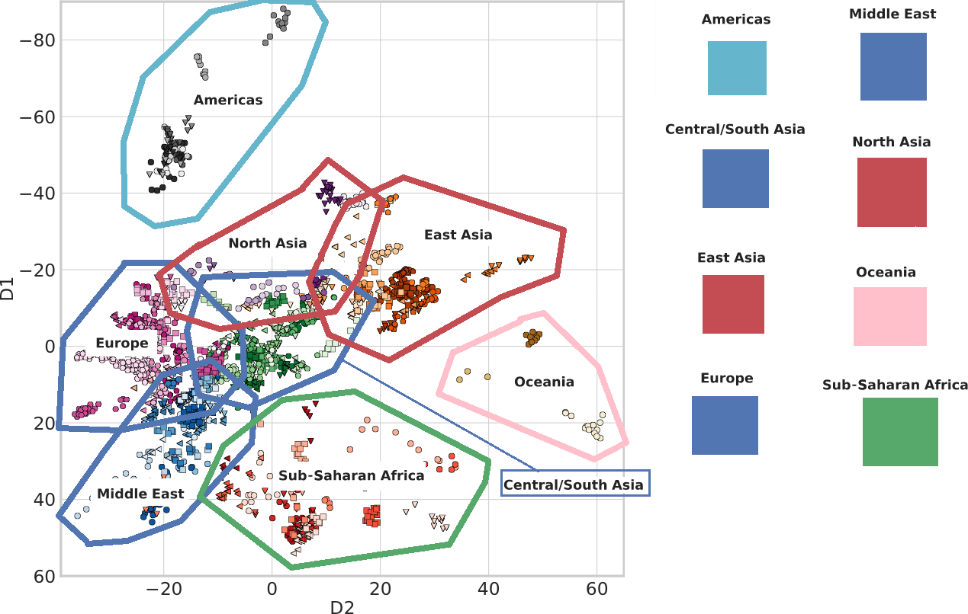
Method
Ausmees, Kristiina, and Carl Nettelblad. "A deep learning framework for characterization of genotype data." bioRxiv (2020). Adapted by Rcihel Bilderbeek

Slide 20
Method
GCAE
Ausmees, Kristiina, and Carl Nettelblad. "A deep learning framework for characterization of genotype data." bioRxiv (2020).

