Slide 1
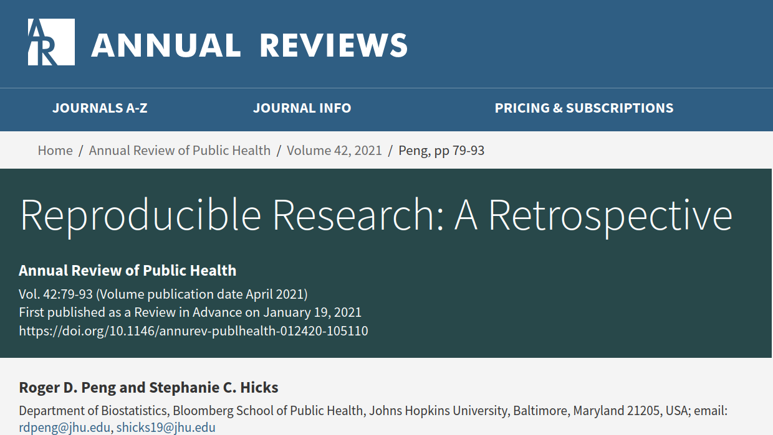
Journal Club
https://github.com/richelbilderbeek/journal_club_20220602

Slide 2
Why this article
I care about Open Science
Article is recent
Reproducible Science
Reproducible
Science
Code
Data

Slide 3
One-slide overview
Reproducibility
Replicability
Re-create results
Re-conclude
Code and data
must be available
Computation experiments are complex
Current state
Path forward

Slide 4
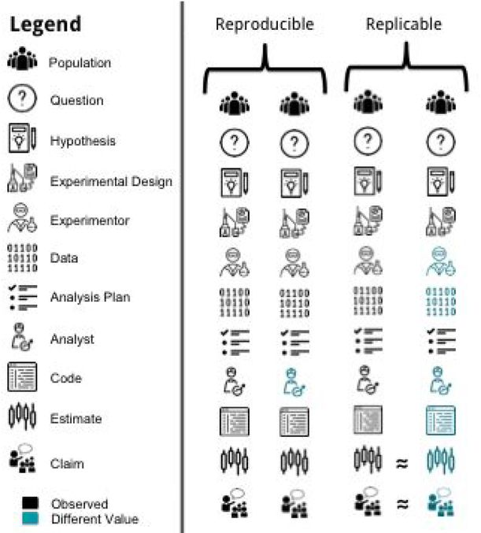
Reproduction:
re-do experiment
Replication:
re-conclude
Patil, Prasad, Roger D. Peng, and Jeffrey T. Leek. "A visual tool for defining reproducibility and replicability." Nature human behaviour 3.7 (2019): 650-652.

Slide 5
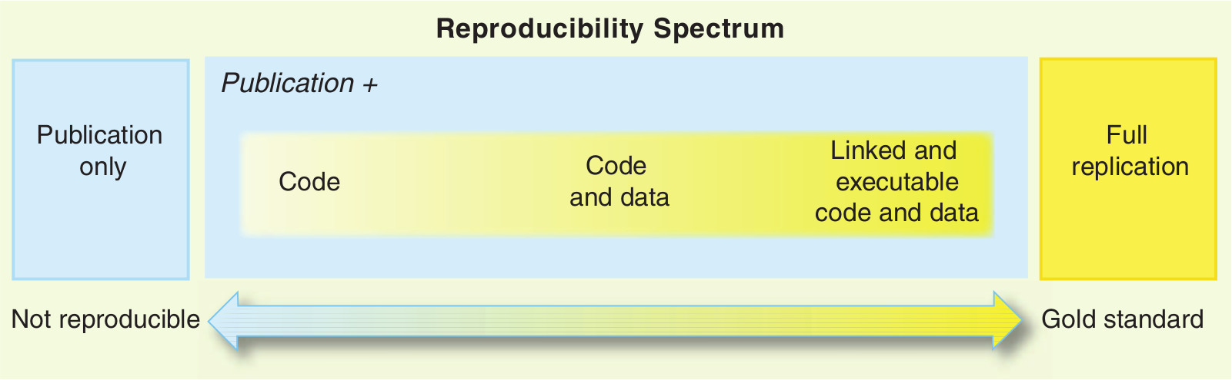
Peng, Roger D. "Reproducible research in computational science." Science 334.6060 (2011): 1226-1227.

Slide 6
The end
https://github.com/richelbilderbeek/journal_club_20220602

