Slide 1
Showing off your helices
Richel Bilderbeek
https://github.com/richelbilderbeek/molimm_presentation_20210111

Slide 2
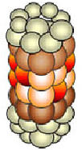
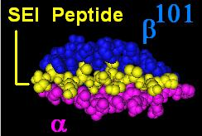
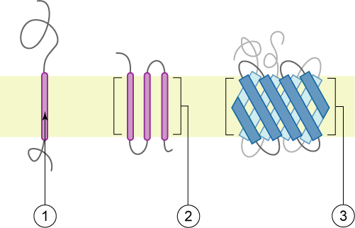
Epitope presentation

Slide 3

Research question
Are epitopes derived from transmembrane helices presented?
Bianchi, Frans, Johannes Textor, and Geert van den Bogaart. "transmembrane Helices are an overlooked source of Major Histocompatibility Complex Class I epitopes." Frontiers in Immunology 8 (2017): 1118.

Slide 4
BTB Research question
Are peptide fragments derived from TMHs presented?
TMH = transmembrane helix

Slide 5
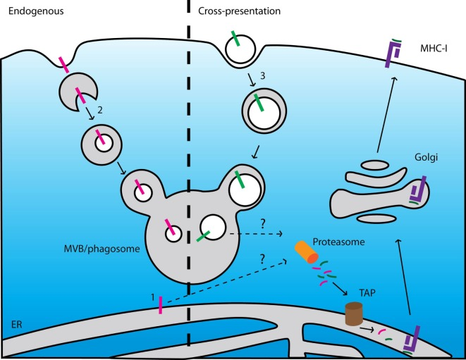


Yes, TMHs are presented
Mechanism is unknown
TMH = transmembrane helix

Slide 6
BTB Research question
Are peptide fragments derived from TMHs presented as often as expected by chance?
For example,
if 5.5% of all 9-mers overlap with a TMH,
5.5% of all 9-mers that MHC-I presents will stem from a TMH
TMH = transmembrane helix

Slide 7
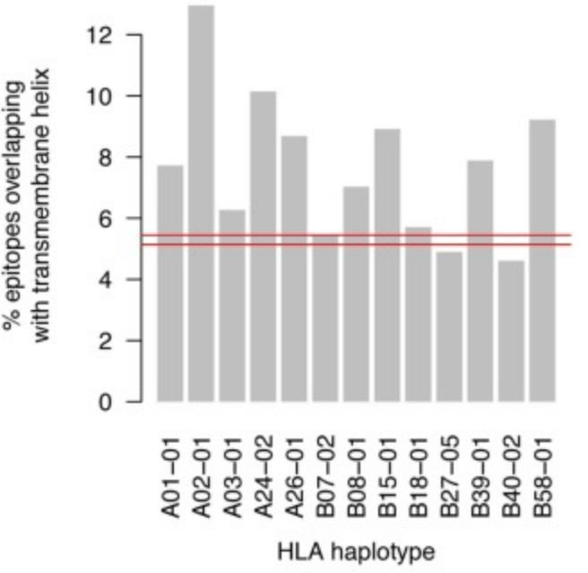
No, TMH-derived epitopes are over-presented in MHC-I in humans
5.5%
TMH = transmembrane helix

Slide 8
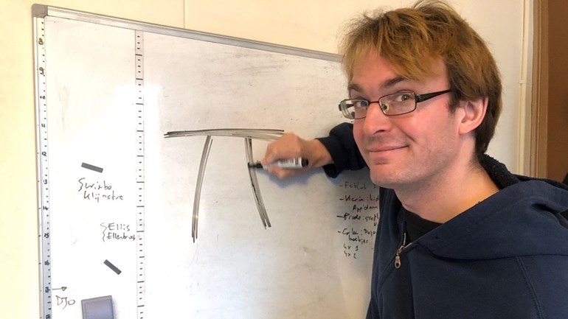

BBB research question
Are peptide fragments derived from TMHs presented as often as expected by chance,
* in MHC-I and MHC-II?
* in humans and other pathogens?
TMH = transmembrane helix

Slide 9
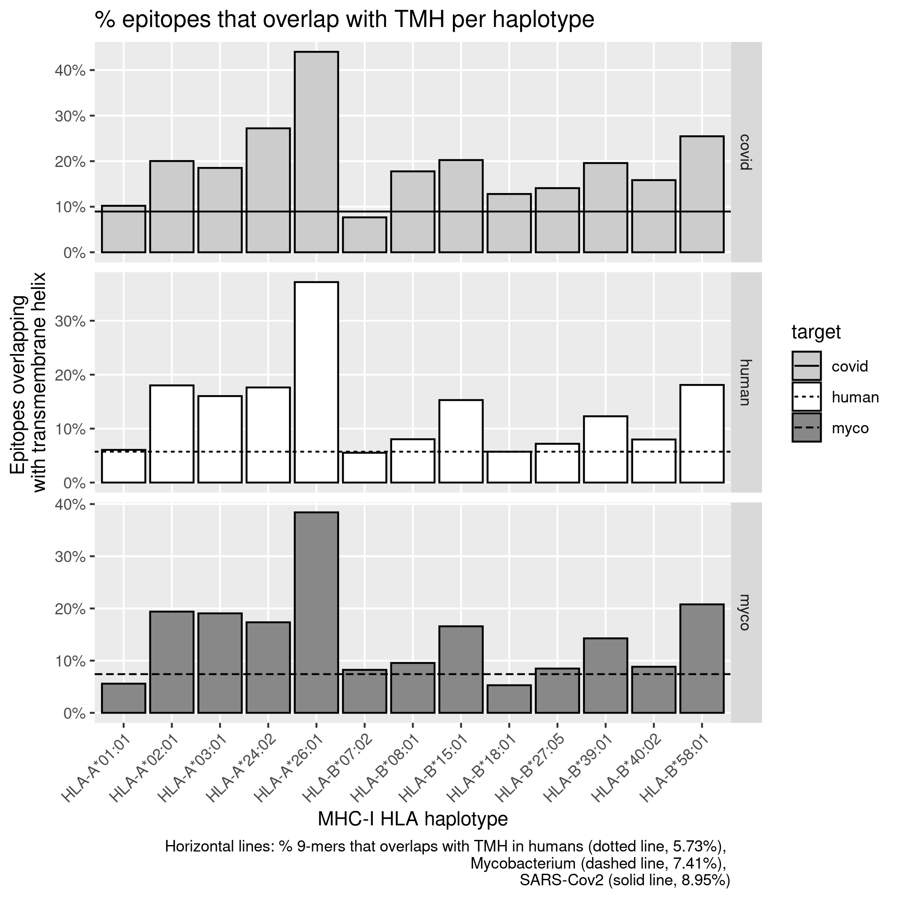
MHC-I in humans

Slide 10
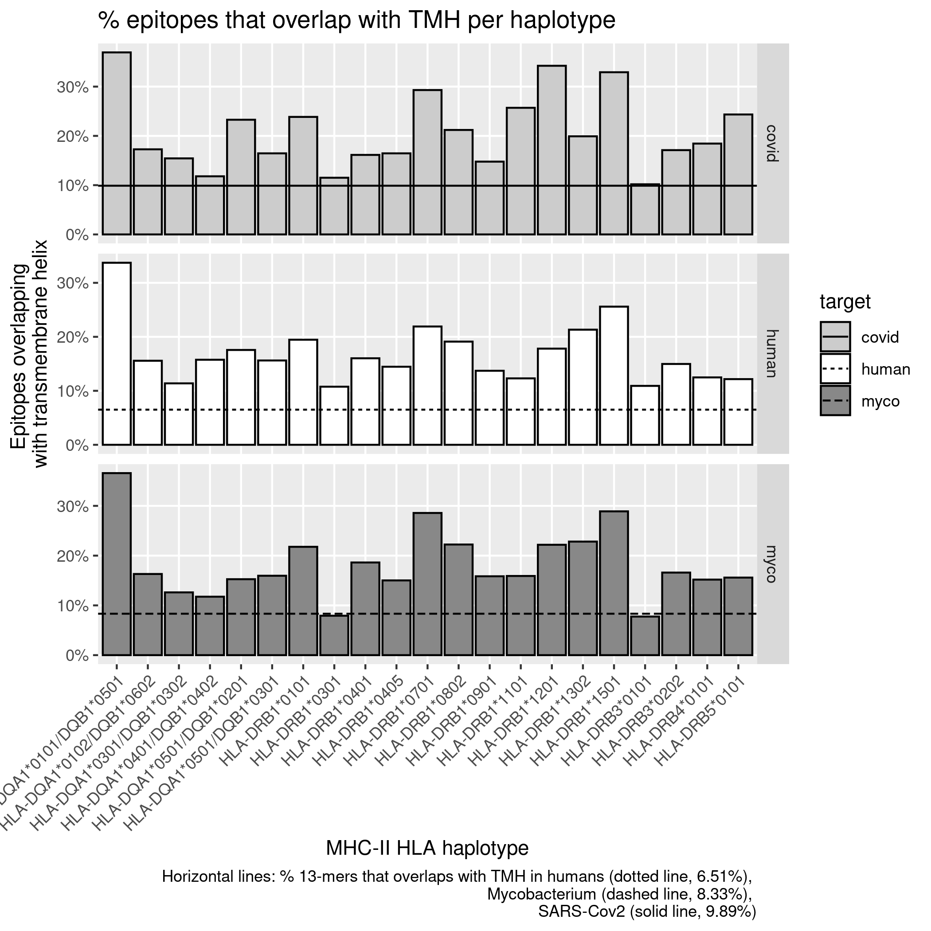
MHC-II in humans

Slide 11
In virus, humans and bacterium

Slide 12
Conclusion
TMHs are presented more often than expected by chance consistently
TMH = transmembrane helix

Slide 13
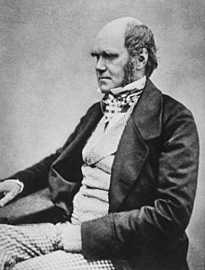
Conclusion
TMHs are presented more often than expected by chance consistently
TMH = transmembrane helix

Slide 14
Research question
Are TMHs evolutionarily conserved?

Slide 15
Are TMHs evolutionary conserved?
Structural integrity TMH
vs
non-TMH
Attentive human immune system
vs
runaway mutation

Slide 16
Methods
Collect SNPs of membrane proteins
Per SNP:
  Get protein sequence
  Predict topologies
  Score if SNPs is in/outside TMH
Do statistics

Slide 17

Collect SNPs of membrane proteins
≈20 millions human SNPs
≈1100 membrane proteins
≈5% of SNPs are AA substitutions
NP_002345.2:p.Ala295Val

Slide 18
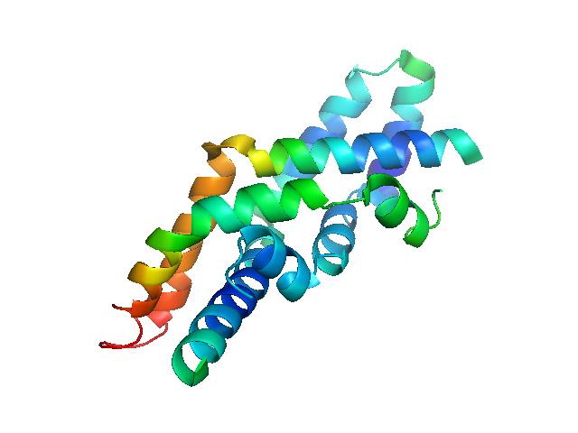
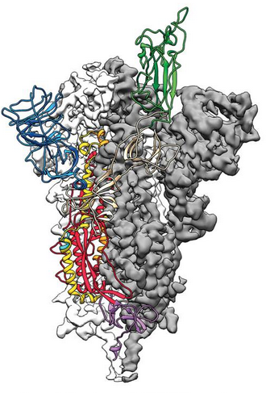
Statistics
A protein has % amino acids that are TMH
Mutations can occur at each amino acids
Do mutations occur in TMHs as often as expected by chance?
(percentages do not resemble real % of TMH of proteins)

Slide 19

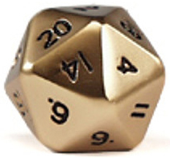
Statistics
A dice has % faces that have the highest value
It can land on each face
Does the dice land on the highest face as expected by chance?

Slide 20
Statistics
17%
5%
(percentages do not resemble real % of TMH of proteins)

Slide 21
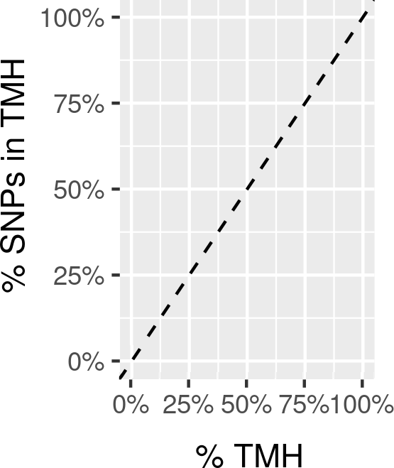
Conservation of SNPs

Slide 22
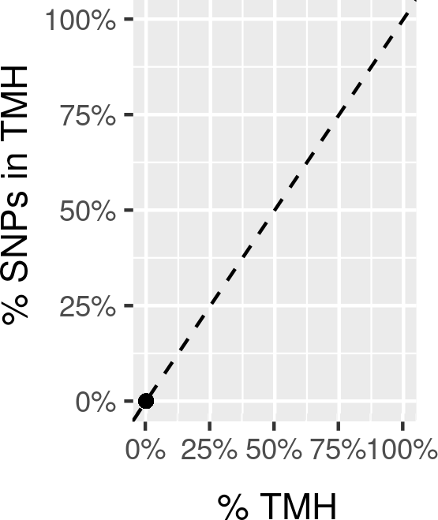
Cytosolic proteins

Slide 23
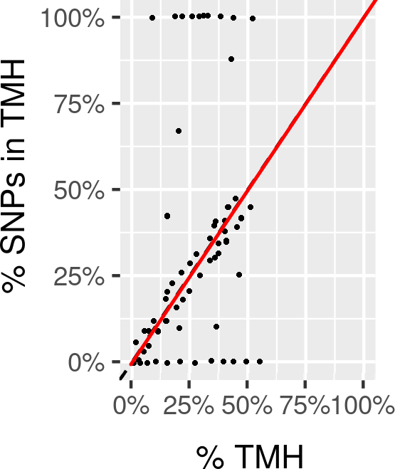
TMHs are evolutionarily neutral

Slide 24
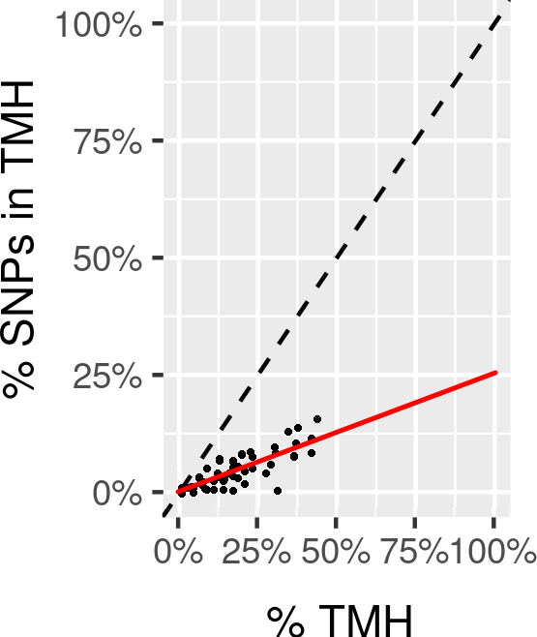
TMHs are evolutionarily conserved

Slide 25
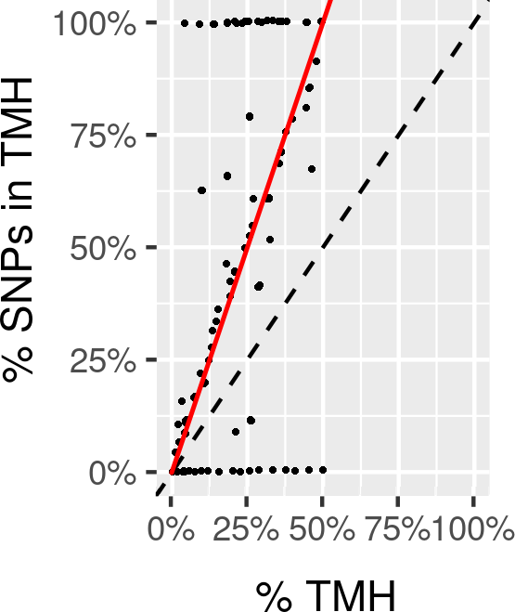
TMHs are a hotspot for mutations

Slide 26
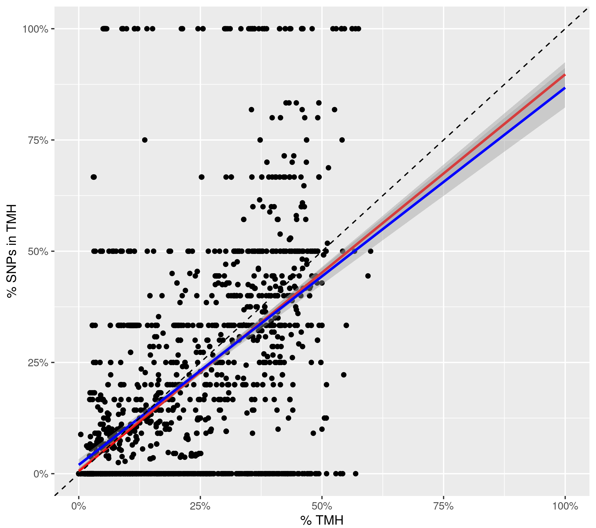
TMHs look evolutionarily conserved!

Slide 27
TMHs are evolutionarily conserved!
Poisson binomial distribution
Do we find as much successes as we expected?
p_{i} = p_{TMH}
n = n_{SNP} = 61457
E(k) ≈ 4203 (p_{mean} ≈ 6.8%)
k = n_{SNP} in TMH = 3889
p ≈ 1.6201 . 10⁻⁹

Slide 28
TMHs are evolutionarily conserved!
Per 1 SNP found in non-TMH, there are 0.925 SNPs in TMHs

Slide 29
Research question 2b
Are TMHs in single-spanner as conserved as TMHs in multi-spanners?
Less wiggle-room
to maintain 1 function
vs
Active sites
within membrane

Slide 30
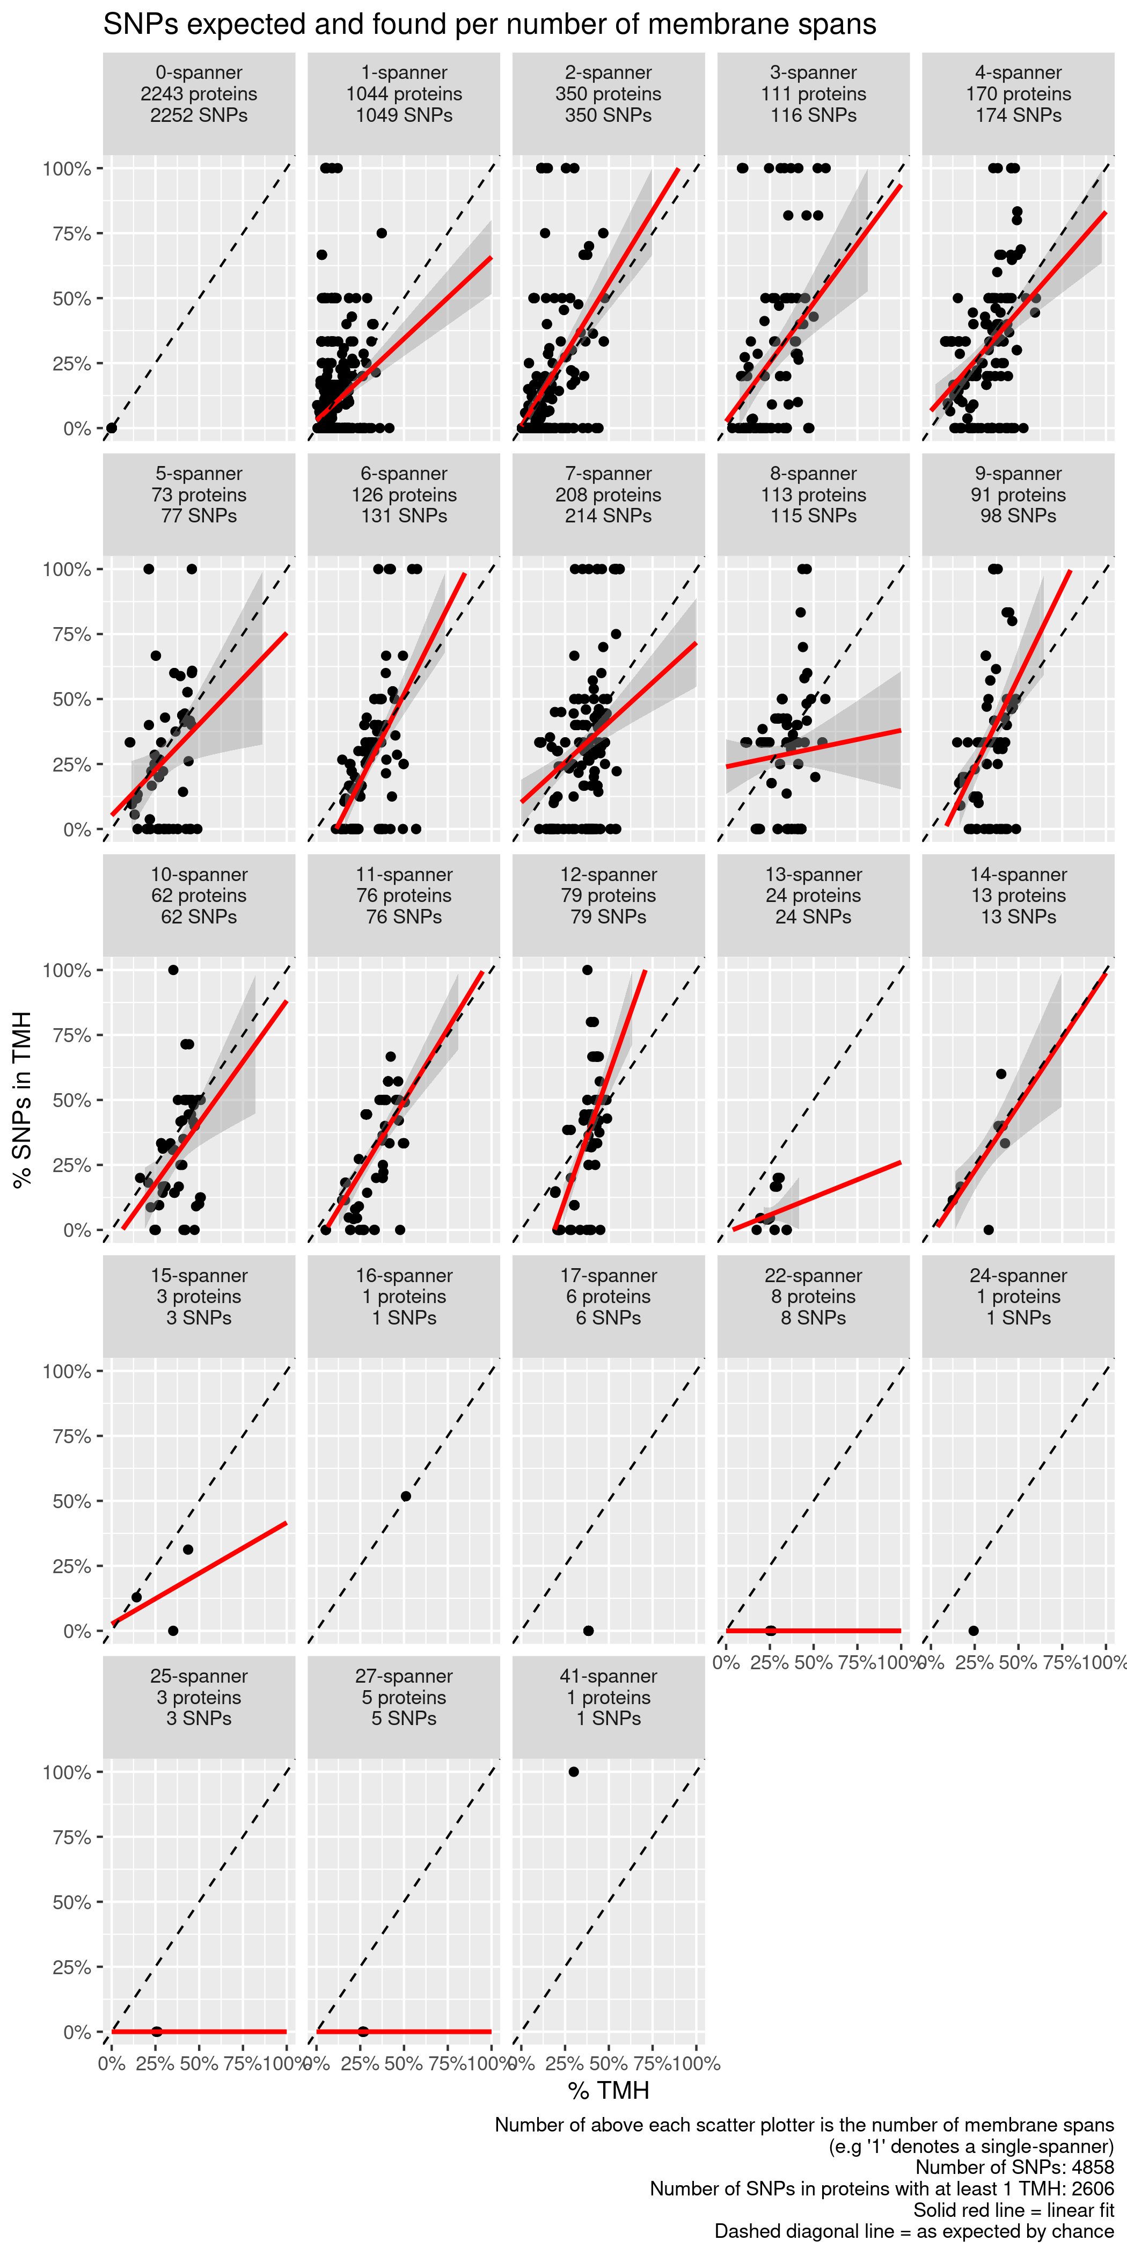
Separate by number of TMHs

Slide 31
Single-spanners look conserved
% SNPs in TMHs
% TMH in protein

Slide 32
2,3,4-spanners look undecided
% SNPs in TMHs
% TMH in protein

Slide 33
4+-spanners look undecided
% SNPs in TMHs
% TMH in protein

Slide 34
Conclusion
TMHs are presented more often than expected by chance consistently
TMHs are evolutionarily conserved

Slide 35
Questions?
richel@richelbilderbeek.nl
https://github.com/richelbilderbeek/molimm_presentation_20210111

