Slide 1
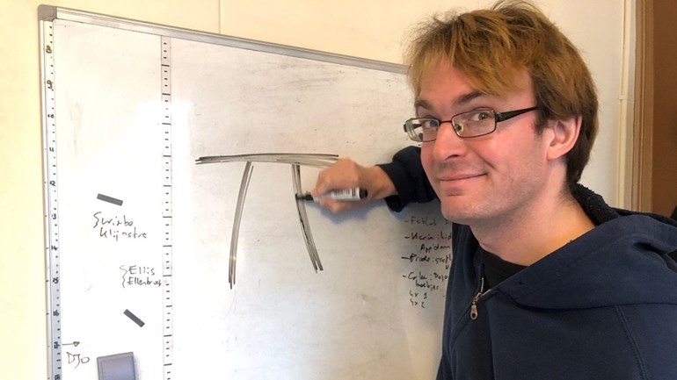

Spend less time coding using test-driven development
Richèl Bilderbeek
UU, IGP
https://github.com/richelbilderbeek/nlseb_tdd_20210420

Slide 2
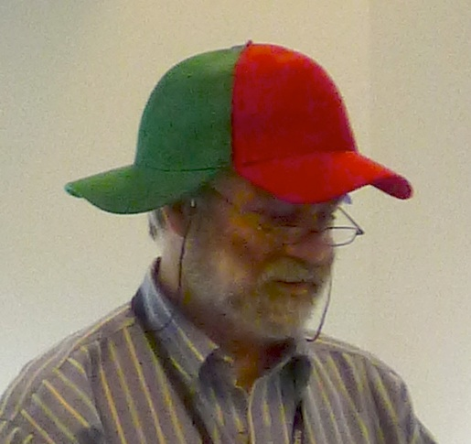
Goal
Why TDD?
What is TDD?
Feel how it works
Notes:
https://en.wikipedia.org/wiki/File:The_B-52%27s_-_Good_Stuff.jpg

Slide 3

Why TDD?
80% of time we debug
TDD reduces time to debug
  Way to develop
  Use new code faster
  Better readable code
  Way to communicate
  Way to teach

Slide 4
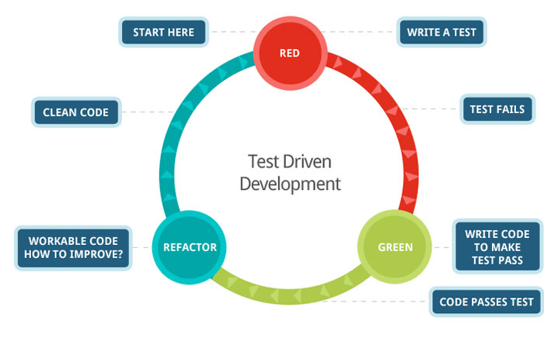
What is TDD?

Slide 5
Demo
Write code for function ‘is_one’
Please interrupt!

Slide 6
Practice
Write is_

Slide 7
Questions?
Richèl Bilderbeek
richel@richelbilderbeek.nl
https://github.com/richelbilderbeek/
igp_presentation_20210413

