Slide 1
Open Science: what, why and how
Richel Bilderbeek
2021-11-11
https://github.com/richelbilderbeek/open_science_presentation_20211111

Slide 2
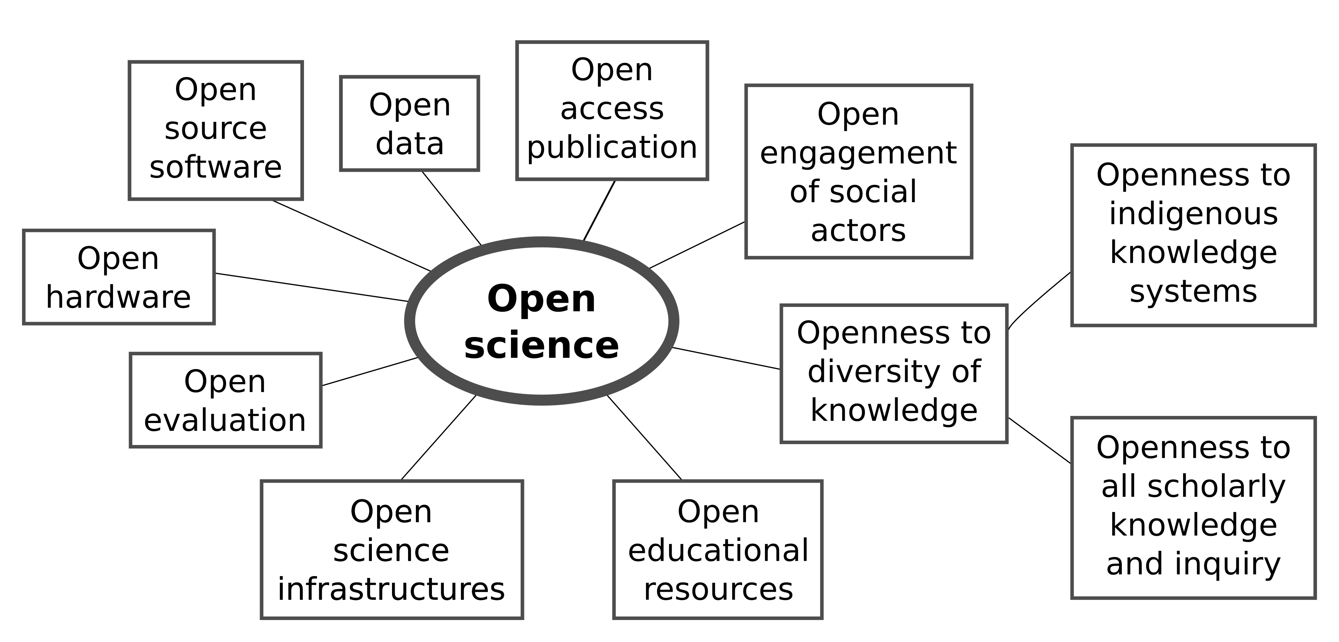

What is Open Science?
https://en.unesco.org/science-sustainable-future/open-science

Slide 3
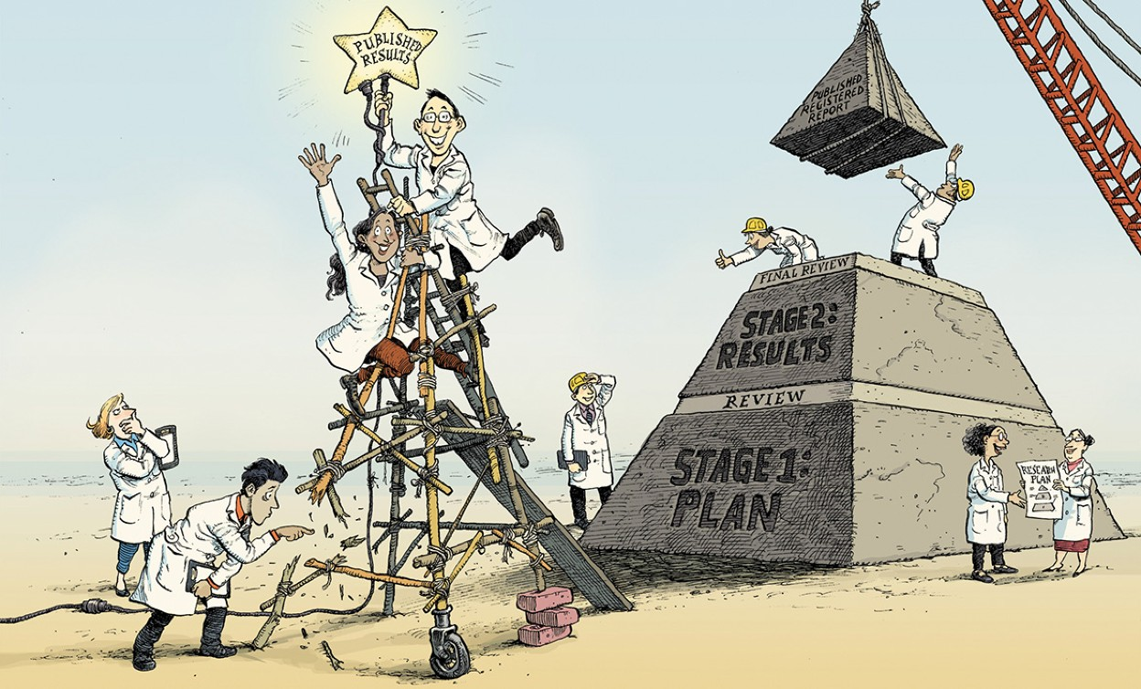
The Registered Report
Chambers, What’s next for Registered Reports?,
https://www.nature.com/articles/d41586-019-02674-6:

Slide 4
Problem
Most published research findings are false [1]
Anything can be significant [2]
[1] Ioannidis, John PA. "Why most published research findings are false." PLoS medicine 2.8 (2005): e124.
[2] Simmons, Joseph P., Leif D. Nelson, and Uri Simonsohn. "False-positive psychology: Undisclosed flexibility in data collection and analysis allows presenting anything as significant." Psychological science 22.11 (2011): 1359-1366.

Slide 5
Most published research findings are false
Ioannidis, John PA. "Why most published research findings are false." PLoS medicine 2.8 (2005): e124.

Slide 6
Anything can be significant
Simmons, Joseph P., Leif D. Nelson, and Uri Simonsohn. "False-positive psychology: Undisclosed flexibility in data collection and analysis allows presenting anything as significant." Psychological science 22.11 (2011): 1359-1366.

Slide 7
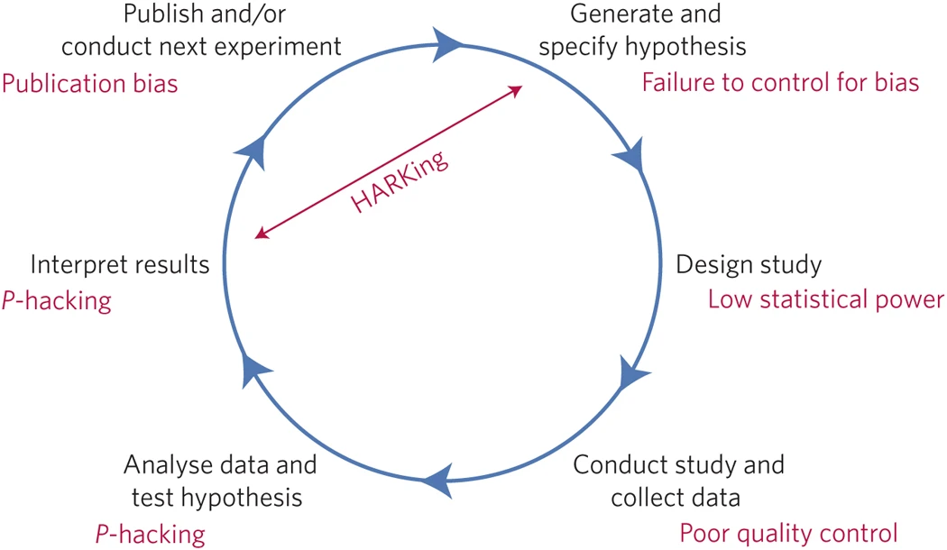
What are threats to reproducible research?
Munafò, Marcus R., et al. "A manifesto for reproducible science." Nature human behaviour 1.1 (2017): 1-9.

Slide 8
Definition: HARKing
Hypothesis After Results are Known
presenting ad hoc and/or unexpected findings as though they had been predicted all along
presenting exploratory work as though it was confirmatory hypothesis testing
Fraser, Hannah, et al. "Questionable research practices in ecology and evolution." PloS one 13.7 (2018): e0200303.

Slide 9
Definition: p hacking
adjusting statistical models, for instance by including or excluding covariates based on the resulting strength of the main effect of interest
remove/keep outliers when it changes significance with reporting
collect more data if results are not significant yet
stop collecting data when results are significant
rounding of a p value to meet a statistical significance threshold (e.g., presenting 0.053 as p < .05).
Fraser, Hannah, et al. "Questionable research practices in ecology and evolution." PloS one 13.7 (2018): e0200303.

Slide 10
Definitions
Cherry picking
  failing to report dependent or response variables or relationships that did not reach statistical significance or other threshold
  failing to report conditions or treatments that did not reach statistical significance or other threshold.
Fraser, Hannah, et al. "Questionable research practices in ecology and evolution." PloS one 13.7 (2018): e0200303.

