Slide 1

Open Science and some of its problems
Richèl Bilderbeek
2023-04-14
https://github.com/richelbilderbeek/osu_talk_20230414

Slide 2


Slide 3
What is science?
Science

Slide 4
What is science?
Career
Knowledge
Scientist
Science
Experiments
Articles
Repeatable

Slide 5
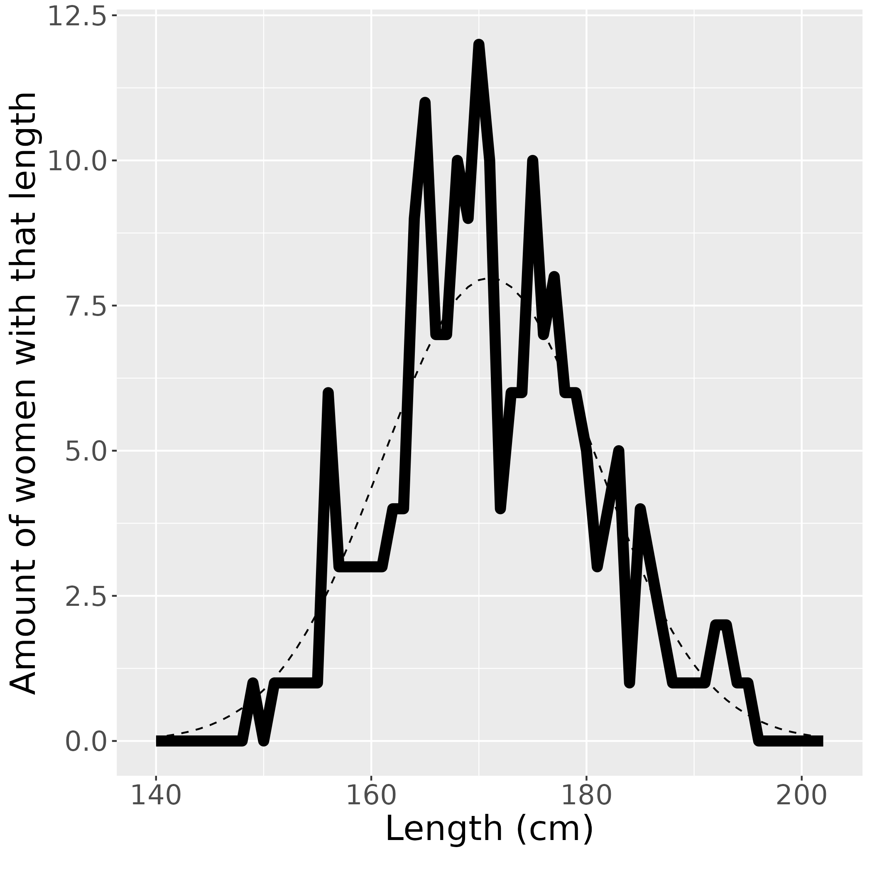
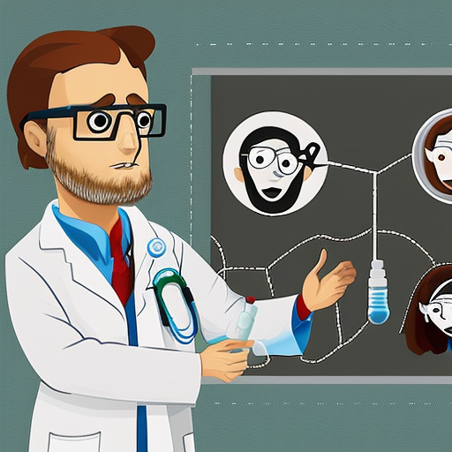
Exploratory research question
There must be a reason why some women are taller!
Gunvald
Example inspired by Simmons, Joseph P., Leif D. Nelson, and Uri Simonsohn. "False-positive psychology: undisclosed flexibility in data collection and analysis allows presenting anything as significant." (2016).

Slide 6
Survey for women
How tall are you?
Do you prefer red over green?
Is your phone number an even number?
… 18 other yes/no questions ...
Response
variable
Smart!
20 things
‘Explanatory‘
variables

Slide 7
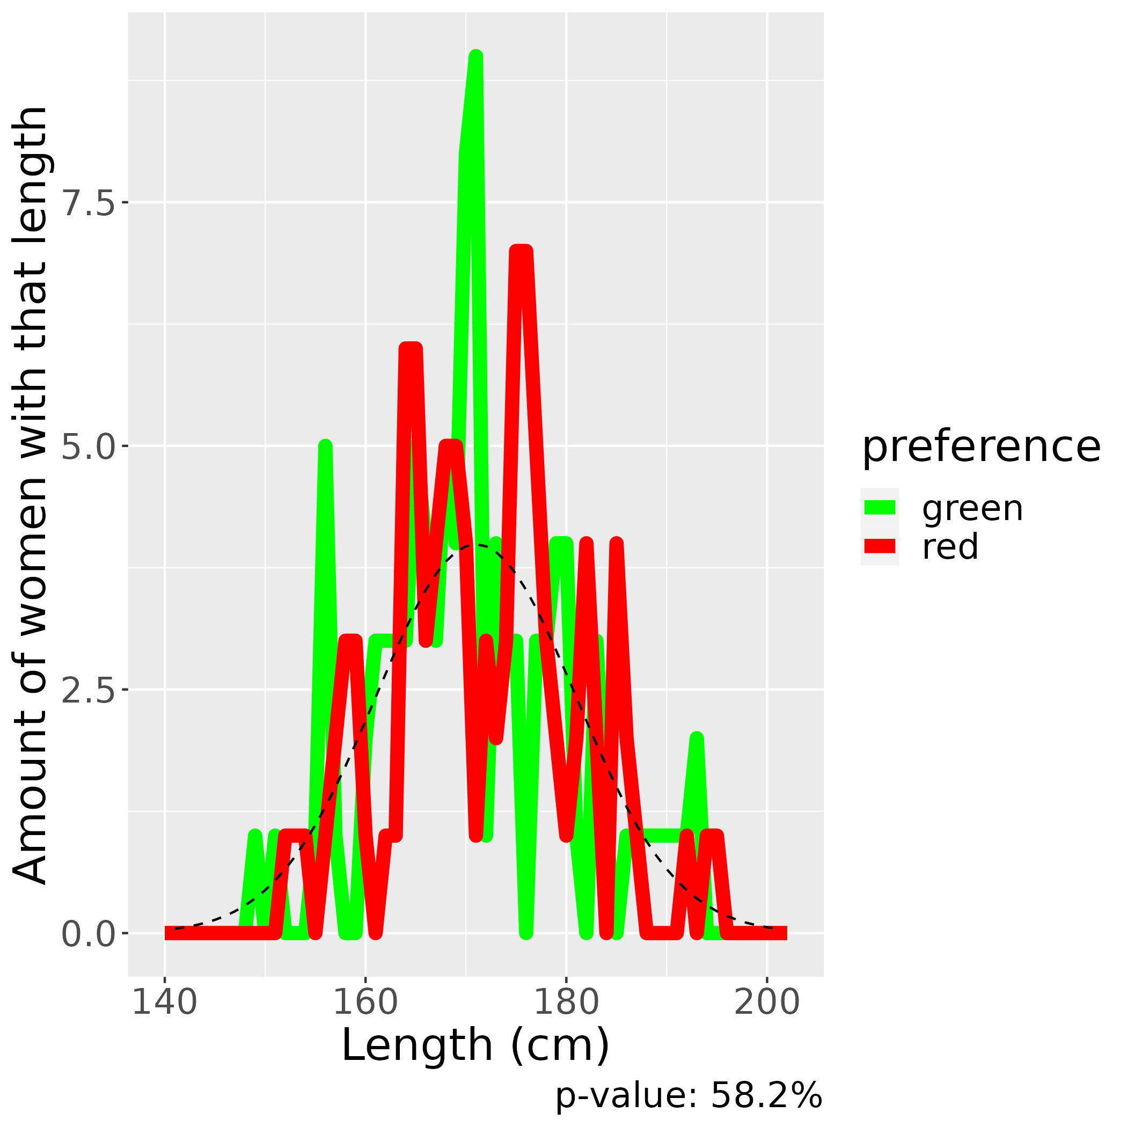
Gunvald is unlucky
Chance is 95%
if there is no effect
Too bad,
no significant finding

Slide 8
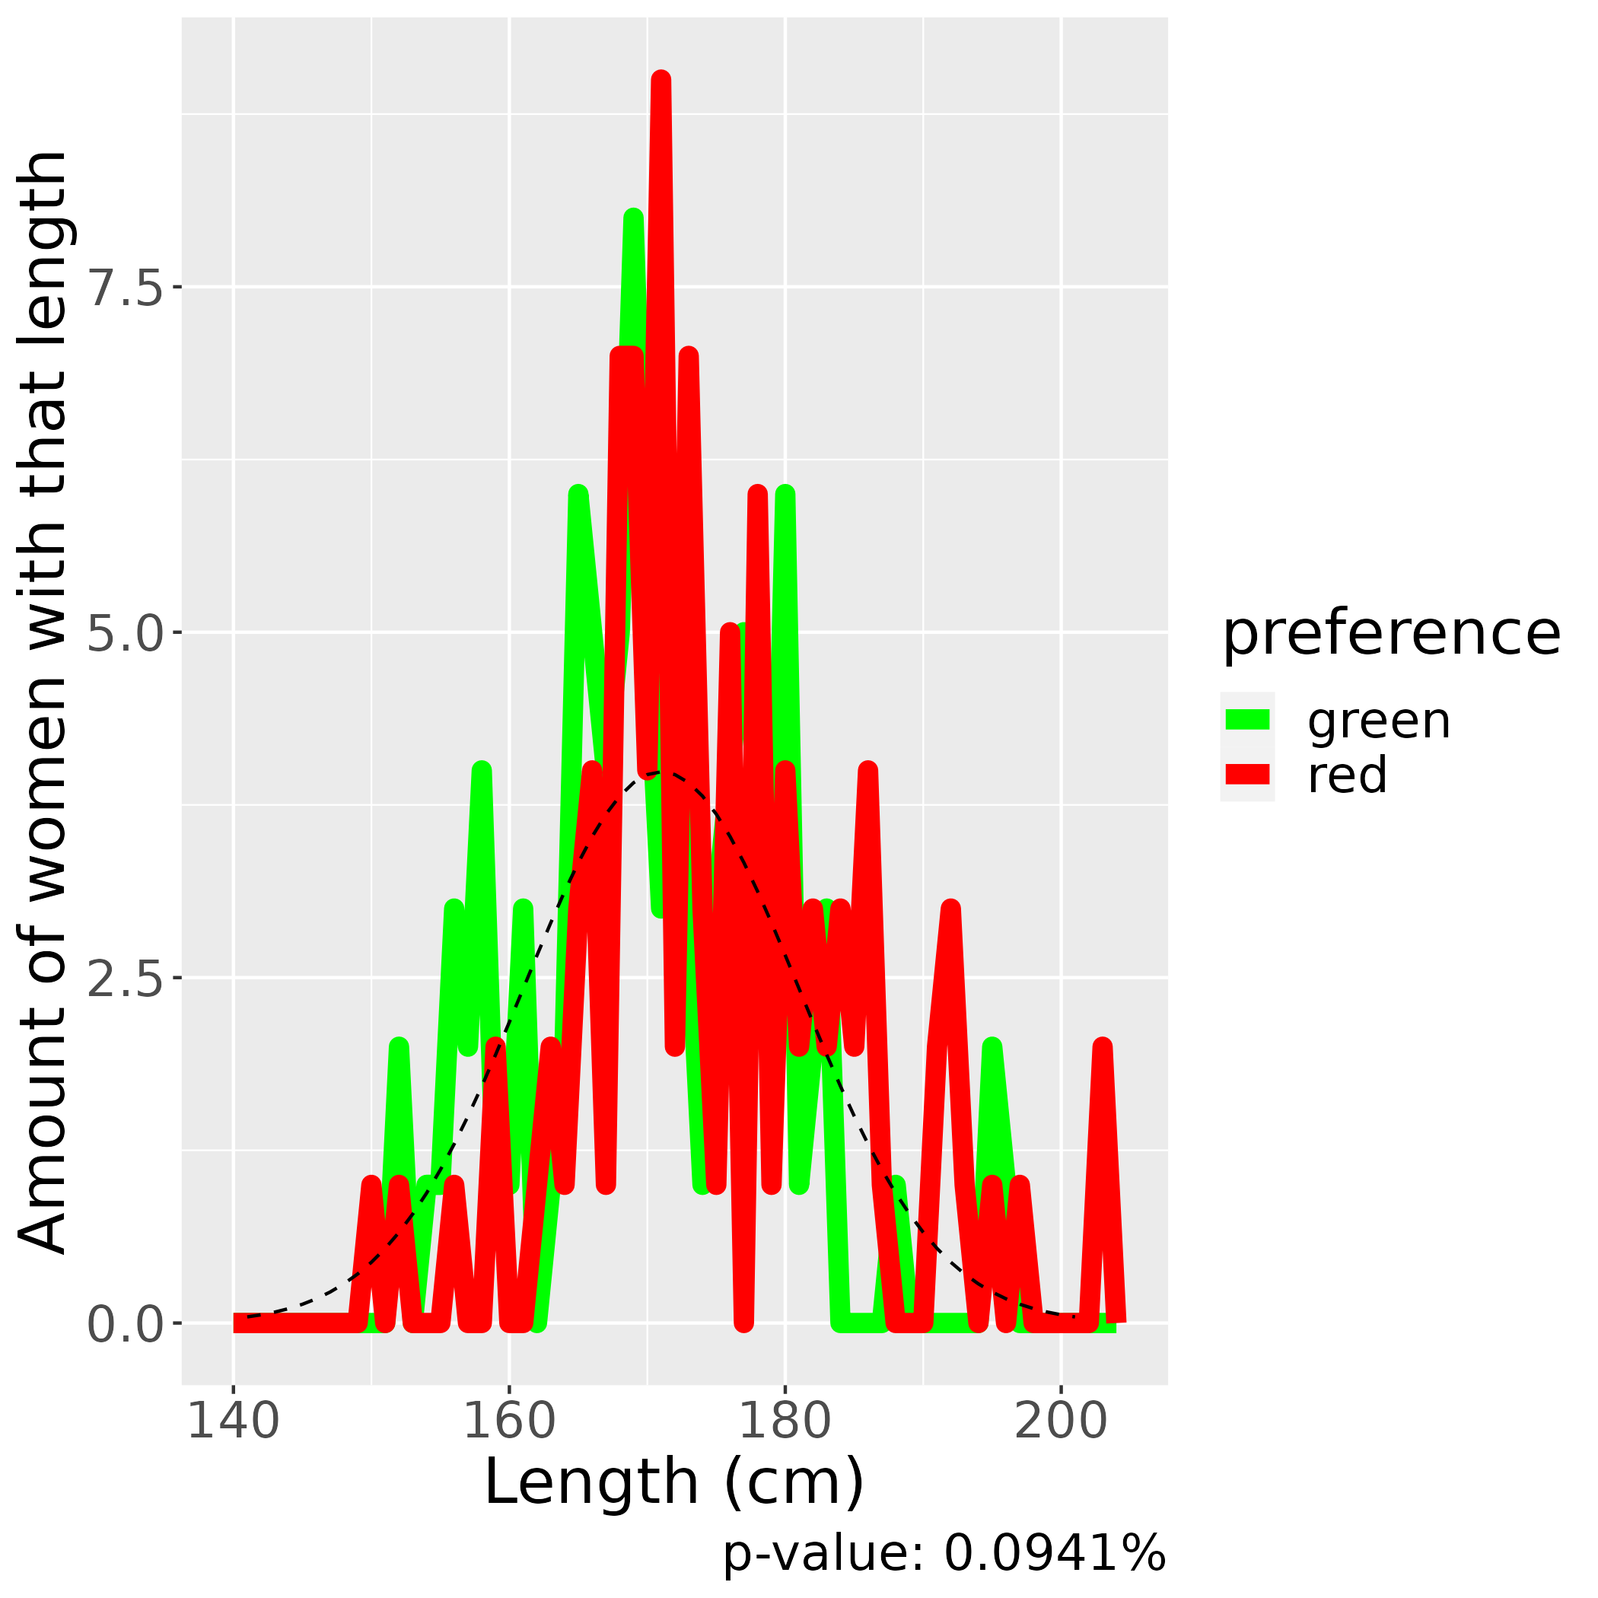
Gunvald is lucky
Chance is 5%
if there is no effect
Eureka!
A significant finding!

Slide 9
Problem
The chance
to find
something
significant
when there
is no effect
is 5%
Tip 1: measure 20 things!

Slide 10
Problem
The chance to find
something significant
when there is no effect
when using 2 things
is at least around 20%
Tip 2: there are 36 ways to tweak an experiment [1]
[1] Wicherts, Jelte M., et al. "Degrees of freedom in planning, running, analyzing, and reporting psychological studies: A checklist to avoid p-hacking." Frontiers in psychology 7 (2016): 1832.

Slide 11

A publication!
I am so creative!
I always
suspected this!
Dr. Gunvald
finds:
women
with even
phone numbers,
if they prefer
red over green,
are taller!
Asked 20 things in survey,
Reports only 2

Slide 12
Is Gunvald evil?
Asked 20 things in survey,
Reports only 2

Slide 13
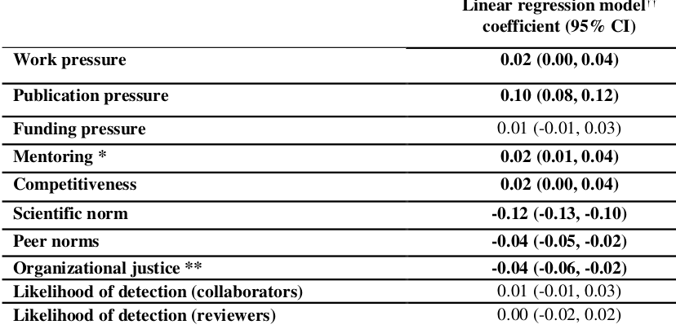
Why do scientists do this?
Publish
or
Perish
It’s just the game
Gopalakrishna, Gowri, et al. "Prevalence of questionable research practices, research misconduct and their potential explanatory factors: a survey among academic researchers in The Netherlands." (2021).

Slide 14
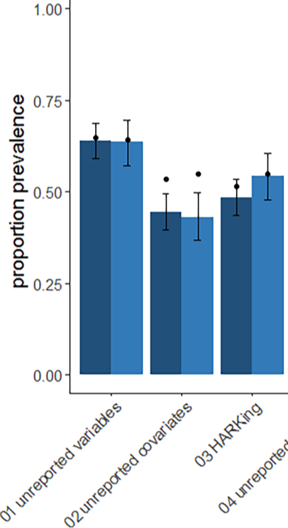
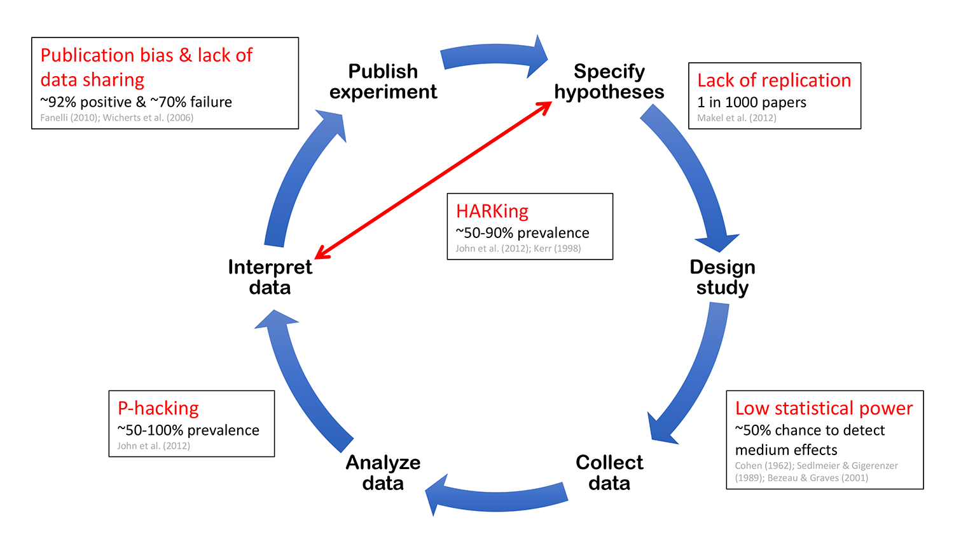
How often do people do this?
Ecology
Evolution
Fraser, Hannah, et al. "Questionable research practices in ecology and evolution." PloS one 13.7 (2018): e0200303.
Image from https://sarneckalab.blogspot.com/2018/05, which is adapted from
Munafò, Marcus R., et al. "A manifesto for reproducible science." Nature human behaviour 1.1 (2017): 1-9.

Slide 15


Is that a problem?
Reproducibility Crisis
  50% cannot reproduce their own work [1]
  11% of pre-clinical cancer studies could be replicated [2]
Open Science can solve this [3,4]
[1] Baker, Monya. "1,500 scientists lift the lid on reproducibility." Nature News 533.7604 (2016): 452.
[2] Begley, C. Glenn, and Lee M. Ellis. "Raise standards for preclinical cancer research." Nature 483.7391 (2012): 531-533.
[3] https://en.unesco.org/science-sustainable-future/open-science
[4] https://research-and-innovation.ec.europa.eu/strategy/strategy-2020-2024/our-digital-future/open-science_en

Slide 16
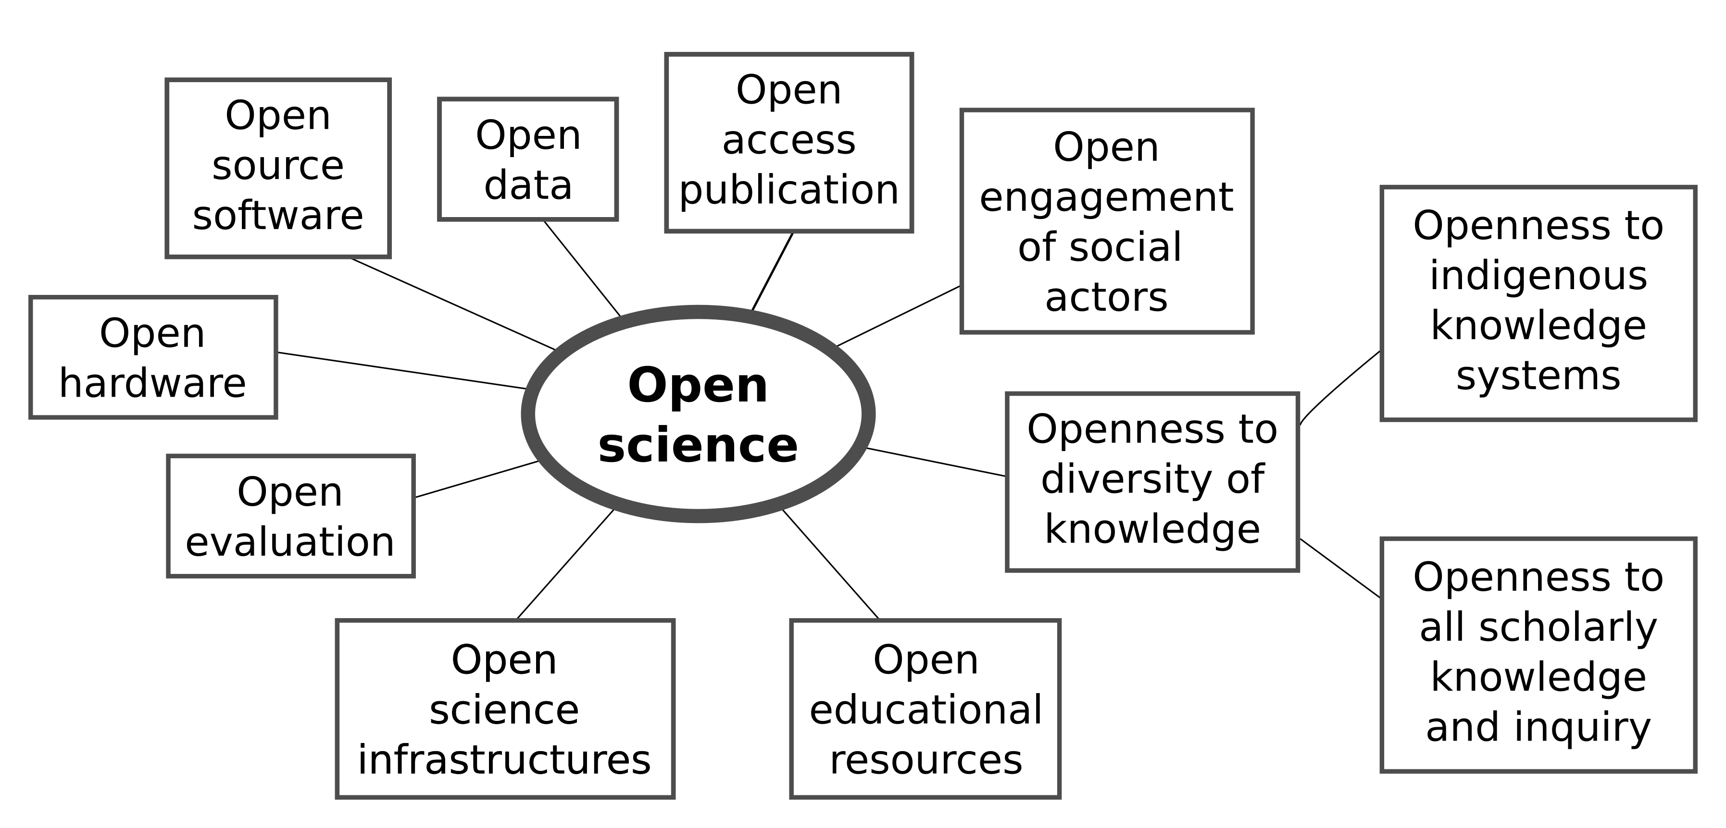
What is Open Science?
https://en.unesco.org/science-sustainable-future/open-science

Slide 17
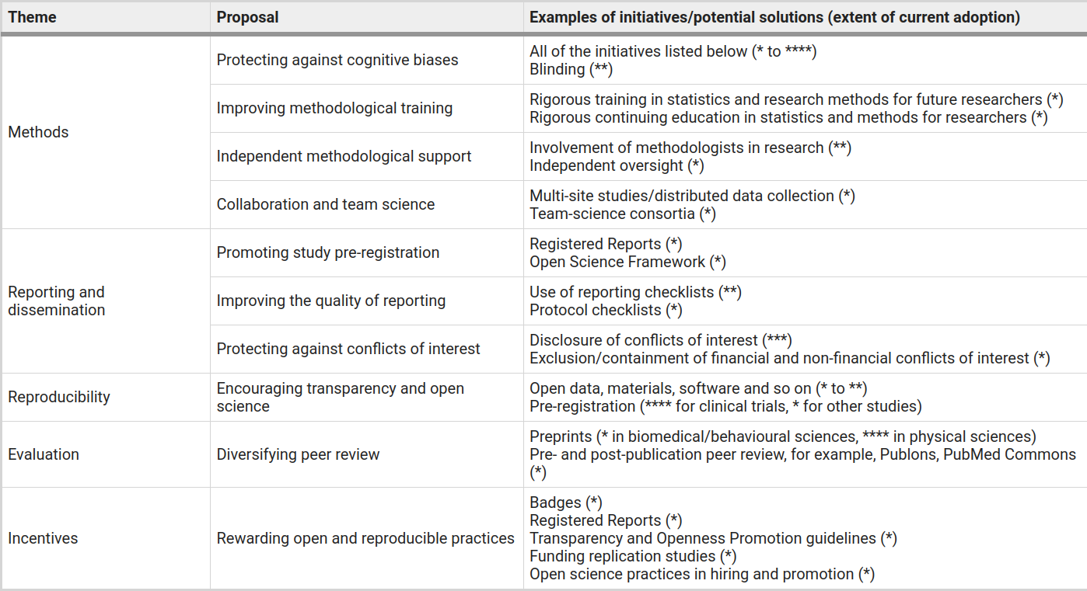
Solutions
Munafò, Marcus R., et al. "A manifesto for reproducible science." Nature human behaviour 1.1 (2017): 1-9.

Slide 18
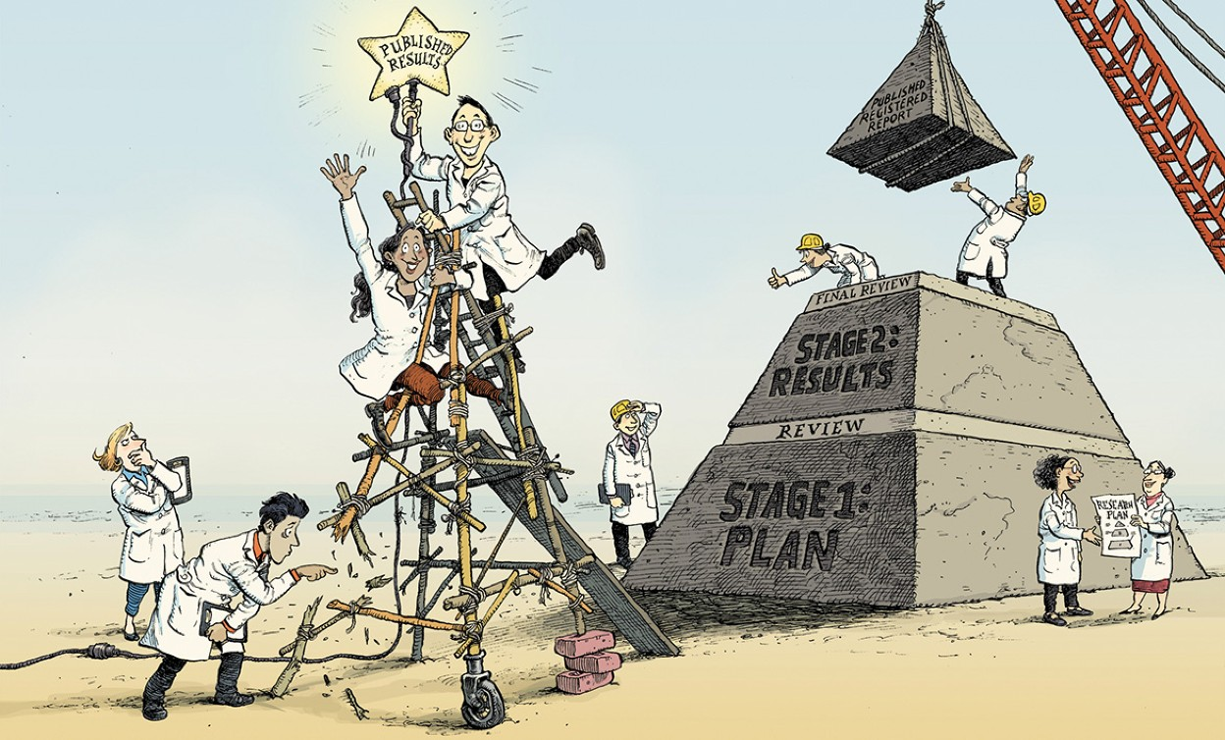
The Registered Report
Chambers, What’s next for Registered Reports?,
https://www.nature.com/articles/d41586-019-02674-6:

Slide 19

Workflow
Registered report
Pre-registration
https://www.elsevier.com/connect/editors-update/cortexs-registered-reports
https://help.osf.io/hc/en-us/articles/360019930913-Submit-a-Registered-Report

Slide 20
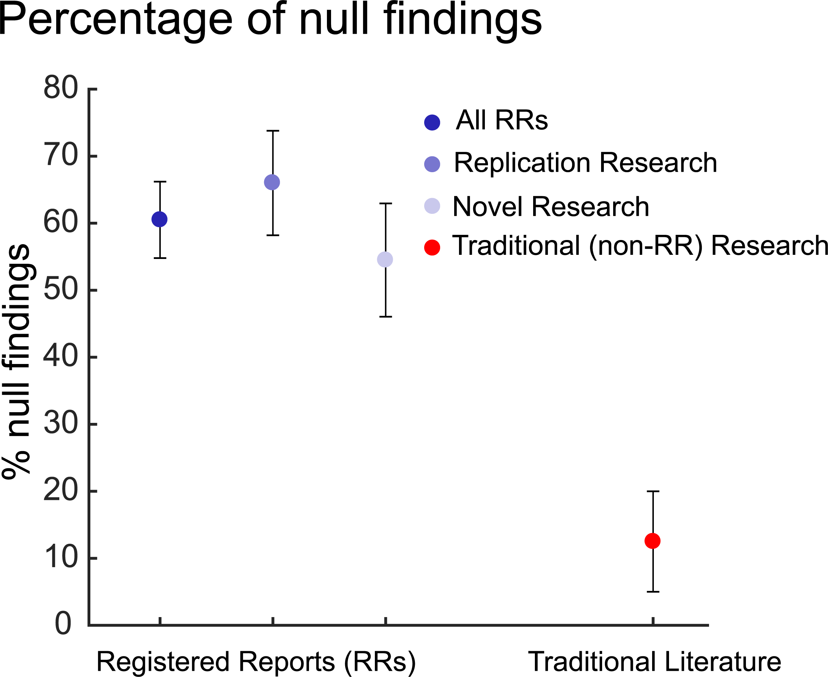
Open Science reports more honestly
Allen, Christopher, and David MA Mehler. "Open science challenges, benefits and tips in early career and beyond." PLoS biology 17.5 (2019): e3000246.

Slide 21
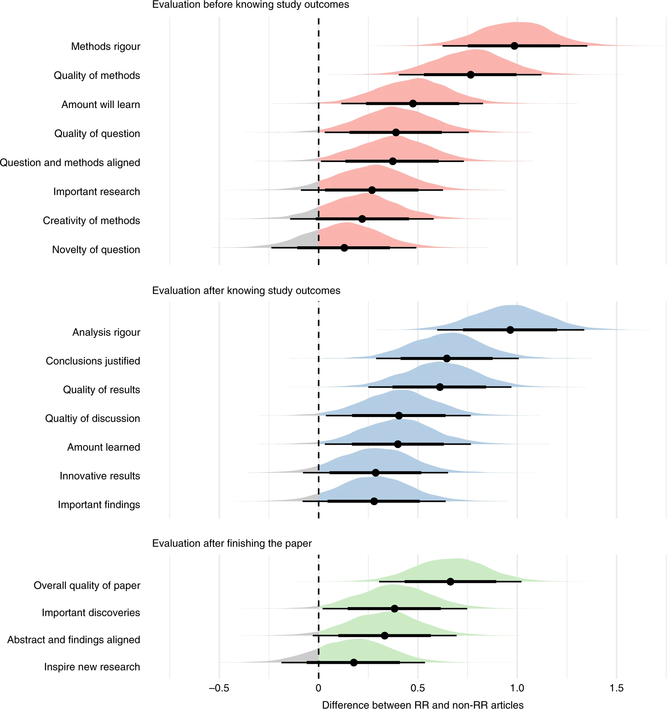
Open Science gives better papers
Soderberg, Courtney K., et al. "Initial evidence of research quality of registered reports compared with the standard publishing model." Nature Human Behaviour 5.8 (2021): 990-997.

Slide 22
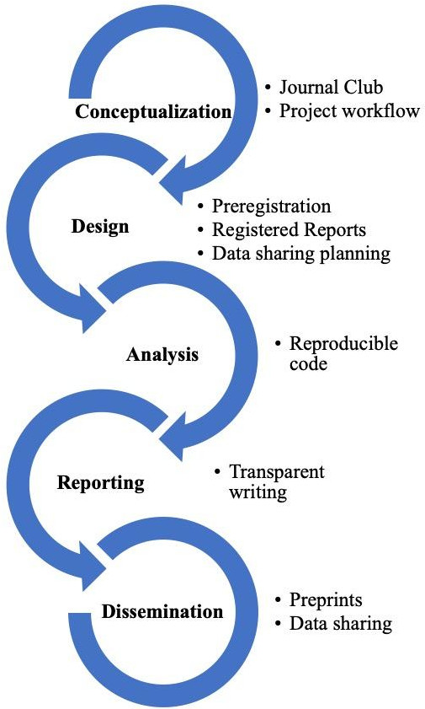
Easing into Open Science: A guide for graduate students and their advisors
We emphasize that engaging in open science behaviors need not be an all or nothing approach, but rather graduate students can engage with any number of the behaviors outlined.
Kathawalla, Ummul-Kiram, Priya Silverstein, and Moin Syed. "Easing into open science: A guide for graduate students and their advisors." Collabra: Psychology 7.1 (2021).

Slide 23
Conclusions
Open Science helps ...
  to find true/reproducible knowledge
  to report ‘no effect’ more honestly
  is easy to get into
Open Science has its problems as well
  no rewards yet

Slide 24
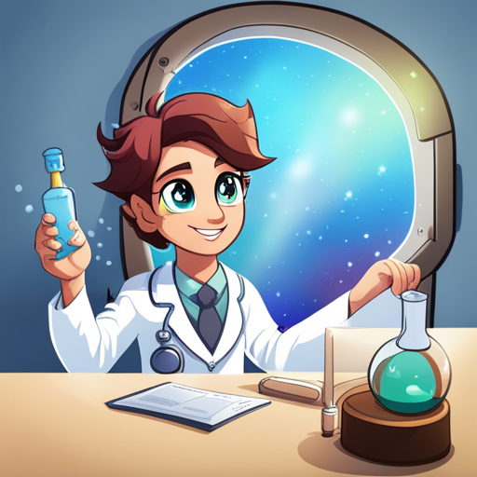
I Open Science!

Slide 25
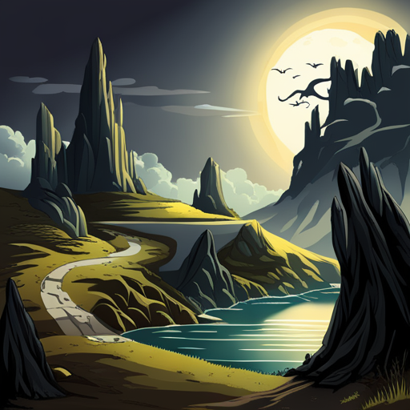

Slide 26
Proposition 1
In any presentation [1], it is hard to be critical when one enjoys the outcome.
  [1] including an Open Science presentation for an audience of people that are interested in Open Science

Slide 27
Why do scientists do this?
Publish
or
Perish
It’s just the game
Gopalakrishna, Gowri, et al. "Prevalence of questionable research practices, research misconduct and their potential explanatory factors: a survey among academic researchers in The Netherlands." (2021).

Slide 28
Why do scientists do this?
[...] a standard deviation increase on the publication pressure scale is
associated with an increase of 0.10 in the overall QRP mean score
Gopalakrishna, Gowri, et al. "Prevalence of questionable research practices, research misconduct and their potential explanatory factors: a survey among academic researchers in The Netherlands." (2021).

Slide 29
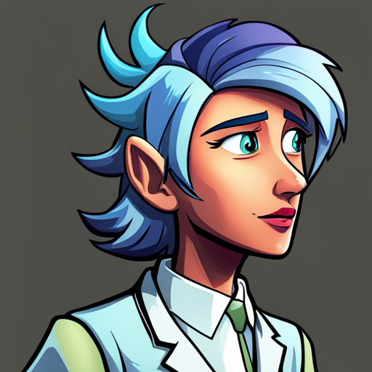
Why do scientists do this?
So, a person that in the top 0.000028% feeling publication pressure does 1 more QRP (out of 11) than a person at the bottom
0.000028%
[...] a standard deviation increase on the publication pressure scale is
associated with an increase of 0.10 in the overall QRP mean score
Unimpressed
Gopalakrishna, Gowri, et al. "Prevalence of questionable research practices, research misconduct and their potential explanatory factors: a survey among academic researchers in The Netherlands." (2021).

Slide 30
Why do scientists do this?
Scientists are complex
There is no single clear cause for them to do questionable research
Unimpressed
Gopalakrishna, Gowri, et al. "Prevalence of questionable research practices, research misconduct and their potential explanatory factors: a survey among academic researchers in The Netherlands." (2021).

Slide 31
Proposition 2
Doing Open Science is easier said than done,
and we prefer to say it is easy

Slide 32

Easing into Open Science?
[...] students may be worried, “Won’t it make it harder to publish my research?”
It is absolutely the case that some practices associated with open science [...] could result in some delays in publishing. However, some open science practices (e.g., posting preprints, Registered Reports) can speed up the process and make it easier
Kathawalla, Ummul-Kiram, Priya Silverstein, and Moin Syed. "Easing into open science: A guide for graduate students and their advisors." Collabra: Psychology 7.1 (2021).

Slide 33
Easing into Open Science?
Kathawalla, Ummul-Kiram, Priya Silverstein, and Moin Syed. "Easing into open science: A guide for graduate students and their advisors." Collabra: Psychology 7.1 (2021).

Slide 34
How easy was it?
This study was accepted as a Stage 1 Registered Report […] and registered on the OSF Registered Report Registry
Kathawalla, Ummul-Kiram, and Moin Syed. "Discrimination, Life Stress, and Mental Health Among Muslims: A Preregistered Systematic Review and Meta-Analysis." Collabra: Psychology 7.1 (2021): 28248.
Even though we did not pre-register the study, we were purposefully very transparent on our “researcher choices”
Kathawalla, Ummul-Kiram, and Moin Syed. "Occupational and Sociocultural Temporal Identity Integration: Links to Overall Health for Muslim-Heritage Immigrants to the United States." Journal of Muslim Mental Health 16.1 (2022).
No aspects of this study were preregistered
Syed, Moin, et al. "Somali migration to the United States: Understanding adaptation through digital stories." Cultural Diversity and Ethnic Minority Psychology 28.3 (2022): 361.

Slide 35
Challenge
Find a scientist in Uppsala that actually does Open Science, or at least:
  Registered report
  Reproducible research
    All code and data uploaded
    For sensitive data, provide a testing data set

Slide 36
Proposition 3
Doing a pre-registration is easier said than done,
as we need to change our way of thinking

Slide 37
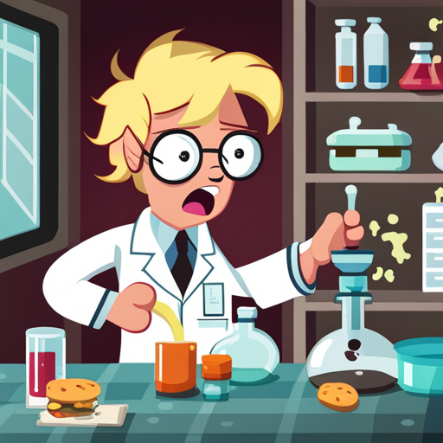
Number #1 pre-registration problem
I cannot know in advance how I am going to analyze my data in an exploratory study!
Yes, you do,
else it is OK

Slide 38
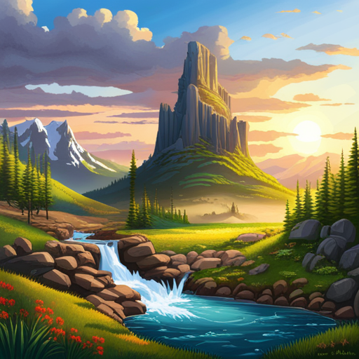
Measure things
We always do research for a reason.
We always compare groups or locations or (experimental) settings or sex or language, etc.
We assume there is a possible difference there

Slide 39

Unexpected findings
It is OK to go dig deeper in the data beyond what was preregistered: do report it as such!
Unexpected finding

Slide 40

Picking the right statistical test
It is OK if you have no idea what to expect.
It is OK to do statistics that reflect this, such as a T-test or a Kolmogorov–Smirnov test.
Or consider specification curve analysis (on the next slide)

Slide 41
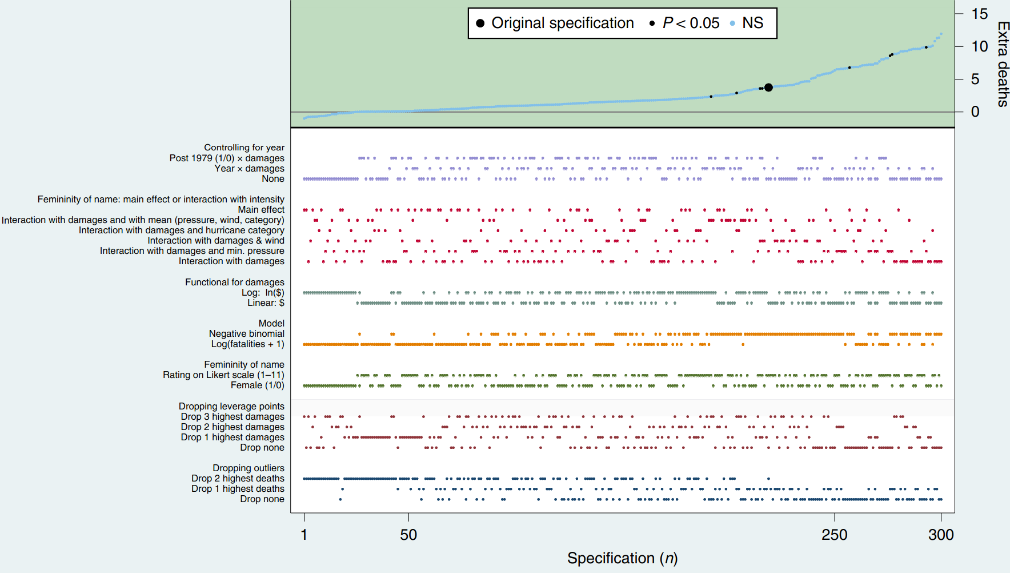
Specification curve analysis
The effect of assigning
female versus male
names to hurricanes
Simonsohn, Uri, Joseph P. Simmons, and Leif D. Nelson. "Specification curve analysis." Nature Human Behaviour 4.11 (2020): 1208-1214.

Slide 42

Specification curve analysis
The gender of the name of a hurricane has no effect on the number of extra deaths
Only a handful out of 300 tests show otherwise.
Simonsohn, Uri, Joseph P. Simmons, and Leif D. Nelson. "Specification curve analysis." Nature Human Behaviour 4.11 (2020): 1208-1214.

Slide 43
Proposition 4
Open Science gives rise to more complex conclusions, due to reproduction

Slide 44
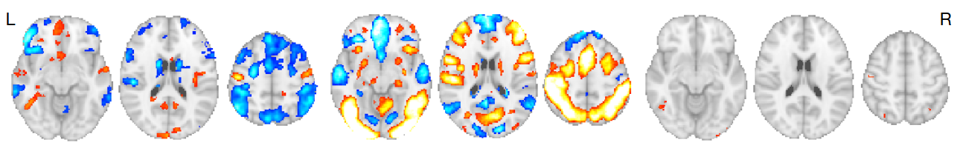
Different teams, different results
Research question: based on the same data, will different research groups accept/reject the same null-hypotheses?
‘There is [an effect] in [a brain area] between treatment A and B’
Botvinik-Nezer, Rotem, et al. "Variability in the analysis of a single neuroimaging dataset by many teams." Nature 582.7810 (2020): 84-88.

Slide 45
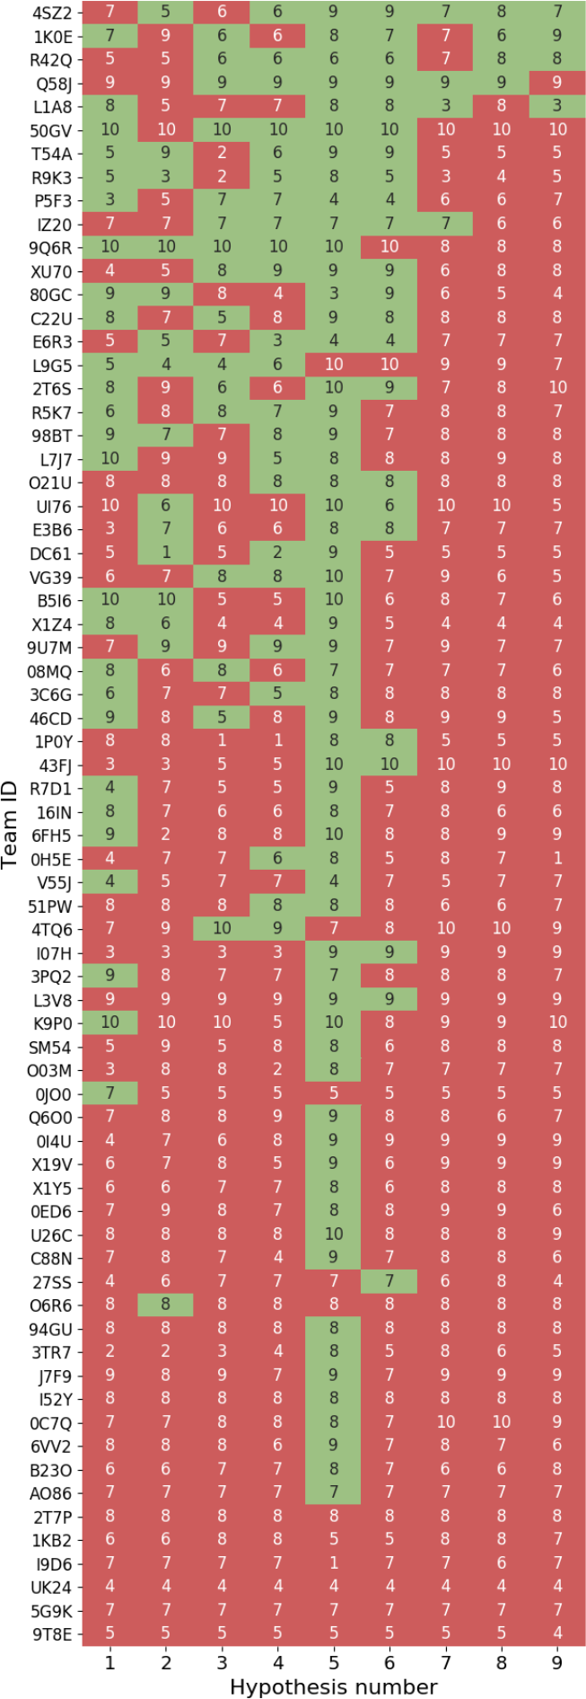
Different teams, different results
Botvinik-Nezer, Rotem, et al. "Variability in the analysis of a single neuroimaging dataset by many teams." Nature 582.7810 (2020): 84-88.

Slide 46
Different teams, different results
Botvinik-Nezer, Rotem, et al. "Variability in the analysis of a single neuroimaging dataset by many teams." Nature 582.7810 (2020): 84-88.

Slide 47
Conclusions
Open Science
  results in better science
  should not be hyped / should be criticized
  results in a more complex knowledge

Slide 48
Questions?
https://github.com/
richelbilderbeek/
osu_talk_20230414

Slide 49
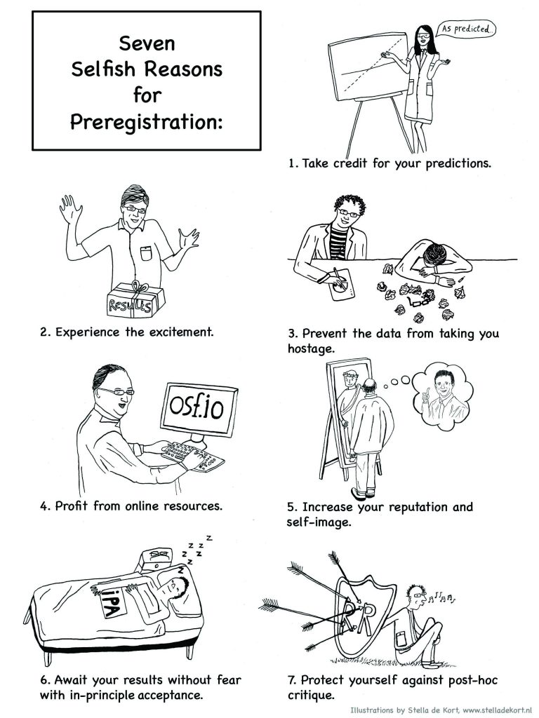
Selfish reason for preregistration
Wagenmakers, Eric-Jan, and Gilles Dutilh. "Seven selfish reasons for preregistration." APS Observer 29 (2016).

