Slide 1
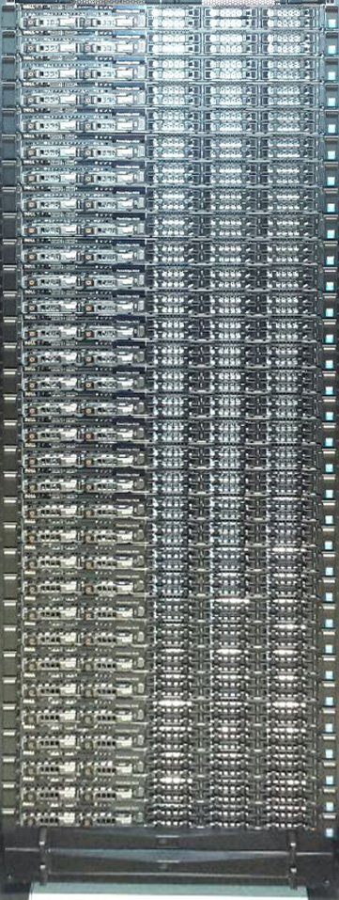
Running a full pipeline on the Peregrine computer cluster
© 2016 Richel Bilderbeek
https://github.com/richelbilderbeek/Peregrine

Slide 2
What, Why, Mastery
I will show how to set up a pipeline that is easy to run and uses multiple cores of Peregrine
Starting each step manually is tedius and might lead to irreproducible research
You can create a pipeline that is started with a single command

Slide 3
Overview
Job without dependencies
Sequential jobs
Parallel jobs

Slide 4
Job without dependencies
Started with ‘run.sh’
Runs ‘simple_job.sh’ on the nodes
‘simple_job.sh’ creates a file ‘out.txt’
simple_job.sh
run.sh
out.txt

Slide 5
Run and check it
p230198@pg-login:simple_job ./run.sh
Submitted batch job 7144352
p230198@pg-login:simple_job cat out.txt
Created by simple_job.sh

Slide 6
run.sh
#!/bin/bash
sbatch simple_job.sh

Slide 7
simple_job.sh
#!/bin/bash
#SBATCH --time=0:01:00
#SBATCH --nodes=1
#SBATCH --ntasks-per-node=1
#SBATCH --ntasks=1
#SBATCH --mem=1M
#SBATCH --job-name=simple_job
#SBATCH --output=simple_job.log
echo "Created by simple_job.sh" > out.txt

Slide 8
Sequential job
Started with ‘run.sh’
Runs jobs on the nodes in sequence
‘job1.sh’ creates a file ‘out.txt’
‘job2.sh’ appends to file ‘out.txt’
Creates a file ‘out.txt’
run.sh
job1.sh
job2.sh
out.txt

Slide 9
Run and check it
p230198@pg-login:simple_job ./run.sh
Submitted batch job 7144352
p230198@pg-login:simple_job cat out.txt
Created by simple_job.sh

Slide 10
run.sh
#!/bin/bash
sbatch simple_job.sh

Slide 11
simple_job.sh
#!/bin/bash
#SBATCH --time=0:01:00
#SBATCH --nodes=1
#SBATCH --ntasks-per-node=1
#SBATCH --ntasks=1
#SBATCH --mem=1M
#SBATCH --job-name=simple_job
#SBATCH --output=simple_job.log
echo "Created by simple_job.sh" > simple_job.txt

