Slide 1
Million Veterans Program
Richel Bilderbeek
2021-11-11
https://github.com/richelbilderbeek/presentation_million_veterans_program_20211111

Slide 2
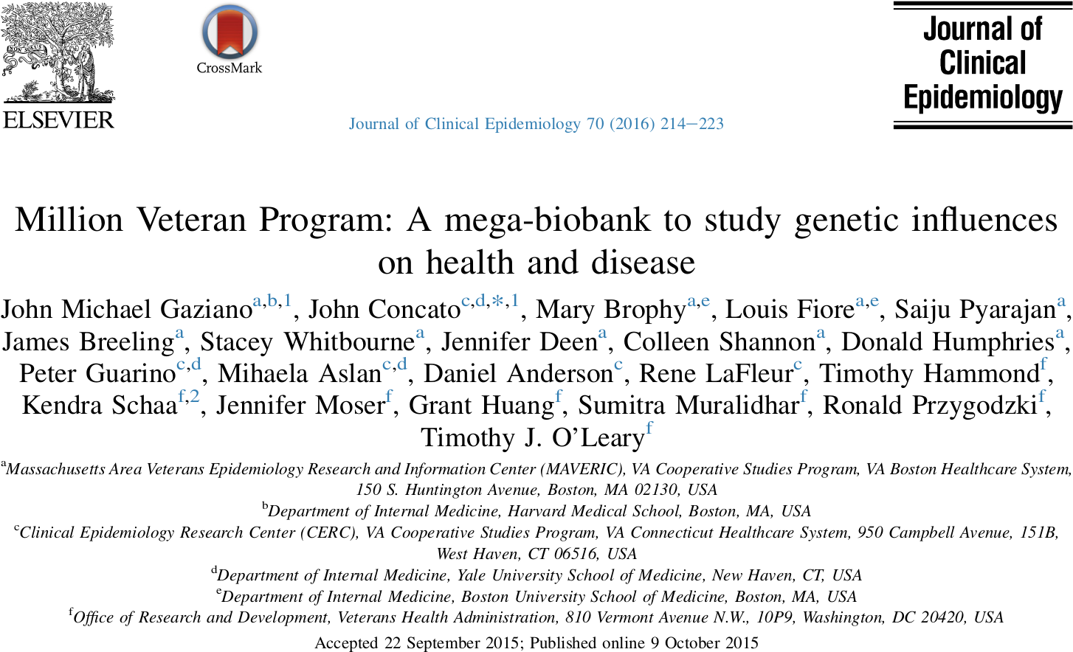
Gaziano, John Michael, et al. "Million Veteran Program: A mega-biobank to study genetic influences on health and disease." Journal of clinical epidemiology 70 (2016): 214-223.

Slide 3
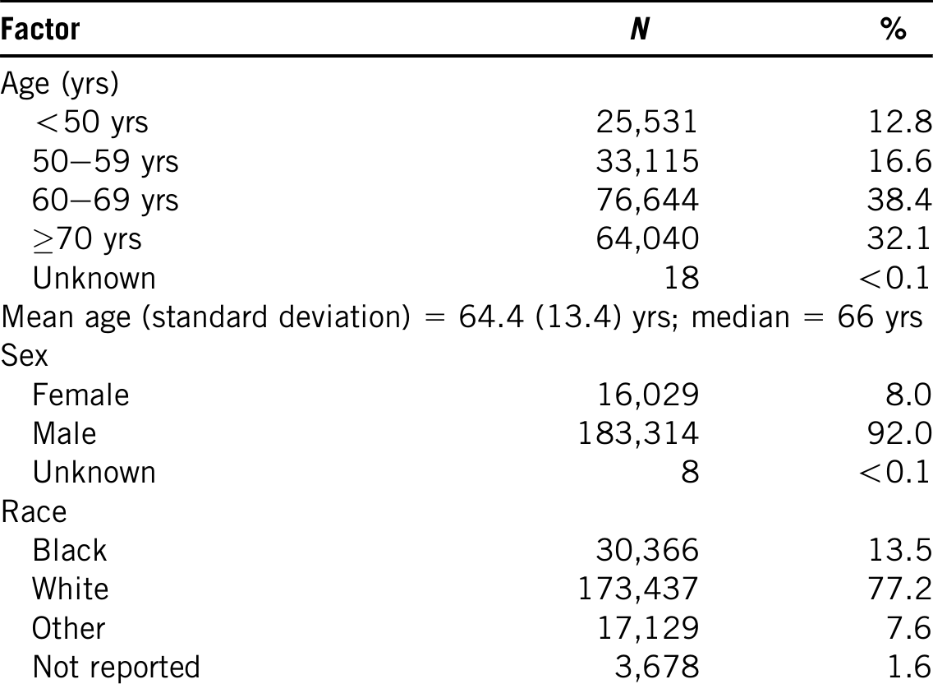
Main cohort info
Gaziano, John Michael, et al. "Million Veteran Program: A mega-biobank to study genetic influences on health and disease." Journal of clinical epidemiology 70 (2016): 214-223.

Slide 4
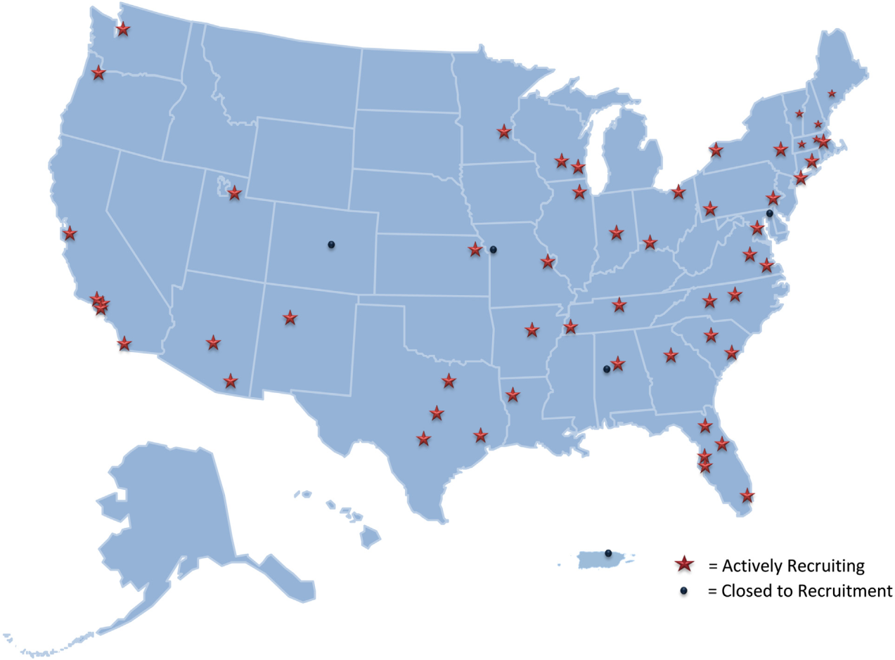
Recruitment
Gaziano, John Michael, et al. "Million Veteran Program: A mega-biobank to study genetic influences on health and disease." Journal of clinical epidemiology 70 (2016): 214-223.

Slide 5
Main data
Medical record
Questionnaire data
Peripheral blood: plasma, buffy coat, and DNA
Genetic data:
All participant: 723K markers
28k participants: whole-exome sequencing
2k participants: whole genome sequencing
Gaziano, John Michael, et al. "Million Veteran Program: A mega-biobank to study genetic influences on health and disease." Journal of clinical epidemiology 70 (2016): 214-223.

Slide 6
Affymetrix Axiom Biobank Array
Enriched for exome SNPs
Has tag SNPs validated for diseases, including psychiatric traits;
Has been augmented with biomarkers of specific interest to the VA population, including:
enrichment for African American and Hispanic ancestry markers
validated markers for common diseases (such as hypertension, prostate cancer, and breast cancer
Gaziano, John Michael, et al. "Million Veteran Program: A mega-biobank to study genetic influences on health and disease." Journal of clinical epidemiology 70 (2016): 214-223.

Slide 7
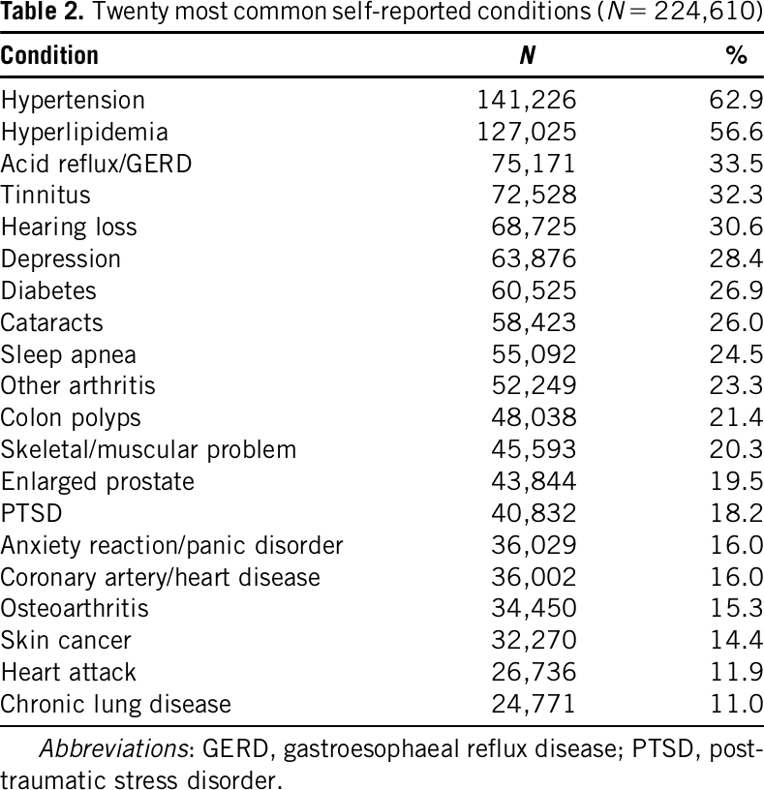
Self-reported conditions
Gaziano, John Michael, et al. "Million Veteran Program: A mega-biobank to study genetic influences on health and disease." Journal of clinical epidemiology 70 (2016): 214-223.

Slide 8
Access to data
Access to metadata for initial queries to define population
Access to detailed data after first approval
Access to HPC after peer review
After analysis, add key findings, data, analysis and publication

Slide 9
Why interesting for us?
Diverse USA population: ‘only’ 77% white
28k WES and 2k WGS → CNVs?

