Slide 1
razzo choices
Richel J.C. Bilderbeek

Slide 2
Overview
Parameter selection
  MBD regime vs nu & q
  # taxa and % extinct vs lambda and mu
Inference models selection
  Generative and best non-generative vs simplest and most complex

Slide 3
Parameter selection
MBD parameters: lambda, mu, nu, q
Compound parameters: # taxa, % extinct taxa, MBD regime
Choices, in this order:
MBD regime vs nu & q
# taxa and % extinct vs lambda and mu
= Richel’s favorite
= Giovanni’s favorite

Slide 4
MBD regime vs nu & q
MB regime | # MB events | q | nu
Few intense MB events | 2 | 1 | T / 2
Intermediate | 4 | 0.5 | T / 4
Many weak MB events | 8 | 0.25 | T / 8
Do/don’t select full/reconstructed trees
with observable/unobservable
number of MB events
Do/don’t track full/reconstructed trees
with observable/unobservable
number of MB events
nu: MB event trigger rate
q: fraction of lineages that speciate during MB event
T: crown age

Slide 5
MBD regime vs nu & q
nu | q
T / 2 | 1
T / 4 | 0.5
T / 8 | 0.25
In all 9 combinations
Do/don’t track full/reconstructed trees
with observable/unobservable
number of MB events
Do/don’t select full/reconstructed trees
with observable/unobservable
number of MB events
nu: MB event trigger rate
q: fraction of lineages that speciate during MB event
T: crown age

Slide 6
# taxa and % extinct vs lambda and mu
Known: nu and q
# extant taxa | % extinct
50 | 0
100 | 25
200 | 50
In all 9 combinations
Do/don’t select
the precise number of extant taxa.
Do/don’t select
the precise percentage
of taxa to go extinct.
Do/don’t track
the precise number of extant taxa.
Do/don’t track
the precise percentage
of taxa to go extinct.

Slide 7
# taxa and % extinct vs lambda and mu
Known: nu and q
lambda | mu
0.4 | 0.0
0.6 | 0.1
0.8 | 0.2
In all 9 combinations
Do/don’t select/limit
a precise number of extant taxa.
Do/don’t select
a precise percentage
of taxa to go extinct.
Do/don’t track
the precise number of extant taxa.
Do/don’t track
the precise percentage
of taxa to go extinct.
lambda: speciation rate
mu: extinction rate

Slide 8
Inference models selection
Generative and best non-generative vs simplest and most complex

Slide 9
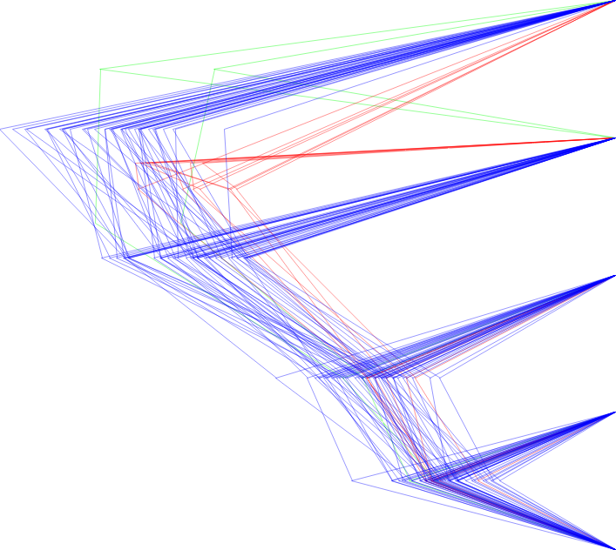
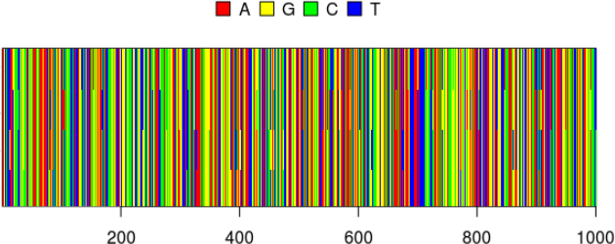
Generative and best non-generative vs simplest and most complex
Pseudo generative
JC69 strict BD
Most complex
GTR RLN BD
No
Site model | Clock model | Tree model | Marginal log likelihood | Weight
JC69 | strict | BD | -194.45 | 66%
GTR | RLN | Yule | -195.20 | 31%
... | ... | ... | ... | ...
Best non-generative
GTR RLN Yule

Slide 10
Generative and best non-generative vs simplest and most complex
Pseudo generative
JC69 strict BD
Intermediate
JC69 RLN BD
Intermediate
GTR strict BD
Most complex
GTR RLN BD
Site model | Clock model | Tree model | Marginal log likelihood | Weight
JC69 | strict | BD | track | track
JC69 | RLN | BD | track | track
GTR | strict | BD | track | track
GTR | RLN | BD | track | track

Slide 11
Other decisions
Number of different alignments per tree: 1, 2, more
Number of BEAST2 runs per alignment: 1, 2, more
Number of MBD trees per parameter setting: 10, 100, 1000, calculate from experiment time
DNA alignment length: 100, 1000, 10k, 100k

