Slide 1


Open Science and scientists being humans
Richèl Bilderbeek
2023-01-29
https://github.com/richelbilderbeek/science_fika_open_science_20230129

Slide 2
Overview
What is science?
What is the problem?
How to solve it

Slide 3
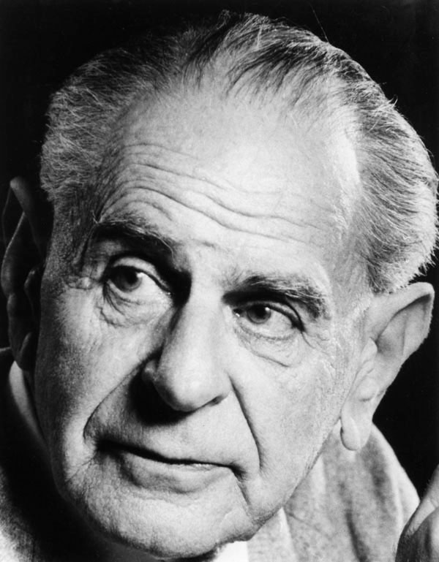
What is science?

Slide 4
What is science?
Science is a systematic endeavor that builds and organizes knowledge in the form of testable explanations and predictions about the universe.

Slide 5
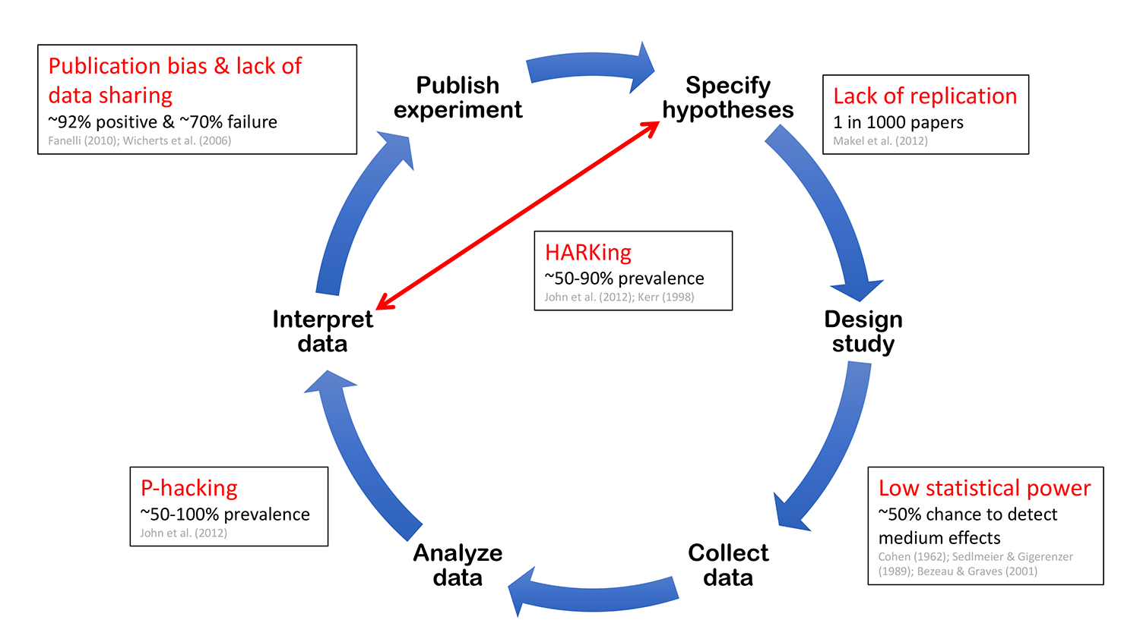
Hypothetico-deductive cycle
From https://sarneckalab.blogspot.com/2018/05, which is adapted from
Munafò, Marcus R., et al. "A manifesto for reproducible science." Nature human behaviour 1.1 (2017): 1-9.

Slide 6
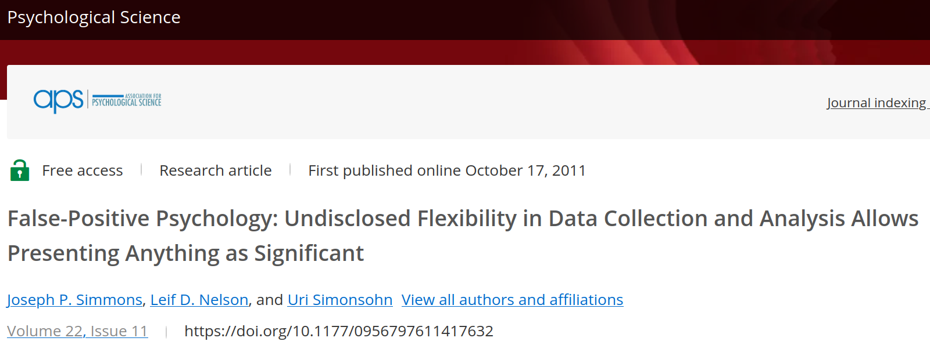
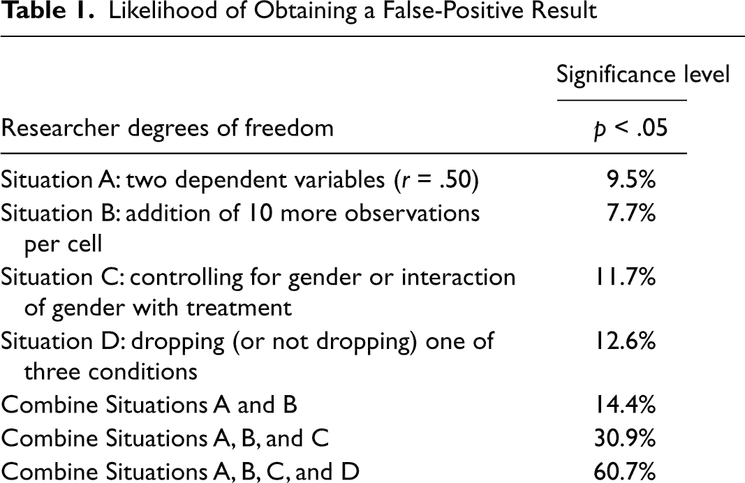
Example
[How the data is analyzed]

Slide 7
Survey for women
How tall are you?
Do you prefer red over green?
Is your phone number an even number?
Do you prefer Minecraft over Fortnite?
… 17 other yes/no questions ...
Smart!
20 things

Slide 8
Hypothesis
H0: Women that prefer the color red over green are, on average, equally tall as women that prefer the other way around
H1: Women that prefer the color red over green are, on average, not equally tall as women that prefer the other way around

Slide 9
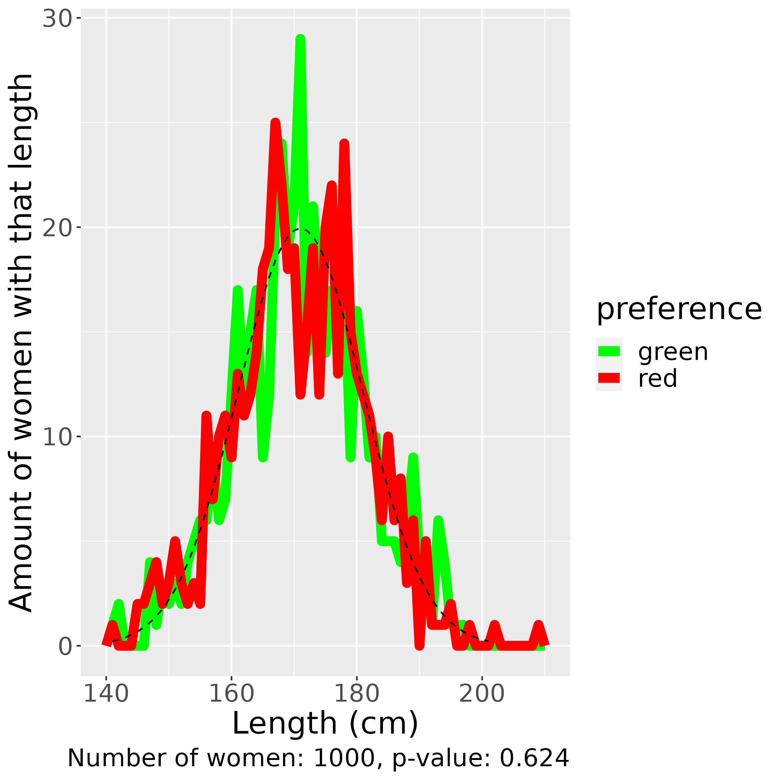
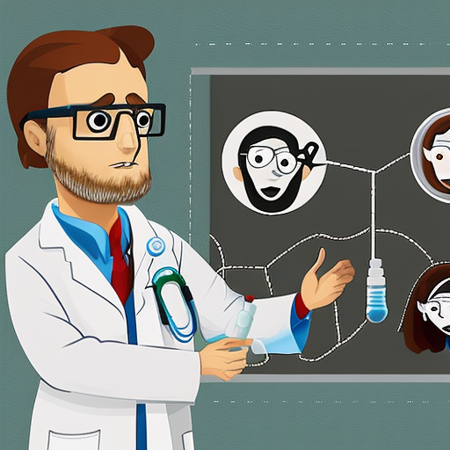
Method
If p-value less than 0.05:
Eureka!
A significant finding!

Slide 10
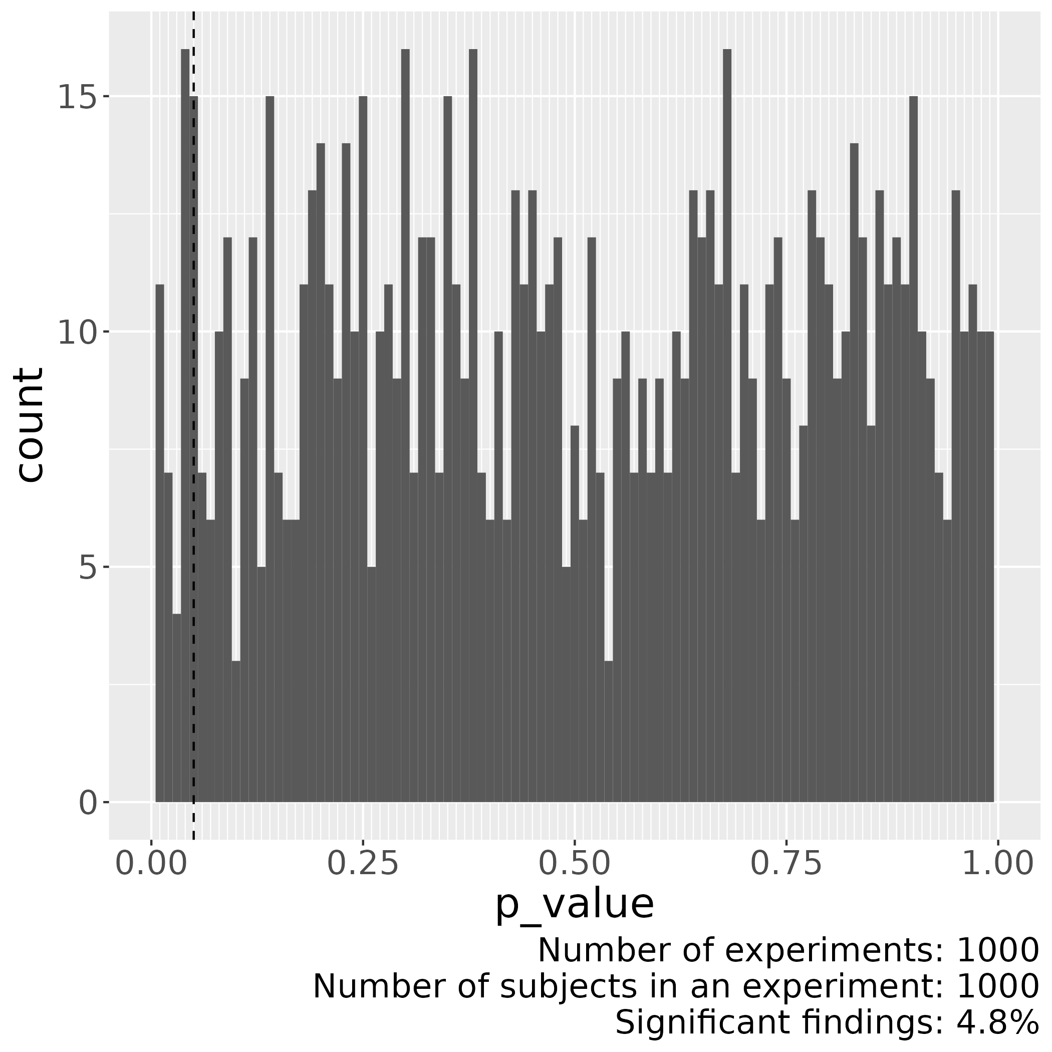
Method
The chance
to find
something
significant
when there
is no effect
is 5%
Tip 1: measure 20 things!

Slide 11
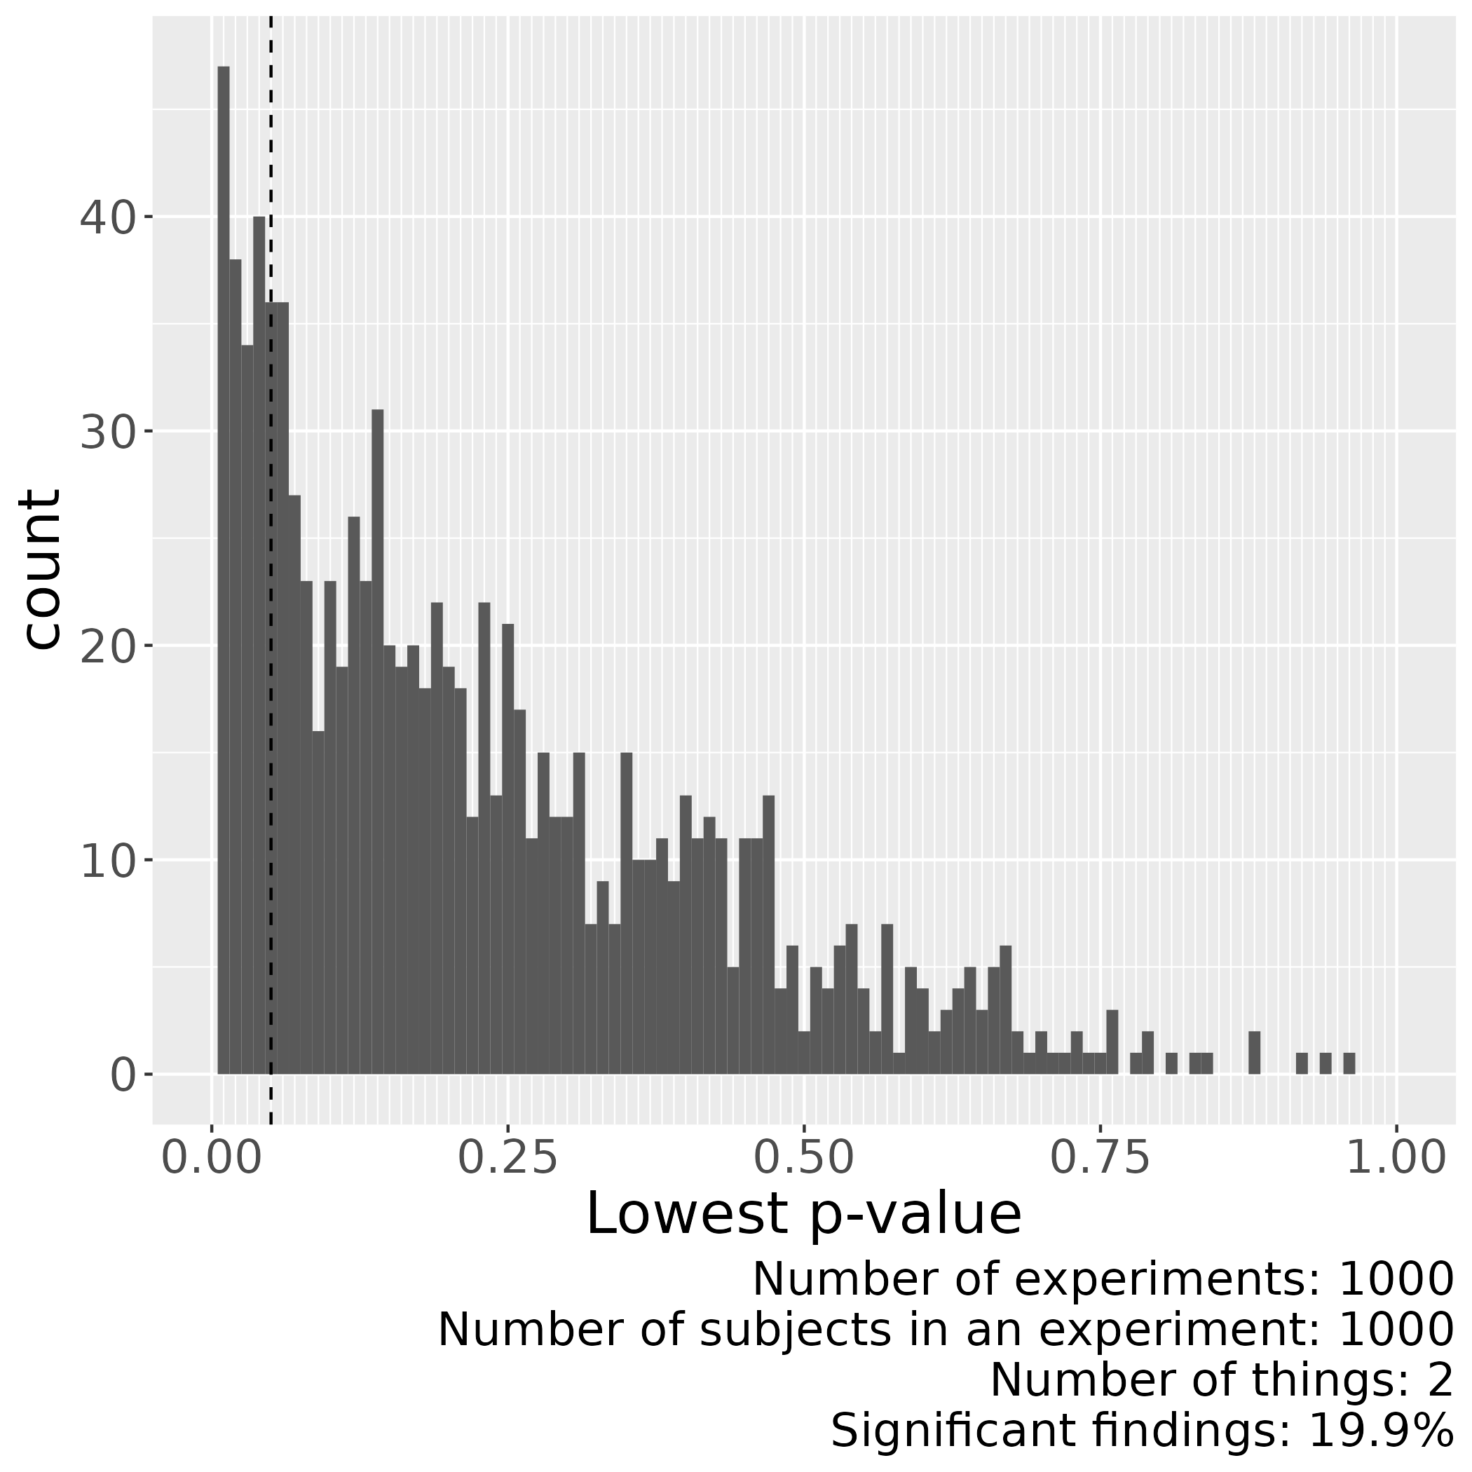
Method
The chance to find
something significant
when there is no effect
when using 2 things
is around 19.9%
Tip 2: there are 36 ways to tweak an experiment [1]
[1] Wicherts, Jelte M., et al. "Degrees of freedom in planning, running, analyzing, and reporting psychological studies: A checklist to avoid p-hacking." Frontiers in psychology 7 (2016): 1832.

Slide 12

A publication!
I always
suspected this!
Women
with even
phone numbers
are taller!
Asked 20 things in survey,
Reports only 1

Slide 13
Is this scientist evil?
Asked 20 things in survey,
Reports only 1

Slide 14
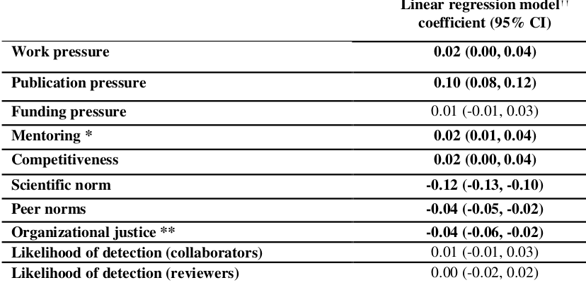
Why do scientists do this?
Publish
or
Perish
It’s just the game
Gopalakrishna, Gowri, et al. "Prevalence of questionable research practices, research misconduct and their potential explanatory factors: a survey among academic researchers in The Netherlands." (2021).

Slide 15
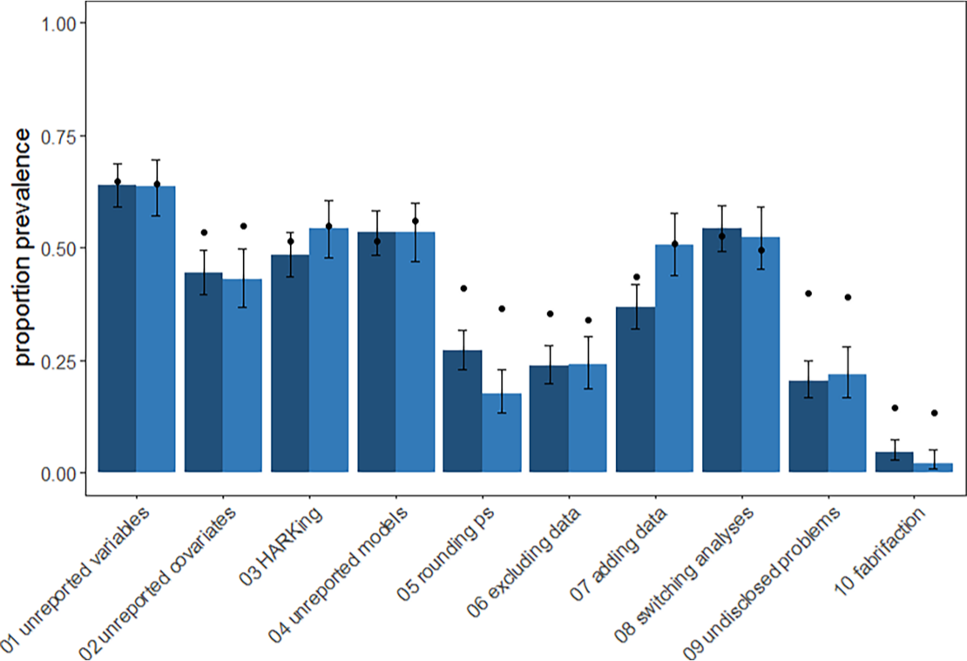
How often do people do this?
Ecology
Evolution
Fraser, Hannah, et al. "Questionable research practices in ecology and evolution." PloS one 13.7 (2018): e0200303.

Slide 16
Is that a problem?
Reproducibility Crisis
  50% cannot reproduce their own work [1]
  11% of pre-clinical cancer studies could be replicated [2]
[1] Baker, Monya. "1,500 scientists lift the lid on reproducibility." Nature News 533.7604 (2016): 452.
[2] Begley, C. Glenn, and Lee M. Ellis. "Raise standards for preclinical cancer research." Nature 483.7391 (2012): 531-533.

Slide 17
What are threats to reproducible research?
From https://sarneckalab.blogspot.com/2018/05, which is adapted from
Munafò, Marcus R., et al. "A manifesto for reproducible science." Nature human behaviour 1.1 (2017): 1-9.

Slide 18
What is Open Science?

Slide 19
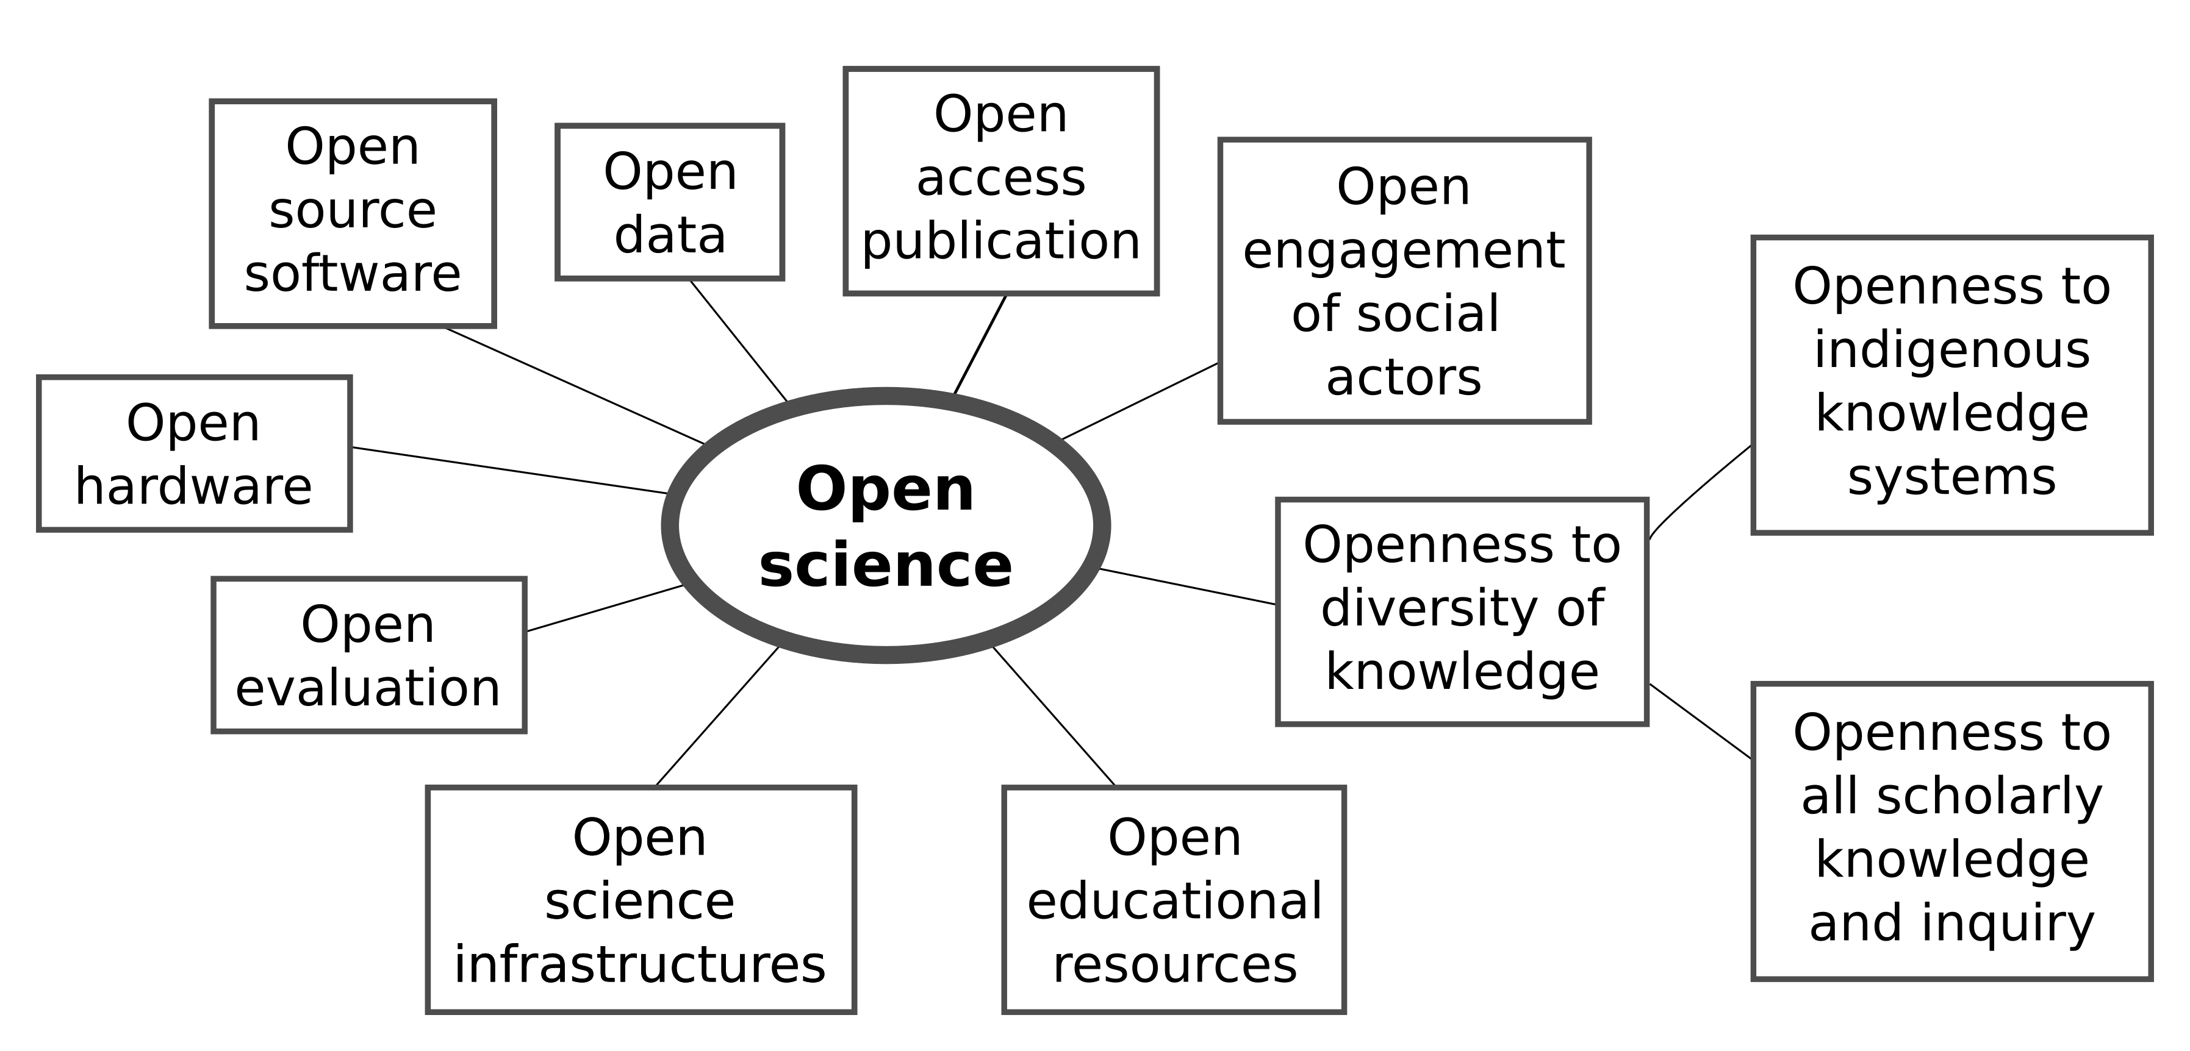

What is Open Science?
https://en.unesco.org/science-sustainable-future/open-science

Slide 20
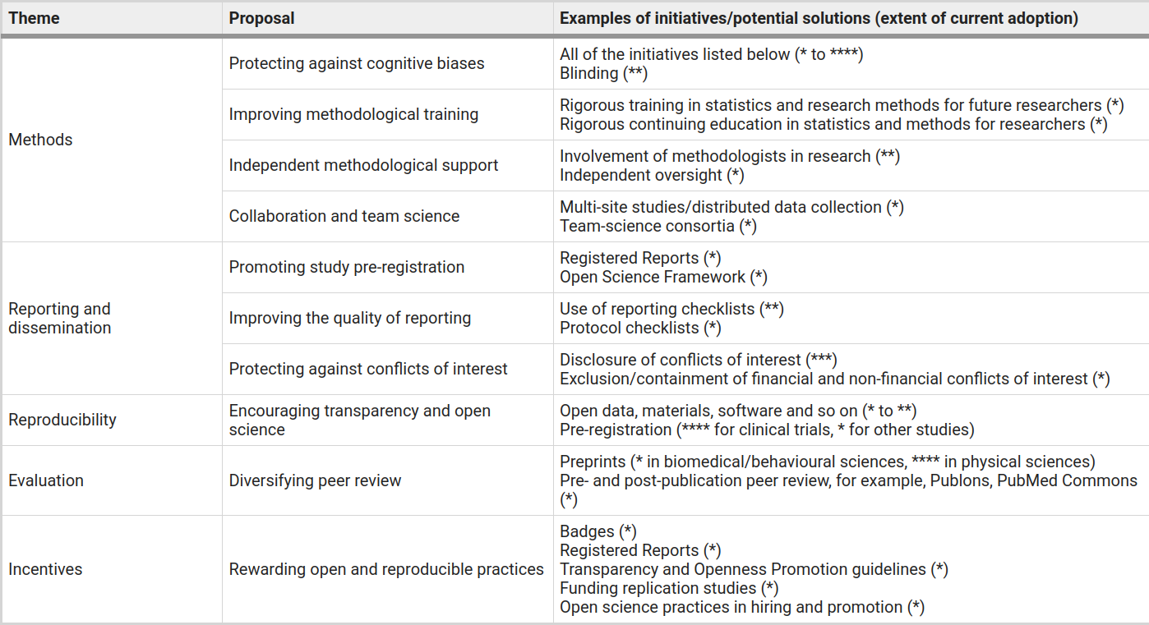
Solutions
Munafò, Marcus R., et al. "A manifesto for reproducible science." Nature human behaviour 1.1 (2017): 1-9.

Slide 21
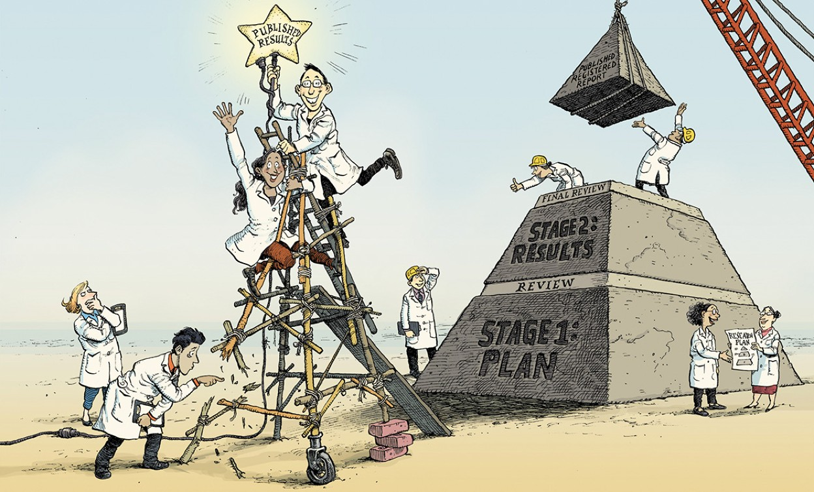
The Registered Report
Chambers, What’s next for Registered Reports?,
https://www.nature.com/articles/d41586-019-02674-6:

Slide 22

Workflow
Pre-registration
Registered report
https://www.elsevier.com/connect/editors-update/cortexs-registered-reports
https://help.osf.io/hc/en-us/articles/360019930913-Submit-a-Registered-Report

Slide 23
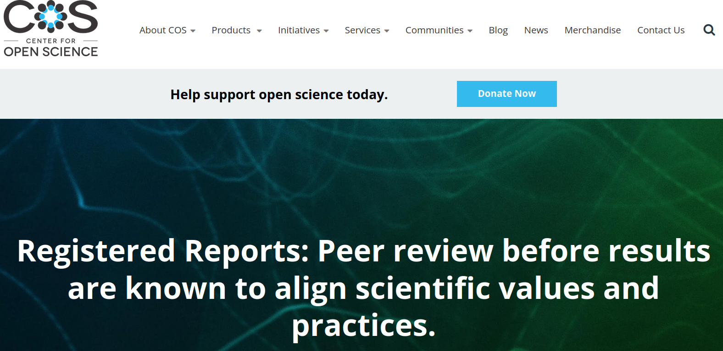
How this looks like
https://www.cos.io/initiatives/registered-reports

Slide 24
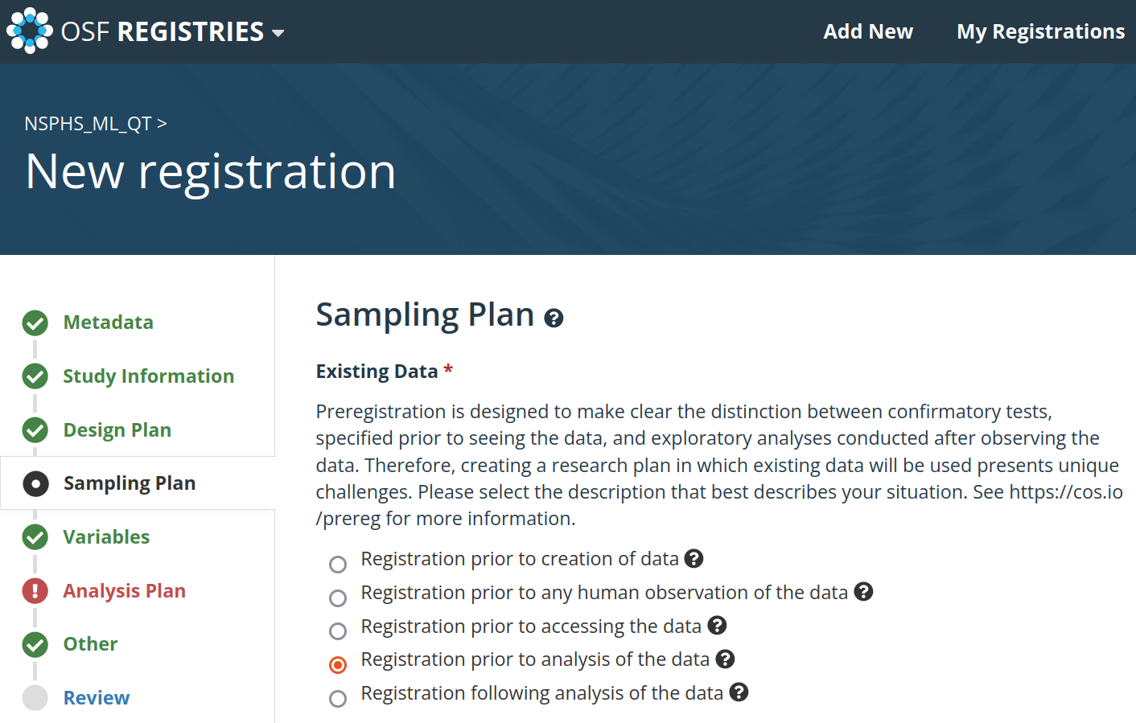
How this looks like

Slide 25
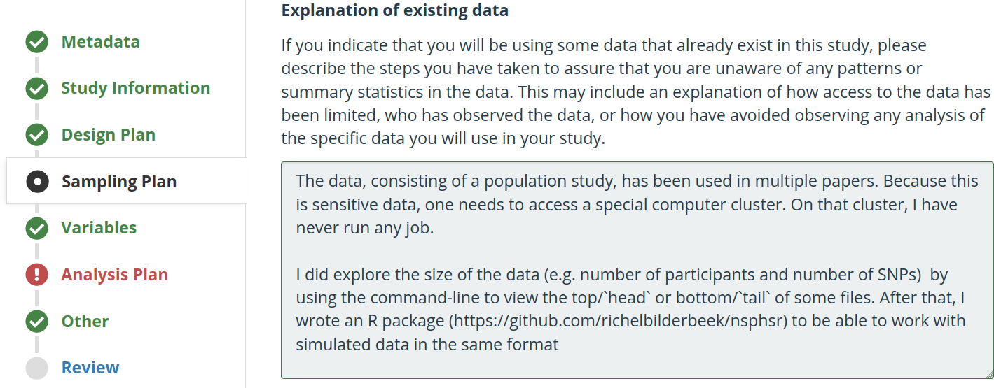
How this looks like

Slide 26
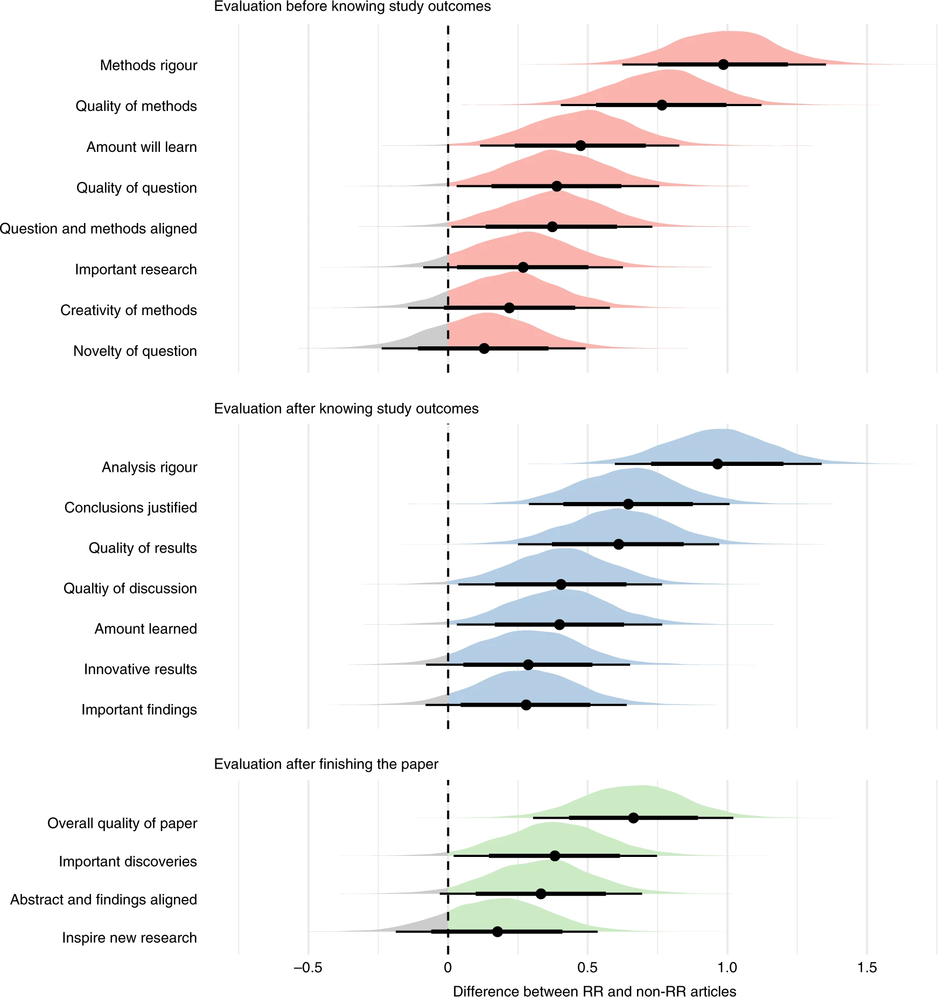
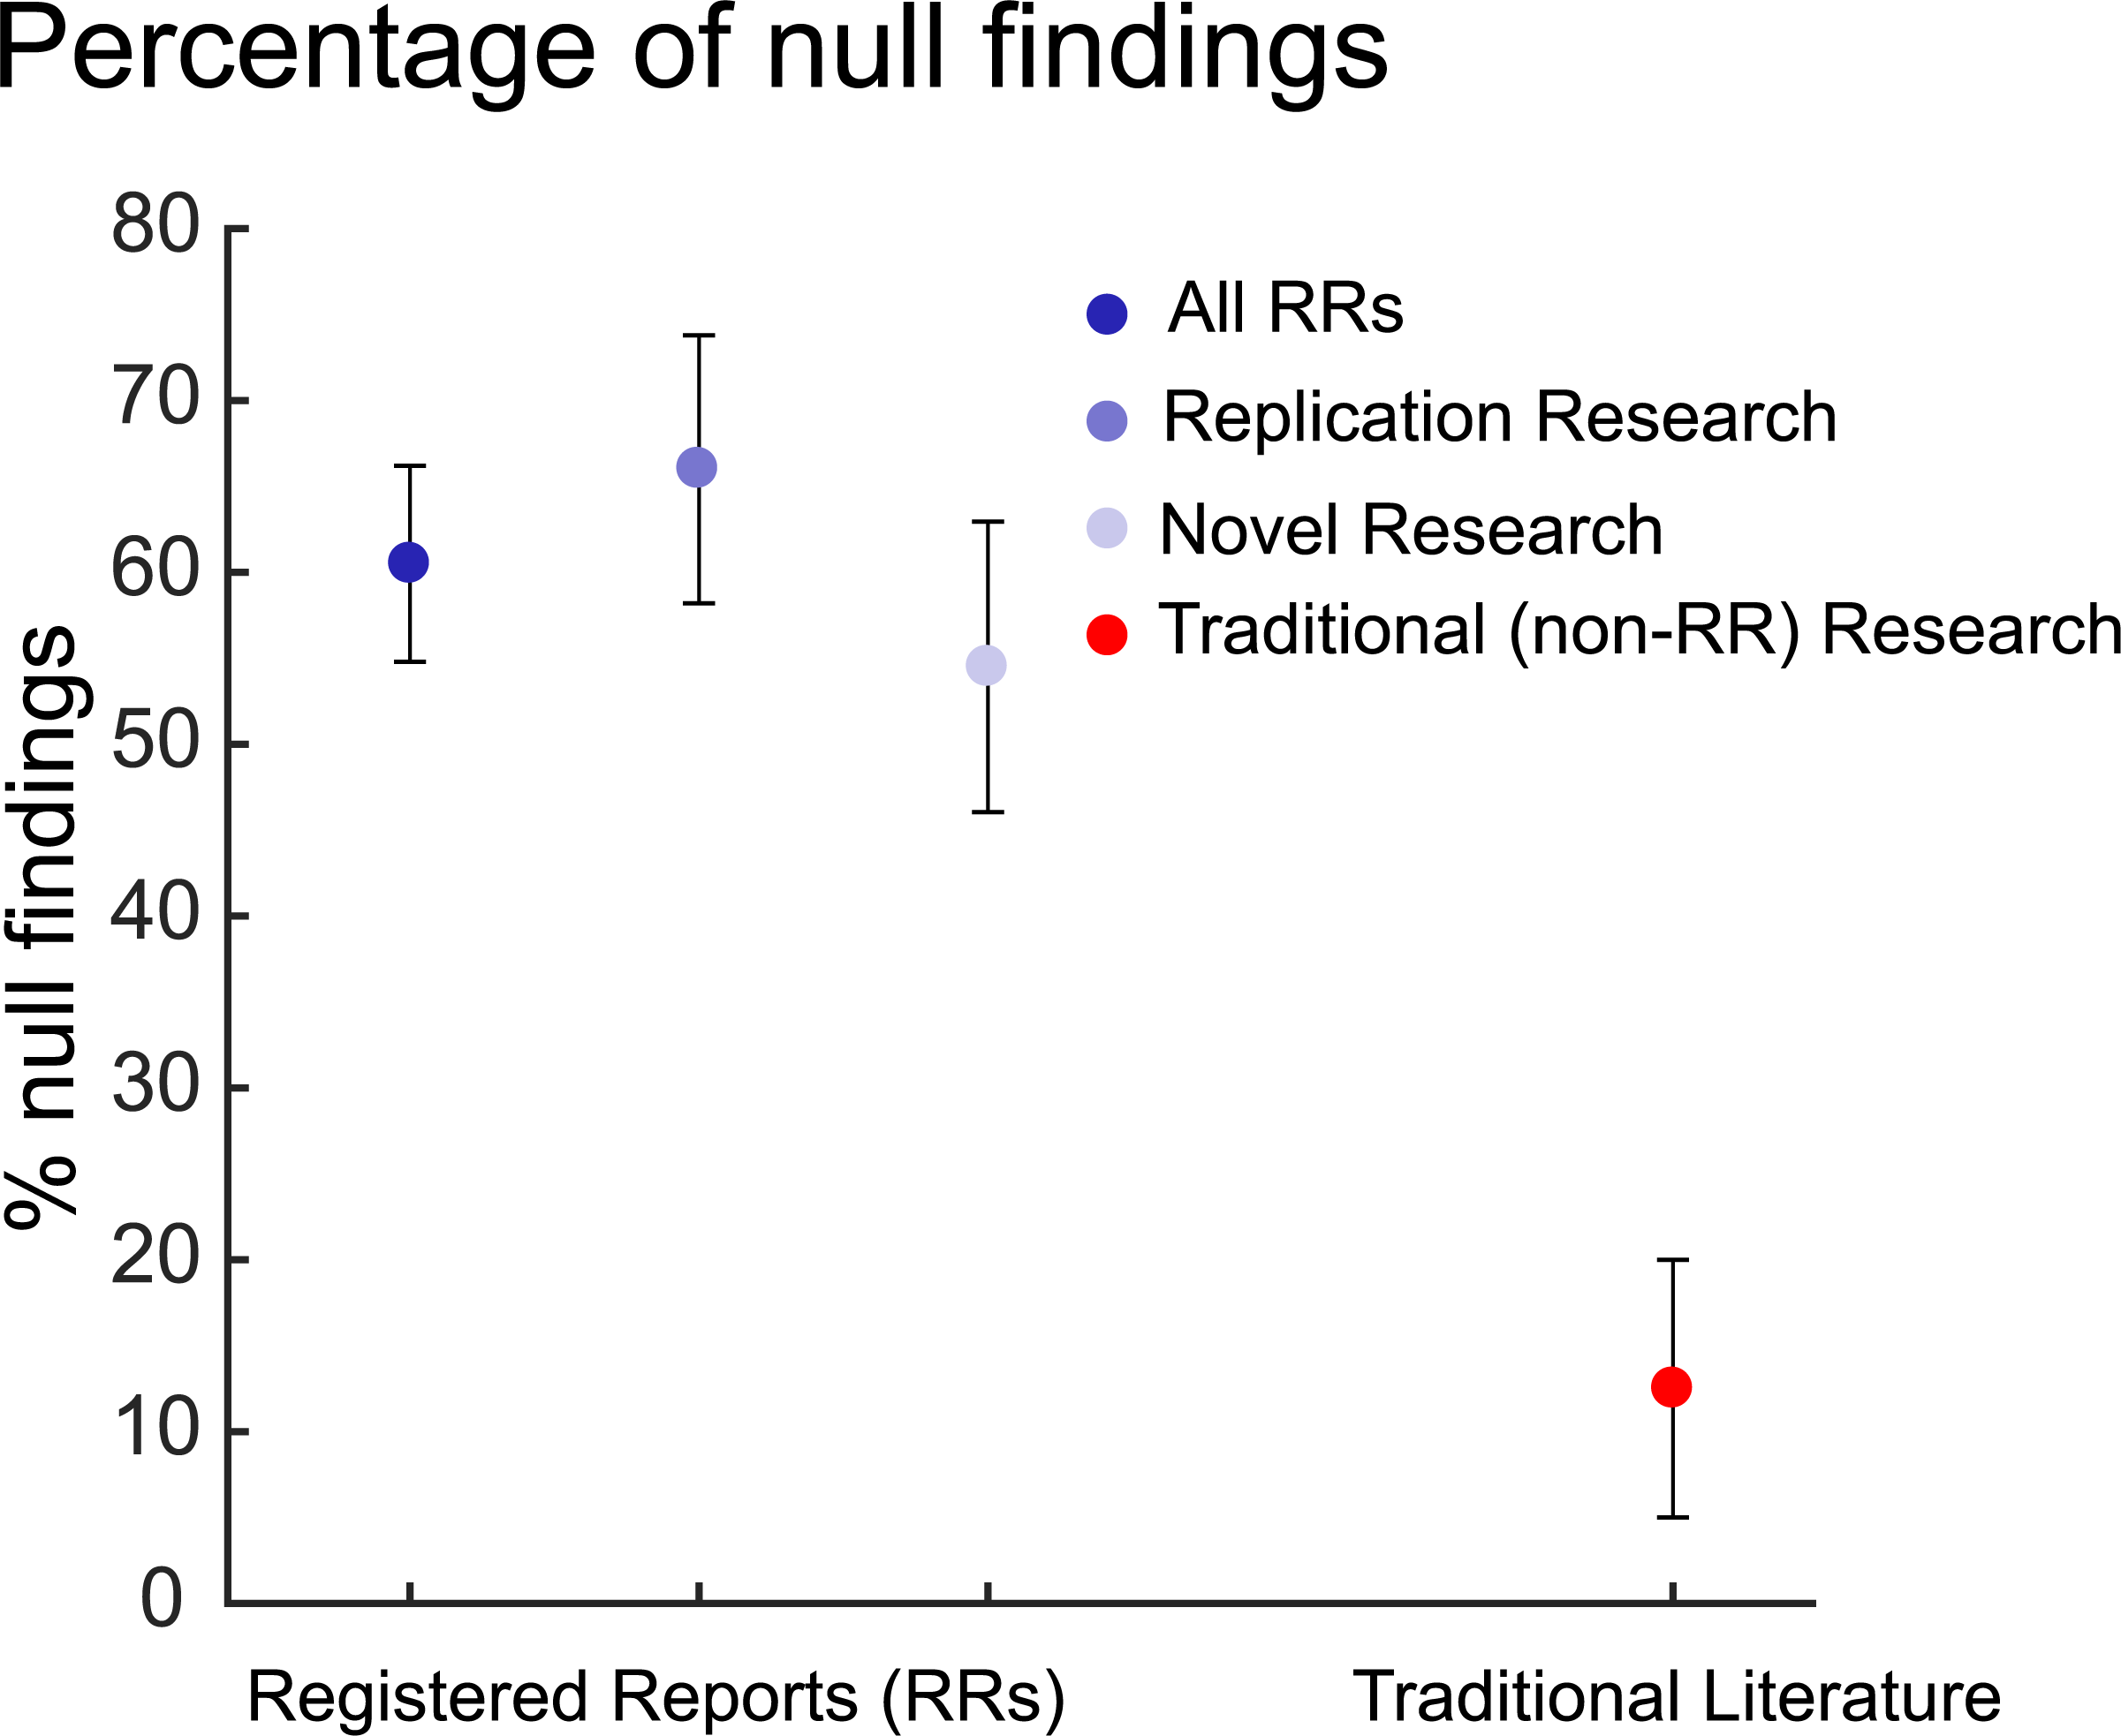
Effect on academia
More null findings [1]
Nicer papers [2] ->
[1] Allen, Christopher, and David MA Mehler. "Open science challenges, benefits and tips in early career and beyond." PLoS biology 17.5 (2019): e3000246.
[2] Soderberg, Courtney K., et al. "Initial evidence of research quality of registered reports compared with the standard publishing model." Nature Human Behaviour 5.8 (2021): 990-997.

Slide 27
Conclusions
Reproducible research is important
It is (too) easy to report a false positive
Registered Reports make it harder to report a false positive
Process is easy
Registered Reports are nicer papers
So, there is nothing that holds you back!

Slide 28
Questions?
https://github.com/richelbilderbeek/open_science_presentation_20211111

Slide 29
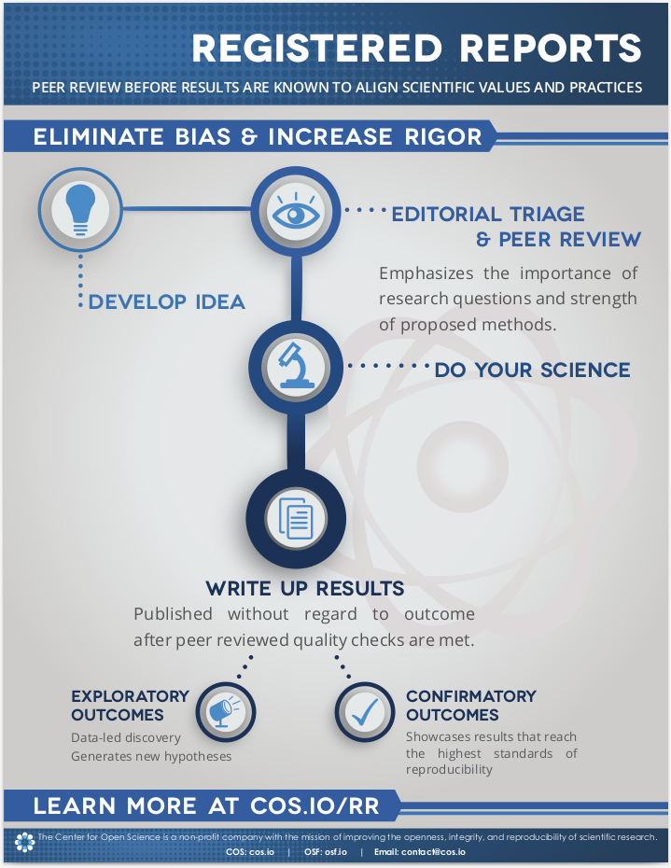
Workflow
https://osf.io/es5vu/

Slide 30
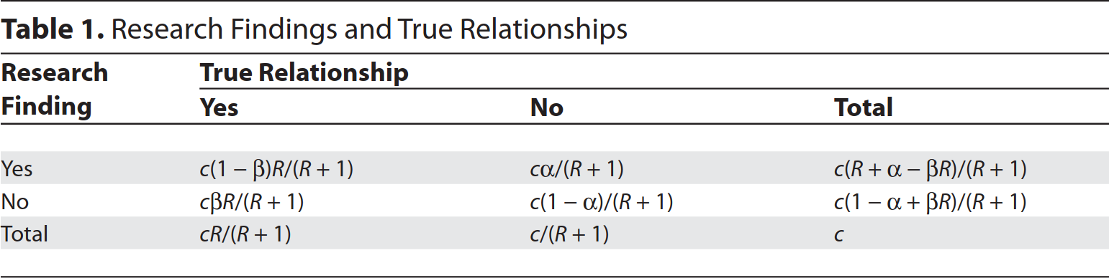
Most published research findings are false
Ioannidis, John PA. "Why most published research findings are false." PLoS medicine 2.8 (2005): e124.

Slide 31
Allen, Christopher, and David MA Mehler. "Open science challenges, benefits and tips in early career and beyond." PLoS biology 17.5 (2019): e3000246.

Slide 32
Better papers
mean difference 0.46, scale range −4 to +4
Soderberg, Courtney K., et al. "Initial evidence of research quality of registered reports compared with the standard publishing model." Nature Human Behaviour 5.8 (2021): 990-997.

Slide 33
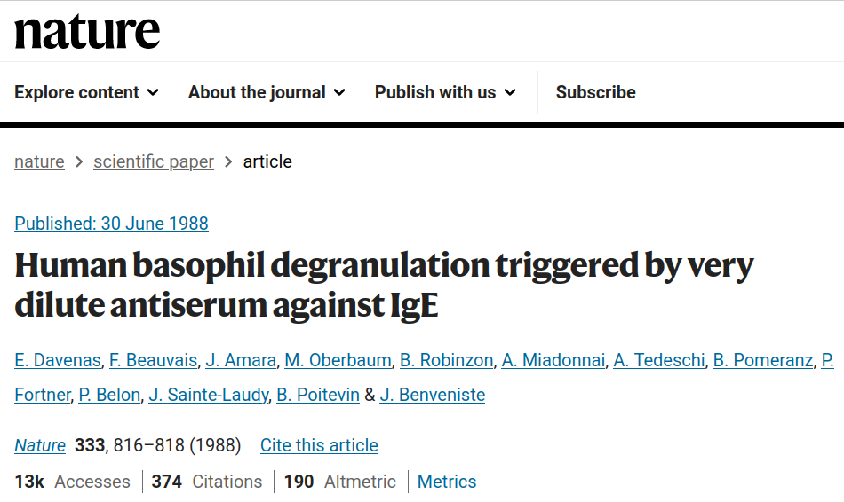
Example 1

Slide 34
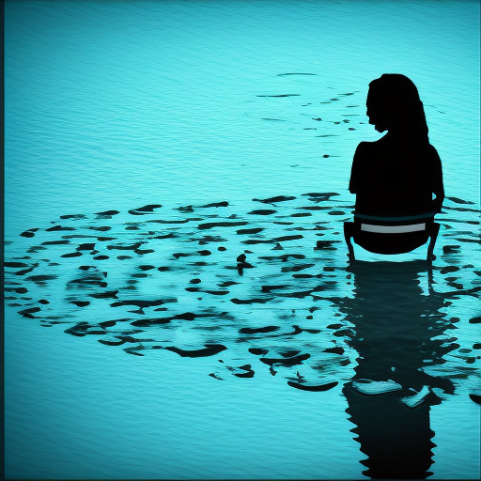
Hypothesis: water has a memory

Slide 35
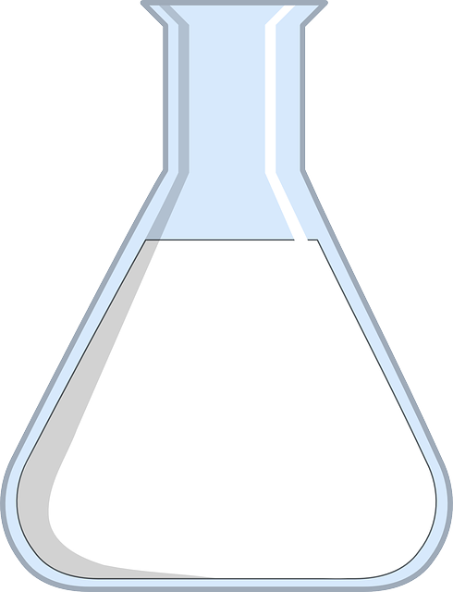
Experiment
Dilute 2x
Shake vigorously
Amount
Effect
Effect
8 | 4 | 2 | 1 | 0.5
100% | 50% | 25% | 12% | 6%
100% | 100% | 100% | 100% | 100%
Notes:
Image from https://bio.libretexts.org/Bookshelves/Microbiology/Book:_Microbiology_(OpenStax)/09:_Microbial_Growth/9.1:_How_Microbes_Grow

Slide 36
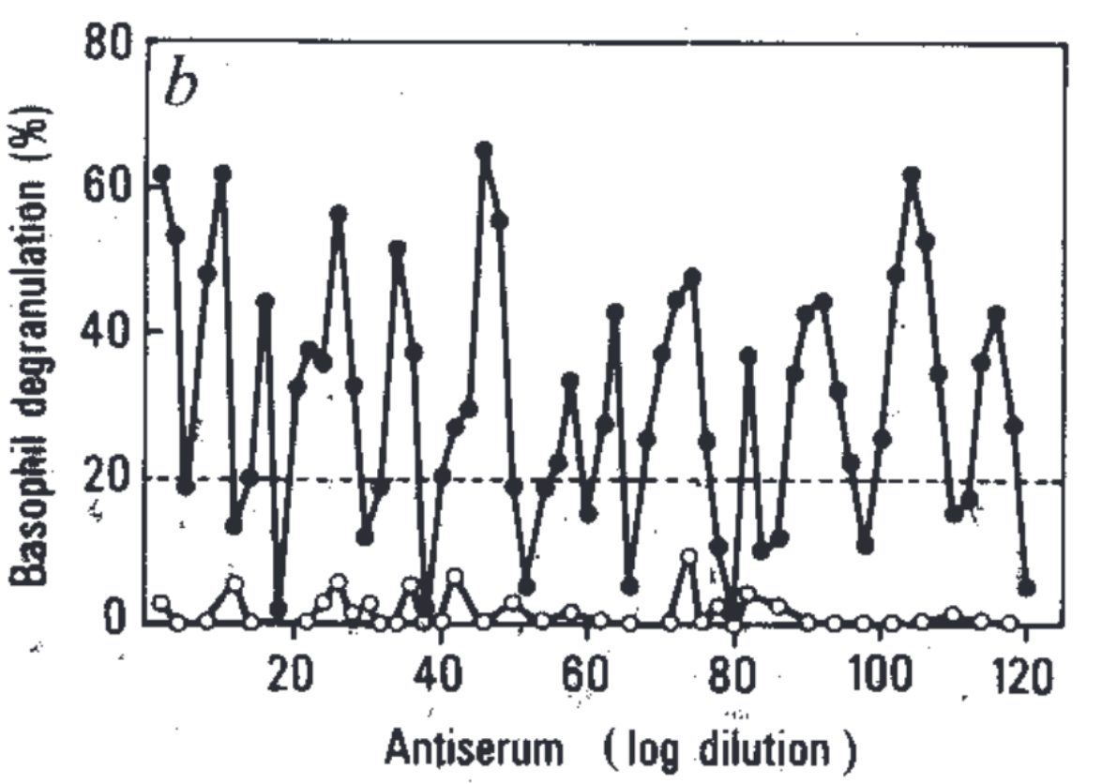
Conclusion: water has a memory
All original molecules are replaced
Effect (%)
Amount of 10x dilutions

Slide 37
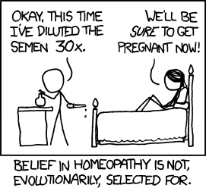
Notes:
https://xkcd.com/765

Slide 38
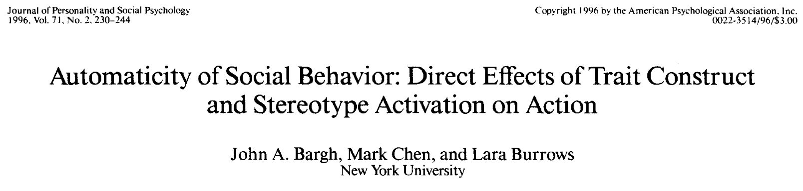
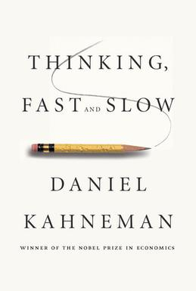
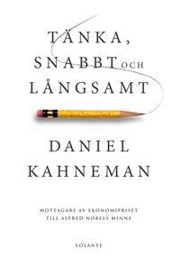
Example 2
Notes:
https://blandadkonfekt.blogspot.com/2013_02_01_archive.html

Slide 39
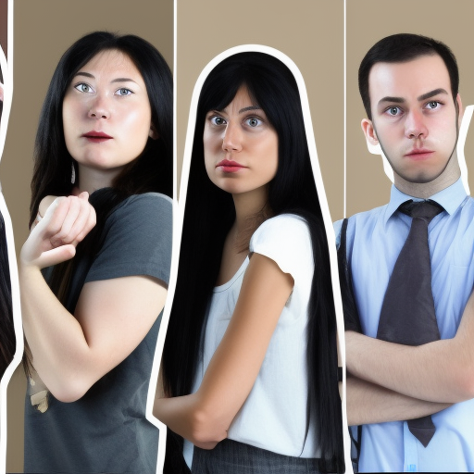
Hypothesis: people can be primed

Slide 40
Experiment
Prime people
Measure behavior
they her bother see usually
they her send see usually
they her respect see usually

Slide 41
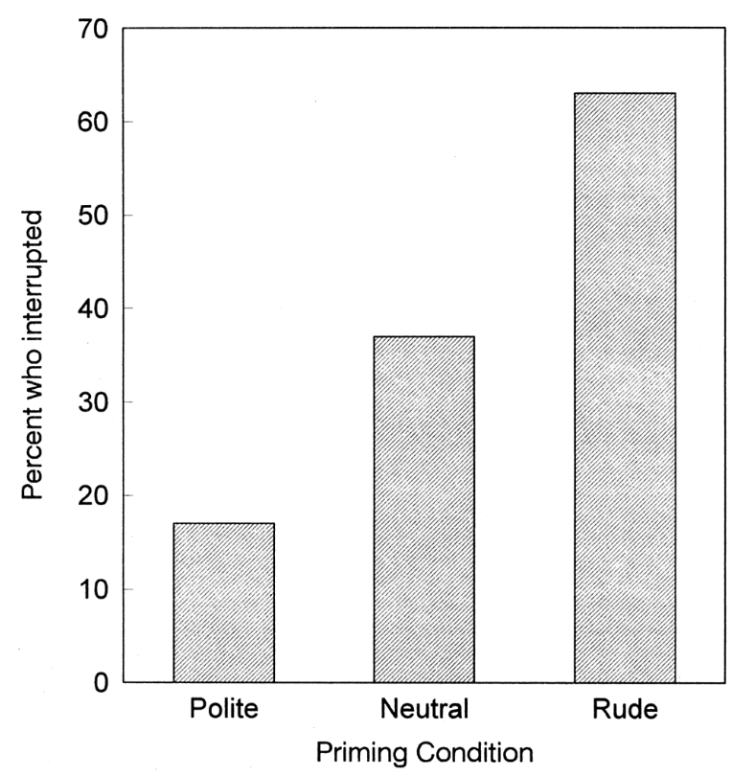
Conclusion: people can be primed

