Slide 1
Quantitative trait prediction using GCAE
Richel Bilderbeek
2022-03-05 10:15-(max)11:15
https://github.com/richelbilderbeek/science_presentation_20220305

Slide 2
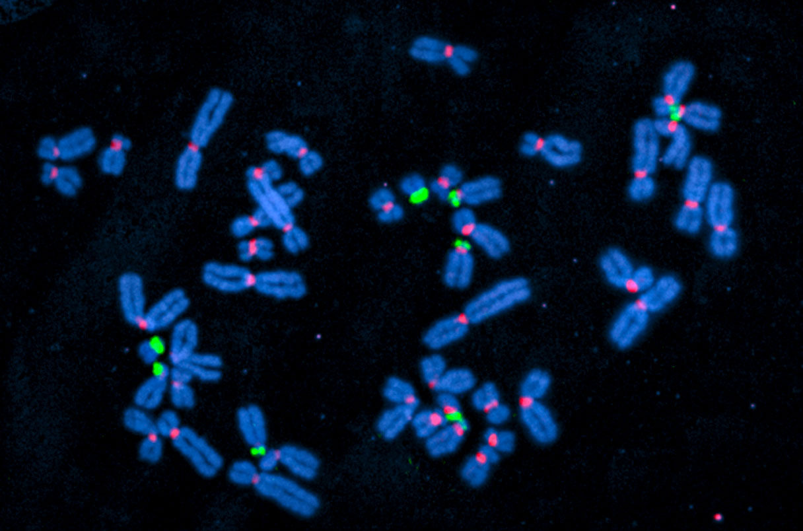
Introduction
Picture from Elizabeth Pennisi. "Most complete human genome yet reveals previously indecipherable DNA". Science (2022)
Deanna M. Church. "A next-generation human genome sequence." Science 376: (2022): 34-35. DOI: 10.1126/science.abo5367

Slide 3
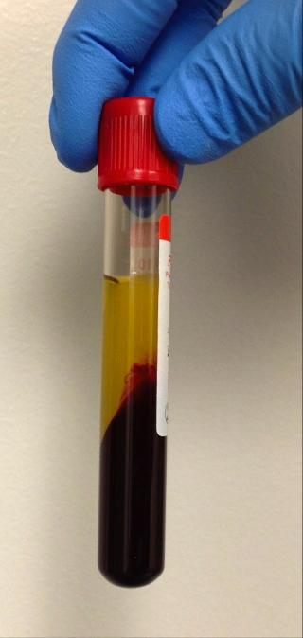

Goal
Predict
≈950 individuals
New
≈400 proteins
Elizabeth Pennisi. "Most complete human genome yet reveals previously indecipherable DNA". Science (2022)
https://en.wikipedia.org/wiki/File:Anatomy-1751201_1280.png
https://commons.wikimedia.org/wiki/Category:Phenotypes#/media/File:Coquina_variation3.jpg
https://commons.wikimedia.org/wiki/File:Blood-tube-fig-2.png

Slide 4
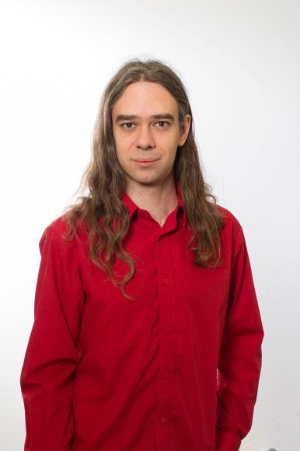
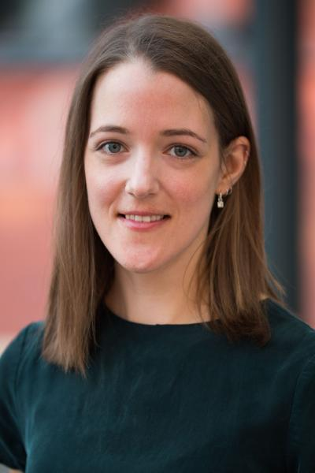
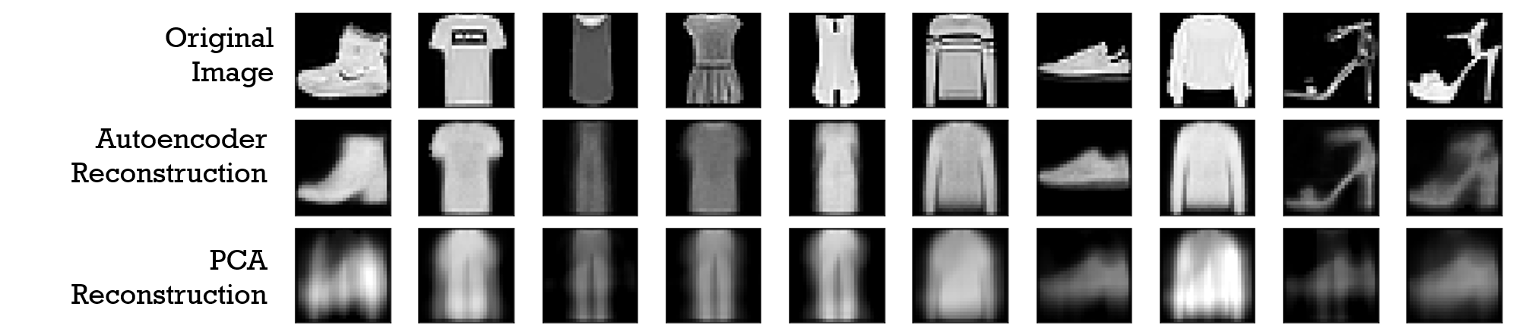
Method: GCAE
Genomic Convolutional Auto Encoder
Dimensionality reduction
Ausmees, Kristiina, and Carl Nettelblad. "A deep learning framework for characterization of genotype data." G3 12.3 (2022): jkac020. https://doi.org/10.1093/g3journal/jkac020
https://en.wikipedia.org/wiki/File:Reconstruction_autoencoders_vs_PCA.png

Slide 5
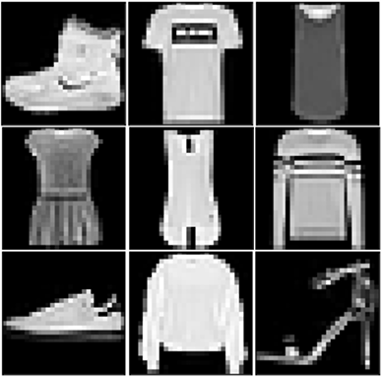
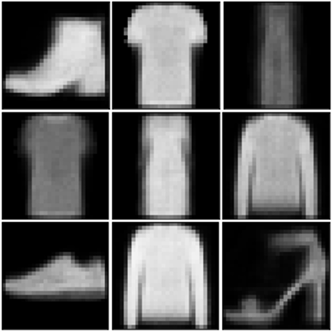
What an auto-encoder does
Latent layer with
dimension reduced data

Slide 6
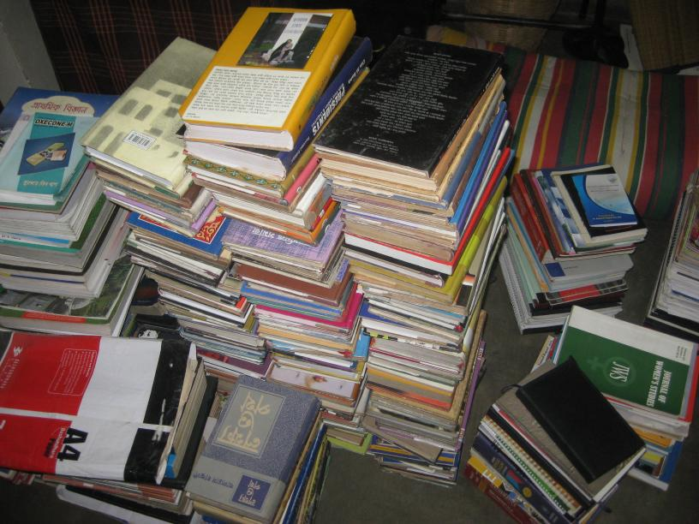
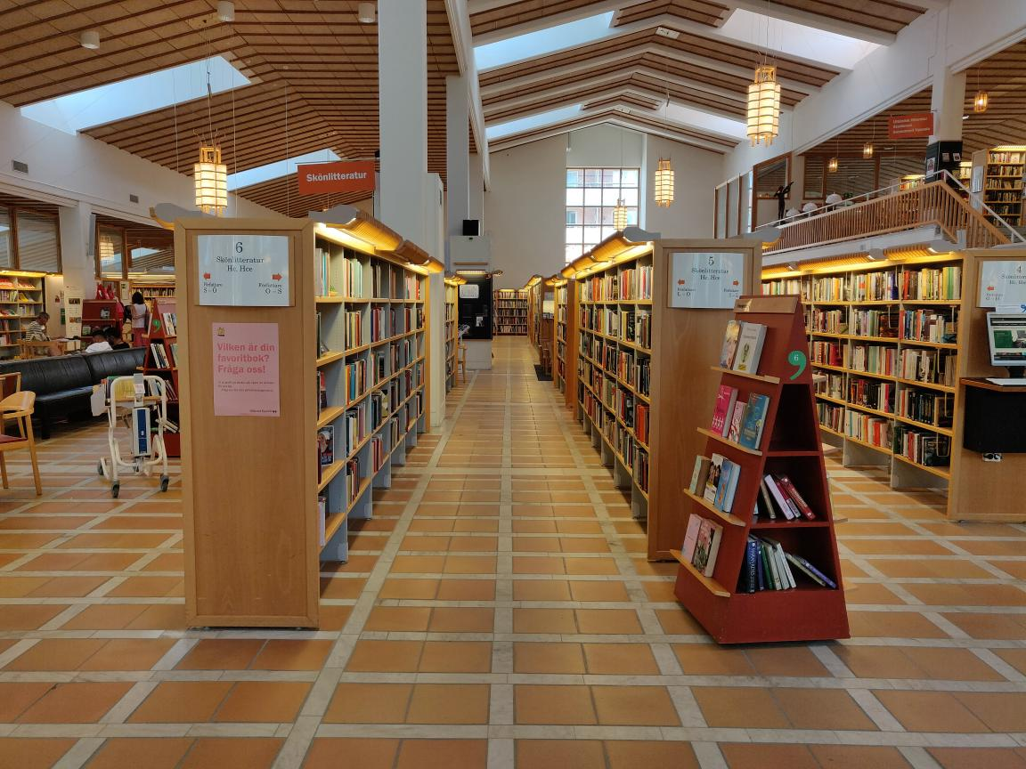
GCAE is an auto-encoder
https://commons.wikimedia.org/wiki/File:Disorganized_books_piling_one_another.JPG2
https://commons.wikimedia.org/wiki/File:Stadsbiblioteket_i_Uppsala_interior_04.jpg

Slide 7
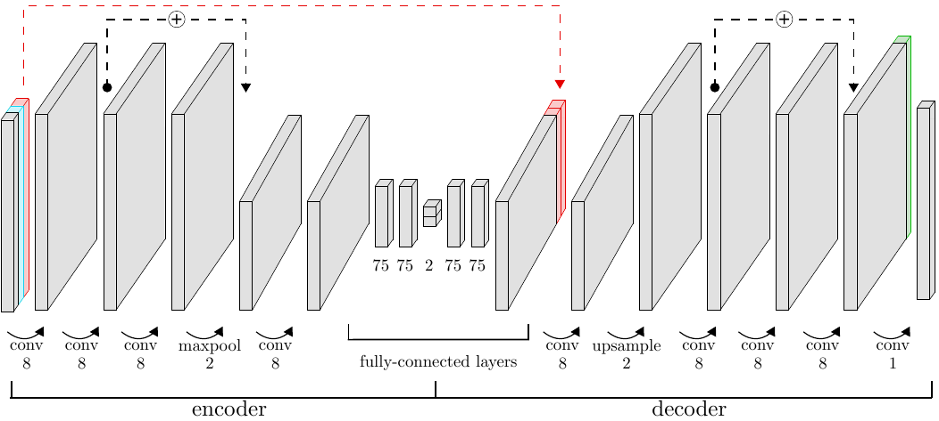
GCAE is highly tunable
https://github.com/kausmees/GenoCAE/blob/master/images/example_architecture.png

Slide 8
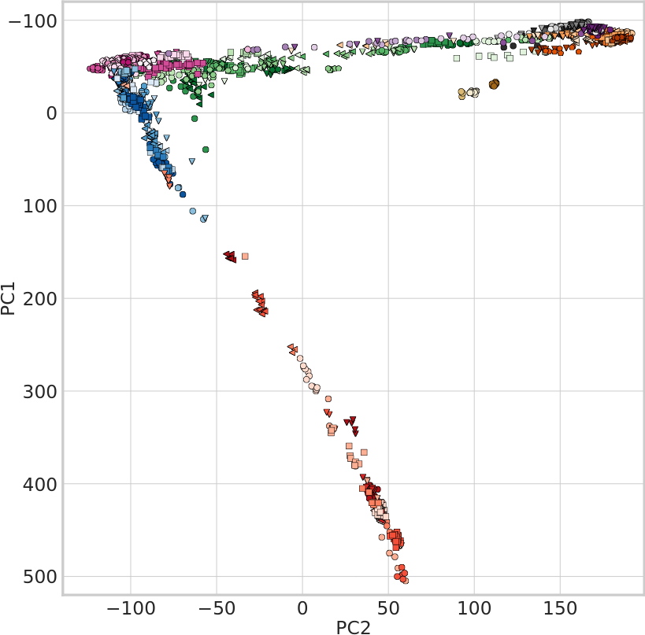
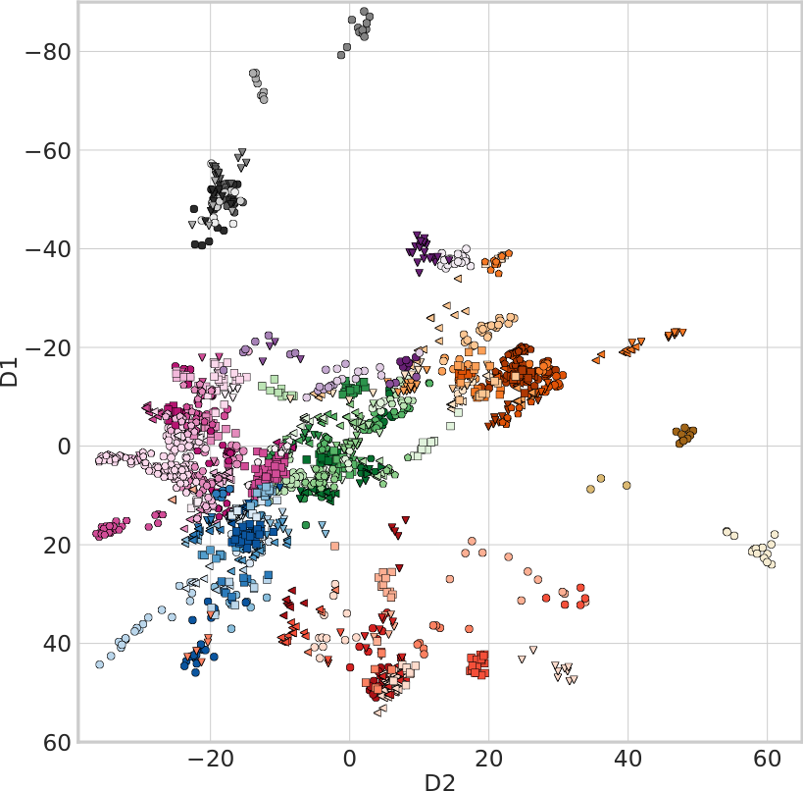
GCAE can do non-linear dimensionality reduction
Ausmees, Kristiina, and Carl Nettelblad. "A deep learning framework for characterization of genotype data." G3 12.3 (2022): jkac020. https://doi.org/10.1093/g3journal/jkac020

Slide 9
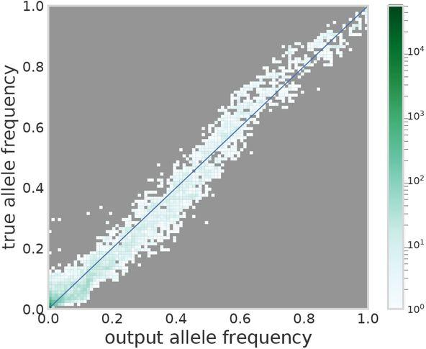
GCAE cannot do rare alleles
Ausmees, Kristiina, and Carl Nettelblad. "A deep learning framework for characterization of genotype data." G3 12.3 (2022): jkac020. https://doi.org/10.1093/g3journal/jkac020

Slide 10
GCAE may do trait prediction
Untested quantitative trait prediction extension
New

Slide 11
Analogy
Unordered genotypes
Ordered genotypes
Predict the number of horses, spaceships, etc.
Protein concentrations
https://commons.wikimedia.org/wiki/File:Disorganized_books_piling_one_another.JPG2
https://commons.wikimedia.org/wiki/File:Stadsbiblioteket_i_Uppsala_interior_04.jpg

Slide 12




What has been done
GCAE
  Can actually run with trait prediction
  Can run on Bianca
gcaer works with GCAE
  Tested to be correct
  Proper error messages
  Extend functionality
nsphs_ml_qt does experiments
  Scripts re-used in many contexts
  Works locally, on Rackham, on Bianca
  You can run these today
nsphs_ml_qt
gcaer
GCAE
https://github.com/richelbilderbeek/GenoCAE/tree/Pheno
https://github.com/richelbilderbeek/gcaer
https://github.com/richelbilderbeek/nsphs_ml_qt

Slide 13
First experiment
Simulate simplest dataset
Run GCAE as-is
Evaluate performance
https://github.com/richelbilderbeek/nsphs_ml_qt/scripts_rackham/02_start_2_richel_issue_126.sh

Slide 14
First experiment: simulated dataset
For PLINK users:
why not just use
0, 1 and 2
for trait values?
1 monogenic trait with H² = h² = 1
1k individuals
MAF = 0.499
|chr |id | posg| pos|ref |alt |
|:---|:-----|----:|---:|:---|:---|
|1 |snp_1 | 0| 1|A |C |
|FID |IID | additive|
|:---|:---|--------:|
|A |1 | 9.424778|
|A |2 | 6.283185|
|A |3 | 3.141593|
|A |4 | 9.424778|
|A |5 | 9.424778|
| |snp_1|
|:--|----:|
|1 | 0|
|2 | 1|
|3 | 2|
|4 | 0|
|5 | 0|
|fam |id |pat |mat | sex| pheno|
|:---|:--|:---|:---|---:|-----:|
|A |1 |0 |0 | 1| -9|
|A |2 |0 |0 | 1| -9|
|A |3 |0 |0 | 1| -9|
|A |4 |0 |0 | 1| -9|
|A |5 |0 |0 | 1| -9|
https://github.com/richelbilderbeek/science_presentation_20220305/blob/master/analysis_richel_126.R

Slide 15
First experiment: PLINK results
PLINK measures association perfectly
| CHR|SNP | BP| NMISS| BETA| SE| R2| T| P|
|---:|:-----|--:|-----:|------:|--:|--:|----------:|--:|
| 1|snp_1 | 1| 1000| -3.142| 0| 1| -116700000| 0|
For PLINK users:
why not just use
0, 1 and 2
for trait values?
|FID |IID | additive|
|:---|:---|--------:|
|A |1 | 9.424778|
|A |2 | 6.283185|
|A |3 | 3.141593|
|A |4 | 9.424778|
|A |5 | 9.424778|
| |snp_1|
|:--|----:|
|1 | 0|
|2 | 1|
|3 | 2|
|4 | 0|
|5 | 0|
https://github.com/richelbilderbeek/science_presentation_20220305/blob/master/analysis_richel_126.R

Slide 16
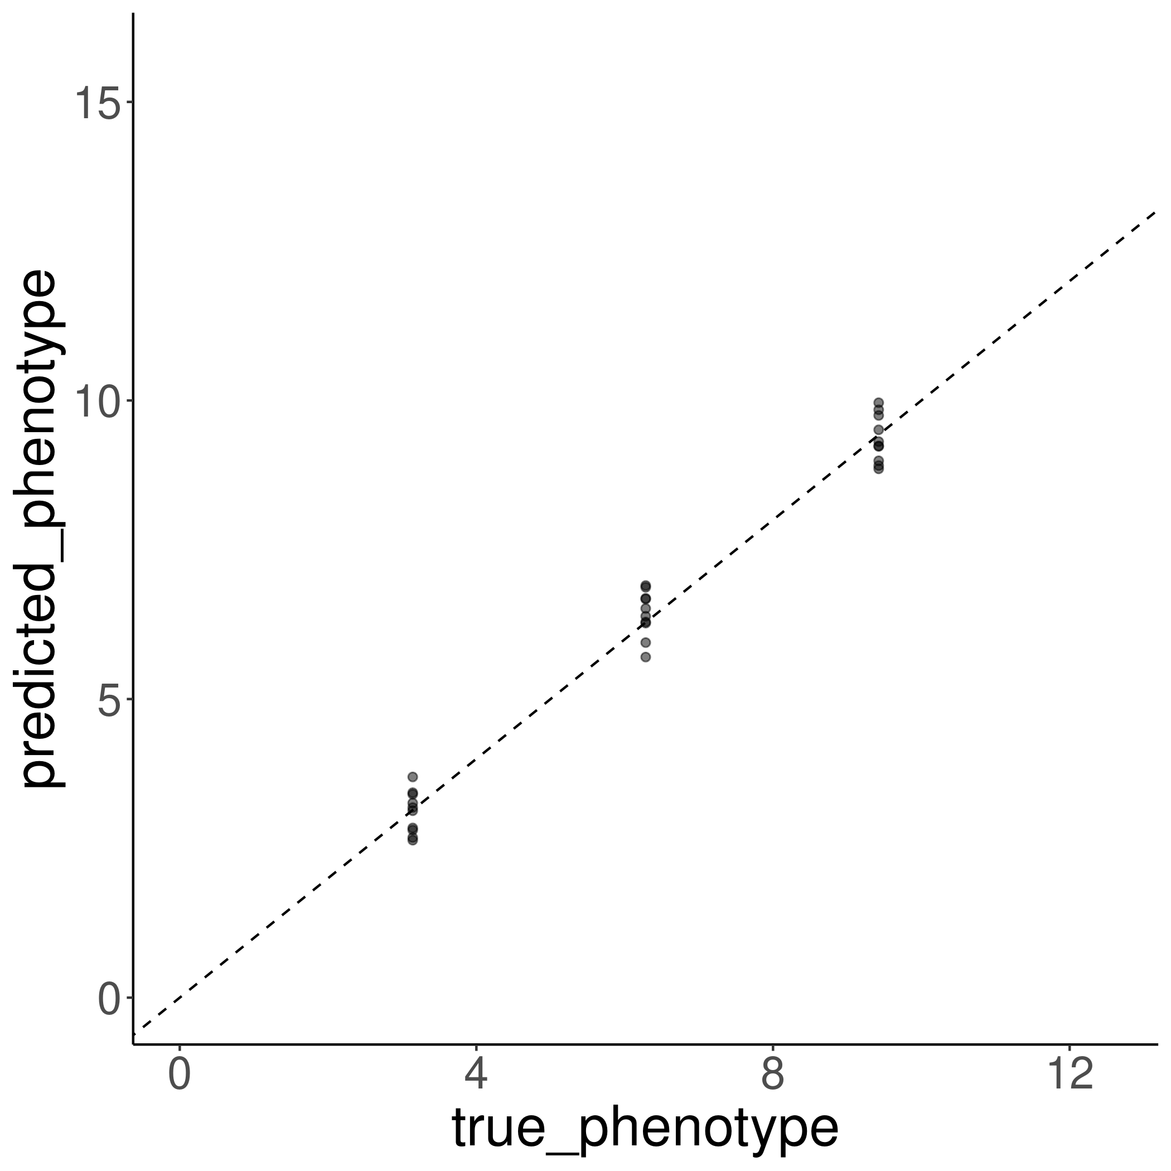
First experiment: expected GCAE predictions
https://github.com/richelbilderbeek/science_presentation_20220305/blob/master/analysis_richel_126.R

Slide 17
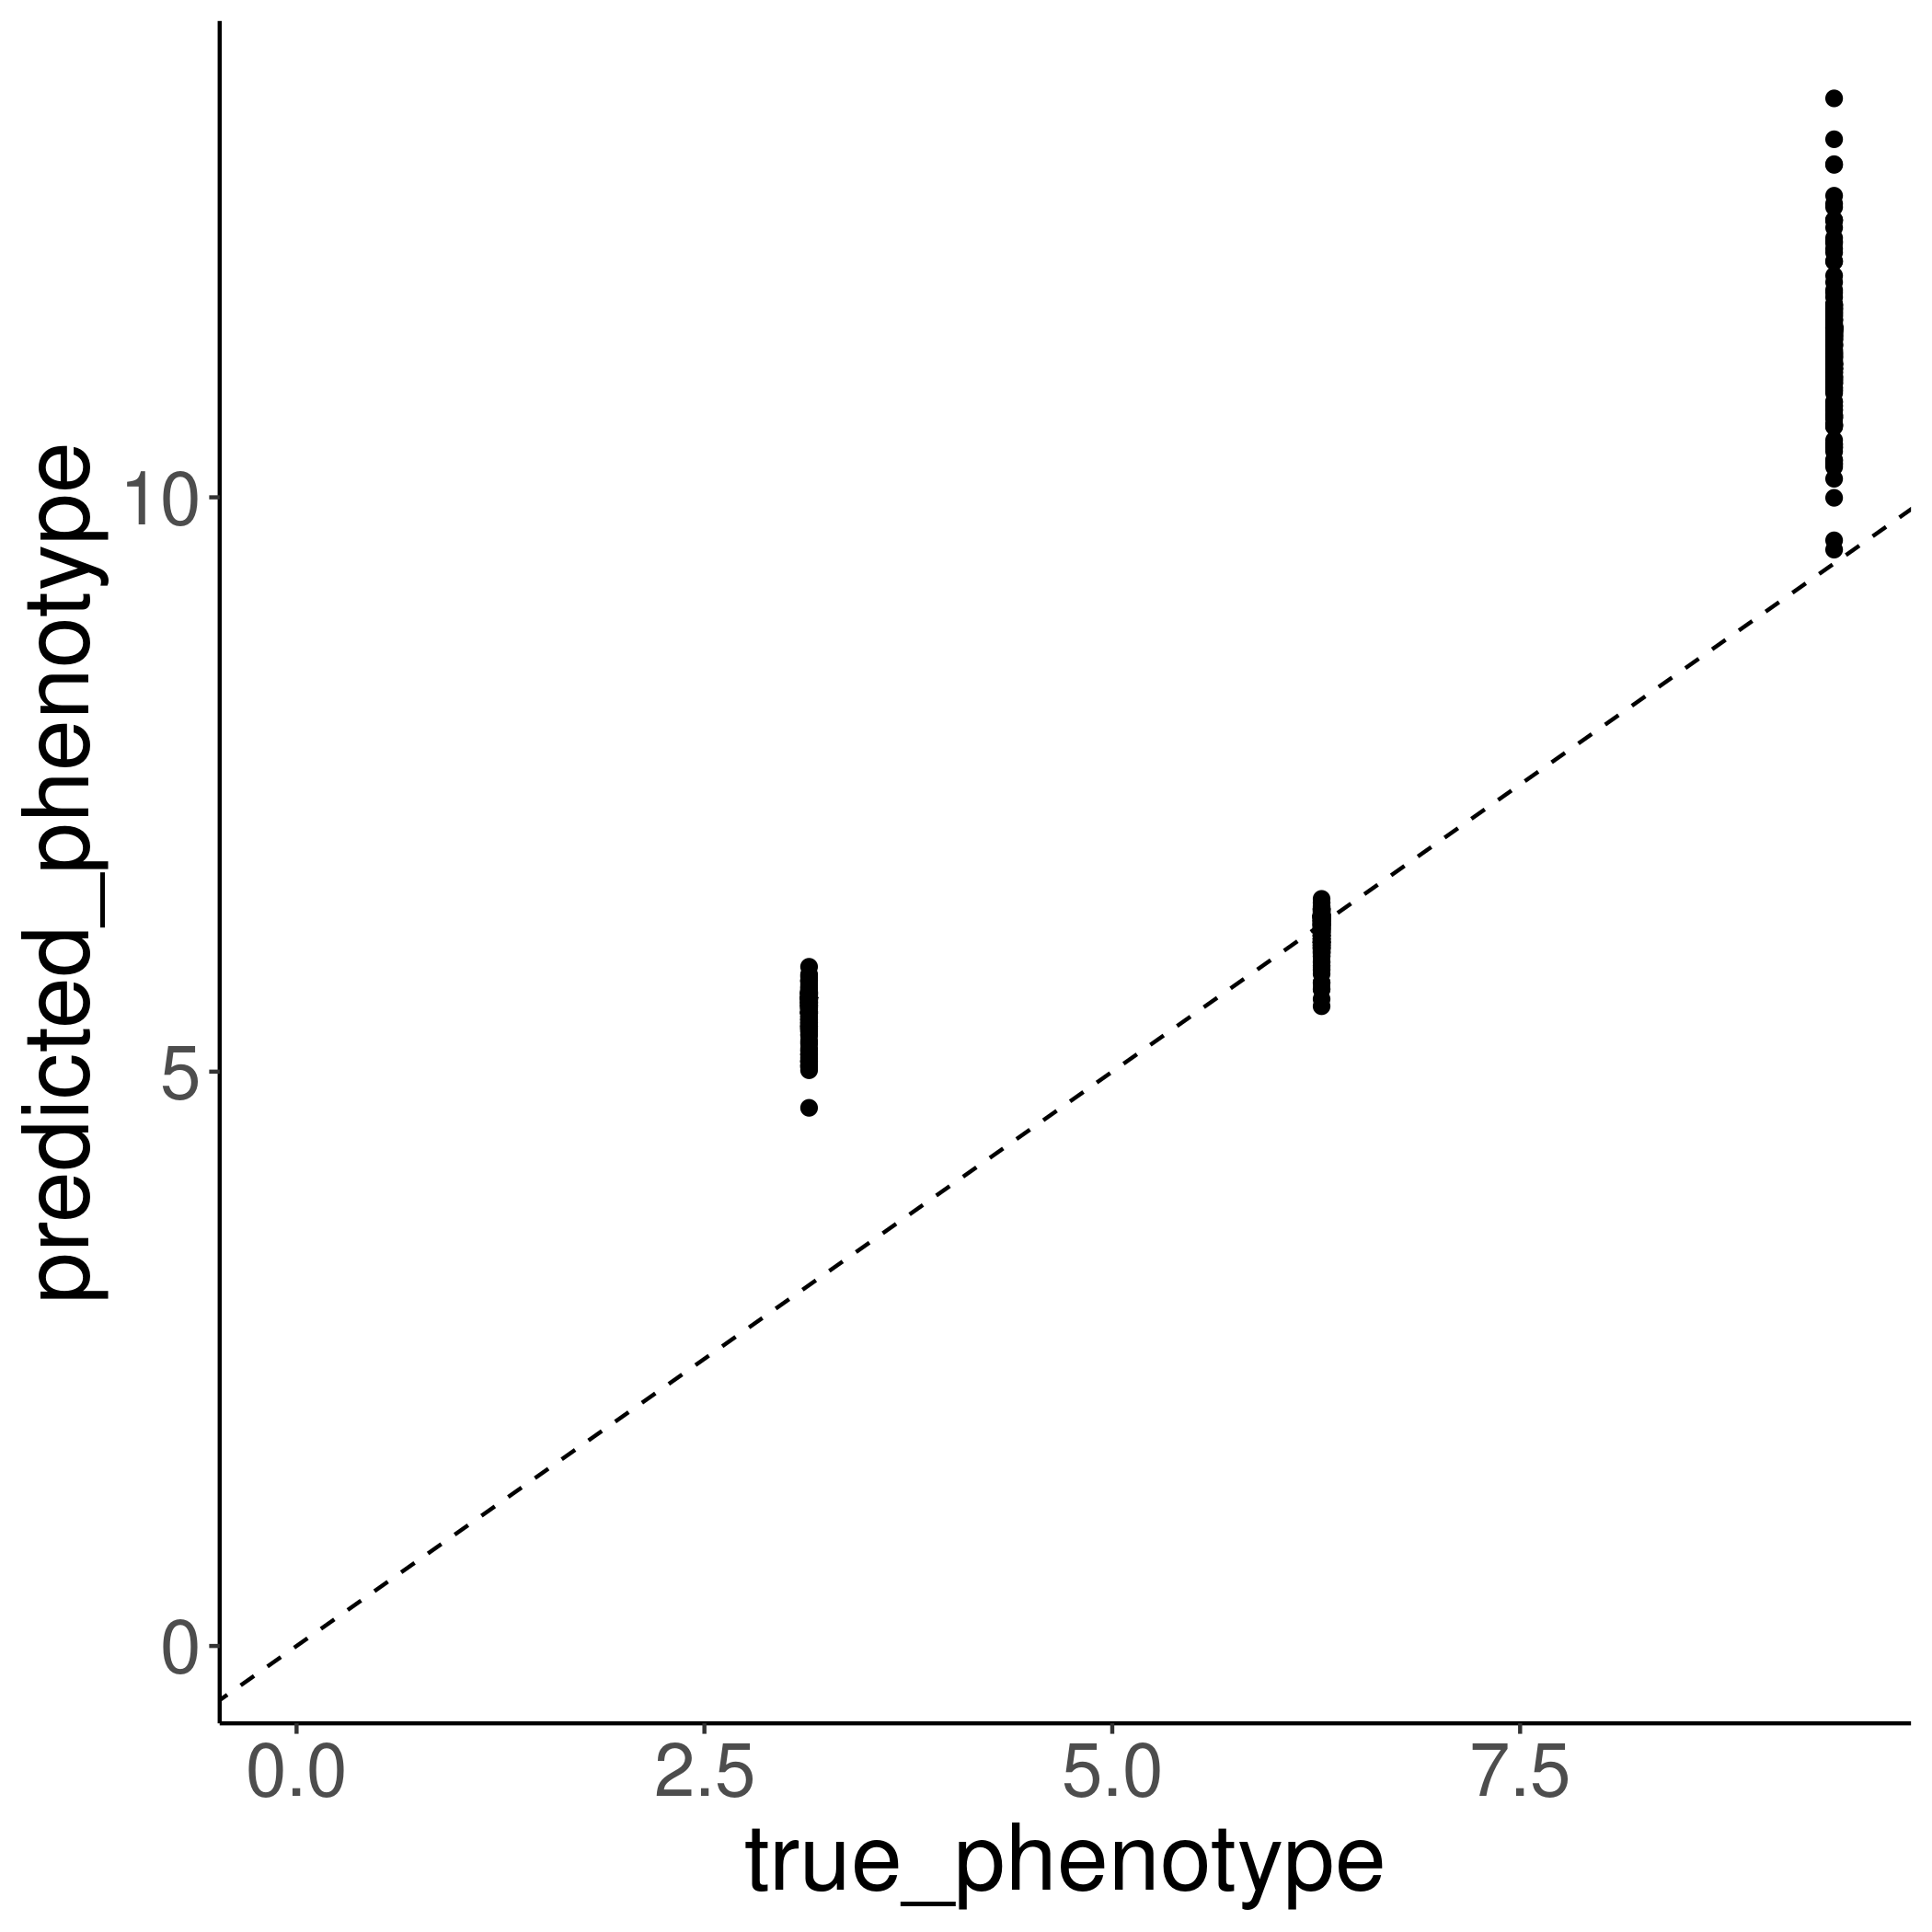
First experiment: GCAE predictions
https://github.com/richelbilderbeek/science_presentation_20220305/blob/master/analysis_richel_126.R

Slide 18
First experiment: conclusions
Proof of concept works, prediction underperforms
Hypothesis:
Underwhelmed

Slide 19
Decision
Tune the network to the problem
  try a simpler neural network
  GCAE focused
Tune the problem to the network
  try harder problems
  application focused

Slide 20
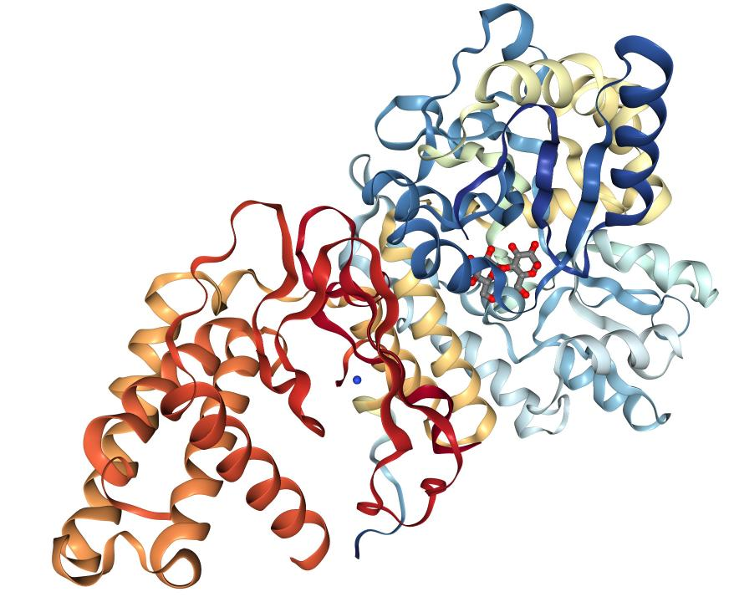
First NSPHS experiment
Use NSPHS and first protein concentration
  Pick 100k random variants
  Adrenomedullin
Run GCAE as-is
Evaluate performance
For NSPHS users:
Can you predict
the performance
already?
https://cn.sinobiological.com/resource/adrenomedullin/proteins

Slide 21
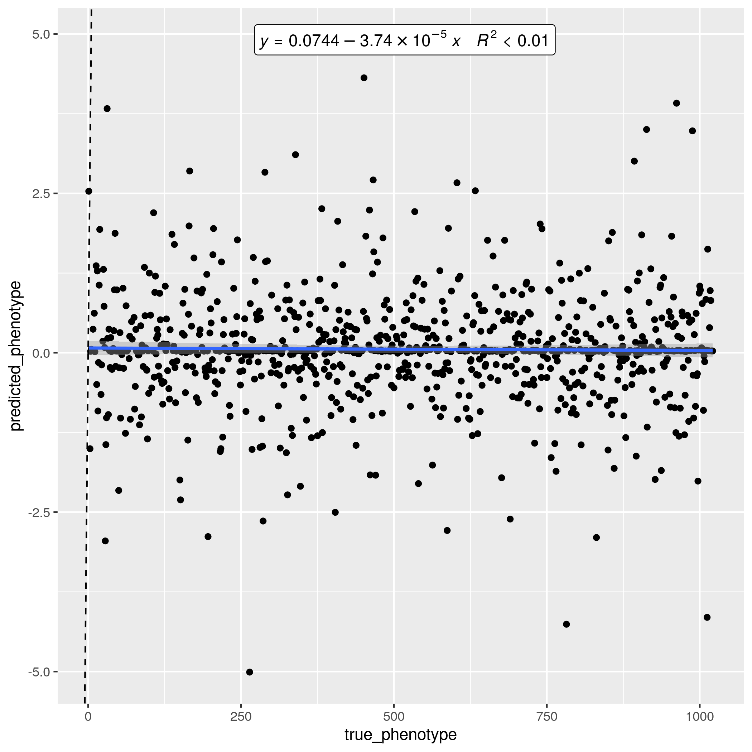
First NSPHS experiment: results
Runs!
60 hours
1k epochs
Unsure about learning trajectory
https://github.com/richelbilderbeek/nsphs_ml_qt/issues/14
https://github.com/richelbilderbeek/nsphs_ml_qt/blob/master/scripts_bianca/02_start_richel_issue_130.sh

Slide 22
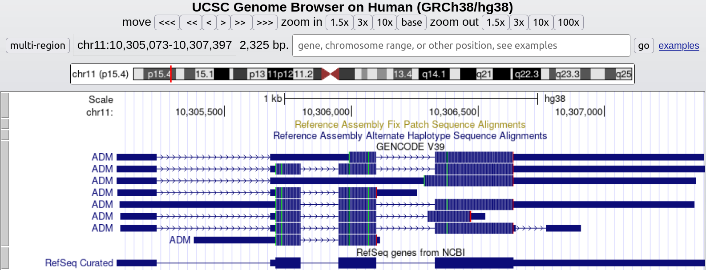
First NSPHS: conclusion
The result is just noise
    The gene for adrenomedullin is monogenic, 52 amino acids
But hey, it works!
https://genome.ucsc.edu/cgi-bin/hgTracks?org=Human&db=hg38&position=chr11:10305073-10307397
Notes:
https://genome.ucsc.edu/cgi-bin/hgTracks?db=hg38&lastVirtModeType=default&lastVirtModeExtraState=&virtModeType=default&virtMode=0&nonVirtPosition=&position=chr11%3A10305073%2D10307397&hgsid=1313268551_t6W9XFrV4G4k4rf8OglawR7JXQIa

Slide 23
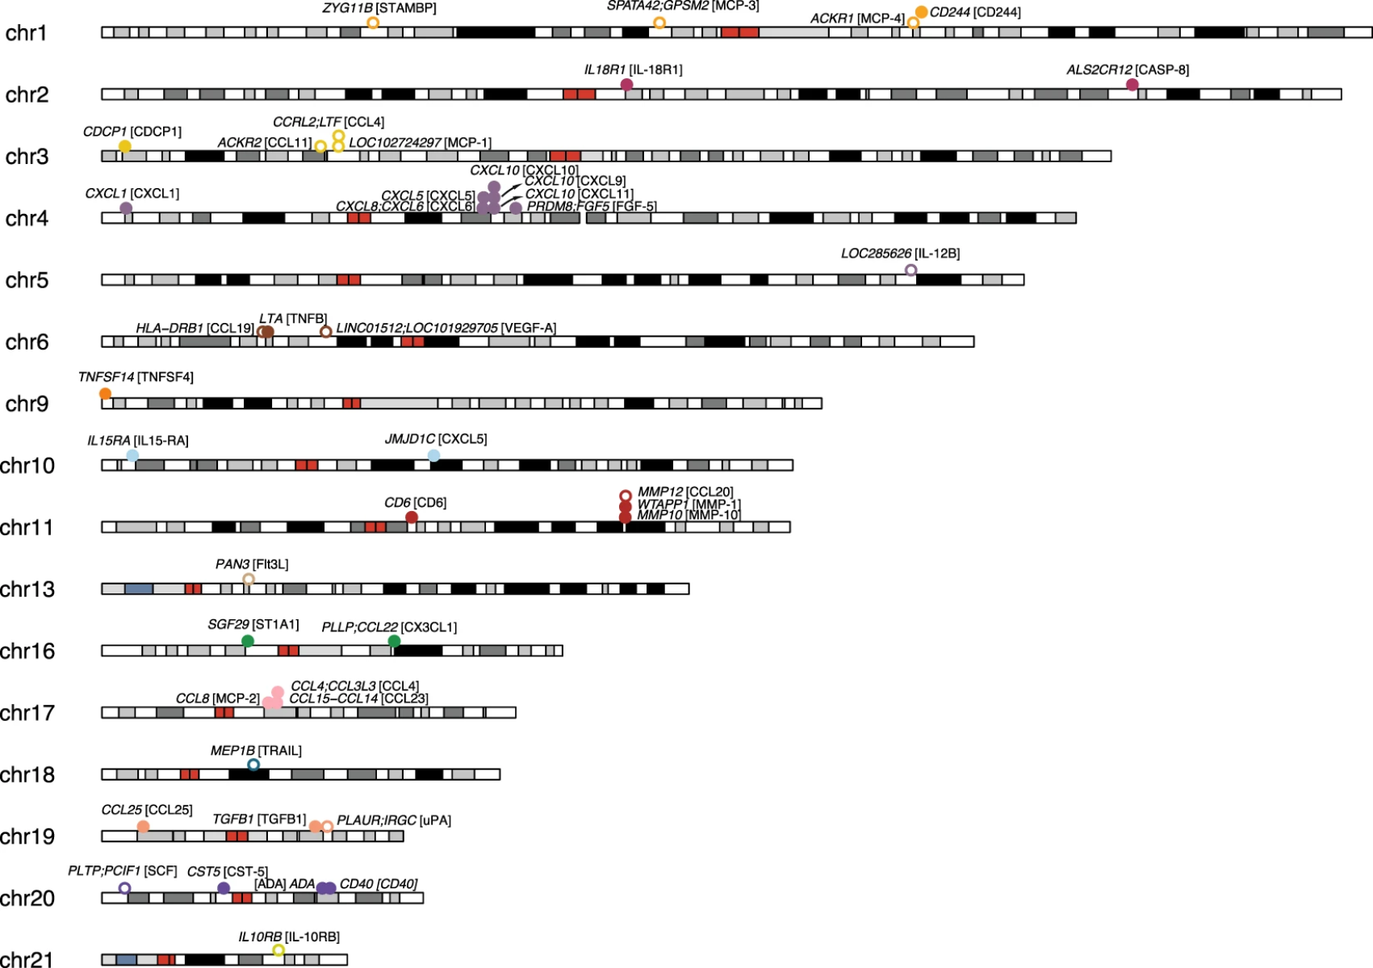
First NSPHS: conclusion
* [ ] Use the SNPs known to have an association, e.g. 0.5 Mb downstream and upstream around known cis-regulatory elements, #5
Höglund, Julia, et al. "Improved power and precision with whole genome sequencing data in genome-wide association studies of inflammatory biomarkers." Scientific reports 9.1 (2019): 1-14.
https://github.com/richelbilderbeek/nsphs_ml_qt/issues/5
Notes:
https://genome.ucsc.edu/cgi-bin/hgTracks?db=hg38&lastVirtModeType=default&lastVirtModeExtraState=&virtModeType=default&virtMode=0&nonVirtPosition=&position=chr11%3A10305073%2D10307397&hgsid=1313268551_t6W9XFrV4G4k4rf8OglawR7JXQIa

Slide 24
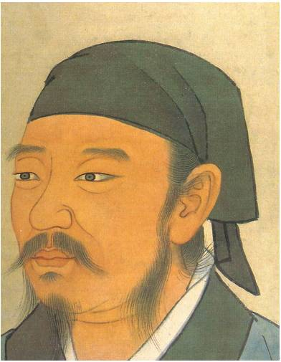
Learning
Learning proceeds
until death
and only then
does it stop
https://en.wikipedia.org/wiki/File:Portrait_of_Xun_Zi.jpg

Slide 25
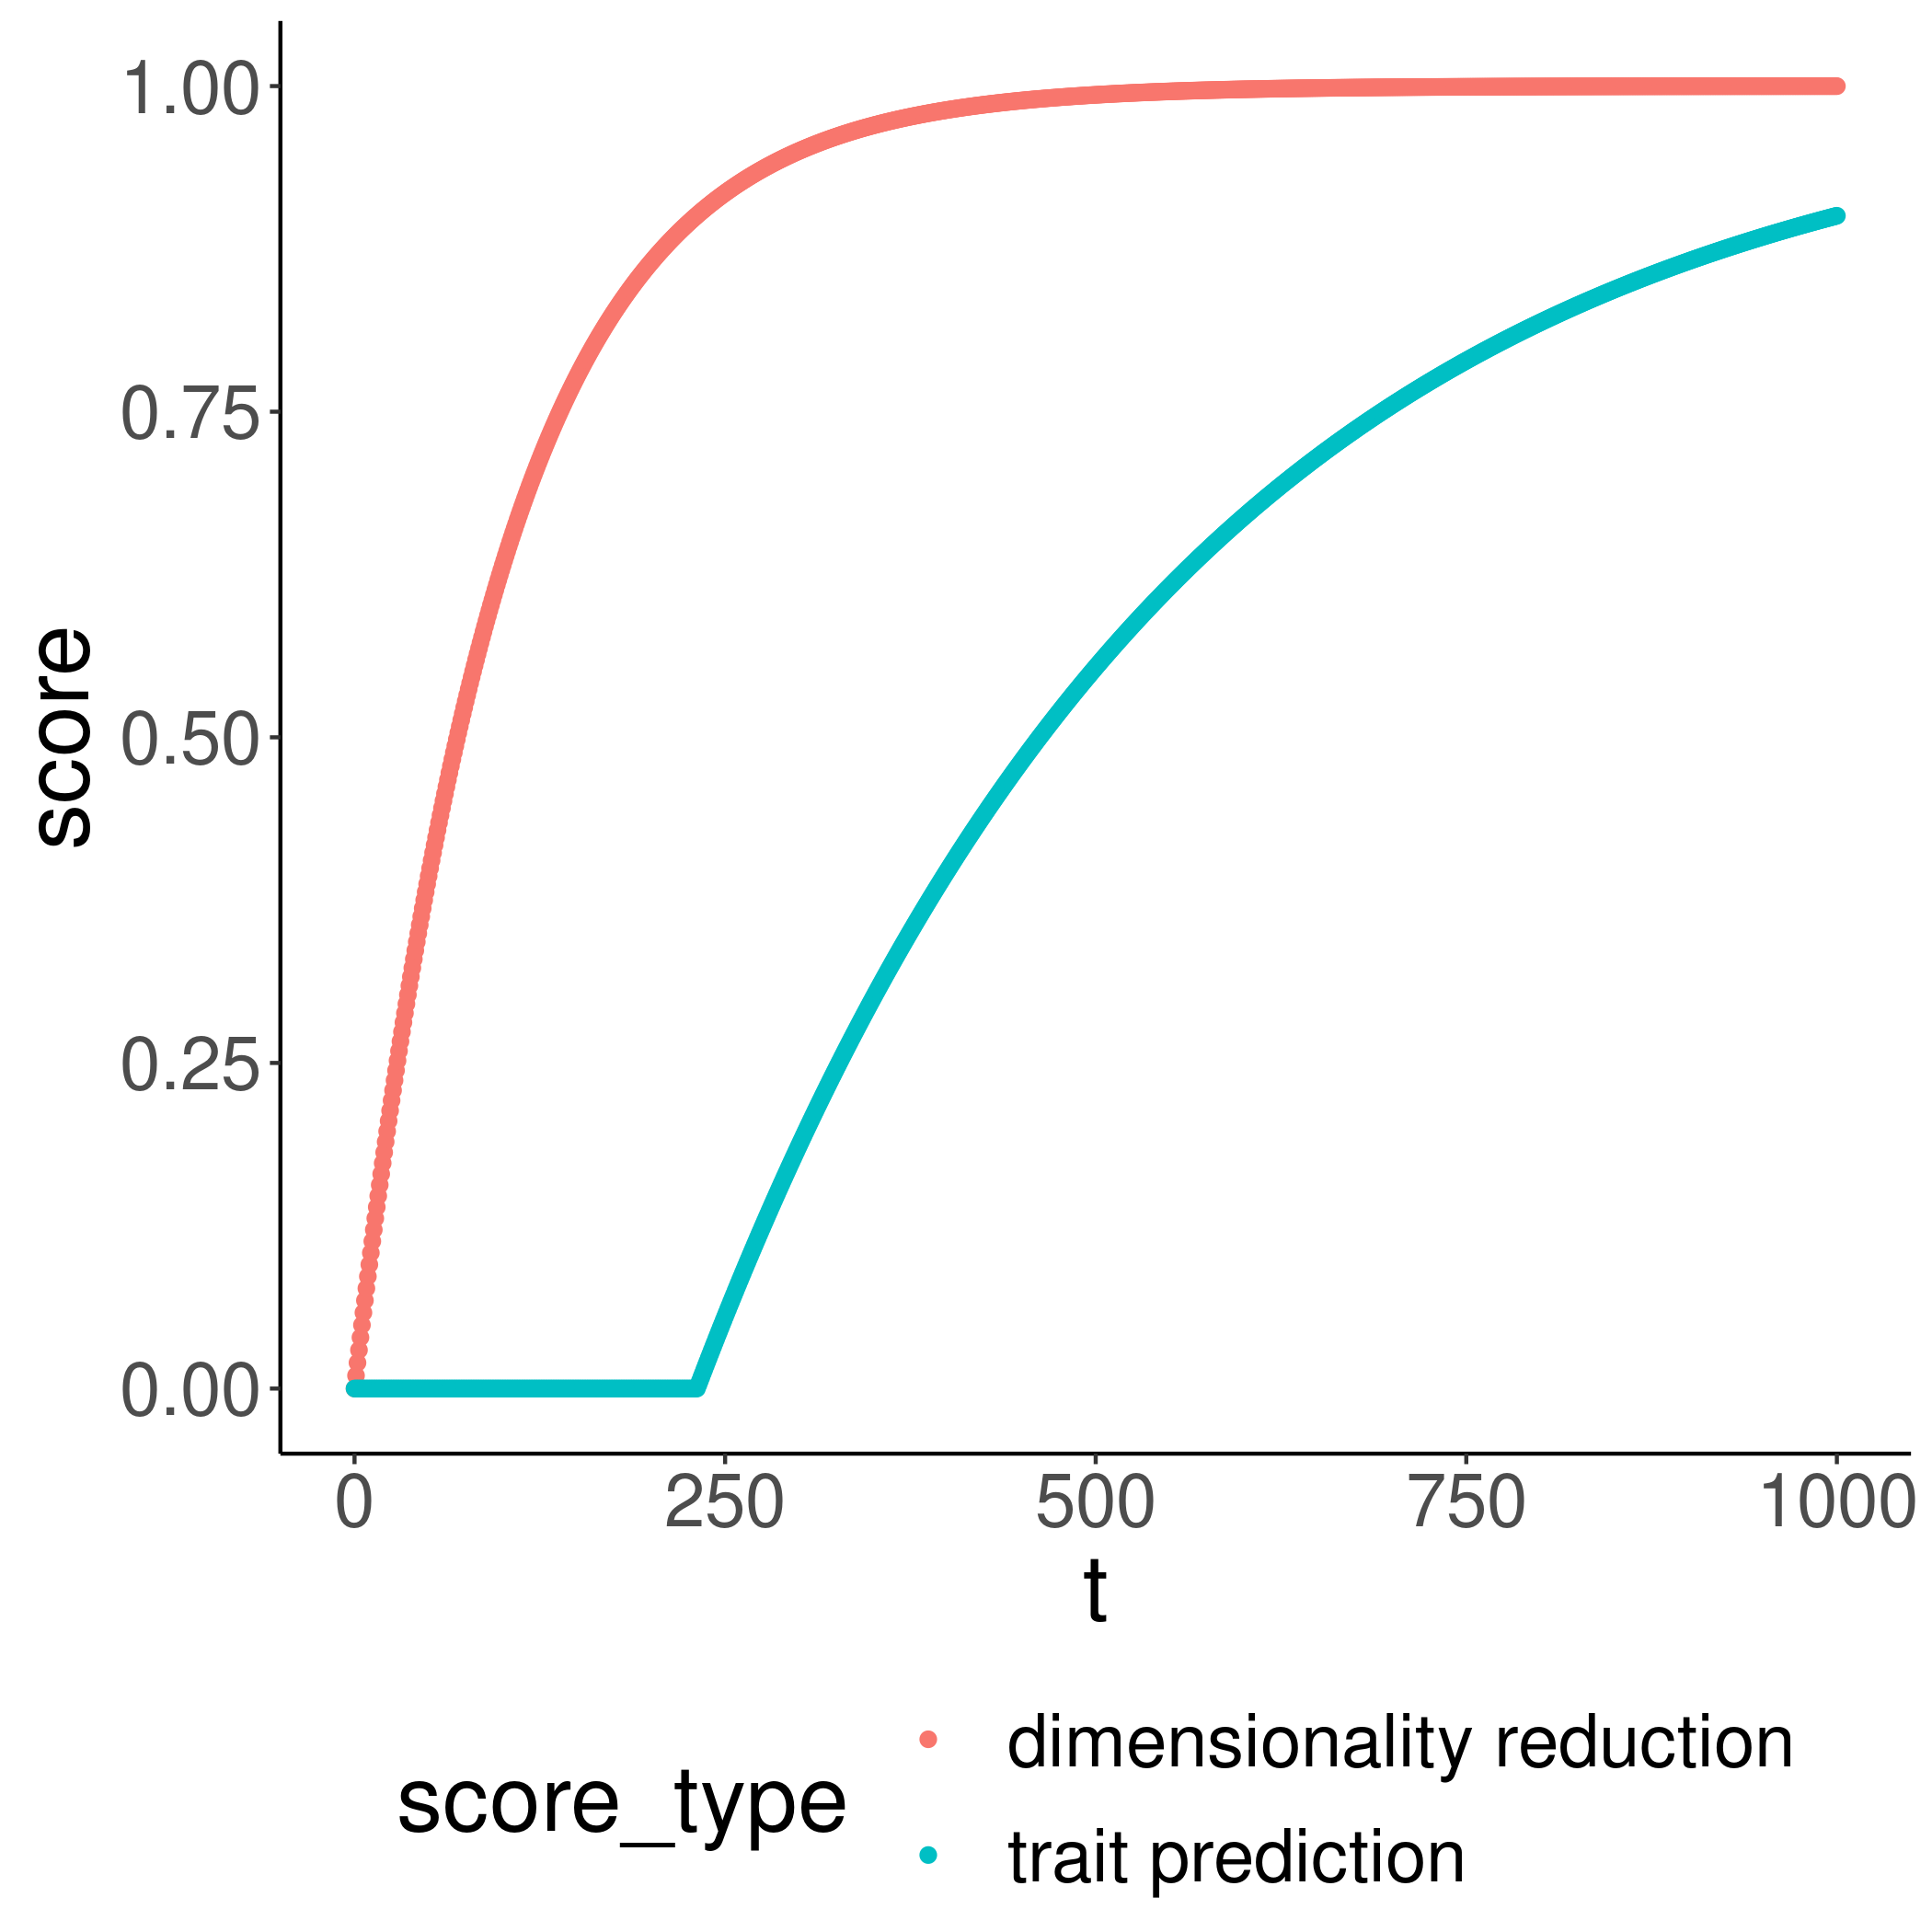
Learning trajectory
Trait prediction can only be trained well after dimensionality reduction is good

Slide 26
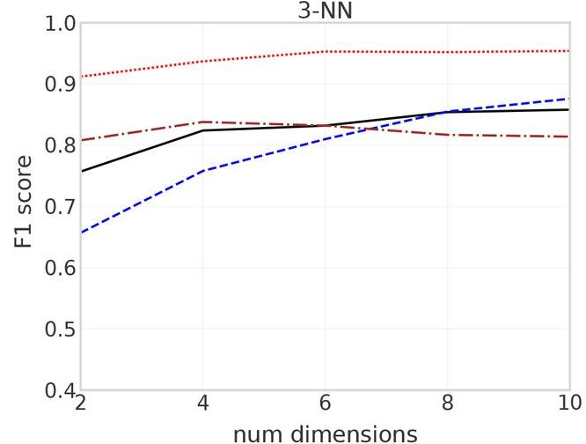
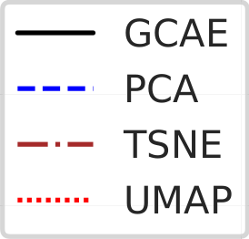
Dimensionality reduction score
Ausmees, Kristiina, and Carl Nettelblad. "A deep learning framework for characterization of genotype data." G3 12.3 (2022): jkac020. https://doi.org/10.1093/g3journal/jkac020

Slide 27

Caveats in application
We cannot assign clusters:
  NSPHS is ≈1 cluster, i.e. Karesuando and Soppero
All we care about is that dimensionality reduction has reached equilibrium
  Using 2 clusters anyway may allow us to do so
Maybe we only care about the trait predictions
27
https://en.wikipedia.org/wiki/Titanic_(1997_film)#/media/File:Titanic_(1997_film)_poster.png

Slide 28
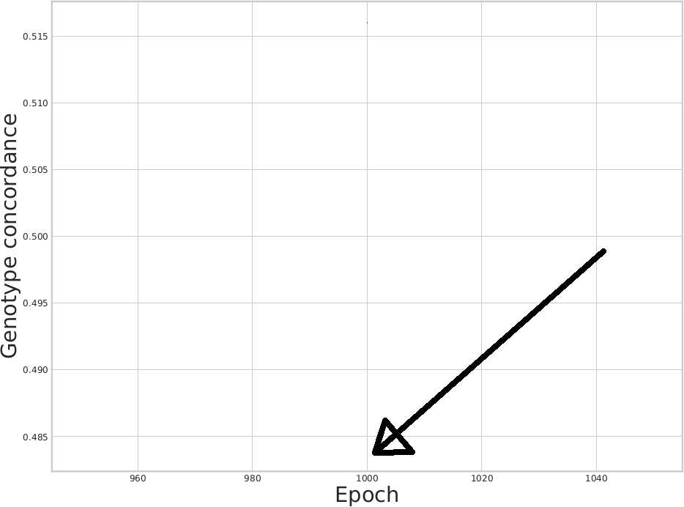

Dimension reduction quality: other way
[ ] Plot the genotype concordance through time, #17
28
https://github.com/richelbilderbeek/gcaer/issues/17

Slide 29
Trait prediction score
How well are phenotypes predicted?
  … in time?
  … comparable between protein concentrations?

Slide 30
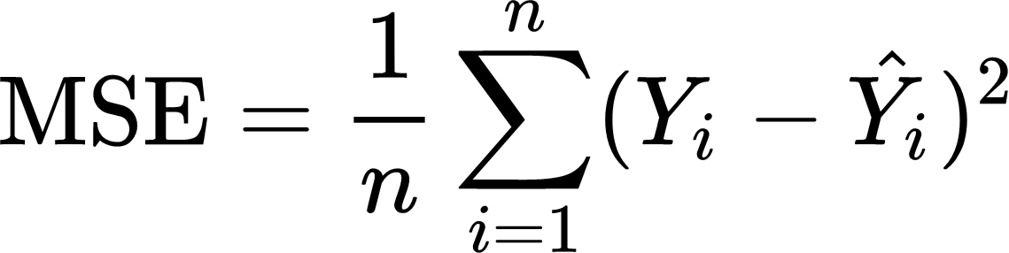
Trait prediction score 1/2: MSE
MSE: Mean squared error
Mean (vertical distance to identity line)²
Scale matters

Slide 31
Trait prediction score 2/2: NMSE
NMSE: Normalized Mean Squared Error
mean <- mean(true_values)
sd <- sd(true_values)
testthat::expect_true(sd > 0.0)
normalized_true_values <- (true_values - mean) / sd
normalized_estimated_values <- (estimated_values - mean) / sd
https://github.com/richelbilderbeek/gcaer/blob/master/R/normalize_true_and_estimated_values.R

Slide 32
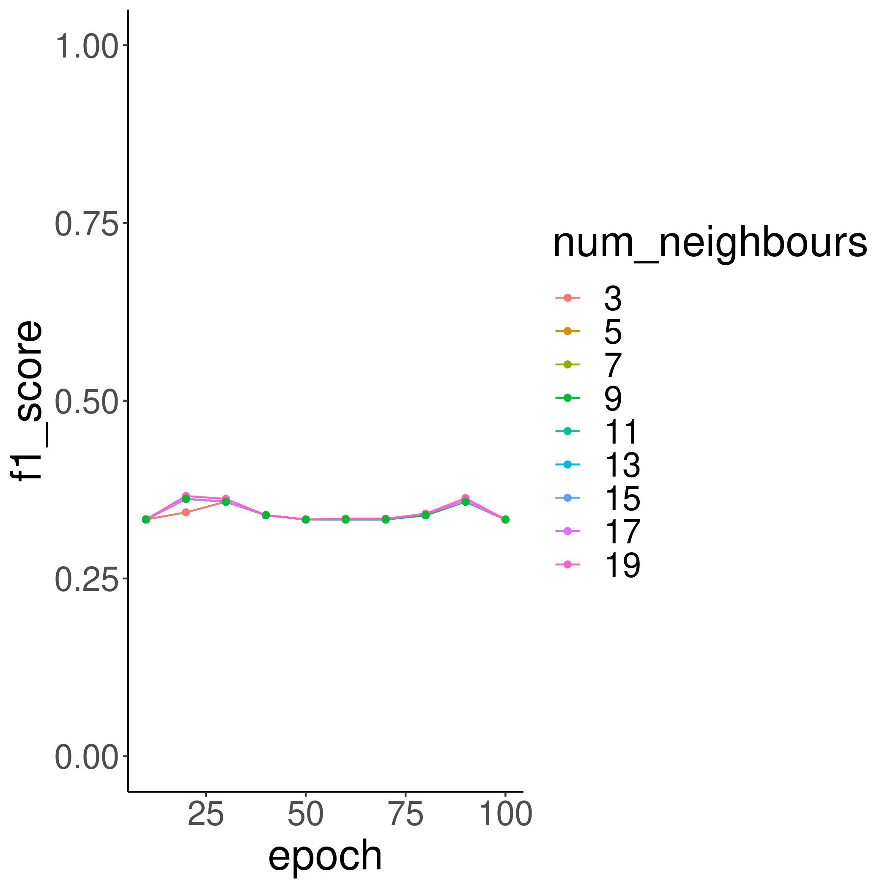
Progress: get learning trajectory
[x] Plot the F1 scores through time, #6

Slide 33
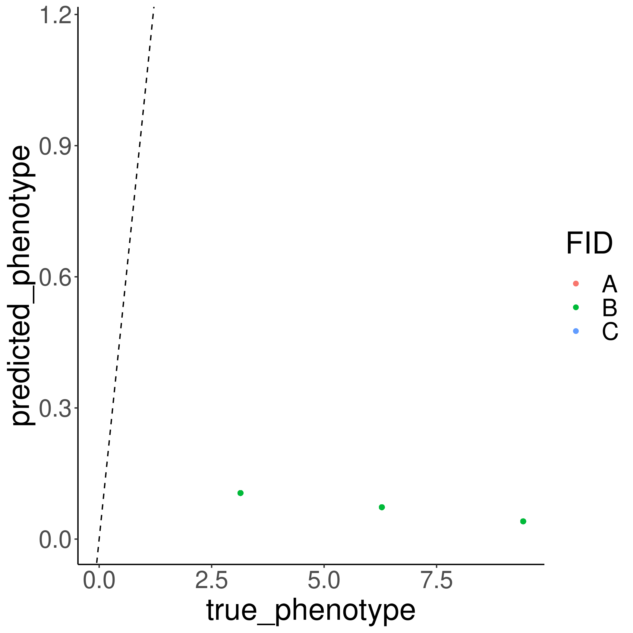
Progress: get learning trajectory
[x] Plot phenotype prediction through time, #21
[ ] Plot NMSE through time, #7
→ Show phenotype_prediction_through_time.gif

Slide 34
Conclusion
The autoencoder needs a hard problem
  Hence, use NSPHS with useful genetic regions
Underwhelmed

Slide 35
Conclusion
Need to determine when GCAE is done learning
  Hence, need to select/devise measures for that

Slide 36
Conclusion
The autoencoder then probably needs tuning
  With a latent layer of 2 neurons (hence 2 dimensions), the autoencoder may underfit challenging data

Slide 37
Discussion
We cannot predict where/where the autoencoder outperforms existing methods …
but it will be when:
  Data of sufficient complexity
  Non-linear relations between the principal components
  Common alleles
  (Noisy data)

Slide 38
Questions?
https://github.com/richelbilderbeek/science_presentation_20220305
https://youtu.be/ldwPcy263IU

