Slide 1
5

Slide 2
4

Slide 3
3

Slide 4
2

Slide 5
1

Slide 6

The Pragmatic Programmer
Sign your work

Slide 7
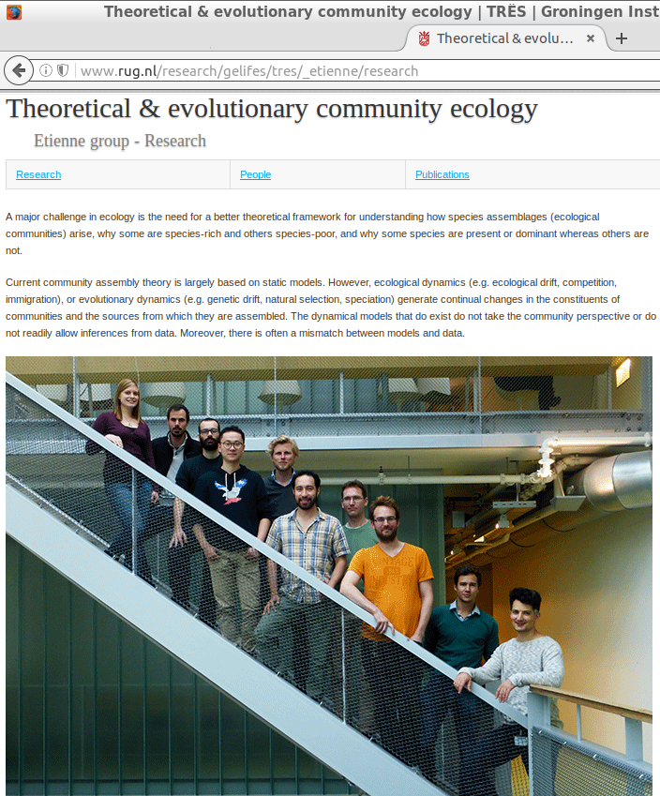
Our group

Slide 8
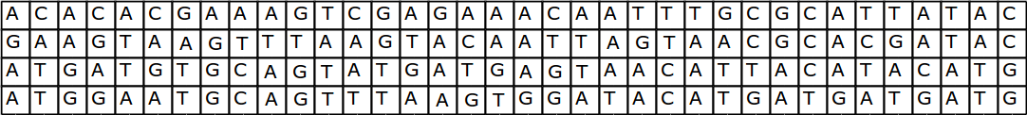
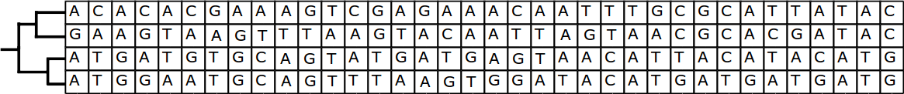
Part of what we do

Slide 9
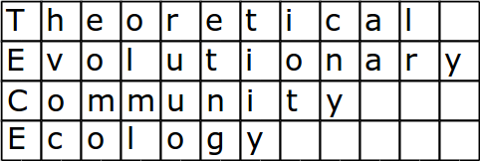
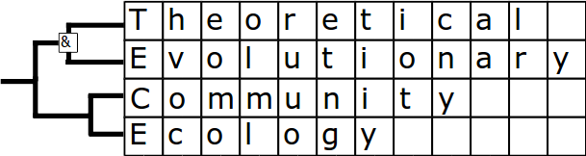

Slide 10
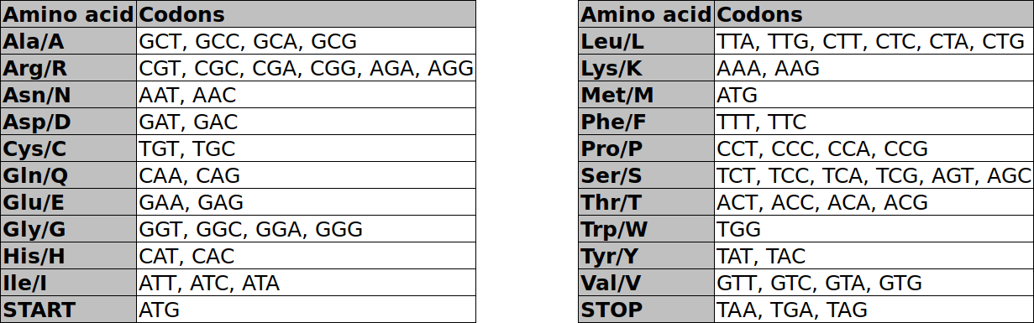
The genetic code

Slide 11
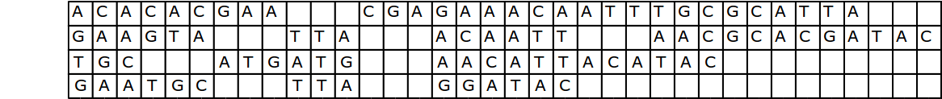
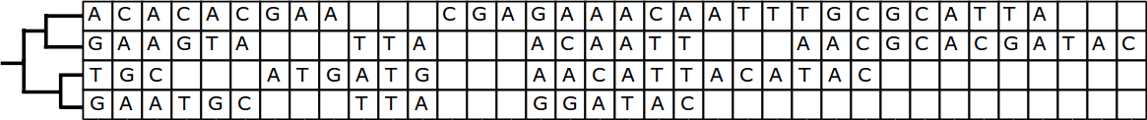
 | 28 | 26 | 27
 |  | 32 | 34
 |  |  | 21

Slide 12
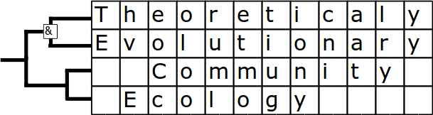
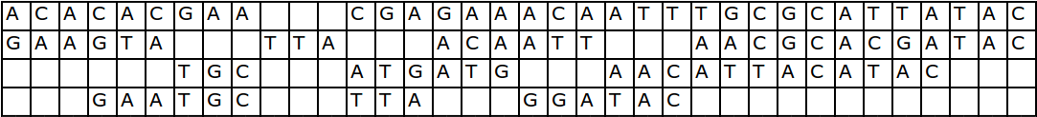
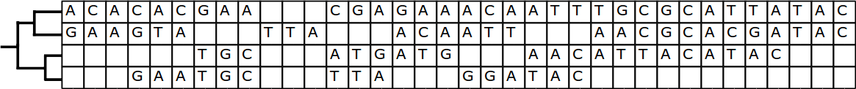
Added for
alignment
purposes
 | 25 | 29 | 30
 |  | 32 | 34
 |  |  | 21

Slide 13
The Pragmatic Programmer
Sign your work

Slide 14
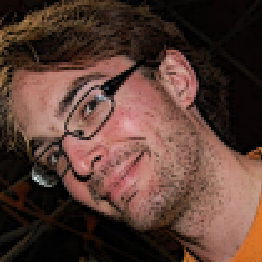


PhD project overview
TECE meeting 2016-11-03
© 2016 Richel Bilderbeek
www.github.com/richelbilderbeek/Science

Slide 15
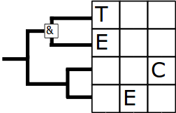
PhD project overview
TECE meeting 2016-11-03
© 2016 Richel Bilderbeek
www.github.com/richelbilderbeek/Science

Slide 16
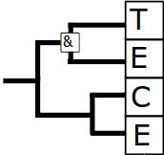
PhD project overview
TECE meeting 2016-11-03
© 2016 Richel Bilderbeek
www.github.com/richelbilderbeek/Science

