Slide 1
5

Slide 2
4

Slide 3
3

Slide 4
2

Slide 5
1

Slide 6

The Pragmatic Programmer
Sign your work

Slide 7
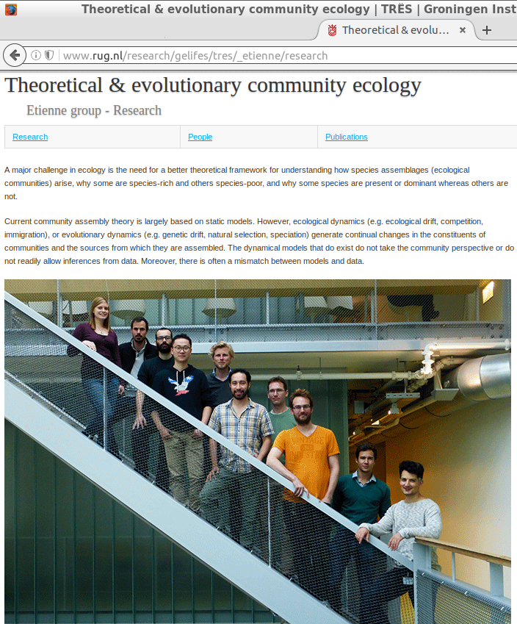
Our group

Slide 8
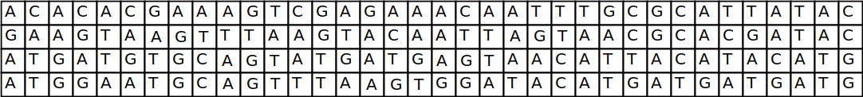
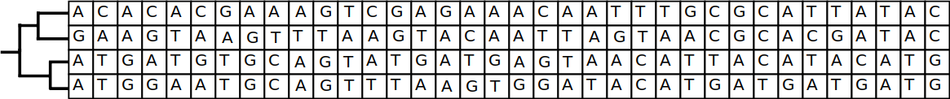
Part of what we do

Slide 9
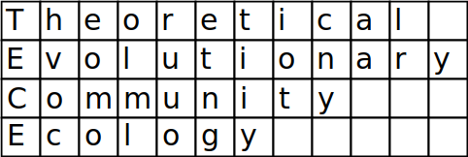
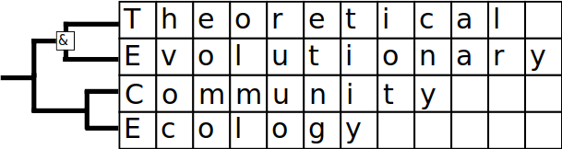

Slide 10
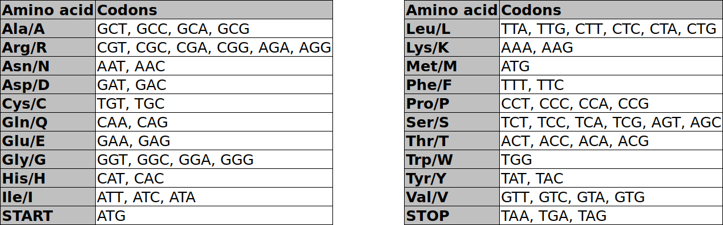
The genetic code

Slide 11
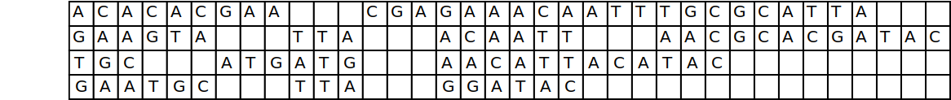
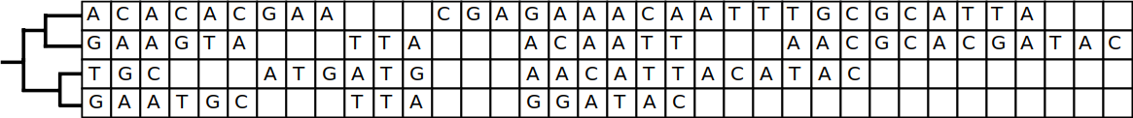
 | 28 | 26 | 27
 |  | 32 | 34
 |  |  | 21

Slide 12
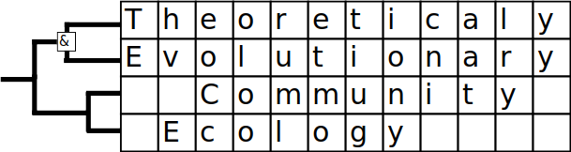
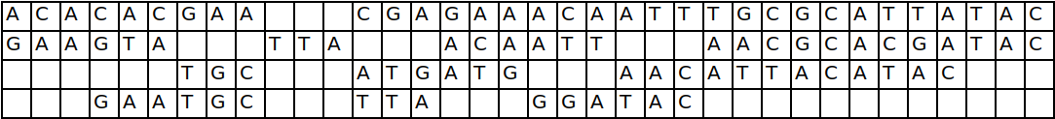
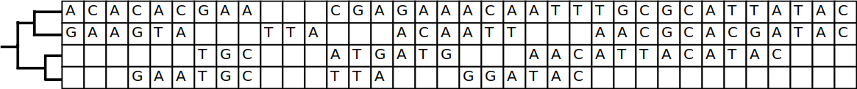
Playfulness
of nature
 | 25 | 29 | 30
 |  | 32 | 34
 |  |  | 21

