Slide 1

The best neighborhood to open a restaurant in Vancouver, Canada

Slide 2
Why Vancouver?
Vancouver is a region that prides itself on the quality and variety of its cuisine
Examples: Japanese, Chinese, Spanish, French
Home to countless of cafes, food markets, and restaurants

Slide 3
Problem & Solution
Variety of food options
Biggest challenge: Finding an ideal location to open a restaurant
Solution: To help potential business owners or investors look for a suitable location to open a restaurant in Vancouver, using a popular clustering technique

Slide 4
Who would benefit from this?
Potential business owners
Potential investors
Foodies
Bloggers

Slide 5

Methodology

Slide 6
Data sources
List of neighborhoods in Vancouver is scraped from Wikipedia
The corresponding coordinates is obtained using geocoder
The venues data in each of the neighborhoods is returned by Foursquare API

Slide 7
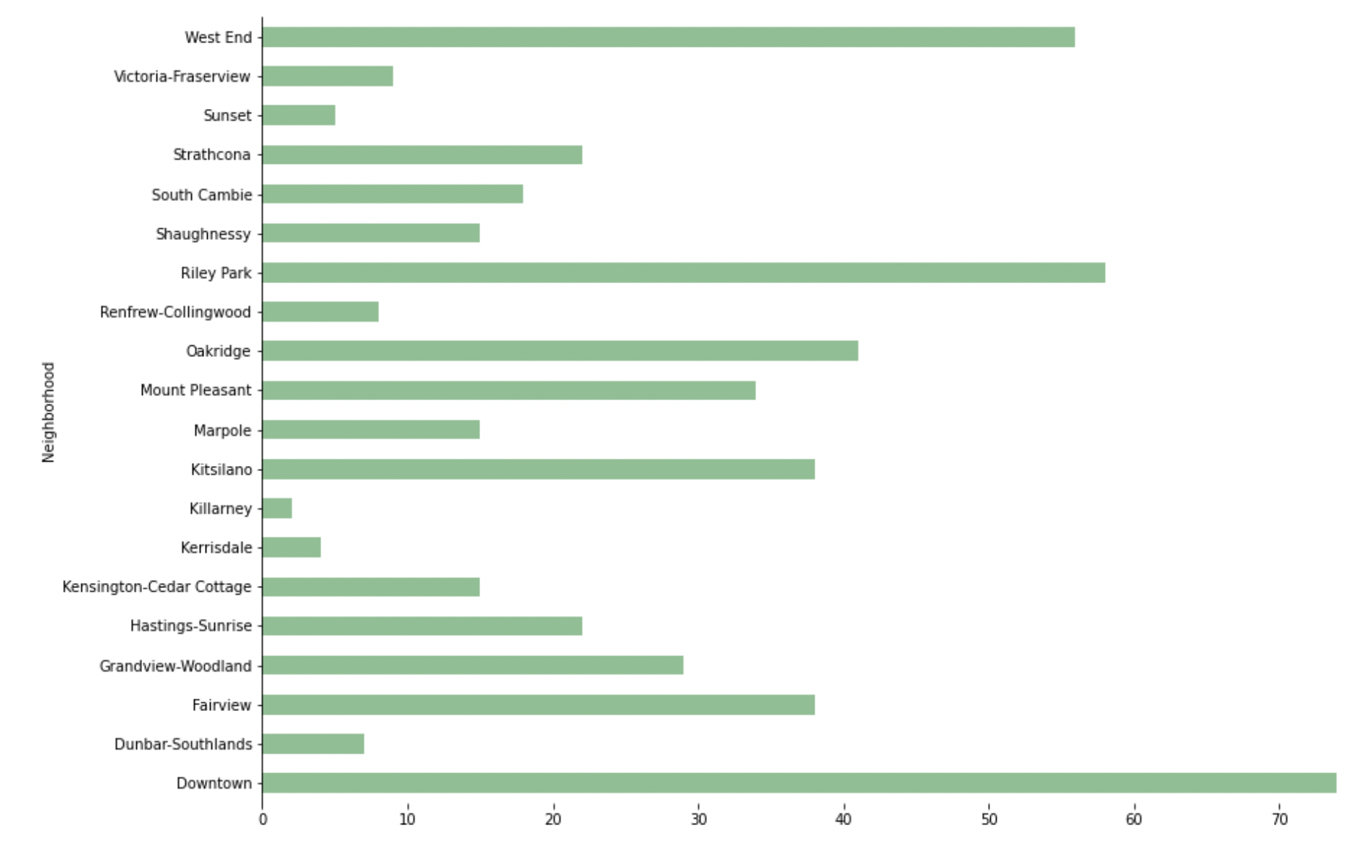
Number of venues in each neighborhood

Slide 8
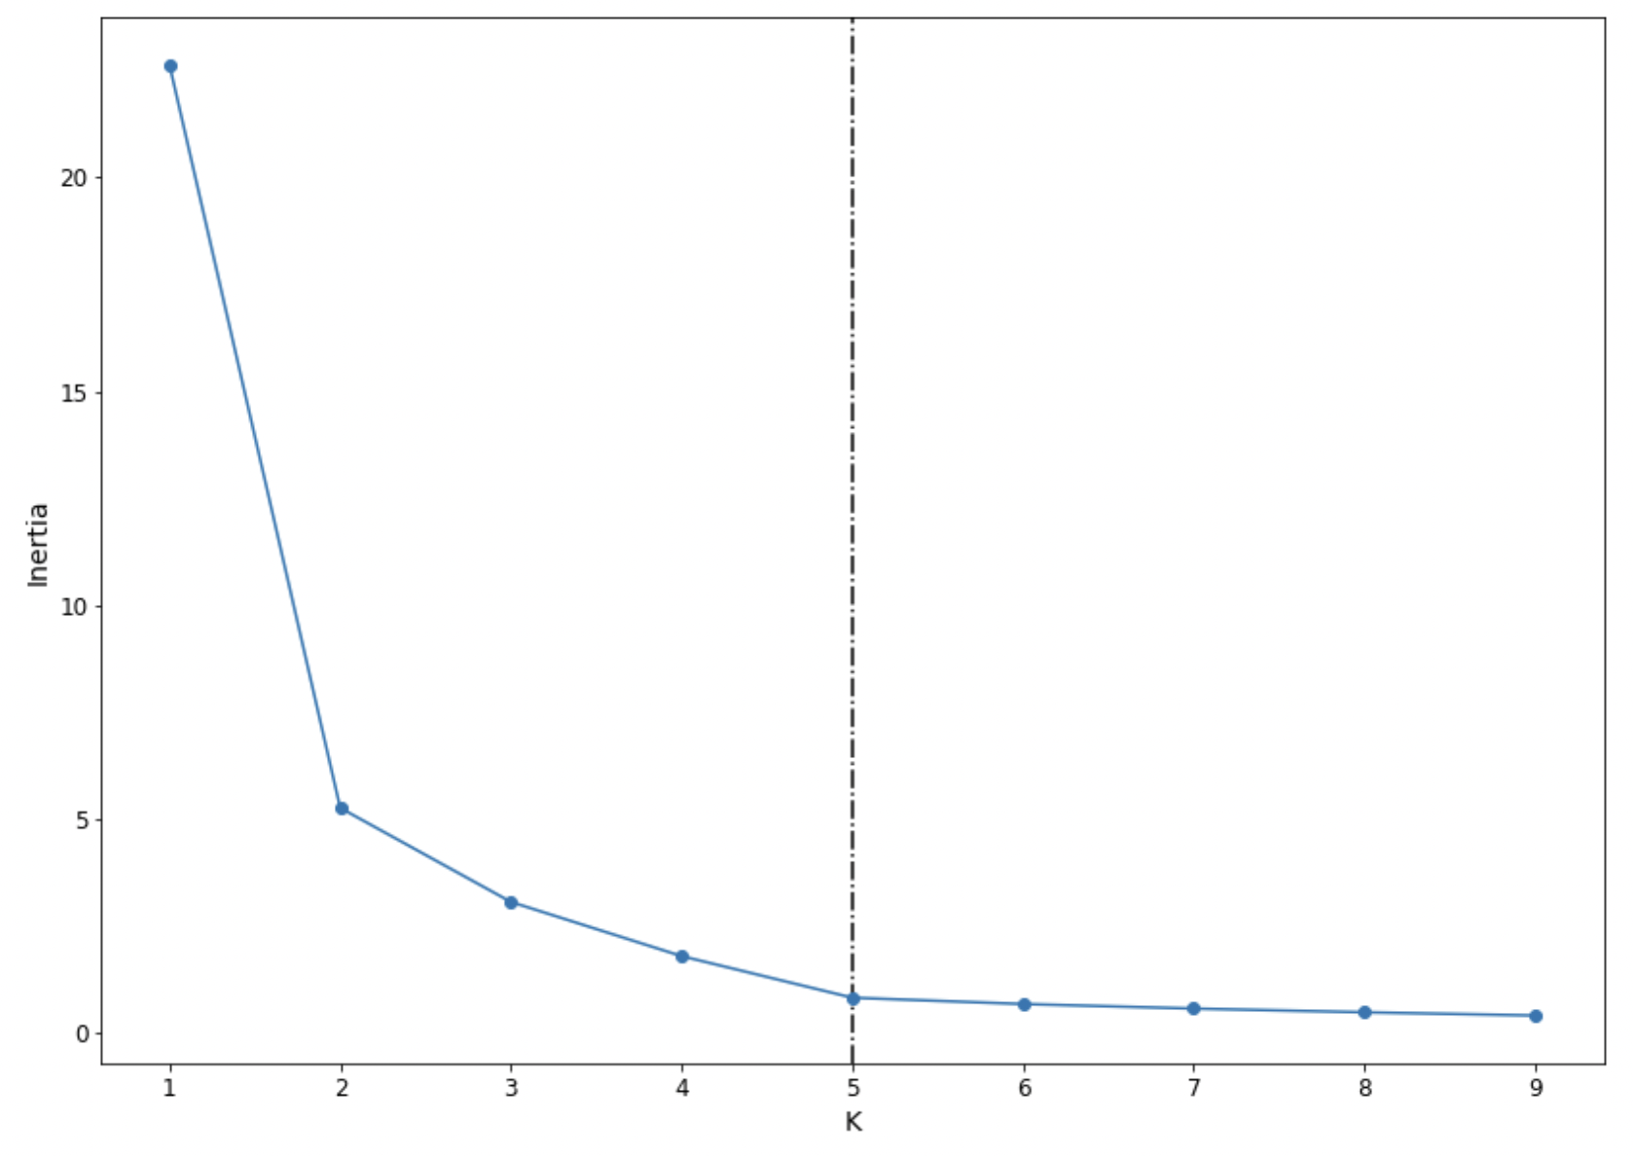
Clustering

Slide 9

Let’s look at top 3 clusters

Slide 10
Cluster 1
Locations:
Downtown Vancouver
Oakridge
South Cambie
Popular Cuisines:
Japanese restaurants
Chinese restaurants

Slide 11
Cluster 2
Location:
Kerrisdale
Further away from downtown
Popular Cuisines:
Spanish restaurants
French restaurants

Slide 12
Cluster 3
Location:
Mount Pleasant
Somewhat close to downtown
Popular Cuisines:
Cafes
Coffee shops

Slide 13
Recommendations
If no budget, open a restaurant in cluster 1
Try to move beyond Japanese and Chinese cuisines
If tight budget, may open a restaurant in cluster 2 or 3
If cluster 2, try to move beyond cafes and coffee shops
If cluster 3, try to move beyond European cuisines

Slide 14
Conclusion and future directions
Provide business recommendations – where to open a restaurant
Utilized popular clustering technique to make accurate prediction
Can be applied to understand the type of cuisines or shop
Ideas include:
Include more data
Include other variables such as rent prices

