Slide 1
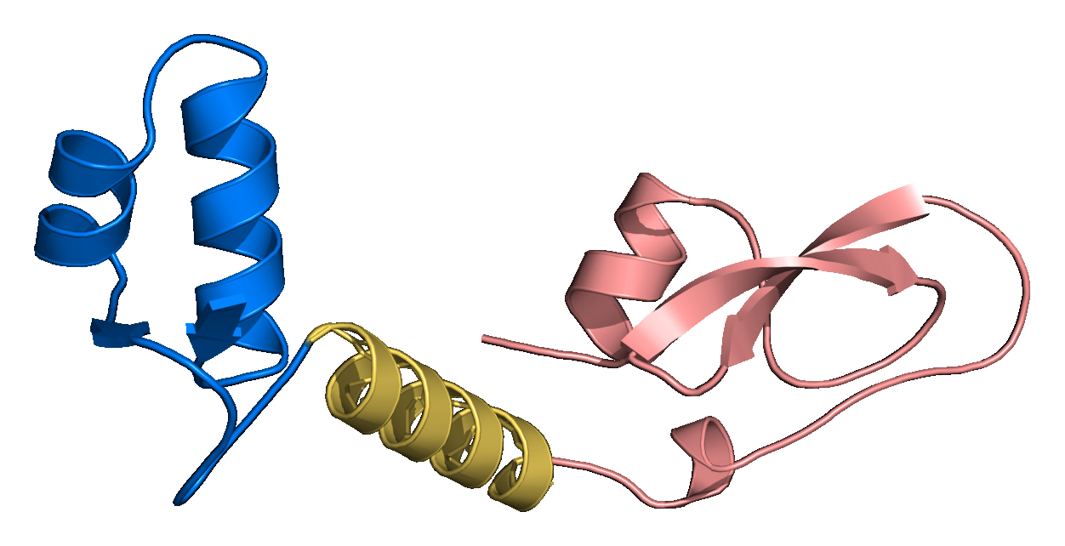
Mini Project: LinkerForge
Designing Linkers for Fusion Proteins
This public, matched AlphaFold2/ColabFold panel compares exact linker sequences, geometry and confidence. It is a structural method demonstration, not a test of biologically trained generator output.
Under the guidance of Chandrima Ghosh
K. J. Somaiya College of Engineering (KJSSE)
Kushagra Srivastava 16010125257
Hardik Tyagi 16010125267
Ram Kankeshwar 16014125025
Predicted 1CRN–(EAAAK)₃–4PTI fusion
Open-source PyMOL 3.1.0 rendering of the highest linker-containing mean-pLDDT construct in the completed public panel. Blue: Crambin · gold: linker · rose: BPTI. [F1, S1–S4]
Notes:
Opening: this deck reports completed computational checks. It does not claim experimental success or an optimal biological linker. The molecular image is the actual saved AlphaFold2/ColabFold rank-1 structure rendered in open-source PyMOL.
Sources:
- M:/ChatGPT/LinkerForge 2/README.md
- M:/ChatGPT/LinkerForge 2/.codex-ppt-build/validation-results-20261025/pymol/crn_eaaak15_hero_trim.png
- M:/ChatGPT/LinkerForge 2/runs/folds/public-multipair-af2ptm-20261021/three_pair_comparison.json
- https://doi.org/10.1038/s41586-021-03819-2
- https://doi.org/10.1038/s41592-022-01488-1
- https://www.pymol.com/support.html
- https://www.rcsb.org/structure/1CRN
- https://www.rcsb.org/structure/4PTI

Slide 2
From natural linkers to designed fusion linkers
Problem: linker choice is context-dependent, while natural evidence and validated design outcomes are sparse.
AIM
To build and evaluate a system that mines natural linker evidence, generates sequences for a specified domain pair and checks fusion structures.
OBJECTIVES
01 · Curate
Build traceable natural-linker records; keep DFL, structural linkers and unknown residues distinct.
02 · Detect
Use the residue classifier to propose spans; audit labels, family splits and no-linker controls.
03 · Generate
Use the Version 1 two-flank infiller with supplied length, residue rules and optional motif constraints.
04 · Validate
Check generated sequences, baselines and complete-fusion geometry under a matched protocol.
05 · Advance
Prepare reviewed training data and independent tests before claiming biological utility.
The current novelty is a research hypothesis, not a demonstrated result. Generating fusion linkers already exists in LINKER; two-sided protein sequence infilling exists in ProtFIM; and a 2026 fusion-linker study combined protein embeddings, predicted structural features and measured activity. Computational fusion screening also has published precedent.
NOVELTY HYPOTHESIS
Sources: FUSION_GENERATOR.md, commit 7a4ccc2; ProtFIM arXiv:2303.16452; LINKER DOI 10.1093/protein/13.5.309.

Slide 3
LITERATURE REVIEW
What detection and generation studies establish
Detection and sequence generation both have prior art. We test their connection in context-specific fusion design.
NO.
PAPER · JOURNAL · DOI
FINDING
LIMITATION / GAP
OUR RESPONSE
01
DFLpred · Bioinformatics (2016)
10.1093/bioinformatics/btw280
Predicts DFL residues from sequence.
Older features; label uncertainty.
Masked CNN; matched-residue test.
02
LINKER · Protein Eng. (2000)
10.1093/protein/13.5.309
Generated fusion-linker sequences.
Generation predates LinkerForge.
Compare with sourced templates.
03
ProtFIM · arXiv (2023)
arXiv:2303.16452
Infills protein segments from both flanks.
Fusion-linker transfer untested.
Two-flank, fixed-length V1.
04
LINKER-Pred · Bioadv. (2024)
10.1093/bioadv/vbae035
Predicts DFL residues with deep learning.
Input and coverage differ.
Common-target retrospective test.
05
CAID3 · NAR (2025)
10.1093/nar/gkaf1066
Benchmarks linker prediction.
Public labels already viewed.
New sealed, family-audited test.
Gap: test context-specific proposals on unseen domain pairs with audited sources and matched controls.
Sources: DFLpred, LINKER, LINKER-Pred and CAID3 DOIs; ProtFIM arXiv:2303.16452; FUSION_GENERATOR.md.

Slide 4
MATERIALS · METHODS · WORKFLOW
The evidence-to-design workflow
The detector, generator and structural panel serve different stages; each claim stops at its own evidence gate.
1 · SOURCES
2 · CURATION
3 · EVIDENCE GATE
4 · DETECT
DisProt / domain maps
PDB / natural records
→
DFL / structural / x
labels stay distinct
→
Family audit
protected preflight
→
ESM-2 + CNN
residue scores
↓
8 · REPORT
7 · SCREEN
6 · GENERATE
5 · REVIEW
Provenance, limits
next test gates
←
Complete-fusion
structural panel
←
V1 two-flank infill
length / motif rules
←
Candidate spans
calls + non-calls
Materials
Source-traced sequences and domain annotations; frozen ESM-2/CNN detector; native conditional transformer generator; public structural controls.
Gate: generator V1 passed synthetic software tests; real-data training, protected comparison and biological validation remain outstanding.

Slide 5
PROJECT OVERVIEW
Two implemented components, one project aim
LinkerForge connects natural-linker discovery to fusion-linker generation. The components have different levels of scientific validation.
TODAY · IMPLEMENTED
NEXT · GATED
A DFL residue detector and source-stratified candidate inventory; Version 1 conditional generator code with exact-length constrained decoding and synthetic smoke tests.
Review natural-linker records; train the generator on eligible family-disjoint data; compare templates and matched baselines on independent targets.
FUTURE · VISION
Rank pair-specific linker proposals, screen full fusion structures and test expression or function experimentally.
Evidence boundary: the generator emits sequences in software tests; no biologically trained weights or demonstrated fusion performance are available.

Slide 6
PROJECT SCOPE
Which proteins are in scope?
The answer depends on whether we mean model training, candidate mining or the future fusion demonstration.
CURRENT DFL TRAINING RECORDS
CANDIDATE MINING SOURCES
Published TR166 / TE82 / TE64 records are identified by DisProt IDs. The checked-in split files do not provide a complete species/name crosswalk, so we should not invent one.
Configured taxa include human, mouse, cow, dog, pig, zebrafish and fruit fly, plus Arabidopsis, maize and wheat. These are candidate-source queries, not verified training examples.
NAMED STRUCTURAL EXAMPLES
The original analysis includes Crambin (Crambe hispanica subsp. abyssinica, plant), BPTI (Bos taurus, cow) and Streptococcal Protein G (bacterium). These are structure-analysis examples, not DFL training rows.
Long-term fusion demo: sfGFP (Aequorea victoria, jellyfish) with mCherry (Discosoma sp., coral). The current DFL split itself lacks a full organism crosswalk. These names do not imply they trained the detector.
Sources: DLD and TR166 manifests; configs/uniprot_*_domain_gap_v1.json; RCSB PDB 1CRN, 4PTI, 1PGA; Addgene plasmid 206947.

Slide 7
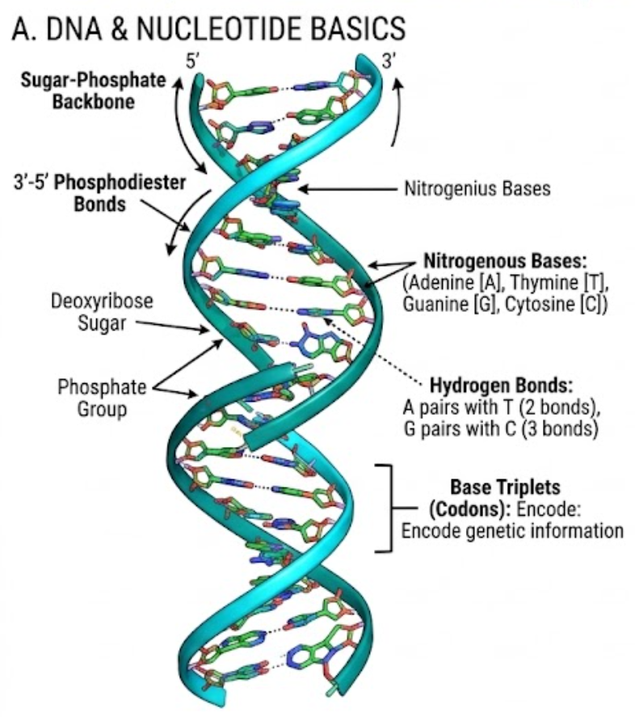
FOUNDATIONS
From DNA to a multidomain protein
DNA encodes the sequence
Bases A, T, G and C form a directional double helix. Transcription and translation turn the encoded sequence into an amino-acid chain.
A linker is a sequence span
The chain folds into domains. An intervening segment between two neighbouring domain boundaries is a candidate interdomain linker.
LINKERFORGE • PROJECT METHODS AND RESULTS
7

Slide 8
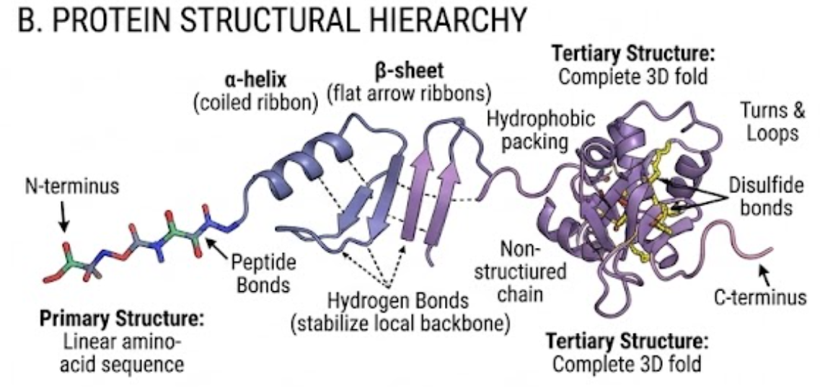
FOUNDATIONS
Sequence, local structure and folded domains
Primary structure
The amino-acid sequence runs from the N-terminus to the C-terminus.
Secondary structure
Local helices, sheets and turns arise from backbone interactions.
Tertiary structure
The complete chain folds through packing and other interactions. Domain boundaries are assigned on this folded architecture.
LINKERFORGE • PROJECT METHODS AND RESULTS
8

Slide 9
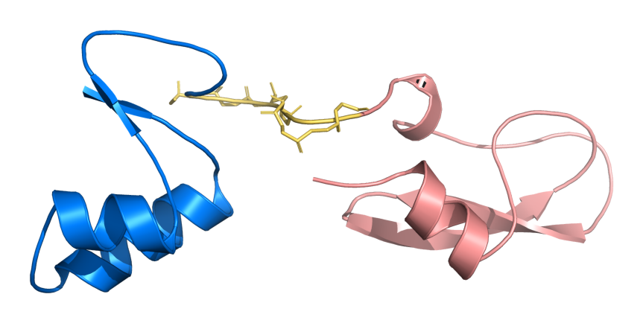
FOUNDATIONS
Start here: what is being designed?
A fusion protein is one continuous amino-acid chain created by connecting two protein regions. LinkerForge evaluates the short peptide placed at that junction.
Domain A — Crambin (PDB 1CRN)
Residues 1–46 in this construct. A domain is a protein region expected to adopt a recognisable three-dimensional fold. Blue identifies the N-terminal partner.
Linker — (GGGGS)₂
Residues 47–56. A linker is a covalently encoded peptide between the partners. Length, sequence and secondary-structure tendency can alter separation, motion and interdomain orientation.
Domain B — BPTI (PDB 4PTI)
Residues 57–114. Rose identifies the C-terminal partner. The junction therefore follows the sequence order Domain A → linker → Domain B.
BLUE Crambin
GOLD (GGGGS)₂
ROSE BPTI
Actual predicted structure used for explanation
Cartoon/ribbon = secondary-structure path; gold sticks = linker backbone atoms. The image is a model, not an experimental crystal structure.
Candidate = one linker sequence under evaluation. Control = a predefined comparison, such as direct fusion or a standard GS repeat.
Figure source: F2; prediction and viewer methods: S1–S4; public domain references: R1–R2.
LINKERFORGE • VALIDATION METHODS & VERIFIED RESULTS
02
Notes:
Sources:
- M:/ChatGPT/LinkerForge 2/README.md
- M:/ChatGPT/LinkerForge 2/.codex-ppt-build/validation-results-20261025/pymol/crn_gs10_unlabeled_trim.png
- M:/ChatGPT/LinkerForge 2/runs/folds/public-multipair-af2ptm-20261021/three_pair_comparison.json
- https://doi.org/10.1038/s41586-021-03819-2
- https://doi.org/10.1038/s41592-022-01488-1
- https://www.pymol.com/support.html
- https://www.rcsb.org/structure/1CRN
- https://www.rcsb.org/structure/4PTI

Slide 10
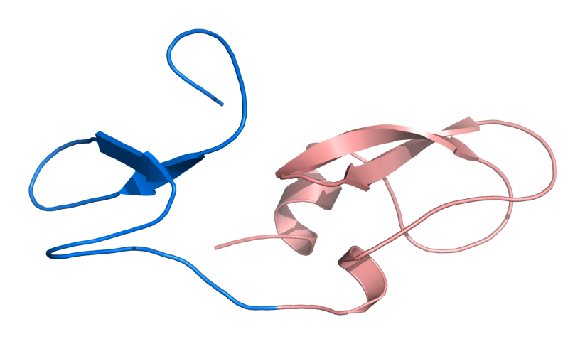
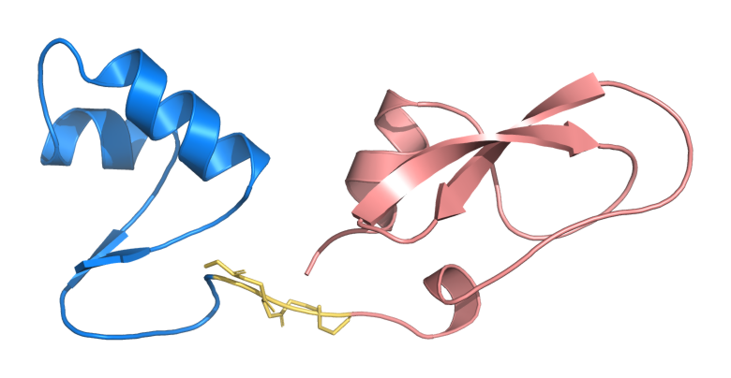
FOUNDATIONS
Linker classes answer different design needs
Direct fusion · 0 aa
Flexible GS linker · 5 aa
Rigid helical linker · 15 aa
No inserted residues. This is a zero-linker baseline, so linker pLDDT is not defined.
GGGGS is glycine/serine-rich and intended to reduce geometric constraint at the junction.
(EAAAK)₃ is helix-forming and intended to act as a more persistent spacer between partners.
Overall pLDDT 74.5 · cross-domain PAE 17.3 Å
Overall pLDDT 87.6 · linker pLDDT 51.2
Overall pLDDT 93.8 · cross-domain PAE 9.7 Å
The three molecular views use the same public Crambin–BPTI pair. Differences are descriptive AlphaFold2/ColabFold outputs, not experimental proof that a class is biologically superior.
Figure sources: F3–F5; prediction and viewer methods: S1–S4; public domain references: R1–R2.
LINKERFORGE • VALIDATION METHODS & VERIFIED RESULTS
03
Notes:
Sources:
- M:/ChatGPT/LinkerForge 2/README.md
- M:/ChatGPT/LinkerForge 2/runs/folds/public-multipair-af2ptm-20261021/three_pair_comparison.json
- M:/ChatGPT/LinkerForge 2/runs/detector-audits/public-fusion-panel-20261020/dflpred_summary.json
- M:/ChatGPT/LinkerForge 2/.codex-ppt-build/validation-results-20261025/pymol/crn_direct_unlabeled_trim.png
- M:/ChatGPT/LinkerForge 2/.codex-ppt-build/validation-results-20261025/pymol/crn_gs5_unlabeled_trim.png
- M:/ChatGPT/LinkerForge 2/.codex-ppt-build/validation-results-20261025/pymol/crn_eaaak15_labeled_trim.png
- https://doi.org/10.1038/s41586-021-03819-2
- https://doi.org/10.1038/s41592-022-01488-1
- https://www.pymol.com/support.html
- https://www.rcsb.org/structure/1CRN
- https://www.rcsb.org/structure/4PTI

Slide 11
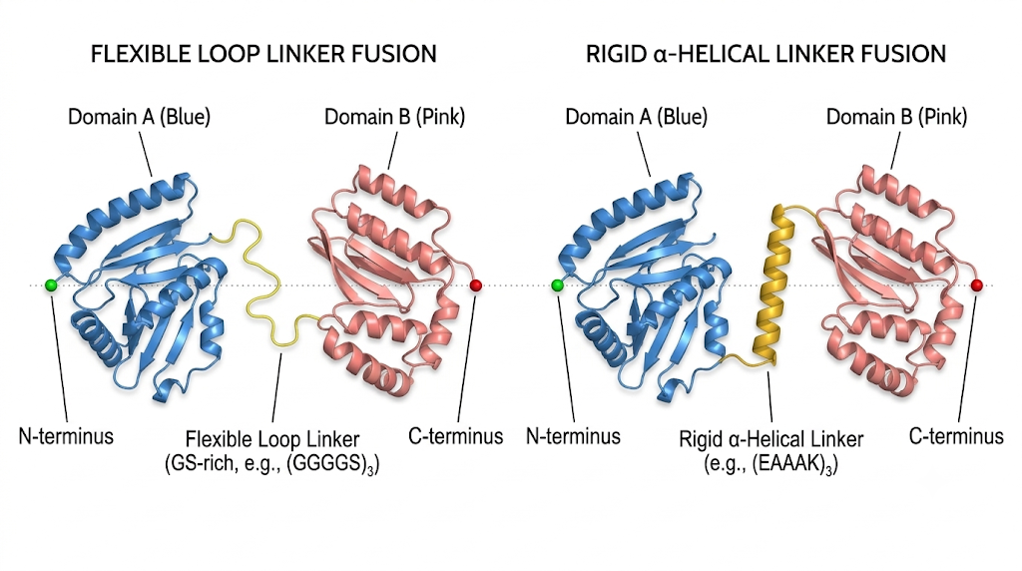
FOUNDATIONS
Flexible and rigid linkers solve different design problems
Allows a broad range of relative motion. Example control: (GGGGS)3, 15 residues.
Helix-forming spacer aims to maintain separation and reduce flexibility; it can still alter expression, folding or activity.
LINKERFORGE • PROJECT METHODS AND RESULTS
11

Slide 12
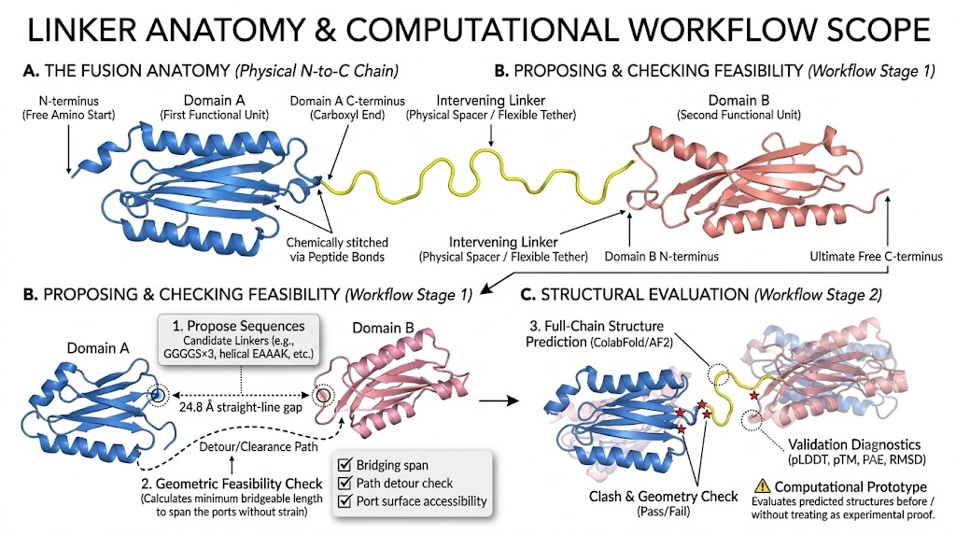

Slide 13
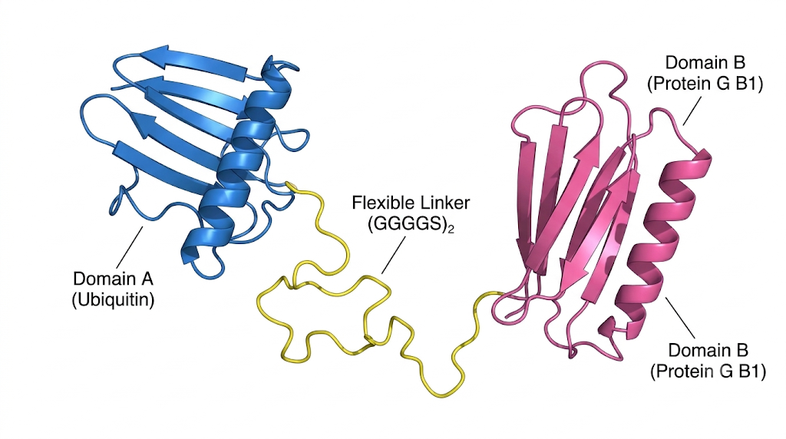

Slide 14
Overall Scope
The Fusion Anatomy (Physical N-to-C Chain) This section traces the continuous, physical polypeptide chain from start to finish.
N-terminus (Free Amino Start): The entire fusion protein sequence begins at this free amino group, establishing the chain's fundamental directionality.
Domain A (First Functional Unit): Displayed in blue, this is the first independently folded protein structure in the sequence.
Domain A C-terminus (Carboxyl End): This is the final residue of Domain A, serving as the exit port where the linker attaches.
Chemically Stitched via Peptide Bonds: The transition from the domain to the linker is not a physical gap; they are covalently bonded together into one continuous molecule.
Intervening Linker (Physical Spacer / Flexible Tether): Shown in yellow, this short engineered peptide segment bridges the two domains to control their spacing and movement.
Domain B N-terminus: The linker directly merges into the starting port of the second domain.
Domain B (Second Functional Unit): Displayed in pink, this is the downstream folded structure of the fusion.
Ultimate Free C-terminus: The continuous chain completely folds through Domain B and terminates at this final carboxyl end.

Slide 15
N-term / C-term (N-terminus / C-terminus): The respective starting end (amino) and finishing end (carboxyl) of a single protein chain.
DFL (Disordered Flexible Linker): A highly flexible connector segment—often built with Glycine and Serine—allowing attached domains to move freely.
IDL (Independent-Domain Linker): A linker connecting two domains that fold and operate completely independently of one another.
DDL (Dependent-Domain Linker): A linker connecting two domains that rely on each other for structural stability or function.
GS-rich / EAAAK: Common linker sequences where "GS" (Glycine/Serine) creates flexible loops, and "EAAAK" repeats create rigid, coiled helical spacers.
pLDDT (predicted Local Distance Difference Test): A 0-to-100 score indicating the software's confidence in the local structure of specific residues (a low score on a linker often just means it is flexible).
pTM (predicted Template Modeling score): A global score from 0 to 1 measuring confidence in the overall fold and 3D topology of the whole protein.
PAE (Predicted Aligned Error): A metric showing how confident the model is about the relative positioning and distance between Domain A and Domain B.
RMSD (Root Mean Square Deviation): A physical distance measurement used to check if a domain warped or lost its natural shape after being fused.
SASA (Solvent-Accessible Surface Area): A calculation measuring how exposed a part of the protein is to its surrounding environment, which is crucial for finding safe attachment sites.

Slide 16
B. Proposing & Checking Feasibility (Workflow Stage 1) This section explains the initial mathematical and geometric screening before any 3D folding occurs.
1. Propose Sequences: The system enumerates candidate linker sequences, such as flexible Gly/Ser repeats (e.g., GGGGS×3) or rigid helical segments (e.g., EAAAK).
24.8 Å Straight-Line Gap: The workflow measures the direct physical distance between the C-terminus of Domain A and the N-terminus of Domain B.
Detour/Clearance Path: Because the linker cannot pass through solid protein, the system maps a safe routing path (the dashed line) around the exterior of the domains.
2. Geometric Feasibility Check: The system calculates the absolute minimum number of amino acids required to bridge the physical gap without stretching or breaking the chain.
Checklist: A candidate passes this stage only if it satisfies the bridging span calculation, passes the path detour check (avoiding collisions), and confirms that the attachment ports are surface-accessible.
C. Structural Evaluation (Workflow Stage 2) This section details how the generated candidates are validated as complete 3D models.
3. Full-Chain Structure Prediction: The workflow uses advanced predictors like ColabFold or AlphaFold2 to fold the entire A-Linker-B sequence into a 3D model.
Clash & Geometry Check (Pass/Fail): The folded model is screened for physical impossibilities, with red stars indicating severe atomic overlaps, chain breaks, or structural collisions that cause a candidate to be rejected.
Validation Diagnostics: The system records structural confidence scores, specifically pLDDT (local residue confidence), pTM (global topology confidence), PAE (relative domain orientation error), and RMSD (how much the domains deformed compared to their natural state).
Computational Prototype Warning: A critical concluding caveat states that LinkerForge evaluates predicted structures computationally, but this prediction does not guarantee in-vivo biological success or serve as experimental proof.

Slide 17
To build a reliable computational model, LinkerForge ingests and cross-references data from a highly curated collection of biological databases. Here is a semantic breakdown of the primary data sources and exactly what structural or sequence information each provides to the workflow:
DisProt (Database of Protein Disorder): Acts as the gold standard for flexibility, providing explicitly curated annotations for Disordered Flexible Linkers (DFLs) and rigid, ordered regions. It supplies clear positive, negative, and unknown region semantics complete with literature citations and curator status.
UniProtKB & UniRef50: Serve as the foundational sequence dictionaries. They supply the canonical, reference amino-acid sequences for proteins across different species, track their evolutionary lineages, and group them into homology clusters for large-scale data mining.
InterPro & Pfam: Function as the biological sequence mappers. They identify the specific families and boundaries of functional protein domains, which is how the system locates the unassigned "gaps" between adjacent domains.
CATH & RCSB PDB (Protein Data Bank): Provide the physical ground truth. PDB supplies the experimentally resolved 3D atomic coordinates and identifies missing sequence residues, while CATH defines precise structural-domain boundaries and their hierarchical classifications.
DLD (Domain Linker Database): Supplies specialized labels distinguishing between Independent-Domain Linkers (IDL) and Dependent-Domain Linkers (DDL). LinkerForge uses this to separate structural domain linking from general flexibility detection.
AlphaFold Database: Contributes computationally predicted 3D protein structures. The workflow strictly categorizes these predictions as a separate tier of evidence to ensure they are never confused with experimentally verified reality.
Published Literature & Benchmarks (CAID3 / DP94): Supply the historical context and testing grounds. Literature records provide documented, engineered linker templates (like flexible GS-rich or rigid helical sequences) along with protease-recognition motifs, while benchmark databases like CAID3 are used retrospectively to evaluate the detector's performance against common targets.

Slide 18
DATABASE & CLASSIFIER
From source records to residue labels
The database stage determines what the model is allowed to learn. Structural domain linkers and disordered flexible linkers are related concepts, not interchangeable labels.
Published DFL sets
TR166 / DisProt labels; annotation coverage varies
Label coding
↓
1 = annotated linker residue
0 = annotated non-linker residue
x = unknown / masked; excluded from loss
DLD
structural IDL / DDL labels; separate task
↓
UniProt / InterPro / Pfam
sequence and domain-family context
↓
Negative examples
PDB / CATH
experimental coordinates and structural domains
Linker-free proteins provide specificity evidence. Unknown or unannotated gaps are not silently converted into negatives.
↓
CAID3
external DFL benchmark; retrospective comparison only
Unknown annotation is not a negative. Mining output is a candidate inventory, not experimentally confirmed positives.
Sources: README §2; DLD conversion notes in TRAINING.md; RESEARCH_HANDOFF.md.

Slide 19
DATABASE & CLASSIFIER
Natural mining creates candidates; curation creates evidence
A sequence gap between domain calls is a candidate span. It does not become a confirmed flexible linker simply because it was mined.
Protein sequences
Residue model
Sequence scores
Gap extraction
Review queue
→
→
→
→
source-indexed records
frozen ESM-2 + CNN
per-position logits
candidate spans
calls + non-calls
27,766 inventory records
27,595 model-scored gaps
Source-tracked sequence / gap inventory assembled in earlier mining work; mixed evidence tiers remain distinct.
Predicted candidate intervals, not 27,595 verified DFLs and not generated engineered linker sequences.
A separate specificity panel contains 40 no-linker proteins; it is not part of the 27,766-record total.
Source: docs/DFL_CLASSIFIER_PUBLICATION_CHECKLIST_2026-10-25.md (inventory accounting).

Slide 20
PHASE 1: SOURCE ACQUISITION (THE RAW DATABASES)
➔ Sequence & Homology: UniProtKB (Swiss-Prot and TrEMBL) provides reference amino acid sequences and accession lineages, while UniRef50 provides homology cluster context for large-scale mining.
➔ Domain Mapping: InterPro and Pfam supply protein-to-domain mappings and family annotations to identify where functional units start and end.
➔ Structural Evidence: CATH and RCSB PDB supply experimentally resolved 3D atomic coordinates, missing residue data, and precise structural domain boundaries.
➔ Curated DFL Annotations: DisProt provides explicit, literature-cited annotations for Disordered Flexible Linkers (DFLs) and ordered regions.
PHASE 2: TARGET EXTRACTION (ISOLATING DOMAIN GAPS)
➔ The system parses FASTA sequences and domain tables, isolating proteins that contain at least two explicitly annotated domains.
➔ It sorts these domain matches by sequence coordinates and extracts "domain gaps," defined strictly as the unassigned sequence intervals sitting directly between two distinct, adjacent domains.
PHASE 3: THE MINING GATE (APPLYING EXCLUSION FILTERS)
➔ Filter 1 (Overlap): Rejects any domain gaps where the flanking domains are overlapping, nested, duplicated, or ambiguous.
➔ Filter 2 (False Domains): Rejects gaps generated by sequence families, short motifs, or sequence repeats that are falsely presented as full domains.
➔ Filter 3 (Location): Explicitly excludes terminal tails (unattached ends of the protein) and single-domain interior loops.
➔ Filter 4 (Architecture): Excludes gaps located between identical repeated domains (homo-repeat gaps).
➔ Filter 5 (Length Window): The prospective interdomain miner proposes 10–60 residue gaps; the older fusion demonstration uses 5–30 residues. Both are project scope rules, not biological truth labels.

Slide 21
LENGTH WINDOWS
The 2–31 range needs a precise definition
We cannot claim that 2–31 is a literature-validated biological linker-length range.
IF THEY ARE COORDINATES
IF THEY ARE LENGTHS
Positions 2 through 31 inclusive contain 30 residues: 31 − 2 + 1 = 30.
That is not the frozen range in the project specification. The old fusion demonstration uses 5–30 aa as a design constraint, not a learned biological law.
FOR NATURAL DFL MINING
The prospective interdomain caller proposes 10–60 residues for eligible domain gaps, then requires a contiguous scored core of at least 10 residues. These are project-defined scope rules.
WHY NOT A HARD BIOLOGICAL CLAIM?
Real DFLs can be shorter, longer or intradomain. A narrow filter changes coverage and creates out-of-scope misses. Validate candidate cutoffs on a separate adjudicated cohort and report sensitivity outside the range.
Sources: README §1; DFL_DEFINITION_AND_PRECISION_PROTOCOL_2026-10-25.md; CAID3 / DFLpred citations therein.

Slide 22
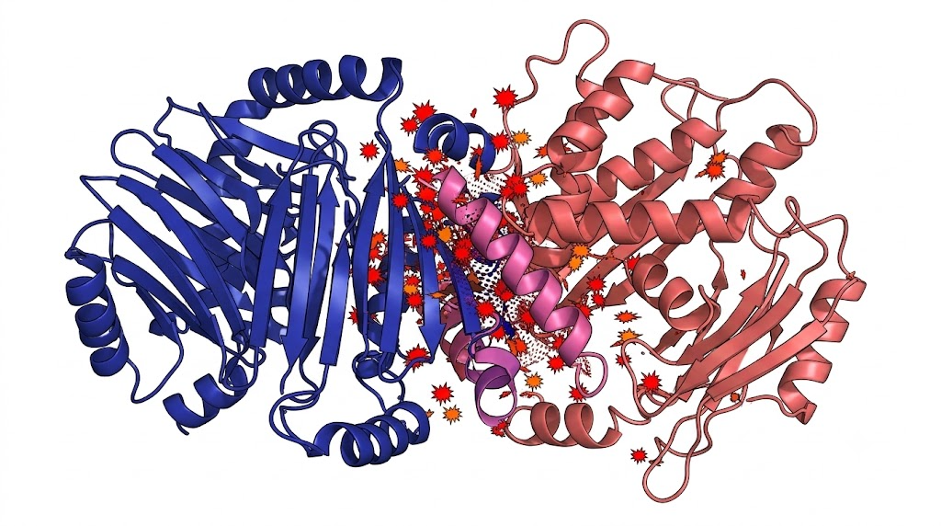
The Problem: The sequence mapping shows two domains, but structurally, they are squashed together, overlapping, or colliding.
Why it’s rejected: There is no distinct physical gap between them. You cannot extract a valid "linker" from a space that doesn't physically exist.

Slide 23
PHASE 1 · START
Build the linker evidence base
Natural and mined records become useful only after their source, span and family relationships are checked.
27,766 source-tier records
971-record review packet
Generator data gate
27,595 model-mined gaps plus natural segments, curated DFLs and cited templates. These are records, not verified training proteins.
A stratified packet was prepared for two independent curators. Completed adjudication is not documented.
Only approved A–linker–B records with source hashes, evidence tiers and audited family splits can enter scientific training.
Phase 1 ends in this talk
with the inventory and review gate defined. The scientific data approval gate is still open.
Published dataset
https://github.com/richennacht/LinkerForge/tree/main/datasets
Source: datasets/README.md; docs/LINKER_CURATION_PROTOCOL_2026-10-21.md; origin/main.
Notes:
Published archive and manifest: https://github.com/richennacht/LinkerForge/tree/main/datasets. Counts from origin/main datasets/README.md and docs/LINKER_CURATION_PROTOCOL_2026-10-21.md. The archive has 27,766 rows, including 27,595 model-mined candidate gaps. The 971-record packet was prepared; completed independent adjudication is not documented. Do not call the full corpus generator training truth.

Slide 24
PHASE 1 · DATASET
How a candidate linker enters the inventory
1 · Ingest
2 · Find a gap
Read source FASTA, domain tables and source identifiers; retain the exact sequence and annotation version.
Require two distinct, non-overlapping adjacent domain accessions and a span between them.
3 · Reject ambiguous spans
4 · Reconcile coordinates
Exclude terminal tails, single-domain interiors, overlaps and nested or duplicated domains.
Match UniProt sequence positions to PDB/CATH residues; reject unresolved missing or conflicting boundaries.
5 · Inspect geometry
6 · Record evidence
C-alpha distances can flag chain breaks and coarse clashes. All-atom clearance remains future work.
Save the span, flanking domains, source tier and rejection reason for independent review.
LINKERFORGE • PROJECT METHODS AND RESULTS
23

Slide 25
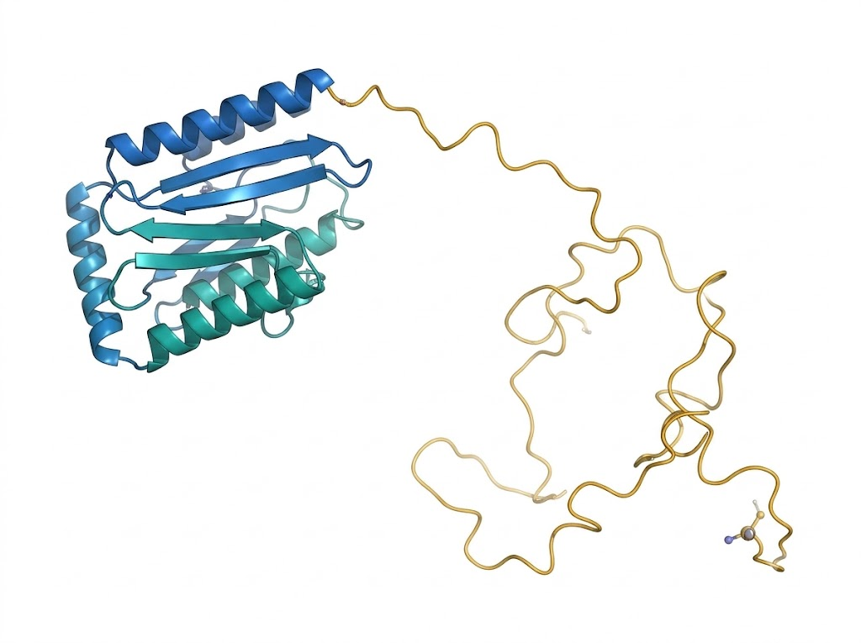
PHASE 1 · EXCLUSION
A terminal tail is not an interdomain linker
The candidate
One folded domain has a flexible extension at its end.
Why it fails
A linker must connect two distinct domains. The terminal tail lacks the second anchor.
LINKERFORGE • PROJECT METHODS AND RESULTS
24

Slide 26
PHASE 1 · EXCLUSION
The terminal-tail rejection gate
Two domains required
Both flanks required
The source annotation must identify at least two distinct domain accessions.
A valid gap has one domain on each side. Terminal sequence has only one.
Position matters
Biological meaning
Exclude N-terminal and C-terminal extensions outside the domain pair.
A free tail does not teach the generator to bridge two folding units.
Structure check
PDB/CATH mapping may clarify the boundary; unresolved residues stay outside the approved set.
LINKERFORGE • PROJECT METHODS AND RESULTS
25

Slide 27
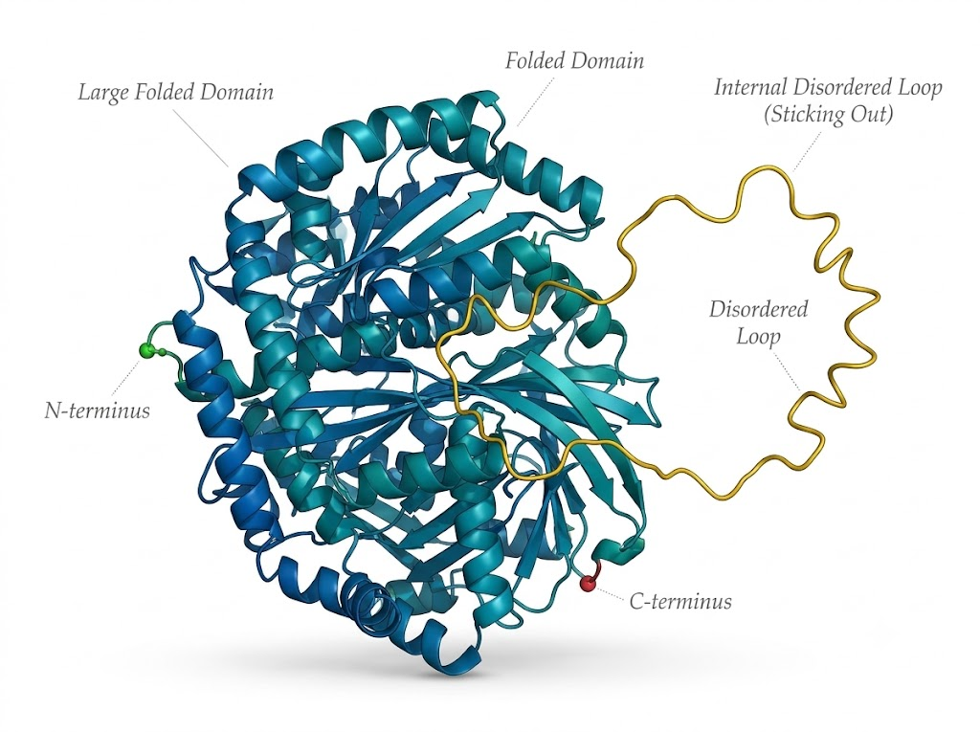
PHASE 1 · EXCLUSION
An internal loop is not an interdomain gap
The candidate
A flexible loop sits inside the boundaries of one folded domain.
Why it fails
Both sides belong to the same domain. Disorder alone does not make the loop an interdomain bridge.
LINKERFORGE • PROJECT METHODS AND RESULTS
26

Slide 28
PHASE 1 · EXCLUSION
The single-domain-interior rejection gate
Map boundaries
Check accessions
InterPro/Pfam coordinates define each annotated domain span.
An internal loop has the same parent domain accession on both flanks.
Exclude interiors
Check structure
A span nested inside one domain cannot enter the interdomain-gap inventory.
CATH/PDB coordinates can test whether the span bridges distinct folded units.
Keep labels distinct
An independently curated DFL annotation remains on its own evidence track.
LINKERFORGE • PROJECT METHODS AND RESULTS
27

Slide 29
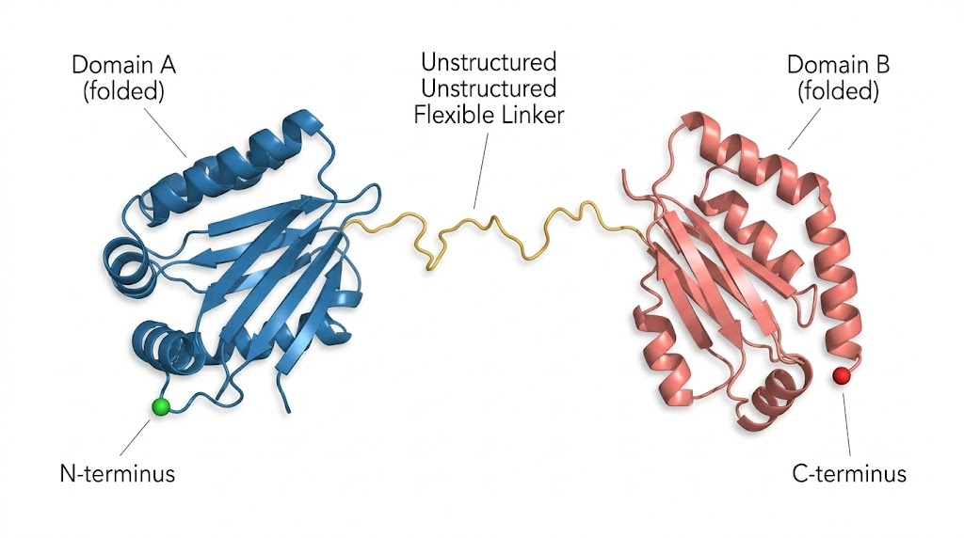
PHASE 1 · CANDIDATE
A gap between two distinct domains enters review
The candidate
Domain A and Domain B are distinct, adjacent and non-overlapping.
What happens next
A 10–60 residue gap is a candidate. Exact mapping and independent annotation or adjudication are still needed for a positive label.
LINKERFORGE • PROJECT METHODS AND RESULTS
28

Slide 30
PHASE 1 · ADJUDICATION
A candidate gap is not yet a positive label
Domain gate
Length gate
Require two distinct, adjacent, non-overlapping flanking accessions.
The mining window is 10–60 residues. The fusion design scope is 5–30 residues.
Coordinate gate
Label gate
Reject missing residues, ambiguous insertion codes and sequence/structure conflicts.
Sourced DFL positives are 1; verified non-linkers are 0; unannotated residues remain unknown.
Review and split gate
A 971-record packet was prepared; completed adjudication is not documented. The protected DFL split fails prospective preflight.
LINKERFORGE • PROJECT METHODS AND RESULTS
29

Slide 31
PHASE 1 · EVIDENCE
Labels and family splits require separate checks
Coordinate reconciliation
Independent review
Map UniProt residues to structural positions; drop unresolved gaps and boundary conflicts.
The 971-record packet is prepared. Completed two-curator adjudication is not documented.
Semantic labels
Benchmark firewall
Positive: sourced DFL. Negative: explicitly verified non-linker. Unknown: masked from supervised loss.
Split whole homology/domain-family clusters. The current protected DFL split fails prospective preflight.
Training decision
Wait for an approved source and family audit before fitting biological detector or generator weights.
LINKERFORGE • PROJECT METHODS AND RESULTS
30

Slide 32
DATABASE & CLASSIFIER
The DLD reference set and its split
Counts are from the official DLD chain archive after explicit unsupported-residue and duplicate-sequence exclusions.
166
60
28
9
2,620
published TR166 train proteins
historic DFL train
development
auxiliary order panel
DLD structural records
DFL label policy
Task separation
1 = annotated positive; 0 = explicit negative; x = unknown/masked. Unknown residues are omitted from ordinary supervised loss and metrics.
DLD has structural IDL/DDL annotations and is a separate auxiliary task. Its labels cannot silently become DFL labels.
Historical DFL splits support reproduction, not a new independent test. The prospective family/benchmark firewall must pass before retraining.
Sources: published TR166 split manifest; reports/DFL_FULL_SCALE_TRAINING_GATE_2026-10-13.md; RESEARCH_HANDOFF.md.

Slide 33
DATASET
Dataset acquisition and evidence labels
The acquisition pipeline combines predictions, natural observations and published templates. Their evidence labels remain separate throughout processing.
Acquisition stage | Input and processing | Output | Scientific interpretation
1. Sequence mining | Scan 161,317 full-length proteins and score candidate linker spans with the sequence detector. | 27,595 mined spans labelled high-confidence or provisional predictions. | A mined span is a computational candidate for review. It is not curator-confirmed ground truth.
2. Natural references | Reconcile CATH/PDB domain boundaries and DisProt annotations with the intervening sequence. | 91 structure-supported CATH/PDB spans and 57 curated DisProt DFL spans. | A natural observation supports linker identity in its native protein. It does not report engineered-fusion success.
3. Engineered templates | Collect published linker sequence patterns and standardise sequence, length, class and source. | 23 templates available as candidates or controls. | A template has literature provenance. It is not a universal success label for arbitrary domain pairs.
4. Provenance and review | Attach source IDs, retrieval records, configuration hashes, software versions and evidence quality. | Auditable derived records and a 971-record dual-curator review packet. | Provenance explains origin and transformation. Evidence quality grades support for identity, not compatibility outcome.
Terms used in the dataset
Candidate span
Evidence type
Evidence quality
Provenance
A subsequence predicted to act as a linker. Review may confirm, revise or reject it.
The record is labelled as mined, natural or engineered so the categories cannot be mistaken for each other.
A grade for source support and curation status. It is not a probability that a fusion will work.
The source and transformation history, including identifiers, hashes and versions needed for traceability.
Dataset inventory and acquisition counts: D12. Review-packet provenance: D13.
07
Notes:
Sources:
- M:/ChatGPT/LinkerForge 2/reports/mined_and_natural_linkers_v1_summary_2026-10-19.json
- M:/ChatGPT/LinkerForge 2/runs/curation/mined-and-natural-v1-review-20261021/manifest.json
- M:/ChatGPT/LinkerForge 2/runs/curation/mined-and-natural-v1-review-20261021/fusion-ranker-preflight.json

Slide 34
DATASET
The 27,766-record inventory is provenance-rich—not compatibility ground truth
Evidence tier | Records | What the label means | Permitted interpretation
Mined high confidence | 6,556 | Computational candidate | Prioritisation / curation queue
Mined provisional | 21,039 | Computational candidate | Exploratory only
Natural CATH/PDB | 91 | Structure-supported natural span | Natural reference example
Natural DisProt | 57 | Curated disordered flexible span | Natural DFL reference
Engineered templates | 23 | Published linker pattern | Template/control sequence
TOTAL | 27,766 | Mixed evidence types | Not a fusion-success dataset
Separate specificity panel: 40 no-linker proteins. These are not included in the 27,766-record total.
Dataset inventory and evidence-tier counts: D12.
LINKERFORGE • VALIDATION METHODS & VERIFIED RESULTS
08
Notes:
Sources:
- M:/ChatGPT/LinkerForge 2/reports/mined_and_natural_linkers_v1_summary_2026-10-19.json

Slide 35
PHASE 1 · INVENTORY
What the dataset contains today
27,766 mixed records
27,595 mined gaps
The archive combines source-backed observations, engineered templates and computationally mined candidate gaps.
6,556 high-score and 21,039 provisional model-mined spans dominate the inventory. These are predictions.
Source-backed records
Review prepared
91 CATH/PDB natural spans, 57 DisProt DFL spans and 23 literature templates have different evidential meanings.
A 971-record packet and separate 40-protein diagnostic panel were prepared; completed independent adjudication is not documented.
What the inventory supports
It supports traceable discovery and retrieval. It is not a collection of experimentally successful fusion designs or an approved generator training set.
LINKERFORGE • PROJECT METHODS AND RESULTS
34

Slide 36
DATASET VALIDATION
Curation was prepared; scientific training remains blocked
Packet component | Records
Mined high confidence | 360
Mined provisional | 440
Natural CATH/PDB | 91
Natural DisProt | 57
Engineered templates | 23
Total per curator | 971
2
563
Independent curator files
Family clusters
Each curator receives the same 971-record packet separately.
Grouping reduces the risk of counting close relatives as independent evidence.
105
NO
Sampling strata
Training authorised
The review packet spans predefined evidence/source categories.
Preflight status is source_inventory_only; compatibility labels and a valid family-disjoint fusion split are absent.
Curator = a subject-matter reviewer. Adjudication = resolving disagreements after two reviewers label independently.
Current status: awaiting independent dual review. The packet validates linker identity/provenance—not engineered-fusion success.
Review-packet manifest and scientific preflight: D13.
LINKERFORGE • VALIDATION METHODS & VERIFIED RESULTS
09
Notes:
Sources:
- M:/ChatGPT/LinkerForge 2/runs/curation/mined-and-natural-v1-review-20261021/manifest.json
- M:/ChatGPT/LinkerForge 2/runs/curation/mined-and-natural-v1-review-20261021/fusion-ranker-preflight.json

Slide 37
CLASSIFIER ARCHITECTURE
Frozen ESM-2 features feed a compact 1/5/1 CNN
The head scores each residue. The small CNN choice keeps the classifier auditable; the richer embedding supplies contextual sequence information.
Input
Frozen ESM-2 35M
Conv1D · k=1
Conv1D · k=5
Conv1D · k=1
→
one 480-d vector
per residue
→
480 to 50
ReLU
→
50 to 5
padding 2 · ReLU
→
5 → 1 logit
per residue
Sequence ≤510 residues
INPUT
ESM-2 t12 35M embeddings are frozen; only the CNN head is trained.
LOSS
Masked binary cross-entropy uses verified 1 / 0 residues; unknown x and padding are ignored.
OUTPUT
One score per amino acid; interval calling and operating threshold are separate, versioned steps.
Sources: src/linkerforge/detector/cnn.py; scripts/train_dfl_b1_v2_three_layer_cnn.py; configs/dfl_b1_v2_three_layer_cnn_2026-10-18.json.

Slide 38
SEQUENCE DETECTOR · DETAILED ARCHITECTURE
Residue embeddings pass through a three-layer convolution head
The current classifier produces one logit for each amino-acid position. This is a detection architecture, not the future fusion-linker generator.
01 · Input
Full protein sequence, tokenized; maximum window follows the versioned config.
↓
02 · Encode
Frozen ESM-2 t12 / 35M; 480-dimensional contextual vector per residue.
↓
03 · Local features
Conv1D kernel 1: 480 → 50 channels; pointwise feature mixing.
↓
04 · Span context
Conv1D kernel 5: 50 → 5 channels; padding 2 preserves residue alignment.
↓
05 · Score
Conv1D kernel 1: 5 → 1 residue logit; sigmoid is applied for score output.
Training choice: freeze pretrained ESM-2; optimize only the compact head with masked residue-wise loss. Score threshold and span calling are calibrated separately.
Sources: src/linkerforge/detector/cnn.py; scripts/train_dfl_b1_v2_three_layer_cnn.py; DFL_UNTOUCHED_COMPARISON_CONTRACT_2026-10-17.md.

Slide 39
CLASSIFIER · LAYER DETAILS
Why the detector head stays small
A frozen protein language model supplies context; three narrow convolutions preserve one output per residue.
Protein sequence
Frozen ESM-2
Conv1D · k=1
Conv1D · k=5
Conv1D · k=1
Amino-acid residues
→
480 features per residue
→
480 → 50 channels
→
50 → 5 channels; ±2 residues
→
5 → 1 logit per residue
Why 1 / 5 / 1?
Learning boundary
The first and last width-1 layers mix features at each position. The middle width-5 layer adds local sequence context without changing residue alignment.
Only the CNN head is trained. Masked loss uses sourced 1 / 0 labels; unknown x and padding are ignored. Threshold and span calling are separate steps.
Detector: locate candidate natural spans. Generator: propose new sequences for a specified domain pair.
Source: src/linkerforge/detector/cnn.py; configs/dfl_b1_v2_three_layer_cnn_2026-10-18.json.
Notes:
Detector architecture from src/linkerforge/detector/cnn.py and configs/dfl_b1_v2_three_layer_cnn_2026-10-18.json. ESM-2 t12/35M supplies 480 features per residue. CNN kernels 1/5/1 and channels 50/5/1. This detector is separate from the conditional fusion-linker generator.

Slide 40
DETECTOR METHOD
How the detector predicts a candidate linker span
It predicts a score for each residue, then a separate rule groups scores into candidate intervals.
1 · INPUT
Natural protein amino-acid sequence
2 · EMBED
Frozen ESM-2 t12 35M gives 480 features per residue
3 · CLASSIFY
Conv1D kernels 1 / 5 / 1; channels 50 / 5 / 1
4 · SCORE
One residue score; masked loss on known 1 / 0 labels; x is ignored
5 · CALL
Frozen threshold + contiguous-span rules; abstain if mapping or evidence fails
6 · REVIEW
Blindly adjudicate calls and non-calls; measure yield and false calls
Classifier labels: 1 = sourced DFL positive; 0 = explicit verified negative; x = unknown / masked. Structural DLD labels remain a separate task.
Current mining-call cutoff is unset under the prospective protocol; historical thresholds are not transferable.

Slide 41
TRAINING & VALIDATION
Training and validation are constrained by label and split eligibility
Historical experiments are useful diagnostics. The protected split currently fails the prospective benchmark firewall.
DATA
DFL sources with 1 / 0 / x semantics; keep DLD structural labels separate
↓
PREFLIGHT
Check source and split hashes, exact sequence and family overlap against protected registries
↓
TRAIN
Frozen ESM-2; train CNN head on eligible masked residues; record config and seed
↓
DEVELOPMENT
Select only on a new family-disjoint development cohort; compare matched baselines
↓
FREEZE
Freeze weights, thresholds and evaluator before untouched labels are revealed
Current status: prior detector training and validation results are reported in the next slides. New DFL training on the protected split is not eligible; do not bypass preflight.
Sources: RESEARCH_HANDOFF.md; DFL_UNTOUCHED_COMPARISON_CONTRACT_2026-10-17.md.

Slide 42
PHASE 1 → PHASE 2
Generate a linker for a chosen domain pair
The talk now moves from finding candidate natural segments to the Version 1 conditional sequence generator.
Input
Version 1 model
Output
Domain A C-terminal flank, Domain B N-terminal flank, requested length, residue rules and optional motif constraints.
A fill-in-middle causal transformer reads both flanks before it emits the first linker residue.
Exact-length peptide-linker proposals with accepted and rejected attempts recorded separately.
Phase 1 closes here
as the presentation hands reviewed-source requirements to the generator. Scientific data approval remains pending.
Phase 2 ends when
a biologically trained checkpoint and a matched, family-held-out generator benchmark exist; neither is yet reported.
Source: FUSION_GENERATOR.md; src/linkerforge/generation/ on origin/main.
Notes:
This is a narrative handoff, not a claim the dataset is approved. Generator V1 is on origin/main and described in FUSION_GENERATOR.md. It uses known-length A/B-flank-conditioned fill-in-middle generation. Synthetic software tests passed; biologically trained weights and matched scientific benchmark results are absent.

Slide 43
VERSION 1 GENERATOR · IMPLEMENTED SOFTWARE
Two domain flanks condition exact-length linker infilling
The V1 code implements a causal transformer and constrained decoder. It has not been trained on reviewed biological linker data.
01 · INPUT
Domain A C-terminal flank and Domain B N-terminal flank; supplied length and optional rigidity or cleavage intent.
↓
02 · SERIALIZE
BOS PREFIX [A flank] SUFFIX [B flank] LENGTH [motif] MIDDLE; then generate linker residues.
↓
03 · MODEL
Native pre-norm causal transformer: 4 layers, 8 heads, width 256; optional frozen HF backbone with LoRA.
↓
04 · DECODE
Emit the requested residue count; enforce alphabet and motif rules, bounded attempts and a rejection log.
Verified in synthetic CPU smoke: three updates, checkpoint reload and one proposal. No real-data fit, structure recovery or fusion efficacy is established.
Sources: FUSION_GENERATOR.md; configs/fusion-generator-native.json; reports/generator-readiness-2026-10-18.md; commit 7a4ccc2.

Slide 44
GENERATOR · DATA HANDOFF
The 27,766 records are an inventory, not 27,766 training proteins
Source tiers must pass review and a family split before any biological generator training.
27,766 records
971-record packet
Eligible examples
V1 training
Mixed mined, natural and engineered source tiers
→
Prepared for two independent curators; adjudication not documented
→
Only reviewed A–linker–B records with source and family audit
→
Implemented trainer waits for approved manifest and execution receipt
Inventory composition
6,556 high-score mined gaps • 21,039 provisional mined gaps
91 CATH/PDB segments • 57 DisProt DFL segments • 23 cited templates
Training gate
Mined spans are review candidates. The generator preflight refuses unreviewed scientific data, source/family collisions and missing protected-sequence registries.
Source: datasets/README.md; docs/LINKER_CURATION_PROTOCOL_2026-10-21.md; FUSION_GENERATOR.md.
Notes:
The 27,766 rows are a mixed record inventory, not unique proteins or generator training examples. Five-tier counts and 971-record review packet: datasets/README.md and docs/LINKER_CURATION_PROTOCOL_2026-10-21.md on origin/main at 0f9ebbb. Generator preflight: src/linkerforge/generation/data.py. No completed dual-curator adjudication or biologically trained generator checkpoint is documented.

Slide 45
GENERATOR · INPUT SERIALIZATION
A linker request exposes both domain flanks before generation
Version 1 fills one tandem C-terminus(A) to N-terminus(B) junction; the requested length is supplied.
Physical sequence
Domain A C-terminal flank
→
L linker residues
→
Domain B N-terminal flank
Model prompt
BOS PREFIX [A flank] SUFFIX [B flank] RIGIDITY CLEAVAGE LENGTH [MOTIF + POSITION] MIDDLE
Why this order?
The causal model sees both attachment contexts before its first linker token. It reserves the full linker space, crops flanks next to the junction and uses one token per residue.
Source: src/linkerforge/generation/tokenizer.py; contracts.py; FUSION_GENERATOR.md.
Notes:
Tokenizer: src/linkerforge/generation/tokenizer.py on origin/main at 0f9ebbb. Domain B is exposed before linker generation in a fill-in-middle serialization. Both flanks are attachment-adjacent and at least one residue per side is retained. The input request supplies length; model does not predict length. Internal insertion and multiple tethers fail explicitly.

Slide 46
GENERATOR · MODEL ARCHITECTURE
A causal transformer predicts the next linker residue
The native V1 reference model starts from random weights; an optional pretrained-backbone adapter is separate.
Token + position
4 causal blocks
Final LayerNorm
20 residue logits
Residue and control embeddings; width 256
→
Each block: pre-norm → 8-head masked attention → residual → pre-norm → 4× FFN → residual
→
Aligned hidden state at each generated position
→
One logit for each canonical amino acid
Native configuration
4 layers • 8 heads • hidden width 256 • dropout 0.1 • causal mask
Optional route
A frozen Hugging Face causal protein model with LoRA projections is implemented, but no compatible pretrained protein checkpoint is selected or biologically tested.
Source: src/linkerforge/generation/model.py; configs/fusion-generator-native.json.
Notes:
Exact native topology and dimensions: src/linkerforge/generation/model.py and configs/fusion-generator-native.json on origin/main at 0f9ebbb. CausalBlock has LayerNorm, QKV attention, projection, residual, second LayerNorm, 4x feed-forward and residual. Optional HF route validates residue-exact tokenization and immutable model identity; it was tested only with a randomly initialized local GPT-2 fixture. No suitable public pretrained protein checkpoint has been selected.

Slide 47
GENERATOR · TRAINING OBJECTIVE
The loss is applied only where the linker residue is free to learn
This is a known-length reconstruction task with reviewed natural records, not a learned length predictor.
A reviewed training record must contain
Domain A sequence + observed linker + Domain B sequence + supplied design request
Source ID and hash + evidence tier + audited family IDs + train/development assignment
Masked next-token loss
Scored: free linker residue positions
Ignored: prompt, padding, supplied motif positions
Each record contributes mean free-residue cross entropy; record means are averaged over the batch.
Source: src/linkerforge/generation/tokenizer.py; model.py; engine.py; data.py.
Notes:
Training target and -100 masks: tokenizer.py. Model loss: model.py. Training: engine.py. Scientific data preflight: data.py. Prompt, padding, and forced motif positions are excluded. The trainer has bounded steps/time, AdamW, gradient clipping, deterministic shuffles, hash-checked checkpoints and exact resume. A synthetic CPU smoke ran three updates; no reviewed biological dataset or cloud execution receipt has been provided.

Slide 48
PHASE 2 · TRAINING
How the generator training code works
The implementation is ready for approved records; its only executed optimization is a synthetic CPU smoke test.
1 · Preflight
2 · Collate
3 · Optimize
4 · Checkpoint
Hash every input; require source/family audits, protected-sequence exclusions and an execution receipt.
Expose both domain flanks; score only free linker residues. Ignore prompt, padding and locked motif positions.
Deterministic batches; AdamW; finite-loss checks; clipped gradients; mean free-residue loss per record.
Save model, optimizer and RNG; verify hashes and exact data/config identity before resume.
→
→
→
Observed software run
31 generator tests passed. The smoke used invented records, made three CPU optimizer updates, reloaded a checkpoint and produced one proposal.
Scientific training status
No reviewed biological data fit, approved pretrained protein checkpoint or trained-performance estimate is reported.
Source: src/linkerforge/generation/{data,tokenizer,model,engine}.py; generator-readiness-2026-10-18.md.
Notes:
Generator readiness report at origin/main: reports/generator-readiness-2026-10-18.md. It reports 31 passing generator tests, a tiny native CPU smoke with 2 invented train and 1 invented development record, 3 optimizer updates, checkpoint reload and one proposal. The run is software verification only. Real scientific training requires a reviewed manifest and execution receipt, preflight source/family checks, and a verified execution environment.

Slide 49
PHASE 2 · BENCHMARKING
How Version 1 will be compared
The development evaluator is implemented; real-data benchmark scores are not yet available.
Conditional infiller
V1 model proposes one known-length linker for the specified A/B context.
Length-matched frequency
Training-only frequency control chooses a linker of the supplied length.
Flank-context retrieval
Training-only 2-mer flank retrieval supplies a context baseline.
Cited template library
An external library may enter only after source/family exposure review.
Equal-call protocol
One candidate and one attempt per method on the same family-held-out development records; every missing or rejected call counts against coverage.
Report exact match, edit distance, call coverage and family-cluster uncertainty. Complete-fusion geometry and biology require later tests.
Source: src/linkerforge/generation/{engine,benchmark,baselines}.py; FUSION_GENERATOR.md.
Notes:
Implementation: evaluate_development in src/linkerforge/generation/engine.py and comparison in benchmark.py at origin/main. The current evaluator uses one candidate and one attempt per development record/method, length supplied, frequency and 2-mer retrieval controls built from training only, optional cited external library after exposure review. It reports calls, missing/rejected counts, exact matches and edit distance, with family-cluster analysis. No scientific real-data development comparison is documented.

Slide 50
GENERATOR · DECODING AND EVIDENCE
The decoder returns admissible sequences and records every rejection
Passing the sequence rules is a software result; folding, cleavage, expression and function remain untested.
1 · Request
2 · Sample
3 · Force + filter
4 · Output
A/B flanks, length, allowed alphabet, motif and forbidden junction motifs
Seeded temperature/top-k draws one amino acid at each free position
Lock motif residues; reject wrong length, forbidden residues/motifs and duplicates
Candidate sequences plus attempts, rejection reasons and source/config identity
→
→
→
Verified now
Synthetic CPU smoke: three optimizer steps, checkpoint reload and one generated proposal.
Next evidence
Reviewed-data fit; template/retrieval baselines; family-held-out reconstruction; matched structural and biological tests.
Source: src/linkerforge/generation/constraints.py; engine.py; reports/generator-readiness-2026-10-18.md.
Notes:
Decoding and filters: constraints.py, including allowed alphabet, motif locking, forbidden motifs overlapping linker/junction, duplicate rejection and bounded attempts. Output status is admissible_sequence_only; likelihood is not fusion-success probability. Readiness report at origin/main 0f9ebbb: 31 generator tests passed, three synthetic optimizer updates and one smoke proposal; no biological training or performance evidence.

Slide 51
FUSION DESIGN INTERPRETATION
A detected linker is not a compatibility result
Domain A, a candidate linker and Domain B form a fusion design question beyond residue classification.
Compatibility asks whether the linker preserves both domain folds, permits suitable relative orientation, avoids clashes and leaves functional sites accessible.
Degradation ≠ low pLDDT
Biological degradation means breakdown over time and needs an experimental or kinetic measure. A structural deviation (for example domain RMSD) is a modelling comparison; it does not prove degradation.
Current boundary
No calibrated compatibility score or validated low-stability (<0.9) case is present in the detector outputs. The sketch is conceptual and not a molecular structure.
Source: README §§5–6 (proposed structural funnel); current detector charter.

Slide 52
EVIDENCE BOUNDARY
Three evidence streams, three kinds of claim
The project contains implemented detector and generator software plus a separate public-fusion structure panel.
Structural panel
Twenty-one complete public fusion constructs and 105 AF2-ptm outputs support descriptive confidence and geometry comparisons, not experimental function.
DFL detector
Frozen ESM-2 plus a residue CNN produces candidate spans. Public CAID3 is retrospective; a fresh family-certified benchmark remains open.
Generator V1
Conditional infilling and constrained decoding are implemented and smoke-tested with invented records. Reviewed-data training and biological validation remain open.

Slide 53
PHASE 2 → PHASE 3
Validate what the system actually produced
The presentation now moves from generator software to matched computational evidence and its limitations.
Generator evidence
Structural evidence
Biological evidence
Synthetic smoke establishes that training, checkpointing and decoding run. It does not establish useful biological sequences.
The completed public panel compares fixed linker controls in complete fusion predictions. It is separate from generator V1 output.
Expression, cleavage, stability and function remain unmeasured for generated candidates.
Phase 2 closes here
with an implemented, constrained generator and an open real-data benchmark gate.
Phase 3 begins here
with confidence, geometry, detector comparisons and explicit claim boundaries.
Source: FUSION_GENERATOR.md; README.md; completed public structural panel D1–D11.
Notes:
The AF2/ColabFold and geometry panel that follows uses public fixed controls, not sequences emitted by a biologically trained V1 generator. Distinguish its 21 constructs and 105 ranked model outputs from generator smoke tests. The panel is descriptive computational evidence, not wet-lab function.

Slide 54
METHODS EXPLAINED
AlphaFold2 and ColabFold confidence terms
Each metric answers a different question. Local confidence, global topology and relative domain placement should be interpreted together.
Term | Plain-language question | Scale and direction | Meaning in this deck
pLDDT | How reliable is the local fold around each residue? | 0–100. Higher means greater local confidence. Above 90 is very high, 70–90 is confident, 50–70 is low and below 50 is very low. | Overall pLDDT averages the complete fusion. Linker pLDDT averages inserted residues only. Neither value measures activity or fusion compatibility.
pTM | Does the model have confidence in the overall fold and domain packing? | 0–1. Higher means stronger confidence in global topology. It predicts behaviour related to TM-score. | One value summarises each full model. It does not isolate linker quality and does not prove the predicted interdomain pose is correct.
PAE | After alignment on one residue, how uncertain is the position of another residue? | Reported in ångströms. Lower means greater confidence in relative placement. The residue-pair matrix can be asymmetric. | Cross-domain PAE averages cells between Domain A and Domain B. It is an uncertainty estimate, not a physical distance or an energy.
How to read the reported summaries
Overall pLDDT
Linker pLDDT
Cross-domain PAE
A high full-sequence average can hide a weak linker because folded domains contain most residues.
Low confidence can reflect flexibility, disorder or insufficient information. It does not automatically indicate failure.
Lower values support a more consistently predicted domain arrangement. They do not establish a biologically correct orientation.
These are predictor confidence estimates. They are not LinkerForge accuracy scores or laboratory measurements.
Definitions and interpretation: S1–S2 and S18. Project calculations: D1.
LINKERFORGE • VALIDATION METHODS & VERIFIED RESULTS
04
Notes:
Sources:
- M:/ChatGPT/LinkerForge 2/runs/folds/public-multipair-af2ptm-20261021/three_pair_comparison.json
- M:/ChatGPT/LinkerForge 2/README.md
- https://doi.org/10.1038/s41586-021-03819-2
- https://doi.org/10.1038/s41592-022-01488-1
- https://alphafold.ebi.ac.uk/faq

Slide 55
METHODS EXPLAINED
Geometry and simulation terms used in this study
These measurements describe the saved predicted coordinates or a recorded simulation trajectory. They do not directly measure biological function.
Term | Definition | How to read it | Important limit
Cα continuity | Cα means alpha carbon, one backbone reference atom per amino acid. Adjacent Cα distances are checked along the chain. | A chain-break count of zero supports a continuous backbone. Large adjacent distances flag a broken or malformed junction. | This is a coarse backbone screen. It does not validate bond angles, side chains or energetic favourability.
Cα RMSD | Root-mean-square deviation after aligning matched Cα atoms so overall translation and rotation are removed. | Lower values mean closer coordinate agreement with the reference structure used for alignment. | The value depends on the aligned atoms and reference. It does not measure activity or binding.
SASA and burial | Solvent-accessible surface area estimates surface reachable by a solvent-sized probe. Burial is the loss of accessible area in the fusion. | Higher buried area means the linker hides more domain surface in that saved pose. | Burial can be useful or harmful depending on location. It is not automatically a rejection.
Probe overlaps | Reduce adds hydrogens. Probe then counts severe all-atom steric contacts. | More severe overlap pairs flag possible clashes or strained packing. | Zero severe overlaps does not prove low energy, stability or correct function.
Protected residue | A user-selected residue or region whose accessibility should be monitored, such as ubiquitin Lys48 in the demonstration. | Distance and relative SASA report whether the linker approaches or covers the selected site. | The calculation does not simulate ligand binding, partner binding or conformational ensembles.
Molecular dynamics | A force field propagates atomic coordinates through simulated time. RMSD tracks aligned displacement and Rg tracks overall compactness. | Repeated time traces can reveal drift or disagreement between replicates. | The completed 50 ps runs verify execution only. They are too short to establish equilibrium or stability.
Units: Å = ångström, Å² = square ångström, ps = picosecond, Rg = radius of gyration.
Project measurements: D2–D5 and D7–D11. Structural-validation and simulation methods: S5 and S7–S8.
LINKERFORGE • VALIDATION METHODS & VERIFIED RESULTS
05
Notes:
Sources:
- M:/ChatGPT/LinkerForge 2/runs/folds/acceptance-20261020-ubiquitin-gb1-target10/evidence_checklist-linked-20261021.json
- M:/ChatGPT/LinkerForge 2/runs/structure-audits/reduce-probe-20261021/reduce_probe_overlap_audit.json
- M:/ChatGPT/LinkerForge 2/runs/structure-audits/surface-burial-20261021/surface_burial.json
- M:/ChatGPT/LinkerForge 2/runs/folds/acceptance-20261020-ubiquitin-gb1-target10/protected-site-demo-A48.json
- M:/ChatGPT/LinkerForge 2/runs/openmm/acceptance-1ubq-gs10-2gb1-smoke/run_manifest.json
- https://doi.org/10.1107/S0907444909042073
- https://doi.org/10.1371/journal.pcbi.1005659
- https://github.com/openmm/pdbfixer

Slide 56
CLAIM BOUNDARY
Evidence levels and claim boundaries
A result can be technically reproducible while still lacking outcome labels, prospective evaluation or biological confirmation.
Evidence term | What the term means | Current evidence | Claim boundary
Reproducible result | Inputs, configuration, software versions, hashes and outputs identify exactly what ran. | Recorded for the completed prediction, geometry and smoke-test artifacts. | Supports traceability and rerunning. It does not validate biological performance.
Matched comparison | Candidates receive the same prediction and scoring procedure so settings do not change between conditions. | Twenty-one constructs used one ColabFold protocol. | Reduces protocol confounding. It does not remove model bias or finite-sampling uncertainty.
Descriptive structural evidence | Confidence and geometry metrics describe saved predicted structures. | pLDDT, PAE, continuity, RMSD, burial and overlaps were calculated. | Supports structural inspection. It does not produce a compatibility probability.
Execution smoke test | A short run confirms that the software chain starts, completes and exports expected metrics. | Three CUDA OpenMM replicates of 50 ps completed. | Verifies execution only. It does not establish equilibrium, convergence or stability.
Calibrated compatibility ranker | A trained model maps candidate features to outcome-linked rankings and quantifies uncertainty on held-out data. | No scientifically trained and calibrated fusion ranker is available. | Claims about the best linker or predictive superiority remain unsupported.
Prospective validation | Predictions and thresholds are frozen before protected outcomes are revealed. | The protected detector benchmark remains fail-closed. | Protected labels cannot guide training, feature design, filtering or threshold selection.
Fail-closed means the workflow stops when the independent test conditions are not satisfied. It does not reuse protected labels to continue development.
Evidence sources: D1–D8 and project preflight artifacts. Claim limits follow the frozen project validation contract.
LINKERFORGE • VALIDATION METHODS & VERIFIED RESULTS
06
Notes:
Sources:
- M:/ChatGPT/LinkerForge 2/README.md
- M:/ChatGPT/LinkerForge 2/runs/folds/public-multipair-af2ptm-20261021/three_pair_comparison.json
- M:/ChatGPT/LinkerForge 2/runs/openmm/acceptance-1ubq-gs10-2gb1-smoke/run_manifest.json
- M:/ChatGPT/LinkerForge 2/runs/curation/mined-and-natural-v1-review-20261021/fusion-ranker-preflight.json
- M:/ChatGPT/LinkerForge 2/runs/job-control/final-verification-20261021/status.json

Slide 57
VALIDATION DESIGN
Matched public acceptance run: design, terms and scope
3
7
21
105
Domain pairs
Conditions per pair
Complete constructs
AF2-ptm models
Three public sequence pairs were joined in one fixed orientation.
Direct fusion and six exact linker sequences were compared.
One full fusion sequence for every pair and linker condition.
Five ranked outputs were retained for every construct.
3 pairs × 7 conditions = 21 constructs. Five AlphaFold2-ptm model outputs per construct give 105 rankable structures.
Terms in the experimental design
Settings held constant
Term | Meaning
Domain pair | Ordered sequences of Domain A and Domain B.
Condition | Exact linker sequence, or direct fusion.
Construct | Full Domain A + linker + Domain B sequence.
Model rank | One of five AF2-ptm outputs; not laboratory replicates.
Protocol factor | Fixed setting
Predictor | ColabFold 1.6.3 using AlphaFold2-ptm
MSA search | MMseqs2 with UniRef and environmental sequences
Sampling | Five models, one seed
Templates | No structural templates
Ranking | pLDDT-based output ranking
Question this run answers
Question this run cannot answer
Under one fixed prediction protocol, how do confidence and structural descriptors vary across linker conditions and domain pairs?
It does not establish biological success, a universally best linker or trained LinkerForge accuracy. Protected labels were not used.
Run design and outputs: D1. Predictor and search methods: S1–S3. Public structures: R1–R6.
LINKERFORGE • VALIDATION METHODS & VERIFIED RESULTS
10
Notes:
Sources:
- M:/ChatGPT/LinkerForge 2/runs/folds/public-multipair-af2ptm-20261021/three_pair_comparison.json
- https://doi.org/10.1038/s41586-021-03819-2
- https://doi.org/10.1038/s41592-022-01488-1
- https://doi.org/10.1038/nbt.3988
- https://www.rcsb.org/structure/1CRN
- https://www.rcsb.org/structure/4PTI
- https://www.rcsb.org/structure/1PGA
- https://www.rcsb.org/structure/1LMB
- https://www.rcsb.org/structure/1UBQ
- https://www.rcsb.org/structure/2GB1

Slide 58
VALIDATION DESIGN
Candidate and control panel
Condition | Sequence | Length | Role
Direct | — | 0 | Zero-linker control
GGGGS | GGGGS | 5 | Short flexible template
(GGGGS)₂ | GGGGSGGGGS | 10 | Flexible template
(GGGGS)₃ | GGGGSGGGGSGGGGS | 15 | Frozen GS control
Waldo | GSAGSAAGSGEF | 12 | Published flexible template
Bird | KESGSVSSEQLAQFRSLD | 18 | Published flexible template
(EAAAK)₃ | EAAAKEAAAKEAAAK | 15 | Rigid helical control
aa = amino acid residue. A 15-aa linker contains fifteen residues between the two fusion partners.
LINKERFORGE • VALIDATION METHODS & VERIFIED RESULTS
11
Notes:
Sources:
- M:/ChatGPT/LinkerForge 2/runs/folds/public-multipair-af2ptm-20261021/three_pair_comparison.json

Slide 59
VERIFIED RESULTS
Overall pLDDT varies with both domain pair and linker
How to read this chart
Each bar is the mean local confidence for one full fusion.
The same linker does not behave identically across pairs.
These bars compare predicted structure confidence; they do not rank biological function.
No winner was selected because thresholds were not frozen before evaluation.
Graph source: D1. Metric definitions: S1–S2. Each colour is one public domain pair; bar height is mean pLDDT.
LINKERFORGE • VALIDATION METHODS & VERIFIED RESULTS
12
Notes:
Sources:
- M:/ChatGPT/LinkerForge 2/runs/folds/public-multipair-af2ptm-20261021/three_pair_comparison.json
- https://doi.org/10.1038/s41586-021-03819-2
- https://doi.org/10.1038/s41592-022-01488-1

Slide 60
DERIVED DESCRIPTIVE ANALYSIS
Relative to direct fusion: linker effects remain pair-dependent
Calculation: Δ = linker-containing construct − the matched direct-fusion value for the same domain pair.
Positive ΔpLDDT indicates higher local confidence than direct fusion. Negative ΔPAE indicates lower predicted interdomain uncertainty. The direction and magnitude vary by pair, so no sequence-independent winner is supported.
Graph source: D1. Read zero as the matched direct-fusion baseline; bars above or below zero show the signed change.
LINKERFORGE • VALIDATION METHODS & VERIFIED RESULTS
13
Notes:
These are arithmetic transformations of the saved 21-construct comparison table; no new model was fitted and no threshold was selected.
Sources:
- M:/ChatGPT/LinkerForge 2/runs/folds/public-multipair-af2ptm-20261021/three_pair_comparison.json
- https://doi.org/10.1038/s41586-021-03819-2
- https://doi.org/10.1038/s41592-022-01488-1

Slide 61
DERIVED DESCRIPTIVE ANALYSIS
Local confidence and interdomain confidence are related—but not interchangeable
Why plot both?
pLDDT describes confidence in local residue neighbourhoods.
Cross-domain PAE describes uncertainty in the relative placement of the two domains.
A construct can contain well-folded domains yet retain uncertain interdomain orientation.
The 21 points are the completed public panel; each colour is one domain pair.
Interpret the lower-right region cautiously: high local confidence plus lower predicted interdomain uncertainty, not experimental performance.
Graph source: D1. One point represents one construct; x = mean pLDDT, y = cross-domain PAE, colour = domain pair.
LINKERFORGE • VALIDATION METHODS & VERIFIED RESULTS
14
Notes:
Sources:
- M:/ChatGPT/LinkerForge 2/runs/folds/public-multipair-af2ptm-20261021/three_pair_comparison.json
- https://doi.org/10.1038/s41586-021-03819-2
- https://doi.org/10.1038/s41592-022-01488-1

Slide 62
VERIFIED RESULTS
Crambin–BPTI: the rigid EAAAK control had the highest descriptive confidence
Condition | Overall pLDDT | Linker pLDDT | pTM | Cross-domain PAE (Å)
Direct (0 aa) | 74.5 | n/a | 0.62 | 17.3
GGGGS (5) | 87.6 | 51.2 | 0.60 | 16.2
(GGGGS)₂ (10) | 86.4 | 48.0 | 0.55 | 20.1
(GGGGS)₃ (15) | 84.2 | 52.3 | 0.50 | 24.1
Waldo (12) | 83.4 | 46.4 | 0.55 | 20.4
Bird (18) | 85.0 | 60.9 | 0.57 | 18.8
(EAAAK)₃ (15) | 93.8 | 84.9 | 0.69 | 9.7
Highlighted row = highest linker-containing mean pLDDT in this pair; post hoc observation, not a validated winner.
LINKERFORGE • VALIDATION METHODS & VERIFIED RESULTS
15
Notes:
Sources:
- M:/ChatGPT/LinkerForge 2/runs/folds/public-multipair-af2ptm-20261021/three_pair_comparison.json

Slide 63
VERIFIED RESULTS
Protein G–repressor: direct fusion was highest; GGGGS₅ led the linker conditions
Condition | Overall pLDDT | Linker pLDDT | pTM | Cross-domain PAE (Å)
Direct (0 aa) | 94.9 | n/a | 0.66 | 14.4
GGGGS (5) | 92.2 | 48.9 | 0.59 | 21.5
(GGGGS)₂ (10) | 90.2 | 40.5 | 0.57 | 23.8
(GGGGS)₃ (15) | 88.6 | 36.9 | 0.54 | 26.0
Waldo (12) | 87.9 | 41.6 | 0.55 | 25.4
Bird (18) | 89.7 | 64.9 | 0.54 | 26.0
(EAAAK)₃ (15) | 89.7 | 52.8 | 0.56 | 24.3
The direct-fusion control has no linker pLDDT because it contains zero linker residues.
LINKERFORGE • VALIDATION METHODS & VERIFIED RESULTS
16
Notes:
Sources:
- M:/ChatGPT/LinkerForge 2/runs/folds/public-multipair-af2ptm-20261021/three_pair_comparison.json

Slide 64
VERIFIED RESULTS
Ubiquitin–GB1: direct fusion and EAAAK₁₅ were close in overall pLDDT
Condition | Overall pLDDT | Linker pLDDT | pTM | Cross-domain PAE (Å)
Direct (0 aa) | 88.2 | n/a | 0.61 | 16.7
GGGGS (5) | 87.0 | 48.6 | 0.56 | 21.1
(GGGGS)₂ (10) | 81.7 | 37.7 | 0.53 | 22.8
(GGGGS)₃ (15) | 82.7 | 39.0 | 0.53 | 23.4
Waldo (12) | 84.1 | 44.4 | 0.54 | 21.8
Bird (18) | 80.2 | 44.9 | 0.52 | 24.3
(EAAAK)₃ (15) | 87.9 | 50.9 | 0.51 | 24.9
A small difference in pLDDT alone does not establish functional superiority.
LINKERFORGE • VALIDATION METHODS & VERIFIED RESULTS
17
Notes:
Sources:
- M:/ChatGPT/LinkerForge 2/runs/folds/public-multipair-af2ptm-20261021/three_pair_comparison.json

Slide 65
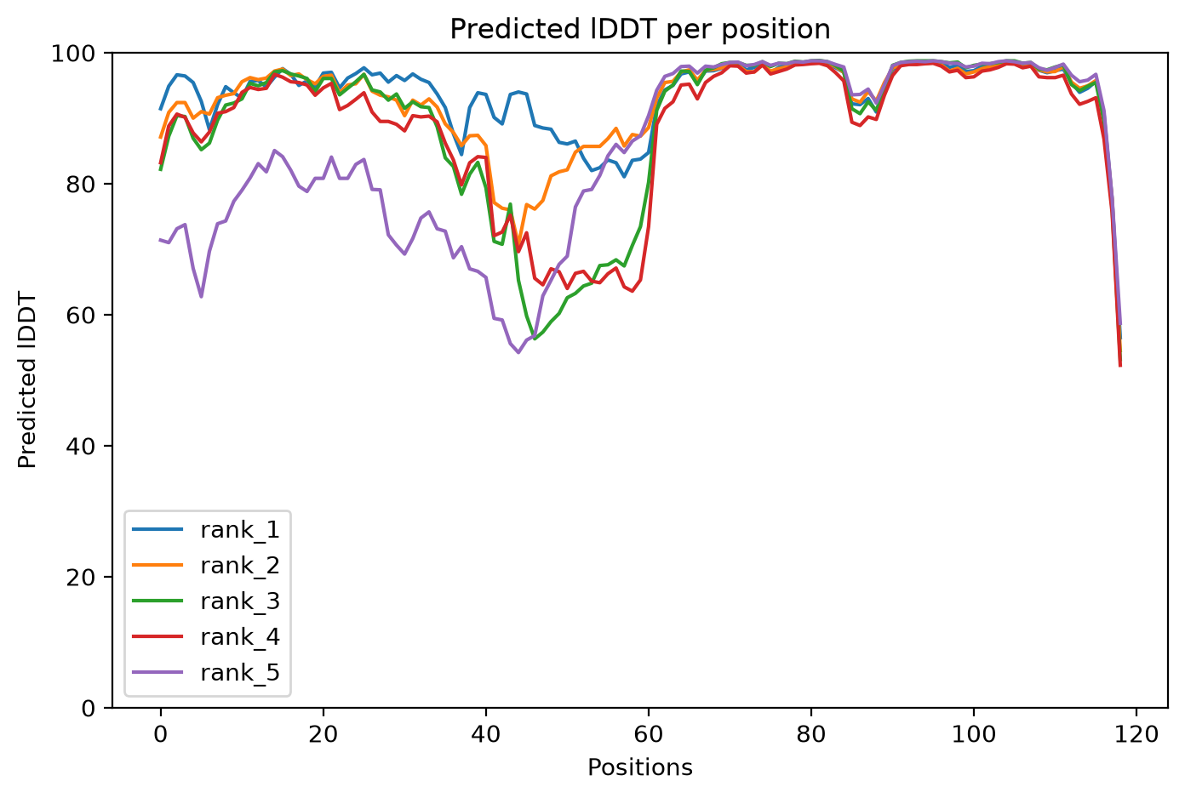
VERIFIED RESULT SPOTLIGHT
Highest linker-containing mean pLDDT: 1CRN–EAAAK₁₅–4PTI
93.8
Overall mean pLDDT
Full 119-residue fusion; highest linker-containing value in the 21-construct panel.
84.9
Linker mean pLDDT
Mean over EAAAKEAAAKEAAAK only.
0.69
9.7 Å
pTM
Cross-domain PAE
Global confidence.
Interdomain uncertainty.
How to read: x-axis = residue position; y-axis = predicted lDDT/pLDDT (0–100); each coloured line = one AF2-ptm model rank. A local dip marks lower local confidence at those residues.
This is an AlphaFold2/ColabFold confidence result—not a LinkerForge accuracy score and not proof of expression, activity or stability.
Graph source: F6 and D1. Confidence definitions and model method: S1–S2. Public structure references: R1–R2.
LINKERFORGE • VALIDATION METHODS & VERIFIED RESULTS
18
Notes:
Sources:
- M:/ChatGPT/LinkerForge 2/runs/folds/public-multipair-af2ptm-20261021/three_pair_comparison.json
- M:/ChatGPT/LinkerForge 2/runs/folds/public-multipair-af2ptm-20261021/prediction/LinkerForge_1CRN_4PTI_eaaak_15_plddt.png
- https://doi.org/10.1038/s41586-021-03819-2
- https://doi.org/10.1038/s41592-022-01488-1
- https://www.rcsb.org/structure/1CRN
- https://www.rcsb.org/structure/4PTI

Slide 66
Structural view: 1CRN–(EAAAK)₃–4PTI
PyMOL displays the saved rank-1 coordinates. Cartoon geometry highlights secondary structure, while the linker backbone is shown in greater atomic detail.
Blue · Crambin (residues 1–46)
The N-terminal public reference domain. Visual compactness provides a qualitative check. Reference-aligned RMSD is needed to quantify fold preservation.
Gold · (EAAAK)₃ (residues 47–61)
The 15-residue linker is shown as cartoon plus backbone sticks. Rank 1 predicts a mainly helical pose, consistent with the EAAAK design intent. One pose does not describe an ensemble.
Rose · BPTI (residues 62–119)
The C-terminal public reference domain. Visible separation helps inspect the pose, but clash checks, PAE and reference alignment carry the quantitative interpretation.
Rendering provenance
Open-source PyMOL 3.1.0 rendered the saved AlphaFold2-ptm rank-1 PDB. PyMOL visualises and measures coordinates; it does not run the prediction or simulation.
Structure figure: F1. Predicted coordinates: D1. Rendering: S3. Public domain references: R1–R2.
19
Notes:
Sources:
- M:/ChatGPT/LinkerForge 2/.codex-ppt-build/validation-results-20261025/pymol/crn_eaaak15_hero_trim.png
- M:/ChatGPT/LinkerForge 2/runs/folds/public-multipair-af2ptm-20261021/three_pair_comparison.json
- https://www.pymol.com/support.html
- https://doi.org/10.1038/s41586-021-03819-2
- https://doi.org/10.1038/s41592-022-01488-1
- https://www.rcsb.org/structure/1CRN
- https://www.rcsb.org/structure/4PTI

Slide 67
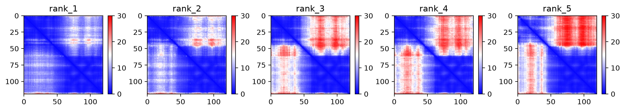
VERIFIED RESULT SPOTLIGHT
PAE asks a different question: are domain positions mutually certain?
Within-domain diagonal blocks describe internal confidence. Off-diagonal blocks compare residues across the two domains and reveal uncertainty in their relative placement.
Axes
Colour
Rank-to-rank variation
Both axes are residue positions in the full fusion. The diagonal compares each residue with itself, while rectangular blocks correspond to domain and linker regions.
Blue indicates lower predicted alignment error. Red indicates greater uncertainty. The 0–30 Å colour scale describes expected positional error, not physical distance.
The five models disagree mainly in off-diagonal regions. Ensemble disagreement therefore adds information that a single mean PAE value cannot show.
Rank 1 produced the reported 9.7 Å mean cross-domain PAE. Other ranks show greater interdomain uncertainty.
Heatmap source: F7 and D1. PAE definition and prediction method: S1–S2.
LINKERFORGE • VALIDATION METHODS & VERIFIED RESULTS
20
Notes:
Sources:
- M:/ChatGPT/LinkerForge 2/runs/folds/public-multipair-af2ptm-20261021/three_pair_comparison.json
- M:/ChatGPT/LinkerForge 2/runs/folds/public-multipair-af2ptm-20261021/prediction/LinkerForge_1CRN_4PTI_eaaak_15_pae.png
- https://doi.org/10.1038/s41586-021-03819-2
- https://doi.org/10.1038/s41592-022-01488-1

Slide 68
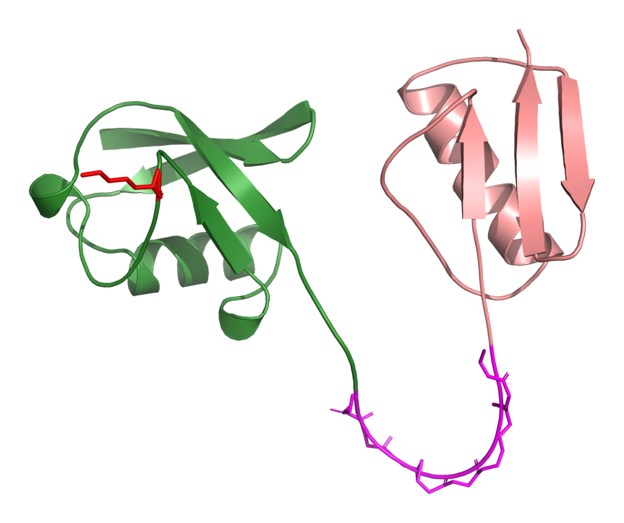
DETAILED GEOMETRY
Ubiquitin–GS₁₀–GB1: reference preservation and a protected-site example
Measurement | Verified value | Meaning
Residues | 142 | Full fusion length
Chain breaks | 0 | No detected backbone discontinuity
Max adjacent Cα distance | 4.04 Å | Largest neighbouring Cα separation
Severe Cα overlaps | 0 | No coarse Cα collision
Domain A RMSD | 0.94 Å | Ubiquitin vs reference
Domain B RMSD | 3.02 Å | GB1 vs reference
Lys48 relative SASA | 0.537 | Geometric accessibility estimate
Min linker distance to Lys48 | 25.28 Å | No <4 Å linker contact
GREEN Ubiquitin
MAGENTA GS₁₀
ROSE GB1
RED Lys48
Protected residue = a site the user wants monitored. The current implementation measures geometry/accessibility; it does not yet model ligand binding, partner binding or conformational ensembles.
Structure figure: F8. Geometry sources: D2–D3. Rendering: S3. Public domain references: R5–R6.
LINKERFORGE • VALIDATION METHODS & VERIFIED RESULTS
21
Notes:
Sources:
- M:/ChatGPT/LinkerForge 2/runs/folds/acceptance-20261020-ubiquitin-gb1-target10/evidence_checklist-linked-20261021.json
- M:/ChatGPT/LinkerForge 2/runs/folds/acceptance-20261020-ubiquitin-gb1-target10/protected-site-demo-A48.json
- M:/ChatGPT/LinkerForge 2/.codex-ppt-build/validation-results-20261025/pymol/ubq_gs10_lys48_unlabeled_trim.png
- https://www.pymol.com/support.html
- https://www.rcsb.org/structure/1UBQ
- https://www.rcsb.org/structure/2GB1

Slide 69
DERIVED STRUCTURAL COMPARISON
Reference-domain RMSD across the seven ubiquitin–GB1 conditions
Calculation
Each predicted domain was aligned to its public reference structure. RMSD is the root-mean-square displacement of matched Cα atoms after alignment.
Lower values indicate closer coordinate agreement in this single predicted model.
GB1 RMSD is consistently larger than ubiquitin RMSD across this panel, but no acceptance cutoff was frozen.
Reference preservation is a structural descriptor. It does not establish retained activity or binding.
Graph source: D2. Read each paired bar as Cα RMSD after alignment; lower bars indicate closer coordinate agreement.
LINKERFORGE • VALIDATION METHODS & VERIFIED RESULTS
22
Notes:
Sources:
- M:/ChatGPT/LinkerForge 2/runs/folds/matched-baselines-20261020-1ubq-2gb1/comparison_summary.json
- https://www.rcsb.org/structure/1UBQ
- https://www.rcsb.org/structure/2GB1

Slide 70
DETAILED GEOMETRY
Hydrogen-aware overlaps and surface burial are descriptive screens
Left: higher bars mean more severe overlap pairs after Reduce/Probe adds hydrogens.
Right: higher bars mean more domain surface is hidden by the linker in the saved pose.
No acceptance threshold was frozen. These measurements flag geometry for review; they do not produce a compatibility probability.
Graph sources: D4–D5. Reduce/Probe method: S5. Å² = square ångström.
LINKERFORGE • VALIDATION METHODS & VERIFIED RESULTS
23
Notes:
Sources:
- M:/ChatGPT/LinkerForge 2/runs/structure-audits/reduce-probe-20261021/reduce_probe_overlap_audit.json
- M:/ChatGPT/LinkerForge 2/runs/structure-audits/surface-burial-20261021/surface_burial.json
- https://doi.org/10.1107/S0907444909042073
- https://doi.org/10.1093/bioinformatics/btp163
- https://doi.org/10.1038/s41586-020-2649-2

Slide 71
ORTHOGONAL DETECTOR CHECK
DFLpred recognises flexible-linker character—not fusion compatibility
Term: recall
The fraction of deliberately inserted linker residues called as DFL by the detector.
Four public pairs × seven conditions = 28 constructs.
High recall for GS-rich spans means DFLpred recognised flexible/disordered character.
Low EAAAK recall is expected for a rigid helix and does not mean incompatibility.
Evidence quality: orthogonal public detector sensitivity—not compatibility validation.
Graph source: D6. Detector method: S6. Bar height = mean inserted-span recall across four public pairs.
LINKERFORGE • VALIDATION METHODS & VERIFIED RESULTS
24
Notes:
Sources:
- M:/ChatGPT/LinkerForge 2/runs/detector-audits/public-fusion-panel-20261020/dflpred_summary.json
- https://doi.org/10.1093/bioinformatics/btw280

Slide 72
REPRODUCIBILITY
Execution validation: three OpenMM smoke replicates and a passing software pipeline
OpenMM item | Verified value
Replicates | 3
Production length | 50 ps each
Accelerator | CUDA
OpenMM | 8.2
Evidence quality | Execution smoke only
Read each bar as the final saved Cα RMSD from the starting structure after alignment. It is one endpoint, not a stability trend.
Software verification
417 Python tests passed • 6 skipped • 35 subtests passed • 69 JSON schemas validated • whitespace check passed
50 ps proves the protocol executed; it is not a production-length stability simulation.
Graph and table sources: D7–D8. Molecular-dynamics engine and preparation tools: S7–S8.
LINKERFORGE • VALIDATION METHODS & VERIFIED RESULTS
25
Notes:
Sources:
- M:/ChatGPT/LinkerForge 2/runs/openmm/acceptance-1ubq-gs10-2gb1-smoke/run_manifest.json
- M:/ChatGPT/LinkerForge 2/runs/job-control/final-verification-20261021/status.json
- https://doi.org/10.1371/journal.pcbi.1005659
- https://github.com/openmm/pdbfixer

Slide 73
TIME-RESOLVED EXECUTION EVIDENCE
OpenMM smoke test through time: three independent 50 ps trajectories
RMSD tracks coordinate displacement from the starting structure after alignment.
Radius of gyration summarises overall Cα compactness around the molecular centre.
Interpretation limit: the traces verify that the recorded CUDA/OpenMM protocol propagated all three replicates and emitted structural metrics. Fifty picoseconds is far too short to demonstrate equilibration, convergence or biological stability.
Trace sources: D7, D9–D11. Method: S7. ps = picosecond; RMSD = aligned displacement; Rg = compactness.
LINKERFORGE • VALIDATION METHODS & VERIFIED RESULTS
26
Notes:
Sources:
- M:/ChatGPT/LinkerForge 2/runs/openmm/acceptance-1ubq-gs10-2gb1-smoke/replicate-001/structural-metrics.csv
- M:/ChatGPT/LinkerForge 2/runs/openmm/acceptance-1ubq-gs10-2gb1-smoke/replicate-002/structural-metrics.csv
- M:/ChatGPT/LinkerForge 2/runs/openmm/acceptance-1ubq-gs10-2gb1-smoke/replicate-003/structural-metrics.csv
- M:/ChatGPT/LinkerForge 2/runs/openmm/acceptance-1ubq-gs10-2gb1-smoke/run_manifest.json
- https://doi.org/10.1371/journal.pcbi.1005659

Slide 74
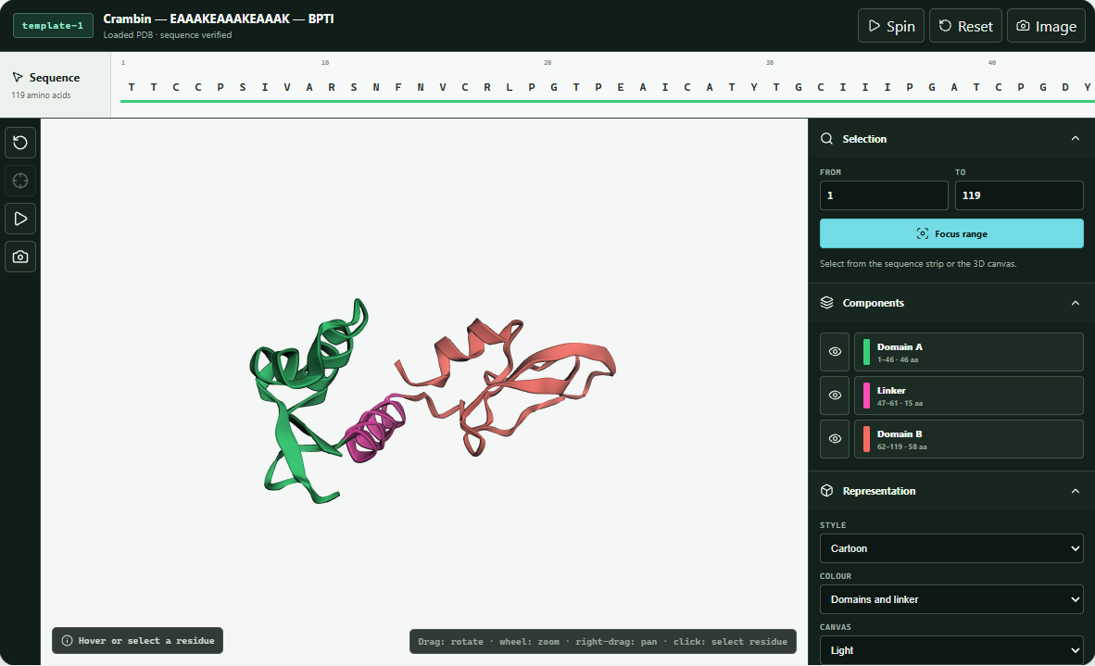
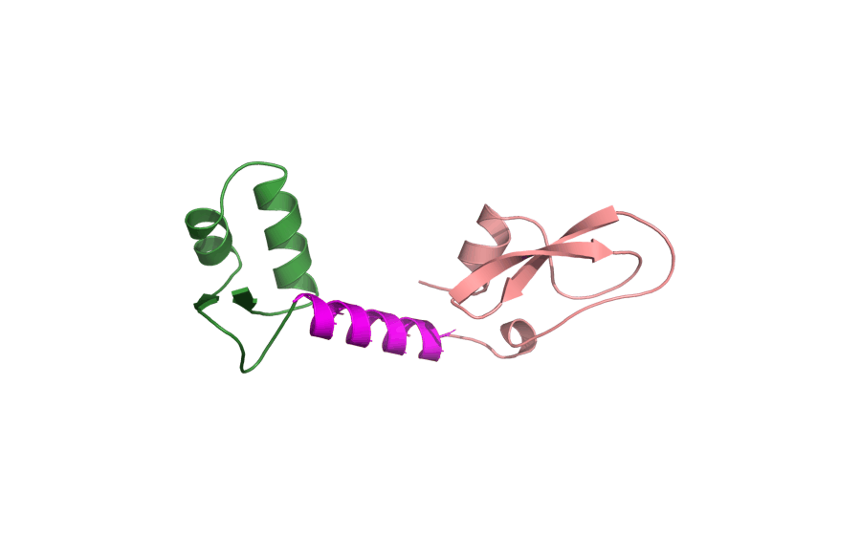
APPLICATION EVIDENCE
How the verified structure is inspected inside LinkerForge
Rotating molecular view
The animated GIF is generated from the same saved rank-1 PDB. It rotates in slideshow mode where the PowerPoint viewer supports animated GIF playback; static previews show one frame.
What the application exposes
• Candidate selection and full-fusion context
• Domain/linker colour legend
• Cartoon representation and pLDDT colouring
• Spin, reset-view and PNG-export controls
• Explicit ‘PDB loaded’ status
Captured application window
The viewer supports structural inspection; it does not perform molecular dynamics.
Image sources: F9–F10. Embedded viewer: S11. PyMOL rotation: S4. Application framework: S13–S16.
LINKERFORGE • VALIDATION METHODS & VERIFIED RESULTS
27
Notes:
Sources:
- M:/ChatGPT/LinkerForge 2/.codex-ppt-build/validation-results-20261025/linkerforge-colored-viewer-workspace.png
- M:/ChatGPT/LinkerForge 2/.codex-ppt-build/validation-results-20261025/pymol/crn_eaaak15_rotation.gif
- M:/ChatGPT/LinkerForge 2/README.md
- https://doi.org/10.1093/bioinformatics/btu829
- https://www.pymol.com/support.html
- https://react.dev/reference/react
- https://www.typescriptlang.org/docs/
- https://vite.dev/guide/
- https://tauri.app/start/

Slide 75
TRAINING & VALIDATION
Detector and generator evidence must stay separate
Development scores, public comparisons, mined records and generator software tests answer different questions.
Development
Three-seed prototype results exist on small historical DFL panel; selected-point metrics are not independent validation.
DLD fold 4
At ~0.90 observed precision, baseline recall 0.0766; asymmetric 0.0846; fixed ensemble 0.0861. DLD structural label task.
CAID3 common-27
LinkerForge APS 0.241 vs LINKER-Pred 0.398 and LINKER-Pred-Lite 0.429; public retrospective comparison.
Generator V1
31 generator tests passed; synthetic CPU smoke ran three updates, reloaded a checkpoint and emitted one proposal. No biological training.
Interpretation
The 27,766-record inventory is discovery data, not generator training truth. Reviewed data, family splits and matched baselines are required for scientific evaluation.
Sources: reports/generator-readiness-2026-10-18.md; datasets/README.md; DFL_SAM_REPEAT_AND_LOCKED_CAID3_2026-10-17.md.

Slide 76
DETECTOR RESULTS
What the active detector has shown so far
These results are evidence at different stages—not one interchangeable leaderboard score.
01 · DEVELOPMENT
Three-seed SAM baseline mean APS 0.7918 on 7,427 known historical development residues. New variants gained at most +0.0067 APS but breached the proxy-specificity guardrail.
02 · DLD VALIDATION
At ~0.90 observed precision, baseline recall 0.0766; asymmetric loss 0.0846; fixed ensemble 0.0861. Positive denominator: 6,205 labelled linker residues.
03 · CAID3 TRANSFER
Common 27 proteins / 15,570 residues: LinkerForge APS 0.241 vs LINKER-Pred 0.398, LINKER-Pred-Lite 0.429, LINKER-Pred2 0.386. Retrospective public set.
Result: the classifier runs and mines candidate gaps; transfer and high-precision recall remain limited. The public comparison is diagnostic, not a new selection target.
Sources: reports/DFL_SAM_REPEAT_AND_LOCKED_CAID3_2026-10-17.md; reports/DETECTOR_RECALL_VALIDATION_2026-10-09.md; reports/CAID3_COMMON_COVERAGE_RESULT_2026-10-11.md.

Slide 77
LIMITATIONS & NEXT STEPS
Why the complete system is not biologically validated
Software execution, detector scores and structural predictions do not establish useful engineered-linker performance.
Ontology
DLD structural IDL/DDL, DFL and generic disorder are not interchangeable labels.
Annotation
Many residues are unknown; absence of annotation is not a verified negative.
Benchmark
CAID3 was used retrospectively; no score can be used for further selection.
Split
Candidate DP94 overlap makes current protected preflight fail closed.
Coverage
CAID3 linker-positive set cannot measure no-linker-protein specificity.
Biology
The generator emits sequence candidates in synthetic tests; neither detector calls nor structural scores prove fusion function.
Next gates: adjudicate sources → audit families → train and compare the generator → check complete structures → measure function.

Slide 78
LIMITATIONS
Limitations: labels and evaluation
These limits affect what the current scores can support.
1 · Label scope
DFL, generic disorder and DLD structural IDL / DDL are different targets. Do not pool them as one truth set.
2 · Incomplete negatives
Unknown x residues are not negatives. Many mined candidates have no independent label.
3 · Dataset eligibility
Protected DFL split fails prospective preflight. DLD cluster metadata needs independent homology audit.
4 · Benchmark reuse
CAID3 was already viewed. Its scores are retrospective and cannot select new models or thresholds.
5 · Weak transfer
CAID3 common-27 APS is 0.241 versus 0.398 for LINKER-Pred. No superiority claim is supported.
Sources: RESEARCH_HANDOFF.md; DFL_UNTOUCHED_COMPARISON_CONTRACT_2026-10-17.md; DFL_SAM_REPEAT_AND_LOCKED_CAID3_2026-10-17.md.

Slide 79
LIMITATIONS
Limitations: mining, generation and biology
These are evidence gaps in addition to the benchmark and label limits on the previous slide.
6 · High-precision trade-off
DLD fold-4 recall is low at about 0.90 observed precision: 0.0766 baseline, 0.0861 fixed ensemble.
7 · Mining is unvalidated
27,595 gaps are model calls, not confirmed linkers. Mining precision / recall and utility are unknown.
8 · Species and source bias
Candidate-source queries are not a species-balanced, audited training cohort. Current split lacks a complete organism crosswalk.
9 · Length rule
2–31 is unsupported as stated. 5–30 is an old design constraint; 10–60 is a project-defined mining-gap rule.
10 · Generator not trained
V1 code generates sequences in synthetic smoke only; no reviewed-data weights, measured stability, expression or function.
Sources: datasets/README.md; FUSION_GENERATOR.md; reports/generator-readiness-2026-10-18.md; detector reports.

Slide 80
CONCLUSION
What the complete project supports so far
Question | What is supported now | What is not supported
Can the workflow run end to end? | Yes: matched ColabFold panel, geometry audits, visualisation and 3 × 50 ps OpenMM smoke completed. | Production-scale MD and wet-lab validation.
Are results provenance-bearing? | Yes: configurations, hashes, versions and source IDs are recorded in run artifacts. | Independent replication on another institution's infrastructure.
Was one high-confidence construct observed? | Yes: among 18 linker-containing constructs, 1CRN–EAAAK₁₅–4PTI had the highest mean pLDDT, 93.8, with 9.7 Å cross-domain PAE. | That it is biologically optimal or experimentally successful.
Does the V1 generator run? | Yes: software tests and a synthetic three-update smoke produced a candidate sequence. | Real-data performance or experimental fusion success.
Defensible claim: LinkerForge has a provenance-aware detector, conditional generator software and a reproducible structural comparison panel. Biological linker superiority is untested.
LINKERFORGE • VALIDATION METHODS & VERIFIED RESULTS
28
Notes:
Sources:
- M:/ChatGPT/LinkerForge 2/README.md
- M:/ChatGPT/LinkerForge 2/runs/folds/public-multipair-af2ptm-20261021/three_pair_comparison.json
- M:/ChatGPT/LinkerForge 2/runs/curation/mined-and-natural-v1-review-20261021/fusion-ranker-preflight.json
- M:/ChatGPT/LinkerForge 2/runs/openmm/acceptance-1ubq-gs10-2gb1-smoke/run_manifest.json

Slide 81
CONCLUSION AND NEXT EVIDENCE
Evidence needed to validate the complete project
The detector, generator and structural panel each require their own independent evidence before claims can be combined.
Unresolved claim | Why current evidence is insufficient | Evidence needed | Current disposition
Generator and ranker validation | Generator V1 has only synthetic smoke; the 27,766 rows are not engineered-fusion outcomes. | Reviewed generator data, family-held-out reconstruction, matched baselines; separate outcomes for ranking. | Training and compatibility claims remain gated.
Prospective detector performance | Protected labels must not influence feature design, filtering, thresholds or model selection. | Save predictions under a predeclared protocol, then reveal independent labels once and report the locked result. | Firewall remains fail-closed.
Structural generalisation | Three public pairs cannot establish behaviour across unrelated domain families or prediction systems. | Family-disjoint pairs, matched alternative structure models, PAE analysis, domain preservation and steric review. | Future computational validation.
Dynamic stability | Three 50 ps trajectories verify execution but do not show convergence or long-timescale behaviour. | A predefined production protocol with replicated longer simulations, equilibration checks and post-run change analysis. | Production OpenMM remains future scope.
Biological performance | Predicted confidence and geometry do not measure expression, activity or stability in a biological system. | Expression and solubility tests, activity assays, stability measurements and structural experiments for selected constructs. | Outside the completed computational scope.
Fail-closed means the workflow stops when protected comparison conditions are not satisfied. It does not reuse public or unavailable protected labels to tune the system.
LINKERFORGE • VALIDATION METHODS & VERIFIED RESULTS
29
Notes:
Sources:
- M:/ChatGPT/LinkerForge 2/README.md
- M:/ChatGPT/LinkerForge 2/runs/curation/mined-and-natural-v1-review-20261021/fusion-ranker-preflight.json
- M:/ChatGPT/LinkerForge 2/reports/mined_and_natural_linkers_v1_summary_2026-10-19.json
- M:/ChatGPT/LinkerForge 2/runs/folds/public-multipair-af2ptm-20261021/three_pair_comparison.json
- M:/ChatGPT/LinkerForge 2/runs/openmm/acceptance-1ubq-gs10-2gb1-smoke/run_manifest.json

Slide 82
PHASE 3 · END
What the validation phase establishes
The evidence supports an implemented pipeline and a public computational comparison, with clear next gates.
EVIDENCE TRACK
ESTABLISHED
NEXT GATE
Dataset
27,766 source-tier records and a prepared 971-record review packet.
Independent adjudication and approved family-disjoint training records.
Generator
V1 model, trainer and constrained decoder pass synthetic software tests.
Reviewed-data fit and a matched held-out sequence benchmark.
Validation
Matched fixed-control fusion structures and short execution smoke are reported.
Generated-candidate structural tests and biological outcome measurements.
Phase 3 ends with computational evidence and explicit limits. The final design claim still needs held-out comparison and experiment.
Sources: datasets/README.md; generator-readiness-2026-10-18.md; public panel D1–D11; RESEARCH_HANDOFF.md.
Notes:
This phase closeout distinguishes source inventory, generator software and fixed-control structural predictions. None is a measured outcome for a generated engineered fusion. The next study needs data adjudication, biological generator fit and independent paired benchmark, then structural and wet-lab tests.

Slide 83
REFERENCES
References and project records
The sources below cover DFL detection, protein infilling, fusion-linker prior art and project evidence.
Dosztányi et al. (2016). DFLpred. Bioinformatics. DOI 10.1093/bioinformatics/btw280.
Jumper et al. (2021). AlphaFold. Nature. DOI 10.1038/s41586-021-03819-2.
Crasto & Feng (2000). LINKER: fusion-linker sequence generator. Protein Eng. DOI 10.1093/protein/13.5.309.
Lin et al. (2023). Evolutionary-scale prediction of atomic-level protein structure. Science. DOI 10.1126/science.ade2574.
ProtFIM (2023). Protein sequence fill-in-middle. arXiv:2303.16452.
Saito & Rehmsmeier (2015). Precision–recall plots. PLoS ONE. DOI 10.1371/journal.pone.0118432.
LINKER-Pred. Bioinformatics Advances (2024). DOI 10.1093/bioadv/vbae035.
LinkerForge FUSION_GENERATOR.md: implemented V1 architecture, trainer and decoding contract.
CAID3 assessment (2025). Nucleic Acids Research. DOI 10.1093/nar/gkaf1066.
Generator readiness (18 Oct 2026): synthetic software tests; detector handoff: retrospective result limits.
DisProt flexible-linker ontology. IDPO:0000033. disprot.org/idpo/IDPO:0000033.
datasets/README.md: 27,766-row source-tier inventory and validation limits.

Slide 84
ACKNOWLEDGEMENTS
Thank you
LinkerForge · Mini Project
Kushagra Srivastava
Ram Kankeshwar
Hardik Tyagi
Under the guidance of Chandrima Ghosh
K. J. Somaiya College of Engineering (KJSSE)
With thanks to our guide and institution.

Slide 85
FIGURE-READING GUIDE
How to read the result figures
Start with the axes and units, then identify what each colour or line represents. Interpret direction only after checking whether higher or lower is favourable for that metric.
Figure type | What one mark represents | How to read direction | Terms used
Grouped bar | One construct under one linker condition; colour identifies the domain pair or domain. | Compare bar height only within the stated axis and unit. pLDDT: higher confidence. RMSD/PAE: lower values mean closer agreement or less predicted error. | Mean = arithmetic average; Å = ångström; Å² = square ångström.
Delta bar | Difference from the matched direct-fusion control for the same domain pair. | Zero is the control. Positive ΔpLDDT means higher local confidence. Negative ΔPAE means lower predicted interdomain uncertainty. | Δ = candidate value minus control value.
Scatter plot | One complete fusion construct. | Move right for higher mean pLDDT and down for lower PAE. The lower-right region has stronger predicted confidence, not proven biological performance. | Point = construct; colour = domain pair.
Residue trace | One model rank traced across the complete sequence. | Dips identify residue ranges with lower local confidence. Compare the five lines to see model-rank agreement. | Position = residue index; pLDDT = predicted local distance difference test.
PAE heatmap | One residue-pair uncertainty estimate per pixel. | Blue means lower predicted aligned error. Off-diagonal blocks report confidence in relative domain placement. | Diagonal = residue compared with itself; colour scale is expected error, not physical distance.
MD line trace | One replicate sampled through simulation time. | A plateau can be inspected, but 50 ps cannot establish equilibrium or convergence. Compare all replicates and the full protocol. | ps = picosecond; RMSD = aligned displacement; Rg = radius of gyration or compactness.
Every figure in this deck reports a computational measurement. None of the axes measures expression, activity or experimental success.
LINKERFORGE • VALIDATION METHODS & VERIFIED RESULTS
30
Notes:
Sources:
- M:/ChatGPT/LinkerForge 2/runs/folds/public-multipair-af2ptm-20261021/three_pair_comparison.json
- M:/ChatGPT/LinkerForge 2/runs/folds/matched-baselines-20261020-1ubq-2gb1/comparison_summary.json
- M:/ChatGPT/LinkerForge 2/runs/structure-audits/reduce-probe-20261021/reduce_probe_overlap_audit.json
- M:/ChatGPT/LinkerForge 2/runs/structure-audits/surface-burial-20261021/surface_burial.json
- M:/ChatGPT/LinkerForge 2/runs/detector-audits/public-fusion-panel-20261020/dflpred_summary.json
- M:/ChatGPT/LinkerForge 2/runs/openmm/acceptance-1ubq-gs10-2gb1-smoke/run_manifest.json
- https://doi.org/10.1038/s41586-021-03819-2
- https://doi.org/10.1038/s41592-022-01488-1
- https://doi.org/10.1371/journal.pcbi.1005659

Slide 86
TOOLS AND SOFTWARE
Scientific software used in the completed evidence
This table lists software recorded in the completed prediction, geometry, detector and simulation artifacts. Planned tools that did not produce these results are omitted.
Software | Recorded version or revision | Role in this project | Citation
ColabFold | 1.6.3 | Runs the AlphaFold2-ptm prediction workflow and records rankable full-fusion models. | S2
AlphaFold2-ptm | model family recorded in config | Predicts complete-fusion coordinates, pLDDT, pTM and PAE. | S1
MMseqs2 | used through ColabFold search mode | Builds the UniRef plus environmental multiple-sequence alignment input. | S3
PyMOL | open-source 3.1.0 | Renders and inspects saved PDB coordinates; creates the labelled stills and rotation. | S4
Reduce / Probe | 4.15.250408 / 2.18.211005 | Adds hydrogens and reports severe all-atom overlap pairs. | S5
DFLpred | revision b62a4b95… | Checks whether inserted spans resemble disordered flexible linkers. | S6
OpenMM | 8.2 | Executes the three CUDA molecular-dynamics smoke replicates. | S7
PDBFixer | 1.10.0 | Prepares the predicted structure for the recorded OpenMM protocol. | S8
Python | 3.14.5; OpenMM env 3.12.12 | Runs project scripts, audits, summaries and tests. | python.org
Biopython | 1.86 | Reads structures and supports structure/sequence processing. | S9
NumPy | 2.5.4 | Performs numerical geometry and surface calculations. | S10
CUDA | platform recorded; device 0, mixed precision | Accelerates OpenMM on the NVIDIA GPU. | developer.nvidia.com/cuda-zone
Versions come from D1, D4–D7 and committed environment manifests. Citation details appear on slides 35–36.
LINKERFORGE • VALIDATION METHODS & VERIFIED RESULTS
31
Notes:
Sources:
- M:/ChatGPT/LinkerForge 2/runs/folds/public-multipair-af2ptm-20261021/three_pair_comparison.json
- M:/ChatGPT/LinkerForge 2/runs/structure-audits/reduce-probe-20261021/reduce_probe_overlap_audit.json
- M:/ChatGPT/LinkerForge 2/runs/detector-audits/public-fusion-panel-20261020/dflpred_summary.json
- M:/ChatGPT/LinkerForge 2/runs/openmm/acceptance-1ubq-gs10-2gb1-smoke/run_manifest.json
- https://doi.org/10.1038/s41586-021-03819-2
- https://doi.org/10.1038/s41592-022-01488-1
- https://doi.org/10.1038/nbt.3988
- https://www.pymol.com/support.html
- https://doi.org/10.1107/S0907444909042073
- https://doi.org/10.1093/bioinformatics/btw280
- https://doi.org/10.1371/journal.pcbi.1005659
- https://github.com/openmm/pdbfixer
- https://doi.org/10.1093/bioinformatics/btp163
- https://doi.org/10.1038/s41586-020-2649-2

Slide 87
TOOLS AND SOFTWARE
Application and reproducibility software used
Exact JavaScript and Rust versions come from the committed lockfiles. The list covers the website, desktop shell, embedded molecular viewers and verification tooling.
 | Locked version | Role | Primary source
React / React DOM | 19.2.8 | Single-window application interface and state rendering. | react.dev [S13]
TypeScript | 6.0.3 | Typed application and viewer integration code. | typescriptlang.org [S14]
Vite | 8.3.5 | Development server and production web build. | vite.dev [S15]
3Dmol.js | 2.5.4 | Interactive full-fusion predicted-structure viewer. | DOI 10.1093/bioinformatics/btu829 [S11]
Mol* | embedded reference viewer | Displays public reference structures requested by PDB identifier. | DOI 10.1093/nar/gkab314 [S12]
Tauri / Tauri API | 2.12.4 | Desktop shell and secure bridge to local Rust commands. | tauri.app [S16]
Rust / Cargo | 1.99.0 | Compiles the local desktop backend. | rust-lang.org
Serde / serde_json | 1.0.229 / 1.0.154 | Serialises versioned run records and command results. | serde.rs
Tokio | 1.53.3 | Manages local processes, files and timeouts in the desktop backend. | tokio.rs
sha2 | 0.10.9 | Computes SHA-256 provenance hashes. | crates.io/crates/sha2
Vitest / ESLint | 4.1.11 / 10.9.1 | Runs frontend tests and static checks. | vitest.dev / eslint.org
JSON Schema | project schemas; specification 2020-12 | Validates machine-readable result contracts. | json-schema.org [S17]
Software
Version sources: frontend/package-lock.json, frontend/src-tauri/Cargo.lock and the final verification status artifact.
LINKERFORGE • VALIDATION METHODS & VERIFIED RESULTS
32
Notes:
Sources:
- M:/ChatGPT/LinkerForge 2/frontend/package-lock.json
- M:/ChatGPT/LinkerForge 2/frontend/src-tauri/Cargo.lock
- M:/ChatGPT/LinkerForge 2/runs/job-control/final-verification-20261021/status.json
- https://react.dev/reference/react
- https://www.typescriptlang.org/docs/
- https://vite.dev/guide/
- https://doi.org/10.1093/bioinformatics/btu829
- https://doi.org/10.1093/nar/gkab314
- https://tauri.app/start/
- https://json-schema.org/specification

Slide 88
CITATIONS AND PROVENANCE
Figure and image provenance
Every molecular image derives from a saved prediction or application capture. PyMOL changes representation and colour only; it does not create the predicted coordinates.
Code | Slides | Figure or image | Direct source and transformation
F1 | 1, 3, 19 | Crambin–EAAAK₁₅–BPTI hero | Rank-1 PDB from D1; rendered in PyMOL 3.1.0; domains/linker coloured by residue range.
F2 | 2 | Crambin–GS₁₀–BPTI explanatory view | Rank-1 public-panel PDB; rendered in PyMOL without labels.
F3–F5 | 3 | Direct, GGGGS₅ and EAAAK₁₅ views | Three matched D1 rank-1 PDBs; identical PyMOL representation and camera family.
F6 | 18 | Per-residue predicted lDDT plot | ColabFold output PNG for all five AF2-ptm model ranks; associated construct is in D1.
F7 | 20 | Five PAE heatmaps | ColabFold output PNG for the same construct and five model ranks.
F8 | 21 | Ubiquitin–GS₁₀–GB1 with Lys48 | Rank-1 PDB from D2/D3; PyMOL colours domains, linker and protected residue.
F9 | 27 | LinkerForge application window | Local screenshot of the implemented prediction workspace and embedded viewer.
F10 | 27 | Rotating fusion animation | Animated GIF rendered from the same F1 rank-1 PDB in PyMOL.
Public domain sequence/structure identities: R1 1CRN, R2 4PTI, R3 1PGA, R4 1LMB, R5 1UBQ and R6 2GB1.
LINKERFORGE • VALIDATION METHODS & VERIFIED RESULTS
33
Notes:
Sources:
- M:/ChatGPT/LinkerForge 2/.codex-ppt-build/validation-results-20261025/pymol/crn_eaaak15_hero_trim.png
- M:/ChatGPT/LinkerForge 2/.codex-ppt-build/validation-results-20261025/pymol/crn_gs10_unlabeled_trim.png
- M:/ChatGPT/LinkerForge 2/.codex-ppt-build/validation-results-20261025/pymol/crn_direct_unlabeled_trim.png
- M:/ChatGPT/LinkerForge 2/.codex-ppt-build/validation-results-20261025/pymol/crn_gs5_unlabeled_trim.png
- M:/ChatGPT/LinkerForge 2/.codex-ppt-build/validation-results-20261025/pymol/crn_eaaak15_labeled_trim.png
- M:/ChatGPT/LinkerForge 2/runs/folds/public-multipair-af2ptm-20261021/prediction/LinkerForge_1CRN_4PTI_eaaak_15_plddt.png
- M:/ChatGPT/LinkerForge 2/runs/folds/public-multipair-af2ptm-20261021/prediction/LinkerForge_1CRN_4PTI_eaaak_15_pae.png
- M:/ChatGPT/LinkerForge 2/.codex-ppt-build/validation-results-20261025/pymol/ubq_gs10_lys48_unlabeled_trim.png
- M:/ChatGPT/LinkerForge 2/.codex-ppt-build/validation-results-20261025/linkerforge-colored-viewer-workspace.png
- M:/ChatGPT/LinkerForge 2/.codex-ppt-build/validation-results-20261025/pymol/crn_eaaak15_rotation.gif
- https://www.pymol.com/support.html
- https://www.rcsb.org/structure/1CRN
- https://www.rcsb.org/structure/4PTI
- https://www.rcsb.org/structure/1PGA
- https://www.rcsb.org/structure/1LMB
- https://www.rcsb.org/structure/1UBQ
- https://www.rcsb.org/structure/2GB1

Slide 89
CITATIONS AND PROVENANCE
Graph and measurement data provenance
The graphs are editable PowerPoint charts built from the listed immutable or provenance-bearing project artifacts. No values were inferred from screenshots.
Code | Slides | Project source relative to repository root | Content used
D1 | 10–20, 28–30 | runs/folds/public-multipair-af2ptm-20261021/three_pair_comparison.json | 21 constructs, 105 ranks, pLDDT, pTM, PAE and prediction provenance.
D2 | 21–22 | runs/folds/matched-baselines-20261020-1ubq-2gb1/comparison_summary.json | Matched ubiquitin–GB1 geometry and reference RMSD.
D3 | 21 | runs/folds/acceptance-20261020-ubiquitin-gb1-target10/evidence_checklist-linked-20261021.json; protected-site-demo-A48.json | Chain continuity, domain RMSD and protected-site measurements.
D4 | 23 | runs/structure-audits/reduce-probe-20261021/reduce_probe_overlap_audit.json | Hydrogen-aware severe-overlap pair counts and exact tool versions.
D5 | 23 | runs/structure-audits/surface-burial-20261021/surface_burial.json | Fixed-coordinate linker-attributed buried surface area.
D6 | 24 | runs/detector-audits/public-fusion-panel-20261020/dflpred_summary.json | Inserted-span recall across four public pairs.
D7 | 25–26 | runs/openmm/acceptance-1ubq-gs10-2gb1-smoke/run_manifest.json | Protocol, versions, replicate endpoints and claim boundary.
D8 | 25 | runs/job-control/final-verification-20261021/status.json | Completed repository test and schema-validation stages.
D9–D11 | 26 | runs/openmm/acceptance-1ubq-gs10-2gb1-smoke/replicate-001..003/structural-metrics.csv | Time-resolved RMSD and radius-of-gyration series.
D12 | 7–8 | reports/mined_and_natural_linkers_v1_summary_2026-10-19.json | Dataset acquisition counts and distinct evidence tiers.
D13 | 7, 9 | runs/curation/mined-and-natural-v1-review-20261021/manifest.json; fusion-ranker-preflight.json | Dual-review packet composition and blocked training preflight.
All paths are relative to the LinkerForge repository. Speaker notes retain absolute source paths used during deck generation.
LINKERFORGE • VALIDATION METHODS & VERIFIED RESULTS
34
Notes:
Sources:
- M:/ChatGPT/LinkerForge 2/runs/folds/public-multipair-af2ptm-20261021/three_pair_comparison.json
- M:/ChatGPT/LinkerForge 2/runs/folds/matched-baselines-20261020-1ubq-2gb1/comparison_summary.json
- M:/ChatGPT/LinkerForge 2/runs/folds/acceptance-20261020-ubiquitin-gb1-target10/evidence_checklist-linked-20261021.json
- M:/ChatGPT/LinkerForge 2/runs/folds/acceptance-20261020-ubiquitin-gb1-target10/protected-site-demo-A48.json
- M:/ChatGPT/LinkerForge 2/runs/structure-audits/reduce-probe-20261021/reduce_probe_overlap_audit.json
- M:/ChatGPT/LinkerForge 2/runs/structure-audits/surface-burial-20261021/surface_burial.json
- M:/ChatGPT/LinkerForge 2/runs/detector-audits/public-fusion-panel-20261020/dflpred_summary.json
- M:/ChatGPT/LinkerForge 2/runs/openmm/acceptance-1ubq-gs10-2gb1-smoke/run_manifest.json
- M:/ChatGPT/LinkerForge 2/runs/job-control/final-verification-20261021/status.json
- M:/ChatGPT/LinkerForge 2/runs/openmm/acceptance-1ubq-gs10-2gb1-smoke/replicate-001/structural-metrics.csv
- M:/ChatGPT/LinkerForge 2/runs/openmm/acceptance-1ubq-gs10-2gb1-smoke/replicate-002/structural-metrics.csv
- M:/ChatGPT/LinkerForge 2/runs/openmm/acceptance-1ubq-gs10-2gb1-smoke/replicate-003/structural-metrics.csv
- M:/ChatGPT/LinkerForge 2/reports/mined_and_natural_linkers_v1_summary_2026-10-19.json
- M:/ChatGPT/LinkerForge 2/runs/curation/mined-and-natural-v1-review-20261021/manifest.json
- M:/ChatGPT/LinkerForge 2/runs/curation/mined-and-natural-v1-review-20261021/fusion-ranker-preflight.json

Slide 90
REFERENCES
Primary scientific references
Code | Reference | Used for
S1 | Jumper J et al. Highly accurate protein structure prediction with AlphaFold. Nature 596, 583–589 (2021). doi:10.1038/s41586-021-03819-2 | AlphaFold2, pLDDT and PAE interpretation.
S2 | Mirdita M et al. ColabFold: making protein folding accessible to all. Nature Methods 19, 679–682 (2022). doi:10.1038/s41592-022-01488-1 | ColabFold workflow and prediction provenance.
S3 | Steinegger M, Söding J. MMseqs2 enables sensitive protein sequence searching for the analysis of massive data sets. Nature Biotechnology 35, 1026–1028 (2017). doi:10.1038/nbt.3988 | Sequence-search method used by ColabFold.
S4 | The PyMOL Molecular Graphics System, Version 3.1.0, Schrödinger, LLC. Citation format: pymol.com/support.html | Molecular stills, labels and animation.
S5 | Chen VB et al. MolProbity: all-atom structure validation for macromolecular crystallography. Acta Crystallographica D66, 12–21 (2010). doi:10.1107/S0907444909042073 | Reduce/Probe hydrogen-aware contact analysis.
S6 | Meng F, Kurgan L. DFLpred: high-throughput prediction of disordered flexible linker regions. Bioinformatics 32, i341–i350 (2016). doi:10.1093/bioinformatics/btw280 | Orthogonal DFL detector check.
S7 | Eastman P et al. OpenMM 7: rapid development of high performance algorithms for molecular dynamics. PLOS Computational Biology 13:e1005659 (2017). doi:10.1371/journal.pcbi.1005659 | Molecular-dynamics engine.
S8 | PDBFixer documentation and source: github.com/openmm/pdbfixer | Structure preparation before OpenMM.
S9 | Cock PJA et al. Biopython: freely available Python tools for computational molecular biology and bioinformatics. Bioinformatics 25, 1422–1423 (2009). doi:10.1093/bioinformatics/btp163 | Sequence and structure processing.
S10 | Harris CR et al. Array programming with NumPy. Nature 585, 357–362 (2020). doi:10.1038/s41586-020-2649-2 | Numerical analysis.
LINKERFORGE • VALIDATION METHODS & VERIFIED RESULTS
35
Notes:
Sources:
- https://doi.org/10.1038/s41586-021-03819-2
- https://doi.org/10.1038/s41592-022-01488-1
- https://doi.org/10.1038/nbt.3988
- https://www.pymol.com/support.html
- https://doi.org/10.1107/S0907444909042073
- https://doi.org/10.1093/bioinformatics/btw280
- https://doi.org/10.1371/journal.pcbi.1005659
- https://github.com/openmm/pdbfixer
- https://doi.org/10.1093/bioinformatics/btp163
- https://doi.org/10.1038/s41586-020-2649-2

Slide 91
REFERENCES
Application, confidence guidance and public structures
Code | Reference or authoritative source | Used for
S11 | Rego N, Koes D. 3Dmol.js: molecular visualization with WebGL. Bioinformatics 31, 1322–1324 (2015). doi:10.1093/bioinformatics/btu829 | Embedded predicted-structure viewer.
S12 | Sehnal D et al. Mol* Viewer: modern web app for 3D visualization and analysis of large biomolecular structures. Nucleic Acids Research 49, W431–W437 (2021). doi:10.1093/nar/gkab314 | Embedded public-reference viewer.
S13–S17 | React reference; TypeScript documentation; Vite guide; Tauri documentation; JSON Schema 2020-12 specification. | Application interface, desktop shell, build system and result validation.
S18 | AlphaFold Protein Structure Database FAQ: alphafold.ebi.ac.uk/faq | pLDDT confidence bands and PAE interpretation.
R1 | RCSB PDB 1CRN: rcsb.org/structure/1CRN | Crambin public reference.
R2 | RCSB PDB 4PTI: rcsb.org/structure/4PTI | BPTI public reference.
R3 | RCSB PDB 1PGA: rcsb.org/structure/1PGA | Protein G public reference.
R4 | RCSB PDB 1LMB: rcsb.org/structure/1LMB | Lambda repressor public reference.
R5 | RCSB PDB 1UBQ: rcsb.org/structure/1UBQ | Ubiquitin public reference.
R6 | RCSB PDB 2GB1: rcsb.org/structure/2GB1 | GB1 public reference.
This register covers project software, scientific methods and public data sources used by the documented workflow.
LINKERFORGE • VALIDATION METHODS & VERIFIED RESULTS
36
Notes:
Sources:
- https://doi.org/10.1093/bioinformatics/btu829
- https://doi.org/10.1093/nar/gkab314
- https://react.dev/reference/react
- https://www.typescriptlang.org/docs/
- https://vite.dev/guide/
- https://tauri.app/start/
- https://json-schema.org/specification
- https://alphafold.ebi.ac.uk/faq
- https://www.rcsb.org/structure/1CRN
- https://www.rcsb.org/structure/4PTI
- https://www.rcsb.org/structure/1PGA
- https://www.rcsb.org/structure/1LMB
- https://www.rcsb.org/structure/1UBQ
- https://www.rcsb.org/structure/2GB1

Slide 92
APPENDIX · QUALITY CONTROL
Validation is a chain of explicit checks
A successful software run is different from a validated biological claim.
STEP
CHECK
AVAILABLE EVIDENCE
Source
IDs, sequence, source release, coordinates
Manifest and source references; mixed evidence tiers
Labels
Positive / explicit negative / unknown semantics
1 / 0 / x masks; unknowns excluded, never recoded
Split
Exact sequence + family collision + benchmark firewall
Current protected DFL preflight fails; new training gated
Model
Frozen encoder / config / checkpoint / seed
Versioned code/config and historical run records
Prediction
Coverage, scores, thresholds, interval caller
27,595 mined gaps; candidate calls not validated labels
Independent review
Blind calls and non-calls by source/family strata
Required before precision, recall or enrichment claim
Biology
Structure, expression, activity and stability
Not established by sequence detector or prediction metrics
Per-job record should retain source IDs, Git SHA, config hash, environment / library versions, input hashes, seed, coverage and failure reason.
Source: README §7; RESEARCH_HANDOFF.md; untouched-comparison contract.

Slide 93
APPENDIX · EXAMPLE RUNS
Representative runs across the project pipeline
Examples summarize reported evidence; missing raw outputs are marked rather than inferred.
STAGE
EXAMPLE
MEASURED OUTPUT
READOUT / LIMIT
Classifier training
Historical three-seed DFL panel
Mean APS 0.7918; AUROC 0.9076; Fmax 0.7022
Small development set; no independent claim.
High precision
DLD fold-4 validation
Baseline: 475 TP / 52 FP; precision .9013; recall .0766
Validation operating point, not DFL test.
Fixed ensemble
DLD fold-4 validation
534 TP / 59 FP; recall .0861; specificity .9574
Compared with baseline; no independent replication.
Public comparison
CAID3 common-27
LinkerForge APS .241; LINKER-Pred .398; Lite .429
Retrospective; not available for tuning.
Mining
27k inventory
27,766 records; 27,595 scored gaps
Not independently adjudicated; PPV unknown.
Generator V1
Synthetic CPU smoke
3 updates; checkpoint reload; 1 emitted proposal
Invented records; no biological training or efficacy.
Structure / stability
Fusion analysis from source deck
No calibrated <0.9 stability value for the active detector
Detector does not output a structure or stability score.
Sources: generator-readiness-2026-10-18.md; datasets/README.md; DFL_SAM_REPEAT_AND_LOCKED_CAID3_2026-10-17.md.

Slide 94
APPENDIX · CASE RECORDS
Sequence and structure records needed for a biological example
Version 1 emits sequences in synthetic smoke. A real generated fusion case still needs reviewed input records, a trained checkpoint and traceable structures.
SEQUENCE OUTPUT
STRUCTURE OUTPUT
Required fields: exact FASTA; accession and isoform; 1-based residue interval; source annotation; model/checkpoint; threshold; sequence hash.
For a future fusion study: show Domain A, linker and Domain B separately; report model version, confidence, closure, clashes and domain preservation.
EXAMPLE RECORD STATUS
The public 47-slide structural panel tests fixed linkers, not output from a biologically trained generator. Its plots are descriptive computational evidence.
A future case record should link exact A/B sequences, request constraints, generated linker, checkpoint hash, full FASTA, predicted structure and rejection measurements.
Sources: FUSION_GENERATOR.md; README §§5–7; full-fusion provenance records.

Slide 95
DISCUSSION
Questions & Answers
What evidence would turn the Version 1 generator into a validated design method?
Discussion prompts
01
Which mined records can pass independent review for generator training?
02
How should two-flank infilling compare with templates and retrieval?
03
Which structure and biological tests should decide whether a linker works?

