Slide 1
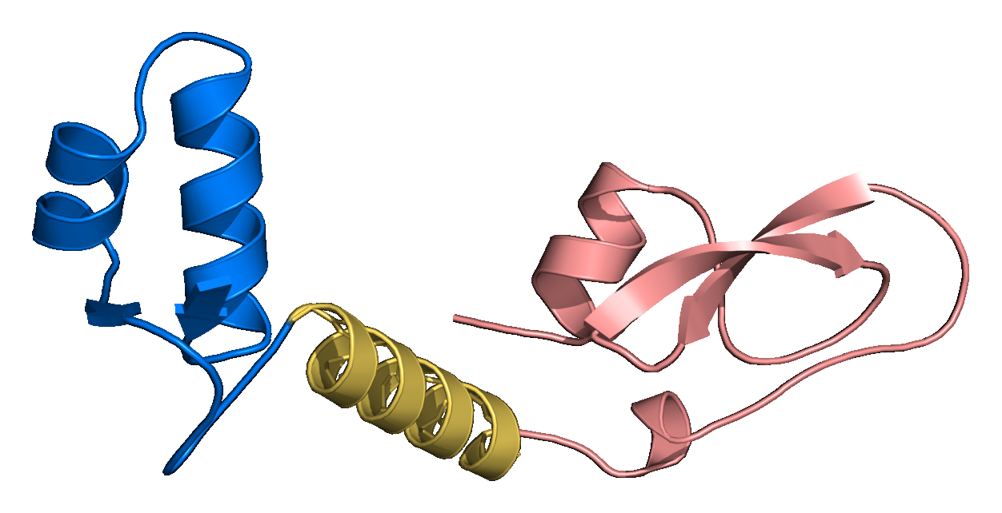
LINKERFORGE
Validation methods
and verified results
A research presentation of the completed computational evidence: dataset provenance, matched AlphaFold2/ColabFold comparison, structural confidence, PyMOL inspection, geometry audits, detector cross-checks and OpenMM execution validation.
Predicted 1CRN–(EAAAK)₃–4PTI fusion
Open-source PyMOL 3.1.0 rendering of the highest linker-containing mean-pLDDT construct in the completed public panel. Blue: Crambin · gold: linker · rose: BPTI. [F1, S1–S4]
COMPUTATIONAL EVIDENCE ONLY
25 OCTOBER 2026
Notes:
Opening: this deck reports completed computational checks. It does not claim experimental success or an optimal biological linker. The molecular image is the actual saved AlphaFold2/ColabFold rank-1 structure rendered in open-source PyMOL.
Sources:
- M:/ChatGPT/LinkerForge 2/README.md
- M:/ChatGPT/LinkerForge 2/.codex-ppt-build/validation-results-20261025/pymol/crn_eaaak15_hero_trim.png
- M:/ChatGPT/LinkerForge 2/runs/folds/public-multipair-af2ptm-20261021/three_pair_comparison.json
- https://doi.org/10.1038/s41586-021-03819-2
- https://doi.org/10.1038/s41592-022-01488-1
- https://www.pymol.com/support.html
- https://www.rcsb.org/structure/1CRN
- https://www.rcsb.org/structure/4PTI

Slide 2
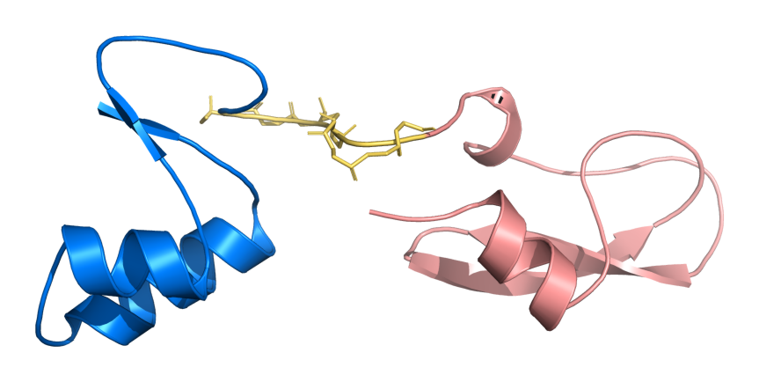
FOUNDATIONS
Start here: what is being designed?
A fusion protein is one continuous amino-acid chain created by connecting two protein regions. LinkerForge evaluates the short peptide placed at that junction.
Domain A — Crambin (PDB 1CRN)
Residues 1–46 in this construct. A domain is a protein region expected to adopt a recognisable three-dimensional fold. Blue identifies the N-terminal partner.
Linker — (GGGGS)₂
Residues 47–56. A linker is a covalently encoded peptide between the partners. Length, sequence and secondary-structure tendency can alter separation, motion and interdomain orientation.
Domain B — BPTI (PDB 4PTI)
Residues 57–114. Rose identifies the C-terminal partner. The junction therefore follows the sequence order Domain A → linker → Domain B.
BLUE Crambin
GOLD (GGGGS)₂
ROSE BPTI
Actual predicted structure used for explanation
Cartoon/ribbon = secondary-structure path; gold sticks = linker backbone atoms. The image is a model, not an experimental crystal structure.
Candidate = one linker sequence under evaluation. Control = a predefined comparison, such as direct fusion or a standard GS repeat.
Figure source: F2; prediction and viewer methods: S1–S4; public domain references: R1–R2.
LINKERFORGE • VALIDATION METHODS & VERIFIED RESULTS
02
Notes:
Sources:
- M:/ChatGPT/LinkerForge 2/README.md
- M:/ChatGPT/LinkerForge 2/.codex-ppt-build/validation-results-20261025/pymol/crn_gs10_unlabeled_trim.png
- M:/ChatGPT/LinkerForge 2/runs/folds/public-multipair-af2ptm-20261021/three_pair_comparison.json
- https://doi.org/10.1038/s41586-021-03819-2
- https://doi.org/10.1038/s41592-022-01488-1
- https://www.pymol.com/support.html
- https://www.rcsb.org/structure/1CRN
- https://www.rcsb.org/structure/4PTI

Slide 3
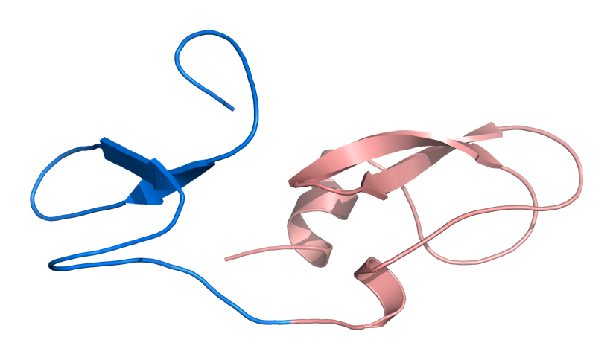
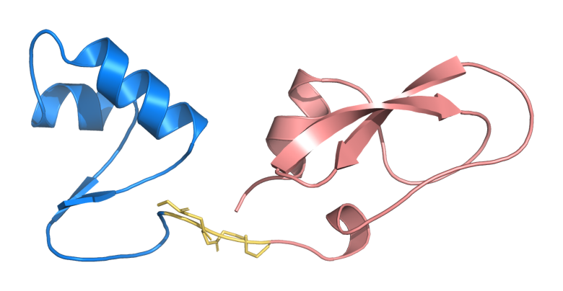
FOUNDATIONS
Linker classes answer different design needs
Direct fusion · 0 aa
Flexible GS linker · 5 aa
Rigid helical linker · 15 aa
No inserted residues. This is a zero-linker baseline, so linker pLDDT is not defined.
GGGGS is glycine/serine-rich and intended to reduce geometric constraint at the junction.
(EAAAK)₃ is helix-forming and intended to act as a more persistent spacer between partners.
Overall pLDDT 74.5 · cross-domain PAE 17.3 Å
Overall pLDDT 87.6 · linker pLDDT 51.2
Overall pLDDT 93.8 · cross-domain PAE 9.7 Å
The three molecular views use the same public Crambin–BPTI pair. Differences are descriptive AlphaFold2/ColabFold outputs, not experimental proof that a class is biologically superior.
Figure sources: F3–F5; prediction and viewer methods: S1–S4; public domain references: R1–R2.
LINKERFORGE • VALIDATION METHODS & VERIFIED RESULTS
03
Notes:
Sources:
- M:/ChatGPT/LinkerForge 2/README.md
- M:/ChatGPT/LinkerForge 2/runs/folds/public-multipair-af2ptm-20261021/three_pair_comparison.json
- M:/ChatGPT/LinkerForge 2/runs/detector-audits/public-fusion-panel-20261020/dflpred_summary.json
- M:/ChatGPT/LinkerForge 2/.codex-ppt-build/validation-results-20261025/pymol/crn_direct_unlabeled_trim.png
- M:/ChatGPT/LinkerForge 2/.codex-ppt-build/validation-results-20261025/pymol/crn_gs5_unlabeled_trim.png
- M:/ChatGPT/LinkerForge 2/.codex-ppt-build/validation-results-20261025/pymol/crn_eaaak15_labeled_trim.png
- https://doi.org/10.1038/s41586-021-03819-2
- https://doi.org/10.1038/s41592-022-01488-1
- https://www.pymol.com/support.html
- https://www.rcsb.org/structure/1CRN
- https://www.rcsb.org/structure/4PTI

Slide 4
METHODS EXPLAINED
AlphaFold2 and ColabFold confidence terms
Each metric answers a different question. Local confidence, global topology and relative domain placement should be interpreted together.
Term | Plain-language question | Scale and direction | Meaning in this deck
pLDDT | How reliable is the local fold around each residue? | 0–100. Higher means greater local confidence. Above 90 is very high, 70–90 is confident, 50–70 is low and below 50 is very low. | Overall pLDDT averages the complete fusion. Linker pLDDT averages inserted residues only. Neither value measures activity or fusion compatibility.
pTM | Does the model have confidence in the overall fold and domain packing? | 0–1. Higher means stronger confidence in global topology. It predicts behaviour related to TM-score. | One value summarises each full model. It does not isolate linker quality and does not prove the predicted interdomain pose is correct.
PAE | After alignment on one residue, how uncertain is the position of another residue? | Reported in ångströms. Lower means greater confidence in relative placement. The residue-pair matrix can be asymmetric. | Cross-domain PAE averages cells between Domain A and Domain B. It is an uncertainty estimate, not a physical distance or an energy.
How to read the reported summaries
Overall pLDDT
Linker pLDDT
Cross-domain PAE
A high full-sequence average can hide a weak linker because folded domains contain most residues.
Low confidence can reflect flexibility, disorder or insufficient information. It does not automatically indicate failure.
Lower values support a more consistently predicted domain arrangement. They do not establish a biologically correct orientation.
These are predictor confidence estimates. They are not LinkerForge accuracy scores or laboratory measurements.
Definitions and interpretation: S1–S2 and S18. Project calculations: D1.
LINKERFORGE • VALIDATION METHODS & VERIFIED RESULTS
04
Notes:
Sources:
- M:/ChatGPT/LinkerForge 2/runs/folds/public-multipair-af2ptm-20261021/three_pair_comparison.json
- M:/ChatGPT/LinkerForge 2/README.md
- https://doi.org/10.1038/s41586-021-03819-2
- https://doi.org/10.1038/s41592-022-01488-1
- https://alphafold.ebi.ac.uk/faq

Slide 5
METHODS EXPLAINED
Geometry and simulation terms used in this study
These measurements describe the saved predicted coordinates or a recorded simulation trajectory. They do not directly measure biological function.
Term | Definition | How to read it | Important limit
Cα continuity | Cα means alpha carbon, one backbone reference atom per amino acid. Adjacent Cα distances are checked along the chain. | A chain-break count of zero supports a continuous backbone. Large adjacent distances flag a broken or malformed junction. | This is a coarse backbone screen. It does not validate bond angles, side chains or energetic favourability.
Cα RMSD | Root-mean-square deviation after aligning matched Cα atoms so overall translation and rotation are removed. | Lower values mean closer coordinate agreement with the reference structure used for alignment. | The value depends on the aligned atoms and reference. It does not measure activity or binding.
SASA and burial | Solvent-accessible surface area estimates surface reachable by a solvent-sized probe. Burial is the loss of accessible area in the fusion. | Higher buried area means the linker hides more domain surface in that saved pose. | Burial can be useful or harmful depending on location. It is not automatically a rejection.
Probe overlaps | Reduce adds hydrogens. Probe then counts severe all-atom steric contacts. | More severe overlap pairs flag possible clashes or strained packing. | Zero severe overlaps does not prove low energy, stability or correct function.
Protected residue | A user-selected residue or region whose accessibility should be monitored, such as ubiquitin Lys48 in the demonstration. | Distance and relative SASA report whether the linker approaches or covers the selected site. | The calculation does not simulate ligand binding, partner binding or conformational ensembles.
Molecular dynamics | A force field propagates atomic coordinates through simulated time. RMSD tracks aligned displacement and Rg tracks overall compactness. | Repeated time traces can reveal drift or disagreement between replicates. | The completed 50 ps runs verify execution only. They are too short to establish equilibrium or stability.
Units: Å = ångström, Å² = square ångström, ps = picosecond, Rg = radius of gyration.
Project measurements: D2–D5 and D7–D11. Structural-validation and simulation methods: S5 and S7–S8.
LINKERFORGE • VALIDATION METHODS & VERIFIED RESULTS
05
Notes:
Sources:
- M:/ChatGPT/LinkerForge 2/runs/folds/acceptance-20261020-ubiquitin-gb1-target10/evidence_checklist-linked-20261021.json
- M:/ChatGPT/LinkerForge 2/runs/structure-audits/reduce-probe-20261021/reduce_probe_overlap_audit.json
- M:/ChatGPT/LinkerForge 2/runs/structure-audits/surface-burial-20261021/surface_burial.json
- M:/ChatGPT/LinkerForge 2/runs/folds/acceptance-20261020-ubiquitin-gb1-target10/protected-site-demo-A48.json
- M:/ChatGPT/LinkerForge 2/runs/openmm/acceptance-1ubq-gs10-2gb1-smoke/run_manifest.json
- https://doi.org/10.1107/S0907444909042073
- https://doi.org/10.1371/journal.pcbi.1005659
- https://github.com/openmm/pdbfixer

Slide 6
CLAIM BOUNDARY
Evidence levels and claim boundaries
A result can be technically reproducible while still lacking outcome labels, prospective evaluation or biological confirmation.
Evidence term | What the term means | Current evidence | Claim boundary
Reproducible result | Inputs, configuration, software versions, hashes and outputs identify exactly what ran. | Recorded for the completed prediction, geometry and smoke-test artifacts. | Supports traceability and rerunning. It does not validate biological performance.
Matched comparison | Candidates receive the same prediction and scoring procedure so settings do not change between conditions. | Twenty-one constructs used one ColabFold protocol. | Reduces protocol confounding. It does not remove model bias or finite-sampling uncertainty.
Descriptive structural evidence | Confidence and geometry metrics describe saved predicted structures. | pLDDT, PAE, continuity, RMSD, burial and overlaps were calculated. | Supports structural inspection. It does not produce a compatibility probability.
Execution smoke test | A short run confirms that the software chain starts, completes and exports expected metrics. | Three CUDA OpenMM replicates of 50 ps completed. | Verifies execution only. It does not establish equilibrium, convergence or stability.
Calibrated compatibility ranker | A trained model maps candidate features to outcome-linked rankings and quantifies uncertainty on held-out data. | No scientifically trained and calibrated fusion ranker is available. | Claims about the best linker or predictive superiority remain unsupported.
Prospective validation | Predictions and thresholds are frozen before protected outcomes are revealed. | The protected detector benchmark remains fail-closed. | Protected labels cannot guide training, feature design, filtering or threshold selection.
Fail-closed means the workflow stops when the independent test conditions are not satisfied. It does not reuse protected labels to continue development.
Evidence sources: D1–D8 and project preflight artifacts. Claim limits follow the frozen project validation contract.
LINKERFORGE • VALIDATION METHODS & VERIFIED RESULTS
06
Notes:
Sources:
- M:/ChatGPT/LinkerForge 2/README.md
- M:/ChatGPT/LinkerForge 2/runs/folds/public-multipair-af2ptm-20261021/three_pair_comparison.json
- M:/ChatGPT/LinkerForge 2/runs/openmm/acceptance-1ubq-gs10-2gb1-smoke/run_manifest.json
- M:/ChatGPT/LinkerForge 2/runs/curation/mined-and-natural-v1-review-20261021/fusion-ranker-preflight.json
- M:/ChatGPT/LinkerForge 2/runs/job-control/final-verification-20261021/status.json

Slide 7
DATASET
Dataset acquisition and evidence labels
The acquisition pipeline combines predictions, natural observations and published templates. Their evidence labels remain separate throughout processing.
Acquisition stage | Input and processing | Output | Scientific interpretation
1. Sequence mining | Scan 161,317 full-length proteins and score candidate linker spans with the sequence detector. | 27,595 mined spans labelled high-confidence or provisional predictions. | A mined span is a computational candidate for review. It is not curator-confirmed ground truth.
2. Natural references | Reconcile CATH/PDB domain boundaries and DisProt annotations with the intervening sequence. | 91 structure-supported CATH/PDB spans and 57 curated DisProt DFL spans. | A natural observation supports linker identity in its native protein. It does not report engineered-fusion success.
3. Engineered templates | Collect published linker sequence patterns and standardise sequence, length, class and source. | 23 templates available as candidates or controls. | A template has literature provenance. It is not a universal success label for arbitrary domain pairs.
4. Provenance and review | Attach source IDs, retrieval records, configuration hashes, software versions and evidence quality. | Auditable derived records and a 971-record dual-curator review packet. | Provenance explains origin and transformation. Evidence quality grades support for identity, not compatibility outcome.
Terms used in the dataset
Candidate span
Evidence type
Evidence quality
Provenance
A subsequence predicted to act as a linker. Review may confirm, revise or reject it.
The record is labelled as mined, natural or engineered so the categories cannot be mistaken for each other.
A grade for source support and curation status. It is not a probability that a fusion will work.
The source and transformation history, including identifiers, hashes and versions needed for traceability.
Dataset inventory and acquisition counts: D12. Review-packet provenance: D13.
LINKERFORGE • VALIDATION METHODS & VERIFIED RESULTS
07
Notes:
Sources:
- M:/ChatGPT/LinkerForge 2/reports/mined_and_natural_linkers_v1_summary_2026-10-19.json
- M:/ChatGPT/LinkerForge 2/runs/curation/mined-and-natural-v1-review-20261021/manifest.json
- M:/ChatGPT/LinkerForge 2/runs/curation/mined-and-natural-v1-review-20261021/fusion-ranker-preflight.json

Slide 8
DATASET
The 27,766-record inventory is provenance-rich—not compatibility ground truth
Evidence tier | Records | What the label means | Permitted interpretation
Mined high confidence | 6,556 | Computational candidate | Prioritisation / curation queue
Mined provisional | 21,039 | Computational candidate | Exploratory only
Natural CATH/PDB | 91 | Structure-supported natural span | Natural reference example
Natural DisProt | 57 | Curated disordered flexible span | Natural DFL reference
Engineered templates | 23 | Published linker pattern | Template/control sequence
TOTAL | 27,766 | Mixed evidence types | Not a fusion-success dataset
Separate specificity panel: 40 no-linker proteins. These are not included in the 27,766-record total.
Dataset inventory and evidence-tier counts: D12.
LINKERFORGE • VALIDATION METHODS & VERIFIED RESULTS
08
Notes:
Sources:
- M:/ChatGPT/LinkerForge 2/reports/mined_and_natural_linkers_v1_summary_2026-10-19.json

Slide 9
DATASET VALIDATION
Curation was prepared; scientific training remains blocked
Packet component | Records
Mined high confidence | 360
Mined provisional | 440
Natural CATH/PDB | 91
Natural DisProt | 57
Engineered templates | 23
Total per curator | 971
2
563
Independent curator files
Family clusters
Each curator receives the same 971-record packet separately.
Grouping reduces the risk of counting close relatives as independent evidence.
105
NO
Sampling strata
Training authorised
The review packet spans predefined evidence/source categories.
Preflight status is source_inventory_only; compatibility labels and a valid family-disjoint fusion split are absent.
Curator = a subject-matter reviewer. Adjudication = resolving disagreements after two reviewers label independently.
Current status: awaiting independent dual review. The packet validates linker identity/provenance—not engineered-fusion success.
Review-packet manifest and scientific preflight: D13.
LINKERFORGE • VALIDATION METHODS & VERIFIED RESULTS
09
Notes:
Sources:
- M:/ChatGPT/LinkerForge 2/runs/curation/mined-and-natural-v1-review-20261021/manifest.json
- M:/ChatGPT/LinkerForge 2/runs/curation/mined-and-natural-v1-review-20261021/fusion-ranker-preflight.json

Slide 10
VALIDATION DESIGN
Matched public acceptance run: design, terms and scope
3
7
21
105
Domain pairs
Conditions per pair
Complete constructs
AF2-ptm models
Three public sequence pairs were joined in one fixed orientation.
Direct fusion and six exact linker sequences were compared.
One full fusion sequence for every pair and linker condition.
Five ranked outputs were retained for every construct.
3 pairs × 7 conditions = 21 constructs. Five AlphaFold2-ptm model outputs per construct give 105 rankable structures.
Terms in the experimental design
Settings held constant
Term | Meaning
Domain pair | The ordered Domain A and Domain B sequences used to build a fusion.
Condition | The exact linker sequence inserted between the same two domains, including direct fusion.
Construct | One complete Domain A + linker + Domain B amino-acid sequence.
Model rank | One of five AF2-ptm outputs ordered by prediction confidence. The ranks are not five laboratory replicates.
Protocol factor | Fixed setting
Predictor | ColabFold 1.6.3 using AlphaFold2-ptm
MSA search | MMseqs2 with UniRef and environmental sequences
Sampling | Five models, one seed
Templates | No structural templates
Ranking | pLDDT-based output ranking
Question this run answers
Question this run cannot answer
Under one fixed prediction protocol, how do confidence and structural descriptors vary across linker conditions and domain pairs?
It does not establish biological success, a universally best linker or trained LinkerForge accuracy. Protected labels were not used.
Run design and outputs: D1. Predictor and search methods: S1–S3. Public structures: R1–R6.
LINKERFORGE • VALIDATION METHODS & VERIFIED RESULTS
10
Notes:
Sources:
- M:/ChatGPT/LinkerForge 2/runs/folds/public-multipair-af2ptm-20261021/three_pair_comparison.json
- https://doi.org/10.1038/s41586-021-03819-2
- https://doi.org/10.1038/s41592-022-01488-1
- https://doi.org/10.1038/nbt.3988
- https://www.rcsb.org/structure/1CRN
- https://www.rcsb.org/structure/4PTI
- https://www.rcsb.org/structure/1PGA
- https://www.rcsb.org/structure/1LMB
- https://www.rcsb.org/structure/1UBQ
- https://www.rcsb.org/structure/2GB1

Slide 11
VALIDATION DESIGN
Candidate and control panel
Condition | Sequence | Length | Role
Direct | — | 0 | Zero-linker control
GGGGS | GGGGS | 5 | Short flexible template
(GGGGS)₂ | GGGGSGGGGS | 10 | Flexible template
(GGGGS)₃ | GGGGSGGGGSGGGGS | 15 | Frozen GS control
Waldo | GSAGSAAGSGEF | 12 | Published flexible template
Bird | KESGSVSSEQLAQFRSLD | 18 | Published flexible template
(EAAAK)₃ | EAAAKEAAAKEAAAK | 15 | Rigid helical control
aa = amino acid residue. A 15-aa linker contains fifteen residues between the two fusion partners.
LINKERFORGE • VALIDATION METHODS & VERIFIED RESULTS
11
Notes:
Sources:
- M:/ChatGPT/LinkerForge 2/runs/folds/public-multipair-af2ptm-20261021/three_pair_comparison.json

Slide 12
VERIFIED RESULTS
Overall pLDDT varies with both domain pair and linker
How to read this chart
Each bar is the mean local confidence for one full fusion.
The same linker does not behave identically across pairs.
These bars compare predicted structure confidence; they do not rank biological function.
No winner was selected because thresholds were not frozen before evaluation.
Graph source: D1. Metric definitions: S1–S2. Each colour is one public domain pair; bar height is mean pLDDT.
LINKERFORGE • VALIDATION METHODS & VERIFIED RESULTS
12
Notes:
Sources:
- M:/ChatGPT/LinkerForge 2/runs/folds/public-multipair-af2ptm-20261021/three_pair_comparison.json
- https://doi.org/10.1038/s41586-021-03819-2
- https://doi.org/10.1038/s41592-022-01488-1

Slide 13
DERIVED DESCRIPTIVE ANALYSIS
Relative to direct fusion: linker effects remain pair-dependent
Calculation: Δ = linker-containing construct − the matched direct-fusion value for the same domain pair.
Positive ΔpLDDT indicates higher local confidence than direct fusion. Negative ΔPAE indicates lower predicted interdomain uncertainty. The direction and magnitude vary by pair, so no sequence-independent winner is supported.
Graph source: D1. Read zero as the matched direct-fusion baseline; bars above or below zero show the signed change.
LINKERFORGE • VALIDATION METHODS & VERIFIED RESULTS
13
Notes:
These are arithmetic transformations of the saved 21-construct comparison table; no new model was fitted and no threshold was selected.
Sources:
- M:/ChatGPT/LinkerForge 2/runs/folds/public-multipair-af2ptm-20261021/three_pair_comparison.json
- https://doi.org/10.1038/s41586-021-03819-2
- https://doi.org/10.1038/s41592-022-01488-1

Slide 14
DERIVED DESCRIPTIVE ANALYSIS
Local confidence and interdomain confidence are related—but not interchangeable
Why plot both?
pLDDT describes confidence in local residue neighbourhoods.
Cross-domain PAE describes uncertainty in the relative placement of the two domains.
A construct can contain well-folded domains yet retain uncertain interdomain orientation.
The 21 points are the completed public panel; each colour is one domain pair.
Interpret the lower-right region cautiously: high local confidence plus lower predicted interdomain uncertainty, not experimental performance.
Graph source: D1. One point represents one construct; x = mean pLDDT, y = cross-domain PAE, colour = domain pair.
LINKERFORGE • VALIDATION METHODS & VERIFIED RESULTS
14
Notes:
Sources:
- M:/ChatGPT/LinkerForge 2/runs/folds/public-multipair-af2ptm-20261021/three_pair_comparison.json
- https://doi.org/10.1038/s41586-021-03819-2
- https://doi.org/10.1038/s41592-022-01488-1

Slide 15
VERIFIED RESULTS
Crambin–BPTI: the rigid EAAAK control had the highest descriptive confidence
Condition | Overall pLDDT | Linker pLDDT | pTM | Cross-domain PAE (Å)
Direct (0 aa) | 74.5 | n/a | 0.62 | 17.3
GGGGS (5) | 87.6 | 51.2 | 0.60 | 16.2
(GGGGS)₂ (10) | 86.4 | 48.0 | 0.55 | 20.1
(GGGGS)₃ (15) | 84.2 | 52.3 | 0.50 | 24.1
Waldo (12) | 83.4 | 46.4 | 0.55 | 20.4
Bird (18) | 85.0 | 60.9 | 0.57 | 18.8
(EAAAK)₃ (15) | 93.8 | 84.9 | 0.69 | 9.7
Highlighted row = highest linker-containing mean pLDDT in this pair; post hoc observation, not a validated winner.
LINKERFORGE • VALIDATION METHODS & VERIFIED RESULTS
15
Notes:
Sources:
- M:/ChatGPT/LinkerForge 2/runs/folds/public-multipair-af2ptm-20261021/three_pair_comparison.json

Slide 16
VERIFIED RESULTS
Protein G–repressor: direct fusion was highest; GGGGS₅ led the linker conditions
Condition | Overall pLDDT | Linker pLDDT | pTM | Cross-domain PAE (Å)
Direct (0 aa) | 94.9 | n/a | 0.66 | 14.4
GGGGS (5) | 92.2 | 48.9 | 0.59 | 21.5
(GGGGS)₂ (10) | 90.2 | 40.5 | 0.57 | 23.8
(GGGGS)₃ (15) | 88.6 | 36.9 | 0.54 | 26.0
Waldo (12) | 87.9 | 41.6 | 0.55 | 25.4
Bird (18) | 89.7 | 64.9 | 0.54 | 26.0
(EAAAK)₃ (15) | 89.7 | 52.8 | 0.56 | 24.3
The direct-fusion control has no linker pLDDT because it contains zero linker residues.
LINKERFORGE • VALIDATION METHODS & VERIFIED RESULTS
16
Notes:
Sources:
- M:/ChatGPT/LinkerForge 2/runs/folds/public-multipair-af2ptm-20261021/three_pair_comparison.json

Slide 17
VERIFIED RESULTS
Ubiquitin–GB1: direct fusion and EAAAK₁₅ were close in overall pLDDT
Condition | Overall pLDDT | Linker pLDDT | pTM | Cross-domain PAE (Å)
Direct (0 aa) | 88.2 | n/a | 0.61 | 16.7
GGGGS (5) | 87.0 | 48.6 | 0.56 | 21.1
(GGGGS)₂ (10) | 81.7 | 37.7 | 0.53 | 22.8
(GGGGS)₃ (15) | 82.7 | 39.0 | 0.53 | 23.4
Waldo (12) | 84.1 | 44.4 | 0.54 | 21.8
Bird (18) | 80.2 | 44.9 | 0.52 | 24.3
(EAAAK)₃ (15) | 87.9 | 50.9 | 0.51 | 24.9
A small difference in pLDDT alone does not establish functional superiority.
LINKERFORGE • VALIDATION METHODS & VERIFIED RESULTS
17
Notes:
Sources:
- M:/ChatGPT/LinkerForge 2/runs/folds/public-multipair-af2ptm-20261021/three_pair_comparison.json

Slide 18
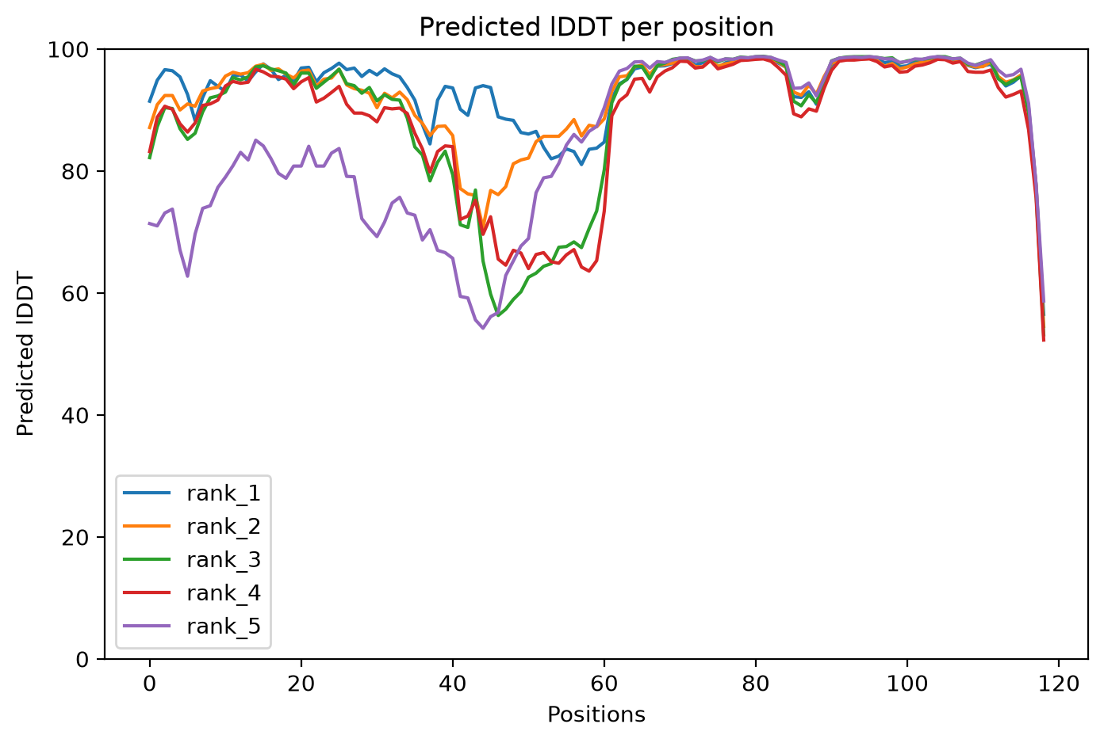
VERIFIED RESULT SPOTLIGHT
Highest linker-containing mean pLDDT: 1CRN–EAAAK₁₅–4PTI
93.8
Overall mean pLDDT
Full 119-residue fusion; highest linker-containing value in the 21-construct panel.
84.9
Linker mean pLDDT
Mean over EAAAKEAAAKEAAAK only.
0.69
9.7 Å
pTM
Cross-domain PAE
Global confidence.
Interdomain uncertainty.
How to read: x-axis = residue position; y-axis = predicted lDDT/pLDDT (0–100); each coloured line = one AF2-ptm model rank. A local dip marks lower local confidence at those residues.
This is an AlphaFold2/ColabFold confidence result—not a LinkerForge accuracy score and not proof of expression, activity or stability.
Graph source: F6 and D1. Confidence definitions and model method: S1–S2. Public structure references: R1–R2.
LINKERFORGE • VALIDATION METHODS & VERIFIED RESULTS
18
Notes:
Sources:
- M:/ChatGPT/LinkerForge 2/runs/folds/public-multipair-af2ptm-20261021/three_pair_comparison.json
- M:/ChatGPT/LinkerForge 2/runs/folds/public-multipair-af2ptm-20261021/prediction/LinkerForge_1CRN_4PTI_eaaak_15_plddt.png
- https://doi.org/10.1038/s41586-021-03819-2
- https://doi.org/10.1038/s41592-022-01488-1
- https://www.rcsb.org/structure/1CRN
- https://www.rcsb.org/structure/4PTI

Slide 19
PYMOL STRUCTURAL INSPECTION
Structural view: 1CRN–(EAAAK)₃–4PTI
PyMOL displays the saved rank-1 coordinates. Cartoon geometry highlights secondary structure, while the linker backbone is shown in greater atomic detail.
Blue · Crambin (residues 1–46)
The N-terminal public reference domain. Visual compactness provides a qualitative check. Reference-aligned RMSD is needed to quantify fold preservation.
Gold · (EAAAK)₃ (residues 47–61)
The 15-residue linker is shown as cartoon plus backbone sticks. Rank 1 predicts a mainly helical pose, consistent with the EAAAK design intent. One pose does not describe an ensemble.
Rose · BPTI (residues 62–119)
The C-terminal public reference domain. Visible separation helps inspect the pose, but clash checks, PAE and reference alignment carry the quantitative interpretation.
Rendering provenance
Open-source PyMOL 3.1.0 rendered the saved AlphaFold2-ptm rank-1 PDB. PyMOL visualises and measures coordinates; it does not run the prediction or simulation.
Structure figure: F1. Predicted coordinates: D1. Rendering: S3. Public domain references: R1–R2.
LINKERFORGE • VALIDATION METHODS & VERIFIED RESULTS
19
Notes:
Sources:
- M:/ChatGPT/LinkerForge 2/.codex-ppt-build/validation-results-20261025/pymol/crn_eaaak15_hero_trim.png
- M:/ChatGPT/LinkerForge 2/runs/folds/public-multipair-af2ptm-20261021/three_pair_comparison.json
- https://www.pymol.com/support.html
- https://doi.org/10.1038/s41586-021-03819-2
- https://doi.org/10.1038/s41592-022-01488-1
- https://www.rcsb.org/structure/1CRN
- https://www.rcsb.org/structure/4PTI

Slide 20
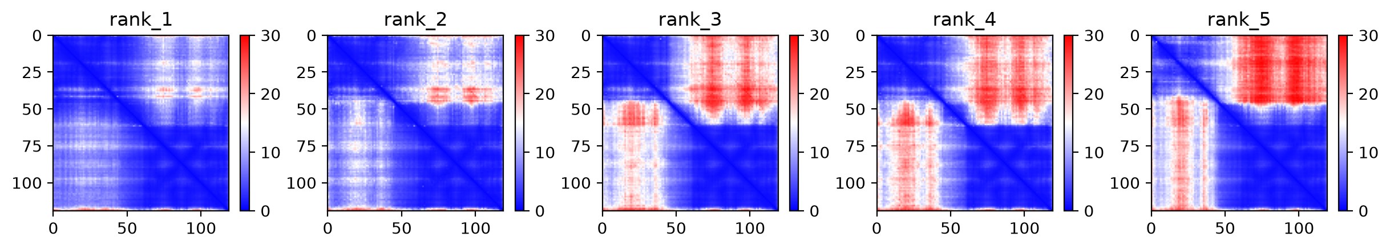
VERIFIED RESULT SPOTLIGHT
PAE asks a different question: are domain positions mutually certain?
Within-domain diagonal blocks describe internal confidence. Off-diagonal blocks compare residues across the two domains and reveal uncertainty in their relative placement.
Axes
Colour
Rank-to-rank variation
Both axes are residue positions in the full fusion. The diagonal compares each residue with itself, while rectangular blocks correspond to domain and linker regions.
Blue indicates lower predicted alignment error. Red indicates greater uncertainty. The 0–30 Å colour scale describes expected positional error, not physical distance.
The five models disagree mainly in off-diagonal regions. Ensemble disagreement therefore adds information that a single mean PAE value cannot show.
Rank 1 produced the reported 9.7 Å mean cross-domain PAE. Other ranks show greater interdomain uncertainty.
Heatmap source: F7 and D1. PAE definition and prediction method: S1–S2.
LINKERFORGE • VALIDATION METHODS & VERIFIED RESULTS
20
Notes:
Sources:
- M:/ChatGPT/LinkerForge 2/runs/folds/public-multipair-af2ptm-20261021/three_pair_comparison.json
- M:/ChatGPT/LinkerForge 2/runs/folds/public-multipair-af2ptm-20261021/prediction/LinkerForge_1CRN_4PTI_eaaak_15_pae.png
- https://doi.org/10.1038/s41586-021-03819-2
- https://doi.org/10.1038/s41592-022-01488-1

Slide 21
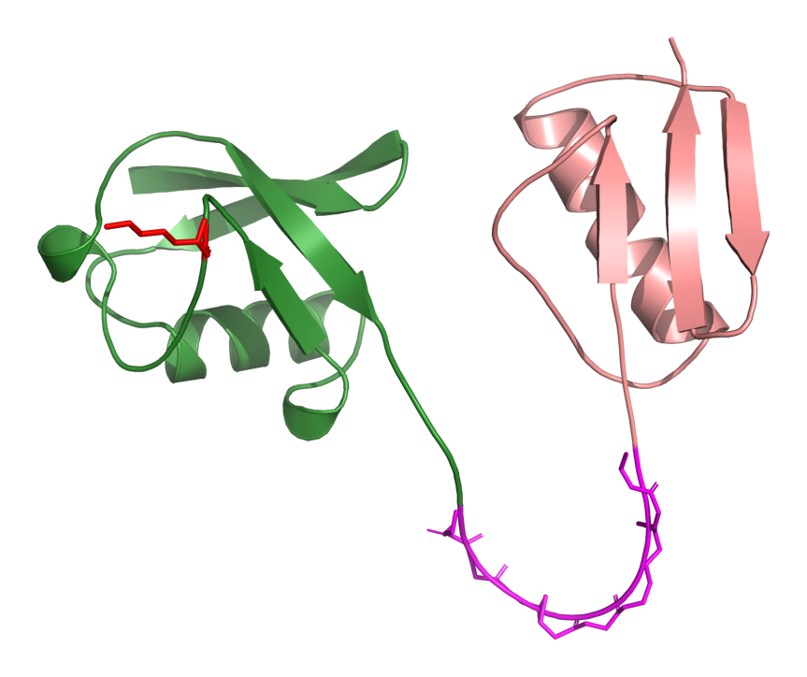
DETAILED GEOMETRY
Ubiquitin–GS₁₀–GB1: reference preservation and a protected-site example
Measurement | Verified value | Meaning
Residues | 142 | Full fusion length
Chain breaks | 0 | No detected backbone discontinuity
Max adjacent Cα distance | 4.04 Å | Largest neighbouring Cα separation
Severe Cα overlaps | 0 | No coarse Cα collision
Domain A RMSD | 0.94 Å | Ubiquitin vs reference
Domain B RMSD | 3.02 Å | GB1 vs reference
Lys48 relative SASA | 0.537 | Geometric accessibility estimate
Min linker distance to Lys48 | 25.28 Å | No <4 Å linker contact
GREEN Ubiquitin
MAGENTA GS₁₀
ROSE GB1
RED Lys48
Protected residue = a site the user wants monitored. The current implementation measures geometry/accessibility; it does not yet model ligand binding, partner binding or conformational ensembles.
Structure figure: F8. Geometry sources: D2–D3. Rendering: S3. Public domain references: R5–R6.
LINKERFORGE • VALIDATION METHODS & VERIFIED RESULTS
21
Notes:
Sources:
- M:/ChatGPT/LinkerForge 2/runs/folds/acceptance-20261020-ubiquitin-gb1-target10/evidence_checklist-linked-20261021.json
- M:/ChatGPT/LinkerForge 2/runs/folds/acceptance-20261020-ubiquitin-gb1-target10/protected-site-demo-A48.json
- M:/ChatGPT/LinkerForge 2/.codex-ppt-build/validation-results-20261025/pymol/ubq_gs10_lys48_unlabeled_trim.png
- https://www.pymol.com/support.html
- https://www.rcsb.org/structure/1UBQ
- https://www.rcsb.org/structure/2GB1

Slide 22
DERIVED STRUCTURAL COMPARISON
Reference-domain RMSD across the seven ubiquitin–GB1 conditions
Calculation
Each predicted domain was aligned to its public reference structure. RMSD is the root-mean-square displacement of matched Cα atoms after alignment.
Lower values indicate closer coordinate agreement in this single predicted model.
GB1 RMSD is consistently larger than ubiquitin RMSD across this panel, but no acceptance cutoff was frozen.
Reference preservation is a structural descriptor. It does not establish retained activity or binding.
Graph source: D2. Read each paired bar as Cα RMSD after alignment; lower bars indicate closer coordinate agreement.
LINKERFORGE • VALIDATION METHODS & VERIFIED RESULTS
22
Notes:
Sources:
- M:/ChatGPT/LinkerForge 2/runs/folds/matched-baselines-20261020-1ubq-2gb1/comparison_summary.json
- https://www.rcsb.org/structure/1UBQ
- https://www.rcsb.org/structure/2GB1

Slide 23
DETAILED GEOMETRY
Hydrogen-aware overlaps and surface burial are descriptive screens
Left: higher bars mean more severe overlap pairs after Reduce/Probe adds hydrogens.
Right: higher bars mean more domain surface is hidden by the linker in the saved pose.
No acceptance threshold was frozen. These measurements flag geometry for review; they do not produce a compatibility probability.
Graph sources: D4–D5. Reduce/Probe method: S5. Å² = square ångström.
LINKERFORGE • VALIDATION METHODS & VERIFIED RESULTS
23
Notes:
Sources:
- M:/ChatGPT/LinkerForge 2/runs/structure-audits/reduce-probe-20261021/reduce_probe_overlap_audit.json
- M:/ChatGPT/LinkerForge 2/runs/structure-audits/surface-burial-20261021/surface_burial.json
- https://doi.org/10.1107/S0907444909042073
- https://doi.org/10.1093/bioinformatics/btp163
- https://doi.org/10.1038/s41586-020-2649-2

Slide 24
ORTHOGONAL DETECTOR CHECK
DFLpred recognises flexible-linker character—not fusion compatibility
Term: recall
The fraction of deliberately inserted linker residues called as DFL by the detector.
Four public pairs × seven conditions = 28 constructs.
High recall for GS-rich spans means DFLpred recognised flexible/disordered character.
Low EAAAK recall is expected for a rigid helix and does not mean incompatibility.
Evidence quality: orthogonal public detector sensitivity—not compatibility validation.
Graph source: D6. Detector method: S6. Bar height = mean inserted-span recall across four public pairs.
LINKERFORGE • VALIDATION METHODS & VERIFIED RESULTS
24
Notes:
Sources:
- M:/ChatGPT/LinkerForge 2/runs/detector-audits/public-fusion-panel-20261020/dflpred_summary.json
- https://doi.org/10.1093/bioinformatics/btw280

Slide 25
REPRODUCIBILITY
Execution validation: three OpenMM smoke replicates and a passing software pipeline
OpenMM item | Verified value
Replicates | 3
Production length | 50 ps each
Accelerator | CUDA
OpenMM | 8.2
Evidence quality | Execution smoke only
Read each bar as the final saved Cα RMSD from the starting structure after alignment. It is one endpoint, not a stability trend.
Software verification
417 Python tests passed • 6 skipped • 35 subtests passed • 69 JSON schemas validated • whitespace check passed
50 ps proves the protocol executed; it is not a production-length stability simulation.
Graph and table sources: D7–D8. Molecular-dynamics engine and preparation tools: S7–S8.
LINKERFORGE • VALIDATION METHODS & VERIFIED RESULTS
25
Notes:
Sources:
- M:/ChatGPT/LinkerForge 2/runs/openmm/acceptance-1ubq-gs10-2gb1-smoke/run_manifest.json
- M:/ChatGPT/LinkerForge 2/runs/job-control/final-verification-20261021/status.json
- https://doi.org/10.1371/journal.pcbi.1005659
- https://github.com/openmm/pdbfixer

Slide 26
TIME-RESOLVED EXECUTION EVIDENCE
OpenMM smoke test through time: three independent 50 ps trajectories
RMSD tracks coordinate displacement from the starting structure after alignment.
Radius of gyration summarises overall Cα compactness around the molecular centre.
Interpretation limit: the traces verify that the recorded CUDA/OpenMM protocol propagated all three replicates and emitted structural metrics. Fifty picoseconds is far too short to demonstrate equilibration, convergence or biological stability.
Trace sources: D7, D9–D11. Method: S7. ps = picosecond; RMSD = aligned displacement; Rg = compactness.
LINKERFORGE • VALIDATION METHODS & VERIFIED RESULTS
26
Notes:
Sources:
- M:/ChatGPT/LinkerForge 2/runs/openmm/acceptance-1ubq-gs10-2gb1-smoke/replicate-001/structural-metrics.csv
- M:/ChatGPT/LinkerForge 2/runs/openmm/acceptance-1ubq-gs10-2gb1-smoke/replicate-002/structural-metrics.csv
- M:/ChatGPT/LinkerForge 2/runs/openmm/acceptance-1ubq-gs10-2gb1-smoke/replicate-003/structural-metrics.csv
- M:/ChatGPT/LinkerForge 2/runs/openmm/acceptance-1ubq-gs10-2gb1-smoke/run_manifest.json
- https://doi.org/10.1371/journal.pcbi.1005659

Slide 27
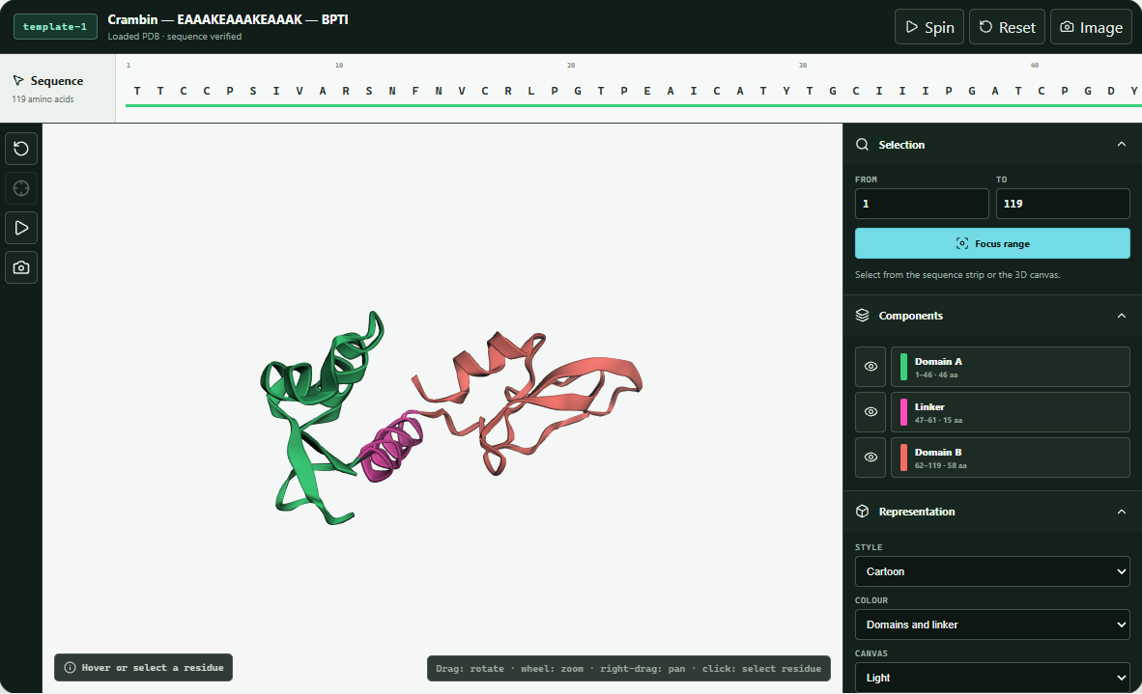
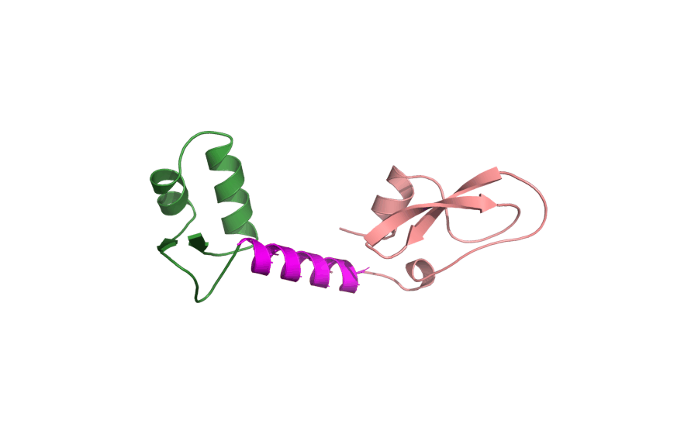
APPLICATION EVIDENCE
How the verified structure is inspected inside LinkerForge
Rotating molecular view
The animated GIF is generated from the same saved rank-1 PDB. It rotates in slideshow mode where the PowerPoint viewer supports animated GIF playback; static previews show one frame.
What the application exposes
• Candidate selection and full-fusion context
• Domain/linker colour legend
• Cartoon representation and pLDDT colouring
• Spin, reset-view and PNG-export controls
• Explicit ‘PDB loaded’ status
Captured application window
The viewer supports structural inspection; it does not perform molecular dynamics.
Image sources: F9–F10. Embedded viewer: S11. PyMOL rotation: S4. Application framework: S13–S16.
LINKERFORGE • VALIDATION METHODS & VERIFIED RESULTS
27
Notes:
Sources:
- M:/ChatGPT/LinkerForge 2/.codex-ppt-build/validation-results-20261025/linkerforge-colored-viewer-workspace.png
- M:/ChatGPT/LinkerForge 2/.codex-ppt-build/validation-results-20261025/pymol/crn_eaaak15_rotation.gif
- M:/ChatGPT/LinkerForge 2/README.md
- https://doi.org/10.1093/bioinformatics/btu829
- https://www.pymol.com/support.html
- https://react.dev/reference/react
- https://www.typescriptlang.org/docs/
- https://vite.dev/guide/
- https://tauri.app/start/

Slide 28
CONCLUSION
Verified conclusions and remaining evidence gap
Question | What is supported now | What is not supported
Can the workflow run end to end? | Yes: matched ColabFold panel, geometry audits, visualisation and 3 × 50 ps OpenMM smoke completed. | Production-scale MD and wet-lab validation.
Are results provenance-bearing? | Yes: configurations, hashes, versions and source IDs are recorded in run artifacts. | Independent replication on another institution's infrastructure.
Was one high-confidence construct observed? | Yes: among 18 linker-containing constructs, 1CRN–EAAAK₁₅–4PTI had the highest mean pLDDT, 93.8, with 9.7 Å cross-domain PAE. | That it is biologically optimal or experimentally successful.
Is a compatibility ranker validated? | No. The 971-record review packet and preflight expose the missing labels. | Predictive superiority over other linker generators.
Defensible claim: LinkerForge provides a reproducible, provenance-aware computational workflow for candidate comparison and structural evidence. It does not prove the best biological linker.
LINKERFORGE • VALIDATION METHODS & VERIFIED RESULTS
28
Notes:
Sources:
- M:/ChatGPT/LinkerForge 2/README.md
- M:/ChatGPT/LinkerForge 2/runs/folds/public-multipair-af2ptm-20261021/three_pair_comparison.json
- M:/ChatGPT/LinkerForge 2/runs/curation/mined-and-natural-v1-review-20261021/fusion-ranker-preflight.json
- M:/ChatGPT/LinkerForge 2/runs/openmm/acceptance-1ubq-gs10-2gb1-smoke/run_manifest.json

Slide 29
CONCLUSION AND NEXT EVIDENCE
Evidence required for stronger scientific claims
Each unresolved claim needs a specific evidence type. Completing software stages alone cannot substitute for missing outcome labels, prospective evaluation or biological measurement.
Unresolved claim | Why current evidence is insufficient | Evidence needed | Current disposition
Linker compatibility ranking | The 27,766-record inventory contains mixed linker evidence, not engineered-fusion outcomes. | A separate outcome dataset, family-disjoint splits, locked baselines, calibration and uncertainty analysis. | Training remains blocked by preflight.
Prospective detector performance | Protected labels must not influence feature design, filtering, thresholds or model selection. | Save predictions under a predeclared protocol, then reveal independent labels once and report the locked result. | Firewall remains fail-closed.
Structural generalisation | Three public pairs cannot establish behaviour across unrelated domain families or prediction systems. | Family-disjoint pairs, matched alternative structure models, PAE analysis, domain preservation and steric review. | Future computational validation.
Dynamic stability | Three 50 ps trajectories verify execution but do not show convergence or long-timescale behaviour. | A predefined production protocol with replicated longer simulations, equilibration checks and post-run change analysis. | Production OpenMM remains future scope.
Biological performance | Predicted confidence and geometry do not measure expression, activity or stability in a biological system. | Expression and solubility tests, activity assays, stability measurements and structural experiments for selected constructs. | Outside the completed computational scope.
Fail-closed means the workflow stops when protected comparison conditions are not satisfied. It does not reuse public or unavailable protected labels to tune the system.
LINKERFORGE • VALIDATION METHODS & VERIFIED RESULTS
29
Notes:
Sources:
- M:/ChatGPT/LinkerForge 2/README.md
- M:/ChatGPT/LinkerForge 2/runs/curation/mined-and-natural-v1-review-20261021/fusion-ranker-preflight.json
- M:/ChatGPT/LinkerForge 2/reports/mined_and_natural_linkers_v1_summary_2026-10-19.json
- M:/ChatGPT/LinkerForge 2/runs/folds/public-multipair-af2ptm-20261021/three_pair_comparison.json
- M:/ChatGPT/LinkerForge 2/runs/openmm/acceptance-1ubq-gs10-2gb1-smoke/run_manifest.json

Slide 30
FIGURE-READING GUIDE
FIGURE-READING GUIDE
How to read the result figures
How to read the result figures
Start with the axes and units, then identify what each colour or line represents. Interpret direction only after checking whether higher or lower is favourable for that metric.
Figure type | What one mark represents | How to read direction | Terms used
Grouped bar | One construct under one linker condition; colour identifies the domain pair or domain. | Compare bar height only within the stated axis and unit. pLDDT: higher confidence. RMSD/PAE: lower values mean closer agreement or less predicted error. | Mean = arithmetic average; Å = ångström; Å² = square ångström.
Delta bar | Difference from the matched direct-fusion control for the same domain pair. | Zero is the control. Positive ΔpLDDT means higher local confidence. Negative ΔPAE means lower predicted interdomain uncertainty. | Δ = candidate value minus control value.
Scatter plot | One complete fusion construct. | Move right for higher mean pLDDT and down for lower PAE. The lower-right region has stronger predicted confidence, not proven biological performance. | Point = construct; colour = domain pair.
Residue trace | One model rank traced across the complete sequence. | Dips identify residue ranges with lower local confidence. Compare the five lines to see model-rank agreement. | Position = residue index; pLDDT = predicted local distance difference test.
PAE heatmap | One residue-pair uncertainty estimate per pixel. | Blue means lower predicted aligned error. Off-diagonal blocks report confidence in relative domain placement. | Diagonal = residue compared with itself; colour scale is expected error, not physical distance.
MD line trace | One replicate sampled through simulation time. | A plateau can be inspected, but 50 ps cannot establish equilibrium or convergence. Compare all replicates and the full protocol. | ps = picosecond; RMSD = aligned displacement; Rg = radius of gyration or compactness.
Every figure in this deck reports a computational measurement. None of the axes measures expression, activity or experimental success.
LINKERFORGE • VALIDATION METHODS & VERIFIED RESULTS
30
Notes:
Sources:
- M:/ChatGPT/LinkerForge 2/runs/folds/public-multipair-af2ptm-20261021/three_pair_comparison.json
- M:/ChatGPT/LinkerForge 2/runs/folds/matched-baselines-20261020-1ubq-2gb1/comparison_summary.json
- M:/ChatGPT/LinkerForge 2/runs/structure-audits/reduce-probe-20261021/reduce_probe_overlap_audit.json
- M:/ChatGPT/LinkerForge 2/runs/structure-audits/surface-burial-20261021/surface_burial.json
- M:/ChatGPT/LinkerForge 2/runs/detector-audits/public-fusion-panel-20261020/dflpred_summary.json
- M:/ChatGPT/LinkerForge 2/runs/openmm/acceptance-1ubq-gs10-2gb1-smoke/run_manifest.json
- https://doi.org/10.1038/s41586-021-03819-2
- https://doi.org/10.1038/s41592-022-01488-1
- https://doi.org/10.1371/journal.pcbi.1005659

Slide 31
TOOLS AND SOFTWARE
TOOLS AND SOFTWARE
Scientific software used in the completed evidence
Scientific software used in the completed evidence
This table lists software recorded in the completed prediction, geometry, detector and simulation artifacts. Planned tools that did not produce these results are omitted.
Software | Recorded version or revision | Role in this project | Citation
ColabFold | 1.6.3 | Runs the AlphaFold2-ptm prediction workflow and records rankable full-fusion models. | S2
AlphaFold2-ptm | model family recorded in config | Predicts complete-fusion coordinates, pLDDT, pTM and PAE. | S1
MMseqs2 | used through ColabFold search mode | Builds the UniRef plus environmental multiple-sequence alignment input. | S3
PyMOL | open-source 3.1.0 | Renders and inspects saved PDB coordinates; creates the labelled stills and rotation. | S4
Reduce / Probe | 4.15.250408 / 2.18.211005 | Adds hydrogens and reports severe all-atom overlap pairs. | S5
DFLpred | revision b62a4b95… | Checks whether inserted spans resemble disordered flexible linkers. | S6
OpenMM | 8.2 | Executes the three CUDA molecular-dynamics smoke replicates. | S7
PDBFixer | 1.10.0 | Prepares the predicted structure for the recorded OpenMM protocol. | S8
Python | 3.14.5; OpenMM env 3.12.12 | Runs project scripts, audits, summaries and tests. | python.org
Biopython | 1.86 | Reads structures and supports structure/sequence processing. | S9
NumPy | 2.5.4 | Performs numerical geometry and surface calculations. | S10
CUDA | platform recorded; device 0, mixed precision | Accelerates OpenMM on the NVIDIA GPU. | developer.nvidia.com/cuda-zone
Versions come from D1, D4–D7 and committed environment manifests. Citation details appear on slides 35–36.
LINKERFORGE • VALIDATION METHODS & VERIFIED RESULTS
31
Notes:
Sources:
- M:/ChatGPT/LinkerForge 2/runs/folds/public-multipair-af2ptm-20261021/three_pair_comparison.json
- M:/ChatGPT/LinkerForge 2/runs/structure-audits/reduce-probe-20261021/reduce_probe_overlap_audit.json
- M:/ChatGPT/LinkerForge 2/runs/detector-audits/public-fusion-panel-20261020/dflpred_summary.json
- M:/ChatGPT/LinkerForge 2/runs/openmm/acceptance-1ubq-gs10-2gb1-smoke/run_manifest.json
- https://doi.org/10.1038/s41586-021-03819-2
- https://doi.org/10.1038/s41592-022-01488-1
- https://doi.org/10.1038/nbt.3988
- https://www.pymol.com/support.html
- https://doi.org/10.1107/S0907444909042073
- https://doi.org/10.1093/bioinformatics/btw280
- https://doi.org/10.1371/journal.pcbi.1005659
- https://github.com/openmm/pdbfixer
- https://doi.org/10.1093/bioinformatics/btp163
- https://doi.org/10.1038/s41586-020-2649-2

Slide 32
TOOLS AND SOFTWARE
TOOLS AND SOFTWARE
Application and reproducibility software used
Application and reproducibility software used
Exact JavaScript and Rust versions come from the committed lockfiles. The list covers the website, desktop shell, embedded molecular viewers and verification tooling.
 | Locked version | Role | Primary source
React / React DOM | 19.2.8 | Single-window application interface and state rendering. | react.dev [S13]
TypeScript | 6.0.3 | Typed application and viewer integration code. | typescriptlang.org [S14]
Vite | 8.3.5 | Development server and production web build. | vite.dev [S15]
3Dmol.js | 2.5.4 | Interactive full-fusion predicted-structure viewer. | DOI 10.1093/bioinformatics/btu829 [S11]
Mol* | embedded reference viewer | Displays public reference structures requested by PDB identifier. | DOI 10.1093/nar/gkab314 [S12]
Tauri / Tauri API | 2.12.4 | Desktop shell and secure bridge to local Rust commands. | tauri.app [S16]
Rust / Cargo | 1.99.0 | Compiles the local desktop backend. | rust-lang.org
Serde / serde_json | 1.0.229 / 1.0.154 | Serialises versioned run records and command results. | serde.rs
Tokio | 1.53.3 | Manages local processes, files and timeouts in the desktop backend. | tokio.rs
sha2 | 0.10.9 | Computes SHA-256 provenance hashes. | crates.io/crates/sha2
Vitest / ESLint | 4.1.11 / 10.9.1 | Runs frontend tests and static checks. | vitest.dev / eslint.org
JSON Schema | project schemas; specification 2020-12 | Validates machine-readable result contracts. | json-schema.org [S17]
Software
Version sources: frontend/package-lock.json, frontend/src-tauri/Cargo.lock and the final verification status artifact.
LINKERFORGE • VALIDATION METHODS & VERIFIED RESULTS
32
Notes:
Sources:
- M:/ChatGPT/LinkerForge 2/frontend/package-lock.json
- M:/ChatGPT/LinkerForge 2/frontend/src-tauri/Cargo.lock
- M:/ChatGPT/LinkerForge 2/runs/job-control/final-verification-20261021/status.json
- https://react.dev/reference/react
- https://www.typescriptlang.org/docs/
- https://vite.dev/guide/
- https://doi.org/10.1093/bioinformatics/btu829
- https://doi.org/10.1093/nar/gkab314
- https://tauri.app/start/
- https://json-schema.org/specification

Slide 33
CITATIONS AND PROVENANCE
CITATIONS AND PROVENANCE
Figure and image provenance
Figure and image provenance
Every molecular image derives from a saved prediction or application capture. PyMOL changes representation and colour only; it does not create the predicted coordinates.
Code | Slides | Figure or image | Direct source and transformation
F1 | 1, 3, 19 | Crambin–EAAAK₁₅–BPTI hero | Rank-1 PDB from D1; rendered in PyMOL 3.1.0; domains/linker coloured by residue range.
F2 | 2 | Crambin–GS₁₀–BPTI explanatory view | Rank-1 public-panel PDB; rendered in PyMOL without labels.
F3–F5 | 3 | Direct, GGGGS₅ and EAAAK₁₅ views | Three matched D1 rank-1 PDBs; identical PyMOL representation and camera family.
F6 | 18 | Per-residue predicted lDDT plot | ColabFold output PNG for all five AF2-ptm model ranks; associated construct is in D1.
F7 | 20 | Five PAE heatmaps | ColabFold output PNG for the same construct and five model ranks.
F8 | 21 | Ubiquitin–GS₁₀–GB1 with Lys48 | Rank-1 PDB from D2/D3; PyMOL colours domains, linker and protected residue.
F9 | 27 | LinkerForge application window | Local screenshot of the implemented prediction workspace and embedded viewer.
F10 | 27 | Rotating fusion animation | Animated GIF rendered from the same F1 rank-1 PDB in PyMOL.
Public domain sequence/structure identities: R1 1CRN, R2 4PTI, R3 1PGA, R4 1LMB, R5 1UBQ and R6 2GB1.
LINKERFORGE • VALIDATION METHODS & VERIFIED RESULTS
33
Notes:
Sources:
- M:/ChatGPT/LinkerForge 2/.codex-ppt-build/validation-results-20261025/pymol/crn_eaaak15_hero_trim.png
- M:/ChatGPT/LinkerForge 2/.codex-ppt-build/validation-results-20261025/pymol/crn_gs10_unlabeled_trim.png
- M:/ChatGPT/LinkerForge 2/.codex-ppt-build/validation-results-20261025/pymol/crn_direct_unlabeled_trim.png
- M:/ChatGPT/LinkerForge 2/.codex-ppt-build/validation-results-20261025/pymol/crn_gs5_unlabeled_trim.png
- M:/ChatGPT/LinkerForge 2/.codex-ppt-build/validation-results-20261025/pymol/crn_eaaak15_labeled_trim.png
- M:/ChatGPT/LinkerForge 2/runs/folds/public-multipair-af2ptm-20261021/prediction/LinkerForge_1CRN_4PTI_eaaak_15_plddt.png
- M:/ChatGPT/LinkerForge 2/runs/folds/public-multipair-af2ptm-20261021/prediction/LinkerForge_1CRN_4PTI_eaaak_15_pae.png
- M:/ChatGPT/LinkerForge 2/.codex-ppt-build/validation-results-20261025/pymol/ubq_gs10_lys48_unlabeled_trim.png
- M:/ChatGPT/LinkerForge 2/.codex-ppt-build/validation-results-20261025/linkerforge-colored-viewer-workspace.png
- M:/ChatGPT/LinkerForge 2/.codex-ppt-build/validation-results-20261025/pymol/crn_eaaak15_rotation.gif
- https://www.pymol.com/support.html
- https://www.rcsb.org/structure/1CRN
- https://www.rcsb.org/structure/4PTI
- https://www.rcsb.org/structure/1PGA
- https://www.rcsb.org/structure/1LMB
- https://www.rcsb.org/structure/1UBQ
- https://www.rcsb.org/structure/2GB1

Slide 34
CITATIONS AND PROVENANCE
CITATIONS AND PROVENANCE
Graph and measurement data provenance
Graph and measurement data provenance
The graphs are editable PowerPoint charts built from the listed immutable or provenance-bearing project artifacts. No values were inferred from screenshots.
Code | Slides | Project source relative to repository root | Content used
D1 | 10–20, 28–30 | runs/folds/public-multipair-af2ptm-20261021/three_pair_comparison.json | 21 constructs, 105 ranks, pLDDT, pTM, PAE and prediction provenance.
D2 | 21–22 | runs/folds/matched-baselines-20261020-1ubq-2gb1/comparison_summary.json | Matched ubiquitin–GB1 geometry and reference RMSD.
D3 | 21 | runs/folds/acceptance-20261020-ubiquitin-gb1-target10/evidence_checklist-linked-20261021.json; protected-site-demo-A48.json | Chain continuity, domain RMSD and protected-site measurements.
D4 | 23 | runs/structure-audits/reduce-probe-20261021/reduce_probe_overlap_audit.json | Hydrogen-aware severe-overlap pair counts and exact tool versions.
D5 | 23 | runs/structure-audits/surface-burial-20261021/surface_burial.json | Fixed-coordinate linker-attributed buried surface area.
D6 | 24 | runs/detector-audits/public-fusion-panel-20261020/dflpred_summary.json | Inserted-span recall across four public pairs.
D7 | 25–26 | runs/openmm/acceptance-1ubq-gs10-2gb1-smoke/run_manifest.json | Protocol, versions, replicate endpoints and claim boundary.
D8 | 25 | runs/job-control/final-verification-20261021/status.json | Completed repository test and schema-validation stages.
D9–D11 | 26 | runs/openmm/acceptance-1ubq-gs10-2gb1-smoke/replicate-001..003/structural-metrics.csv | Time-resolved RMSD and radius-of-gyration series.
D12 | 7–8 | reports/mined_and_natural_linkers_v1_summary_2026-10-19.json | Dataset acquisition counts and distinct evidence tiers.
D13 | 7, 9 | runs/curation/mined-and-natural-v1-review-20261021/manifest.json; fusion-ranker-preflight.json | Dual-review packet composition and blocked training preflight.
All paths are relative to the LinkerForge repository. Speaker notes retain absolute source paths used during deck generation.
LINKERFORGE • VALIDATION METHODS & VERIFIED RESULTS
34
Notes:
Sources:
- M:/ChatGPT/LinkerForge 2/runs/folds/public-multipair-af2ptm-20261021/three_pair_comparison.json
- M:/ChatGPT/LinkerForge 2/runs/folds/matched-baselines-20261020-1ubq-2gb1/comparison_summary.json
- M:/ChatGPT/LinkerForge 2/runs/folds/acceptance-20261020-ubiquitin-gb1-target10/evidence_checklist-linked-20261021.json
- M:/ChatGPT/LinkerForge 2/runs/folds/acceptance-20261020-ubiquitin-gb1-target10/protected-site-demo-A48.json
- M:/ChatGPT/LinkerForge 2/runs/structure-audits/reduce-probe-20261021/reduce_probe_overlap_audit.json
- M:/ChatGPT/LinkerForge 2/runs/structure-audits/surface-burial-20261021/surface_burial.json
- M:/ChatGPT/LinkerForge 2/runs/detector-audits/public-fusion-panel-20261020/dflpred_summary.json
- M:/ChatGPT/LinkerForge 2/runs/openmm/acceptance-1ubq-gs10-2gb1-smoke/run_manifest.json
- M:/ChatGPT/LinkerForge 2/runs/job-control/final-verification-20261021/status.json
- M:/ChatGPT/LinkerForge 2/runs/openmm/acceptance-1ubq-gs10-2gb1-smoke/replicate-001/structural-metrics.csv
- M:/ChatGPT/LinkerForge 2/runs/openmm/acceptance-1ubq-gs10-2gb1-smoke/replicate-002/structural-metrics.csv
- M:/ChatGPT/LinkerForge 2/runs/openmm/acceptance-1ubq-gs10-2gb1-smoke/replicate-003/structural-metrics.csv
- M:/ChatGPT/LinkerForge 2/reports/mined_and_natural_linkers_v1_summary_2026-10-19.json
- M:/ChatGPT/LinkerForge 2/runs/curation/mined-and-natural-v1-review-20261021/manifest.json
- M:/ChatGPT/LinkerForge 2/runs/curation/mined-and-natural-v1-review-20261021/fusion-ranker-preflight.json

Slide 35
REFERENCES
REFERENCES
Primary scientific references
Primary scientific references
Code | Reference | Used for
S1 | Jumper J et al. Highly accurate protein structure prediction with AlphaFold. Nature 596, 583–589 (2021). doi:10.1038/s41586-021-03819-2 | AlphaFold2, pLDDT and PAE interpretation.
S2 | Mirdita M et al. ColabFold: making protein folding accessible to all. Nature Methods 19, 679–682 (2022). doi:10.1038/s41592-022-01488-1 | ColabFold workflow and prediction provenance.
S3 | Steinegger M, Söding J. MMseqs2 enables sensitive protein sequence searching for the analysis of massive data sets. Nature Biotechnology 35, 1026–1028 (2017). doi:10.1038/nbt.3988 | Sequence-search method used by ColabFold.
S4 | The PyMOL Molecular Graphics System, Version 3.1.0, Schrödinger, LLC. Citation format: pymol.com/support.html | Molecular stills, labels and animation.
S5 | Chen VB et al. MolProbity: all-atom structure validation for macromolecular crystallography. Acta Crystallographica D66, 12–21 (2010). doi:10.1107/S0907444909042073 | Reduce/Probe hydrogen-aware contact analysis.
S6 | Meng F, Kurgan L. DFLpred: high-throughput prediction of disordered flexible linker regions. Bioinformatics 32, i341–i350 (2016). doi:10.1093/bioinformatics/btw280 | Orthogonal DFL detector check.
S7 | Eastman P et al. OpenMM 7: rapid development of high performance algorithms for molecular dynamics. PLOS Computational Biology 13:e1005659 (2017). doi:10.1371/journal.pcbi.1005659 | Molecular-dynamics engine.
S8 | PDBFixer documentation and source: github.com/openmm/pdbfixer | Structure preparation before OpenMM.
S9 | Cock PJA et al. Biopython: freely available Python tools for computational molecular biology and bioinformatics. Bioinformatics 25, 1422–1423 (2009). doi:10.1093/bioinformatics/btp163 | Sequence and structure processing.
S10 | Harris CR et al. Array programming with NumPy. Nature 585, 357–362 (2020). doi:10.1038/s41586-020-2649-2 | Numerical analysis.
LINKERFORGE • VALIDATION METHODS & VERIFIED RESULTS
35
Notes:
Sources:
- https://doi.org/10.1038/s41586-021-03819-2
- https://doi.org/10.1038/s41592-022-01488-1
- https://doi.org/10.1038/nbt.3988
- https://www.pymol.com/support.html
- https://doi.org/10.1107/S0907444909042073
- https://doi.org/10.1093/bioinformatics/btw280
- https://doi.org/10.1371/journal.pcbi.1005659
- https://github.com/openmm/pdbfixer
- https://doi.org/10.1093/bioinformatics/btp163
- https://doi.org/10.1038/s41586-020-2649-2

Slide 36
REFERENCES
REFERENCES
Application, confidence guidance and public structures
Application, confidence guidance and public structures
Code | Reference or authoritative source | Used for
S11 | Rego N, Koes D. 3Dmol.js: molecular visualization with WebGL. Bioinformatics 31, 1322–1324 (2015). doi:10.1093/bioinformatics/btu829 | Embedded predicted-structure viewer.
S12 | Sehnal D et al. Mol* Viewer: modern web app for 3D visualization and analysis of large biomolecular structures. Nucleic Acids Research 49, W431–W437 (2021). doi:10.1093/nar/gkab314 | Embedded public-reference viewer.
S13–S17 | React reference; TypeScript documentation; Vite guide; Tauri documentation; JSON Schema 2020-12 specification. | Application interface, desktop shell, build system and result validation.
S18 | AlphaFold Protein Structure Database FAQ: alphafold.ebi.ac.uk/faq | pLDDT confidence bands and PAE interpretation.
R1 | RCSB PDB 1CRN: rcsb.org/structure/1CRN | Crambin public reference.
R2 | RCSB PDB 4PTI: rcsb.org/structure/4PTI | BPTI public reference.
R3 | RCSB PDB 1PGA: rcsb.org/structure/1PGA | Protein G public reference.
R4 | RCSB PDB 1LMB: rcsb.org/structure/1LMB | Lambda repressor public reference.
R5 | RCSB PDB 1UBQ: rcsb.org/structure/1UBQ | Ubiquitin public reference.
R6 | RCSB PDB 2GB1: rcsb.org/structure/2GB1 | GB1 public reference.
This register covers project software, scientific methods and public data sources used by the documented workflow.
LINKERFORGE • VALIDATION METHODS & VERIFIED RESULTS
36
Notes:
Sources:
- https://doi.org/10.1093/bioinformatics/btu829
- https://doi.org/10.1093/nar/gkab314
- https://react.dev/reference/react
- https://www.typescriptlang.org/docs/
- https://vite.dev/guide/
- https://tauri.app/start/
- https://json-schema.org/specification
- https://alphafold.ebi.ac.uk/faq
- https://www.rcsb.org/structure/1CRN
- https://www.rcsb.org/structure/4PTI
- https://www.rcsb.org/structure/1PGA
- https://www.rcsb.org/structure/1LMB
- https://www.rcsb.org/structure/1UBQ
- https://www.rcsb.org/structure/2GB1

