Slide 1

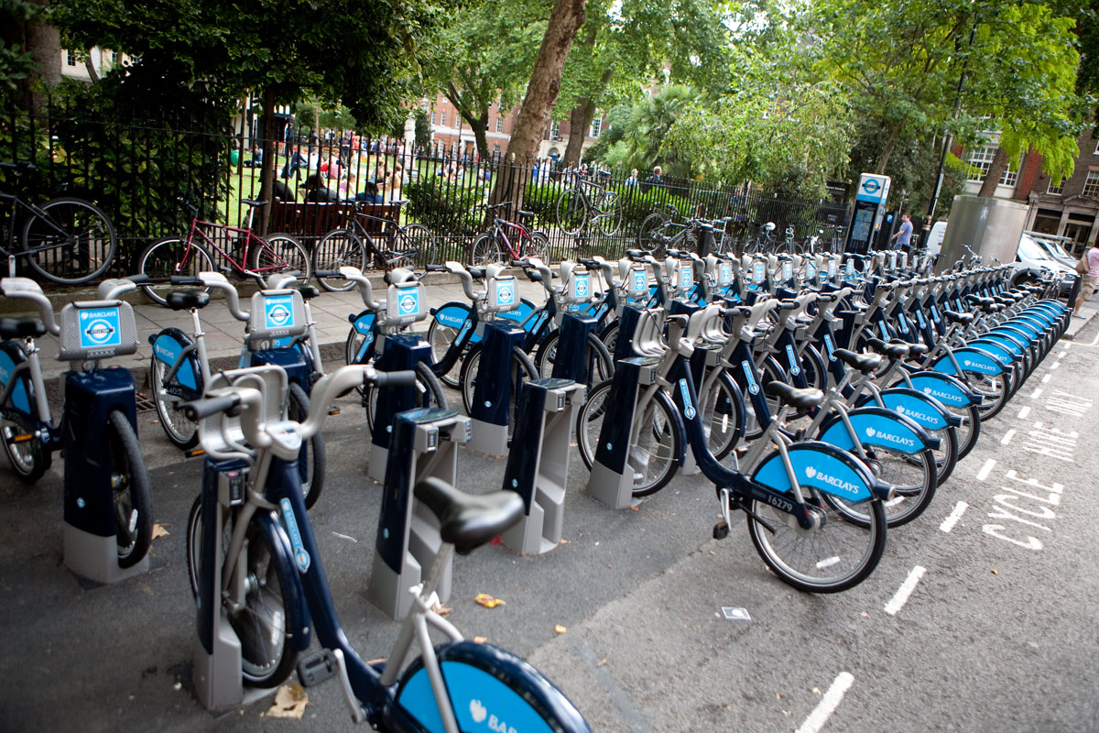
Team 10: Bike Sharing Demand
Rich Gruss
Scout Sujiyot

Slide 2
Executive Summary

Slide 3
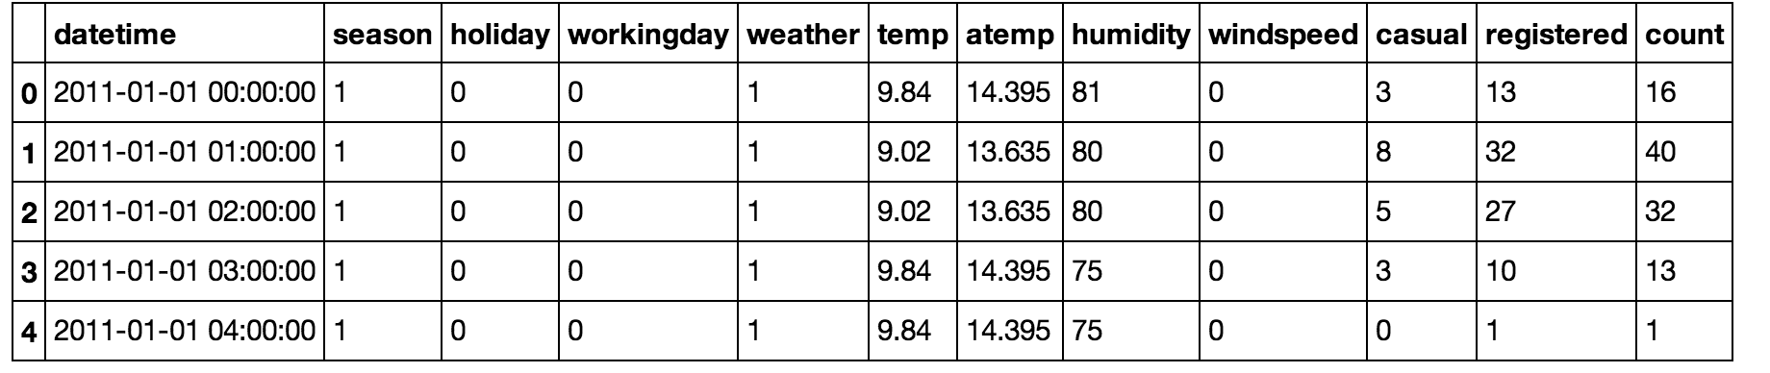
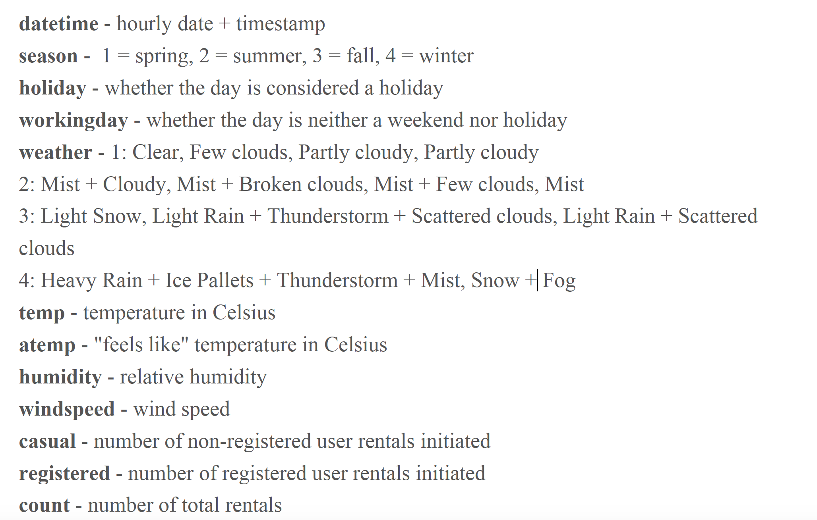
Kaggle Bike Sharing Data

Slide 4
Numerical Summaries

Slide 5
Visualizations

Slide 6
Machine Learning Algorithm(s)
Most Accurate: Naïve Bayes Classifier, dividing counts into 5 bins of approximately 200 bikes each: light, light-medium, medium, medium-heavy, and heavy. Numerical features are scaled.
time_of_day + season + holiday +
workingday + weather + atemp_scaled +
humidity_scaled + windspeed_scaled
Numerical Prediction

Slide 7
Machine Learning Validation
Under 5-fold validation, the Naïve Bayes classifier achieves an accuracy of
68% on test data.
X_train, X_test, y_train, y_test = train_test_split(bike_data_X, bike_data_y, test_size=0.8)
clf = MultinomialNB()
clf.fit(X_train, y_train)
MultinomialNB(alpha=1.0, class_prior=None, fit_prior=True)
test_dataframe = pd.DataFrame()
test_dataframe['category'] = y_test
test_dataframe['pred_category'] = clf.predict(X_test)
print test_dataframe
evaluate_cross_validation(clf, X_test, y_test, 5)
Mean score: 0.662 (+/- 0.013)
[ 0.68140069 0.68943743 0.67336395 0.67623421 0.67489948]
Mean score: 0.679 (+/- 0.003)

Slide 8
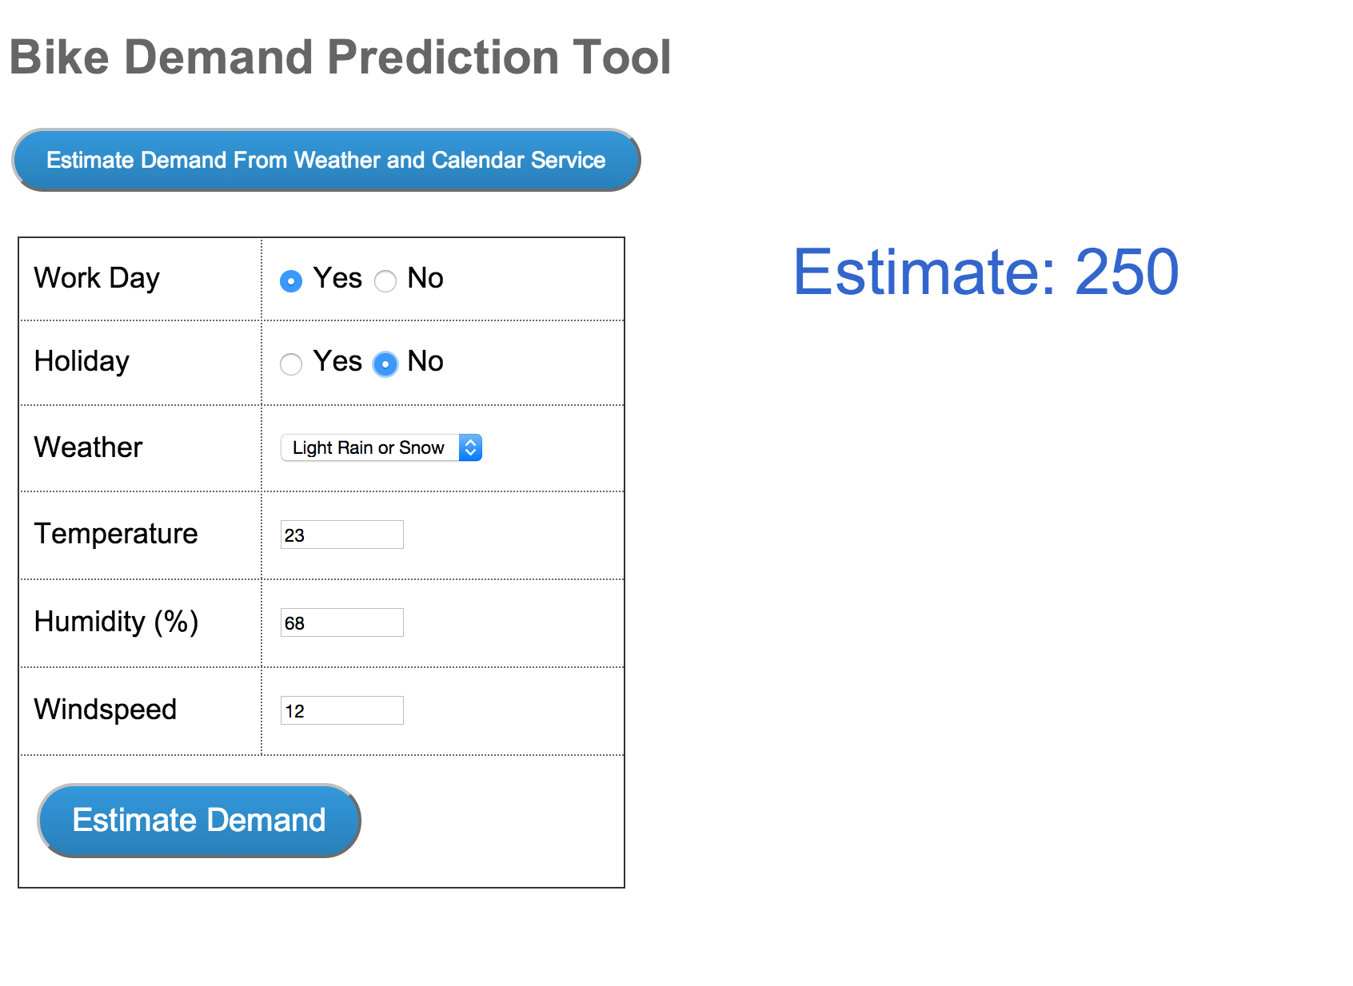
Conclusions and Deployment Recommendations

