Slide 1

Team
9
Cloud Infrastructure Operations
Animesh Das
Brooke Xiao
Priya Sampathkumar
Ruchi Mishra
Sha Hong

Slide 2
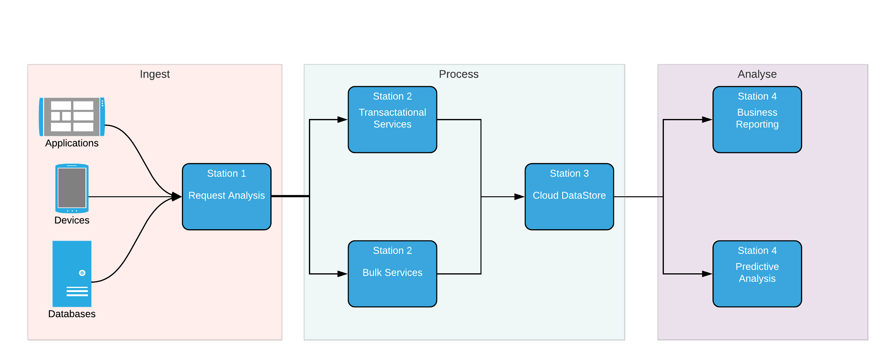

Process Flow
Analyze and queue customer request
Process request through Master-Data management services
Storage of results in Cloud Database server
Predictive Analysis and Business Metrics reported on response
Notes:
Examples of Station 1 : Cloud Pub/Sub , Apache Kafka
Examples of Station 2 : Cloud Dataflow , AWS Batch
Examples of Station 3 : Cloud Bigtable , Apache HBase
Examples of Station 4 : Cloud BigQuery , AWS Redshift , Cloud Machine Learning

Slide 3

Capacity Utilization and Bottleneck Analysis
Station #2
Station | #1 | #2 |  | #3 | #4
 |  | transaction | bulk
Resource type | Analysis Engine | Processor |  | Database Server | Reporting Engine
Resource amount | 10 | 12 | 18 | 20 | 5
Service time | 10s | 15s | 30s | 5s | 2s
Station capacity | 1/s | 0.8/s | 0.6/s | 4/s | 2.5/s
Utilization | 60% | 75% |  | 15% | 24%
Flow unit: Customer Request (e.g. HTTPRequest)
Arrival rate: 1/s
Process capacity: 0.6/s
Output rate=min(arrival rate, process capacity)=0.6/s
*All the values are assumed for illustration purposes

Slide 4

Best Practices
Split the batch flow request
To improve bottleneck service time
Off-peak promotions
Add resource to bulk service
Vertical Scale/Elastic capacity provisioning

Slide 5
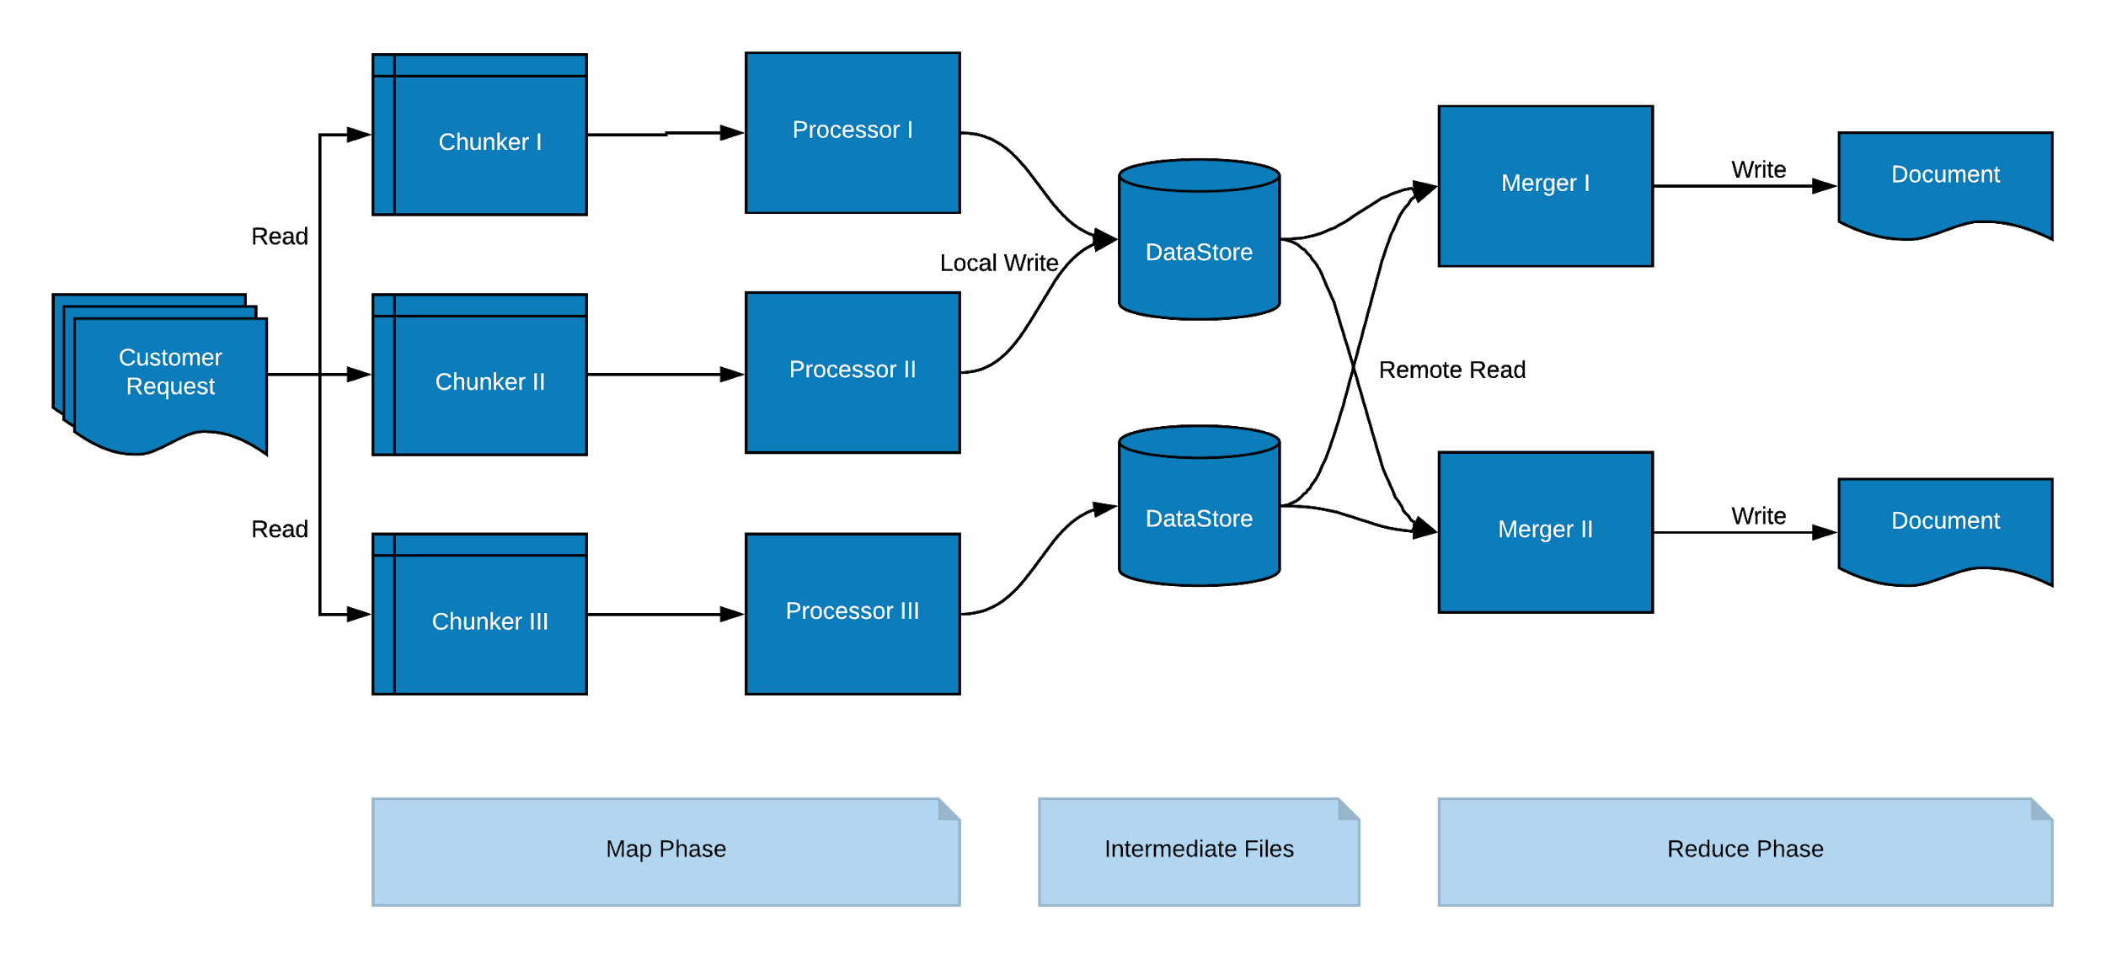
Bulk Processing
Notes:
Q1: Why is split process used in batch processing?
In batch/bulk processing we initially split the incoming customer request(record/file) into smaller chunks.
The reasons do the above are the following:
Splitting/Chunking maximises the utilisation of each of our Processors/Workers. This is similar to the Pooling of resources scenario in Baria Case
Through Data Analysis it was found that the Processors had an upper limit on the number of records it can process at a single time without affecting our Service rate. Hence if the incoming request is higher than this upper limit ( in our actual case this was 65K records) than we split the file into multiple files
Q2: How does it affect the service time compared to the non-split system?
A non-split system is a transactional system where the customer request is in the form of a stream. As the total volume of the incoming request is much smaller compared to a batch processing system, the service time of a transactional method is less.
A split system is used to resolve the bottleneck, but still, some bottleneck continues to exist. Why?
A split system is used to reduce the cost of implementing transactions in a cloud server, not necessarily to resolve the bottleneck. But to increase the capacity of the system, we add more resources to the station and divide work among them, by splitting the incoming request into smaller chunks and then parallel processing all the files.

Slide 6
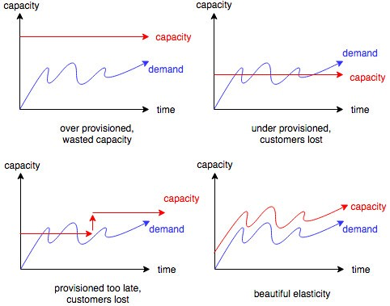
Big Picture
Scalability
vs
Elasticity
in cloud capacity provisioning
Notes:
Scalability
Scaling up or down the existing resources
Use existing infrastructure
Do not impact performance
Predictable workload
Planning of capacity and performance is stable
Scale of growth can be estimated
E.g. virtual desktop infrastructure

Slide 7
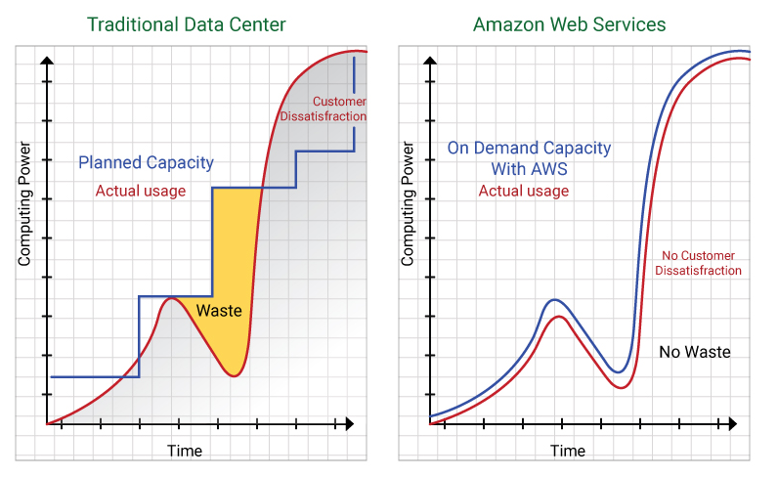
Big Picture
Scalability
vs
Elasticity
in cloud capacity provisioning
Notes:
Scalability
Scaling up or down the existing resources
Use existing infrastructure
Do not impact performance
Predictable workload
Planning of capacity and performance is stable
Scale of growth can be estimated
E.g. virtual desktop infrastructure

Slide 8
In Cloud Capacity Provisioning
VS
Add or remove resources dynamically
Arrival variability is high
Pay-as-you-grow
Optimized IT spend
E.g. in e-commerce and retail, SaaS, mobile, DevOps
Elasticity
Scaling up or down the existing resources
Use existing infrastructure
Do not impact performance
Predictable workload
Planning of capacity and performance is stable
Scale of growth can be estimated
E.g. virtual desktop infrastructure
Scalability
Notes:
Ref:
https://turbonomic.com/blog/on-technology/cloud-elasticity-vs-cloud-scalability/
https://medium.com/@pablo.iorio/elasticity-does-not-equal-scalability-246bd9b3c128

Slide 9
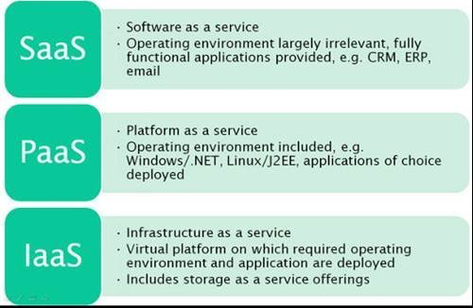
Big Picture
SAAS tenant
Above the arrow is managed by the tenant
PAAS tenant
IAAS tenant
Below the arrow Cloud Service is provisioned by the service provider
Cloud capacity provisioning model that can be made use of by the tenants/clients
Notes:
Ref:
https://www.cmg.org/wp-content/uploads/2015/09/Capacity-Management-for-Cloud-Computing-v6-ext.pdf
https://www.cl.cam.ac.uk/research/srg/opera/publications/papers/2015ccmagSI.pdf

Slide 10
Big Picture
Standardization
Customization
Standard business process delivered by cloud service provider
Infrastructure services or applications can be cost effective for clients, as pay per use model is feasible to offer
Dynamic provisioning of capacity
Highly efficient for the client.
Less flexibility to provide infrastructure services.
Fixed capacity provided at high cost
Public cloud
Hybrid cloud
Private cloud
Retail
Media
Manufacturing
Insurance
Banking
Government
Notes:
Ref:
https://www.cmg.org/wp-content/uploads/2015/09/Capacity-Management-for-Cloud-Computing-v6-ext.pdf
https://www.cl.cam.ac.uk/research/srg/opera/publications/papers/2015ccmagSI.pdf

Slide 11
References
Flow Diagram
Data Model
Capacity Management
Cloud Compliance
Elasticity vs. Scalability
Why elasticity matter!

Slide 12
THANKS

