Slide 1
Fisherbot: A Discord Fishing Bot

Slide 2
Purpose
Create incremental game
  Simple
  Easy
  Fun

Slide 3
Problems
Home network exposed to the internet
Insecurely stored user data

Slide 4
The Solution
Discord bot
  Account security shifted to Discord
  No sensitive user data stored in database
  Home network not open to internet

Slide 5
Interaction

Slide 6
Fishing
Fish or junk randomly selected
Fish added to inventory

Slide 7
Selling
Sell all fish
Sell all junk
Sell everything
Sell individual items

Slide 8
Buying Rods
User uses gold to purchase fishing rod
Fishing rod unlocks new area

Slide 9
Areas
Areas give new fish with different rarity
More gold and xp

Slide 10
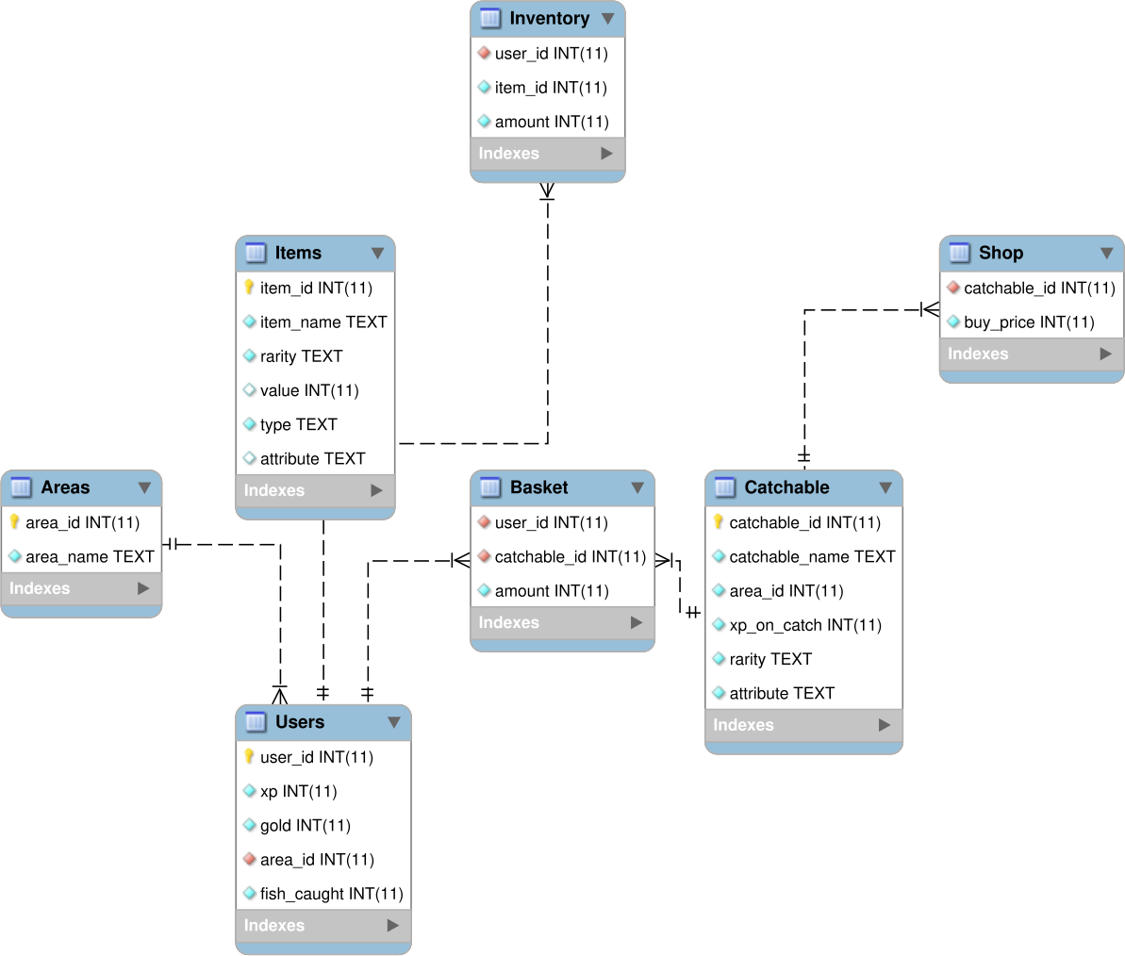
The Database
Users
Items
Catchable
Areas
Inventory
Basket
Shop

Slide 11
Demonstration

