Slide 1
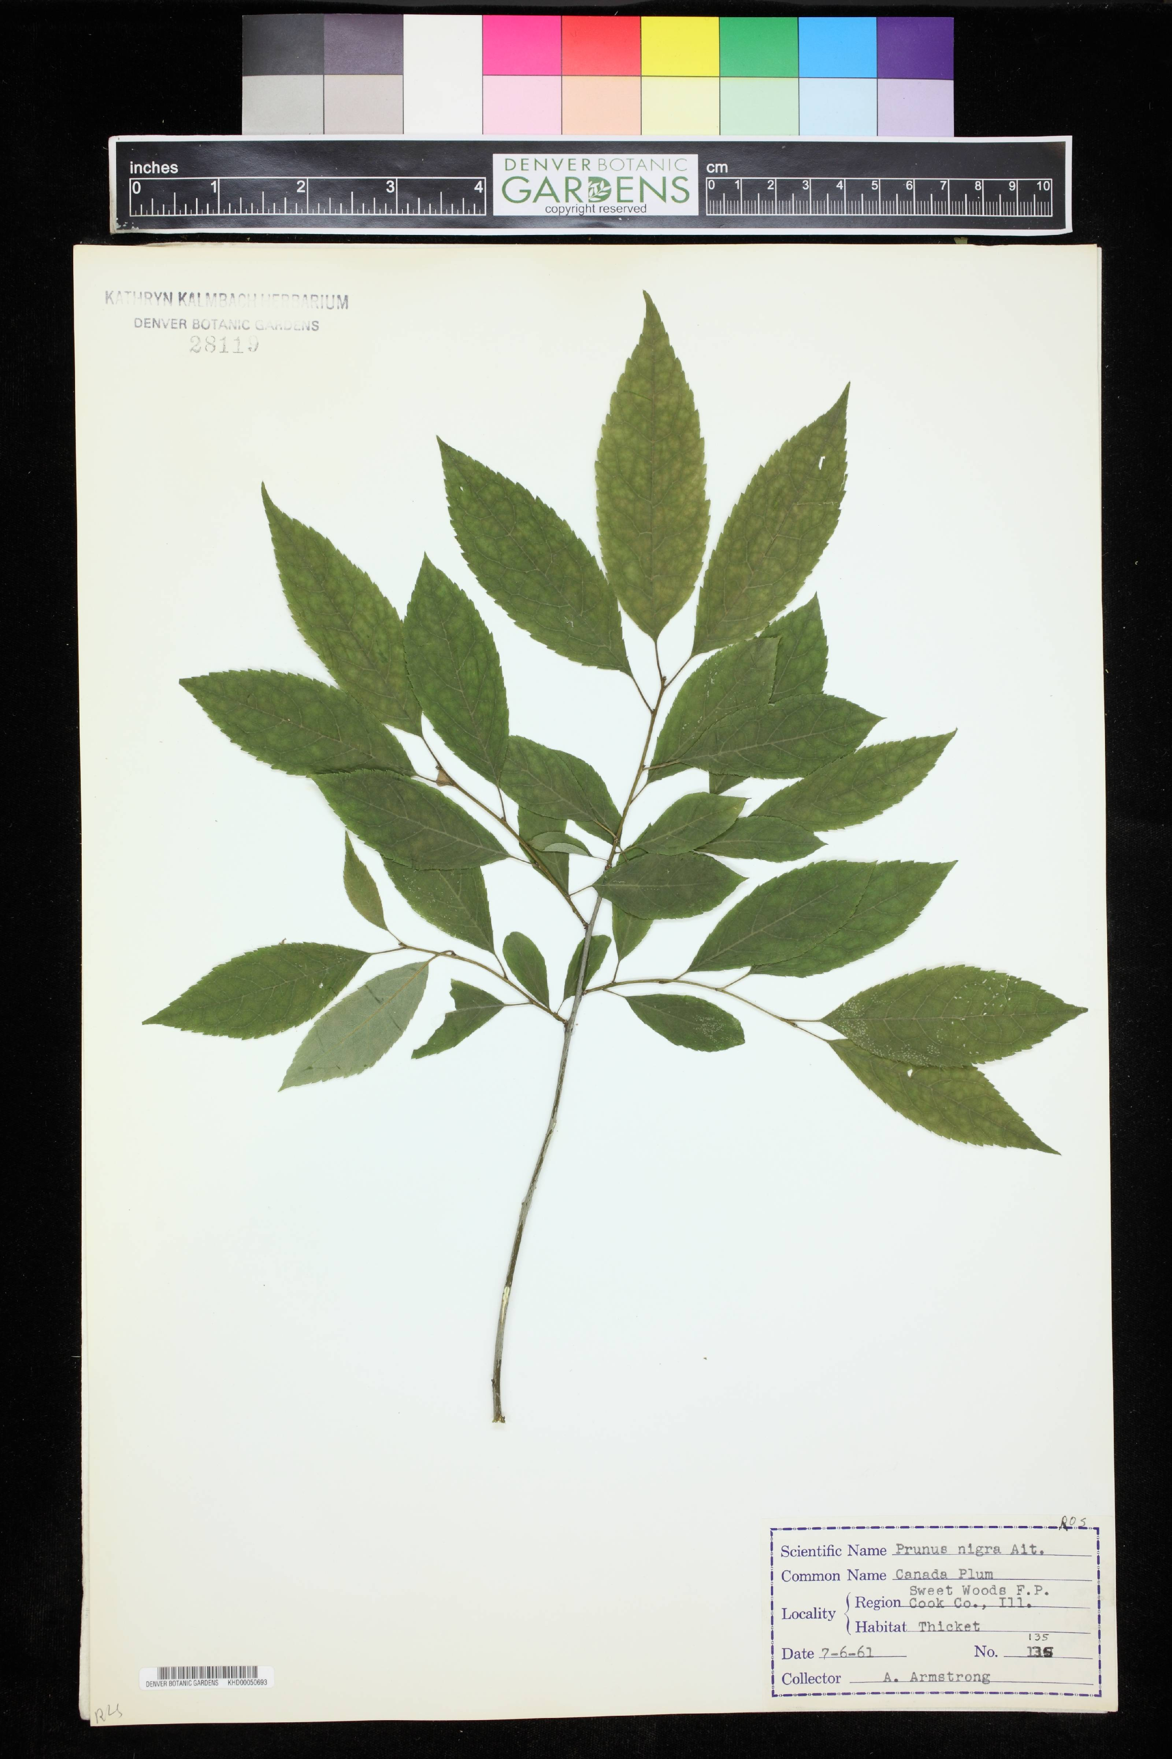
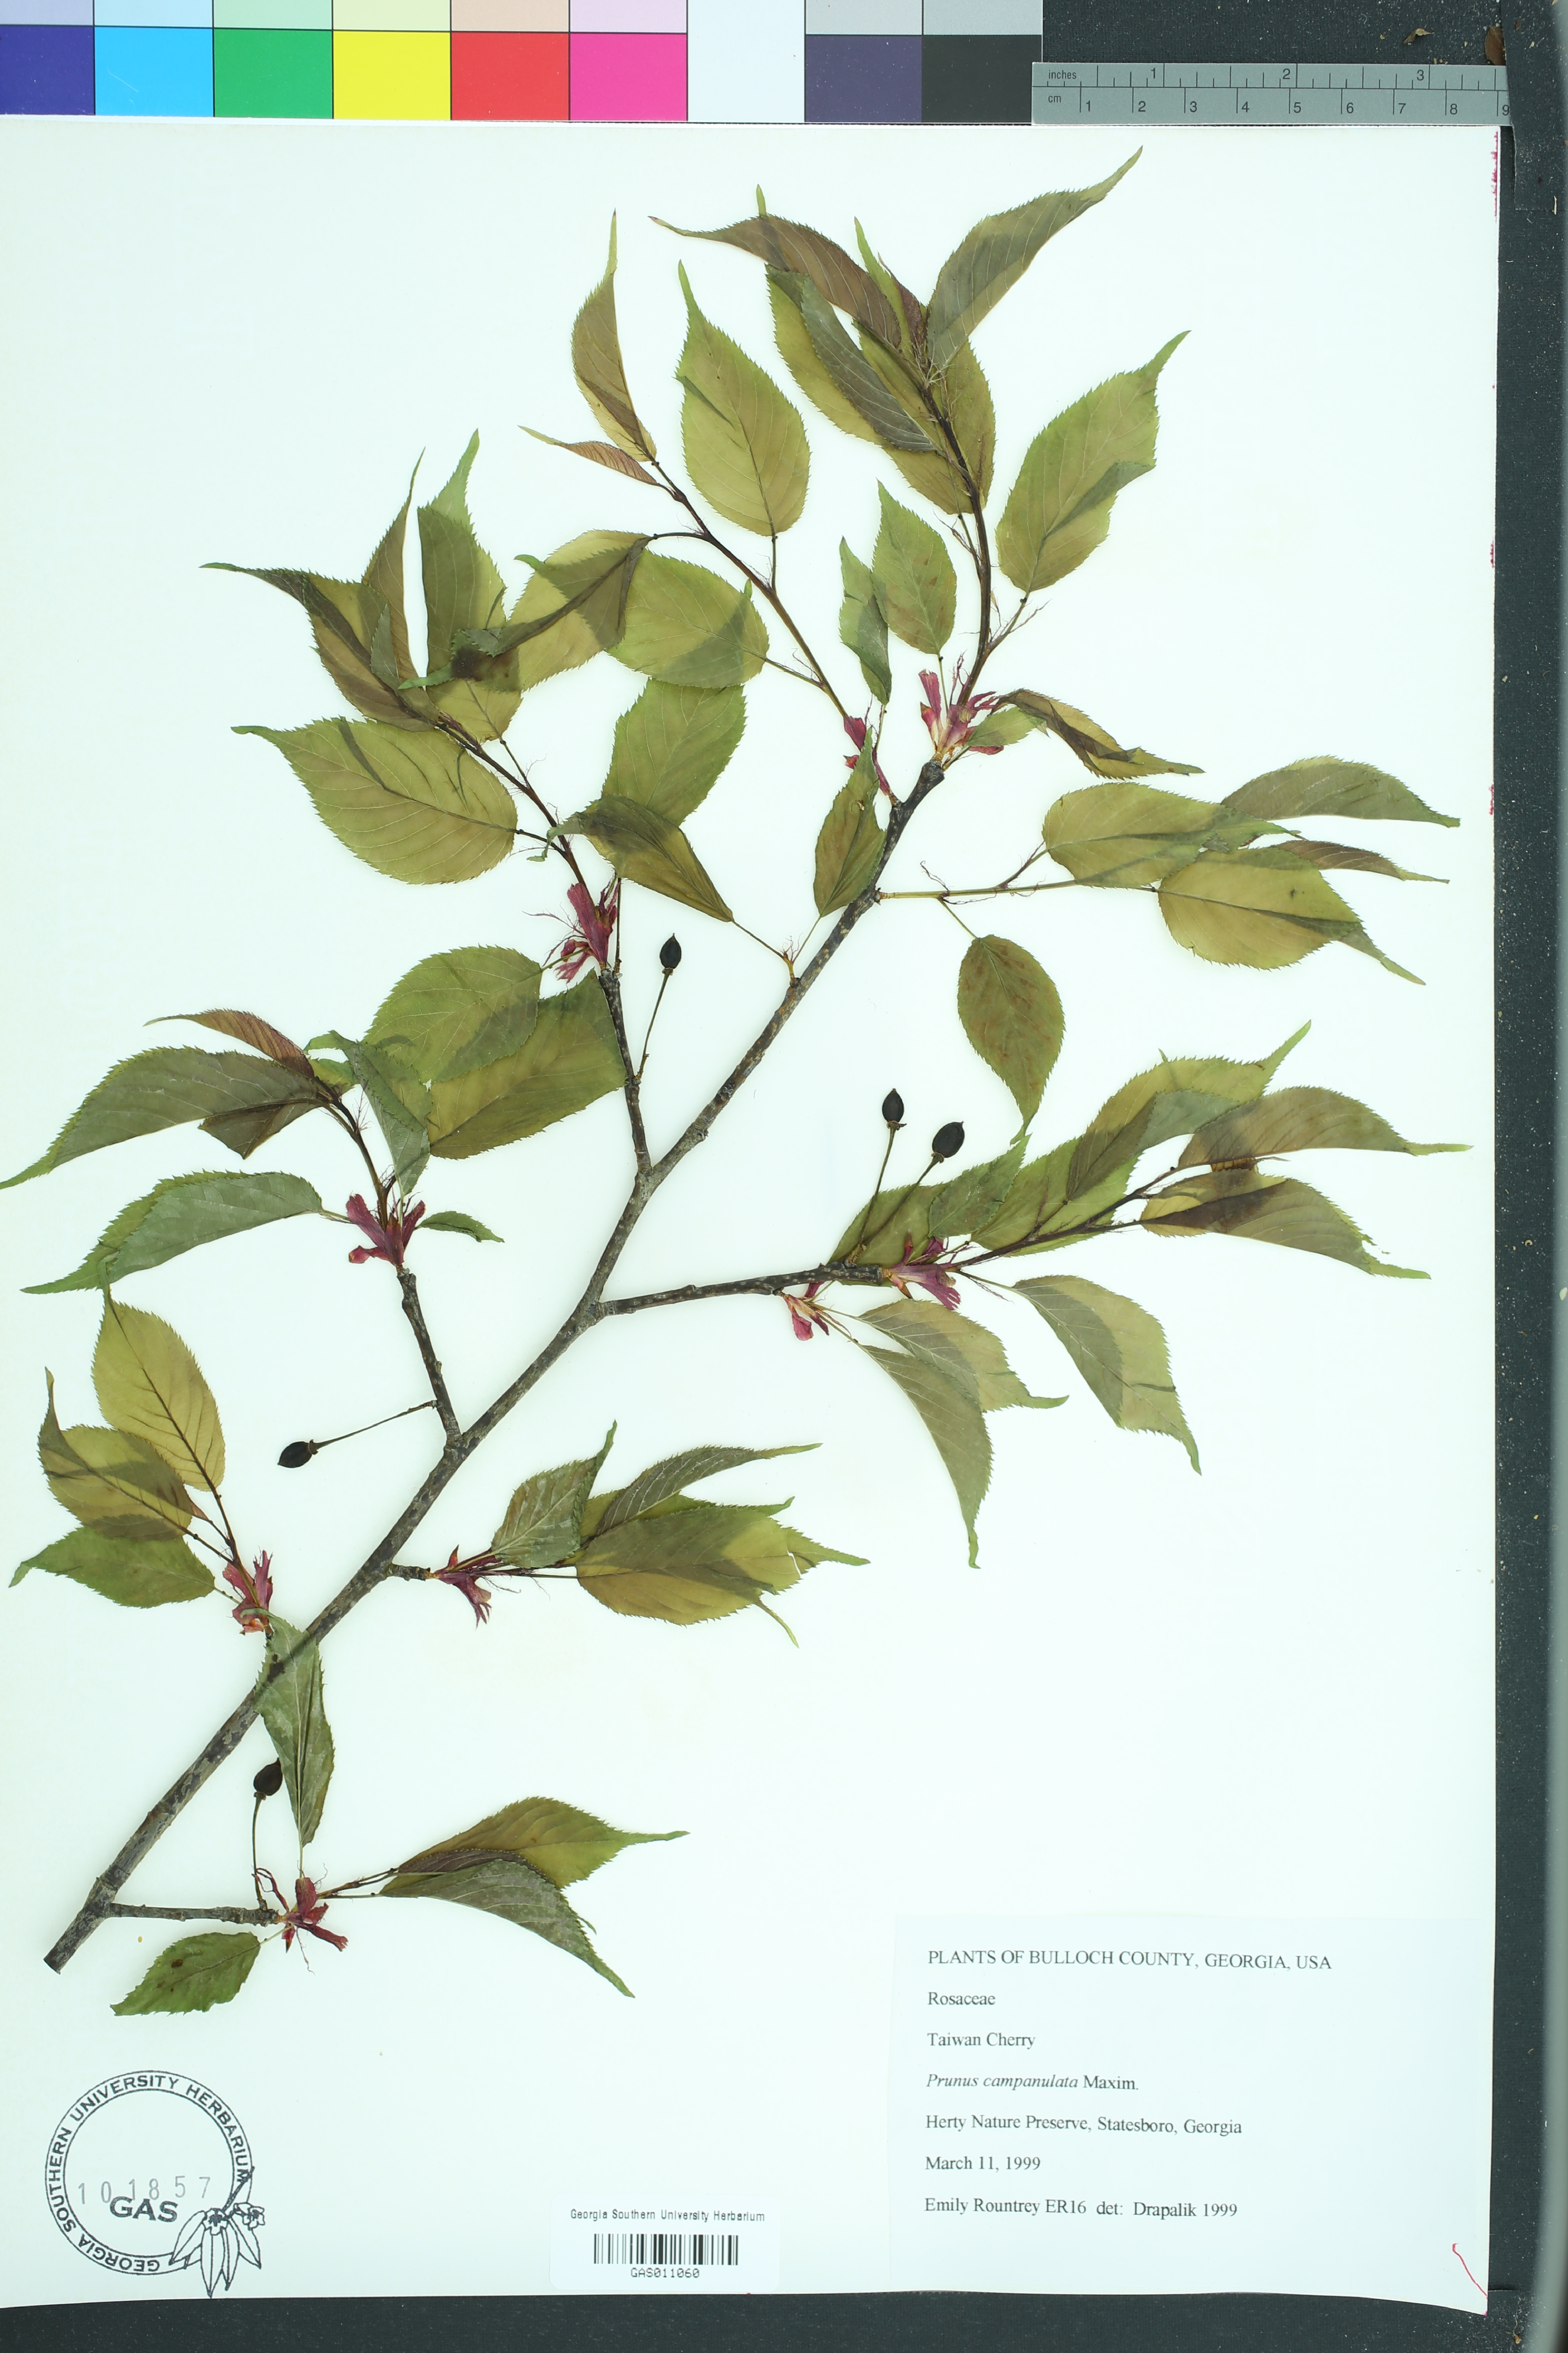
Using deep learning with digitized herbarium specimen image data
Botany 2022 Anchorage

Slide 2
Background
We first presented this workshop last year virtually for ~50 attendees
First time this is a in-person workshop
Please keep in mind the code of conduct
Pacing / Scheduling

Slide 3
Schedule
Time in AKDT | Topic
9:00 - 9:15 | Introduction
9:20 - 9:50 | Module 1: Case studies illustrating how researchers are using deep learning (presenter: Pam Soltis)
 | 10 MINUTE BREAK
10:00 - 10:50 | Module 2: Introduction to python, jupyter notebooks, and google colab (presenter: Sundre Winslow)
 | 10 MINUTE BREAK
11:00 - 11:50 | Module 3: Acquiring and manipulating digitized herbarium images (presenter: Richie Hodel)
 | LUNCH
1:30 - 2:20 | Module 4: Data processing and manipulation options (presenter: Stefano Fochesatto)
 | 10 MINUTE BREAK
2:30 - 3:00 | Module 5: Creating annotated datasets and How to train an object classifier (presenter: Will Weaver)
 | 10 MINUTE BREAK
3:10 - 4:00 | Module 6: Model training and validation (presenter: Richie Hodel)

Slide 4
Introductions
Presenters:
Sundre Winslow
Pam Soltis
Stefano Fochesatto
Will Weaver
Richie Hodel
Attendees
Share:
Institution
Something you hope to learn
Favorite summer outdoor activity
Anything else you want to share!

Slide 5
Resources
https://github.com/richiehodel/Botany2022_DLworkshop
https://etherpad.wikimedia.org/p/Botany2022_DLworkshop
https://botanyconference.org/file.php?file=SiteAssets/2022_code_of_conduct.pdf
https://colab.research.google.com/github/

