Slide 1
HEALTH INFORMATION SYSTEM API
API for Client Management, Program Enrollment, and an API-based Health System

Slide 2
Approach
• Laravel 12 + Sanctum
• Separated Web and API Authentication
• Mobile-Responsive Login and Register UI

Slide 3
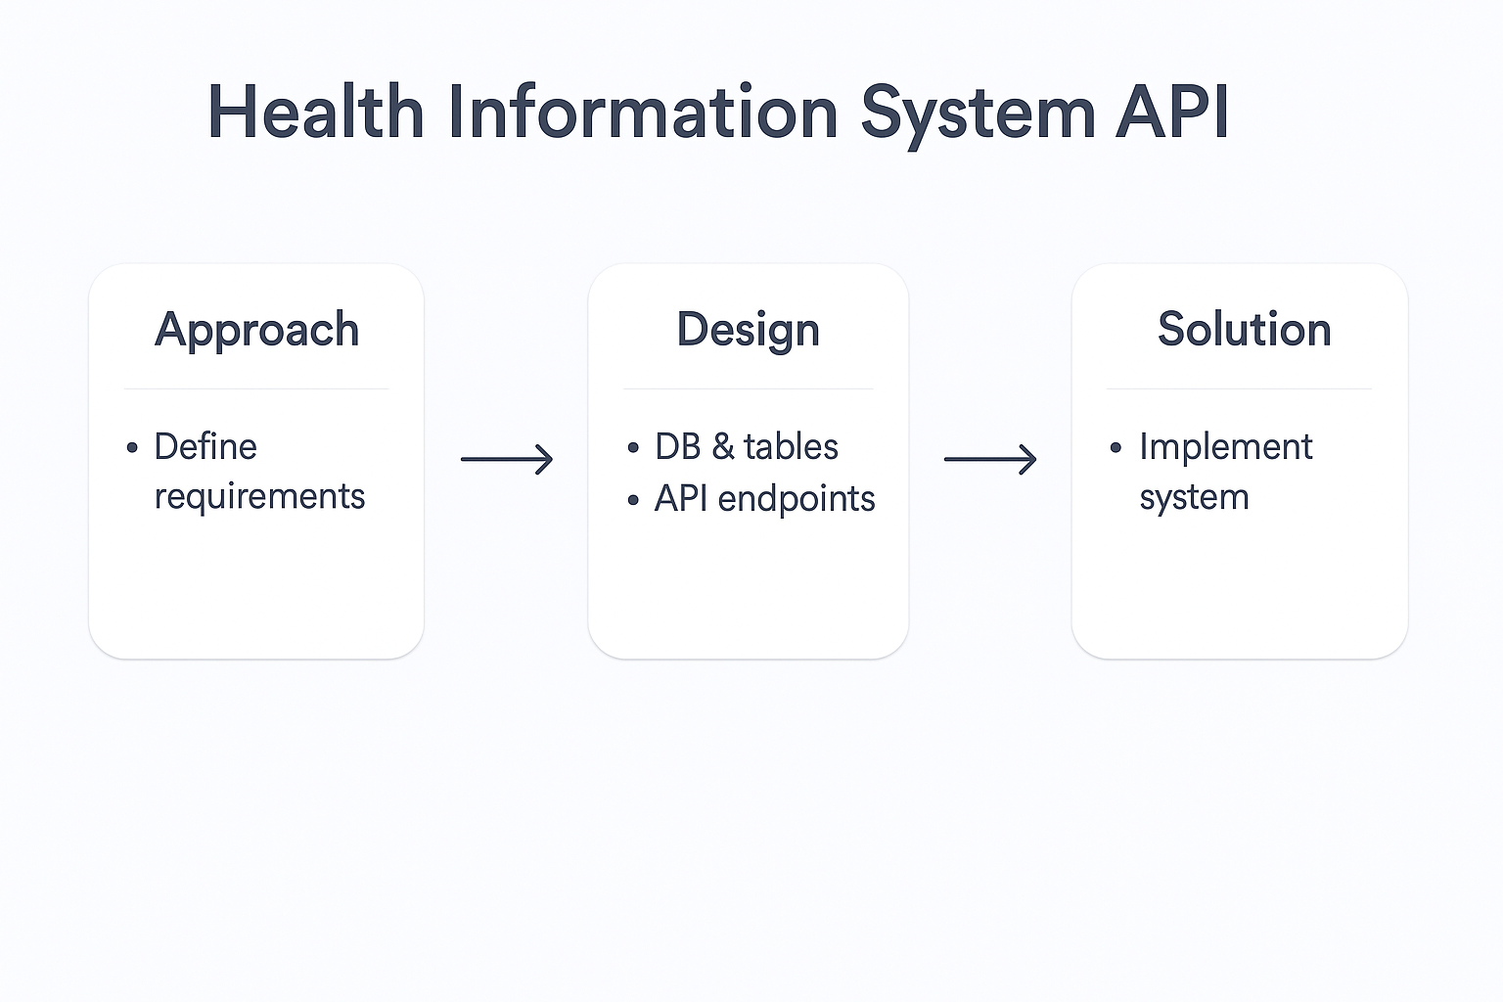
Architecture
Client (Postman/CLI/Browser) → Laravel API → Database (MySQL)

Slide 4
Core Features
• Register/Login Users
• Manage Clients
• Manage Programs
• Enroll & Unenroll Clients
• Search Clients
• View Client Profiles
• API Documentation

Slide 5
Technology Stack
• Laravel 12
• Sanctum
• PHP 8.2
• MySQL
• Postman / PowerShell Scripts/ web browser
• Blade UI

Slide 6
Testing & Validation
• Postman API Collection Tests
• Powershell CLI Testing
• Manual Web Testing: Login, Dashboard, Logout

Slide 7
Final Thoughts
Secure, scalable API foundation.
Clean and professional codebase.
Ready for real-world expansion.

