Slide 1


BIASHARA SACCO
PRODUCT SHOWCASE
THE COMPLETE SACCO PLATFORM
Run the wholeco‑operativein one place.
Members, savings, loans, guarantors, transactions, share capital, reports and access control — every module, one system, built for SACCOs.
SAVINGS · CREDIT · REPORTS01 / 15

Slide 2
BIASHARA SACCO02 / 15
WHAT IS BIASHARA
A SACCO management systemdesigned for daily operations.
MEMBERS
371
live in the Biashara workspace
SAVINGS
UGX 899M
Biashara replaces the patchwork of spreadsheets, paper files and stand-alone apps that most SACCOs juggle. Every member, every shilling and every decision lives in a single, role-aware system.
on the books across member accounts
LEDGER
27
chart-of-accounts entries, double-entry
OVERVIEW · LIVE BIASHARA SACCO TENANTONE PLATFORM. TEN MODULES.

Slide 3










BIASHARA SACCO03 / 15
MODULE MAP
Ten modules. One workflow.
Each tile maps to a section of the app, accessible to the right people through fine-grained roles and permissions.
Savings
Dashboard
Members
Deposits, withdrawals
Loans
Guarantors
Role-based metrics
Profiles & status
Full lifecycle
Request & approve
Transactions
Share Capital
Reports
Data Import
Roles & Access
Unified ledger
Equity & dividends
Analytics & audits
Granular per type
Fine-grained RBAC
THE MAPWHAT WE’LL COVER

Slide 4

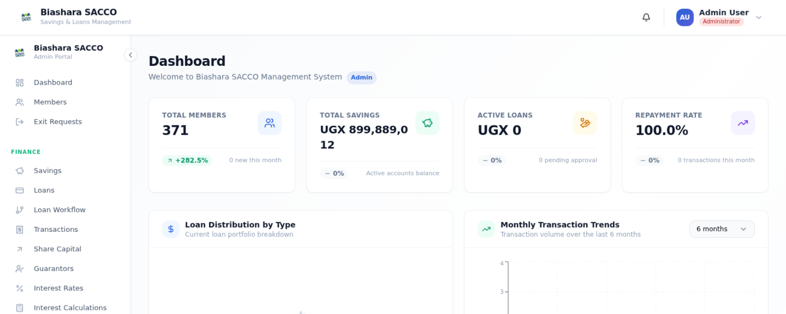
BIASHARA SACCO04 / 15
MODULE 01 · DASHBOARD
The numbers thatmatter, on arrival.
Role-aware home screen
LIVE SCREEN · BIASHARA SACCO371 MEMBERS · UGX 899M
A treasurer, an admin and a member each land on a different view.
Live financial pulse
Total savings, outstanding loans, share capital — refreshed in real time.
Quick actions
Record a deposit, log a repayment or open a member file in one click.
DASHBOARD · CAPTURED FROM THE RUNNING APPSTART HERE

Slide 5

BIASHARA SACCO05 / 15
MODULE 02 · MEMBERS
The member, nevera row in a spreadsheet.
Onboarding & profiles
National ID, contact, department, employer — captured once, used everywhere.
371
0
active members
pending approval
Lifecycle status
Pending, active, inactive, dormant — every state visible and filterable.
Single member view
Inactive
Dormant
Savings balances, active loans, guarantor links and history in one record.
no recent activity
flagged for review
MEMBERS · LIVE FROM BIASHARA SACCO TENANTKNOW WHO YOU SERVE

Slide 6

BIASHARA SACCO06 / 15
MODULE 03 · SAVINGS
Every shillingaccounted for.
Deposits & withdrawals
TOTAL ON BOOK
UGX 899,889,012
Recorded against the right account, with a clear running balance.
Account statements
Live, across all accounts
Generated on demand for any member, any date range.
Three account types
Regular savings, fixed deposits and group accounts — each with its own rules.
REGULAR
01
Day-to-day deposits
FIXED & GROUP
SAVINGS · LIVE FROM BIASHARA SACCO TENANTTHREE ACCOUNT TYPES
Term deposits, chama / merry-go-round
02·03

Slide 7

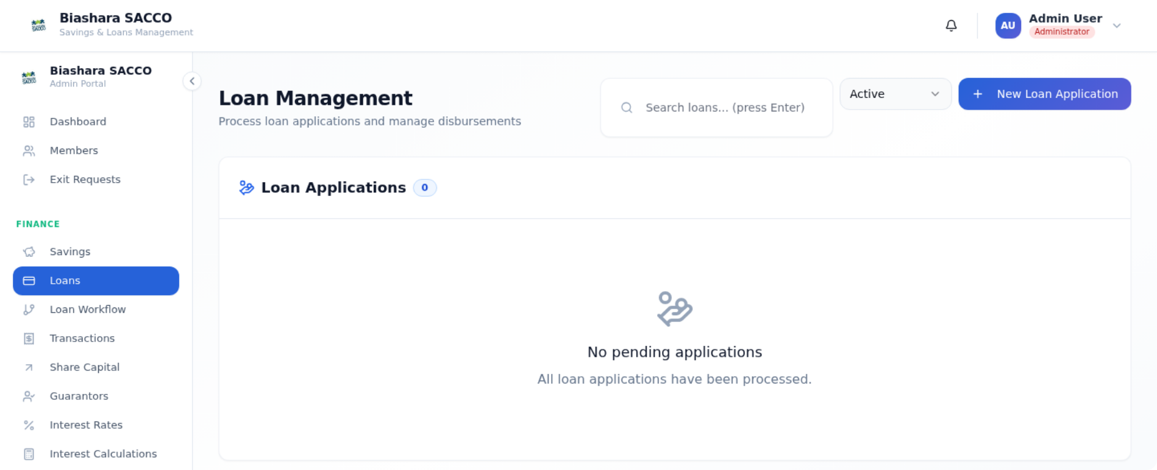
BIASHARA SACCO07 / 15
MODULE 04 · LOANS
From applicationto final repayment.
01
02
03
04
05
LOAN MANAGEMENTLIVE SCREEN
Apply
Guarantee
Approve
Disburse
Repay
New loans, top-ups & documents
Each with its own approval path; payslips and IDs on every file.
Amortization schedules
Generated automatically for every active loan.
Live tenant: 0 active loans · 100% repayment
Members imported; loan book seeding next.
LOANS · CAPTURED FROM THE RUNNING APPFIVE-STEP LIFECYCLE

Slide 8

BIASHARA SACCO08 / 15
MODULE 05 · GUARANTORS
Trust, recordedand verifiable.
Request & respond
Borrowers nominate guarantors; each one accepts or declines in their own dashboard.
FLOW
1
Borrower nominates
2
Guarantor reviews
Linked to the loan file
Status, exposure and acceptance date sit alongside the loan record.
3
Accept or decline
Notifications, not phone calls
4
Loan unlocks
In-app alerts replace the back-and-forth that used to slow approvals.
Every state change is timestamped and stored in the loan’s audit log.
GUARANTORSFASTER, CLEANER APPROVALS

Slide 9


BIASHARA SACCO09 / 15
MODULE 06 · TRANSACTIONS
One ledger.Every movement.
Unified financial ledger
LIVE LEDGERTODAY
Deposits, withdrawals and repayments in one feed.
Deposit · J. Wanjiru
+12,000
Audit trail by default
Regular savings · 10:14
Actor, timestamp and source on every entry.
Repayment · M. Otieno
+8,500
Filter, find, reconcile
Loan #1142 · 09:48
By member, by date, by type.
Disbursement · F. Njoroge
+50,000
Loan #1148 · 08:30
TRANSACTIONSTHE SINGLE SOURCE OF TRUTH

Slide 10

BIASHARA SACCO10 / 15
MODULE 07 · SHARE CAPITAL
Member equity,tracked to the cent.
Equity by member
Shares purchased, transferred and held — visible per member, per period.
DIVIDEND RUN
1 click
Dividend distribution
Calculated from holdings and posted in a single, auditable run.
from declared rate to per-member allocations posted across the entire register.
Statements on demand
Members can see contributions and dividends in their own profile.
Auditable end to end
SHARE CAPITALEQUITY, TRACKED

Slide 11

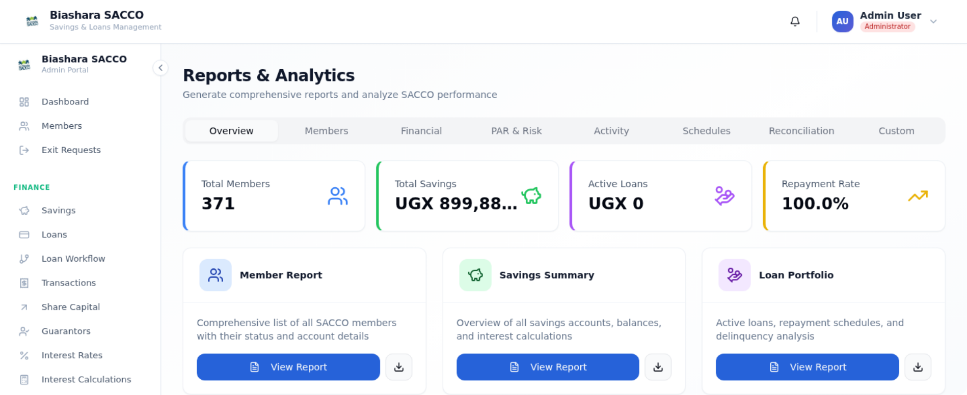
BIASHARA SACCO11 / 15
MODULE 08 · REPORTS
Decisions backedby real numbers.
MEMBERS
SAVINGS
REPORTS & ANALYTICSLIVE SCREEN
Roster & status
Balances summary
LOANS
COMPLIANCE
Portfolio & arrears
Financial stmts.
RISK
TRAIL
Dormant & PAR
Audit logs
Live tenant: 371 members · UGX 899,889,012 · 100% repayment
REPORTS · CAPTURED FROM THE RUNNING APPSIX REPORT FAMILIES

Slide 12

BIASHARA SACCO12 / 15
MODULE 09 · DATA IMPORT
Bring your records in,one type at a time.
TYPE 01
TYPE 02
TYPE 03
TYPE 04
TYPE 05
Members
Bulk member onboarding from CSV.
Savings
Loans
Loan repayments
Bulk savings
Account openings and balances.
Loan books with active balances.
Bulk CSV repayment posting.
Mass deposit posting from payroll.
Each import is its own permission.
GRANULAR RBAC
Grant a clerk “import savings” without giving them loans.
DATA IMPORTFIVE INDEPENDENT PERMISSIONS

Slide 13

BIASHARA SACCO13 / 15
MODULE 10 · ROLES & ACCESS
The right people seethe right things.
Per-action permissions
SAMPLE MATRIX
Read, create, update, delete, execute — defined per resource.
RESOURCE
ADMIN
TREAS.
MEMBER
Custom roles
Build a “branch officer” or “loan auditor” without code.
Members
✓
✓
—
Approve loan
✓
—
—
Visual role-permission matrix
Tick the boxes; the system enforces them everywhere.
Import savings
✓
✓
—
Own statement
✓
✓
✓
ROLES & ACCESSFINE-GRAINED, BY DESIGN

Slide 14
BIASHARA SACCO14 / 15
BUILT FOR TRUST
AUDIT LOGS
Members trust theSACCO. The SACCOtrusts the system.
Every change, on the record.
Actor, timestamp and before/after value for every sensitive action.
ROLE ENFORCEMENT
Permissions checked everywhere.
Both the API and the screen ask the same question before showing data.
AUTOMATED BACKUPS
Daily snapshots, kept safe.
Recover from a mistake without losing the day’s work.
TRUSTTHE QUIET FOUNDATION

Slide 15


BIASHARA SACCO15 / 15
BIASHARA SACCO
Management system
Ready to see Biasharain your SACCO?
Members, savings, loans, guarantors, transactions, share capital, reports, imports and access — all in one trusted workspace.
ENDThank you

