Slide 1
Bachelor's Thesis
Taxonomy and Analysis of
Failure Modes in N-gram Based
Generative Retrieval
WU Vienna - Richard Takacs

Slide 2
Presentation Outline
01
Background
Sparse → Dense → Generative Retrieval · SEAL & MINDER architectures · Datasets
02
Research Questions
RQ1: Taxonomy of failure modes in the literature · RQ2: Empirical analysis of n-gram GR failures
03
RQ1 — Failure Taxonomy
Representation · Training · Inference · Response
04
RQ2 — Empirical Analysis
Non-discriminative DocIDs · Length bias · Metadata dependency · Cultural bias · Query mismatch · Scoring artifacts
05
Discussion & Conclusions
Root cause tracing · Limitations · Future work
Taxonomy and Analysis of Failure Modes in N-gram Based Generative Retrieval
2

Slide 3
Background
From sparse retrieval to generative retrieval

Slide 4
Three Methods of Information Retrieval
1970s–1980s
2020
2020+
Sparse Retrieval
Dense Retrieval
Generative Retrieval
e.g. BM25, SPLADE
e.g. DPR, Contriever
e.g. SEAL, MINDER, DSI
→ Index lookup via term matching
→ BERT-based dual encoder
→ Corpus encoded into LM parameters
→ High-dimensional sparse vectors
→ Query & doc encoded to dense vectors
→ Autoregressively generates DocIDs
→ Fast, interpretable, no training needed
→ Cosine similarity matching
→ No external index needed
→ Fails on vocabulary mismatch
→ Requires separate vector index (e.g. FAISS)
→ Single end-to-end model
Taxonomy and Analysis of Failure Modes in N-gram Based Generative Retrieval
4

Slide 5
Generative Retrieval — How It Works
DocID Types
Retrieval Pipeline
Numeric
1
Corpus Indexing
Random integers, hierarchical cluster paths, PQ-codes
All documents & passages encoded into LM weights during training
Titles
2
Query Encoding
Document title; works well on NQ, fails on MSMARCO
Encoder (BART/T5) embeds the query into a fixed representation
N-grams / Substrings
3
DocID Generation
Any contiguous span of text from the corpus (SEAL, MINDER)
Decoder autoregressively generates DocID tokens via beam search
Pseudoqueries
Synthetically generated queries per document (MINDER)
4
Constrained Decoding
FM-Index or Trie ensures only corpus-valid sequences are generated
Term Sets
Permutation-invariant bag of terms
5
Passage Ranking
DocIDs are scored to get final ranked passage list
Hybrid
Combination of the above
Taxonomy and Analysis of Failure Modes in N-gram Based Generative Retrieval
5

Slide 6
SEAL and MINDER — Analyzed Models
SEAL
Bevilacqua et al.
MINDER
Li et al.
→ DocIDs = any n-gram substring in the corpus
→ Extends SEAL with three identifier views per passage
→ FM-Index constrains decoding to valid corpus strings
→ View 1: Document title
→ Scoring: log-odds ratio of P(ngram|corpus) vs P(ngram) — rewards rare, query-specific n-grams
→ View 2: N-gram substrings, same as SEAL (but simpler scoring)
→ Aggregates scores from multiple non-overlapping n-grams per passage
→ View 3: Pseudoquery — synthetic query generated for each passage
→ Limitation: bound to exact word orderings in corpus
→ Pseudoquery view mitigates lexical gap & compensates for missing metadata
Taxonomy and Analysis of Failure Modes in N-gram Based Generative Retrieval
6

Slide 7
Evaluation Datasets
Natural Questions (NQ)
Google Search queries + English Wikipedia
21M
6,515
Clean, unique article titles. Academic benchmark standard. Structured Wikipedia passages. Favours metadata-heavy retrieval strategies.
Passages
Test queries
MSMARCO
Bing Search queries + Web snippets
8.8M
6,980
Messy, incomplete, non-unique metadata. Reflects real-world search conditions. Harder for models relying on title shortcuts.
Passages
Test queries
Taxonomy and Analysis of Failure Modes in N-gram Based Generative Retrieval
7

Slide 8
Research Questions
What we set out to investigate
RQ1
What failure modes of GR systems have been identified in the literature, and how can they be organized into a coherent taxonomy?
RQ2
Which failure modes appear in n-gram-based retrieval? When and how do they happen?

Slide 9
RQ1 — Failure Mode Taxonomy

Slide 10
Taxonomy Overview — Four Stages
Highlight = Analysis Presented Here
01 Representation
02 Training
03 Inference
04 Response
Indistinct DocIDs ₁,₂,₃,₄
Tokenization failures ₂₉
Static DocID assignment ₁₈
Metadata over-reliance ₁₄,₁₅
Lexical mismatch ₁₉,₁₄
N-gram contiguity constraint ₁₄
Dynamic corpus / deletion / forgetting ₅,₆,₇
Western-centric bias ₂₀,₂₁,₂₂,₂₃
Zero-shot failure ₁₉,₂₄
Distillation errors ₂₅,₂₆
Unlabeled documents ₇,₂₇
Capacity limits ₂₇,₁₂
False pruning ₈,₉,₃
LLM hallucination ₁₀,₁₁
Latency / compute cost ₁₂
Context window limits ₄,₁₃
Length bias ₁₂,₁₄,₁₅
Lost in the Middle ₁₆
Generation error accumulation ₁₂
Privacy / PII leakage ₄
Retrieval diversity failure ₂,₃
Parametric vs. contextual conflict ₁₃
DocID hallucination ₁₄,₁₇
Citation hallucination ₂₈
Taxonomy and Analysis of Failure Modes in N-gram Based Generative Retrieval
10

Slide 11
RQ1 — Representation Failures
Failure modes rooted in how documents are identified
Indistinct / Non-Unique DocIDs
IVF = "Inverted File Index" or "In Vitro Fertilization" - same identifier but two unrelated documents. In cluster-based DocIDs, "Apple" (company) and "apple" (fruit) can be forced into one cluster.
Tokenization Failures
Rare terms like "Zyloprim" split into "Zy-lo-prim" — model assigns low probability to each meaningless subword. Non-Latin scripts up to 10× more tokens per word than English.
Static DocID Assignment (Non-differentiability)
DocIDs fixed before training begins → indexing module cannot receive gradients. Model mimics a fixed index rather than learning optimal representations.
N-gram Contiguity Constraint
For n-gram-based models, n-grams must be strictly contiguous. Intervening tokens break the span. Passage cutoffs also break span.
Lexical Mismatch
Even with parametric knowledge, query "heart attack" may not trigger DocID "myocardial infarction" if the association was not learned during identifier and model training.
Taxonomy and Analysis of Failure Modes in N-gram Based Generative Retrieval
11

Slide 12
RQ1 — Training Failures
Failure modes emerging from how models are trained and updated
Catastrophic Forgetting
Sequential indexing of new documents causes >25pt accuracy drop on original corpus. ~88% of documents experience at least one forgetting event during training.
Dynamic Corpus / Deletion
New docs unavailable until full retraining. Deleted docs remain in model weights → privacy and compliance risk. Unlike dense retrieval which can re-index instantly.
Western-Centric Bias
BART trained on English Wikipedia + BookCorpus → implicitly defaults to US/European context. T5 similarly. Query 'the capital' may assume USA. NQ and MSMARCO are also Eurocentric.
Zero-Shot Failure
Models trained on NQ perform well on NQ-like queries but degrade sharply on OOD distributions. NCI drops from 71.2 to 27.7 R@100 when evaluated on unseen queries
Capacity Limits at Scale
DSI MRR@10 drops from 80.3 (100k corpus) to 24.2 (8.8M corpus). Adding 8.8M atomic DocIDs adds ~6.8B parameters to output layer alone.
Distillation / Teacher Bias
If cross-encoder teacher is used and misranks a document, the GR student bakes that error into its weights. Teacher errors become quasi-structural biases.
Taxonomy and Analysis of Failure Modes in N-gram Based Generative Retrieval
12

Slide 13
RQ1 — Inference Failures
Failure modes during autoregressive DocID generation
False Pruning (Beam Search)
Retrieval Diversity Failure
Beam search discards a DocID prefix if its cumulative probability lags competitors, even if subsequent tokens would have been correct. Once pruned, the path is irrecoverable.
Ambiguous queries (e.g. 'What is IVF?') can return topically redundant passages all targeting one interpretation, ignoring others.
Length Bias
DocID Hallucination
Token probabilities are multiplicative. Each extra token shrinks total sequence probability, drowning out precise identifiers.
Without constraints, model generates DocIDs not present in corpus. Mitigated in practice via FM-Index or Trie. Some methods use intentional pseudoquery hallucination.
Generation Error Accumulation
Inference Latency
Error rate rises from ~1% at position 1 to >12% by position 6. Model 'loses its train of thought' generating long DocID sequences.
Token-by-token autoregressive generation is FLOP-intensive. Scales poorly with beam size and sequence length vs. simple vector lookups in DR/SR.
Taxonomy and Analysis of Failure Modes in N-gram Based Generative Retrieval
13

Slide 14
RQ1 — Response Generation Failures
Post-retrieval failures in the RAG / answer synthesis stage
Note: these failures belong to the response generation (RAG) stage, not core GR, but included for a complete taxonomy.
LLM Hallucination
Context Window Limits
Summarizer generates information absent from retrieved passages, relying on parametric knowledge instead.
Query requiring 20 sources gets truncated at document 5, so information is discarded.
Lost in the Middle
Parametric vs. Contextual Conflict
LLMs over-weigh information at beginning and end of context, ignoring middle documents regardless of relevance.
Retrieved doc says "Chancellor is Christian Stocker" but LM weights say "Karl Nehammer", model may trust outdated weights.
Citation Hallucination
Privacy / PII Leakage
Model claims "sky is blue [Doc 2]" but the fact is actually from Doc 1. Hurts verifiability and user satisfaction.
Query about address formats returns a real memorized home address from training data → compliance challenge.
Taxonomy and Analysis of Failure Modes in N-gram Based Generative Retrieval
14

Slide 15
RQ2 — Empirical Analysis
N-gram GR failures: when and how do they occur?

Slide 16
RQ2 — Methodology
Output Data
Key Signals
Metrics
→ Top-100 retrieved passages per query
→ N-gram corpus frequency
→ Hits@1, @10, @100
→ Matched n-gram identifiers & scores to passages
→ N-gram length (unigrams vs. multi-token)
→ MRR
→ Annotated ground-truth passages
→ Title vs. body vs. pseudoquery score share
→ nDCG@10, nDCG@100
→ Query & answer strings
→ Lexical query–ngram overlap
→ Recall@10, @100
→ Token diversity
→ Spearman ρ correlations
6,515
6,980
1M+
2
NQ queries
MSMARCO queries
Passages analyzed
Models compared
Taxonomy and Analysis of Failure Modes in N-gram Based Generative Retrieval
16

Slide 17
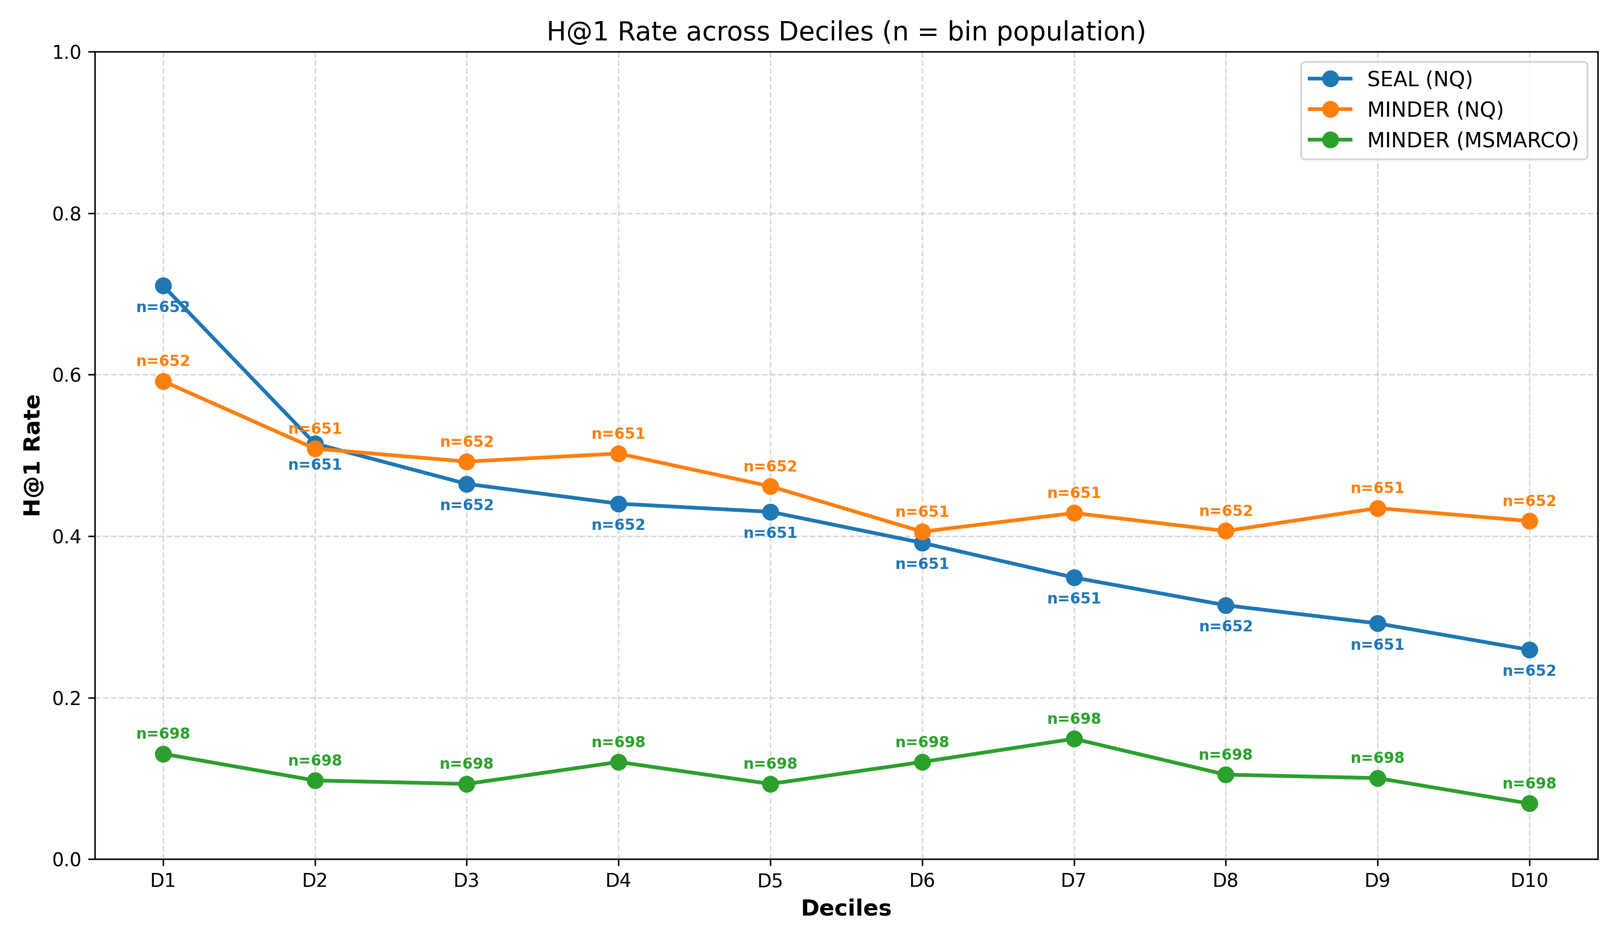
RQ2 · Non-Discriminative DocIDs
Model relies on generic n-grams, triangulating instead of identifying
The model generates generic words matching thousands of passages rather than pinpointing the correct one. Forces the model to 'triangulate' from common n-grams instead of directly generating a discriminative identifier.
Deciles created by taking each queries’ top result’s the top-5 highest scored (= highest weighted) n-grams
28,753
21,310
SEAL avg. top-5
n-gram freq. (NQ)
MINDER avg. top-5
n-gram freq. (NQ)
42,380
MINDER avg. top-5
n-gram freq. (MSMARCO)
Taxonomy and Analysis of Failure Modes in N-gram Based Generative Retrieval
17

Slide 18
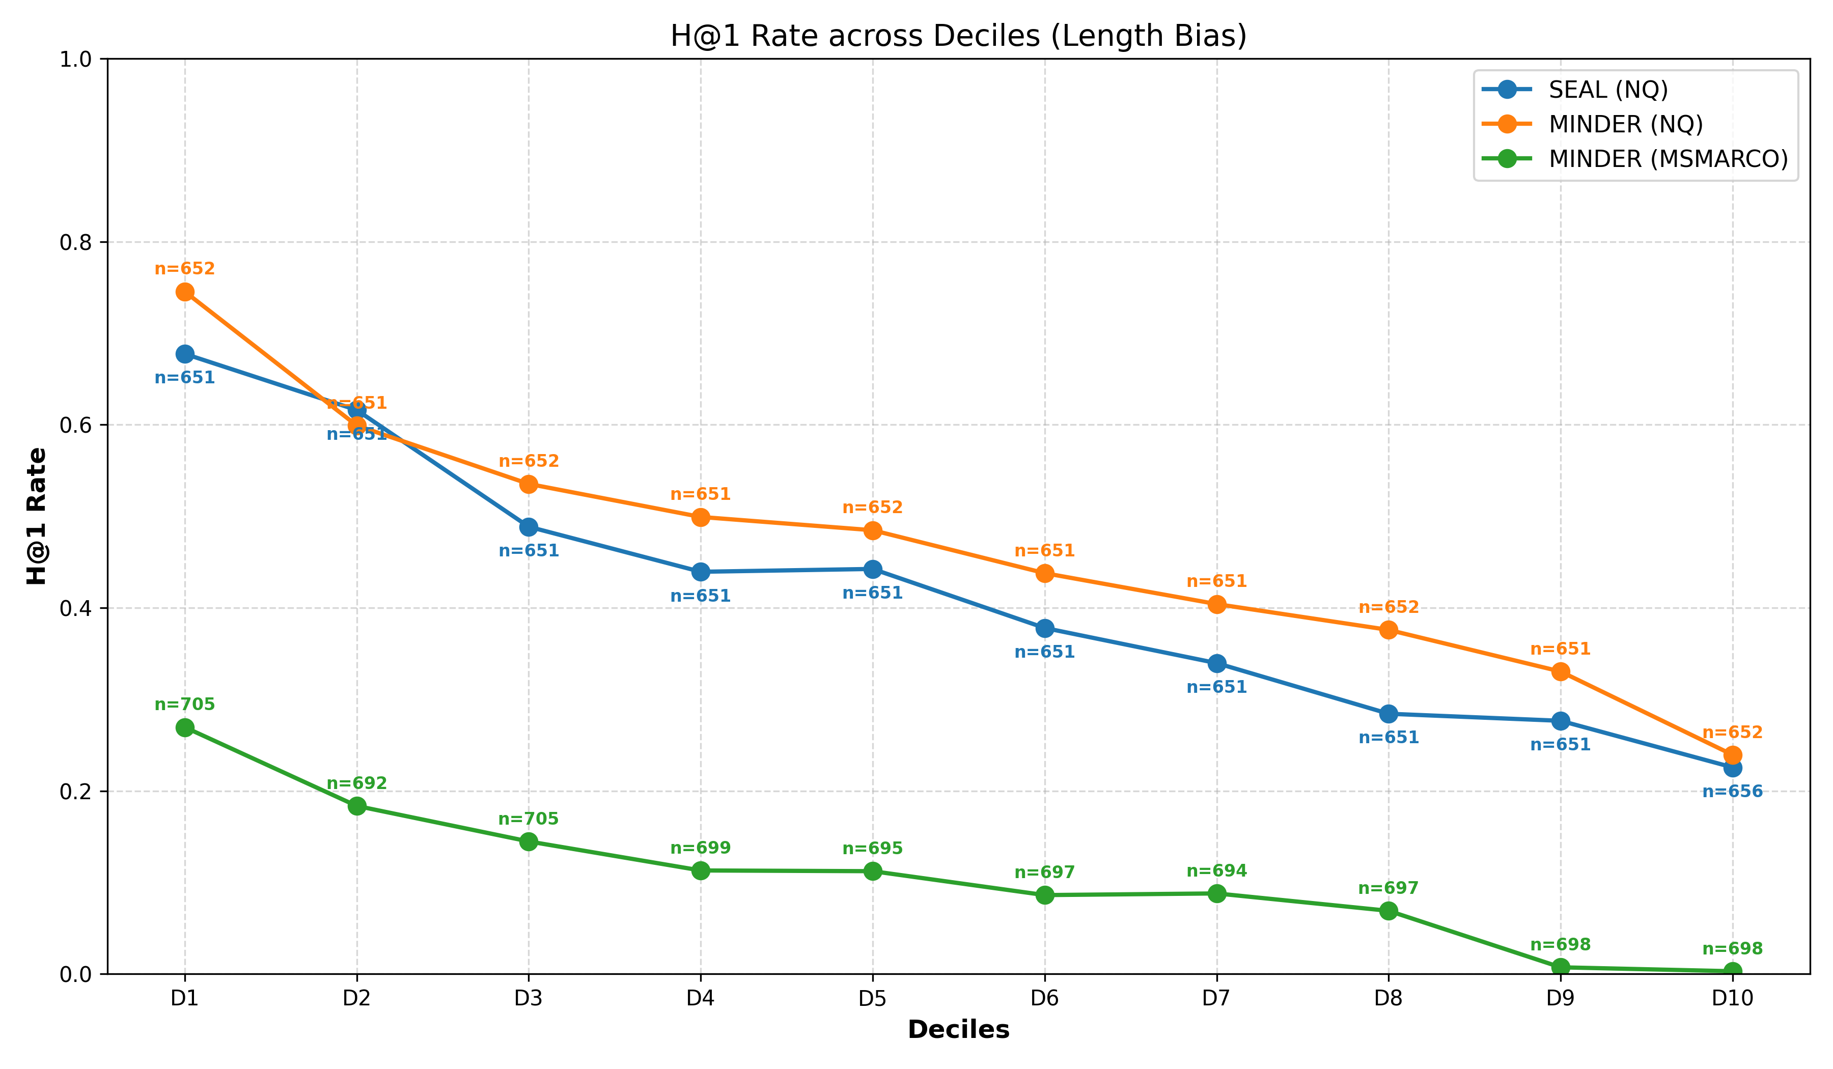
RQ2 · Length Bias
Autoregressive probability penalises long, discriminative n-grams
86.9%
85.3%
1.28
Unigram %
SEAL (NQ)
Unigram %
MINDER (NQ)
Avg. n-gram
length (words) — SEAL
Token probabilities are multiplicative. Each token added to a sequence reduces its total probability score.
The model therefore prefers short, generic n-grams like "War" over precise sequences like "The Napoleonic Wars", as they are statistically safer to generate.
This drowns out the most discriminative identifiers
Taxonomy and Analysis of Failure Modes in N-gram Based Generative Retrieval
18

Slide 19
RQ2 · Metadata Dependency
Both SEAL and MINDER over-rely on passage titles as retrieval shortcuts
SEAL (NQ) — % of total score mass
MINDER (NQ) — % of total score mass
Titles 39.85%
Body n-grams 60.15%
Titles 29.6%
Pseudoq. 19.67%
Body 50.73%
Title scoring advantage
When answer appears as title n-gram vs. body n-gram: SEAL scores it 2,866% higher · MINDER: 2,499% higher → title acts as near-perfect signal when present.
Successful retrievals rely less on titles
For correctly retrieved passages, the advantage drops to 1,876% (SEAL) and 1,439% (MINDER) → success correlates with better use of body text.
MSMARCO: performance collapse
SEAL is 30.7% worse Recall@5 than BM25 on MSMARCO. MINDER only 3.1% better. Neither reached 30% Recall@5₁₅→ metadata absence shows shortcut
Taxonomy and Analysis of Failure Modes in N-gram Based Generative Retrieval
19

Slide 20
RQ2 · Cultural Bias
Western-centric training data skews retrieval for non-Western queries
Query: "where did the southern song have their capital?" → Correct answer: Lin'an (Southern Song Dynasty, China, ~1127 AD)
SEAL
MINDER
• All top-100 results about the southern United States
• Ground truth appears at rank 4
• 'southern' → US South · 'song' → country music / Dixie · 'capital' → Nashville / Richmond
• All top-100 results relevant to Ancient China
• Song Dynasty passage not in top-100 at all
• Pseudoquery: "what was the capital of the song dynasty in north china"
• BART trained overwhelmingly on English/Western data
• Success is attributable to the pseudoquery identifier view
Another example: who was the last king of scotland based on (correct answer: Idi Amin, former Ugandan President. SEAL retrieved Scottish heads of state, MINDER succeeded)
Pseudoquery view can partially compensate by generating contextually richer identifiers by counteracting the base LM's pretraining data.
Taxonomy and Analysis of Failure Modes in N-gram Based Generative Retrieval
20

Slide 21
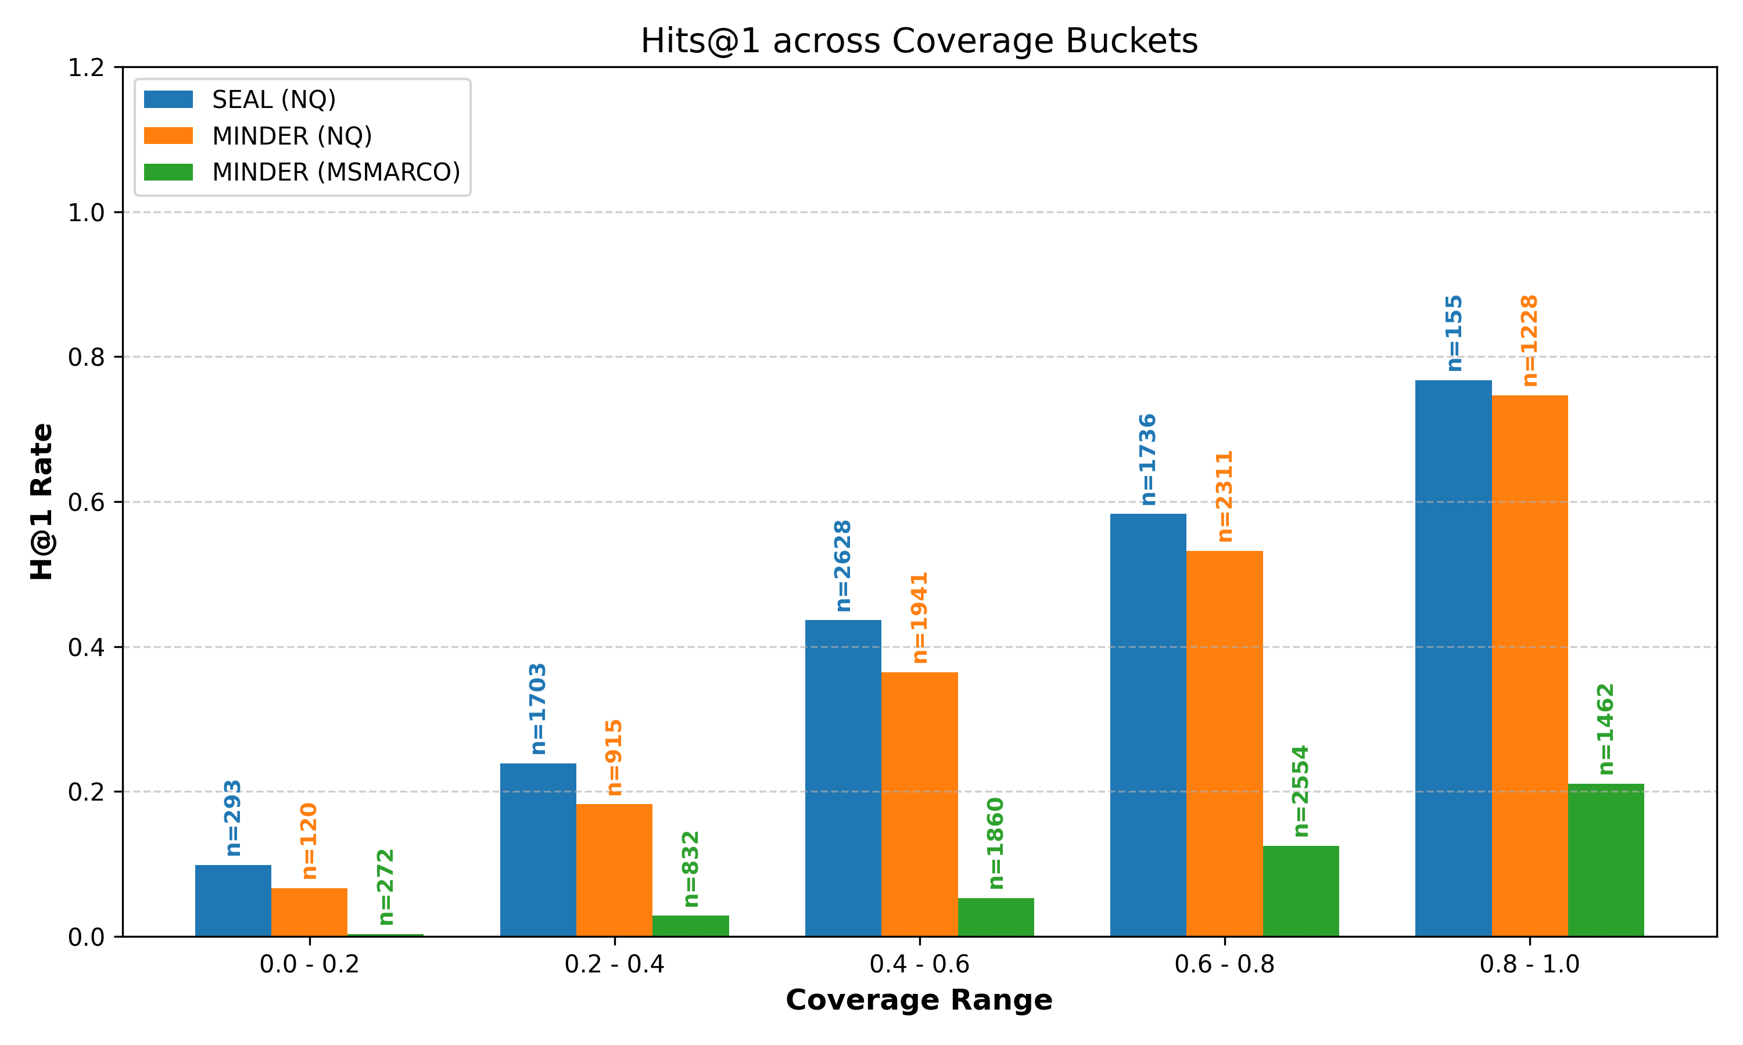
RQ2 · Query–DocID Lexical Mismatch
Coverage C(Q, Gₙ): fraction of query tokens appearing in generated n-grams
For each query, we took the highest-scored passage’s coverage query-docid coverage score, then stratified it into 5 buckets
Spearman ρ: Coverage C(Q,Gₙ) vs. Hitrate (all p < 0.001)
SEAL (NQ)
Hits@1: ρ = 0.323
MINDER (NQ)
Hits@1: ρ = 0.380
MINDER (MSMARCO)
Hits@1: ρ = 0.223
Taxonomy and Analysis of Failure Modes in N-gram Based Generative Retrieval
21

Slide 22
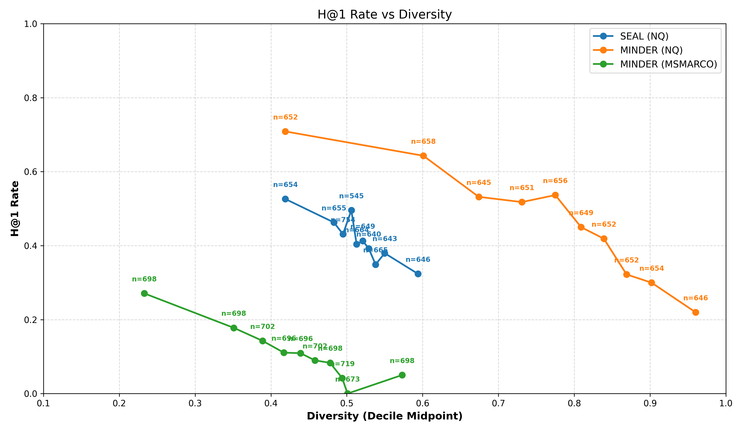
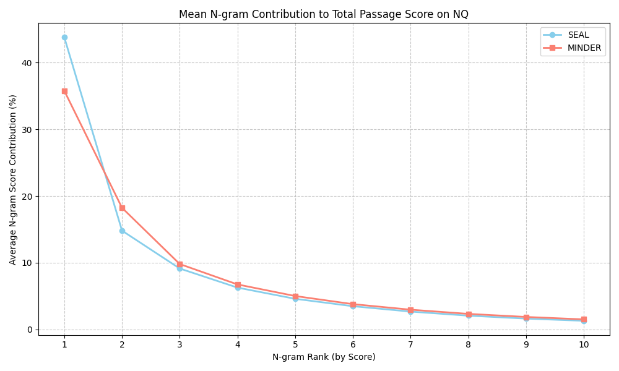
RQ2 · Concentration & Token Diversity
Result: high overlap = signals model confidence = success.
High redundancy does not lead to lower success rates. High diversity = loss of focus = failure.
Lower ratio (distributed evidence) → higher Hits@1.
When one wrong n-gram dominates, remaining low-scoring n-grams cannot always correct the ranking.
MINDER's lower ratio reflects multiview identifiers (titles + pseudoq. + n-grams) distributing score more evenly.
Score Concentration (Single-DocID Overreliance)
Token Diversity
Metric: top n-gram score ÷ sum of all n-gram scores.
Metric: unique tokens ÷ total tokens across all generated n-grams.
Taxonomy and Analysis of Failure Modes in N-gram Based Generative Retrieval
22

Slide 23
Discussion & Conclusions
Root causes, limitations, and future directions

Slide 24
Limitations & Future Work
Limitations
Future Work
Empirical analysis limited to SEAL & MINDER on NQ / MSMARCO open-domain QA.
No experiments on other KILT tasks (dialogue generation, fact verification, slot filling, entity linking).
Several GR models analyzed qualitatively only → these require dedicated studies.
Multilingual GR: non-English corpora exhibit unique tokenization & cultural bias failure profiles.
Continual learning solutions: dynamic corpora remain an unsolved challenge with massive practical upside.
Alternative architectures: RetNet / Mamba could address latency & scalability without Transformer overhead.
Future Work
Future Work
Task-specific failure analysis for code retrieval, entity linking, multi-hop QA.
Comprehensive response generation failure taxonomy.
Multimodal GR failure modes (audiovisual retrieval models exhibit unique failure patterns).
Skip-gram based DocIDs: relaxes contiguity constraint for storage tradeoff
Permutation-invariant decoding: reduces false pruning sensitivity.
Non-differentiability: Straight-Through Estimator enables end-to-end gradient flow.
Taxonomy and Analysis of Failure Modes in N-gram Based Generative Retrieval
26

Slide 25
Conclusions
RQ1
A taxonomy of GR failure modes across Representation, Training, Inference, and Response stages was developed from the literature.
RQ2·1
N-gram GR models know the semantic neighbourhood of the answer → the dominant failure is discriminative ranking.
RQ2·2
RQ2·2
Metadata dependency is a structural training bias: both SEAL and MINDER overweigh titles → a feature on NQ, a failure on MSMARCO.
RQ2·4
MINDER's pseudoquery identifiers help disambiguation and evening out the score distribution, but cannot fully compensate for absent metadata.
Overall
GR promises an elegant architecture, but remains brittle. Solutions to many of its failure modes are not fully achieved. It is promising but not production-ready as of now.
Thank you

Slide 26
References
[1]: Zhang, F., Liu, X., Jia, X., Zhang, Y., Zhang, S., Li, X., … Zhang, Z. (2025, July). Multi-level Relevance Document Identifier Learning for Generative Retrieval. In W. Che, J. Nabende, E. Shutova, & M. T. Pilehvar (Eds), Proceedings of the 63rd Annual Meeting of the Association for Computational Linguistics (Volume 1: Long Papers) (pp. 10066–10080). doi:10.18653/v1/2025.acl-long.497
[2]: Cheng, J., Dou, Z., Zhu, Y., & Li, X. (2025). Descriptive and Discriminative Document Identifiers for Generative Retrieval. Proceedings of the AAAI Conference on Artificial Intelligence, 39(11), 11518–11526. doi:10.1609/aaai.v39i11.33253
[3]: Sun, W., Yan, L., Chen, Z., Wang, S., Zhu, H., Ren, P., … Ren, Z. (2023). Learning to Tokenize for Generative Retrieval. arXiv [Cs.IR]. Retrieved from http://arxiv.org/abs/2304.04171
[4]: Li, X., Jin, J., Zhou, Y., Zhang, Y., Zhang, P., Zhu, Y., & Dou, Z. (2025). From Matching to Generation: A Survey on Generative Information Retrieval. arXiv [Cs.IR]. Retrieved from http://arxiv.org/abs/2404.14851
[5]: Chen, J., Zhang, R., Guo, J., de Rijke, M., Chen, W., Fan, Y., & Cheng, X. (2023). Continual Learning for Generative Retrieval over Dynamic Corpora. Proceedings of the 32nd ACM International Conference on Information and Knowledge Management, 306–315. Presented at the Birmingham, United Kingdom. doi:10.1145/3583780.3614821
[6]: Mehta, S. V., Gupta, J., Tay, Y., Dehghani, M., Tran, V. Q., Rao, J., … Metzler, D. (2023). DSI++: Updating Transformer Memory with New Documents. arXiv [Cs.CL]. Retrieved from http://arxiv.org/abs/2212.09744
[7]: Kuo, T.-L., Chiu, T.-W., Lin, T.-S., Wu, S.-Y., Huang, C.-W., & Chen, Y.-N. (2024). A Survey of Generative Information Retrieval. arXiv [Cs.IR]. Retrieved from http://arxiv.org/abs/2406.01197
[8]: Zhang, P., Liu, Z., Zhou, Y., Dou, Z., Liu, F., & Cao, Z. (2024). Generative Retrieval via Term Set Generation. arXiv [Cs.IR]. Retrieved from http://arxiv.org/abs/2305.13859
[9]: Zeng, H., Luo, C., & Zamani, H. (2024). Planning Ahead in Generative Retrieval: Guiding Autoregressive Generation through Simultaneous Decoding. arXiv [Cs.IR]. Retrieved from http://arxiv.org/abs/2404.14600
[10]: Huang, L., Yu, W., Ma, W., Zhong, W., Feng, Z., Wang, H., … Liu, T. (2025). A Survey on Hallucination in Large Language Models: Principles, Taxonomy, Challenges, and Open Questions. ACM Transactions on Information Systems, 43(2), 1–55. doi:10.1145/3703155
[11]: Ji, Z., Lee, N., Frieske, R., Yu, T., Su, D., Xu, Y., … Fung, P. (2023). Survey of Hallucination in Natural Language Generation. ACM Computing Surveys, 55(12), 1–38. doi:10.1145/3571730
[12]: Yuan, P., Wang, X., Feng, S., Pan, B., Li, Y., Wang, H., … Li, K. (2024). Generative Dense Retrieval: Memory Can Be a Burden. arXiv [Cs.IR]. Retrieved from http://arxiv.org/abs/2401.10487
[13]: Agrawal, G., Kumarage, T., Alghamdi, Z., & Liu, H. (2024). Mindful-RAG: A Study of Points of Failure in Retrieval Augmented Generation. arXiv [Cs.IR]. Retrieved from http://arxiv.org/abs/2407.12216
[14]: Bevilacqua, M., Ottaviano, G., Lewis, P., Yih, S., Riedel, S., & Petroni, F. (2022). Autoregressive Search Engines: Generating Substrings as Document Identifiers. In A. H. Oh, A. Agarwal, D. Belgrave, & K. Cho (Eds), Advances in Neural Information Processing Systems. Retrieved from https://openreview.net/forum?id=Z4kZxAjg8Y
[15]: Li, Y., Yang, N., Wang, L., Wei, F., & Li, W. (2023b). Multiview Identifiers Enhanced Generative Retrieval. arXiv [Cs.CL]. Retrieved from http://arxiv.org/abs/2305.16675
[16]: Barnett, S., Kurniawan, S., Thudumu, S., Brannelly, Z., & Abdelrazek, M. (2024). Seven Failure Points When Engineering a Retrieval Augmented Generation System. arXiv [Cs.SE]. Retrieved from http://arxiv.org/abs/2401.05856
[17]: Cao, N. D., Izacard, G., Riedel, S., & Petroni, F. (2021). Autoregressive Entity Retrieval. arXiv [Cs.CL]. Retrieved from http://arxiv.org/abs/2010.00904
[18]: Yang, T., Song, M., Zhang, Z., Huang, H., Deng, W., Sun, F., & Zhang, Q. (2023). Auto Search Indexer for End-to-End Document Retrieval. arXiv [Cs.IR]. Retrieved from http://arxiv.org/abs/2310.12455
[19]: Liu, Y.-A., Zhang, R., Guo, J., Zhou, C., de Rijke, M., & Cheng, X. (2024). On the Robustness of Generative Information Retrieval Models. arXiv [Cs.IR]. Retrieved from http://arxiv.org/abs/2412.18768
[20]: Naous, T., Ryan, M. J., Ritter, A., & Xu, W. (2024). Having Beer after Prayer? Measuring Cultural Bias in Large Language Models. arXiv [Cs.CL]. Retrieved from http://arxiv.org/abs/2305.14456
[21]: Aowal, M. A., Islam, M. T., Mammen, P. M., & Shetty, S. (2023). Detecting Natural Language Biases with Prompt-based Learning. arXiv [Cs.CL]. Retrieved from http://arxiv.org/abs/2309.05227
[22]: Navigli, R., Conia, S., & Ross, B. (2023). Biases in Large Language Models: Origins, Inventory, and Discussion. J. Data and Information Quality, 15(2). doi:10.1145/3597307
[23]: Gallegos, I. O., Rossi, R. A., Barrow, J., Tanjim, M. M., Kim, S., Dernoncourt, F., … Ahmed, N. K. (2024). Bias and Fairness in Large Language Models: A Survey. Computational Linguistics, 50(3), 1097–1179. doi:10.1162/coli_a_00524
[24]: Zhang, Z., Ma, X., Sun, W., Ren, P., Chen, Z., Wang, S., … Ren, Z. (2025). Replication and Exploration of Generative Retrieval over Dynamic Corpora. arXiv [Cs.IR]. Retrieved from http://arxiv.org/abs/2504.17519
[25]: Li, Y., Zhang, Z., Wang, W., Nie, L., Li, W., & Chua, T.-S. (2024, August). Distillation Enhanced Generative Retrieval. In L.-W. Ku, A. Martins, & V. Srikumar (Eds), Findings of the Association for Computational Linguistics: ACL 2024 (pp. 11119–11129). doi:10.18653/v1/2024.findings-acl.662
[26]: Li, Y., Yang, N., Wang, L., Wei, F., & Li, W. (2023a). Learning to Rank in Generative Retrieval. arXiv [Cs.CL]. Retrieved from http://arxiv.org/abs/2306.15222
[27]: Pradeep, R., Hui, K., Gupta, J., Lelkes, A. D., Zhuang, H., Lin, J., … Tran, V. Q. (2023). How Does Generative Retrieval Scale to Millions of Passages? arXiv [Cs.IR]. Retrieved from http://arxiv.org/abs/2305.11841
[28]: Niu, C., Wu, Y., Zhu, J., Xu, S., Shum, K., Zhong, R., … Zhang, T. (2024, August). RAGTruth: A Hallucination Corpus for Developing Trustworthy Retrieval-Augmented Language Models. In L.-W. Ku, A. Martins, & V. Srikumar (Eds), Proceedings of the 62nd Annual Meeting of the Association for Computational Linguistics (Volume 1: Long Papers) (pp. 10862–10878). doi:10.18653/v1/2024.acl-long.585
[29]: Herold, C., Kozielski, M., Santavas, N., Versley, Y., & Khadivi, S. (2025). Vocabulary Customization for Efficient Domain-Specific LLM Deployment. arXiv [Cs.CL]. Retrieved from http://arxiv.org/abs/2509.26124
Analysis code available on: https://github.com/richietk/thesis

