Slide 1
Transformation of imperative code to functional code
Richard Vašek

Slide 2
Agenda
What
Why
How

Slide 3
What
Java
Program
Haskell

Slide 4
Why
Immutability
Efficiency
Stateless programs
No side effects
Concurrency

Slide 5
How
Java code
Abstract Syntax Tree
Control Flow Graph
Single Static Assignment Form
Abstract Syntax Tree
Haskell code

Slide 6
What to use
Kotlin
Javaparser
Graphviz
Pipes and filters

Slide 7
Kotlin
Java platform
Statically typed
Modern syntax
More functional
Great compatibility with Java

Slide 8
Transformation

Slide 9
Java code
Well known
Allows imperative style

Slide 10
Simple Java example

Slide 11
Abstract Syntax Tree
Parse Java (Javaparser)
Create AST

Slide 12
Control Flow Graph
Run search from AST root
Visualize (Graphviz)
Notes:
Map AST statements and expressions to CFG
Visualize for debugging usage

Slide 13
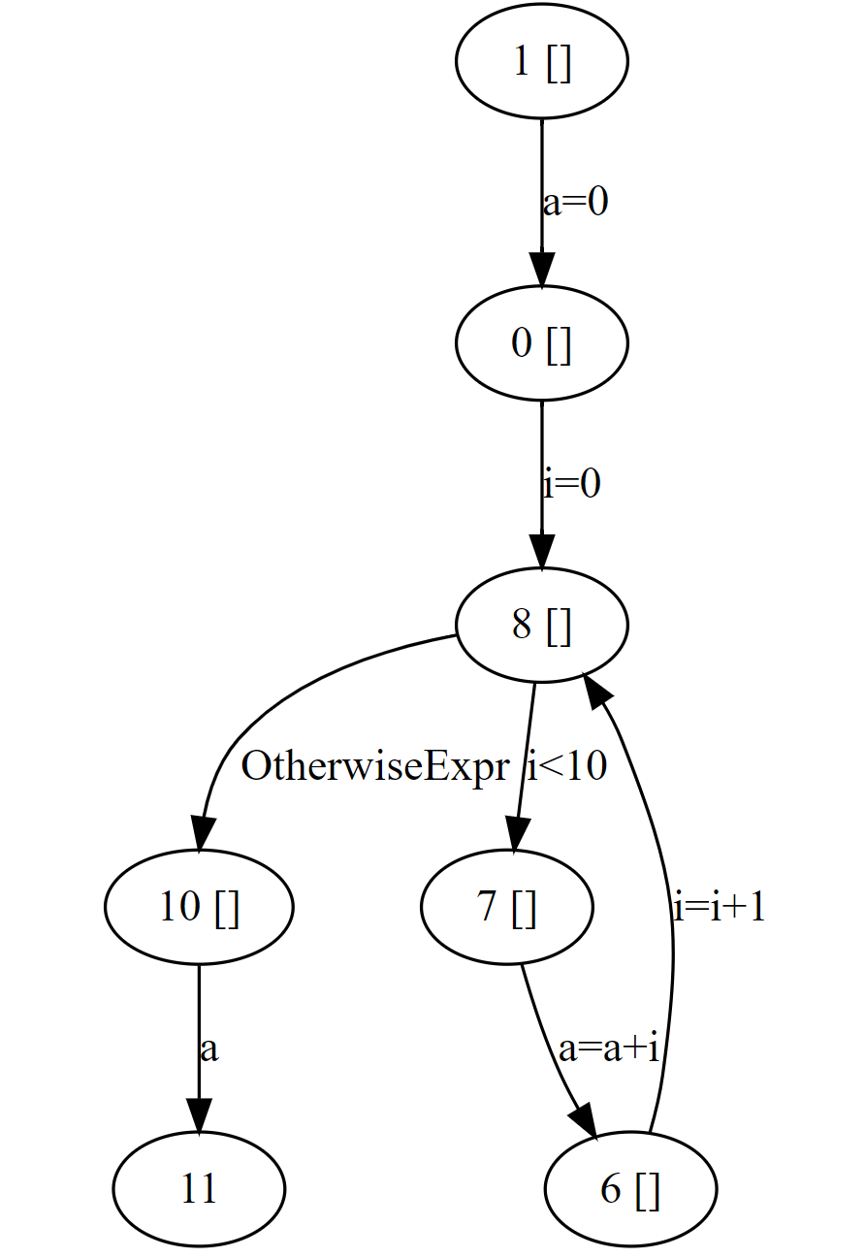

Slide 14
Single Static Assignment Form
Immutable variables

Slide 15
Problems

Slide 16
What now?
New variable for each assignment

Slide 17
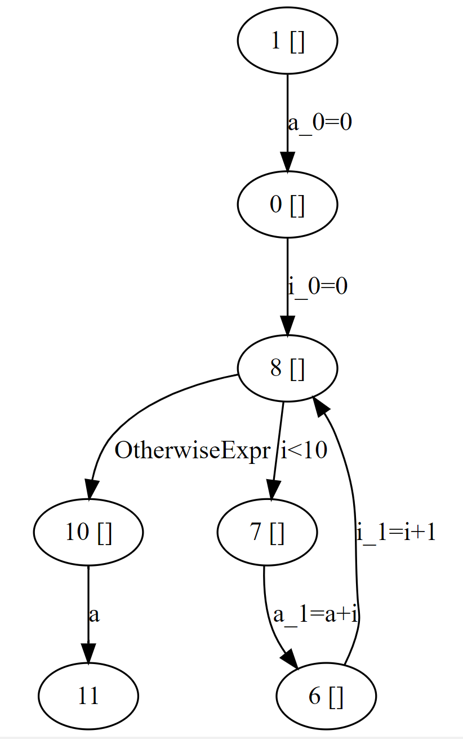

Slide 18
Another Problem

Slide 19
Phi functions for the rescue

Slide 20
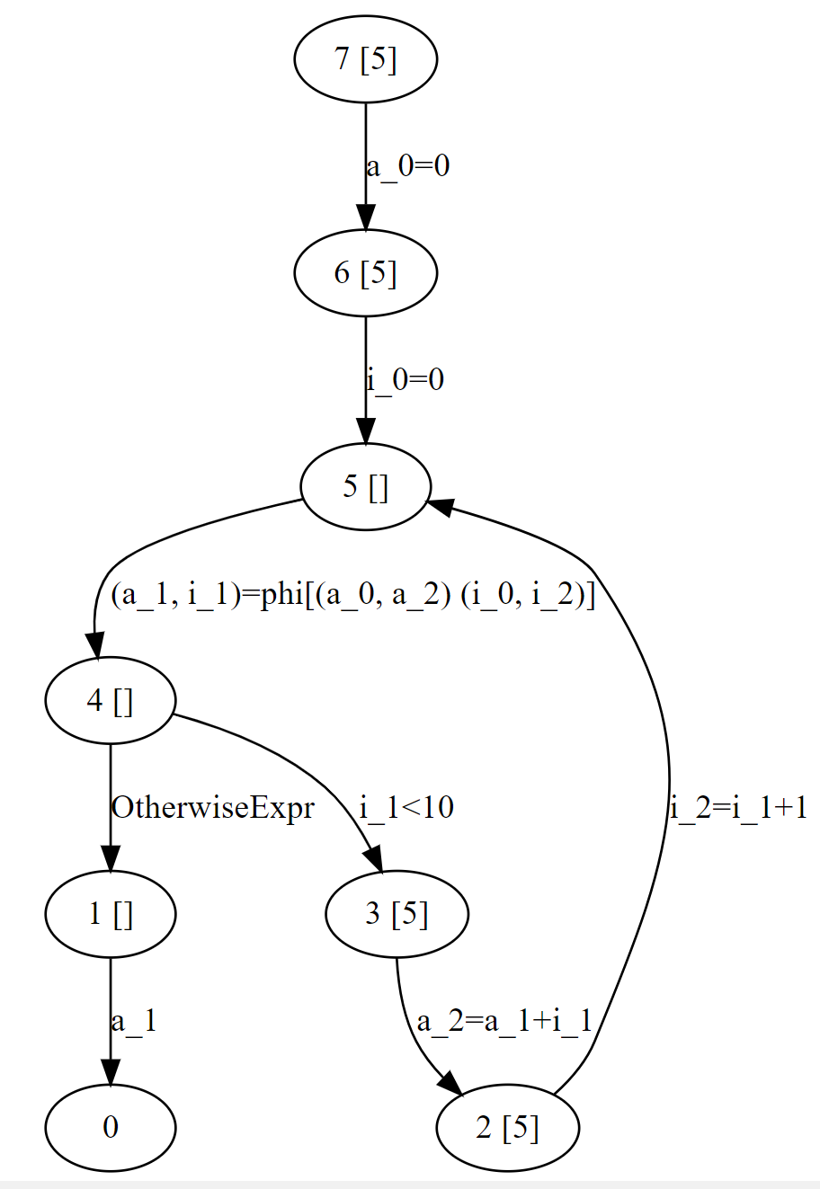

Slide 21
Where do we need them?

Slide 22
And for which variables?

Slide 23
Ron Cytron’s algorithm
Calculate correct placements
Dominator Tree
Dominance Frontiers

Slide 24
Abstract Syntax Tree
Syntax translation
% to `mod`
phi -> Haskell functions
optimal placement
Notes:
Some syntax translation is needed Where is the best placement for them in the AST

Slide 25
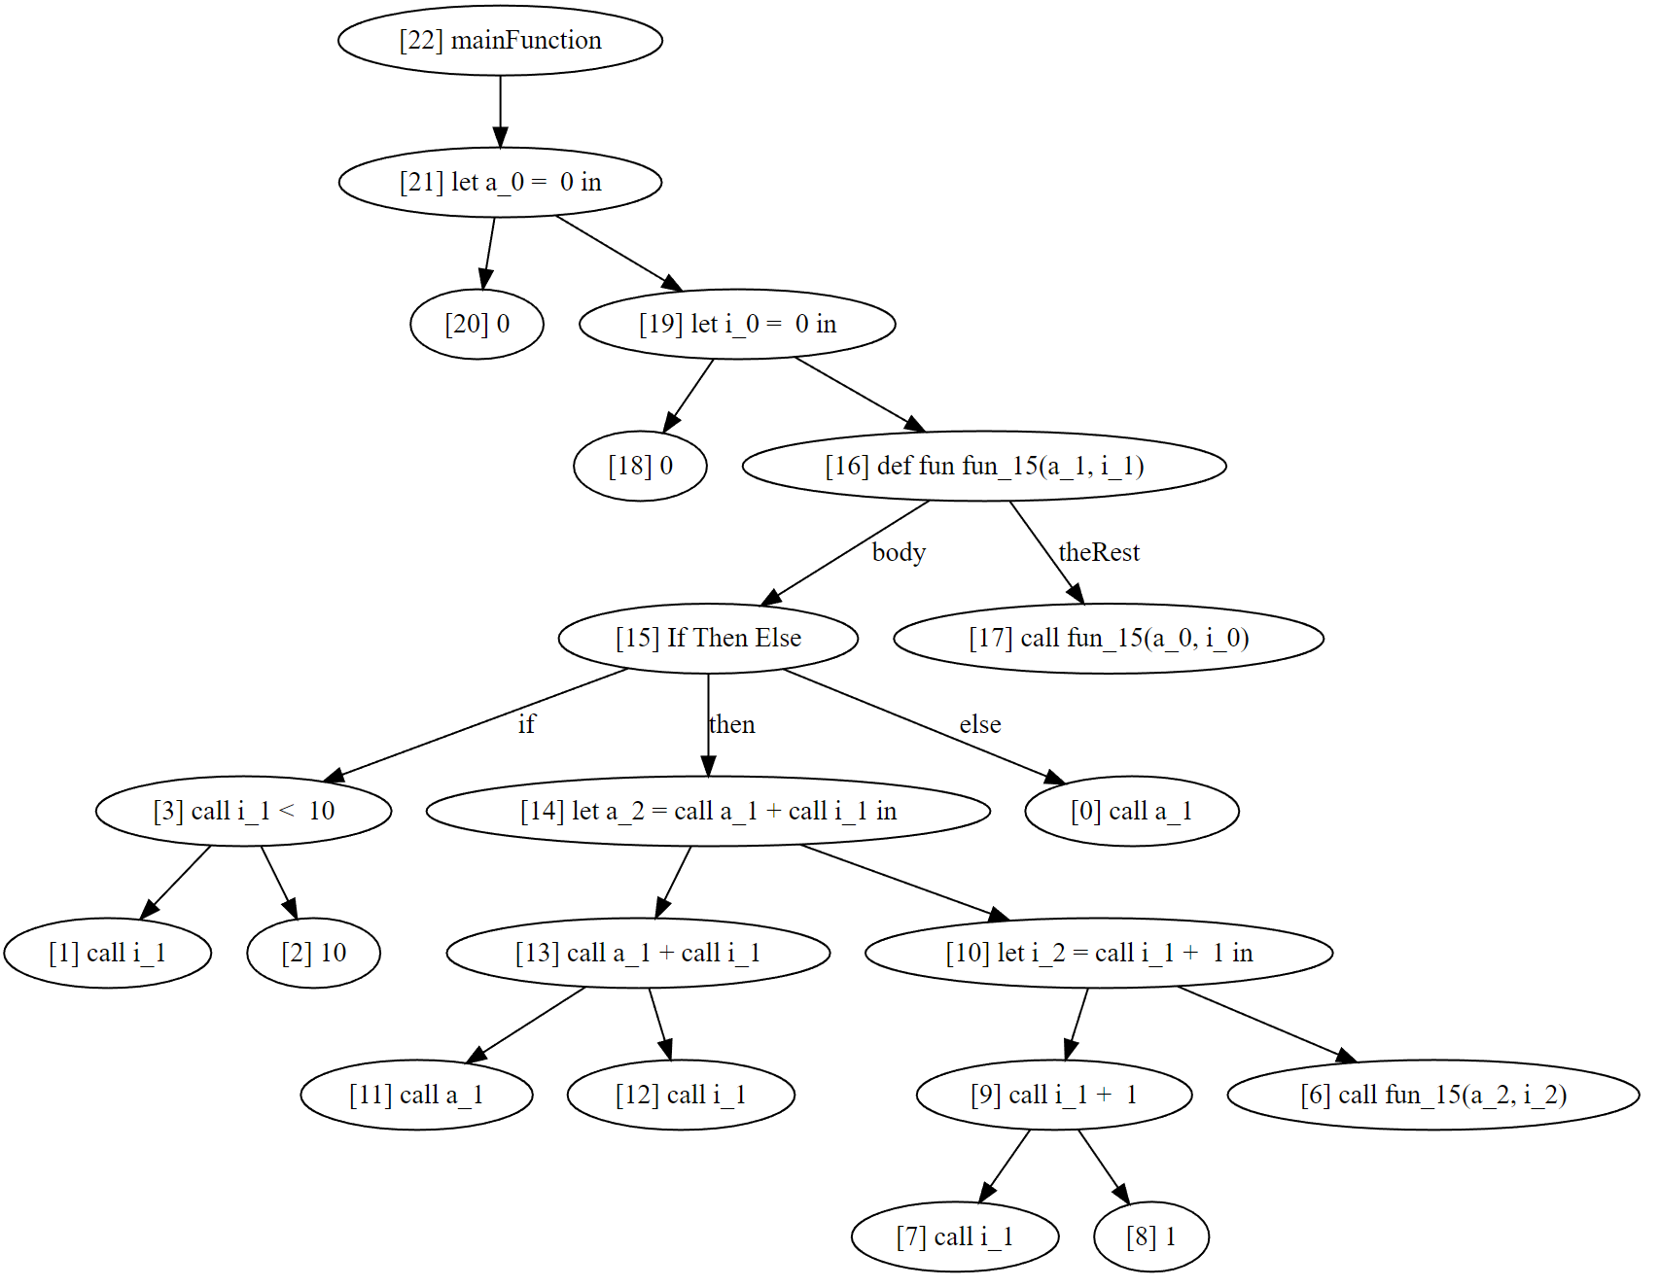

Slide 26
Haskell code
(node) -> code
Repeat
Join
Code format
Inline code
Multiline code
Notes:
Each node in AST generates small piece of code and joins it with children code.

Slide 27
Simple code generation
Indentation sensitive
Inline functions

Slide 28
Simple code generation

Slide 29
Simple code generation
Works
Not human readable
Unnecessary keywords

Slide 30
Let’s Beautify Haskell
Multiline templates
Offset argument
Remove unnecessary keywords
Let in vs where

Slide 31
Simple Java example

Slide 34
Code to run it in Kotlin

Slide 35
Variable scopes

Slide 37
Some processing is needed
i++ -> i = i + 1

Slide 38
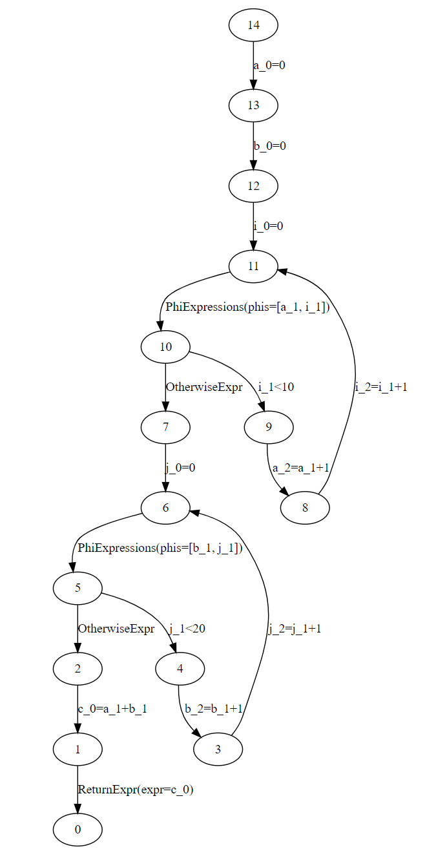

Slide 39
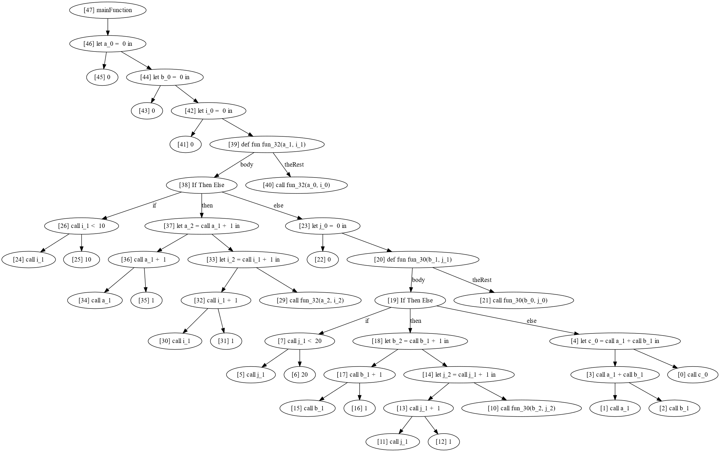

Slide 41
Thank You
https://github.com/richiewenn/imp2fun

