Slide 1

CIFAR-10 Image Classification
CNN & Transfer Learning
Comparing a custom CNN against MobileNetV2 and ResNet50
on the CIFAR-10 benchmark dataset
Deep Learning • Python • TensorFlow / Keras

Slide 2






Overview
Dataset & EDA
CIFAR-10: 60K images across 10 classes
Preprocessing
Normalization and data preparation
Model Architectures
Custom CNN, MobileNetV2, ResNet50
Training & Evaluation
Accuracy, loss curves and confusion matrices
Model Comparison
Side-by-side metrics and analysis
Conclusions & Future Work
Key takeaways and next steps

Slide 3
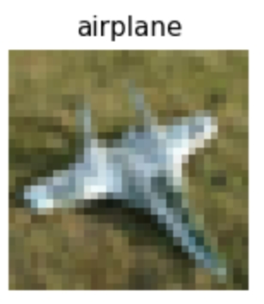
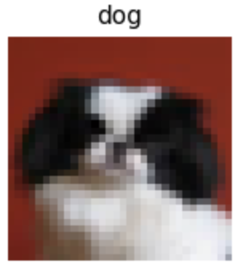
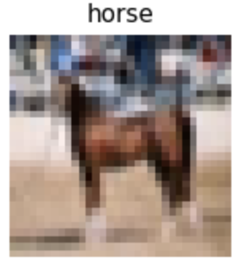
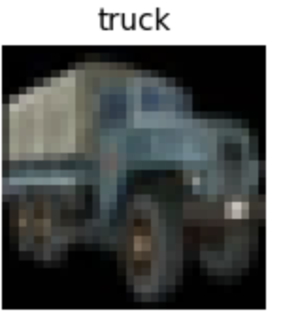
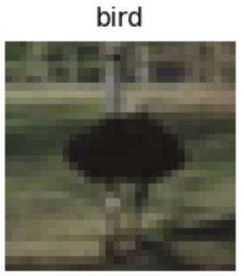
The CIFAR-10 Dataset
60,000 color images (32×32 px) across 10 everyday object classes
50,000
10,000
10
32×32
Training Images
Test Images
Classes
Resolution (px)
Classes: airplane • automobile • bird • cat • deer • dog • frog • horse • ship • truck

Slide 4
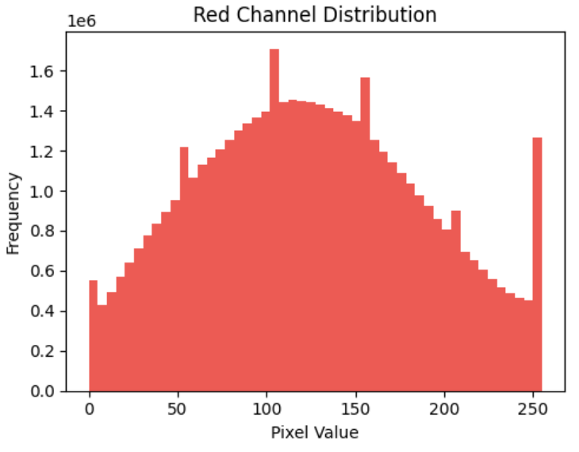
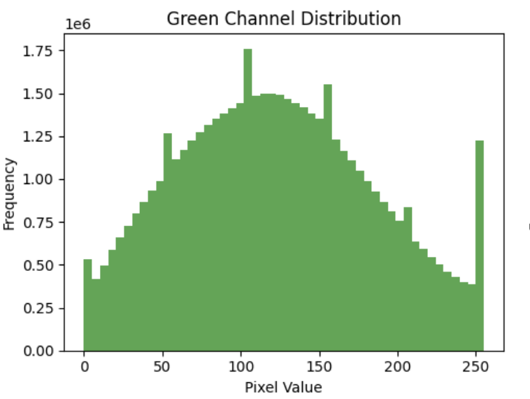
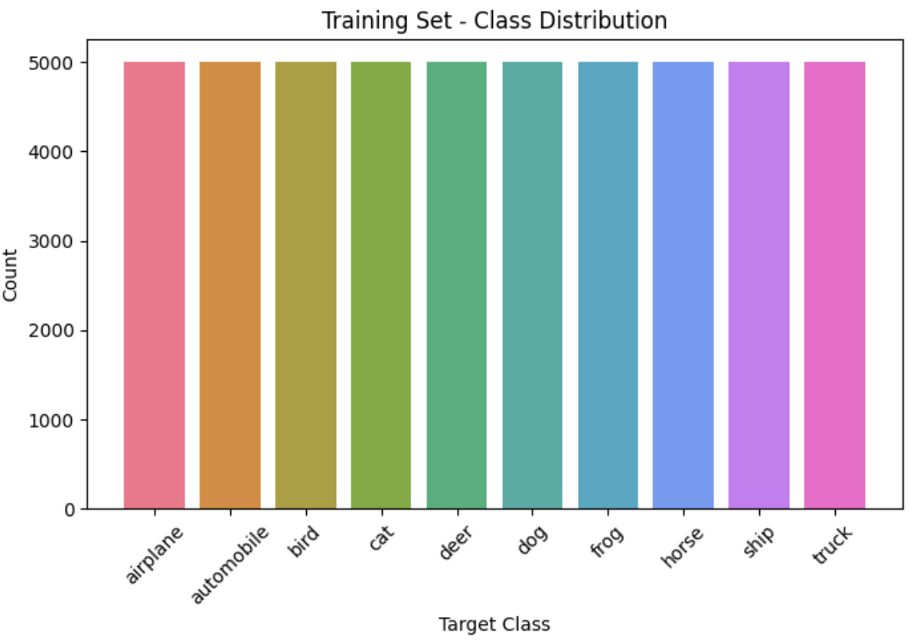
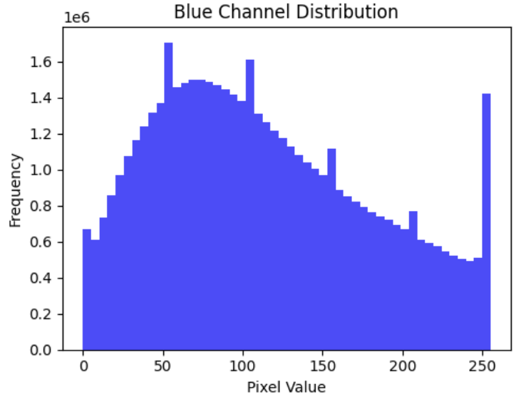
Exploratory Data Analysis
Class Distribution
Pixel Statistics (RGB)
Both training and test sets are perfectly balanced — 5,000 and 1,000 images per class respectively. No resampling needed.
Per-channel means are close (~120–130), indicating natural-color images with moderate brightness and balanced channels.

Slide 5
Preprocessing
Pixel Normalization
Scaled pixel values from [0, 255] to [0, 1] by dividing by 255. This improves gradient flow and training stability across all three models.
Input Handling
Custom CNN accepts the native 32×32 inputs. MobileNetV2 and ResNet50 include a built-in Resizing layer that upscales to 96×96 before the pretrained backbone.
Training Strategy
All models share EarlyStopping (patience: 5) to prevent overfitting and ReduceLROnPlateau (patience: 3) to adaptively lower learning rates during training plateaus.

Slide 6
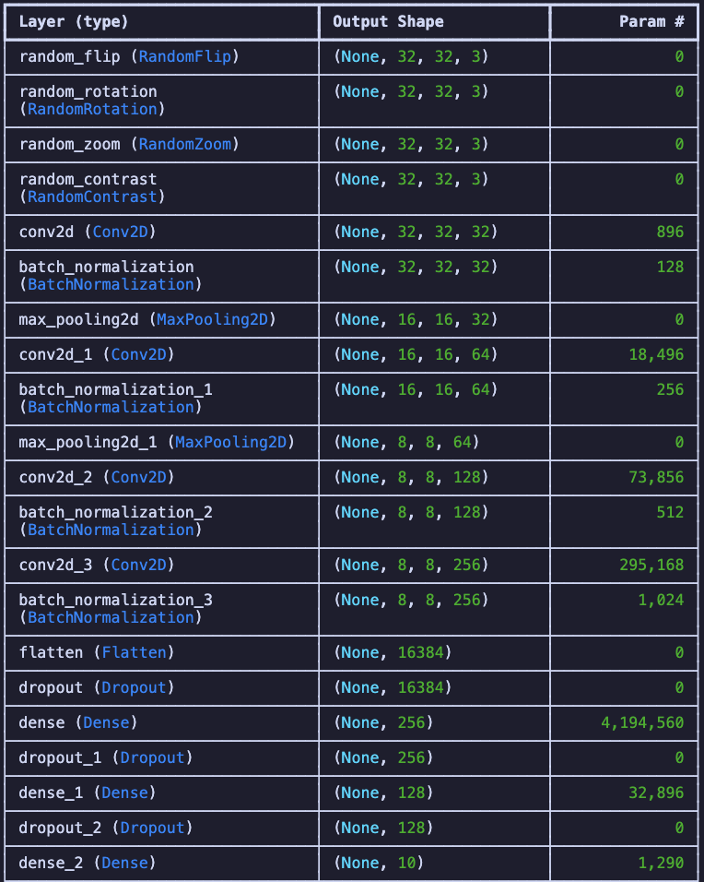
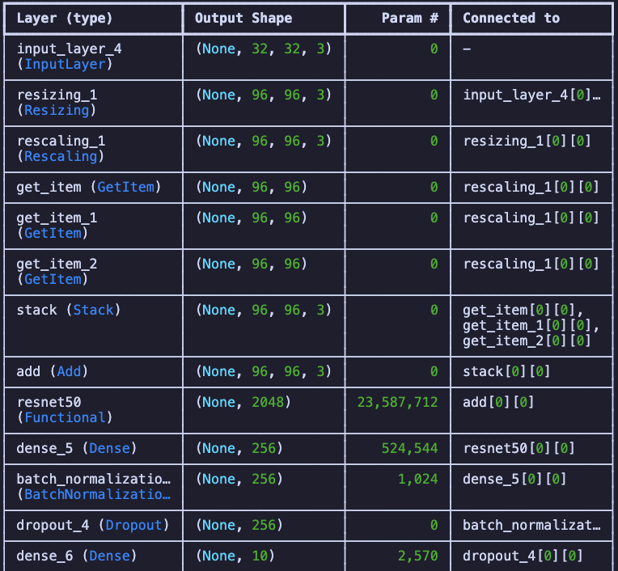
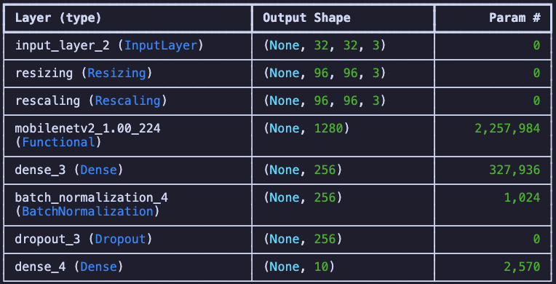
Model Architectures
Three approaches compared: a custom CNN built from scratch, and two transfer learning models with frozen pretrained weights.
Custom CNN
MobileNetV2
ResNet50
~4.6M params
4 Aug blocks + 4 Conv blocks + Dense head
~2.3M params
Transfer learning (frozen)
32→96×96 upscaled
~23.6M params
Transfer learning (frozen)
32→96×96 upscaled

Slide 7
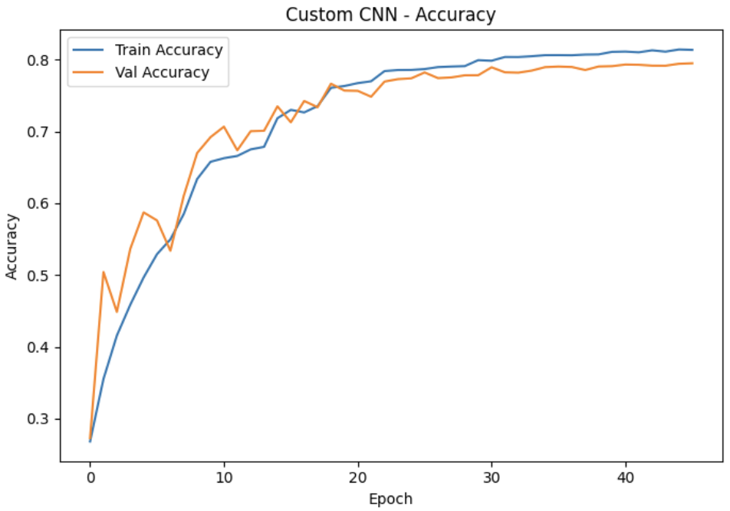
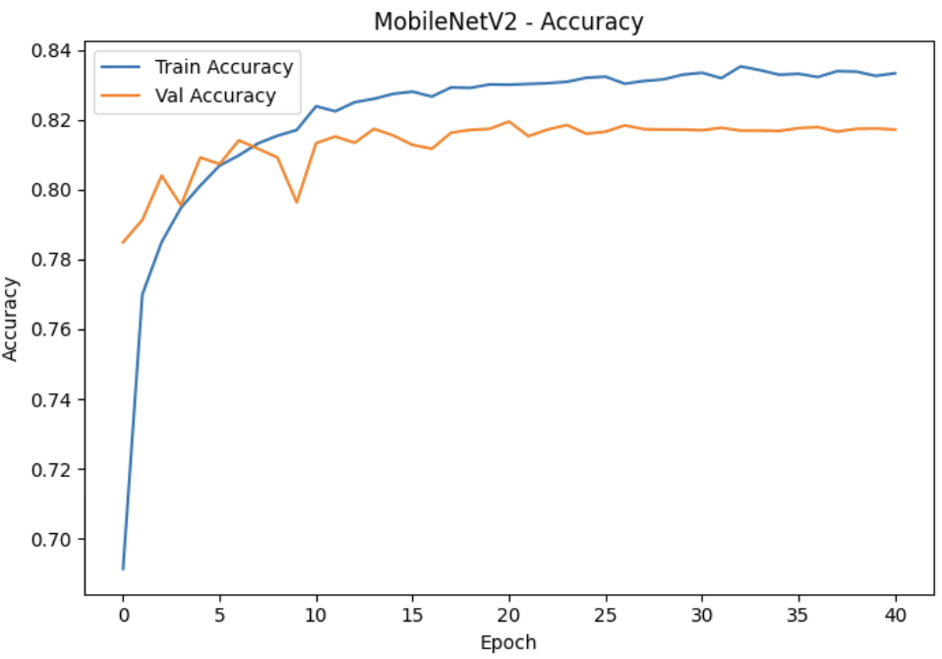
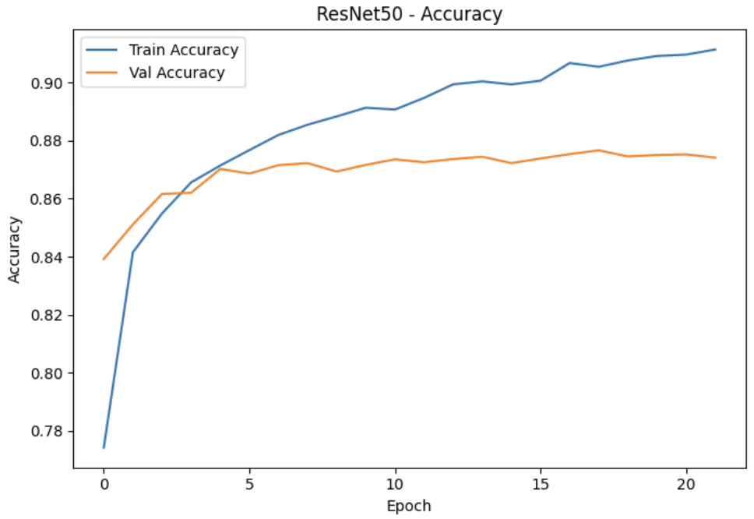
Training Progression: Accuracy
Validation accuracy over training epochs — all models use EarlyStopping and ReduceLROnPlateau callbacks.
Custom CNN
MobileNetV2
ResNet50
All three models converge within ~20–40 epochs. ResNet50 shows the smoothest learning curve, while the custom CNN exhibits more variance. However, we can see that the Transfer Learning models tend to overfit, with minimal accuracy improvement on the validation set.

Slide 8
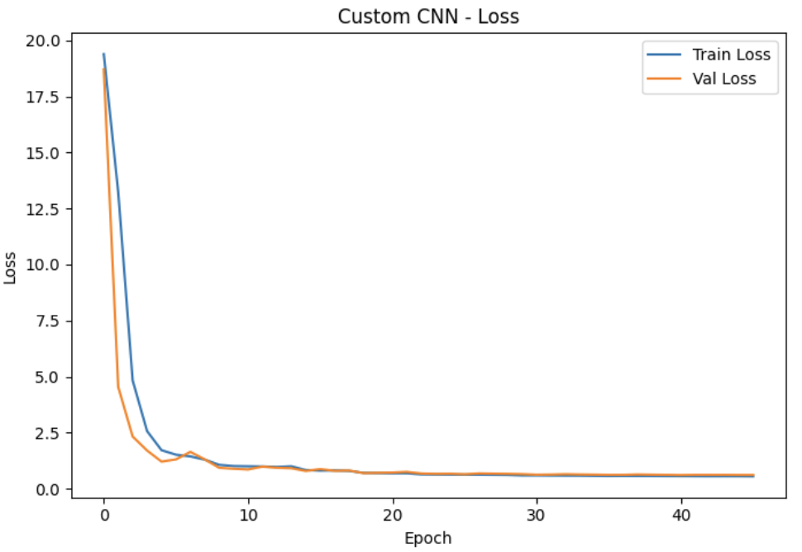
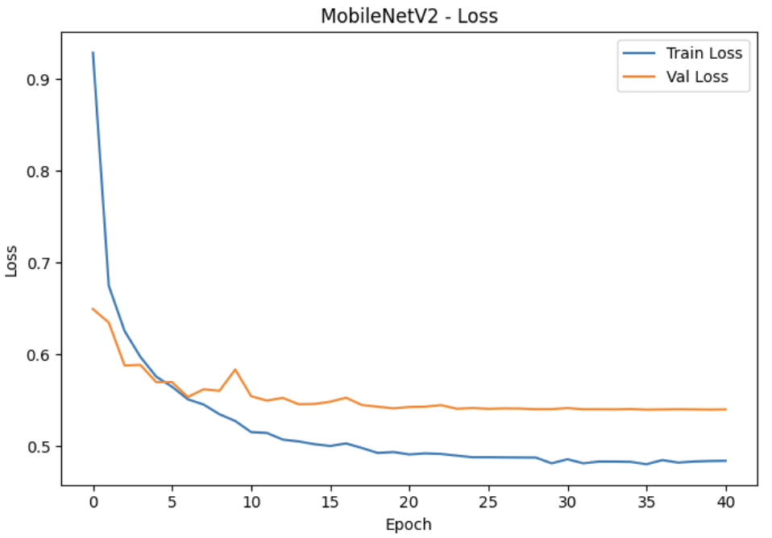
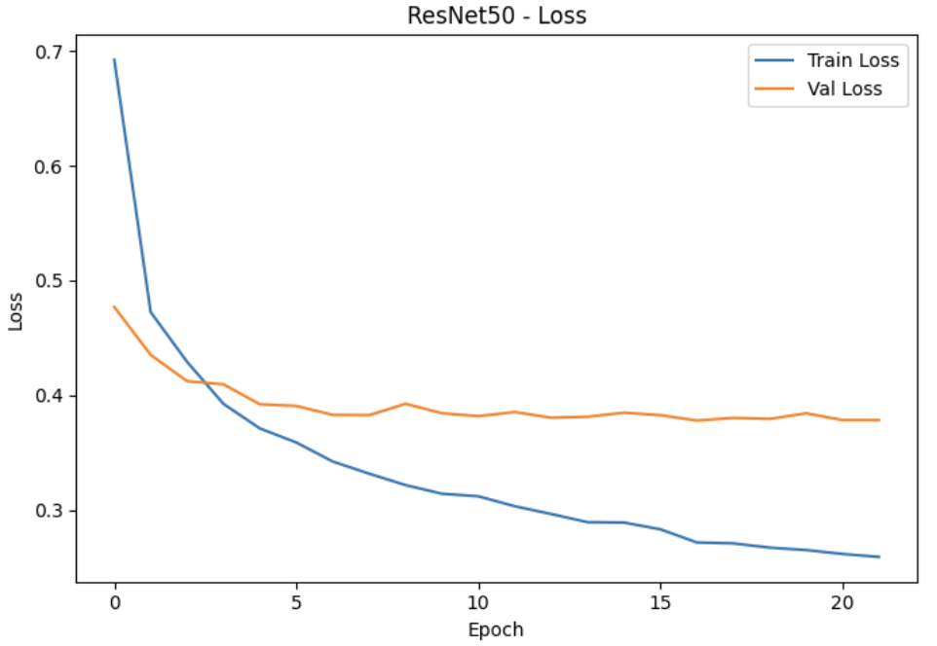
Training Progression: Loss
Training and validation loss curves — divergence between the two indicates overfitting tendency. TL models would probably need more regularization.
Custom CNN
MobileNetV2
ResNet50
ReduceLROnPlateau effectively smooths the loss descent. EarlyStopping prevents unnecessary epochs beyond convergence.

Slide 9
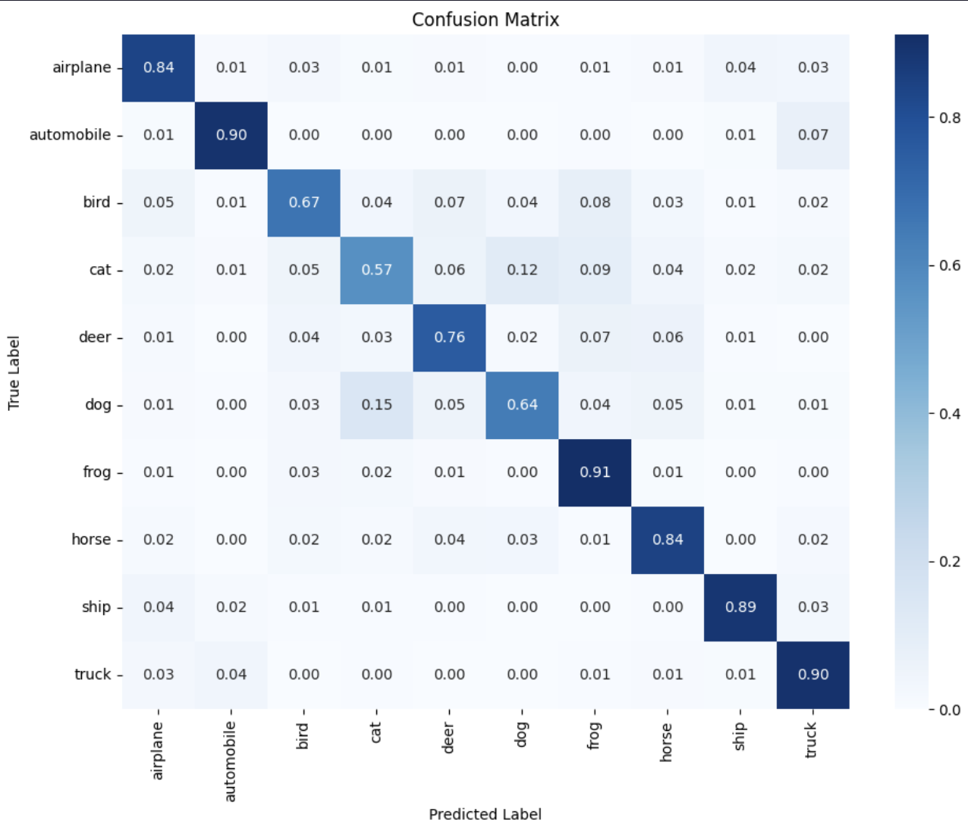
Confusion Matrices
Test set predictions — diagonal dominance shows correct classifications. Off-diagonal entries reveal class confusion patterns.
Custom CNN
Common misclassifications across all models: cat ↔ dog, automobile ↔ truck — visually similar classes at 32×32 resolution.

Slide 10
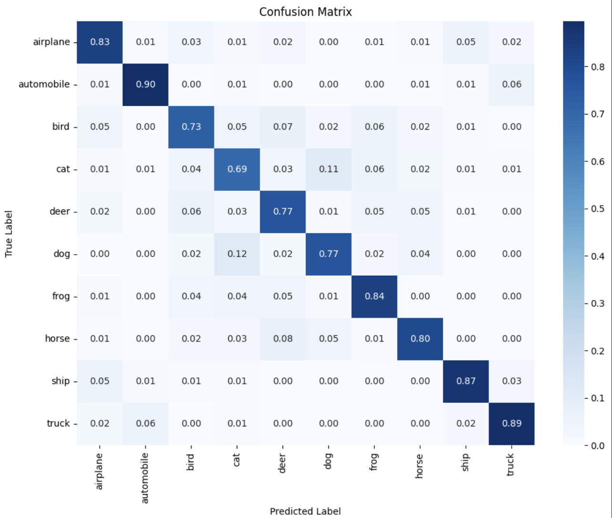
Confusion Matrices
Test set predictions — diagonal dominance shows correct classifications. Off-diagonal entries reveal class confusion patterns.
MobileNetV2
Common misclassifications across all models: cat ↔ dog, automobile ↔ truck — visually similar classes at 32×32 resolution.

Slide 11

Confusion Matrices
Test set predictions — diagonal dominance shows correct classifications. Off-diagonal entries reveal class confusion patterns.
ResNet50
Common misclassifications across all models: cat ↔ dog, automobile ↔ truck — visually similar classes at 32×32 resolution.

Slide 12
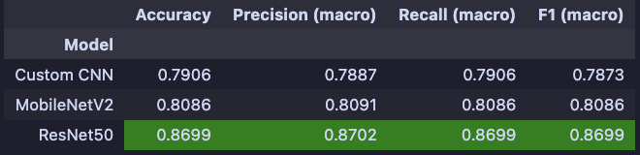
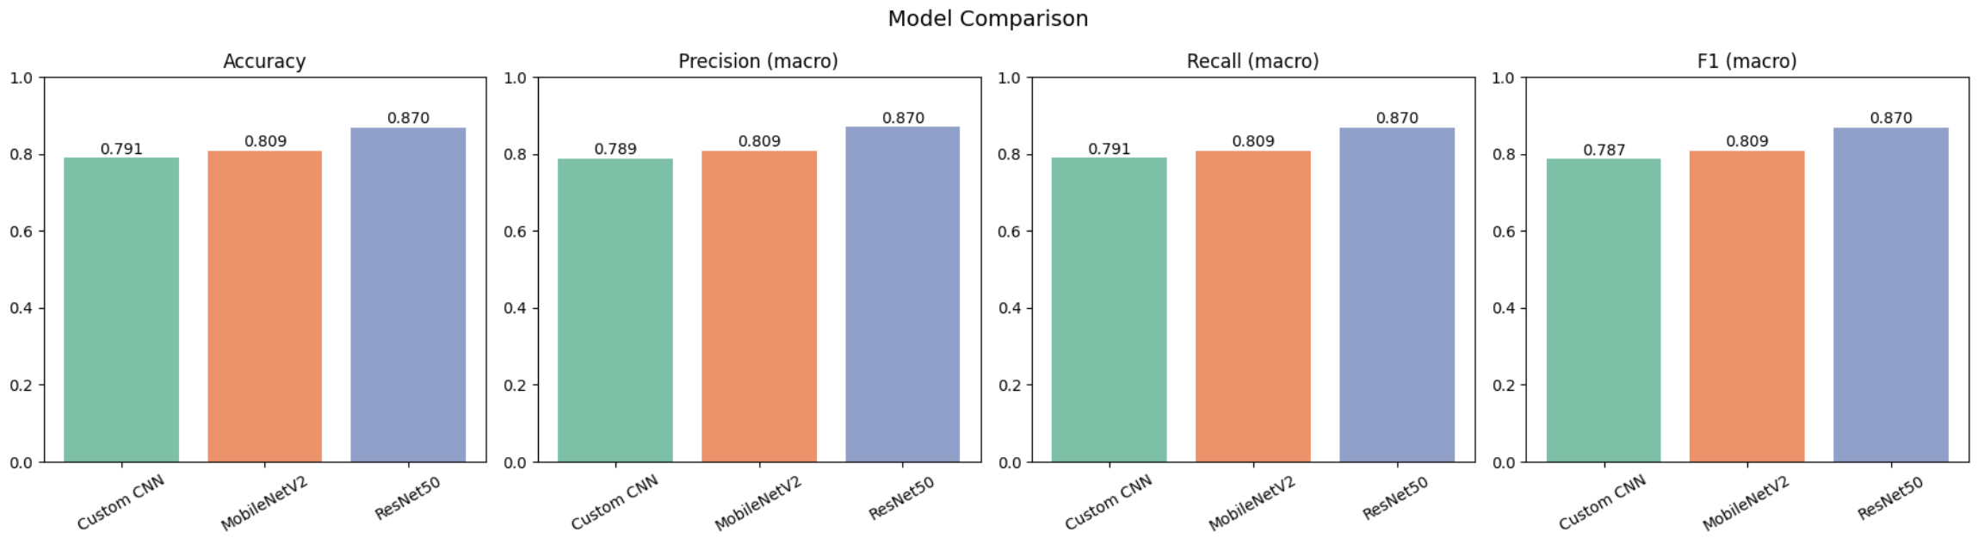
Model Comparison: Metrics
Side-by-side performance on the held-out test set — accuracy, precision, recall, and F1-score (macro-averaged).

Slide 13
Comparison Analysis
Custom CNN
Fastest to train. Achieves solid performance but requires significant architectural tuning. Best suited when resources are limited.
MobileNetV2
Best balance of performance and efficiency (~2.3M params). Smooth convergence with minimal tuning. Lightweight pretrained backbone ideal for this task.
ResNet50
Heaviest model (~23.6M params), longest training time (~2x). Delivers the strongest results, but requires upscaling (32→96). Best when compute is not a constraint.

Slide 14
Key Findings
Transfer learning outperforms custom architectures
Even with frozen weights, pretrained models match or exceed a carefully tuned CNN — with far less engineering effort.
MobileNetV2 strikes the best trade-off
Fewest parameters among all three models, smooth convergence, and strong performance. An excellent default choice for CIFAR-scale tasks.
Resolution matters for deeper pretrained models
ResNet50 requires upscaling from 32×32 to 96×96, adding overhead. ImageNet features transfer better at higher resolutions.
Common failure modes are consistent
All models struggle with visually similar classes (cat ↔ dog, automobile ↔ truck), suggesting resolution — not architecture — is the bottleneck.

Slide 15

Future Work
Fine-tune pretrained layers
Higher-resolution datasets
Unfreeze the top layers of MobileNetV2 and ResNet50 and retrain with a low learning rate. This allows the pretrained features to adapt to CIFAR-10's characteristics and could push ResNet50 past the 90% test accuracy threshold.
Evaluate how these architectures perform on larger images (e.g., CIFAR-100, ImageNet subset) where pretrained features transfer more naturally without the need for upscaling from 32×32.

Slide 16

Thank You
Questions & Discussion
CIFAR-10 Image Classification • CNN & Transfer Learning

