Slide 1
0.9349
FAKE NEWS
Best Macro F1
TF-IDF + Logistic Regression
DETECTOR
NLP Classification Pipeline
5 feature methods · 3 classifiers · 15 combinations
Ironhack · NLP Challenge

Slide 2
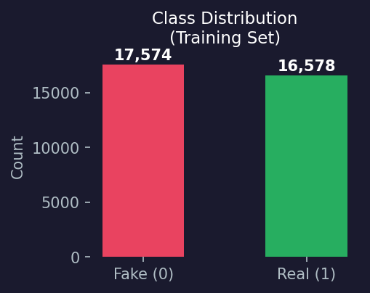
DATASET & PROBLEM
34,152
9,984
Goal
Training samples
Test samples
Classify news headlines as real or fake using NLP — no article body, headline text only.
~51%
~49%
Label encoding
Fake headlines
Real headlines
0 Fake
1 Real
Train / Validation Split
80/20 stratified split → 27,321 train · 6,831 validation
Class balance preserved: 51.45% fake / 48.55% real

Slide 3
NLP PIPELINE
Raw
Headline
→
Clean &
Normalize
→
Tokenize &
Lemmatize
→
Feature
Extraction
→
Train
Classifier
→
Predict
Preprocessing Steps
Before → After (examples)
Fix mojibake characters (‚î → -, √© → e, ...)
"rubio‚s campaign just committed suicide in this state"
Normalize country codes (u.s. → usa, u.k. → uk)
→ "rubio campaign committed suicide state"
Expand contractions (don't → do not)
"senator warren calls on fed to remove wells fargo board"
Strip non-alphanumeric ([^a-z0-9] removed)
→ "senator warren call fed remove well fargo board"
Remove English stopwords (NLTK corpus)
"zimbabwe's mugabe coup chief meet with smiles"
Lemmatize tokens (WordNetLemmatizer)
→ "zimbabwe mugabe coup chief meet smile"

Slide 4
FEATURE EXTRACTION METHODS
BoW
TF-IDF
Word2Vec
fastText
BERT
Bag of Words
TF-IDF
Word2Vec
fastText
BERT
14,931
14,931
100-dim
300-dim
768-dim
dimensions
dimensions
dimensions
dimensions
dimensions
Count of token occurrences.
Sparse matrix, no word order.
Weights rare-but-discriminative
terms higher than common ones.
Trained on training corpus.
Mean-pooled word vectors.
Pretrained cc.en.300.bin.
Subword-aware; handles typos.
bert-base-uncased CLS token.
Frozen; no fine-tuning.
← Classical NLP
Neural / Contextual →

Slide 5
CLASSIFIERS
Logistic
Regression
Random
Forest
Naive
Bayes
Linear baseline
Ensemble of decision trees
Probabilistic baseline
Parameters
Parameters
Parameters
max_iter=1000
Random state: 96
n_estimators=200
All CPU cores (n_jobs=-1)
MultinomialNB (BoW, TF-IDF)
GaussianNB (dense embeddings)
Insight
Insight
Insight
Best overall — linear decision
boundary works well with sparse
high-dim BoW/TF-IDF features.
Captures non-linear patterns.
Strong with Word2Vec features.
Fast and competitive with
sparse features. Gaussian NB
struggles with dense embeddings.
→ WINNER
→ Strong runner-up
→ Surprisingly competitive
✗ Gradient Boosting was tested and dropped — poor performance + slow training

Slide 6
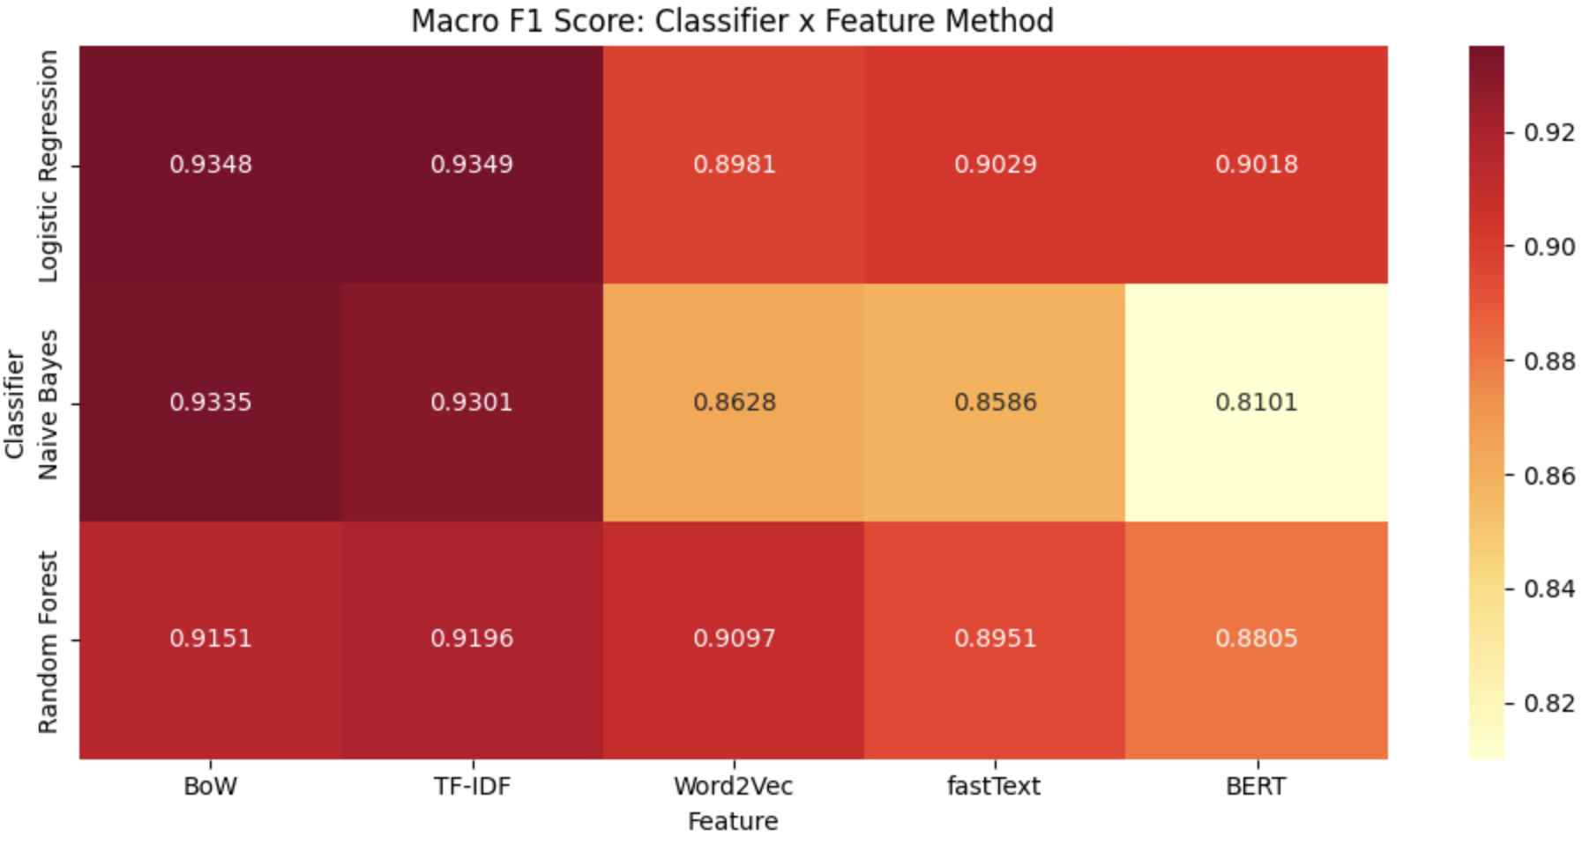
RESULTS — MACRO F1 HEATMAP
Key Observations
BoW & TF-IDF consistently
outperform all other features
LR is the top classifier
across all feature types
Naive Bayes competitive with
sparse features only
BERT + Naive Bayes is the
worst combo (F1: 0.8101)
Top-4 combos all exceed
Macro F1 of 0.93

Slide 7
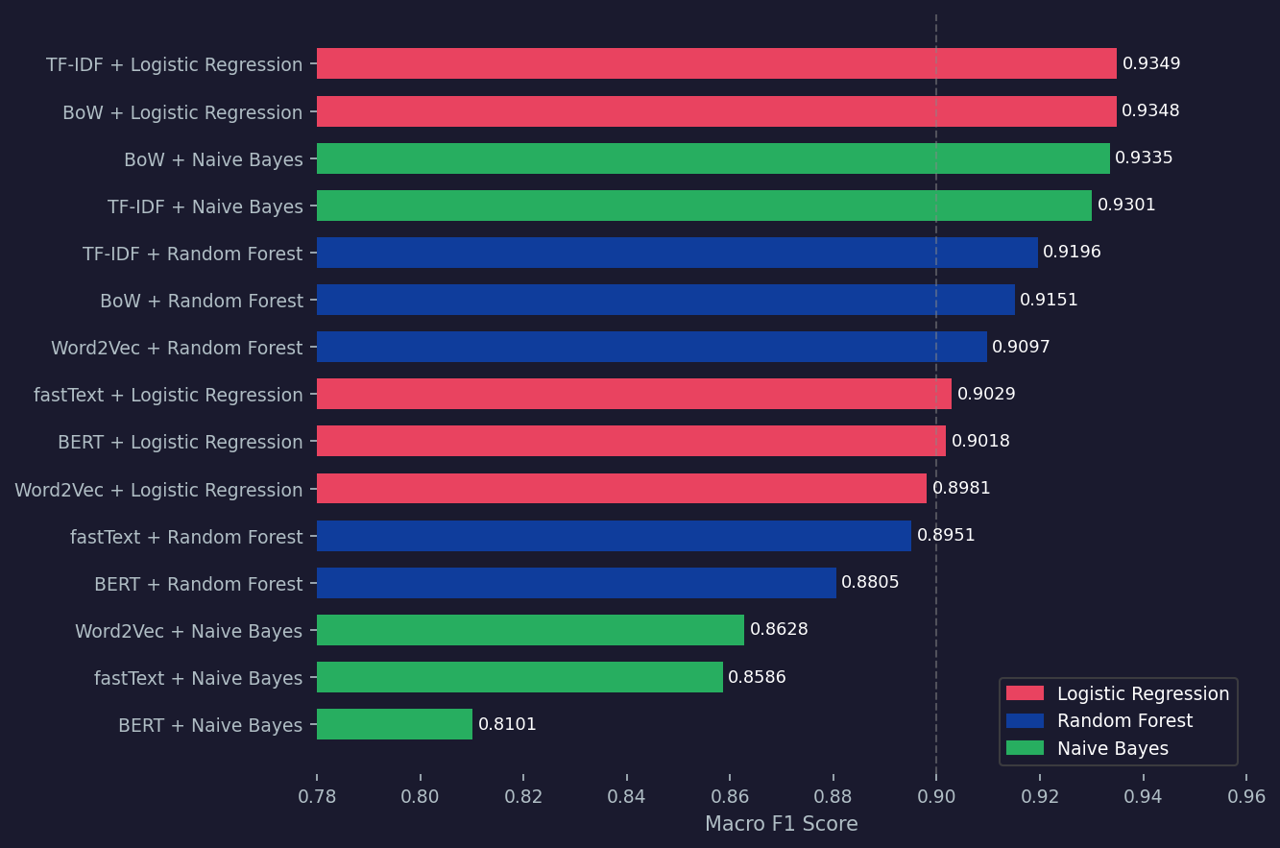
ALL 15 COMBINATIONS — RANKED
#1 BEST
TF-IDF
+
Logistic Regression
0.9349
#15 WORST
BERT
+
Naive Bayes
0.8101

Slide 8
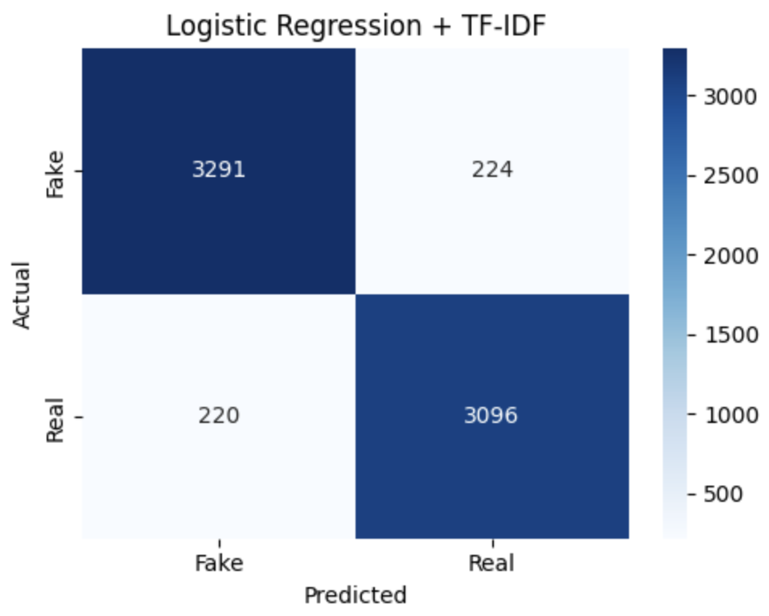
BEST MODEL · TF-IDF + LOGISTIC REGRESSION
Macro F1: 0.9349
Validation set · 6,831 samples
Class
Precision
Recall
F1-Score
Fake
0.94
0.94
0.94
Real
0.93
0.93
0.93
Why TF-IDF + LR Works
TF-IDF down-weights ubiquitous words, surfaces discriminative terms
Fake headlines overuse sensational tokens ('breaking', 'shocking', 'must see')
Real headlines use specific named entities and neutral phrasing
High-dimensional sparse features favor linear models (large margin)
Logistic Regression: fast, interpretable, no overfitting on 27K samples

Slide 9
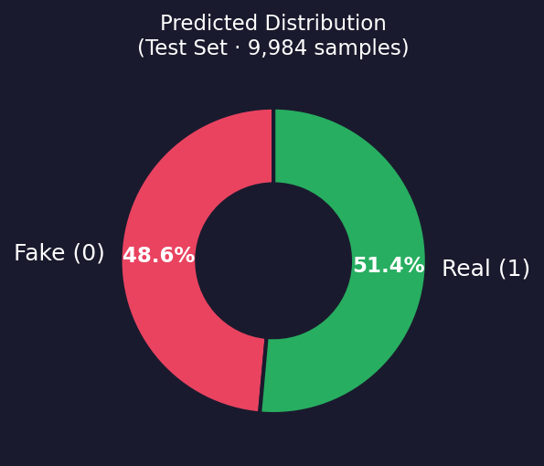
TEST SET PREDICTIONS
9,984
Output File
Total test samples
data/processed/
testing_data_predicted.csv
4,849
Tab-separated
No header row
Original file order
preserved
Predicted Fake (0)
5,135
Predicted Real (1)
48.6%
Fake rate
51.4%
Real rate
Accuracy Estimate
Macro F1 = 0.9349 on validation. Expect ~92-93% on test set given balanced classes.

Slide 10
KEY TAKEAWAYS
Simple > Complex
TF-IDF + Logistic Regression (0.9349 F1) beats BERT (0.9018) without fine-tuning. For headline-level classification, interpretable bag-of-words methods are hard to beat.
Logistic Regression dominates
LR is #1 across BoW, TF-IDF, fastText, BERT, and Word2Vec features. High-dimensional sparse representations favor linear decision boundaries.
Classical NLP is still powerful
Top 6 of 15 combinations use only BoW or TF-IDF. These compute in seconds vs. hours for BERT feature extraction.
BERT needs fine-tuning
Frozen CLS embeddings are not sufficient. Fine-tuning the full BERT model on the task would likely push performance above 0.95+ F1.
Balanced dataset advantage
~50/50 class split means accuracy ≈ macro F1. No class imbalance to address.
Best model: TF-IDF + Logistic Regression · Macro F1: 0.9349 · Test output saved

