Slide 1
Changes to the About Us Page

Slide 2
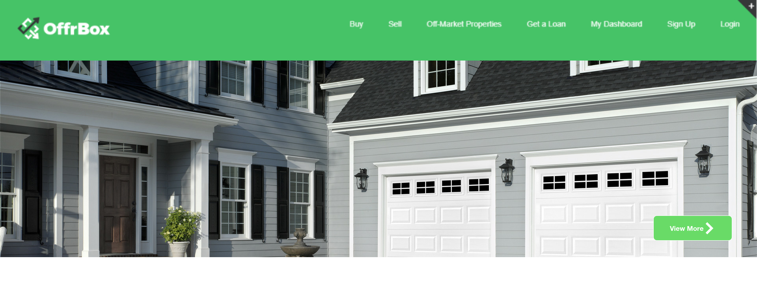

Screen-1:
This portion can be used to display images of the various properties we have as a slideshow. We can may be add some text to be displayed while showing some properties to highlight some features of the company. This can add some dynamic feature to the web page.
This button can be used to send the user directly to the property page to view all properties.

Slide 3
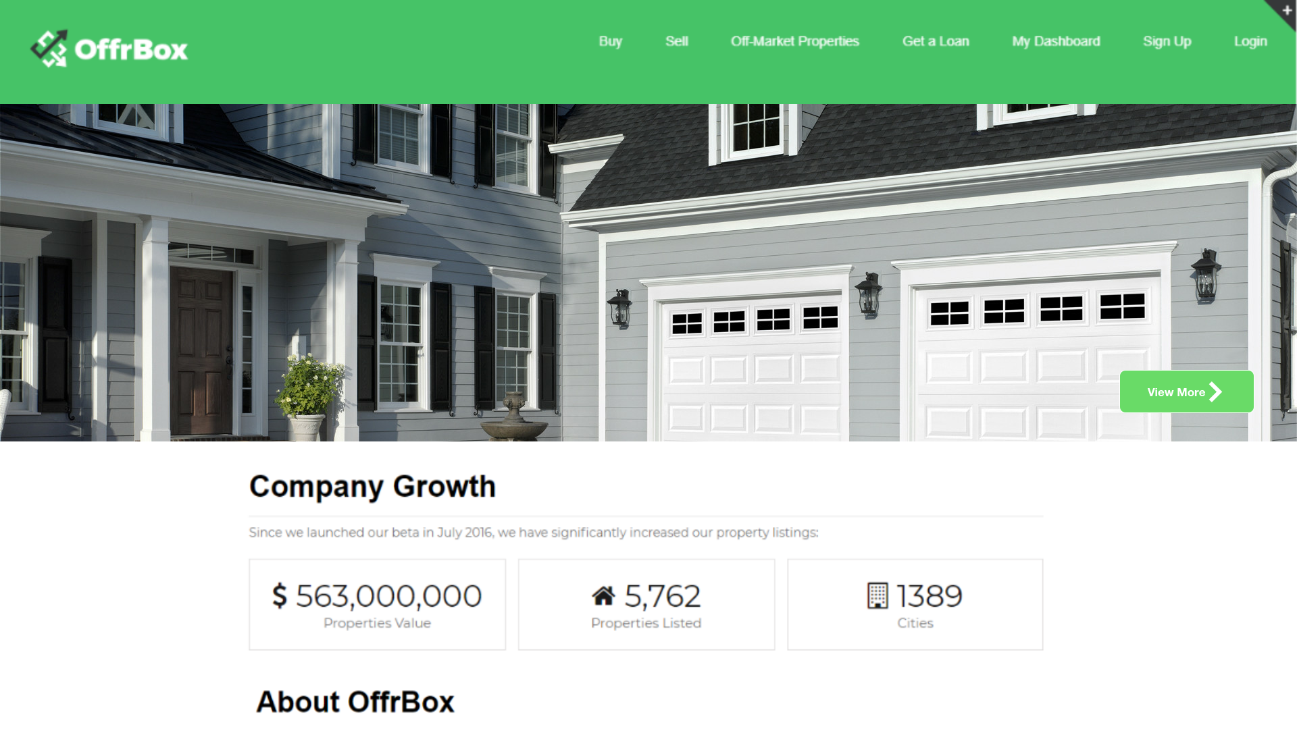
Screen-2:
The side menu has been removed as the options it had like About OffrBox, and Alumni were on the same page, making it redundant. This gives us more space to add elements like content and pictures to the page.
The company growth part has been moved up, to attract clients to see the numbers and then read about the company.

Slide 4
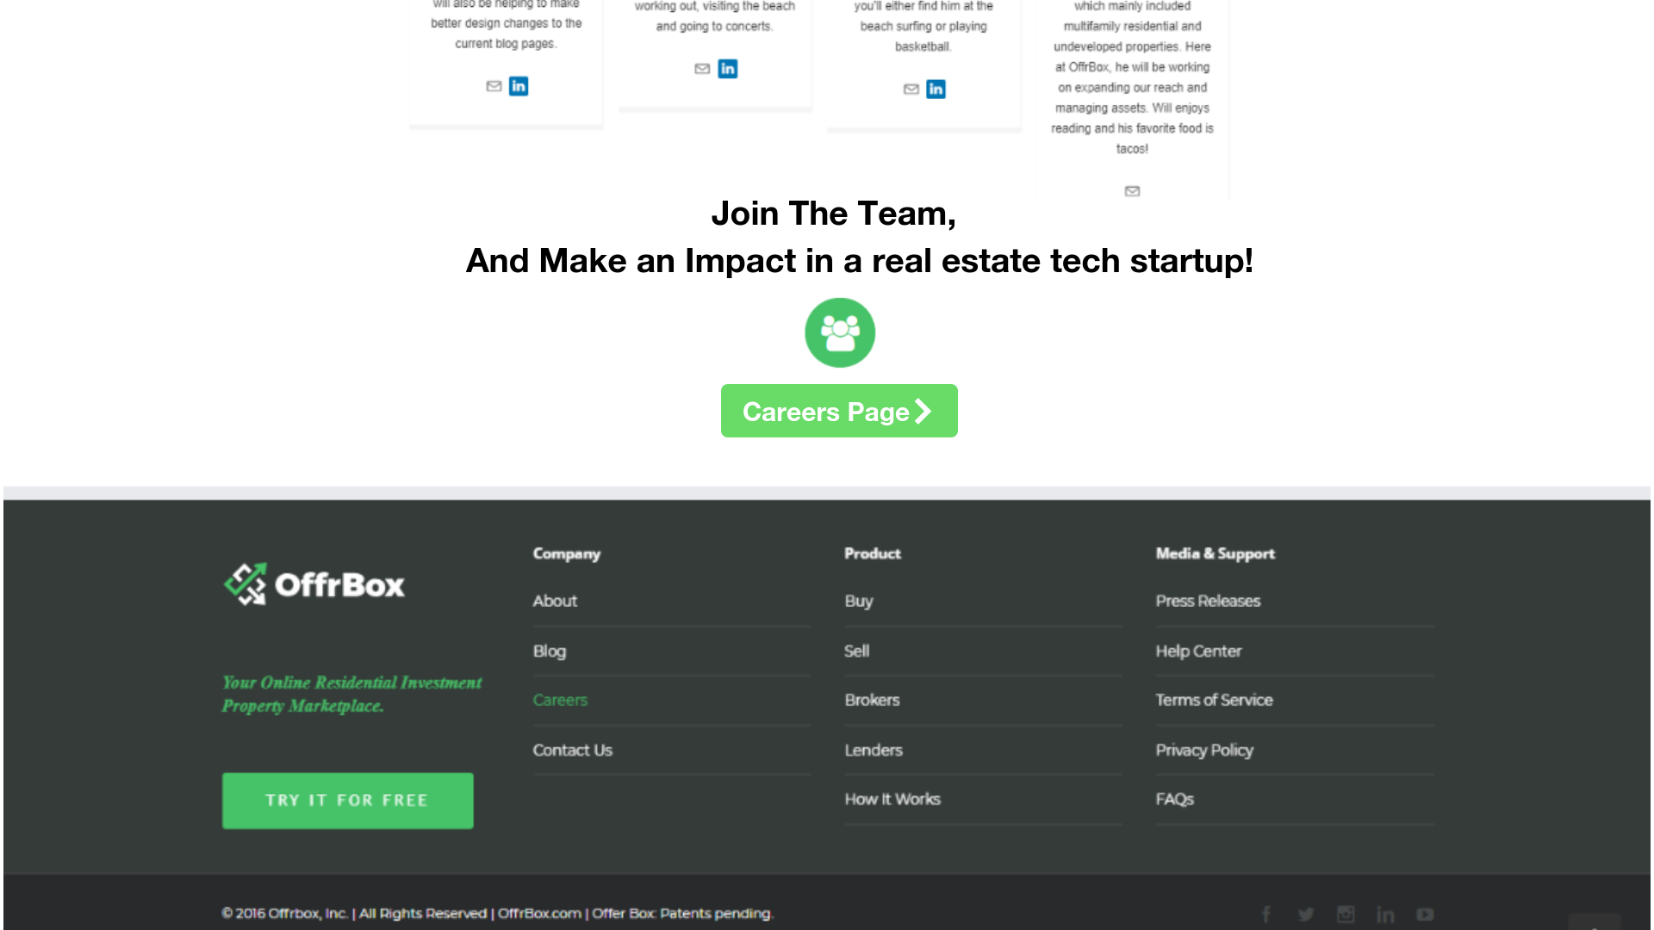
Screen-3:
We can directly add the option to the careers page before the footer, by providing a button and linking it to the career page.
This saves us from adding it to the menu.

Slide 5
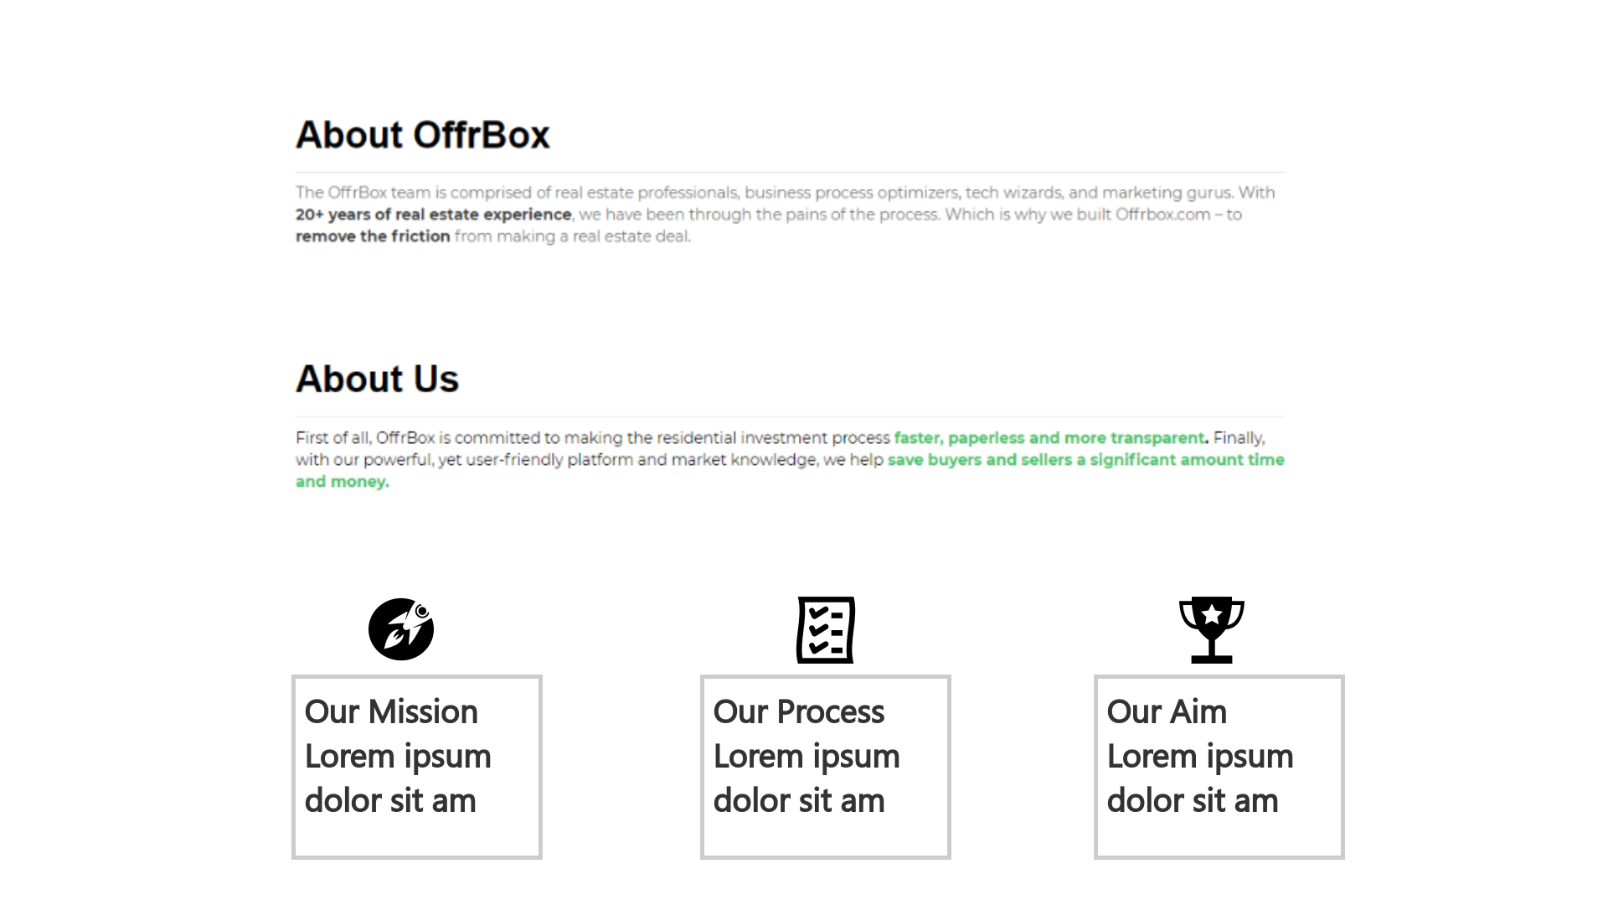
Screen-4:
We can summarize our about us content by specifying the mission, process or goals for the company.
This will make it concise and specific.

Slide 6
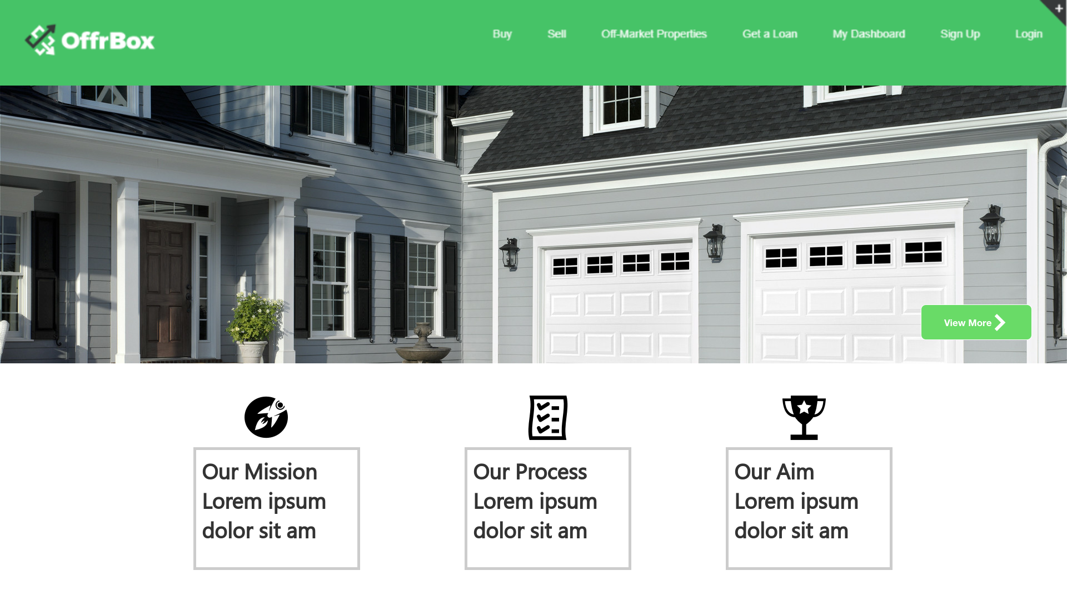
Screen-5:
Other alternatives: We can add our mission, goals , and related part with the about us and about OffrBox content, and then display company growth.
It will be similar to the present content layout.

