Slide 1
DEPARTMENT OF EDUCATON PROGRAMMES
Contact Us:
Email: code.des@ucc.edu.gh
Tel: 031 229 00 57

Slide 2
Academic Programmes
SN | Programmes | Duration
1. 2. | M.ED/MA/MPHIL(ADMINISTRATION IN HIGHER EDUCATION M.ED (EDUCATIONAL ADMINISTRATION | 2/3 Semesters 2 Semesters
3. | M.ED/MPHIL (EDUCATIONAL PSYCHOLOGY) | 2/3 Semesters
4. | M.ED/MA/MPHIL(GUIDANCE AND COUNSELLING | 2/3 Semesters
5. | M.ED/MA/MPHIL (MEASUREMENT AND EVALUATION) | 2/3 Semesters
6. | M.ED (SPECIAL EDUCATION) | 2 Semesters

Slide 3
Academic Programmes
SN | Programmes | Duration
7. | M.ED (CURRICULUM AND TEACHING) | 2 Semesters
8. | M.ED (ARTS EDUCATION) | 2 Semesters
9. 10. | M.ED (SOCIAL STUDIES) POST GRADUATE DIPLOMA in EDUCATION (PGDE) | 2 Semesters 2 Semesters

Slide 4
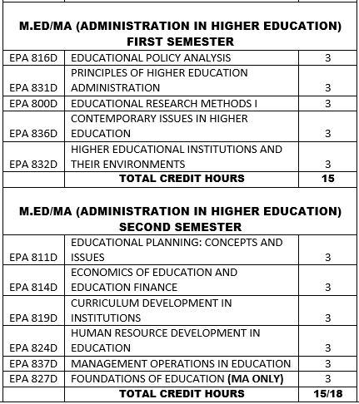
M.ED/MA (ADMINISTRATION IN HIGHER EDUCATION - 2 Semesters
Duration: Two (2) semesters
First Semester

Slide 5
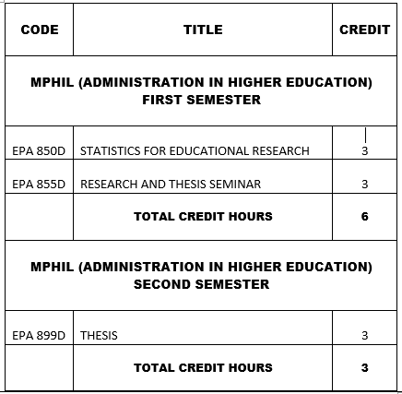
MPHIL (ADMINISTRATION IN HIGHER EDUCATION - 3 Semesters
Duration: Two (2) semesters
First Semester

Slide 6
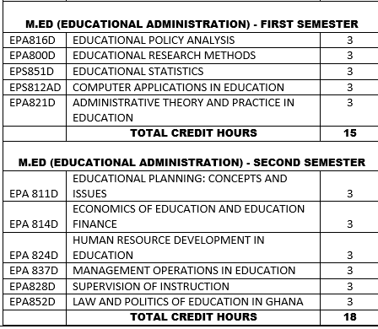
M.ED (EDUCATIONAL ADMINISTRATION– 2 Semesters

Slide 7
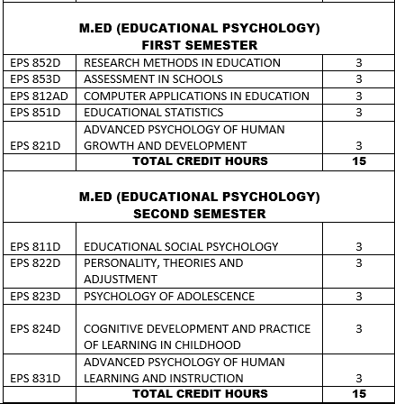
M.ED/MA (EDUCATIONAL PSYCHOLOGY – 2 Semesters)

Slide 8
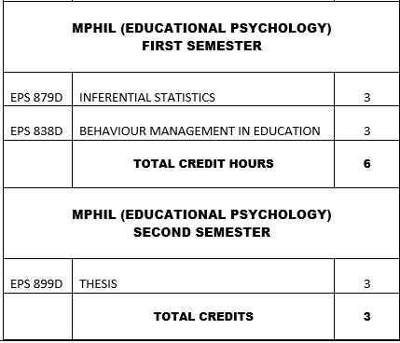
MPHIL (EDUCATIONAL PSYCHOLOGY – 3 Semesters)

Slide 9
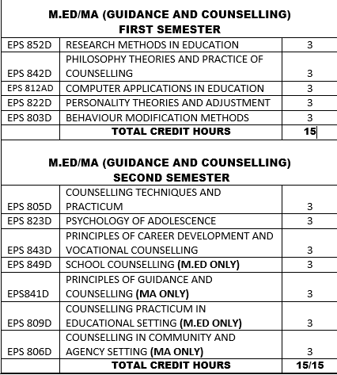
M.ED/MA (GUIDANCE & COUNSELLING – 2 SEMESTERS

Slide 10
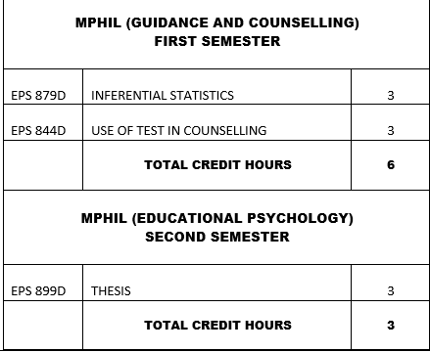
M.PHIL (GUIDANCE & COUNSELLING – 3 SEMESTERS

Slide 11
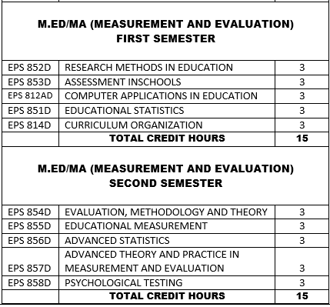
M.ED/MA (MEASUREMENT & EVALUATION– 2 SEMESTERS

Slide 12
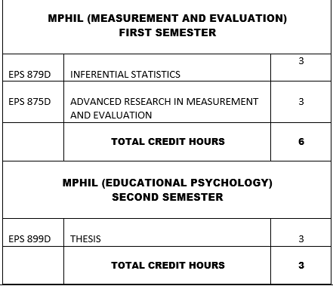
M.PHIL (MEASUREMENT & EVALUATION– 3 SEMESTERS

Slide 13
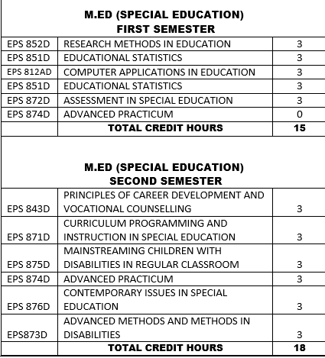
M.ED (SPECIAL EDUCATION– 2 SEMESTERS

Slide 14
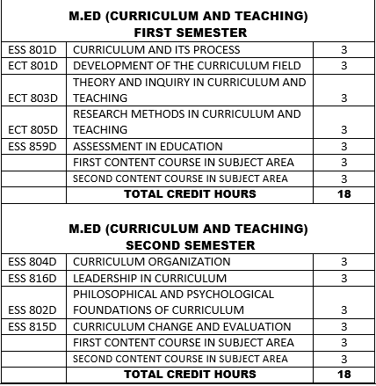
M.ED (CURRICULUM & TEACHING ) - 2 SEMESTERS

Slide 15
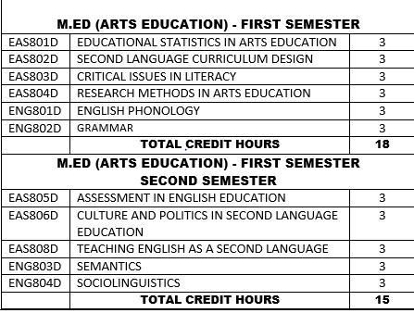
M.ED (ARTS EDUCATION) - 2 SEMESTERS

Slide 16
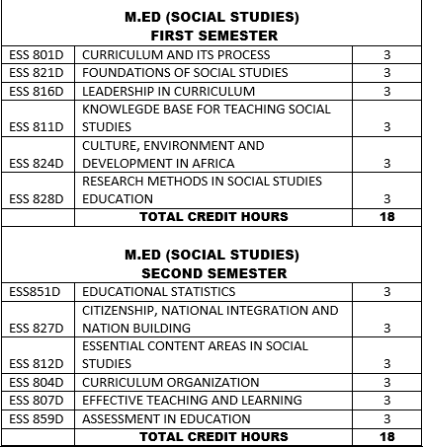
M.ED (SOCIAL STUDIES) - 2 SEMESTERS

Slide 17
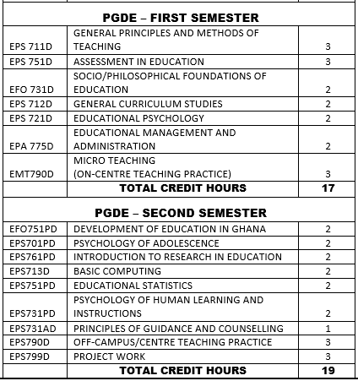
POSTGRADUATE DIPLOMA IN EDUCATION (PGDE) - 2 SEMESTERS

Slide 18
Mode of Programme Delivery – FTF and Online
SN | Programmes | Face to Face | Online
1. 2. | M.ED/MA/MPHIL(ADMINISTRATION IN HIGHER EDUCATION M.ED (EDUCATIONAL ADMINISTRATION | Refer to timetable | Refer to timetable
3. | M.ED/MPHIL (EDUCATIONAL PSYCHOLOGY)
4. | M.ED/MA/MPHIL(GUIDANCE AND COUNSELLING
5. | M.ED/MA/MPHIL (MEASUREMENT AND EVALUATION)
6. | M.ED (SPECIAL EDUCATION)
7. | POST GRADUATE DIPLOMA IN EDUCATION PROGRAMME(PGDE)

Slide 19
Mode of Programme Delivery – FTF and Online
SN | Programmes | Face to Face | Online
8. | M.ED (CURRICULUM AND TEACHING) | Refer to timetable | Refer to timetable
9. | M.ED (ARTS EDUCATION)
10. | M.ED (SOCIAL STUDIES)

Slide 20
Administrative Staff and Supporting Staff of the Unit
Administrative Staff
Prof. Joseph Tufuor Kwarteng – Head of Programmes
Dr. Beatrice Asante Somuah– Registration and Examination Officer
Mrs. Sarah Mensah-Bonso – Principal Administrative Assistant
Mr. Nana Ekow Assan – Senior Administrative Assistant
Mr. Francis Annor – Clearner/Messenger
Service Personnel
Abigail Koomson
Christiana Martei
Philomina Kwabena
Raheema Amoah
Petula Bainin
Kwaku Asare Baffoe
Richard Nana K. Mensah
Contact Us:
Email: code.des@ucc.edu.gh
Tel: 031 229 00 57

