Slide 1
Chapters 1 & 2
Programming and Programs
John Keyser’s
Modifications of Slides by
Bjarne Stroustrup
www.stroustrup.com/Programming

Slide 2
This is a course
In Programming
For beginners
  who want to become professionals
    i.e., people who can produce systems that others will use
  who are assumed to be bright
    Though not (necessarily) geniuses
  who are willing to work hard
    Though do need sleep occasionally, and take a normal course load
Using the C++ programming language
Stroustrup/Programming

Slide 3
Not!
A Washout course
  “If you can get into the science/engineering parts of a university, you can handle this course”
A course in
  The C++ programming language
For students
  who want to become language lawyers
    We try not to get bogged down in technical obscurities
  who are assumed to be a bit dim and fairly lazy
    We try not to spoon feed
Using
  Some untested software development methodologies and a lot of unnecessarily long words
Stroustrup/Programming

Slide 4
The Aims
Teach/learn
  Fundamental programming concepts
  Key useful techniques
  Basic Standard C++ facilities
After the course, you’ll be able to
  Write small colloquial C++ programs
  Read much larger programs
  Learn the basics of many other languages by yourself
  Proceed with an “advanced” C++ programming course
After the course, you will not (yet) be
  An expert programmer
  A C++ language expert
  An expert user of advanced libraries
Stroustrup/Programming

Slide 5
The Means
Lectures
  Attend every one
Notes/Chapters
  Read a chapter ahead (about one per lecture)
  Read the chapter again after each lecture
  Feedback is welcome (typos, suggestions, etc.)
Stroustrup/Programming

Slide 6
The Means (Cont.)
Work
  Review questions in chapters
  Review “Terms” in Chapters
  Drills
    Always do the drills
    Always do the drills before the exercises
  Exercises
  Course specific
    Projects
      That’s where the most fun and the best learning takes place
    Quizzes
    Exams
Stroustrup/Programming

Slide 7
Cooperate on Learning
Except for the work you hand in as individual contributions, we strongly encourage you to collaborate and help each other
If in doubt if a collaboration is legitimate: ask!
  Don’t claim to have written code that you copied from others
  Don’t give anyone else your code (to hand in for a grade)
  When you rely on the work of others, explicitly list all of your sources – i.e. give credit to those who did the work
Don’t study alone when you don’t have to
  Form study groups
  Do help each other (without plagiarizing)
Go to your TA's office hours
  Go prepared with questions
  The only stupid questions are the ones you wanted to ask but didn’t
Stroustrup/Programming

Slide 8
Why C++ ?
You can’t learn to program without a programming language
The purpose of a programming language is to allow you to express your ideas in code
C++ is the language that most directly allows you to express ideas from the largest number of application areas
C++ is the most widely used language in engineering areas
  http://www.research.att.com/~bs/applications.html
Stroustrup/Programming

Slide 9
Why C++ ?
C++ is precisely and comprehensively defined by an ISO standard
  And that standard is almost universally accepted
C++ is available on almost all kinds of computers
Programming concepts that you learn using C++ can be used fairly directly in other languages
  Including C, Java, C#, and (less directly) Fortran
Stroustrup/Programming

Slide 10
Rough course outline
Part I: The basics
  Types, variables, strings, console I/O, computations, errors, vectors functions, source files, classes
Part II: Input and Output
  File I/O, I/O streams
  Graphical output
  Graphical User Interface
Part III: Data structures and algorithms
  Free store, pointers, and arrays
  Lists, maps, sorting and searching, vectors, templates
  The STL
Part IV: Broadening the view
  Software ideals and history
  Text processing, numerics, embedded systems programming, testing, C, etc.
Stroustrup/Programming

Slide 11
Rough course outline (Cont.)
Throughout
  Program design and development techniques
  C++ language features
  Background and related fields, topics, and languages
Note: Appendices
  C++ language summary
  C++ standard library summary
  Index (extensive)
  Glossary (short)
Class will basically be one chapter per class!
Stroustrup/Programming

Slide 12
Promises
Detail: We will try to explain every construct used in this course in sufficient detail for real understanding
  There is no “magic”
Utility: We will try to explain only useful concepts, constructs, and techniques
  We will not try to explain every obscure detail
Completeness: The concepts, constructs, and techniques can be used in combination to construct useful programs
  There are, of course, many useful concepts, constructs, and techniques beyond what is taught here
Stroustrup/Programming

Slide 13
More Promises
Realism: The concepts, constructs, and techniques can be used to build “industrial strength” programs
  i.e., they have been used to …
Simplicity: The examples used are among the simplest realistic ones that illustrate the concepts, constructs, and techniques
  Your exercises and projects will provide more complex examples
Scalability: The concepts, constructs, and techniques can be used to construct large, reliable, and efficient programs
  i.e., they have been used to …
Stroustrup/Programming

Slide 14
Why programming?
Our civilization runs on software
  Most engineering activities involve software
Note: most programs do not run on things that look like a PC
  a screen, a keyboard, a box under the table
Stroustrup/Programming

Slide 15

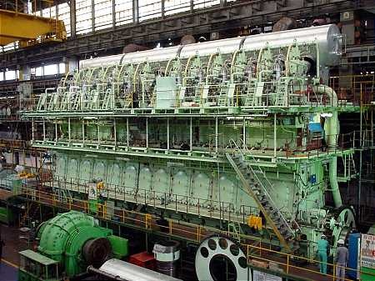
Ships
Monitoring
Engine
Hull design
Pumps
Design
Construction
Management
Stroustrup/Programming

Slide 16
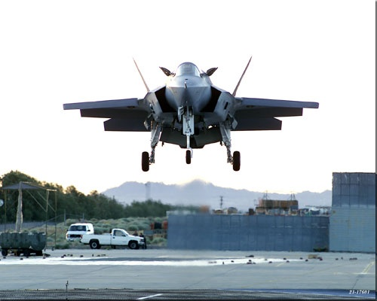

Aircraft
Communication
Control
Display
Signal processing
“Gadget” control
Monitoring
Stroustrup/Programming

Slide 17
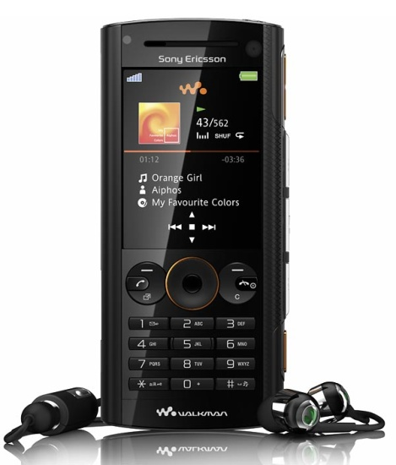
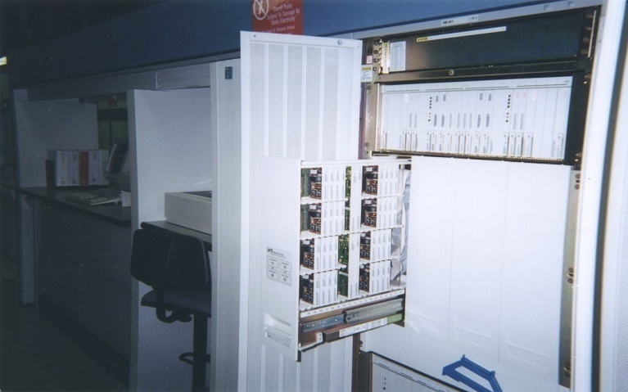
Phones
Voice quality
User interfaces
Billing
Mobility
Switching
Reliability
Provisioning
Images
Stroustrup/Programming

Slide 18


Energy
Control
Monitoring
Analysis
Design
Communications
Visualization
Manufacturing
Stroustrup/Programming

Slide 19
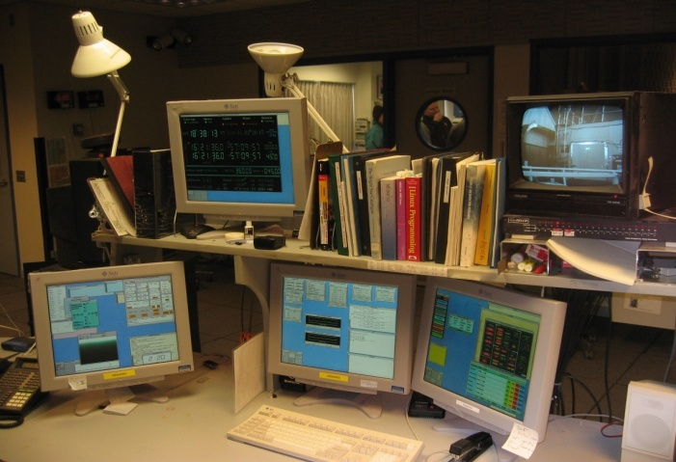
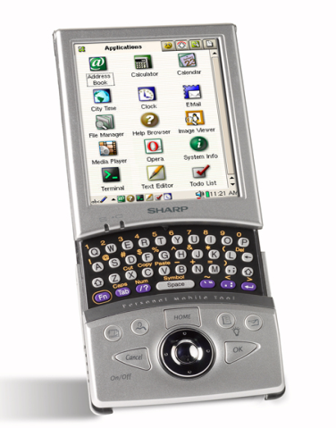
PC/workstation
There’s a lot more to computing than games, word processing, browsing, and spreadsheets!
Stroustrup/Programming

Slide 20
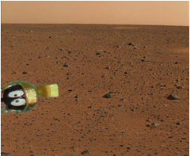
Where is C++ Used?
Just about everywhere
Mars rovers, animation, graphics, Photoshop, GUI, OS, compilers, slides, chip design, chip manufacturing, semiconductor tools, etc.
See www.research.att/~bs/applications.html
Stroustrup/Programming

Slide 21
So what is programming?
Conventional definitions
  Telling a very fast moron exactly what to do
  A plan for solving a problem on a computer
  Specifying the order of a program execution
    But modern programs often involve millions of lines of code
    And manipulation of data is central
Definition from another domain (academia)
  A … program is an organized and directed accumulation of resources to accomplish specific … objectives …
    Good, but no mention of actually doing anything
The definition we’ll use
  Specifying the structure and behavior of a program, and testing that the program performs its task correctly and with acceptable performance
    Never forget to check that “it” works
Software == one or more programs
Stroustrup/Programming

Slide 22
Programming
Programming is fundamentally simple
  Just state what the machine is to do
So why is programming hard?
  We want “the machine” to do complex things
    And computers are nitpicking, unforgiving, dumb beasts
  The world is more complex than we’d like to believe
    So we don’t always know the implications of what we want
  “Programming is understanding”
    When you can program a task, you understand it
    When you program, you spend significant time trying to understand the task you want to automate
  Programming is part practical, part theory
    If you are just practical, you produce non-scalable unmaintainable hacks
    If you are just theoretical, you produce toys
Stroustrup/Programming

Slide 23
Compilation and linking
C++ compiler
C++ source code
Object code
linker
Library Object code
Executable program
You write C++ source code
  Source code is (in principle) human readable
The compiler translates what you wrote into object code (sometimes called machine code)
  Object code is simple enough for a computer to “understand”
The linker links your code to system code needed to execute
  E.g. input/output libraries, operating system code, and windowing code
The result is an executable program
  E.g. a .exe file on windows or an a.out file on Unix
Stroustrup/Programming

Slide 24
Dynamic Linking
C++ compiler
C++ source code
Object code
Compile-time
linker
Library Interface Object code
Executable program
Dynamic Library Object code
Run-time
linker
Running Program
Sometimes libraries are so large that you don’t want all their code in your executable
Sometimes libraries can change over time, and you don’t want to have to create a new executable each time
Dynamic linking: link only a small amount of object code ahead of time, then at runtime find the library and link more code.
Stroustrup/Programming

Slide 25
A first program – just the guts…
// …
int main() // main() is where a C++ program starts
{
cout << "Hello, world!\n"; // output the 13 characters Hello, world!
// followed by a new line
return 0; // return a value indicating success
}
// quotes delimit a string literal
// NOTE: “smart” quotes “ ” will cause compiler problems.
// so make sure your quotes are of the style " "
// \n is a notation for a new line
Stroustrup/Programming

Slide 26
A first program – complete
// a first program:
#include "std_lib_facilities_3.h" // get the library facilities needed for now
int main() // main() is where a C++ program starts
{
cout << "Hello, world!\n"; // output the 13 characters Hello, world!
// followed by a new line
return 0; // return a value indicating success
}
// note the semicolons; they terminate statements
// braces { … } group statements into a block
// main( ) is a function that takes no arguments ( )
// and returns an int (integer value) to indicate success or failure
Stroustrup/Programming

Slide 27
A second program
// modified for Windows console mode:
#include "std_lib_facilities_3.h" // get the facilities for this course
int main() // main() is where a C++ program starts
{
cout << "Hello, world!\n"; // output the 13 characters Hello, world!
// followed by a new line
keep_window_open(); // wait for a keystroke
return 0; // return a value indicating success
}
// without keep_window_open() the output window will be closed immediately
// before you have a chance to read the output (on Visual C++ 2003)
Stroustrup/Programming

Slide 28
Hello, world!
“Hello world” is a very important program
  Its purpose is to help you get used to your tools
    Compiler
    Program development environment
    Program execution environment
  Type in the program carefully
    After you get it to work, please make a few mistakes to see how the tools respond; for example
      Forget the header
      Forget to terminate the string
      Misspell return (e.g. retrun)
      Forget a semicolon
      Forget { or }
      …
Stroustrup/Programming

Slide 29
Hello world
It’s almost all “boiler plate”
  Only cout << "Hello, world!\n" directly does anything
That’s normal
  Most of our code, and most of the systems we use simply exist to make some other code elegant and/or efficient
  “real world” non-software analogies abound
“Boiler plate,” that is, notation, libraries, and other support is what makes our code simple, comprehensible, trustworthy, and efficient.
  Would you rather write 1,000,000 lines of machine code?
This implies that we should not just “get things done”; we should take great care that things are done elegantly, correctly, and in ways that ease the creation of more/other software:
  Style Matters!
Stroustrup/Programming

Slide 30
The next lecture
Will talk about types, values, variables, declarations, simple input and output, very simple computations, and type safety.
Stroustrup/Programming

